Slide 1
Every Student Succeed Act Per-Pupil Expenditures Reporting Application January 23, 2024

Slide 2
Slide Notes
*Slide notes are used throughout this presentation.

Slide 3
Webinar Reminders
Please mute your microphone
During the webinar please use the Q&A function
Please send questions to essappe@cde.ca.gov
Please visit the CDE ESSA Per-Pupil Expenditure Reporting web page at https://www.cde.ca.gov/fg/ac/es/ for additional resources and tools
The slides and a video of the presentation will be posted on the CDE website at https://www.cde.ca.gov/fg/ac/es/

Slide 4
Every Student Succeeds Act (ESSA) Per Pupil Expenditures (PPE) Reporting Update (1)
The law specific to per-pupil expenditures for State report cards:
Section 1111(h)(1)(C)(x)
(1) ANNUAL STATE REPORT CARD
(C) MINIMUM REQUIREMENTS…
(x) The per-pupil expenditures of Federal, State, and local funds, including actual personnel expenditures and actual nonpersonnel expenditures of Federal, State, and local funds, disaggregated by source of funds, for each local educational agency and each school in the State for the preceding fiscal year.

Slide 5
Every Student Succeeds Act (ESSA) Per Pupil Expenditures (PPE) Reporting Update (2)
The law specific to per-pupil expenditures for LEAs:
Section 1111(h)(2)(C)
(2) ANNUAL LOCAL EDUCATIONAL AGENCY REPORT CARD
(C) MINIMUM REQUIREMENTS.—The State educational agency shall ensure that each local educational agency collects appropriate data and includes in the local educational agency’s annual report the information described in paragraph (1)(C), disaggregated in the same manner as required under such paragraph, except for clause (xii) of such paragraph, as applied to the local educational agency and each school served by the local educational agency...

Slide 6
Guidance
Final non-regulatory guidance from the ED.
https://www2.ed.gov/policy/elsec/leg/essa/report-card-guidance-final.pdf
CDE issued a letter on August 1, 2018.
https://www.cde.ca.gov/fg/ac/co/essappeltr.asp
Notes:
Intended to provide information and guidance to assist LEAs with meeting the PPE reporting requirement.
Calculation guidelines: included and excluded expenditures, expenditures tracked at the school-level versus LEA-level, student counts
Reporting and presenting the data
Preparation considerations

Slide 7
ESSA PPE Calculation (1) School-Level Expenditures
School-Level Expenditures (Federal + State/Local)
School Share of Central-Level Expenditures (Federal + State/Local)
Student Count

Slide 8
ESSA PPE Calculation (2) LEA-Level Expenditures
Total Included Expenditures (Federal + State/Local)
Student Count

Slide 9
ESSA PPE Calculation (3)
Included Expenditures
The ESEA requires that per-pupil expenditure calculations include actual personnel and nonpersonnel expenditures of all federal, state, and local funds disaggregated by source of funds.
The following activities could be included as current expenditures:
Instruction
Instructional and Student Support Services
School and General Administration
Plant Operations and Maintenance
Student Transportation
Food Services
Enterprise Operations

Slide 10
ESSA PPE Calculation (4)
Excluded Expenditures
The following expenditures do not meet the definition of K-12 current expenditures:
Debt Service (Function 9100, Object 74XX)
Capital Outlays (Function 8500; Object 6XXX)
Community Services (Goal 8100, Function 5000)
Adult Education (Fund 11; Goal 4XXX)
Payments to private schools
Payments to other LEAs
Payments to charter schools outside the LEA
County Services to Districts (Goal 8600)

Slide 11
School-level vs. Central Expenditures
School-Level Reporting
Contain actual personnel and non-personnel expenditures that are identified to a specific school site (e.g., teacher salaries and benefits, site discretionary – non personnel expenditures).
Central-Level Reporting
Actual personnel and non-personnel expenditures that could not be identified to a particular school-site.
Examples of these activities could include:
Pupil Transportation
Food Services
Plant Operations and Maintenance
Instructional and Student Support Services
General Administration (e.g., Superintendent’s Office, Board Services, Fiscal Services)

Slide 12
Allocation of Central-Level Expenditures
Central-level expenditures may be allocated to each school based on metrics deemed appropriate for each type of expenditure. Examples include:
Number of students served in the school (e.g., for the superintendents salary)
The percentage of time allocated by LEA personnel to each school (e.g., for staff who serve multiple schools)
Square footage (e.g., for utility costs)

Slide 13
Student Count
To maintain consistency in ESSA PPE reporting, CDE requires cumulative enrollment figures to be utilized for ESSA PPE Reporting.
The CDE will display the cumulative enrollment figure for each school.
Cumulative Enrollment Data Webpage: https://www.cde.ca.gov/ds/ad/filesenrcum.asp

Slide 14
What type of elements will be reported?
School Level Expenditures | School A | School B
Federal | $456 | $209
B. State and Local | $6,111 | $4,965
C. School-level Total | $6,567 | $4,965

Slide 15
What type of elements will be reported? (continued)
School Share of Central Expenditures | School A | School B
D. Federal | $161 | $161
E. State and Local | $5,378 | $5,378
F. School Share of Central Total | $5,539 | $5,539
G. Total School Expenditures (C + F) | $12,106 | $10,504
H. Student Count | 250 | 450

Slide 16
Where will the PPE data be reported?
The data will be reported as part of the Local Educational Agency Accountability Report Card (LARC).
https://www.cde.ca.gov/ta/ac/le/

Slide 17
How will the PPE data be collected?
Data will be collected through a web application.
The CDE provided access codes to the Superintendent and Chief Business Official for each LEA and to the Administrator for each direct-funded charter school listed within the California School Directory.
Amounts can be hand-keyed or prepared in Excel and imported in a CSV (comma delimited) format.

Slide 18
2021-22 Reporting Common Issues
Enrollment
Incorrect data source used
School-level and central-level per-pupil amounts
Amount entered as a total amount, rather than a per-pupil amount.
LEA Federal and State/Local per-pupil amounts
Amount entered as a total amount, rather than a per-pupil amount.
LEA Total Excluded Expenditures
No amount entered
Amount entered as a per-pupil amount, rather than a total amount.

Slide 19
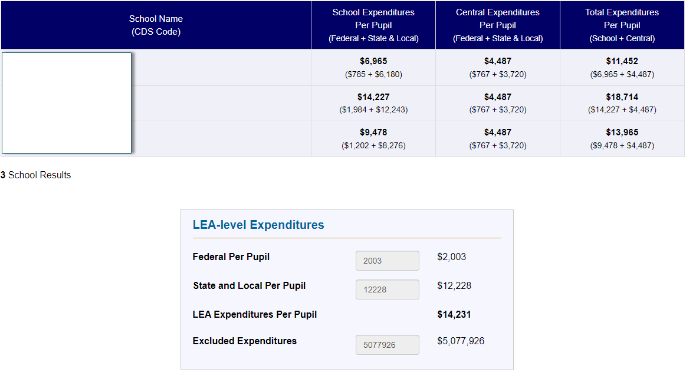
Characteristics of a quality submission
Notes:
This slide shows a properly completed submission for three LEAs with the LEA names blocked. Per pupil amounts are given for the school, central, federal, and state and local expenditures portions. The excluded expenditures listed in the LEA-level expenditures box at the bottom of the slide are listed as a total for the LEA (not per pupil).

Slide 20
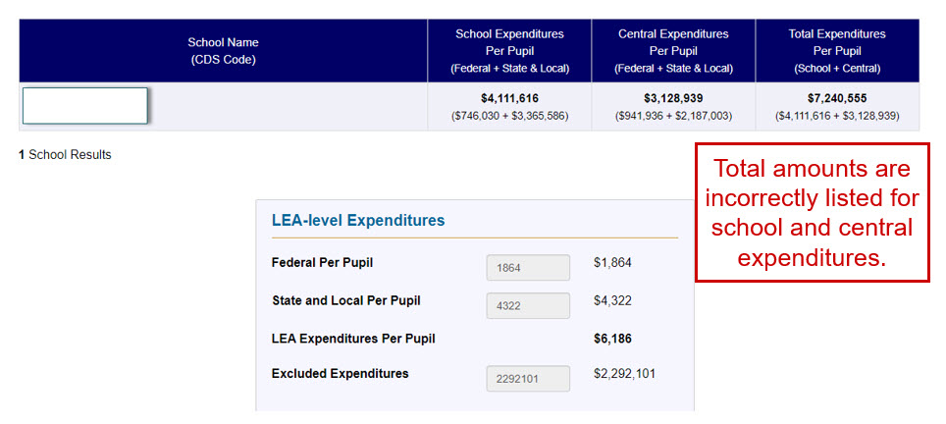
What’s wrong with this submission?(1)
Notes:
This slide shows an improperly completed submission for one LEA with the LEA names blocked. Total amounts incorrectly are given for the school and central expenditures portions. The federal, and state and local expenditures portions are correctly completed with expenditures broken down on the per pupil level.

Slide 21
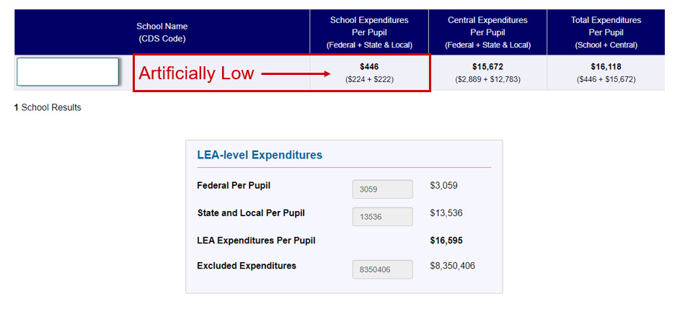
What’s wrong with this submission?(2)
Notes:
This slide shows an improperly completed submission for one LEA with the LEA name blocked. Per pupil amounts are given for the school, central, federal, and state and local expenditures portions. However, the amount spent at the school level appears to be artificially low.

Slide 22
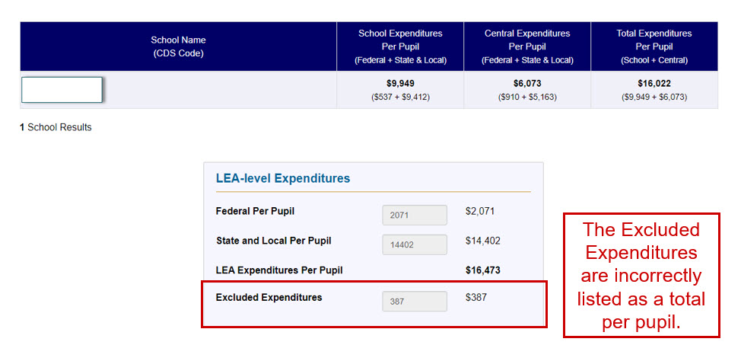
What’s wrong with this submission?(3)
Notes:
This slide shows an improperly completed submission for one LEA with the LEA name blocked. Per pupil amounts are given for the school, central, federal, and state and local expenditures portions. The excluded expenditures are incorrectly entered and broken down on a per pupil basis.

Slide 23
Frequently Asked Questions (1)
1. Do we include preschool expenditures, including amounts reported in the Child Development Fund (12)?
At this time, the CDE does not collect enrollment for preschool and child development activities. Therefore, an LEA would have the flexibility to include or exclude preschool and child development expenditures from their calculation.
2. How do we determine cafeteria expenditures that are federal versus state and local? Since reimbursement funding for both all comes in under one resource code.
In this situation, the CDE recommends to account for these types of expenditures as local expenditures.

Slide 24
Frequently Asked Questions (2)
3. Do we include special education expenditures? If so, would we include all funding sources?
Yes, special education expenditures from all funding sources would be included in the per-pupil expenditure calculation.
4. Do we exclude STRS On-Behalf Expenditures entries, since those are paid by the State?
Yes, the STRS On-Behalf expenditures would be excluded since those are not LEA costs.

Slide 25
Frequently Asked Questions (3)
5. Do we include Funds 14 – 40?
Yes, these funds would be included. However, an LEA would exclude expenditures in categories that are suggested for exclusion.
6. Do we include CARES Act funding?
Yes, CARES Act funding would be included in the calculation since the expenditures represent the day to day operations of a school. However, an LEA would exclude expenditures in categories that are suggested for exclusion.

Slide 26
Please email ESSA per-pupil expenditure requirement questions to: essappe@cde.ca.gov

Slide 27
School-Level Finance Survey January 23, 2024

Slide 28
School-Level Finance Survey (1)
The School-Level Finance Survey (SLFS) is a survey to meet the demand for finance data at the school level. Policymakers, researchers, and the public have long voiced concerns about the equitable distribution of school funding within and across school districts.
Approved in May 2023, the Office for Civil Rights (OCR), an agency within the U.S. Department of Education (ED), worked with the National Center for Education Statistics (NCES) to make the SLFS part of the Civil Rights Data Collection (CRDC).
The Civil Rights Data Collection (CRDC) is a mandatory federal data collection effort. California LEAs meet this requirement through various CDE collection efforts.
Notes:
The School-Level Finance Survey (SLFS) is a survey to meet the demand for finance data at the school level. Policymakers, researchers, and the public have long voiced concerns about the equitable distribution of school funding within and across school districts.
Originally, the School-Level Finance Survey (SLFS) was a voluntary data collection conducted annually by the National Center for Education Statistics (NCES), an agency within the U.S. Department of Education (ED).
Approved in May 2023, the Office for Civil Rights (OCR), an agency within the U.S. Department of Education (ED), worked with the National Center for Education Statistics (NCES) to make the SLFS part of the Civil Rights Data Collection (CRDC).
The Civil Rights Data Collection (CRDC) is a mandatory federal data collection effort. California LEAs meet this requirement through various CDE collection efforts.

Slide 29
School-Level Finance Survey (2)
Department of Education Organization Act (DEOA) conveys to the Assistant Secretary for Civil Rights the authority to “collect or coordinate the collection of data necessary to ensure compliance with civil rights laws within the jurisdiction of the Office for Civil Rights.” See 20 U.S.C. § 3413(c)(1)
To learn more about the CRDC please visit https://www2.ed.gov/about/offices/list/ocr/frontpage/faq/crdc.html
Notes:
On your screen is federal language granting the authority to the Office for Civil Rights to “collect or coordinate the collection of data necessary to ensure compliance with civil rights law”, in this situation, it allowed for the inclusion of the SLFS as part of Civil Rights Data Collection (CRDC) effort.

Slide 30
Data Collection Timeline
Fiscal Year of Data Collection | Required Data | CDE Collection Window
2022-23 | ESSA PPE Submission | Dec. 2023 – March 2024
2023-24 | NCES Function: Instruction (1000) | Dec. 2024 – March 2025
2024-25 | NCES Functions: Instruction (1000) Pupil Support Services (2100) Instruction Support Services (2200) School Administration (2700) | Annual collection beginning December 2025
Notes:
On your screen you see the data collection timeline. Prior to and after the SLFS became mandatory, the CDE expressed concerns about being able to collect and provide the Department of Education with the requested data elements. The result of those conversations is a Data Plan with the timeline seen on screen. The first data collection for FY 2022-23, with CDE collection window of December 2023 to March 2024, is met by LEAs submitting their ESSA-PPE submission. For Fiscal Year 2023-24, CDE collection window of December 2024 to March 2025, the requirement is to obtain Instruction expenditures as defined by NCES Function 1000. In a few slides we will go over a crosswalk that provides the equivalent to NCES Function 1000 using the CDE Standardized Account Code Structure known as SACS. Lastly, starting Fiscal Year 2024-25, the NCES Functions and Exhibits identified will be required to be submitted within the CDE collection window beginning December 2025.

Slide 31
Data Collection Timeline (continued)
Fiscal Year of Data Collection | Required Data | CDE Collection Window
2024-25 | Plus, three exhibits Salaries paid to teachers (NCES Function 1000; Object codes 1x1 and 1x3) Salaries paid to instructional staff or assistants (NCES Function 1000; Object code 1x2) Books and periodicals (NCES Function 1000 and 2200; Object code 640) | Annual collection beginning December 2025

Slide 32
Expenditures
School-Level Expenditures
Total current operation expenditures for activities dealing with the interaction of teachers and students in the classroom, home, as well as co-curricular activities.
Report amounts for activities of teachers and instructional aides or assistants engaged in regular instruction, special education, and vocational education programs.
Adult Education (Fund 11; Goal 4XXX) expenditures are to be excluded.
Central Level Expenditures
Report all current expenditures typically reported at the central/school district level that have been allocated to each school.
Notes:
Now that we are aware that no action is needed by LEAs to fulfill the Fiscal Year 2022-23 collection requirement, lets discuss the Fiscal Year 2023-24, which will be collected starting December 2024 to March 2025.
You will notice that this slide is very similar to the ESSA-PPE slide depicting included and excluded expenditures. In essence, the data collection will be the same as the ESSA-PPE except that you will be providing an aggregate amount, not a per pupil amount.
(read slide)

Slide 33
FY 2023-24 Reporting Period

Slide 34
FY 2023-24 Reporting Period (1)
NCES Function | NCES Description | SACS Function(s)
1000 | Instruction | 1000 - Instruction 1110 - Special Education: Separate Classes 1120 - Special Education: Resource Specialist Instruction 1130 - Special Education: Supplemental Aids and Services in Regular Classrooms 1190 - Special Education: Other Specialized Instructional Services
Notes:
To obtain the equivalent of NCES Function 1000, the CDE has created a crosswalk. On screen you have a simplified version of the crosswalk. We have determined that NCES Function 1000 is equivalent to SACS Functions 1000, 1110, 1120, 1130, and 1190.

Slide 35
FY 2023-24 Reporting Period (2) For NCES Function 1000 Only:
School-Level Expenditures (Federal, State, & Local) Filtered by NCES Function 1000
School Share of Central-Level Expenditures (Federal, State, & Local) Filtered by NCES Function 1000
Total School-Level Expenditures Filtered by NCES Function 1000
Notes:
Here is a graphical representation of the formula to obtain NCES Function 1000 – Instruction. You will notice that the formula is very similar to the ESSA-PPE calculation. As mentioned previously, the main difference is that the aggregate of the expenditures is not divided per pupil. The formula is School-level expenditures (Federal, State, and local) filtered by NCES function 1000 plus, School share of central-level expenditures (Federal, State, and local) filtered by NCES function 1000 equals the total school-level expenditures filtered by NCES function 1000.

Slide 36
FY 2023-24 Reporting Period (3) Modified Formula Using SACS:
Note: Please ensure that only Object Codes within the Expenditures range (Objects 1000-7499) are used when filtering by the recommended SACS Function Codes.
School-Level Expenditures (Federal, State, & Local) Filtered by SACS Functions 1000, 1110, 1120, 1130, and 1190
School Share of Central-Level Expenditures (Federal, State, & Local) Filtered by SACS Functions 1000, 1110, 1120, 1130, and 1190
Total School-Level Expenditures Filtered by SACS Functions 1000, 1110, 1120, 1130, and 1190
Notes:
On screen you have the original formula modified to include the crosswalk information. A friendly reminder, as the amounts calculated are expenditures, please ensure that only Object Codes within the Expenditures Range (Objects 1000-7499) are used when filtering by the recommended SACS Function Codes. The equation is School-level expenditures (federal, state, and local) filtered by SACS functions 1000, 1110, 1120, 1130, and 1190 plus, school share of central-level expenditures (federal, state, and local) filtered by SACS functions 1000, 1110, 1120, 1130, and 1190 equals to, total school level expenditures filtered by SACS functions 1000, 1110, 1120, 1130, and 1190.
We understand that there are some LEAs that do not use the Standardized Account Code Structure (SACS) and therefore defer to their expertise in determining the equivalent to NCES Function 1000. We highly recommend for those LEAs that do not use SACS to document how they arrived at their calculation.

Slide 37
FY 2024-25 and Beyond Reporting Periods
Notes:
The following slides provide crosswalk information for the future reporting requirements. This is data that will be collected starting December 2025 to March 2026. I will be briefly presenting them for your general information. Please note that an in-depth webinar will be provided once the data collection application has been built out for data entry.

Slide 38
FY 2024-25 and Beyond Reporting Periods (1)
NCES Description & Function | SACS Description & Function(s)
Instruction – 1000 | 1000 - Instruction 1110 - Special Education: Separate Classes 1120 - Special Education: Resource Specialist Instruction 1130 - Special Education: Supplemental Aids and Services in Regular Classrooms 1190 - Special Education: Other Specialized Instructional Services
Notes:
We are already familiar with NCES Function 1000 – Instruction, what is new is NCES Function 2100 – Student Support Services. To the right you can find the equivalent SACS Functions.

Slide 39
FY 2024-25 and Beyond Reporting Periods (1) (continued)
NCES Description & Function | SACS Description & Function(s)
Student Support Services - 2100 | 3110 - Guidance and Counseling Services 3120 - Psychological Services 3130 - Attendance and Social Work Services 3140 - Health Services 3150 - Speech, Pathology, and Audiology Services 3900 - Other Pupil Services

Slide 40
FY 2024-25 and Beyond Reporting Periods (2)
NCES Description & Function | SACS Description & Function(s)
Instructional Staff Support - 2200 | 2100 – Instructional Supervision and Administration 2130 – Curriculum Development 2140 – In-House Instructional Staff Development 2420 – Instructional Library, Media, and Technology 2490 – Other Instructional Resources 3160 – Pupil Testing Services
School Administration - 2400 | 2700 – School Administration
Notes:
Include all the elements that will be needed. This may need to be a few slides.

Slide 41
FY 2024-25 and Beyond Reporting Periods (3)
NCES Description & Function | SACS Description & Object(s)
Salaries paid to teachers (With NCES Function 1000) | 1100 – Certificated Teachers’ Salaries
Salaries paid to instructional staff or assistants (With NCES Function 1000) | 2100 – Classified Instructional Salaries 2200 – Classified Support Salaries 2900 – Other Classified Salaries
Books and Periodicals (with NCES Functions 1000 and 2200) | 4100 - Approved Textbooks and Core Curricula Materials 4200 - Books and Other Reference Materials
Notes:
A main difference for FY 2024-25 data collection, CDE collection window December 2025 to March 2026, are the exhibits you see on screen. These exhibits are a subset of data collected within NCES Functions 1000 and 2200. These exhibits will require a filtering of SACS Functions using SACS Object codes. More in-depth information about the exhibits will be provided at a later date.

Slide 42
Current and Future Efforts
Modification to ESSA-PPE application
Support to LEAs
Letter to LEAs
Web page
Notes:
Beginning with the FY 2023–24 data collection period (CDE Collection Window from December 2024 to March 2025), the CDE will modify the ESSA-PPE web-based application to capture NCES Function 1000. By the FY 2024–25 data collection (CDE Collection Window December 2025 to March 2026) the ESSA-PPE application will be modified to collect all required data elements. Once the application has been modified to capture both ESSA-PPE and SLFS data, it is likely be rebranded to make it clear that there are 2 data collection requirements and the webpage to access the application may be updated.
Regarding support to LEA’s, we are working on delivering a comprehensive letter to LEA’s providing information on how to perform the calculations required within the SLFS. Additionally, we are working on creating a webpage that will host various resources such as the letter to the LEA’s, Zoom information to join a live webinar, and recording of all webinars associated with this requirement, including this one. The webpage will also include resources such as the Data Collection Timeline, and the Crosswalk for easy retrieval as well as Federal resources for LEA’s to explore the history of this data collection requirement.
We anticipate being able to launch this webpage by Mid May.

Slide 43
Frequently Asked Questions
What does my LEA have to do to meet the SLFS requirement for FY 2022-23 (Collection Window December 2023-March 2024)?
The SLFS requirement will be met for FY 2022-23 if the LEA completes its ESSA-PPE data collection.
What does my LEA have to do to meet the SLFS requirement for FY 2023-24 (Collection Window December 2024- March 2025)?
The LEA will need to provide the total current expenditures (school-level and central) for Instruction for each of its schools. A crosswalk has been provided to assist LEAs in identifying which SACS Functions should be used.

Slide 44
Frequently Asked Questions (continued)
My school(s) does not use SACS to capture financial data. What can we do to meet this requirement?
We defer to the LEA’s expertise in determining the equivalent to NCES Function 1000. We highly recommend for documentation to be kept on how they arrived at their calculation.
4. What system will my LEA use to submit the Instruction amounts for each school?
LEAs will use the ESSA-PPE web application. The web application will have a dedicated section for the SLFS collection.

Slide 45
Please email SLFS questions to: SACSINFO@cde.ca.gov

