Slide 1
The Early Education Teacher
Development Grant
Request for Application
Technical Assistance Webinar
April 14, 2022
3:30 to 4:30 p.m.
Early Education Division
Early Education System Improvement Office

Slide 2


Introductions
Sheila Self
Education Administrator
Alana Pinsler
Child Development Consultant
Grant Support Team: Sara Dodge | Kim Nguyen | Niki Niknia | Diana Lua

Slide 3
Technical Assistance Webinar Agenda
Room Check
Basic Information
Fundamental Information
The Application
Award Determinations
Highlight some Key Dates
Questions (time permitting)
Room check:
You can turn on closed captioning
You can ask Questions in the Q&A feature
Time permitting, we will answer questions at the end
YES - this webinar is being recorded
YES - A copy of this slide deck will be posted to the request for application (RFA) webpage

Slide 4
Early Education Teacher Development Grant
Introduction

Slide 5
Introduction
Overview: $100 million in competitive funds available to both -
Increase the number of highly-qualified California State Preschool Program (CSPP) and Transitional Kindergarten (TK) program teachers; and
Increase specific competencies for CSPP, TK, and Kindergarten (K) teachers.
Background: While preparing for full Universal PreKindergarten (UPK) implementation, there is a need to plan to increase the number of credentialed and permitted teachers entering the workforce to meet the growing needs and to increase the professional development opportunities for the current workforce.

Slide 6
Introduction (2)
Webpage: The Early Education Teacher Development (EETD) Grant RFA can be found here:
https://www.cde.ca.gov/fg/fo/r2/eetdg22rfa.asp
  Overview and Instructions – including application questions
  Snap Survey link
  Budget documents
  Current Assurances and Certifications
  Frequently Asked Questions

Slide 7
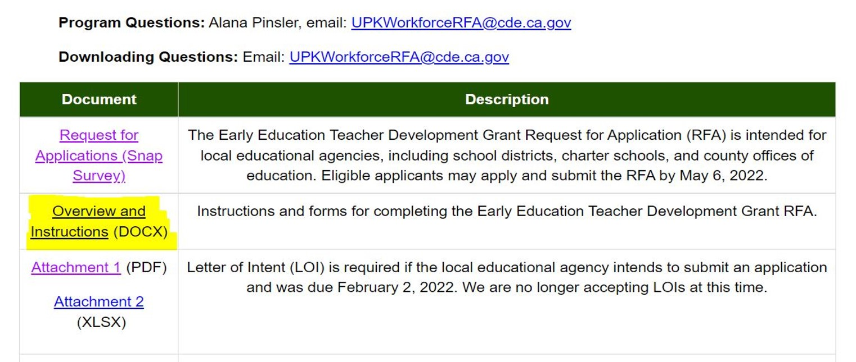
Introduction (3)
From the RFA webpage, open up the Overview and Instructions document.

Slide 8
EETD Grant
Basic Information

Slide 9
Basic Information
Grant Period: The grant period begins July 1, 2022, and ends June 30, 2025.
Authorization: Chapter 2 of Part 6, Division 1 of Title 1 of the California Education Code (EC), Article 13.2, commencing with Section 8281.5.
Eligibility: Eligible local educational agencies (LEAs), which includes school districts, county offices of education (COEs), and charter schools, or a consortium of the aforementioned entities.

Slide 10
Basic Information (2)
Consortium: An LEA may apply independently or on behalf of a consortium of LEAs or providers within the local area, which includes CSPP and Head Start programs that are operated by a community-based organization (CBO).
Lead Agency: If applying as a Lead Agency, the LEA must:
  Remain in the consortium as the lead for the entire project period;
  Act as the fiduciary agent, including compiling and submitting the consortium’s fiscal and programmatic information; and
  Collect and submit any data from the other LEAs or providers, as required by the California Department of Education (CDE).

Slide 11
Basic Information (3)
Questions: Questions regarding the application and its process can be submitted to UPKworkforceRFA@cde.ca.gov.
  Questions of a general theme will be answered.
  Anything program-specific that potentially could give an applicant an unfair advantage will not be answered.

Slide 12
EETD Grant
Fundamental Information

Slide 13
Fundamental Information
Administrative Indirect Cost Rule: The LEA must limit total administrative indirect costs to the rate approved by the CDE for the applicable fiscal year in which the funds are spent.
  For out years, build out any salary increases and changes within the indirect cost.

Slide 14
Fundamental Information (2)
Application Checklist Screening Review (Page 8):
The CDE will review all applications for completeness. Applicants may dispute the disqualification within five business days.
Appeals Process (Page 9):
Applicants who wish to appeal must submit a Letter of Appeal, which must be received by CDE no later than 10 business days from Notification of Eligibility.
Submit to
UPKWorkforceRFA@cde.ca.gov

Slide 15
Fundamental Information (3)
Allowable Costs (Page 6):
The funds must be used for any purposes consistent with activities that directly support workforce development and capacity building including, but not limited to, purposes specified in EC Section 8281.5 (d)(6)(A-H). Funds can supplement—not supplant—existing workforce development resources.
Tuition
Transportation and childcare
Substitute teacher pay
Stipends
Career navigation services
Linked courses and cohorts
Training and professional development

Slide 16
Fundamental Information (4)
Non- Allowable Costs (Page 7):
All expenditures must contribute to the activities listed in the RFA and be reasonable, necessary, and within the project proposal described in the application.
Past educational debt
Living expenses
Program operating costs
Consumables
Hourly wage and salary increases
Legal costs
Puppies

Slide 17
EETD Grant
The Application

Slide 18
The Application -
Required Areas for Grantees
Section I: Applicant Information
Section II: Applicant Narrative
Section III: Application Data
Section IV: Application Budget
Section V: Allocation Priority
Section VI: Application Agreement and Certification
Application will be submitted through Snap Survey
by May 13, 2022

Slide 19
Section I: Applicant Information

Slide 20
The Application - Section I: Applicant Information
Question on Survey | Description of Response
LEA or lead LEA | Provide the name of the entity
Type of Entity Applying | Select “School District”, “County Office of Education”, “Charter School”, or “Consortium”
Program Contact’s and Fiscal Contact's Name, Office, Telephone Number, Extension (If Applicable), and Email Address | Insert the name, office name, telephone number, extension number (if applicable), and email address of the Point of Contact and Fiscal Contact.
County | Select the county of service.
Consortium Members (If Applicable) | Insert the names of the entities that are a part of the consortium.

Slide 21
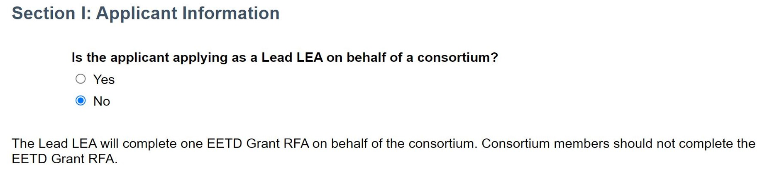
The Application -
Section I: Applicant Information (2)

Slide 22
Section II: Application Narrative

Slide 23
The Application -
Section II: Application Narrative
This section is worth 130 points total.
The Workforce Increases subsection is worth 70 points and has two questions – numbers 1 and 2.
The Professional Development subsection is worth 60 points and has two questions – numbers 3 and 4.

Slide 24
The Application -
Section II: Application Narrative (2)
Requirements:
  Information included in the application must be relevant.
  UPK Planning and Implementation Template responses may be used.
  Inclusion of false or misleading information is a cause for disqualification.
  Character limit of 2500
  An application that is plagiarized in any part or form from another agency’s EETD Grant application will be rejected.

Slide 25
The Application -
Section II: Application Narrative (3)
Questions 1 and 2 Relate to Workforce
Question 1: Describe in detail the LEA or consortium’s plan to increase the number of credentialed teachers who meet the requirements for teaching TK.
Plan should also describe answers to sub-questions (a) through (d)
Question 2: Describe in detail the LEA or consortium’s plan to increase the number of highly-qualified teachers to teach in CSPP.
Plan should also describe answers to sub questions (a) through (d)

Slide 26
The Application -
Section II: Application Narrative (4)
Questions 3 and 4 Relate to Professional Development
Question 3: Describe in detail the LEA or consortium’s plan to increase the competencies for CSPP, TK, and K teachers in the following areas listed in (a) through (f).
Question 4: Describe in detail the LEA or consortium's needs and plans for each of the following items listed in (a) through (f).

Slide 27
Section III: Application Data

Slide 28
The Application -
Section III: Application Data
This section is worth 20 points total.
Two parts:
Provide data for the LEA or consortium using 2021–22 school year data to support your written narrative plans provided in Section II. The data provided will not be scored or monitored.
Check the boxes on the Snap Survey on the following:
  Did you ensure that written prompts link to the data provided in the CSPP data section?
  Did you ensure that written prompts link to the data provided in the TK data section?

Slide 29
Section IV: Application Budget

Slide 30
The Application -
Section IV: Application Budget
This section is worth 15 points total.
Two parts:
Proposed Budget Narrative: Required, worth 15 points
  Provide sufficient detail for each identified cost associated with implementing the proposed goals and activities.
  Once scored by the readers, the CDE will review the budget for completion and cost-effectiveness.
Proposed Budget Summary: Required; not scored
  Grant Program Period is July 1, 2022, through June 30, 2025
  Applicants must provide totals for each Object Code and the Summary should align with the Proposed Budget Detail.

Slide 31
Section V: Allocation Priority
Applicants are only scored on Section V if they meet a threshold qualified score of 115 out of 165 total points on Sections II through IV (70 percent of the total score)

Slide 32
The Application -
Section V: Allocation Priority
This section is worth 70 points total
and is noncumulative.
For an applicant to be scored in Section V:
Passed the Applicant Screen Checklist
Sections II through IV met the threshold of 70 percent (115 out of 165 total points)
All Notification of Eligibility appeals have been heard.
All applications being scored for Section V will begin at zero.

Slide 33
The Application -
Section V: Allocation Priority (2)
Instructions:
Describe the student population the LEA or consortium intends to serve using the 2021–22 fiscal year data, unless otherwise noted.
This includes children that are currently being served and numbers of those planning to be served in full-day CSPP, TK, or K programs offered by the LEA or CBO.
The Why:
The goal of this section is to elevate the statutory targeted student population need alongside an LEA’s workforce needs as required by EC Section 8281.5(d)(5).

Slide 34
The Application -
Section V: Allocation Priority (3)
Provide Either a Yes or No Response
  The extent to which the LEA or consortium is located in a county that has more than three young children, three to five years of age, inclusive, for every licensed childcare slot.
  Does the LEA or consortium operate in an attendance area where a significant disproportionality of particular races or ethnicities, as described in Section 1418(d) of Title 20 of the United States Code, has been identified in special education?

Slide 35
The Application - Section V: Allocation Priority (4)
Provide a Percentage
  Percentage of children that will be served in 2021–22 by the following ages: three, four, and five.
  Percentage of children who were eligible for FRPM in TK and K for the 2019–20 school year.
  Percentage of children who had dual language status in TK and K for the 2019–20 school year.
  Percentage of three-, four-, and five-year-old children with disabilities, as defined by having either an Individualized Education Program (IEP) or an Individualized Family Service Plan (IFSP).
  Percentage of children that will be served by the following program types: CSPP Part-Day, CSPP Full-Day, TK Part-Day, TK Full-Day, K Part-Day, and K Full-Day.

Slide 36
The Application - Section V: Allocation Priority (5)
Provide a Percentage
Percentage of children that will be served in 2021–22 by the following ages: three, four, and five.
Percentage of children who were eligible for FRPM in TK and K for the 2019–20 school year.
Percentage of children who had dual language status in TK and K for the 2019–20 school year.
Percentage of three-, four-, and five-year-old children with disabilities, as defined by having either an Individualized Education Program (IEP) or an Individualized Family Service Plan (IFSP).
Percentage of children that will be served by the following program types: CSPP Part-Day, CSPP Full-Day, TK Part-Day, TK Full-Day, K Part-Day, and K Full-Day.

Slide 37
Section VI:
Application Agreement and Certification

Slide 38
The Application -
Section VI: Application Agreement and Certification
The applicant will be prompted via Snap Survey to sign the application electronically and certify that the information provided in the application is correct and complete.

Slide 39
EETD Grant
Award Determinations

Slide 40
Award Determinations
For an applicant to be eligible for awarding of funds:
Pass Application Screening Checklist
Meets minimum threshold of 70 percent of the total score on Sections II-IV (115 out of 165 total points)
Scored on Section V: Allocation Priority
Funding will then be awarded, within each county's allocation, to
applicants in rank order of total score on Section V until
funding in that county is expended.

Slide 41
Award Determinations –
Accountability
Ongoing communication with the CDE is an
integral part of the reporting requirements.
The following reporting must be completed and submitted:
  A semi-annual fiscal activity report
  An annual narrative progress report
  An annual program report

Slide 42
EETD Grant
Key Dates

Slide 43
Key Dates
Event | Date
Application due | May 13, 2022
Application Checklist Screening Review | May 13–20, 2022
Notification of Ineligibility – Screening sent | May 20, 2022
Notification of Eligibility – Scoring sent | May 31, 2022
Final Funding Awards posted | June 20, 2022

Slide 44
EETD Grant
Questions and Answers

Slide 45
EETD Grant
Resources

