Slide 1
School Emergency Reporting System (SERS) Local Educational Agency (LEA) Training
Joe ANderson
Jake Wolf

Slide 2
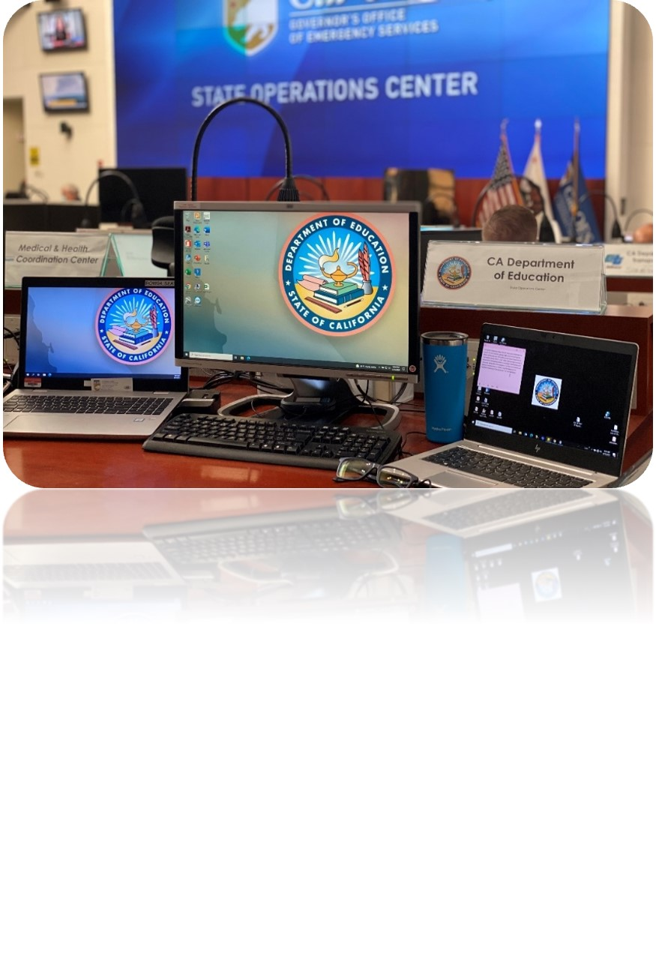
Purpose
The School Emergency Reporting System (SERS) was developed by the California Department of Education’s (CDE) Emergency Services Team (EST) to:
Increase situational awareness within K-12 education at all levels during the response phase of emergency management
Track school closures
Discover unmet needs for schools and coordinate resources

Slide 3
Process
After the incident occurs, the impacted LEAs update their status in SERS.
Once the status is updated, SERS compiles the information. If the LEA did not self report, then CDE will request the LEA to update their status.
Once the status is updated, the results will flow to the school status info on the public site.
From the information provided in SERS by the LEA, the Emergency Services Team will determine if assistance is needed.
If no assistance is needed, no further action is needed.
If assistance is needed, EST informs the County Office of Education (COE), Emergency Operations Center (EOC), State Operations Center (SOC) as necessary, and the EST coordinates resources.

Slide 4
LEA Login
A unique login code is available for each LEA to access the SERS system, which was email to all superintendents on September 1, 2021.
The code may be shared or delegated to other staff.
You may also receive an email prompt from CDE to log in and answer the questions.
Here is the link to the LEA logon portal:https://www3.cde.ca.gov/sers.

Slide 5
CDE Outreach Example Email
The email title should read;
RE: Requesting responses for an Emergency Incident (School Emergency Reporting System)
Recipient would have been preston.usher@sausd.net

Slide 6
CDE Outreach Example Email (Cont.)
Hello Preston Usher, Usher Elementary (20845630000000) is marked as potentially or currently affected by an Emergency Incident (Wildfire – Rosemead Fire). The California Department of Education (CDE)'s School Emergency Reporting System requests that you logon and provide responses for the affected school(s).
The Access Code for your LEA is 12345678 You may logon to the School Emergency Reporting System at https://www3.cde.ca.gov/sers This information assists us in providing aid and informing the public about the status of your school(s). Thank you, Emergency Services Team

Slide 7
Dashboard
Once you log in, the first page that comes up is your LEA Dashboard.
You will see schools that have “Action Required” and “Ongoing Incidents”.
“Action Required” Schools are those of which have been identified by the EST that are potentially affected by the disaster and require LEAs to answer the appointed questions.
“Ongoing Incidents” is where you can find the incident affecting that school.
In rare instances, may find multiple incidents.

Slide 8
Managing Point Of Contact (POC)
From the Dashboard, click the “Settings” tab in the navigation bar.
The default POC is the Superintendent for the LEA.
You may add up to two alternative POCs to manage the LEA account for SERS.

Slide 9
Self Reporting Disasters
To self report a disaster, while in the Dashboard, select “Report New Incident”.
Can be used by LEAs for any incident affecting schools
Public facing page can communicate school status to the public
Select an Incident Type or other emergency if incident type is not listed
If air quality from smoke is the issue, select “Wildfire”
Select the School(s) affected
Use the CTRL or Shift keys to select multiple schools
Click “Choose Affected Schools” after selection

Slide 10
Incident View
This tab shows the status of individual schools and if responses are required.
Schools will remain in a “potentially affected” status until the response is entered.
LEA’s with a large amount of schools may choose to answer via spreadsheet. Select “Download school responses”.

Slide 11
Upload View
Upload spreadsheet by selecting “Upload School Responses”
The Upload Spreadsheet section provides full questions for spreadsheet and instructs on how to answer questions.
Select “Choose File” and insert saved spreadsheet
Select “Upload CSV Responses File”

Slide 12
Editing responses
The top of the responses box is the “Overview”.
The questions in the lower “response” area are different depending on the disaster.
The schools status changes dependent on the answers provided in this section.

Slide 13
Updating Responses
The dashboard will reflect the responses entered.
The LEA can identify a school as no longer affected or not involved.
Selecting “not involved” will remove it from the list.
Selecting “no longer affected” will change status on dashboard.
This dashboard should be checked and updated daily or when there is a change.

Slide 14
Self-Report Demo
Log in as an LEA.
Select “Report New Incident”.
Select “Incident Type” from the dropdown then click the “Report” button
Select all affected schools and click “Choose Affected School(s)” button.
Under “Action” column, select “Add Responses” for each school.
Answer each question. There is one optional question where additional information can be added. Click the “Save Responses” button.
Update responses using the “Edit Responses” or “No Longer Affected” links for each school as the situation changes.

Slide 15
Public Dashboard – School View
Select “Search by School” feature
The Public, local emergency management, and anyone else with web access can search by County, District, COE, or Charter.
Anyone can see this dashboard which is updated real time
Does not share all reported information, due to potential sensitivity
Shows impacted schools, closure status, and dates
Links to California School Directory

Slide 16
Public Dashboard – Incident View
Select the “Search by incident” feature
This view is organized by incident
Can view all impacted schools in California
Can view by specific incidents

Slide 17
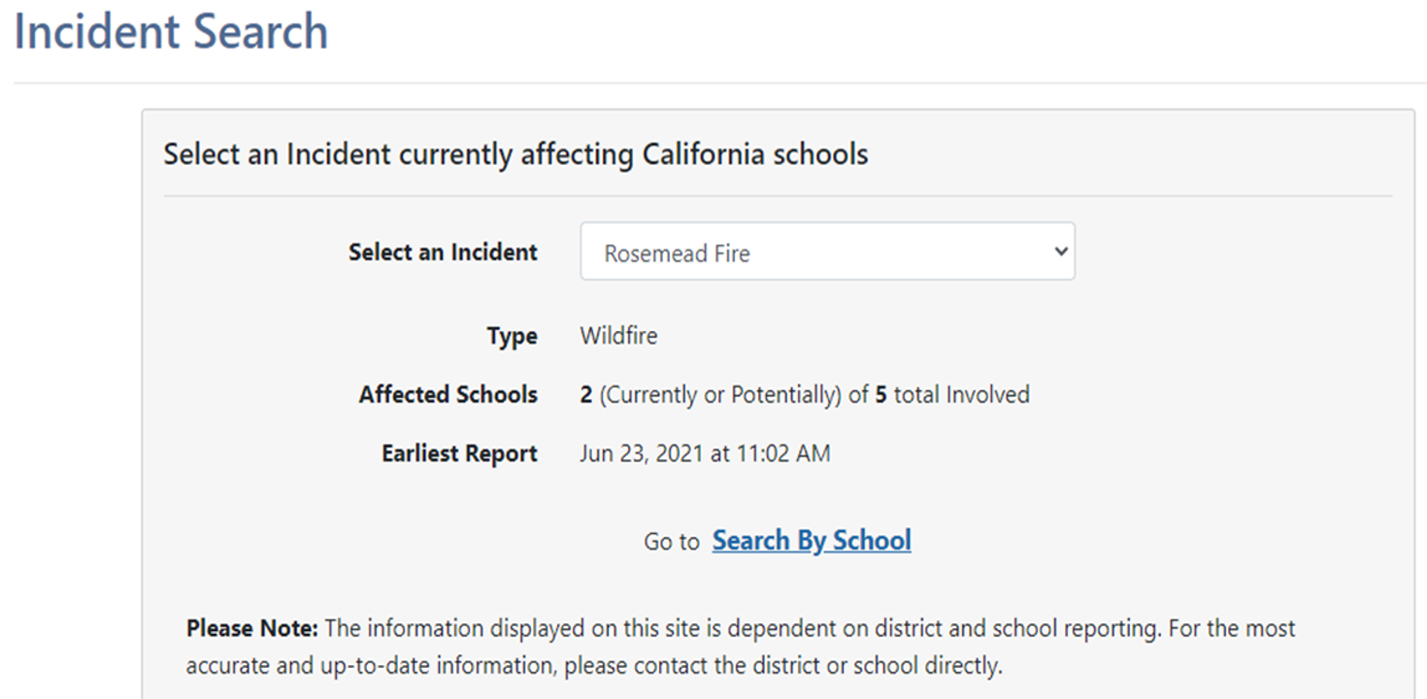
Public Dashboard Incident Summary
When a specific incident is selected, a summary populates

Slide 18
Public Dashboard - List
Each view provides a list of schools.
The section under the incident search feature will populate a list of schools that have been identified by the EST as potentially affected or near the disaster impact area, or have self reported to the SERS system to let the public and their community know of their status.
Schools will be displayed as no longer affected or green, potentially affected or yellow, or affected or red.

Slide 19
What’s in it for You?
Expedite resources to LEAs in need through state and local coordination
Statewide situational awareness
Reduce media requests since information is publicly available
Allows parents and students to see the status of their school

Slide 20
Next Steps
LEAs choose who their POCs will be and update in SERS
CDE posts the public facing page to CDE’s site
LEAs provide feedback on the system
CDE begins phase II of SERS to increase functionality

Slide 21
Contact
Joe Anderson joanderson@cde.ca.gov
Jake Wolf jwolf@cde.ca.gov
General inbox EmergencyServices@cde.ca.gov

