Slide 1
Welcome to the California Universal Meals Listening Session #6 April 19, 2022

Slide 2

Universal Meals Listening Session #6
California Department of Education
Nutrition Services Division

Slide 3

Welcome
Housekeeping:
Line muted
Recorded
Use the Q&A to provide feedback
Questions: UniversalMealsSY22@cde.ca.gov

Slide 4

Agenda
Universal Meals (UM) Overview
Meal Counting and Claiming under UM
Alternative Income Forms
Panelists/Best Practices
FAQ
Resource Guides

Slide 5

Transforming Schools

Slide 6

California Universal Meals Program (1)
Three Components to Universal Meals:
Update of State Meal Mandate
Federal Provision Participation Requirement
Supplemental State Meal Reimbursement

Slide 7
California Universal Meals Program (2)
Federal Meal Provision Requirement:
High poverty schools that are eligible for the Community Eligibility Provision (CEP) must apply for a federal provision
Must apply for CEP or another Provision
Note: LEAs operating CEP must collect alternative income forms

Slide 8
Universal Meals and NSLP/SBP
Universal Meals builds upon participation in the National School Lunch Program (NSLP) and School Breakfast Program (SBP)
Sponsors will still be expected to comply with current federal regulations to operate the NSLP and SBP
Sponsors will either operate under a federal provision, or conduct standard counting and claiming

Slide 9
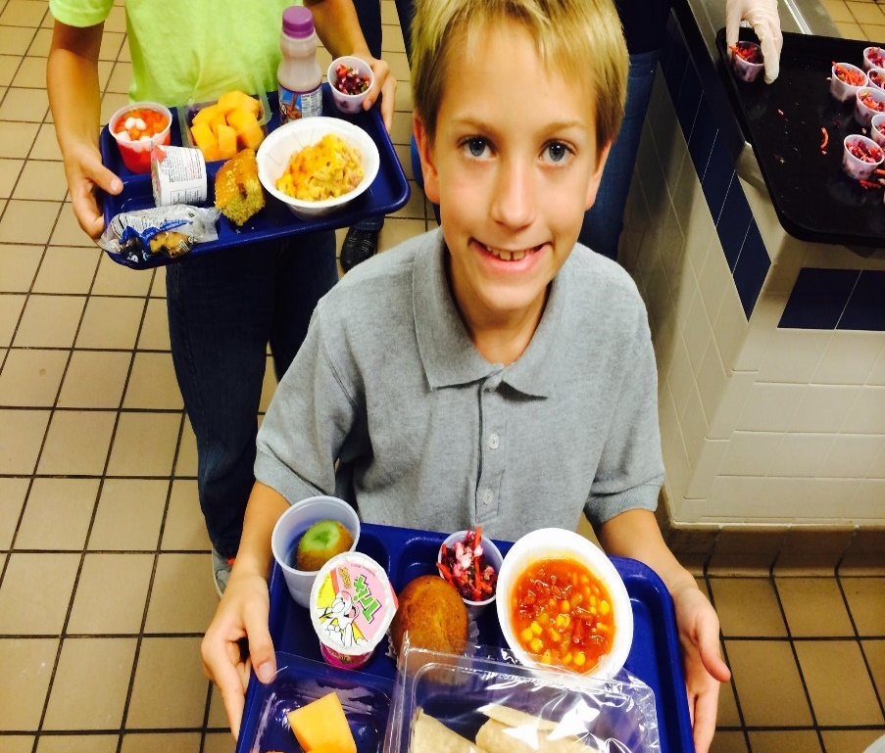
Standard Meal Counting and Claiming
School Food Authorities (SFA) are still required to determine student eligibility
SFAs must still count, record, and claim based on number of meals served and by category (free, reduced-price [RP], paid)

Slide 10
Eligibility Documentation: Meal Applications
A household meal application determines student eligibility by household income or indicates if a child receives certain benefits/assistance
SFAs are required to continue to send out meal applications when Universal Meals begins

Slide 11
Meal Applications (1)
Components of the Meal Application include:
• Student information for all children in the household
• Assistance programs/categorical eligibility
Head Start, CalFresh, CalWorks, etc.
• Gross income for all household members
Contact information and adult signature
Privacy and civil rights statements

Slide 12
Meal Applications (2)
Family income standards adjusted annually, July 1st
SFA must publicly announce the eligibility criteria
SFAs and all participating schools under its jurisdiction must adhere to the federal eligibility criteria. SFAs must include these eligibility criteria in their policy statement.

Slide 13

Meal Applications (3)
Meal Applications can be paper and or electronic
Families can apply anytime during the school year
Not mandatory for families to complete/return
Parents/guardians cannot be compelled to complete

Slide 14
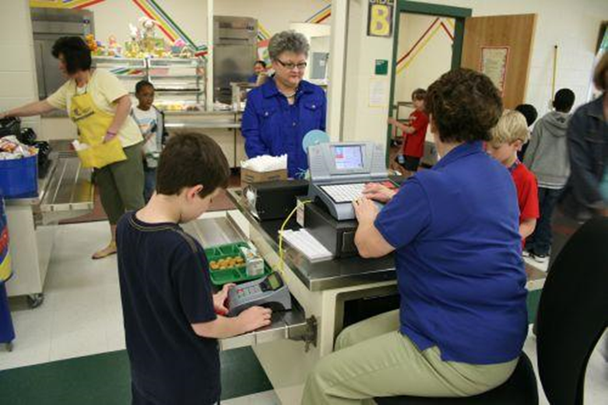
Point of Service Meal Counts
An SFA must ensure that meals:
Meet the meal pattern requirements
Are served to eligible students; and
Are counted daily by category

Slide 15
Claim for Reimbursement (1)
SFA submits monthly claims
Including enrollment, eligibility determinations, and number of meals served in each category (free, RP, paid)
The State Controller’s Office processes and issues reimbursement checks
Reimbursement is a combination of both state and federal funds

Slide 16
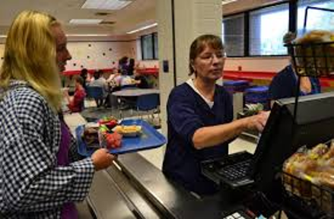
Claim for Reimbursement (2)
All meal reimbursement claims must be submitted within 60 days following the month in which the meals were served to be considered for payment
Ex: July claiming deadline = September 29th
Late claims cannot be processed except in rare circumstances

Slide 17
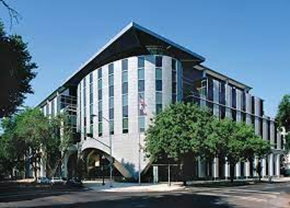
Special Guest
Ruthann Munsterman, Education Fiscal Services Consultant
School Fiscal Services Division

Slide 18
Alternative Income Forms
Local Control Funding Formula (LCFF) and the Unduplicated Pupil Count (UPC)
Alternative Income Forms
Collection Options
LCFF Base Year and Non-base Years
California Longitudinal Pupil Achievement Data System (CALPADS) Reporting
Retention
Alternative Form Templates and Requirements
Frequently Asked Questions (FAQ)s

Slide 19
Overview of LCFF Funding (1)
Most of the LCFF funding is made up of base grant funding, which is a base dollar amount for each student (average daily attendance [ADA]), along with supplemental and concentration grant funding based on ADA and the unduplicated pupil count
This makes up the majority of state funding issued to local education agencies (LEA)

Slide 20
Overview of LCFF Funding (2)
LEAs receive supplemental and concentration grant funding in addition to the base grant funding
The Supplemental Grant is equal to 20 percent of the adjusted base grant multiplied by ADA and the unduplicated percentage of targeted disadvantaged pupils
The Concentration Grant is Equal to 65 percent of the adjusted base grant multiplied by ADA and the percentage of targeted pupils exceeding 55 percent of a school district’s or charter school’s enrollment

Slide 21
Unduplicated Pupil Count
The targeted disadvantaged pupils used to calculate the Supplemental and Concentration Grant funding are the students that make up the Unduplicated Pupil Count (UPC)
The UPC is a count of students who are Free or Reduced Price Meals (FRPM) eligible based on income eligibility or other source of categorical eligibility (direct certification, foster, homeless, migrant) and those identified as English Learners (EL). Students are counted once even if they are eligible in more than one category.

Slide 22
Unduplicated Pupil Count
In order to receive the maximum amount of funding they are entitled to, LEAs must identify students that would typically be considered FRPM eligible based on meal applications
When participating in programs where meal applications cannot be collected, LEAs have the option of collecting alternative income forms to identify FRPM eligible students

Slide 23
Alternative Income Forms (1)
Alternative income forms are forms used in place of, or in conjunction with, meal applications to collect household income information from enrolled students
Information on the forms is reviewed by the LEA to determine whether household income falls within the range to identify students as FRPM eligible

Slide 24
Alternative Income Forms (2)
Alternative income forms can be used by any LEA
LEAs operating Provisions 2 and 3 do not collect meal applications on a regular basis and may benefit from collecting alternative forms during years in which meal applications are not collected
LEAs operating CEP never collect meal applications and will need to collect alternative forms in order to identify income eligible students to be included in the UPC
LEAs not participating in a federal meal program never collect meal applications and will need to collect alternative forms in order to identify income eligible students to be included in the UPC

Slide 25
Alternative Income Form Collection Options (1)
LEAs operating Provision 2, 3, or CEP have options for how frequently forms must be collected:
LEAs can choose to collect forms annually
LEAs can establish a base year for LCFF purposes and collect forms every 4 years

Slide 26
Alternative Income Form Collection Options (2)
LEAs operating a traditional meal program, who choose to collect alternative forms, should collect alternative forms annually
LEAs not operating a federal meal program should collect alternative forms annually

Slide 27
LCFF Base Year (1)
An LCFF base year can be established during the same year as a Provision 2 or 3 base year, if so, the meal applications collected would be the supporting documentation for the base year, or
The LCFF base year can be established during a year other than the base year for Provision 2 or 3
The LEA is responsible for tracking the first year of the LCFF cycle, the base year is not reported to California Department of Education (CDE)

Slide 28
LCFF Base Year (2)
The LCFF base year process is a 4 year cycle
During the LCFF base year (Year 1) alternative forms are collected from as many students as possible
Collection can begin during the spring prior to the upcoming school year (as soon as the income eligibility guidelines for the upcoming school year have been released by USDA) through October 31st of the school year

Slide 29
LCFF Base Year (3)
The forms are processed by the LEA and student eligibility is determined
Student eligibility is reported to CALPADS during the Fall 1 certification period
While LEAs can begin collecting alternative forms in the spring, the FRPM record must be submitted to CALPADS with a start date of July 1 or later in order for the eligibility to count for the upcoming school year

Slide 30
LCFF Non-Base Years
During the three subsequent school years (Years 2, 3, and 4) forms cannot be collected from continuing students
This is true even if the student did not submit a form during the base year collection or if the student was determined to be “paid” eligible during the base year collection
Forms are collected from newly enrolled students only

Slide 31
LCFF Non-Base Year CALPADS Reporting
Eligibility determined during the base year is reported in CALPADS during years 2, 3, and 4
CALPADS does not roll student eligibility over from year to year, the eligibility information must be reported annually in order for the student eligibility to be included in the UPC for that school year

Slide 32
Retention of Forms (1)
Alternative income forms must be retained through the end of the LCFF cycle and in accordance with regular retention requirements
Forms will be reviewed during the annual audit each year, if a form does not exist to support the student eligibility reported in CALPADS, then the LEA will receive an audit finding and a reduction in the UPC
Students identified through direct certification, or as foster, homeless, migrant, or EL do not need an alternate form on file, but should have documentation identifying them as directly certified, foster, homeless, migrant, or EL

Slide 33
Retention of Forms (2)
Alternative forms would fall under the requirements for Class 3 Disposable records:
Title 5, California Code of Regulations, Division 1, Chapter 16, Subsection 16026
A Class 3-Disposable record shall not be destroyed until after the third July 1 succeeding the completion of the audit required by California Education Code Section 41020 or of any other legally required audit, or after the ending date of any retention period required by any agency other than the State of California, whichever date is later. A continuing record shall not be destroyed until the fourth year after it has been classified as Class 3 -Disposable.

Slide 34
Retention of Forms (3)
The three-year retention period for LEAs collecting annually would begin at the end of each school year.
The three-year retention period for LEAs that have established an LCFF base year would begin after the end of the four year cycle.

Slide 35
Alternative Form Templates (1)
Links to the alternative household income form templates are available on the CDE’s LCFF FAQs page under the heading Unduplicated Pupils at Schools with Provision 2 and 3 or CEP Status
Multiple forms are available to allow LEAs to select the template that best meets their needs
The forms are titled Household Income Data Collection Form Sample 1 through Household Income Data Collection Form Sample 5
A link to available translations is included under the description of each form

Slide 36
Alternative Form Templates (2)
The CDE does not update these forms on an annual basis
As noted in the description for the forms that need annual updates, the LEA is responsible for ensuring that the forms they use are updated with the appropriate income eligibility guidelines for the year

Slide 37
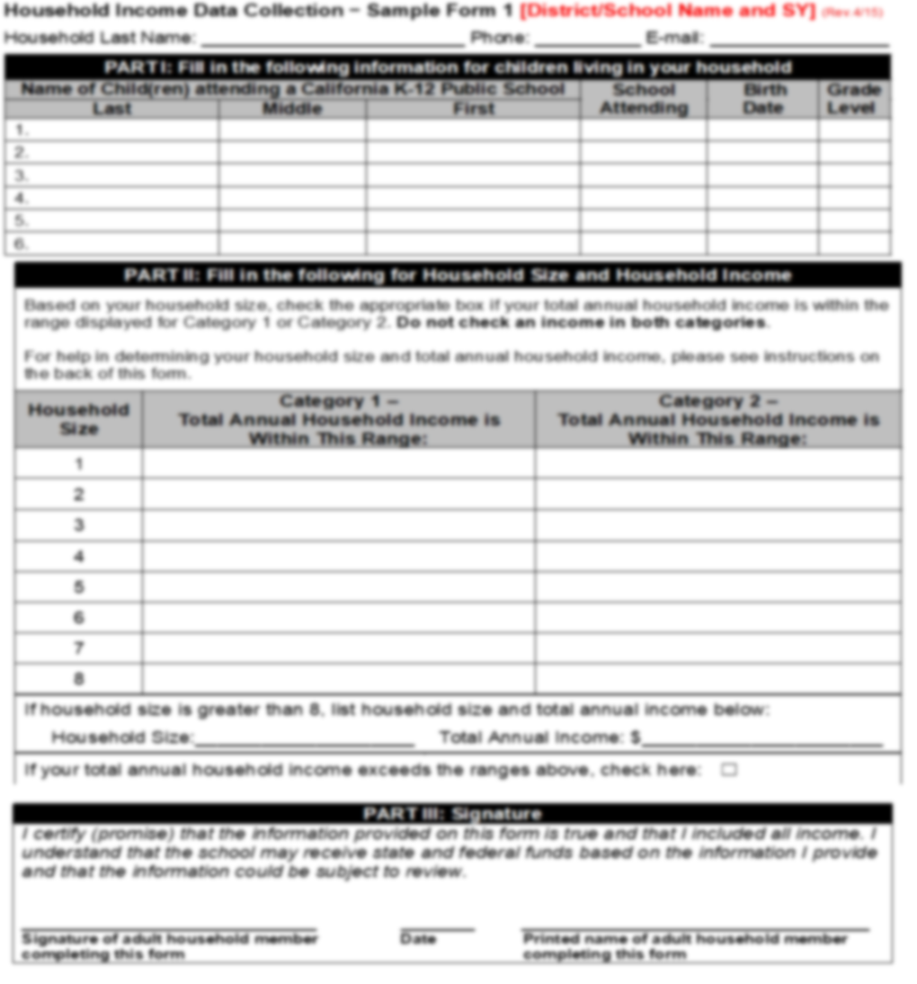
Alternate Income Form (1)

Slide 38
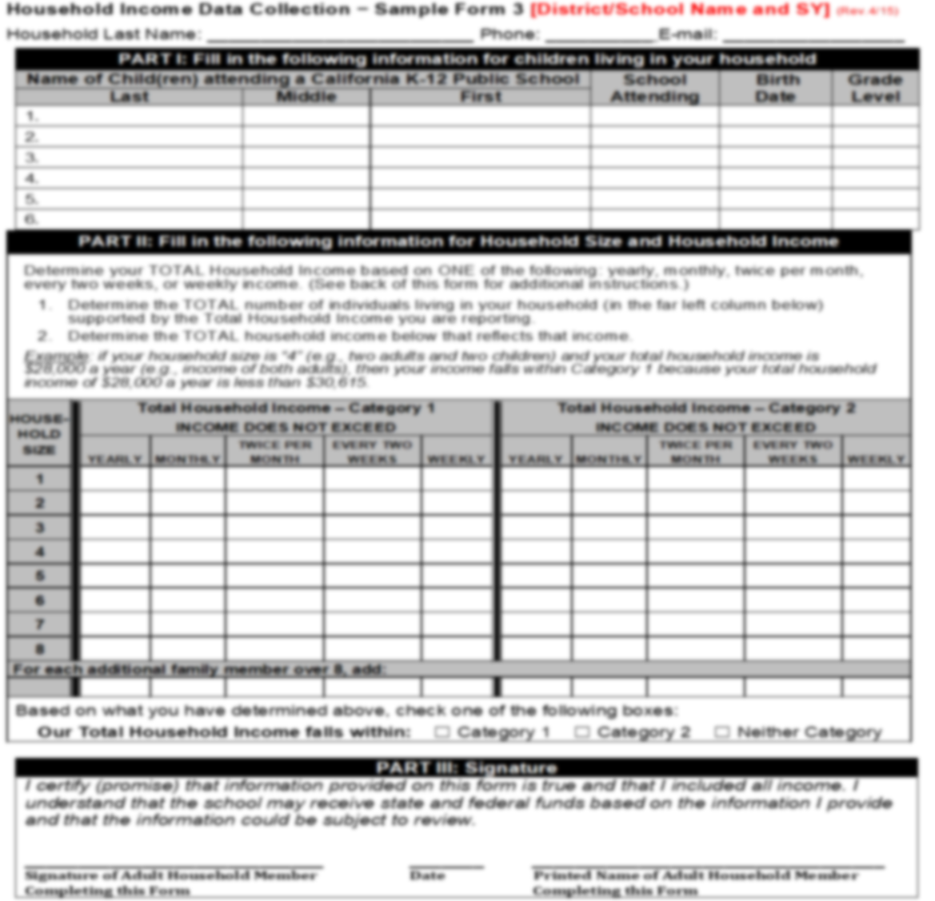
Alternate Income Form (2)

Slide 39
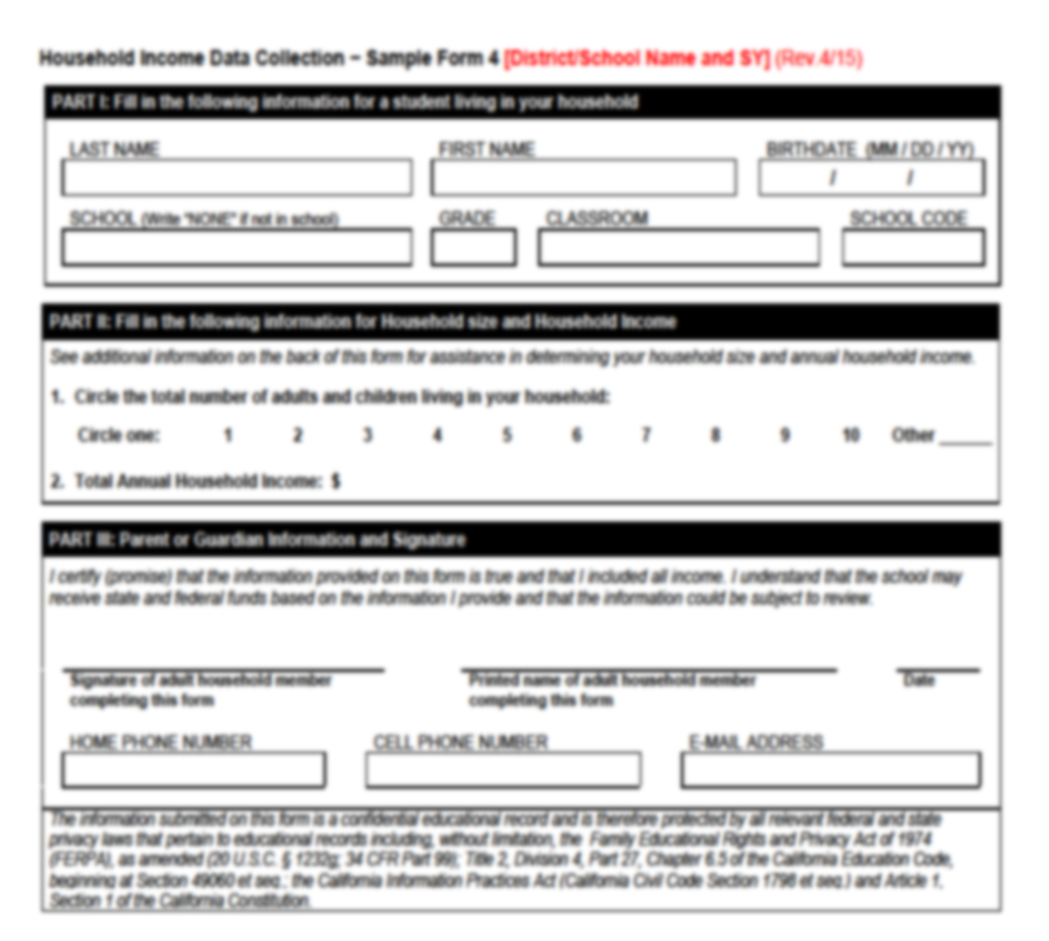
Alternate Income Form (3)

Slide 40
Developing An Alternative Form (1)
LEAs are not required to use any of the CDE templates, they can develop their own alternative form
Forms developed by LEAs are not approved by the CDE

Slide 41
Developing An Alternative Form (2)
Forms that contain the following minimum information would be considered valid documentation of FRPM eligibility:
Information sufficient to identify the pupil(s)
Information sufficient to determine that the pupil or household meets federal income eligibility criteria sufficient to qualify for either a free or reduced-priced meal under the Richard B. Russell National School Lunch Act (Public Law 113-79)
Certification that information is true and correct by the pupil’s adult household member

Slide 42
Meal Applications versus Alternate Income Forms
NSLP/SBP Status | Meal Applications | Alternative Income Forms
Approved NSLP/SBP sponsor, non-provision | Yes, mandatory, on an annual basis. Meal applications still required for students not directly certified. | Optional, but in addition to meal applications.
Approved NSLP/SBP sponsor, CEP | No, prohibited | Yes, forms must be collected annually or in an LCFF-base year and again when the base-year is re-established
Approved NSLP/SBP sponsor, Provisions 2 or 3 | Yes, mandatory, only in the provision-base year. Prohibited from collected in non-base years. | Optional, but in addition to meal applications.

Slide 43
Alternative Forms FAQs (1)
Can distributing, collecting, and processing the alternative forms be paid for by the Cafeteria Fund?
No, Cafeteria Funds cannot be used to pay for anything related to alternative income forms. This should be paid for from the General Fund.

Slide 44
Alternative Form FAQs (2)
If our LEA did not have a good return of forms during the LCFF base year, are we required to wait until after the end of the cycle before establishing a new LCFF base year?
No, LEAs can choose to establish a new LCFF base year during any school year.

Slide 45
Alternative Form FAQs (3)
What happens if a student was identified through direct certification, or as foster, homeless, migrant during the LCFF base year, but not during the subsequent non-base years?
Since the student was identified as FRPM eligible during the base year, they can still be included in the UPC. However, the LEA will need to enter an FRPM record in CALPADS during each of the non-base years in order for that student to be included in the UPC. In addition, the LEA needs documentation from the base year to support the student eligibility. Copies of direct certification lists, foster lists, etc., should be retained to support base year eligibility.

Slide 46
Alternative Form FAQs (4)
Can eligibility from alternative forms be extended to other students in the household?
Yes, eligibility can extend to other students in the household.

Slide 47
Alternative Form FAQs (5)
Can base year eligibility from one continuing student be extended to a newly enrolled student from the same household?
No, eligibility determined in a prior year cannot extend to a newly enrolled student from the same household.

Slide 48
Alternative Form FAQs (6)
Can alternative forms collected after October 31st be used for UPC purposes?
No, forms must be submitted by October 31st in order for student eligibility to be included in the UPC for the current school year.

Slide 49
Alternative Form FAQs (7)
Can we use our meal collection point of sale database (POS) to process information collected on alternate income forms?
Yes, meal collection POS systems can be used to process alternative income forms. However, any fees related to processing the alternative income forms cannot be paid for by the cafeteria fund.

Slide 50
Alternative Form FAQs (8)
Can alternative forms be collected online?
Yes, as long as the online collection meets the requirements for the alternative forms.

Slide 51
Alternative Form FAQs (9)
Does CDE have a sample eligibility letter LEAs can send to households that submit alternative income forms?
No, CDE does not have a sample eligibility letter that can be issued to households, however, LEAs can develop an eligibility letter if they choose to do so.

Slide 52
California Universal Meals Program
With the implementation of California Universal Meals Program this fall there is concern that LEAs will find it more challenging to collect alternative income forms from households
Suggestions for collecting alternative income forms has been included in CALPADS Flash #220

Slide 53
Resources
LCFF FAQs - https://www.cde.ca.gov/fg/aa/lc/lcfffaq.asp
Alternative Income Forms Questions - PASE@cde.ca.gov

Slide 54

Panelists
Yazied Widatalla, Nutrition Director for New Haven Unified School District
Suzanne Morales, Nutrition Director for Placentia-Yorba Linda Unified School District

Slide 55
Reporting/Recordkeeping
SFAs must comply with federal reporting and record keeping requirements:
Records supporting your claiming data, such as number of meals served by category each day
Edit checks, to ensure data is accurate at all sites and during all meal services
Eligibility documentation

Slide 56

Certification and Benefit Issuance
Common errors include:
Incorrect total household members
Incorrect income calculations
Missing information; Social Security number, adult signature, case number, certifying official signature and date

Slide 57

The Future of the Universal Meals Listening Sessions
Next Session:
May 17, 2022 at 2 pm
- State Updates

Slide 58
Resource Guide
California Universal Meals web page
Resources and FAQ
Universal Meals Quick Reference Guides, available in the Child Nutrition Information and Payment System (CNIPS) Download forms
All 16 resources can be found under Form ID: UM QR
USDA More than a Meal toolkit/resource
SNP Guidance, Manuals, and Resources web page

Slide 59

Contact Information
For Questions on Universal Meals
UniversalMealsSY22@cde.ca.gov

Slide 60

Thank you
This institution is an equal opportunity provider.

