Slide 1
Tuesday at 2 School Nutrition Town Hall
February 24, 2026
Nutrition Services Division (NSD)
California Department of Education (CDE)

Slide 2

Town Hall at a Glance
Spotlights
Federal Updates
Guest Speaker
Operational Reminders
Resources & Other Announcements

Slide 3
School Nutrition Program Spotlight

Slide 4
San Juan Unified School District - Prioritizing Locally Grown Ingredients
“A lot of it is being flexible,” Nair said. Pasadena Avenue’s kitchen is small, which makes processing larger fruit like melons difficult, but it can work with citrus. “The Cara Cara oranges are from Fowler Packing, a large grower who is further away (in Fresno), but we try to purchase local food and work a lot with Spork Food Hub out of Davis.”
-Sneh Nair, Director of Nutrition Services
San Juan Unified School District (USD)
“Prioritizing California-grown products supports student access to fresher food, reduces transportation and environmental impacts, and strengthens local and regional agriculture —goals that align with our commitment to student wellness, sustainability, and responsible stewardship of public funds.”
-Raj Rai, spokesperson San Juan USD

Slide 5
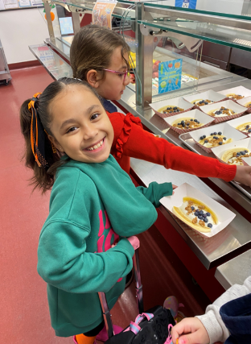
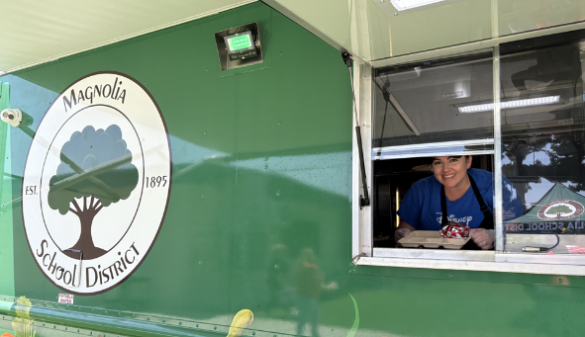
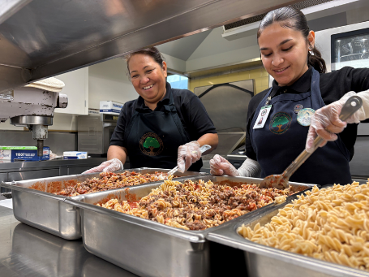
Celebrating California’s School Meals
Photo Contest –Winners (1)
Behind the Counter
Magnolia School District
Mealtime Legends
Magnolia School District
Mealtime Memories
Glendale USD

Slide 6
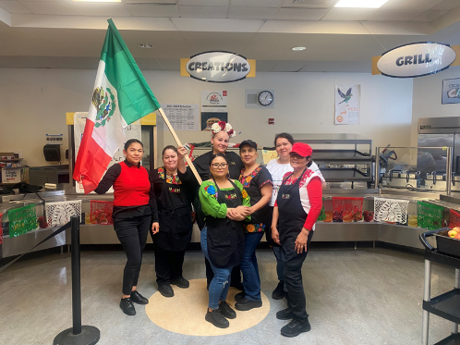
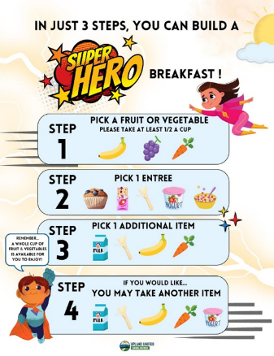
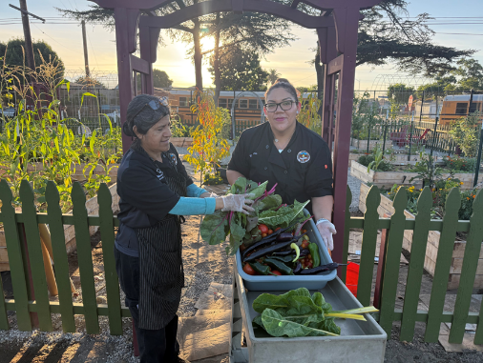
Celebrating California’s School Meals Photo Contest – Winners (2)
Offer Versus
Serve
Upland USD
Sow, Grow, and Show with Farm to School
Azusa USD
Super Selfies
Napa Valley USD

Slide 7
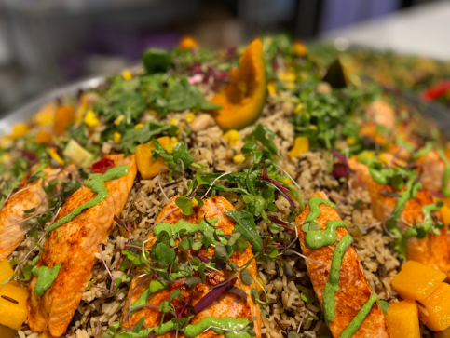
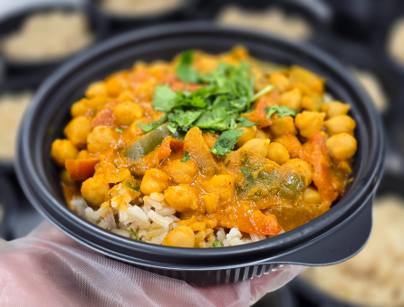
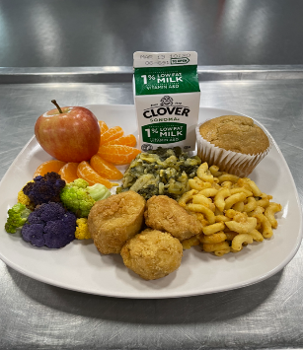
Celebrating California’s School Meals Photo Contest – Cafeteria Creations
Winner
Wonderful College Prep Academy
Wild-Caught Seared Salmon with Native Greens Sauce and Wild Rice
Honorable Mention
Fullerton Joint Union High School District
Chana Masala
Honorable Mention
Monterey Peninsula USD
Plant-based Soul Food

Slide 8

2026 Green Ribbon Schools Awardees
26 schools, 12 school districts, and one county office of education honored
Five earned the highest distinction of "Green Achiever":
  Captain Leland F. Norton Elementary, San Bernardino City Unified School, District, San Bernardino County
  Joaquin Moraga Intermediate, Moraga School District, Contra Costa County
  National School District, San Diego County
  Ravenswood City School District, San Mateo County
  Lycée Français de San Francisco (Private), San Francisco County

Slide 9
Federal Updates

Slide 10
U.S. Department of Agriculture (USDA) Release Memo Addressing 2025–2030 Dietary Guidelines for Americans
Familiarize yourself with key recommendations and how they can be incorporated into School Nutrition Programs (SNP) operations.
What to expect from USDA Food and Nutrition Service:
  Developing a proposed rule to update nutrition program standards and meal requirements. This will allow feedback through rulemaking and public comment process.
  Developing a new educational campaign which will support healthy eating outside of school.
Dietary Guidelines for Americans, 2025–2030 – Eat Real Food SP 02-2026, CACFP 01-2026, SFSP 01-2026, released February 11, 2026 at https://www.fns.usda.gov/cn/dga-realfood

Slide 11
Reminder: Food Allergy Requirements
The CDE SP 01-2026 Whole Milk for Healthy Kids Act of 2025 web page highlights policy guidance on the revised milk requirements under the National School Lunch (NSLP) at https://www.cde.ca.gov/ls/nu/healthykidsact2025.asp
California Education Code (EC) Section 49414.2 requires CDE to provide guidelines to help protect students with food allergies
Various food allergy trainings are available on the CDE Disability Modifications Including Food Allergies web page–Trainings tab at https://www.cde.ca.gov/ls/nu/sn/modaccomdisinclfoodalgry.asp

Slide 12
Food Recovery and Organic Waste Requirements

Slide 13
Senate Bill (SB) 1383 Organic Waste Local Educational Agency Requirements
California Code of Regulations, Title 14, Sections 18986.1 & 18986.2 require the following:
Subscribe to an organic waste collection service, or self-haul organic waste to a recovery facility.
Need to provide containers for the collection of organic waste and non-organic recyclables in all areas where disposal containers are located, except restrooms.
Prohibit employees from placing organic waste in a container not designated for organic waste.
Periodic inspections of containers for contamination and inform employees if containers are contaminated.
Provide information to employees and students on methods for prevention of organic waste generation.

Slide 14
Food Donation Options, Resources & Guidance
Guidance on the Food Donation Program in Child Nutrition Programs (CNPs), USDA web page https://www.fns.usda.gov/cn/guidance-food-donation-program-child-nutrition-programs
CDE Management Bulletin (MB) CNP-02-2018 Guidance on Donation of Leftover Food in Child Nutrition Programs https://www.cde.ca.gov/ls/nu/sn/cnp022018.asp
CDE Food Pantries in Schools web page at https://www.cde.ca.gov/ls/nu/he/schoolfoodpantries.asp
CDE MB CNP-03-2018 The Use of Share Tables https://www.cde.ca.gov/ls/nu/sn/mbcnp032018.asp

Slide 15
Food Recovery and School Pantry Program
Presenter: Eve Birge, Chief Executive Officer
White Pony Express

Slide 16
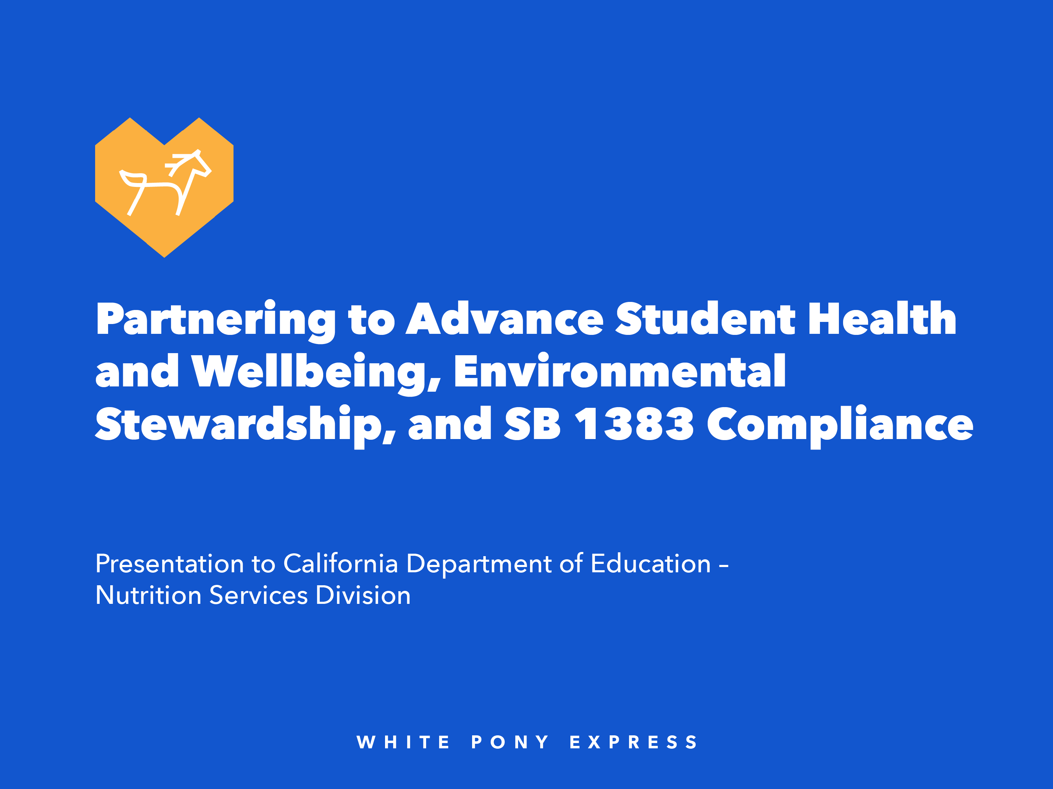
Partnering to Advance Student Health and Wellbeing, Environmental Stewardship, and SB 1383 Compliance

Slide 17
Who We Are and What We Do
White Pony Express rescues high-quality surplus food and delivers it – with love – to neighbors facing food insecurity.
  We partner with grocers, restaurants, farmers, schools, food distributors, and community-based organizations.
  We make SB 1383 compliance simple, safe, and efficient.

Slide 18
Why Food Recovery Matters For Schools
SB 1383 requires institutions to donate at least 20% of edible surplus food.
  Food waste is a leading contributor to landfill methane emissions.
  Schools are uniquely positioned to model sustainability and civic leadership.

Slide 19
Health and Academic Impact
Nutritious food supports student concentration,
attendance, and academic performance.
  Food recovery strengthens community food access for
  vulnerable families.
  Healthy communities contribute to stable, ready-to-learn students.

Slide 20
Family Safety and Security
Food insecurity increases stress, instability and
health risks.
  Recovered food reduces grocery burden for families.
  Stronger food security enhances household resilience
  and wellbeing.

Slide 21
Environmental Impact
Food waste in landfills produces methane, a potent greenhouse gas.
  Food recovery reduces landfill volume and carbon footprint.
  Aligns with California’s climate goals and environmental education priorities.

Slide 22
How White Pony Express (WPE) Ensures
Compliance and Safety
Clear guidance aligned with food safety standards.
  Safe handling, sorting, and rapid redistribution—within hours of pickup.
  Reliable documentation to support SB 1383 compliance.

Slide 23
Simple, Flexible Partnership Model
We schedule pickups based on your campus needs.
  No disruption to nutrition service operations.
  Dedicated support to streamline training and coordination.

Slide 24
Closing the Loop: Our School Pantry Program
White Pony Express also delivers recovered food back to school communities.
  On-campus School Pantry Program allows for direct access for families.
  Strengthens school-based wellness and family engagement initiatives.

Slide 25
Shared Mission and Call to Action
Together we can reduce waste, feed families, and meet
SB 1383 requirements.
  Partner with White Pony Express or a food recovery organization in your area to turn surplus into community impact.
  Let’s lead California in responsible, compassionate food stewardship.

Slide 26
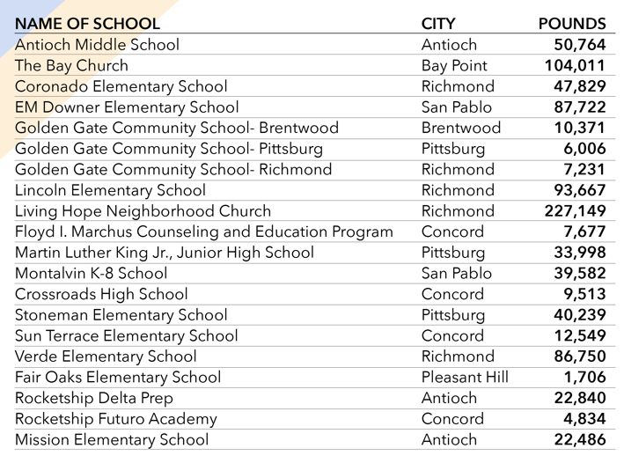
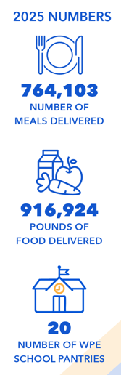
WPE School Pantries

Slide 27
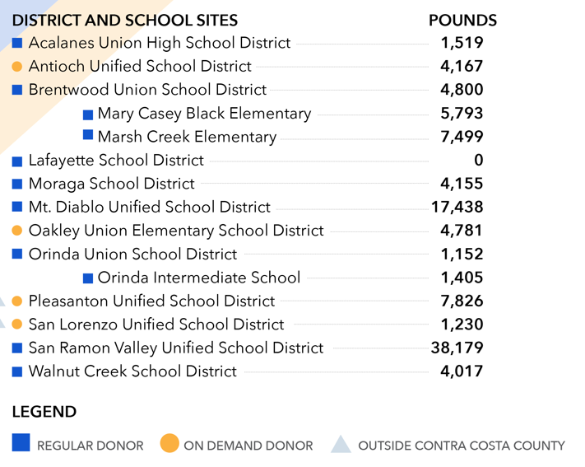
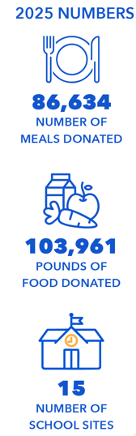
WPE School Donors

Slide 28


WPE Contact Information and Resources
Eve Birge, Chief Executive Officer
925-393-1356
evebirge@whiteponyexpress.org
Ana Bostick, Director of Operations
925-294-0574
anabostick@whiteponyexpress.org
Resources:
White Pony Express web page at https://whiteponyexpress.org/
The Power of Pony Video at https://www.youtube.com/watch?v=F_obb1hiKPU
CA Food Recovery Coalition Membership at https://californiafoodrecoverycoalition.org/members/

Slide 29
Operational Reminders

Slide 30
Meal Service Options During Unanticipated School Closures (1)
School Food Authorities (SFAs) experiencing unanticipated school closures can apply for non-congregate meal service waiver:
National School Lunch Program/School Breakfast Program at any closed school sites also offering virtual instruction.
Seamless Summer Option (SSO) at area eligible school or community sites when school is closed with no virtual instruction.

Slide 31
Meal Service Options During Unanticipated School Closures (2)
Through a waiver from USDA, CDE may approve the following flexibilities:
Non-congregate meals
Meal service time
Offer versus serve
Parent/guardian pick up
Bulk meal distribution, up to 10 operating days
Note: CDE must approve requests and can only allow these flexibilities for up to 10 operating days, anything beyond 10 days requires USDA approval.

Slide 32
Meal Service Options During Unanticipated School Closures (3)
SFAs can also operate SSO and serve congregate meals at non-school sites with CDE approval.
Sites must be area eligible
Sites must operate as open sites
Submit SSO site applications in the Child Nutrition Information and Payment System; no waiver is required
Meal service can last 10 days or longer without USDA approval

Slide 33
Meal Service Options During Unanticipated School Closures: Resources
Resources with additional information and guidance on options for SFAs experiencing unanticipated school closures:
CDE Management Bulletin CNP-02-2020: Meal Service During Unanticipated School Closures https://www.cde.ca.gov/ls/nu/sn/mbcnp022020.asp
CDE Disaster Guidance for Child Nutrition Programs web page https://www.cde.ca.gov/ls/nu/disasterguidance.asp
Online survey to request non-congregate feeding flexibilities https://surveys3.cde.ca.gov/s.asp?k=168054647575

Slide 34
Maximizing USDA Foods Entitlement:
USDA Foods Ordering for School Year (SY) 2026–27
Preplanners and Surveys due Monday, March 2, 2026
Need Ordering Assistance?
  State Co-op and Advance Order Agencies Contact FoodDistibution@cde.ca.gov
  Private Co-op Members reach out to your Co-op

Slide 35
Maximizing USDA Foods Entitlement: Department of Defense (DoD) Fresh Entitlement Reminders
Allocate entitlement for SY 2026–27
Request SY 2025–26 Fresh Fruit and Vegetable Ordering Receipt System (FFAVORS) entitlement transfers by Monday, March 2, 2026
Use your entitlement in FFAVORS by Friday, May 1, 2026

Slide 36
Test Your Knowledge
When ordering USDA Foods for processing, which of the following is the best practice to ensure efficient use of entitlement funds?
Divert as many pounds as possible to avoid running out.
Review prior year usage, calculate your needs using processor tools, and request diversions accordingly.
Repeat last year’s order since it seemed to work ok.
Wait until the end of the school year to determine if you used all diverted pounds and need more for next year.

Slide 37
Test Your Knowledge–Answer
When ordering USDA Foods for processing, which of the following is the best practice to ensure efficient use of entitlement funds?
B. Review prior year usage, calculate your needs using processor tools, and request diversions accordingly.

Slide 38
Resources and Other Announcements

Slide 39
Celebration Dates
Celebration and Dates | Resource Information
National School Breakfast Week March 2-6, 2026 | School Nutrition Association web page at https://schoolnutrition.org/about-school-meals/national-school-breakfast-week/
National Nutrition Month® Month of March | National Nutrition Month® web page at https://www.eatright.org/about-national-nutrition-month
Earth Day April 22, 2026 | Plastic Free Luncheon the Cafeteria Culture.org website at https://www.cafeteriaculture.org/plastic-free-lunch.html

Slide 40
Webinar: Competitive Foods-Charter Elementary, Middle, and High School Requirements
Date: Wednesday, February 25 from 1:30 p.m. to 2:30 p.m.
Topic: This webinar covers competitive food and beverage rules that apply specifically to a charter elementary, middle, or high school campus.
All trainings will be posted on our NSD Learning Site.
Webinar has passed.

Slide 41
Webinar: Honoring Cultural Food Preferences in School Nutrition Programs
Save the date: Tuesday, March 3, 2026, at 2 p.m.
Topic: This webinar will highlight best practices for incorporating student cultural food preferences into student meals.
  Honor the cultures of students
  Strengthen student trust and engagement
  Support equity in school meal participation
Webinar has passed.

Slide 42
Webinar: Rural Non-congregate Meal Service
Save the date: Wednesday, March 4, 2026, at 2 p.m.
Topic: This webinar will provide an overview of the rural non-congregate meal service in the Summer Meal Programs and share resources with program operators who wish to participate in this meal service option this summer
Webinar has passed.

Slide 43
Webinar: 2026 SUN Bucks
2026 SUN Bucks Implementation webinar:
Date: *Tuesday, March 10, 2026 at 2 p.m.
Topic: This webinar will cover SUN Bucks eligibility, applications, and data sharing
*Registration link: Webinar has passed.
*Note the webinar date and registration link have been updated since the January 27, 2026 Town Hall.

Slide 44
Friends of the Earth
Plant-based Webinar Series
Webinar Topic | Date
Innovation in Culturally Diverse, Plant-Based School Meals | March 17, 2026, 2-3:00 p.m.
Making Plant-Based Popular: How to Build Student and Staff Interest in Plant-Based School Meals | April 14, 2026, 2-3:00 p.m.
Plant-Based, Organic, and Regenerative Vendors, Producers, and Procurement Strategies | May 19, 2026, 2-3:00 p.m.
Register for these webinars at: Webinars have passed.

Slide 45
Grant Opportunity: No Kid Hungry
No Kid Hungry California is offering grant funding to expand summer meals
Funding is available for schools and community organizations that are serving rural communities and expanding non-congregate feeding models
Grant amount: Varies, average award is $5,000 - $15,000
Applications due: April 15, 2026

Slide 46
Tuesday at 2 Town Hall Schedule
Held on the fourth Tuesday of the month
Date | Topic
March 24, 2026 | Town Hall updates and guest speaker
April 28, 2026 | Town Hall updates and guest speaker

Slide 47
Professional Standards Crediting Information
Key Area: Administration (3000)
Training Topic: Program Management (3200)
Learning Objective: Manage Staff Work Including Scheduling (3210)
Instructional Hours: 1.5 hours

Slide 48
THIS INSTITUTION IS AN
EQUAL OPPORTUNITY PROVIDER.

