Slide 1
Tuesday at 2 School Nutrition
Town Hall
January 27, 2026
Nutrition Services Division (NSD)
California Department of Education (CDE)

Slide 2

Town Hall at a Glance
Spotlights
Federal and State Updates
Grant Funding & Announcements
Operational Reminders
Resources & Other Announcements

Slide 3
School Nutrition Program Spotlight

Slide 4
Culinary Chef Challenge
The “Taste of the NFL” in partnership with GenYouth and the National Football League (NFL) held their first culinary student chef showdown.
Los Angeles Unified School District (USD) and San Francisco USD participated.
Each student team along with a celebrity chef mentor created and prepared two delicious school meals that met school nutrition guidelines.
While it was a very close competition, Los Angeles USD took top honors.
The winning recipe will be featured on the “Taste of NFL” menu as part of the Super Bowl celebrations.
View showdown highlights at https://www.nbcbayarea.com/video/news/local/nfl-super-bowl-recipe-nonprofit/4013696/.

Slide 5

A Model New Approach: District-level Involvement in Local School Wellness Policies
California School Nutrition Association (CalSNA), PoppySeeds, Winter 2026 Article features:
  Overview of local school wellness policy (LSWP) federal requirements
  Benefits of District involvement in LSWPs
  Best Practice examples
  Highlights the California LSWP Collaborative
  Tools and Resources
Review the CalSNA article https://view.flipdocs.com/CalSNAWinter2026

Slide 6
Federal Updates

Slide 7
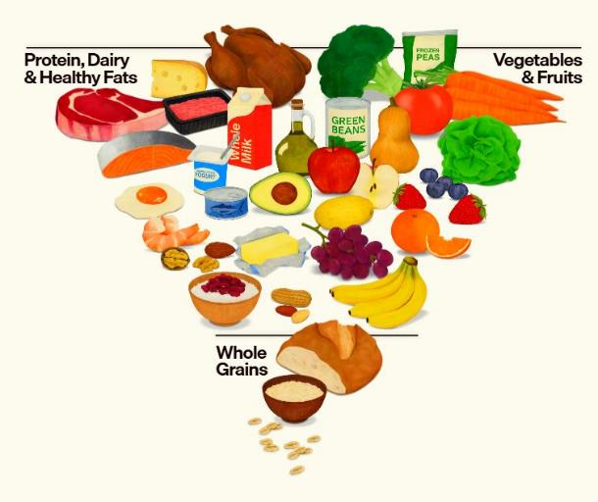
Dietary Guidelines for Americans 2025–2030
Encourages Americans to eat real food, especially whole, nutrient dense foods such as protein, dairy, vegetables, fruits, and healthy fats, including full-fat dairy with no added sugar.
Encourages reduced intake of highly processed foods which are generally high refined carbohydrates, sodium, added sugars, unhealthy fats, and chemical additives.
View the Dietary Guidelines for Americans at https://realfood.gov/.

Slide 8
Whole Milk for Healthy Kids Act of 2025
Revises National School Lunch Program (NSLP) milk requirements as follows:
Adds whole and reduced-fat (2%) milk to current fluid milk options, may be flavored or unflavored and nonorganic or organic options.
Fluid milk substitutes:
  A school food authority (SFA) may offer nondairy beverages to all students. A written statement is only required if the substitute is not offered to all students.
  A parent or legal guardian may provide a written statement to request a fluid milk substitute for disability reasons.
Saturated fat from milk is excluded from the weekly calculations.

Slide 9
Increase to the Micropurchase and Simplified Acquisition Thresholds
Micropurchase threshold has increased from $10,000 to $15,000
  May establish a lower threshold or may increase threshold to $50,000 if qualified through self-certification
Simplified acquisition threshold has increased from $250,000 to $350,000
  May establish a lower threshold
Note: Program Operators must update their procurement procedures prior to making purchases using the increased thresholds
Questions email NSDProcurementReview@cde.ca.gov

Slide 10
State Updates

Slide 11
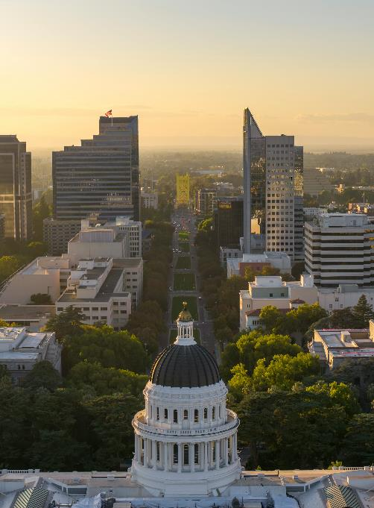
Governor’s Proposed Budget
2026–27 Governor’s Proposed Budget was released January 9, 2026
May Revise is due on May 14, 2026

Slide 12
Updated Guidance: Required Local Policies on Immigration Enforcement at School Sites
Assembly Bill 49 states schools may not allow an officer or employee of an agency conducting immigration enforcement to enter a nonpublic area of a school site for any purpose without being presented with a valid judicial warrant, judicial subpoena, or a court order.
Requires local educational agencies (LEA) to adopt model policies or equivalent by March 1, 2026.
For more information regarding model policy requirements and related guidance visit https://oag.ca.gov/system/files/media/school-guidance-model-k12.pdf.

Slide 13
2026 Ramadan Non-congregate Waiver
CDE can approve meal service flexibilities for students fasting during Ramadan
These flexibilities may only be used during Ramadan (tentatively starting February 17, 2026).
SFAs must request pre-approval through an online survey:
  Waiver for Non-congregate Meals During Ramadan Opt-in Survey at https://surveys3.cde.ca.gov/s.asp?k=176781284233.
These flexibilities include non-congregate meal service, meal service time flexibilities, and waives offer versus serve requirements.
Access the Waiver for Non-congregate Meals During Ramadan listserv at https://www.cde.ca.gov/ls/nu/waivermealduringramadan.asp.

Slide 14

New: Allowable Costs for Cafeteria Funds Web Page
New and consolidated guidance for allowable costs, construction, prohibited costs, capital expenditure requests, and more
Access the CDE Allowable Costs web page at https://www.cde.ca.gov/ls/nu/sn/cafefundallowablecost.asp
Questions email SNPcafefundquestions@cde.ca.gov

Slide 15
Management Bulletin (MB) SNP-12-2025
Professional Standards in the School Nutrition Programs
Release date: The MB has been updated and was released December 3, 2025.
Policy updates: Adds the hiring exception for LEAs with an annual student enrollment of 2,500 or more may elect to hire applicants with at least 10 years of School Nutrition Program (SNP) experience but do not hold a bachelor’s or an associate’s degree.
Resources & information: Includes resources about California's hiring requirements for new SNP Directors and how to track your annual training hours.
MB access: Available on the CDE SNP Management Bulletins web page at https://www.cde.ca.gov/ls/nu/sn/mb.asp.
Questions: Email ProfessionalStandards@cde.ca.gov.

Slide 16
2026 SUN Bucks (1)
2026 SUN Bucks Implementation webinar:
Date: *Tuesday, March 10th at 2 p.m.
Webinar information: SUN Bucks eligibility, applications, and data sharing
Webinar registration:
https://us02web.zoom.us/webinar/register/WN_ZVsY-CT7Q0aLI-dCgBMITw#/registration
*Updated webinar date and registration link

Slide 17
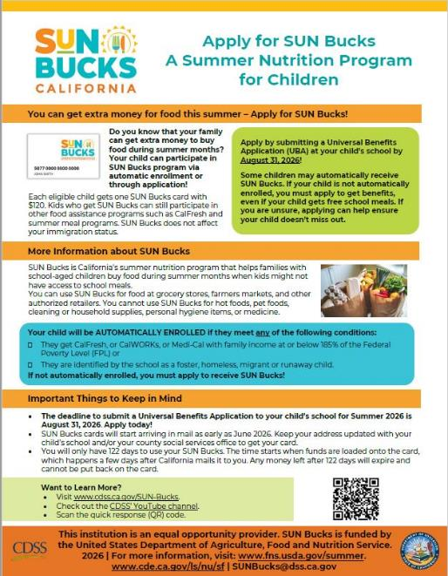
2026 SUN Bucks (2)
Community Eligibility Provision (CEP) and Provision 2 (P2) sites:
"School Flyer - Apply for SUN Bucks!" is now available on the California Department of Social Services website at https://www.cdss.ca.gov/sun-bucks/partners/flyers/flyers-2026

Slide 18
Grant Funding and Announcements

Slide 19
2025 Kitchen Infrastructure and Training (KIT) and Retention & Recruitment (R&R) Grants
2025 KIT and R&R grant Request for Applications is open until Friday, January 30, 2026.
Applications must be completed online and submitted by 4 p.m.
Both grant applications can be accessed through the same link.
Questions can be sent to KIT2025@cde.ca.gov.

Slide 20
Fresh Fruit and Vegetable Program (FFVP) Grant
Funding Amount: Per student award between $50 to $75
Due Date: Friday, February 6, 2026, at 4 p.m.
Eligible Agencies: Public school districts, county offices of education, charter schools, private schools, or residential child care institutions operating the NSLP
Note: SFAs may apply on behalf of elementary school sites that have at least 50 percent or more of its students eligible for free or reduced-price meals
FFVP Request for Applications web page at: https://www.cde.ca.gov/fg/fo/r9/ffvp26rfa.asp
Questions email the FFVP team at FFVP@cde.ca.gov

Slide 21
School Breakfast Program and Summer Meals Program Start-up and Expansion Grants
Funding Amount: $1.017 million available with awards up to $15,000 per school site
Due Date: Friday, February 13, 2026, at 4 p.m.
Eligible Agencies: Public school districts, county offices of education and directly funded charter schools can apply
Note: School sites may be awarded no more than once every three years
More information is available on the Breakfast Grant Request for Applications webpage at https://www.cde.ca.gov/fg/fo/r9/sbsm26rfa.asp

Slide 22
Operational Reminders

Slide 23

Ordering U.S. Department of Agriculture Foods for School Year (SY) 2026–27
U.S. Department of Agriculture (USDA) Foods Available and Price Lists
  Emailed December 23, 2025
Preplanner and Surveys
  Distribute February 1, 2026
  Due March 2, 2026

Slide 24
Get a Jump on USDA Foods Ordering
Review last year’s USDA Foods orders, usage and entitlement spending for direct delivery and at processors
Analyze student participation trends
Develop cycle menus and identify where USDA Foods will be used on menus
Plan multiple uses for high-volume items

Slide 25
Resources and Other Announcements

Slide 26
Universal Meals Program Time Series Evaluation - 2026
In 2022, with the initial funding of Universal Meals, the California legislature funded a time series evaluation.
Purpose: To document the implementation and impact of Universal Meals funding – including successes, challenges and experiences.
Survey topics: Student participation, meal preparation, meal service, meal costs, foods procured and more.
Date: Anticipated mid-February.
Email and link to survey will be provided via listserv.

Slide 27
Available Now: New Procurement Trainings
Eight new procurement trainings are now available on the NSD Learning Site.
  Training topics include: Introduction to procurement, developing a scope of work, informal and formal procurements, Buy American, and the Local Agency Procurement Review process.
Reminder-Annual Procurement Training Requirement: Directors, managers, and staff that work on NSLP procurement activities.
To create a NSD Learning Site account: refer to the Learning Management System Account Setup Job Aid (Form ID LMS 001) in Child Nutrition Information and Payment System or CNIPS for access.
For NSD Learning Site questions or support email NSDLearning@cde.ca.gov.

Slide 28
Coming Soon: Five New Competitive Foods Training Opportunities (1)
All Webinars are from 1:30 p.m. to 2:30 p.m.
Tuesday, February 10:
Overview, Definitions, and Resources
Wednesday, February 11:
Public, Noncharter Elementary School Requirements
Tuesday, February 17:
Public, Noncharter Middle and High School Requirements

Slide 29
Coming Soon: Five New Competitive Foods Training Opportunities (2)
All Webinars are from 1:30 p.m. to 2:30 p.m.
Wednesday, February 18: Public Noncharter Elementary, Middle, and High School Student Organization Requirements
Wednesday, February 25:
Charter Elementary, Middle, and High School Requirements

Slide 30
Webinar: Honoring Cultural Food Preferences in School Nutrition Programs
Save the date: Tuesday, March 3, 2026, at 2 p.m.
This webinar will highlight best practices for incorporating student cultural food preferences into student meals.
  Honor the cultures of students
  Strengthen student trust and engagement
  Support equity in school meal participation
A listserv with webinar registration information will be available soon.

Slide 31

National School Breakfast Week (NSBW)
Dates: March 2-6, 2026
Theme: The Quest for School Breakfast
Resources: School Nutrition Association’s National School Breakfast Week web page at https://schoolnutrition.org/about-school-meals/national-school-breakfast-week/

Slide 32

National Nutrition Month® 2026
March is National Nutrition Month®
Theme: Discover the Power of Nutrition
Resources: National Nutrition Month® web page at https://www.eatright.org/about-national-nutrition-month

Slide 33
No Kid Hungry
School Breakfast Online Newsletter
Breakfast Bites is a short, monthly online newsletter from No Kid Hungry’s Center for Best Practices
Practical ideas and tested solution to improve participation and access to school breakfast
Perfect timing for National School Breakfast Week
Subscribe at https://bestpractices.nokidhungry.org/subscribe

Slide 34
Plant-based Webinar Series
Hosted by Friends of the Earth
Late breaking news:
  Four upcoming webinars – February through May
Registration for all: https://foe-org.zoom.us/meeting/register/vxfQE55OSdeR8hcbhsvjgA#/registration

Slide 35
Tuesday at 2 Town Hall Schedule
Held on the fourth Tuesday of the month
Date | Topic
February 24, 2026 | Town Hall updates and guest speaker
March 24, 2026 | Town Hall updates and guest speaker

Slide 36
NSD Learning Site: Have You Created Your Account Yet?
Reminder: NSD is shifting state-developed trainings from the course catalog to the NSD Learning Site.
To create a new account download CNIPS Form LMS 001 – LMS Account Setup Job Aid for instructions.
For questions and support on this topic, contact NSDLearning@cde.ca.gov.

Slide 37
Professional Standards Crediting Information
Key Area: Administration (3000)
Training Topic: Program Management (3200)
Learning Objective: Manage Staff Work Including Scheduling (3210)
Instructional Hours: 1.5 hours

Slide 38
THIS INSTITUTION IS AN
EQUAL OPPORTUNITY PROVIDER.

