Slide 1
Tuesday @ 2 School Nutrition
Town Hall
June 24, 2025
Opportunities for All Branch (OFAB)
California Department of Education (CDE)

Slide 2

Town Hall at a Glance
District Spotlights
Federal & State Updates
Guest Speaker: Adequate Time to Eat Fact Sheet
Operational Reminders
Resources & Other Announcements

Slide 3
District Spotlights

Slide 4
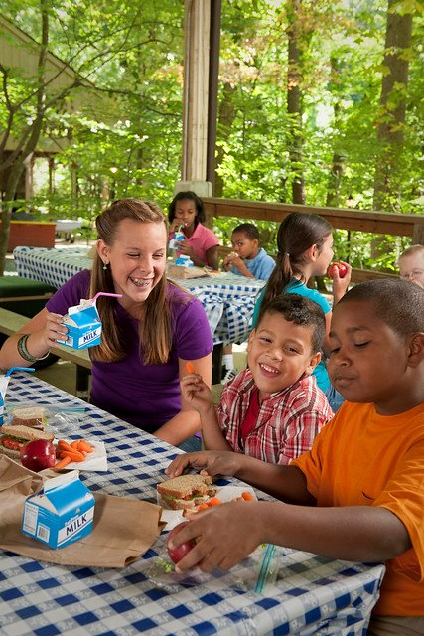
District Spotlight: Summer Meals Kick-Off
The Public Policy Institute of California (PPIC) featured West Contra Costa Unified School District (USD) on their May 28, 2025, Blog Post.
The blog highlighted how programs like SUN Bucks and Summer Meals Programs help provide food assistance when School is out.
Learn more about what West Contra Costa USD is doing on the PPIC blog page at https://www.ppic.org/blog/west-contra-costas-summer-meal-programs-provide-food-and-community/.

Slide 5
Federal Updates

Slide 6
Reminder: Crediting Fruits and Vegetables at Breakfast
The U.S. Department of Agriculture (USDA) released the memo Full-Year Continuing Appropriations and Extensions Act, 2025: Effect on Child Nutrition Programs SP 13-2025, CACFP 10-2025, SFSP 06-2025.
Ending June 30, 2025, schools may no longer credit any vegetable offered in the place of fruit without including vegetables from other subgroups in weekly menus at breakfast.
Effective July 1, 2025, when vegetables are offered in the place of fruit two or more times per week, schools must offer at least two vegetable subgroups at breakfast per week.
7 Code of Federal Regulations (CFR) Section 220.8(c)(2)(ii)

Slide 7
Reminder: Updated
Child Nutrition Program (CNP)
Requirements

Slide 8
Added Sugar Product Based Limits
Effective July 1, 2025
Phase 1. New added sugar product-based limits for:
Breakfast cereals: No more than 6 grams (g) per dry ounce (oz)
Yogurt: 12 g per 6 oz (2 g per oz)
Flavored milk:
    10 g or less per 8 fluid oz
    15 g per 12 fluid oz when sold as a competitive food in middle and high schools
Phase 2. Overall weekly limits effective July 1, 2027

Slide 9
Registered Dietitian Signature Authority for Medical Statements Effective April 1, 2025
By July 1, 2025, the final rule notes in part, that school food authorities (SFA) must also accept a medical statement signed by a registered dietitian (RD).
In California, this provision became effective April 1, 2025.
The CDE also permits the following state licensed healthcare professionals to complete and sign a written medical statement for disability accommodations in the CNPs: licensed physicians, physician assistants, or nurse practitioners.
Title 7 Code of Federal Regulations (CFR) Section 210.10(m)(1)(i)

Slide 10
Updates to National School Lunch Program (NSLP) Afterschool Snacks
Effective July 1, 2025 (1)
NSLP Afterschool Snack requirements now align with the Child and Adult Care Food Program (CACFP) snack standards.
Now contains five meal components- fruits and vegetables are separate
Only one of the two components served at snack may be a beverage.
No more than half of the weekly fruit or vegetable offerings may be in the form of juice.
Milk must be fat-free or low-fat and may be unflavored or flavored.
Grain-based desserts do not count toward the grain requirement.
At least 80 percent of the weekly grains offered must be whole grain rich.

Slide 11
Updates to NSLP Afterschool Snacks
Effective July 1, 2025 (2)
  Added sugars:
    Breakfast cereals must contain no more than 6 g of added sugars per dry oz.
    Yogurt must contain no more than 12 g of added sugars per 6 oz (2 g of added sugars per oz).
    Note that these are the same limitations for NSLP
    7 CFR Section 210.10(o)(2)(i)

Slide 12
Updates to Competitive Beverage Requirements
Effective July 1, 2025
Flavored milk: Contains no more than 10 g of added sugars per 8 fluid oz (elementary schools) or no more than 15 g of added sugars per 12 fluid oz (middle and high schools).
7 CFR sections 210.11(l)(1)(ii), (2)(ii), and 3(ii)
Title 5, California Code of Regulations (5 CCR) Section 15576 (e)(3)
  Nondairy milk: Contains no more than 23 g of total sugars per 8 fluid oz (elementary schools) or no more than 35 g of total sugars per 12 fluid oz (middle and high schools) serving and no more than 3 g of fat per 8 fluid oz (all schools).
    5 CCR Section 15576(f)(3)

Slide 13
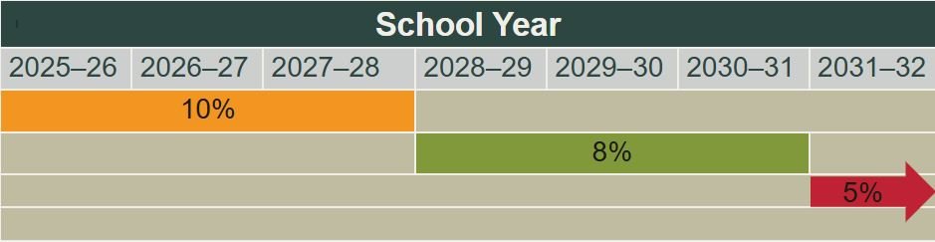
Buy American New Threshold
Effective July 1, 2025
Non-domestic food purchases cannot exceed 10 percent of total food purchases.*
Exceptions must be counted towards the 10 percent cap of non-domestic purchases.
*USDA Foods are not included in these calculations or the cap.

Slide 14
Poultry and Seafood Products from the People’s Republic of China
USDA Policy Memo SP 13-2025 Full-Year Continuing Appropriations and Extensions Act, 2025: Effect on Child Nutrition Programs
  Prohibits CNP funds from procuring raw or processed poultry or seafood products from the People’s Republic of China
  Through September 30, 2025

Slide 15
State Updates

Slide 16
2025–26 Local Agency Procurement Review - Schedule Released
Schedule announced for SFAs receiving a Local Agency Procurement Review (LAPR) in School Year (SY) 2025–26
Training opportunities to prepare for LAPR are coming this September
Questions about the LAPR, contact NSDProcurementReview@cde.ca.gov

Slide 17
Guidance for Accepting Processed Product Documentation for Meal Pattern Requirements
SNP-08-2025; SFSP-08-2025; FDP-08-2025
The Management Bulletin (MB) provides updated guidance for CNP operators of the NSLP, School Breakfast Program (SBP), and Summer Food Service Program (SFSP) on:
  Retaining documentation to demonstrate how a processed end product or food item contributes to the meal pattern utilizing one of four methods.
  Ensuring program operators have a process to maintain documentation for verifying meal program requirements.
  Providing updates to the Child Nutrition (CN) Label Verification System and clarification of the Valid Until date shown on the CN Label Verification Report.
Review the MB on the CDE’s Legislation, Regulations and Policies web page at https://www.cde.ca.gov/ls/nu/lr/.

Slide 18
SY 2025–26 Annual Updates
2025–26 Annual Updates in the Child Nutrition Information and Payment System (CNIPS) will open early July. A listserv with instructions and resources will be sent once the 2025–26 program year is open.
Applications must be approved before meal claims can be submitted for reimbursement.
As a reminder, SFAs serving summer school meals under the NSLP/SBP will input June meal service data and claims in 2024–25 program year and July/August data in 2025–26 program year.

Slide 19
Summer Meal Program Reminders
Update CNIPS site applications when operations change at any approved Seamless Summer Option (SSO)/SFSP feeding site.
Data in CNIPS is posted to summer feeding site websites/resources, so meal service times and days must be accurate.

Slide 20
Find a Summer Meals Site Near You!
The California Meals for Kids Mobile App (updated daily) is available in the app store for all iOS, Android or Microsoft devices or online at https://www.cde.ca.gov/re/mo/cameals.asp.
The CDE Summer Meal Service Site webpage (updated weekly) is available online at https://www.cde.ca.gov/ds/sh/sn/summersites25.asp.
All local educational agencies (LEA) are required to conduct outreach for Summer Meal sites.

Slide 21
Survey: Achieving Higher Standards for Healthy School Meals (1)
Survey Overview:
Purpose of the Survey: To inform the response to the Governor’s Executive Order N-1-25 by collecting current SFA strategies to reduce food additives, barriers faced, and recommendations for how to achieve higher standards for healthy school meals.
Dates: April 9–28, 2025
Total SFA Participants: n=259

Slide 22
Survey: Achieving Higher Standards for Healthy School Meals (2)
Meal Preparation Practices:
56% reported scratch cooking at some sites.
76% reported speed scratch cooking.
SFAs reported that, on average, 43% of their meals are freshly prepared, scratch cooked meals.
Top 5 Barriers to scratch cooking were: limitations in kitchen space, kitchen infrastructure, funding for additional staff positions to support increased labor requirements of scratch cooking, cold storage space, and staff skill sets.​

Slide 23
Survey: Achieving Higher Standards for Healthy School Meals (3)
SFAs current practices–Food Additives:
53% limit artificial sweeteners.
32% limit sodium nitrites and nitrates.
18% limit the dough conditioner Azodicarbonamide (ADA).
15-17% limit these preservatives: Tertiary Butylhydroquinone (TBHQ), Butylated Hydroxyanisole (BHA), Butylated Hydroxytoluene (BHT), and Propyl Gallate (PG).

Slide 24
Survey: Achieving Higher Standards for Healthy School Meals (4)
SFAs are the most ready and able to:
  Restrict artificial colors.
  Reduce added sugars.
  Eliminate non-nutritive sweeteners.
  Eliminate sodium, nitrites/nitrates.

Slide 25
Adequate Time to Eat Fact Sheet
Guest Speakers: Maryam Shayegh and Ron Little
Child Nutrition Advisory Council Members

Slide 26
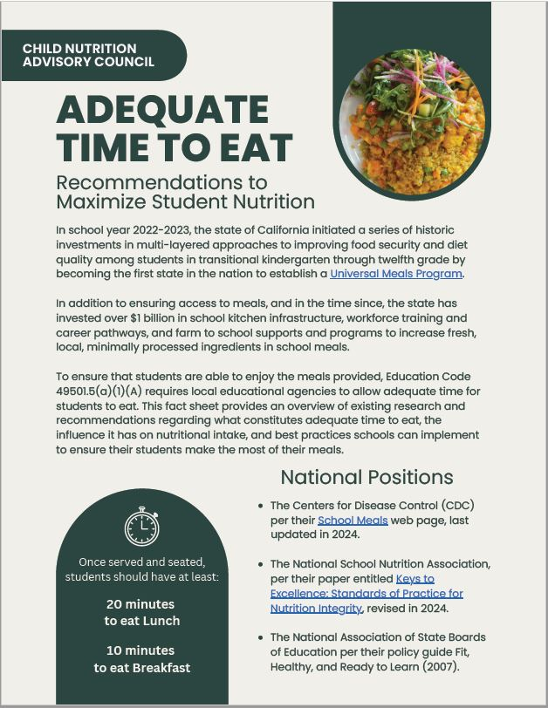
Access the Adequate Time to Eat Fact Sheet
Find the Adequate Time to Eat Fact Sheet on the CDE Ensuring Adequate Time to Eat web page at https://www.cde.ca.gov/ls/nu/sn/timetoeat.asp.

Slide 27
SUN Bucks 2025

Slide 28
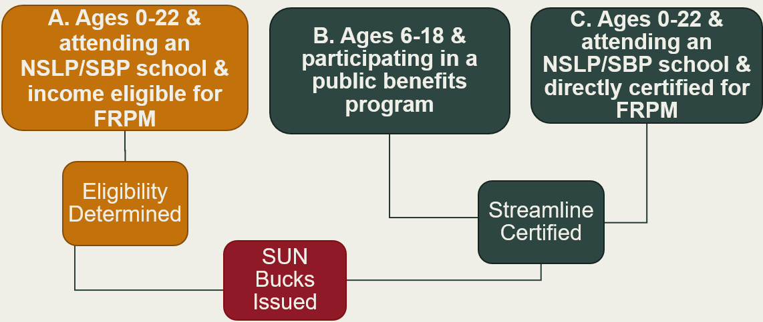
Eligibility ABCs
Full Text Description For SUN Bucks Eligibility Image

Slide 29
Universal Benefits Application (UBA) (1)
School Meal Program Model | SUN Bucks Application Requirement
Standard Counting and Claiming | NSLP Meal Application only
Community Eligibility Provision (CEP) | UBA
Provision 2 (P2) | NSLP Application during base year UBA during non-base years

Slide 30
Universal Benefits Application (2)
Student Eligibility Type | UBA Required?
Directly Certified (CalFresh, CalWorks, Medi-Cal) including those with extended benefits | No
Categorically Eligible (Migrant, Homeless, or Foster) | No
Income Eligible | Yes

Slide 31
Online UBA Collection
CDE has been made aware that some point-of-sale, or POS, software companies are advising SFAs to change either the name or components of online meal applications to align with UBA/SUN Bucks requirements.
  This should only be done for schools operating CEP or P2 in non-base years.
  Standard counting and claiming and P2 base year sites must continue to use the standard NSLP meal application.

Slide 32
SUN Bucks 2025 Funding for LEAs (1)
California’s approved Plan of Operations and Management includes funding for LEAs to support workload associated with eligibility determinations and verification requirements specific to SUN Bucks.
The Governor’s 2025 proposed budget, also known as the May Revise includes LEA funding for SUN Bucks.

Slide 33
SUN Bucks 2025 Funding for LEAs (2)
It is anticipated that LEA funding will be provided in the form of a reimbursement allocation in quarter 1 of calendar year 2026.
Funding allocation will be based on the number of applications processed and verified by each LEA.
The information in this slide is contingent on the approval of the SUN Bucks LEA funding included in the final state budget.

Slide 34
SUN Bucks 2025 Funding for LEAs (3)
LEAs will need to submit data on application processing and verification to the CDE in early 2026.
SUN Bucks funds should be placed in the LEA’s general fund, not the cafeteria fund.
The information in this slide is contingent on the approval of the SUN Bucks LEA funding included in the final state budget

Slide 35
SUN Bucks 2025 Data Collection
CALPADS Flash #297 was revised June 12th and supersedes the original flash #297 published in March.
    Overview of SUN Bucks Eligibility
    Data Submission to Education Data Collection System
    Best Practices

Slide 36
Operational Reminders

Slide 37
Test Your Knowledge
What annual task must all Food Distribution Program (FDP) recipient agencies do before July 31?
Hint:
It involves CNIPS.

Slide 38
Test Your Knowledge: Answer
What annual task must all FDP participants do before July 31?
Update and submit the SY 2025–26 FDP contract packet in the CNIPS.
Questions regarding this topic email fooddistribution@cde.ca.gov.

Slide 39
Important Operational Dates:
Next 30-90 Days (1)
Action | Date
Submit Summer 2025: SSO applications* | 30 days prior to the start of meal service
Advertise Availability of Summer Meals | Prior to the end of the SY
Site Visit for New Summer Meal Sites (SFSP only) | First week of operations
*Applications must be approved prior to the start of meal service.

Slide 40
Important Operational Dates:
Next 30-90 Days (2)
Action | Date
CEP Applications and P2 Applications Due | June 30, 2025
SY 2025–26 Annual Updates in CNIPS Open Early July. Note: Listserv to be released once opened. | Packets must be approved before 2025–26 claims can be submitted
Food Distribution Center Allocation A Orders Due | July 7, 2025
FDP Annual Contract Packet Update | July 31, 2025

Slide 41
Apportionment Reporting-Reminder
Action | Date
Kitchen Infrastructure and Training (KIT) 2021 | June 30, 2025
KIT 2022*† | June 30, 2025
School Food Best Practices† | June 30, 2025
*The KIT 2022 Final Report was released on June 17, 2025, while the proposed reporting and encumbrance extension is under consideration.
† A unique link to the final report was emailed to the CNIPS contact for all participating agencies from the email surveys@cde.ca.gov.

Slide 42
Resources and Other Announcements

Slide 43
Farm to Summer Celebration Week
Dates: 3rd week in June each summer
Elements: Taste, Teach, Share
Earn Recognition: Completion of a pre- and post-survey to receive a One in a Melon Certificate, recognition by the CDE and an online badge
2024 Farm to Summer Celebration Week Data:
  44 program operators
  494 summer sites
  ~90,000 students participated in activities

Slide 44

2024 Farm to Summer
Celebration Week-Winners (1)
Adelanto Elementary School District (SD)
Antioch USD
Capistrano USD
Colton Joint USD (JUSD)
Delhi USD
Di Giorgio Elementary SD
Eastside Union Elementary SD
El Nido SD
Esparto USD
Fresno USD
Fullerton SD
Glendale USD
Heber Elementary SD
Hesperia USD
Jurupa USD
Kern High SD
Lake Elementary School
Laytonville USD
Little Lake City SD
Lodi USD
Lynwood USD

Slide 45
2024 Farm to Summer Celebration Week-Winners (2)
Menifee Union SD
Morgan Hill USD
Murrieta Valley USD
Natomas USD
Oak Valley Union Elementary School
Ontario-Montclair SD
Operation Specialist
Palm Springs USD
Pajaro Valley USD
Redlands USD
Rialto USD
Riverside USD
Rowland USD
San Bernardino City USD
San Diego USD
San Juan USD
San Luis Coastal USD
Santa Cruz City Schools Food Services
Tahoe Truckee USD
Upland USD
Vista USD
Yuba City USD
Yucaipa-Calimesa JUSD

Slide 46

2025 Farm to Summer Celebration Week
Dates: June 16-20, 2025
Theme: Summer Foods Around the World
Earn Recognition:
  Pre- and Post-survey
  Taste, Teach, and Connect
Action: Complete the forthcoming post-survey

Slide 47
School Food Marketing Focus Group
What: Friends of the Earth is hosting a “School Food Marketing Focus Group.”
Purpose: Provide feedback on marketing resources and connect with peers to share what’s working and help shape future school food marketing tools and strategies around food marketing strategies.
Date: The focus group will be held Thursday, June 26, from 1:00–2:30 p.m.
Action Items:
  Complete a short survey addressing your current marketing efforts.
  Submit the focus group RSVP to receive your calendar invite.

Slide 48
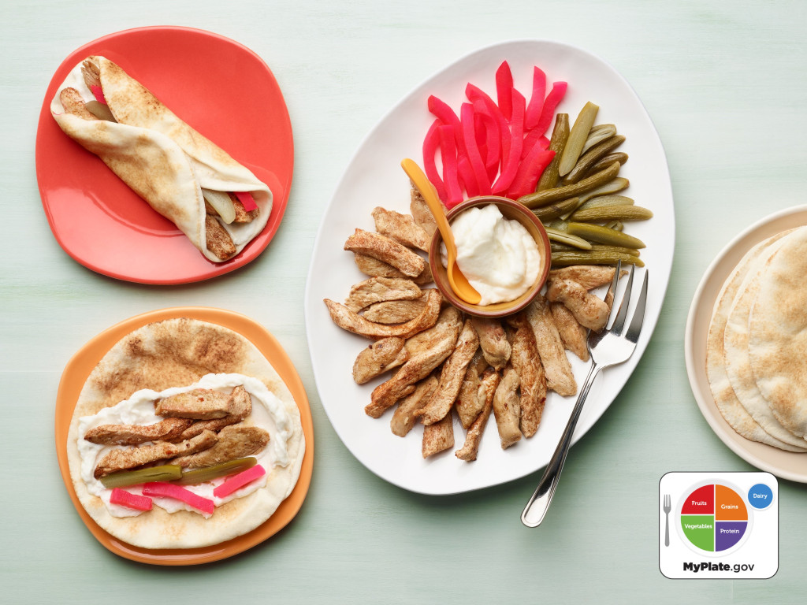
UPDATE: Culinary Arts Trainings
RSVP by July 3! Mediterranean Menus of Flavor hands-on training:
San Diego - July 31, 2025
Sacramento - August 5, 2025
Bakersfield - August 7, 2025
Fresno - August 12, 2025
Oakland - August 14, 2025
    Time: 8:00 a.m. - 12:30 p.m.

Slide 49
NSD Learning Site: Account Setup Reminder!
For food service and food service management company staff only:
Instructions are available in CNIPS Download Forms.
  LMS Reg 001 – Learning Management System (LMS) Account Self-Registration Access for Child Nutrition Program Operators Job Aid
  LMS Reg 002 - LMS Account Self-Registration and Access Set-up Slides for CNP Operators
Questions? Contact us at NSDLearning@cde.ca.gov.

Slide 50
Tuesday @ 2 Town Hall Schedule
Held on the fourth Tuesday of the month
Month | Format | Date
July | No Town Hall | N/A
August | State Update | August 26, 2025
September | State Update and Guest Speaker | September 23, 2025

Slide 51
Professional Standards Crediting Information
Key Area: Administration (3000)
Training Topic: Program Management (3200)
Learning Objective: Manage Staff Work Including Scheduling (3210)
Instructional Hours 1.5 hours

Slide 52
Full Text Description For SUN Bucks Eligibility Image (1)
The Eligibility ABCs slide provides a visual illustration of the ways in which children are eligible for SUN Bucks benefits. There are three groups (boxes) at the top of the image labeled A, B and C. Group A is a dark orange color on the left side of the image and states, “A. Ages 0-22 & attending an NSLP/SBP school & income eligible for FRMP” Below this group is a line connecting to a dark orange box with “Eligibility Determined” stated in the box. There is a line below the Eligibility Determined box connecting to a dark read box with “SUN Bucks Issues.” Group B is a dark green box that states, “B. Ages 6-18 & participating in a public benefits program.” Full text description continues to the next slide.

Slide 53
Full Text Description For SUN Bucks Eligibility Image (2)
Group C is a dark green box and states, “C. Ages 0-22 & attending an NSLP/SBP school & directly certified for FRMP.” Both Group B and C have lines connecting to a dark green box with “Streamline Certified” written in it. The dark green Streamline Certified box has a line connecting to the same dark red box SUN Bucks Issued mentioned earlier.
Return to SUN Bucks Eligibility Image Slide

Slide 54
0

