Slide 1
Tuesday @ 2 School Nutrition Town Hall
March 25, 2025

Slide 2
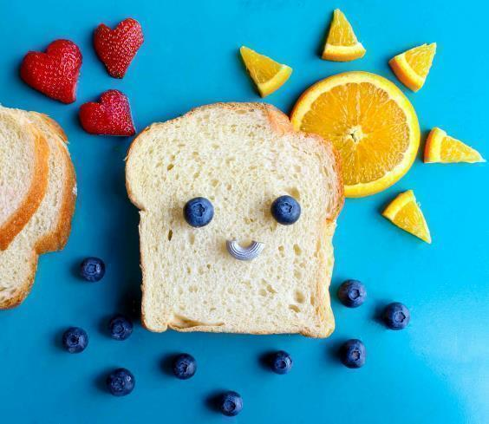
Town Hall at a Glance
District Spotlight
Federal & State Updates
Operational Reminders
Resources & Other Announcements

Slide 3
District Spotlights

Slide 4
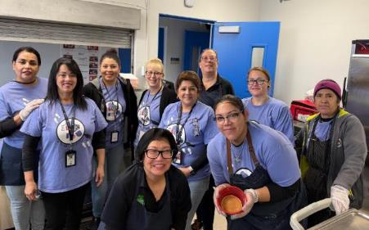
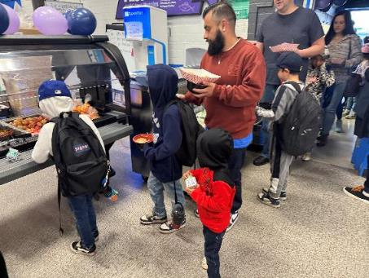
National School Breakfast Week: Azusa Unified School District (USD)
Goal: Market the school breakfast program to parents.
Message: Delicious school breakfasts are scratch cooked with quality farm to school ingredients.
Parents paid $4.00 to enjoy breakfast with their kids!

Slide 5
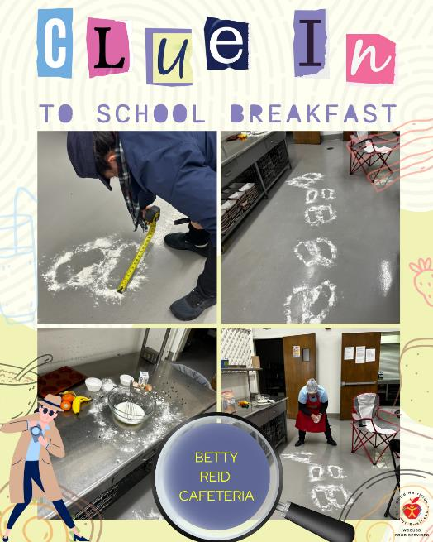
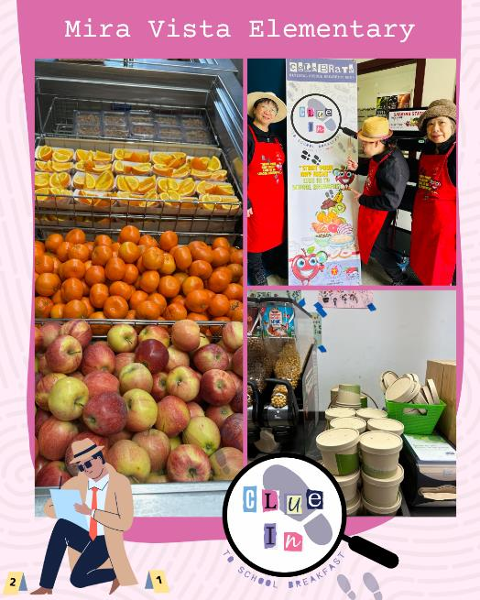
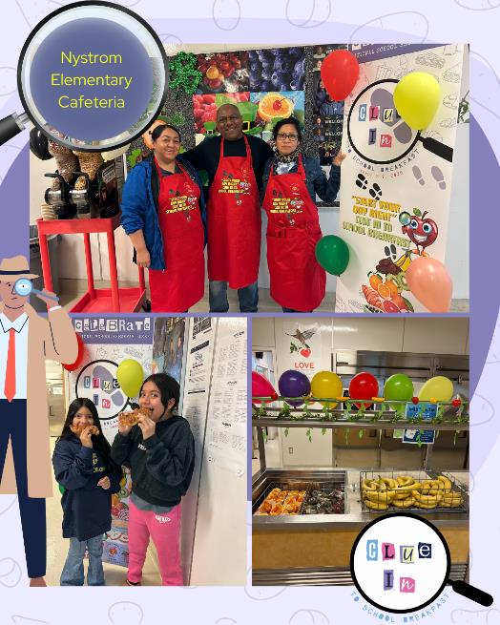
National School Breakfast Week: West Contra Costa USD

Slide 6
San Diego USD – Ramadan
Sandi Coast Café is offering non-congregate meals to students observing Ramadan utilizing the Ramadan Waiver.
Students, parents, or guardians complete a Ramadan Request Form.
Two precooked and packaged meals are provided at the end of each school day.
California Department of Education (CDE) pre-approval is required, and the waiver is effective through the end of Ramadan.
Learn more by visiting the CDE’s Waiver for Non-congregate Meals During Ramadan web page at https://www.cde.ca.gov/ls/nu/ramadanwaivermeals.asp [Please note: the waiver period is closed].

Slide 7
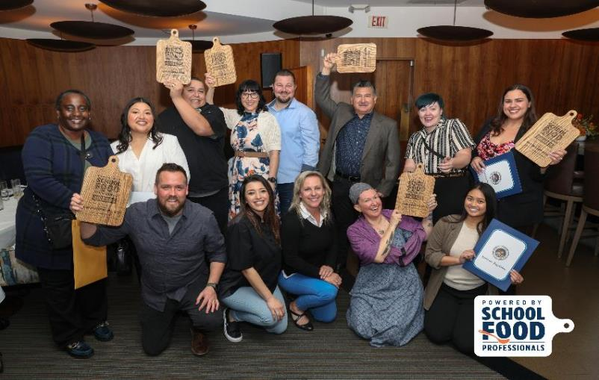
Powered by School Food Professionals Awards Winners (1)
Best Original Recipe: San Luis Coastal USD, Thai Basil Lentil Burger
Best Scratch-Cooked Adaptation: Azusa USD, Chicken Wings
Best Farm to School Recipe: Nevada City School of the Arts, Whole Wheat Penne Pasta

Slide 8
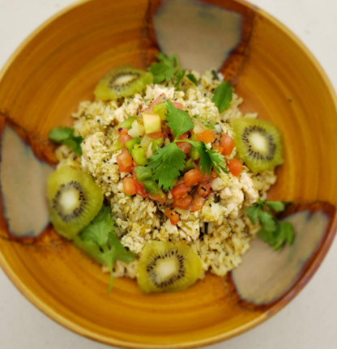
Powered by School Food Professionals Awards Winners (2)
Best Take on a Culinary Trend: Upland USD, Vegan Lemon Blueberry Breakfast Bar
Best Culinary Relevant Recipe: San Diego USD, Birria
Community Choice Recipe: Marysville Joint USD, Kickin' Kiwi Chicken Chili Verde
Learn more about the Powered by School Food Professionals awardees at https://www.schoolfoodpros.org/celebrating-the-winners-of-the-powered-by-school-food-professionals-awards/

Slide 9
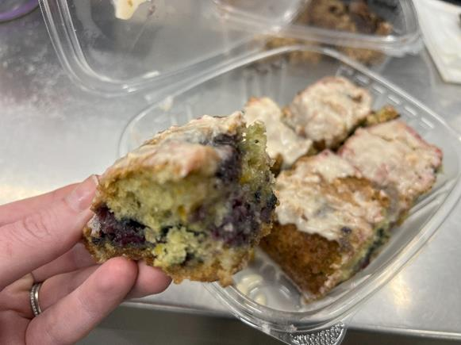
Standardized Recipe: Vegan Lemon Blueberry Breakfast Bar
The Upland USD's Vegan Lemon Blueberry Breakfast Bar uses lemons grown from the Upland Baldy View Elementary orchard.
The bar features whole-wheat and enriched flour, fresh lemon juice, blueberries, soy yogurt, apple sauce and more.

Slide 10
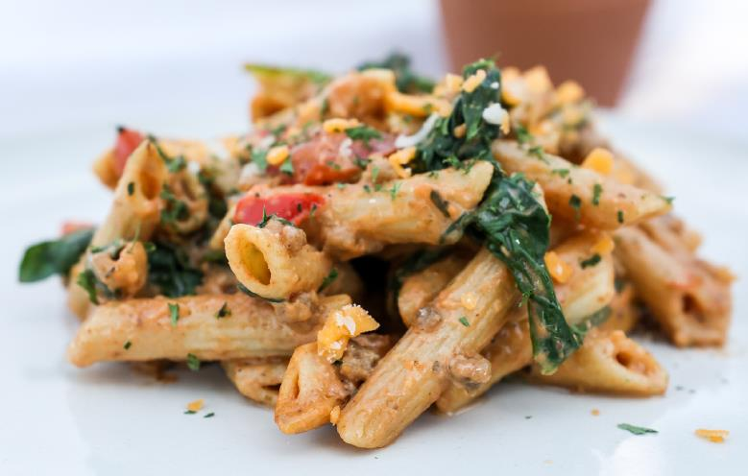
Standardized Recipe: Beefy Pizzeria Pasta
The Kern County Superintendent of Schools developed this delicious whole grain pasta entrée.
This pasta features whole grain penne pasta, ground beef, onions, fresh spinach, tomatoes, cheese, black pepper, and oregano.
Find Team Nutrition Challenge standardized recipes at https://www.cde.ca.gov/ls/nu/he/tasteofcachallengegrant.asp

Slide 11
Federal Updates

Slide 12
2025–26 Income Eligibility Guidelines
The U.S. Department of Agriculture (USDA) has released the 2025–26 Income Eligibility Guidelines (IEG).
Reference the listserv released on March 20, 2025, for links to the IEGs for free and reduced-price tables.
Find the 2025–26 IEGs on CDE's Rates, Eligibility Scales & Funding web page at https://www.cde.ca.gov/ls/nu/rs/.

Slide 13
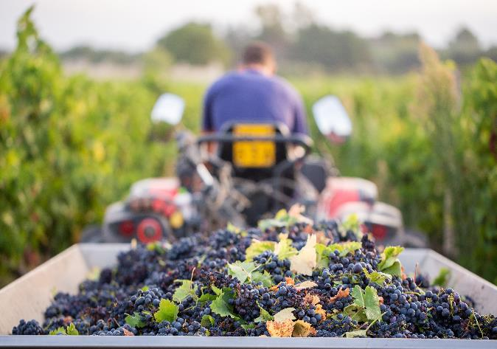
Termination of Local Food for Schools and Child Care Cooperative Agreement (LFSCC)
The LFSCC funding was terminated on Friday, March 7, 2025.
The Local Food for Schools funding awarded in 2022 remains in effect.
The CDE is finalizing and processing final payments for the 2022 Local Food for Schools grant.

Slide 14
State Updates

Slide 15
Proposed Senate Bills (SB)
SB 225 (McNerney) School nutrition: guardian meal reimbursement
SB 341 (Perez) Instructional School Gardens Program
SB 393 (Gonzalez) Pupil Health: school nutrition
SB 411 (Perez) Stop Child Hunger Act of 2025
SB 444 (Hurtado) State Healthy Food Access Policy

Slide 16
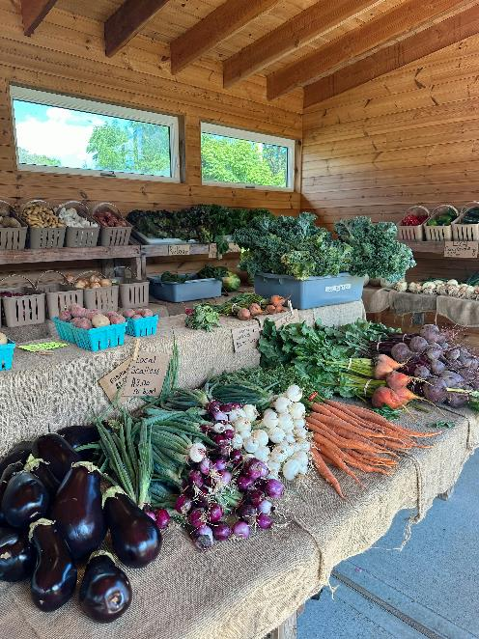
Proposed Assembly Bills (AB)
AB 675 (Aguiar-Curry) Office of Farm to Fork: California Farm to School Program
AB 1264 (Gabriel) Pupil Nutrition
Comments or questions about these proposed bills, reach out to your local representative.

Slide 17
Governor's Executive Order N-1-25
Online survey will be released in early April and will ask for:
Current practices in school meals (model of operation, rough percent scratch cooking, factors impacting ability to expand scratch cooking)
Existing use of preservatives: Butylated Hydroxyanisole (BHA), Butylated Hydroxytoluene (BHT), Propyl Gallate (PG), Tert-Butylhydroquinone (TBHQ), sodium nitrates and nitrites, non-nutritive sweeteners, Azodicarbonamide (ADA)
Recommendations for opportunities for higher standards for
Added sugars, sodium, and each of meal component categories
Implementation timelines
Competitive Foods

Slide 18

SUN Bucks 2025
The Department of Social Services and the CDE continue to work with the USDA towards an approved Plan of Operations and Management (POM) for SUN Bucks 2025.
California’s proposed POM includes funding for local educational agencies (LEA) to support workload associated with eligibility determinations and verification requirements specific to SUN Bucks.

Slide 19

SUN Bucks 2025 Eligibility
Eligibility for 2025 SUN Bucks will be determined in the following ways:
Streamlined certification: no action required by families
Income Eligibility: action required

Slide 20
SUN Bucks Streamlined Certification
Streamlined certification through the California Statewide Automated Welfare System (CalSAWS): Age 6–18 and enrollment in CalFresh, CalWORKs, or Medi-Cal (at or under 185% of the Federal Poverty Level [FPL]).
Direct Certification or Categorical Eligibility through the California Longitudinal Pupil Achievement Data System (CALPADS): Age 0–22, enrollment in a school participating in the National School Lunch Program (NSLP)/School Breakfast Program (SBP) Applications, and participating CalFresh, CalWORKs, or Medi-Cal (at or under 185% of the FPL) or designation as homeless, migrant, foster, or runaway.
No action required

Slide 21
SUN Bucks Income Eligibility
Approved NSLP Applications: Standard Counting and Claiming sites and Provision 2 [base year] sites in their base year or
Approved Universal Benefits Applications (UBA): Community Eligibility Program (CEP) and Provision 2 (non-base year)
Applications must be submitted by September 1, 2025 to be eligible for SUN Bucks 2025
Alternative Income Forms (AIF) cannot be used to
determine eligibility for 2025 SUN Bucks

Slide 22
Sun Bucks Universal Benefits Application
The UBA template was released to LEAs on Thursday, March 6, 2025.
Action: Schools operating CEP or Provision 2 in non-base years will need to make UBAs available for families to apply for SUN Bucks benefits for summer 2025.
Deadline: Applications must be submitted by families by Monday, Sept 1, 2025, to receive a SUN Bucks benefits for summer 2025.

Slide 23
Sun Bucks Universal Benefits Application: Frequently Asked Questions (FAQ) (1)
Q: Who at the LEA should process the applications? A: LEAs can determine who is responsible for collecting and processing UBAs.
Q: Will the UBA template be available in other languages? A: Yes, the CDE is working to translate the UBA template into other threshold languages.
The languages will include Spanish, Arabic, Armenian (Eastern and Western), Chinese (Traditional and Simplified), Farsi (Persian), Hindi, Hmong, Japanese, Khmer (Cambodian), Korean, Lao, Portuguese (Brazilian and Continental), Punjabi (Indian), Russian, Samoan, Tagalog, Ukrainian, Urdu, and Vietnamese.

Slide 24
Sun Bucks Universal Benefits Application – FAQs (2)
Q: Can Cafeteria Funds be used to support the processing of UBAs? A: No, Cafeteria funds cannot be used to pay for collecting and processing UBAs. California's SUN Bucks plan that is under review by USDA includes funding for LEAs to support this work.
Q: Can the UBA be used for Local Control Funding Formula (LCFF) purposes? A: Yes, the UBA can qualify students for SUN Bucks benefits and make eligibility determinations for the Unduplicated Pupil Count for the LCFF.

Slide 25
Sun Bucks Universal Benefits Application – FAQs (3)
Q: Do we need to collect meal applications and UBAs? A: No, Standard Counting and Claiming sites and Provision 2 (P2) sites in their base year must collect NSLP applications; determinations made through the NSLP application will be carried forward for SUN Bucks eligibility and the Unduplicated Pupil Count.
Q: How will LEAs submit data from UBAs to the CDE? A: The CDE will be collecting SUN Bucks eligibility from LEAs (based on NSLP applications and UBAs) through the Education Data Collection System. A CALPADS flash with more information about data submission is forthcoming.

Slide 26
Sun Bucks Resources
CDE SUN Bucks Web Page: https://www.cde.ca.gov/ls/nu/sunbucks.asp
CDSS SUN Bucks Web Page: https://cdss.ca.gov/sun-bucks
CDE Univeral Benefits Application: https://www.cde.ca.gov/ls/nu/universalbenefitsapp.asp
CDE CALPADS Flash: Coming soon
Summer EBT Questions: SummerEBT@cde.ca.gov

Slide 27
Operational Reminders

Slide 28
Reminder: Food Safety Inspections
School food authorities (SFA) are required to obtain two food safety inspections at each site from the local environmental health department.
Group homes are exempt from obtaining food safety inspections but still must complete the food safety inspection survey in Child Nutrition Information and Payment System (CNIPS).
2024–25 food safety inspection surveys will open in CNIPS in July for the 2025–26 program year.

Slide 29
Community Eligibility Provision (1)
CEP applications for the 2025–26 school year are due Monday, June 30, 2025 (7 Code of Federal Regulations 245.9(f)(4)(i)).
Direct certification lists and site enrollment figures must be reflective of data on file as of Tuesday, April 1, 2025.
Sites with an Identified Student Percentage (ISP) of 25% are eligible to apply, and sites with ISP of 40% or greater must apply for a federal provision (CEP or Provision 2).

Slide 30
Community Eligibility Provision (2)
SFAs mid-CEP cycle should consider the following:
Will any school sites be closing for School Year (SY) 2025–26?
Will any school sites combine with other sites for SY 2025–26?
Will you be adding or dropping sites from an existing CEP group?
If yes, to any of these questions, reapplying may be necessary.
Pull data on Tuesday, April 1, 2025.
Contact your assigned School Nutrition Program (SNP) specialist to discuss re-applying for CEP.

Slide 31
Summer 2025 Operations (1)
Program operators can start submitting Seamless Summer Option (SSO) and Summer Food Service Program (SFSP) applications for summer 2025.
SSO site applications must be approved before summer operations begin.
SFSP applications must be submitted by Thursday, May 15, 2025, or 30 days prior to the start of summer operations, whichever comes first. SFSP applications must be approved before meal service can begin.

Slide 32
Summer 2025 Operations (2)
Work with district administrators to determine programming and meal service needs for summer.
Schools offering summer school and wanting to serve meals only to enrolled students can continue operating the SNPs; no additional application is required.
SFAs wanting to offer community feeding, serve only Expanded Learning Opportunities Program students, or offer rural non-congregate meal service should apply for SSO/SFSP.

Slide 33
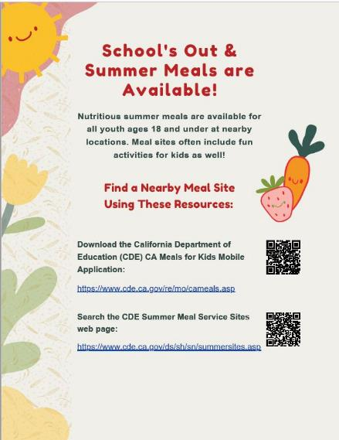
Updated: Summer Meals Flyer
School's Out & Summer Meals are Available flyer is now available.
Share this flyer with parents and community partners.
Access the flyer on the CDE Summer Food Service Program Information web page at https://www.cde.ca.gov/ls/nu/sf/sfspinfo.asp under the Resources tab.

Slide 34
Important Operational Dates: Next 30-90 Days (1)
Action | Date
Cooperative Agreements or Piggyback Contracts Survey | March 28, 2025
Use your entitlement in the Fresh Fruits and Vegetables Order Receipt System or FFAVORS | May 1, 2025

Slide 35
Important Operational Dates: Next 30-90 Days (2)
Action | Date
Submit Summer 2025: SSO applications* | 30 days prior to the start of meal service
Submit Summer 2025: SFSP applications* | May 15th or 30 days prior to the start of operations
CEP Applications Due | June 30, 2025
*Applications must be approved prior to the start of meal service.

Slide 36
Resources and Other Announcements

Slide 37

Mark Your Calendar: Celebrate School Nutrition Culinary Professionals
School Nutrition Employee Week is April 28-May 2, 2025
School Lunch Hero Day is May 2, 2025

Slide 38
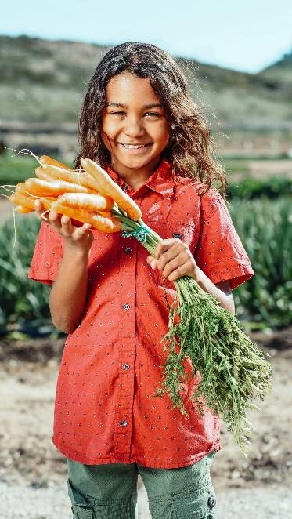
Nutrition Services Division Farm to School Needs Assessment
It’s short!
14 questions, 15-minute survey.
It’s helpful!
Share with us your implementation needs.
It’s available now!
…through June 1, 2025.
Take the Farm to School Needs Assessment at https://surveys3.cde.ca.gov/s.asp?k=172374591515

Slide 39
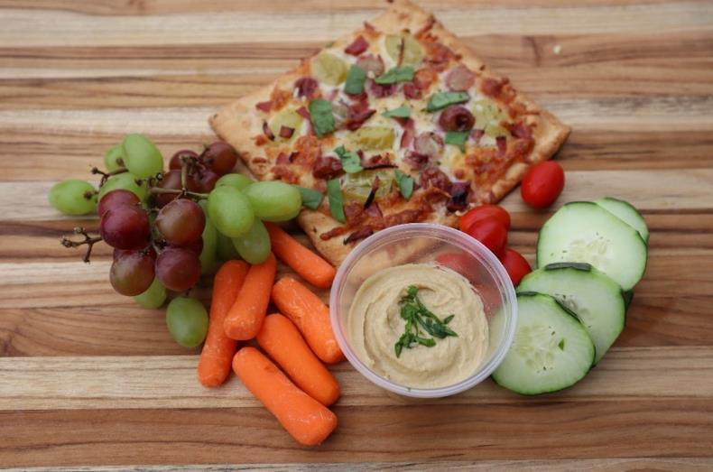
Photo Contest Coming Soon!
CDE’s Celebrating California's School Meals Photo Contest
Enter your best photos of staff, students, and school meals.
Look for an announcement coming soon!

Slide 40
Child Nutrition Advisory Council (CNAC) Recruitment – Apply Today
Recruiting the following CNAC member positions:
Child Care Food Program Sponsor
Classroom Teacher
Consultant Position
Curriculum Coordinator
Lay Person
School Administrator
School Board Member
High School Student
Applications due Monday, April 21, 2025
Learn more on the CNAC web page at https://www.cde.ca.gov/ls/nu/he/cnac.asp.
Send questions to the CNAC team at CNAC@cde.ca.gov.

Slide 41
Food Distribution Program Collaboration Committee Members (1)
Kat Soltanmorad – Tahoe-Truckee USD
Janet Barth – Morongo USD
Joe Cook – Antelope Valley Union High School District
Lilian Arreguin – Real Journey Academies, Inc.
Joshua Rogers – Greenfield USD
Vince Enserro – Chico USD
Michelle Antoinette Hernandez – Carpinteria USD
Judi Reynolds – Fallbrook Union High School District

Slide 42
Food Distribution Program Collaboration Committee Members (2)
Brian Tungate – Haynes Family of Programs
Dr. Betty Crocker – Lodi USD & Super Co-Op Lead District
Diana Flores – Sacramento City USD
Clell Hoffman – San Leandro USD
Kayla Cain – Val Verde USD
Barbara Jellison – West Contra Costa USD
Tawny Cowell – Shasta Union High School District
Julia Thompson – Lunchline, Inc. (USDA Foods processor)
Carole Erb – JTM Provision Co., Inc. (USDA Foods processor)

Slide 43
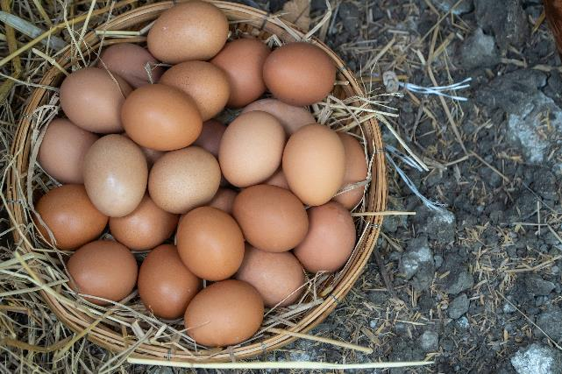
USDA Foods Availability
USDA Foods eggs are impacted by the Avian Flu.
Eight shipments of eggs for the current year were affected.
USDA expects to purchase by the end of the school year.
CDE is working with processors to find excess to backfill orders.

Slide 44
Reminder: USDA Foods in Schools Survey
USDA Survey: USDA Foods in Schools Product Information Sheets and the USDA Foods Database (Voluntary)
Due: Tuesday, April 18, 2025
Survey: https://www.cde.ca.gov/ls/nu/usdarequestsfeedback.asp [Please note that the survey has closed]
Questions: Please contact the USDA at USDAFoods@usda.gov with any questions

Slide 45

California Local School Wellness Policy Collaborative 2025 Survey
Inform the work of the Local School Wellness Policy Collaborative by responding to their survey and sharing your:
Needs for local school wellness policy tools, resources and support.
Wellness policy successes and more!
Responses due by Tuesday, April 8, 2025
Access the survey link at https://survey.alchemer.com/s3/7878399/CA-LSWP-Collaborative-2025-Survey

Slide 46
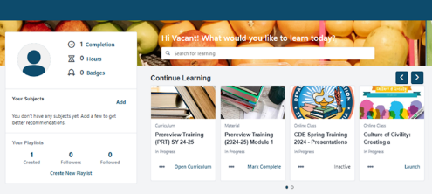
Nutrition Services Division Learning Site: Registration Reminder!
For food service and food service management company staff only:
Instructions are available in CNIPS Download Forms
LMS Reg 001 - LMS Account Self-Registration Access for Child Nutrition Program (CNP) Operators Job Aid
LMS Reg 002 - LMS Account Self-Registration and Access Set-up Slides for CNP Operators
Questions: Contact us at NSDLearning@cde.ca.gov

Slide 47

Webinar: Updates to School Nutrition Standards
Training Date: April 23, 2025, 1 p.m. to 2 p.m.
Training provides an overview of updates from the Final Rule for Child Nutrition Programs: Meal Patterns Consistent with the 2020–2025 Dietary Guidelines for Americans & California-specific standards.
Register for this training at https://us02web.zoom.us/webinar/register/WN_24X2quAASKG0H17sfeUbtg [Please note: the registration has closed]

Slide 48

Training: Institute of Child Nutrition
Subscribe to the Institute of Child Nutrition news and updates to receive updates on new and upcoming free training and resources.
Access training and resources on the ICN website at https://theicn.org/

Slide 49
Tuesday @ 2 Town Hall Schedule Held on the fourth Tuesday of the month
Month | Format | Date
April | State Update and Guest Speaker | April 22, 2025
May | State Update | May 27, 2025
June | State Update and Guest Speaker | June 24, 2025

Slide 50
Professional Standards Crediting Information
Key Area: Administration (3000)
Training Topic: Program Management (3200)
Learning Objective: Manage Staff Work Including Scheduling (3210)
Instructional Hours 1.5 hours

Slide 51
Final Slide

