Slide 1
Tuesday at 2 School Nutrition
Town Hall
October 28, 2025
Nutrition Services Division (NSD)
California Department of Education (CDE)

Slide 2

Town Hall at a Glance
District Spotlights
Federal and State Updates
Grant Funding & Announcements
Operational Reminders
Resources & Other Announcements

Slide 3
District Spotlight

Slide 4
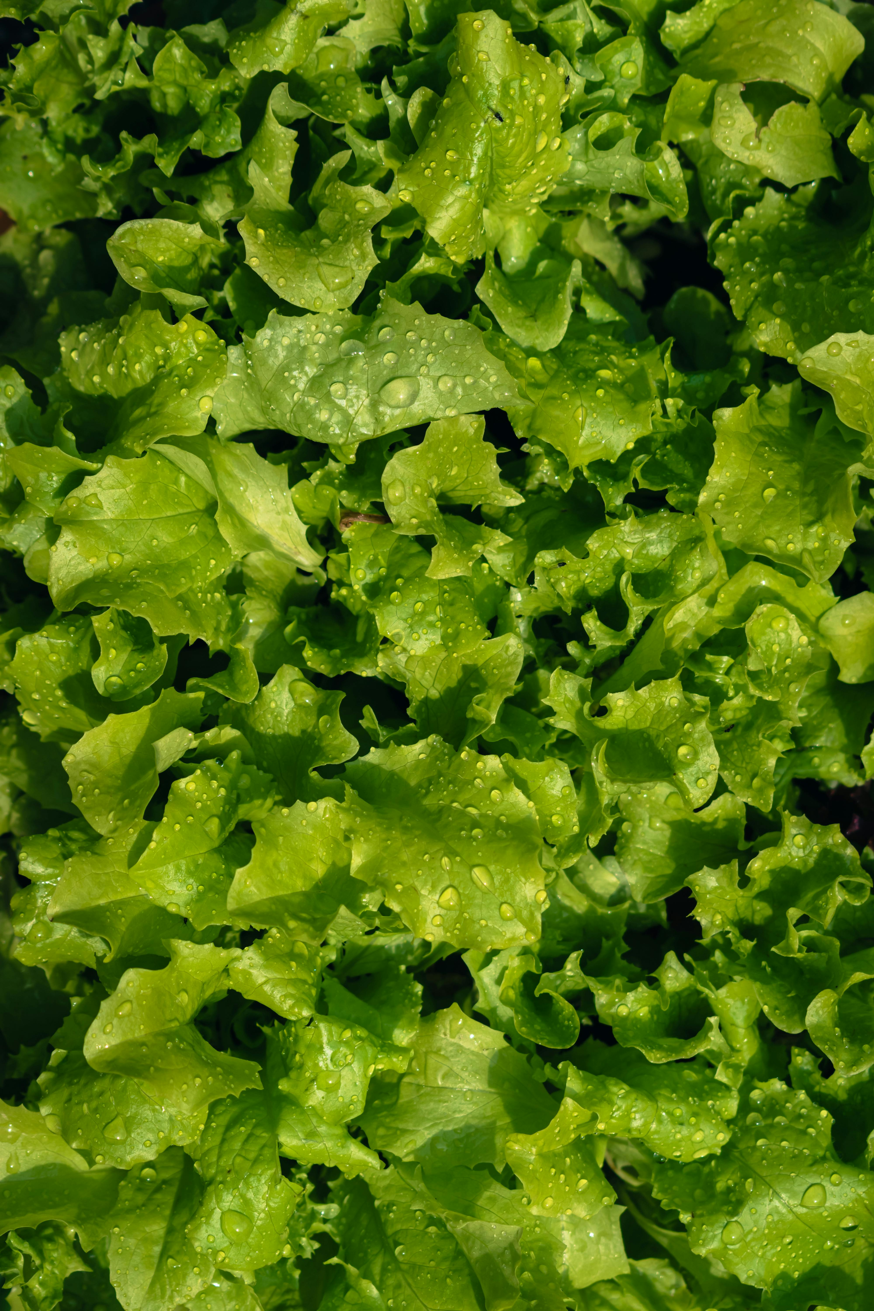
District Spotlight: Farm to School Month
Quimby Oak Middle School in Evergreen School District
Students are growing lettuce and snap peas using a hydroponic system
Grows approximately 28 pounds of lettuce monthly
14 of 16 schools in the district participate in Fork Farms projects
Watch the KTVU Fox 2 story, “San Jose students growing their own lunch with hydroponic farms”, at https://www.ktvu.com/news/san-jose-students-growing-own-lunch-hydroponic-farms​

Slide 5

District Spotlight: National School Lunch Week Twin Rivers Unified School District (1)
A variety of regionally inspired flavors from across the world were offered daily to celebrate their National School Lunch Week & CA Crunch Day:
Monday (Italian): Chicken parmesan & garlic bread
Tuesday (Asian): Chicken ramen bowl
Wednesday (Tex Mex): BBQ chicken pizza

Slide 6

District Spotlight: National School Lunch Week Twin Rivers Unified School District (2)
Thursday (Latin): Carnitas bowl with cilantro rice & elote salad.
Friday (Mediterranean & Coastal): Hummus with yogurt sauce & choice of pita or pretzels
CA Crunch Day: Students received a crunchy local apple

Slide 7
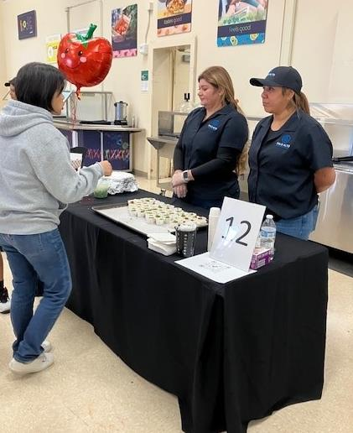
Action for Healthy Kids: The School Nutrition Exchange: Western Regional Roundtable at Palo Alto Unified School District
Recognition opportunity for school nutrition programs (SNP) to celebrate the CA Healthy Meal Incentive (HMI) program awardees and gather input on initiatives to support delivering nutritious school meals.
Opportunity to showcase their approaches and achievements through roundtable discussions, networking, and food tasting event.

Slide 8
Federal Updates

Slide 9
State Updates

Slide 10
Update: Ultra Processed Foods (UPF)s in California
Governor Newsom signed Assembly Bill (AB) 1264: Pupil nutrition: restricted school foods and ultra processed foods of concern: prohibition, which implements a phased approach to eliminate UPFs of concern with full implementation by July 1, 2035.
  2027, California Department of Public Health plans to begin training for schools and food vendors will begin reporting on foods sold to schools
  2032, Food vendors can no longer sell/offer restricted school foods or UPFs of concern to schools
  2035, Schools no longer serving restricted foods in meal programs and competitive foods

Slide 11

Senate Bill 411: Stop Child Hunger Act of 2025​
Directed the CDE in partnership with the California Department of Social Services to create a singular online SUN Bucks universal benefits application.
This bill was vetoed by the Governor.
Search for the AB 1264 and Senate Bill 411 on the California Legislative Information website at https://leginfo.legislature.ca.gov/faces/home.xhtml.

Slide 12
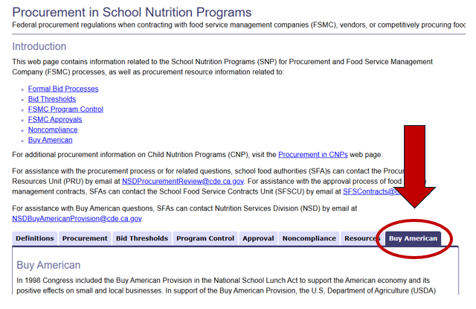
New Buy American Web Page and Frequently Asked Questions (FAQs)
CDE web page updates:
Procurement in School Nutrition Programs web page, Buy American tab at https://www.cde.ca.gov/ls/nu/sn/fsmcproc.asp
Frequently Asked Procurement Questions web page at https://www.cde.ca.gov/ls/nu/pr/procurementcnpfaqs.asp

Slide 13
Grant Funding and Announcements

Slide 14
Reminder: 2026 Farm to School Grant Program Request for Applications
United States Department of Agriculture’s (USDA) Patrick Leahy Farm to School grant program is open.
Grant amounts: $100,000 - $500,000
Eligibility: Local agencies, Child Nutrition Programs and others may apply
Applications due: Friday, December 5, 2025
USDA Farm to School Grant Program web page at https://www.fns.usda.gov/f2s/grant

Slide 15
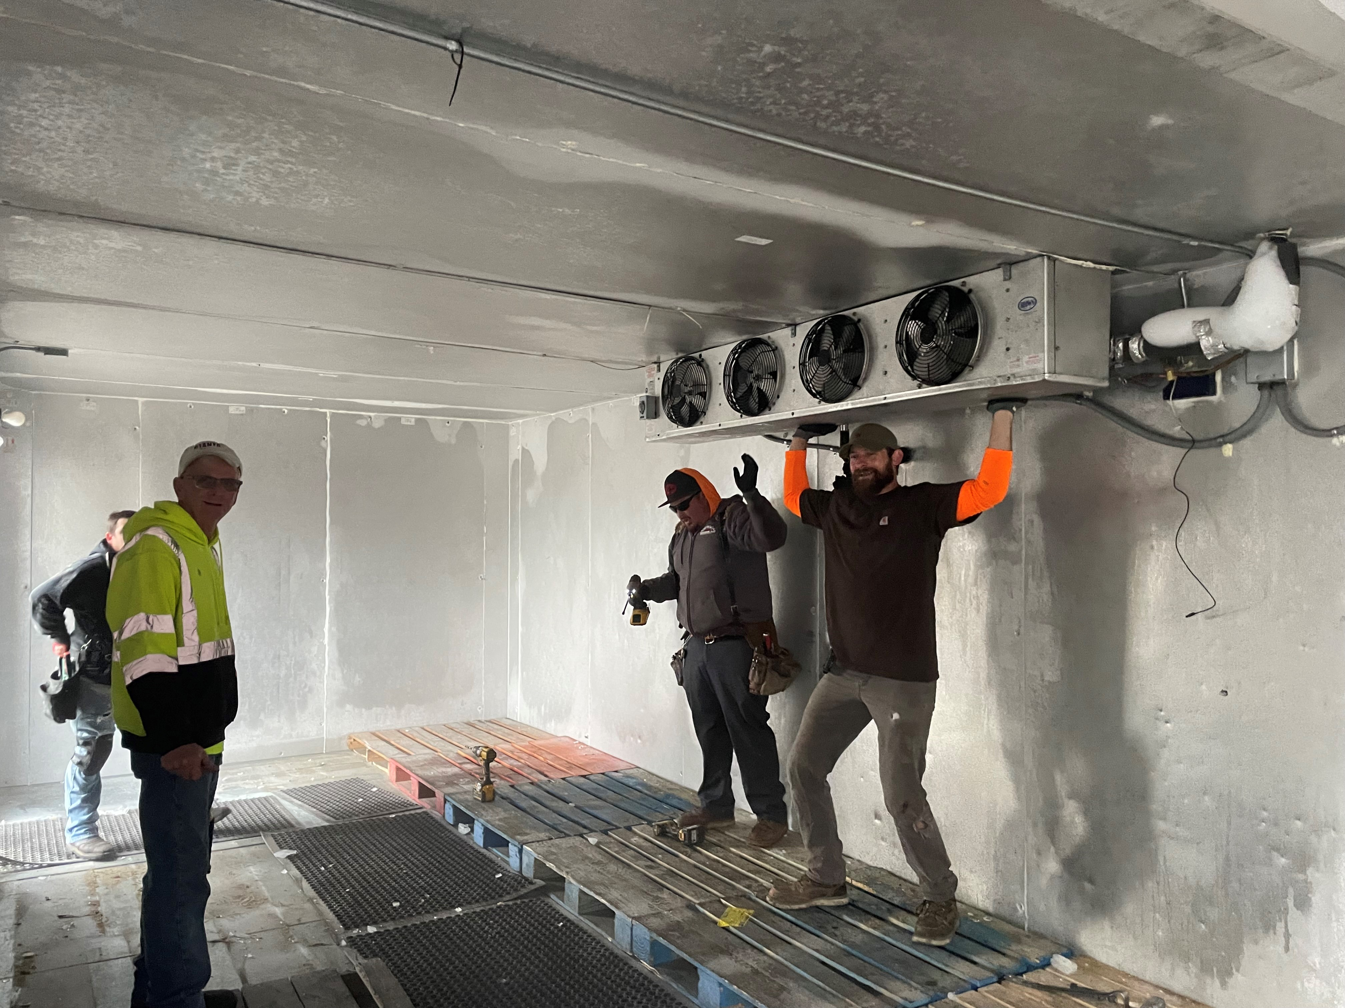
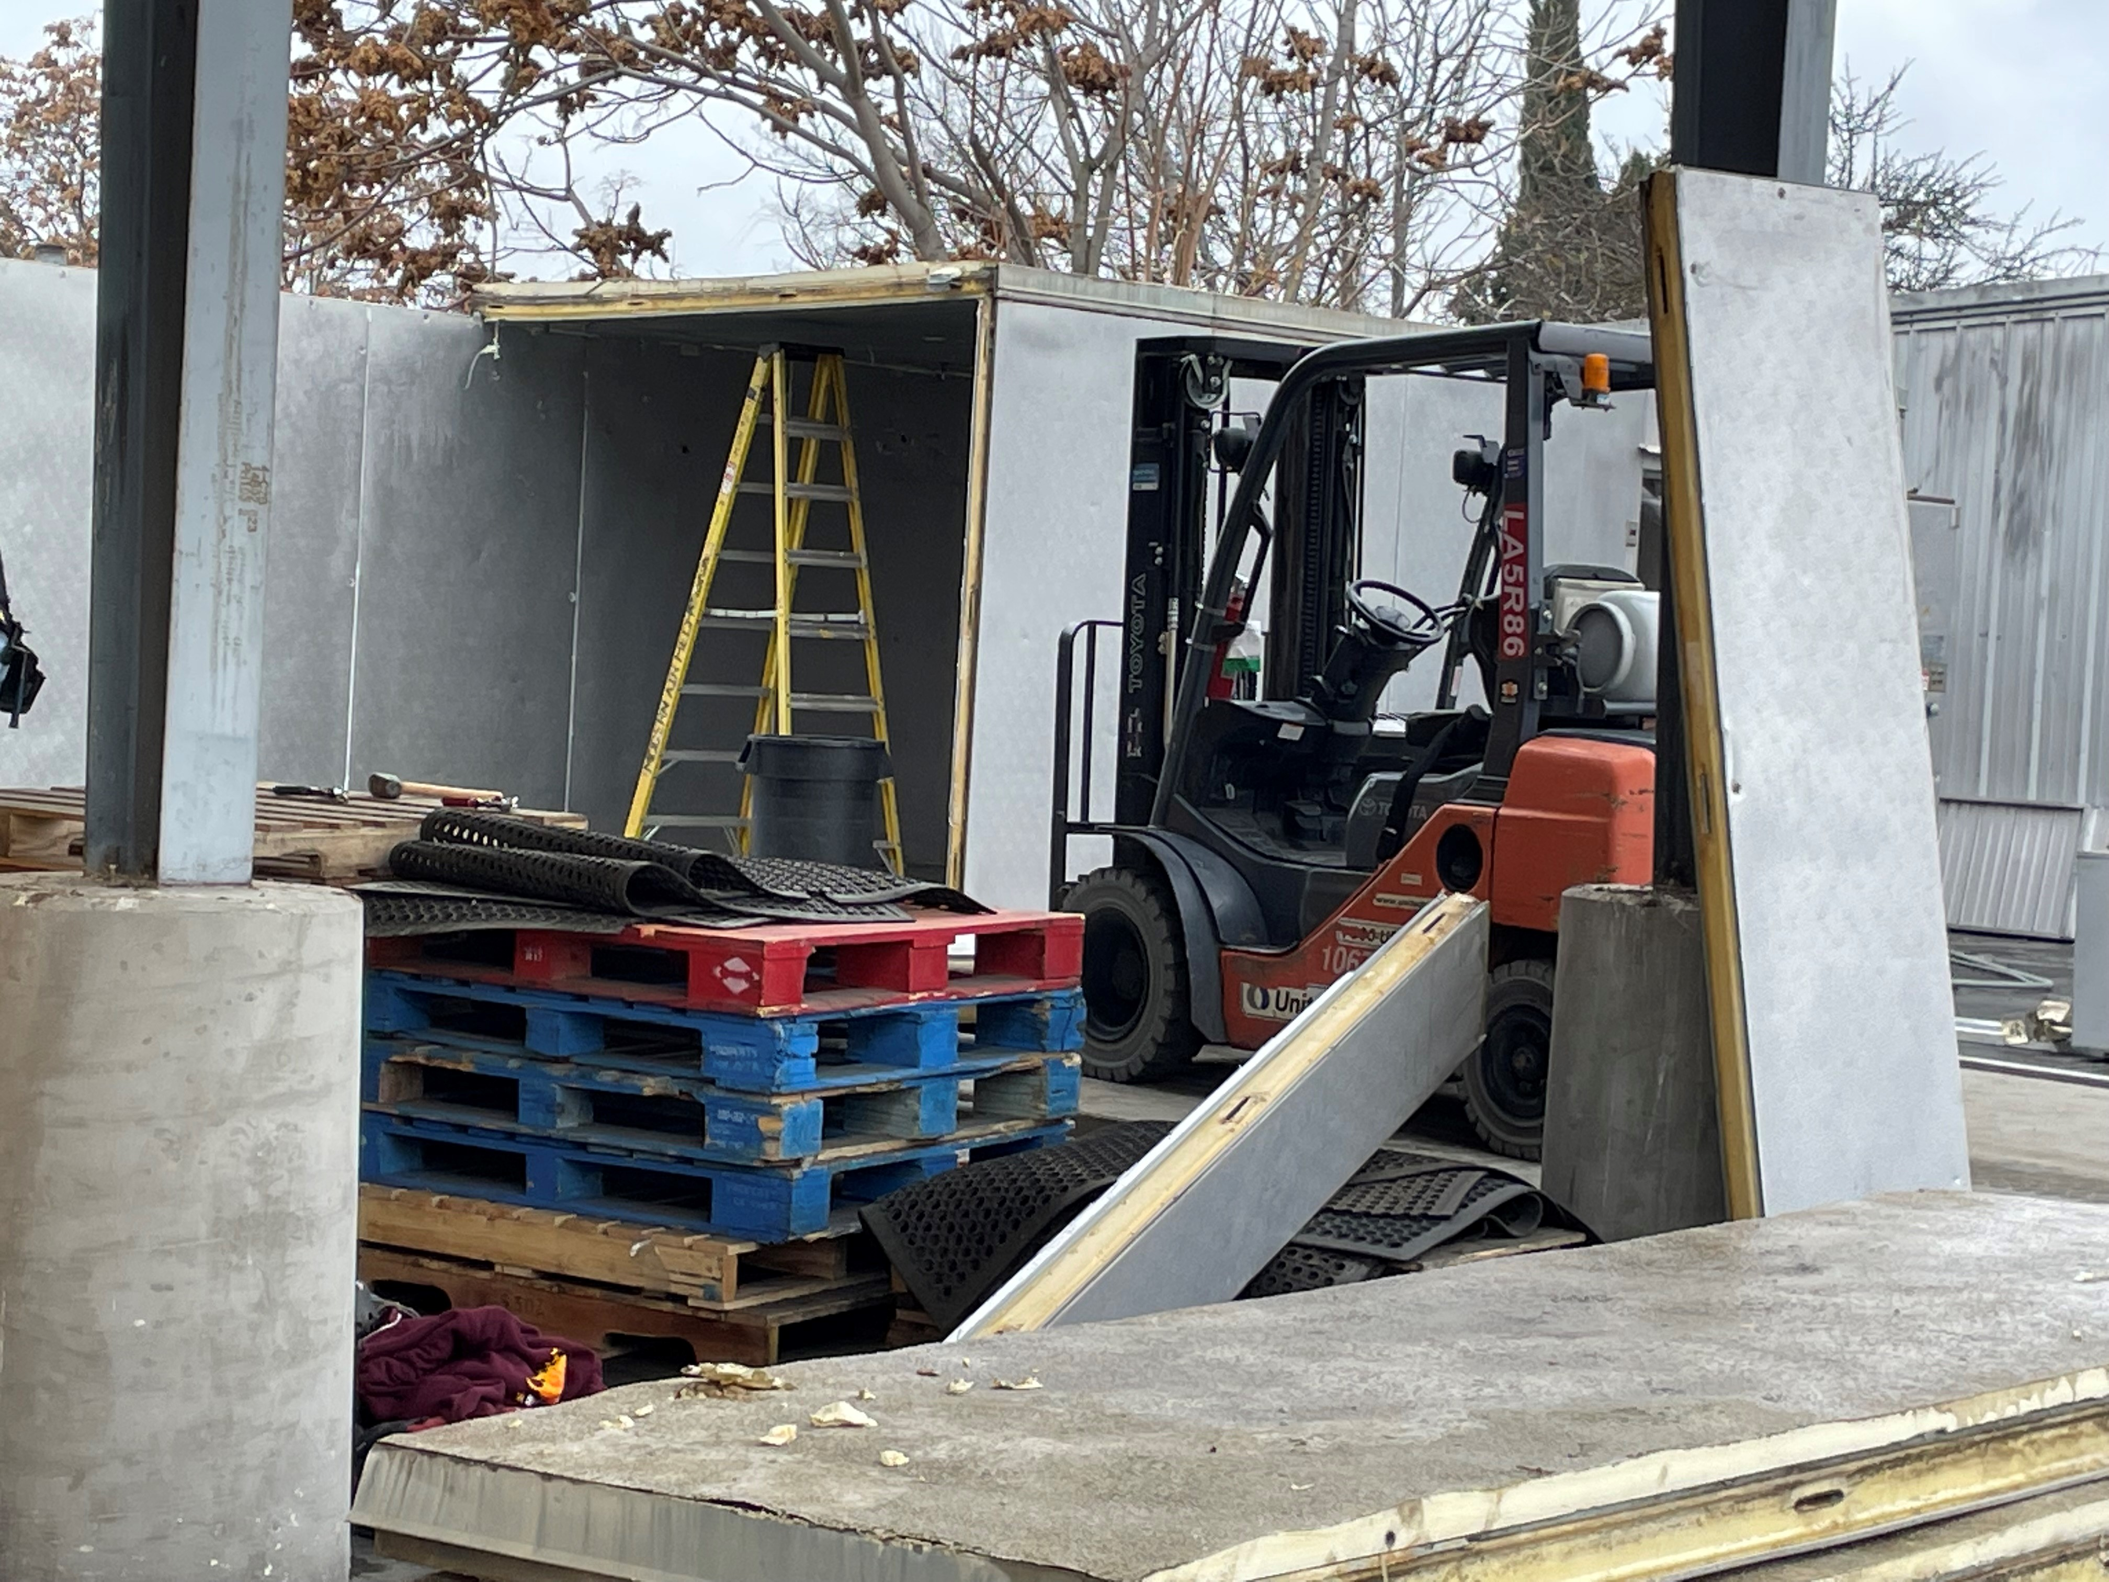
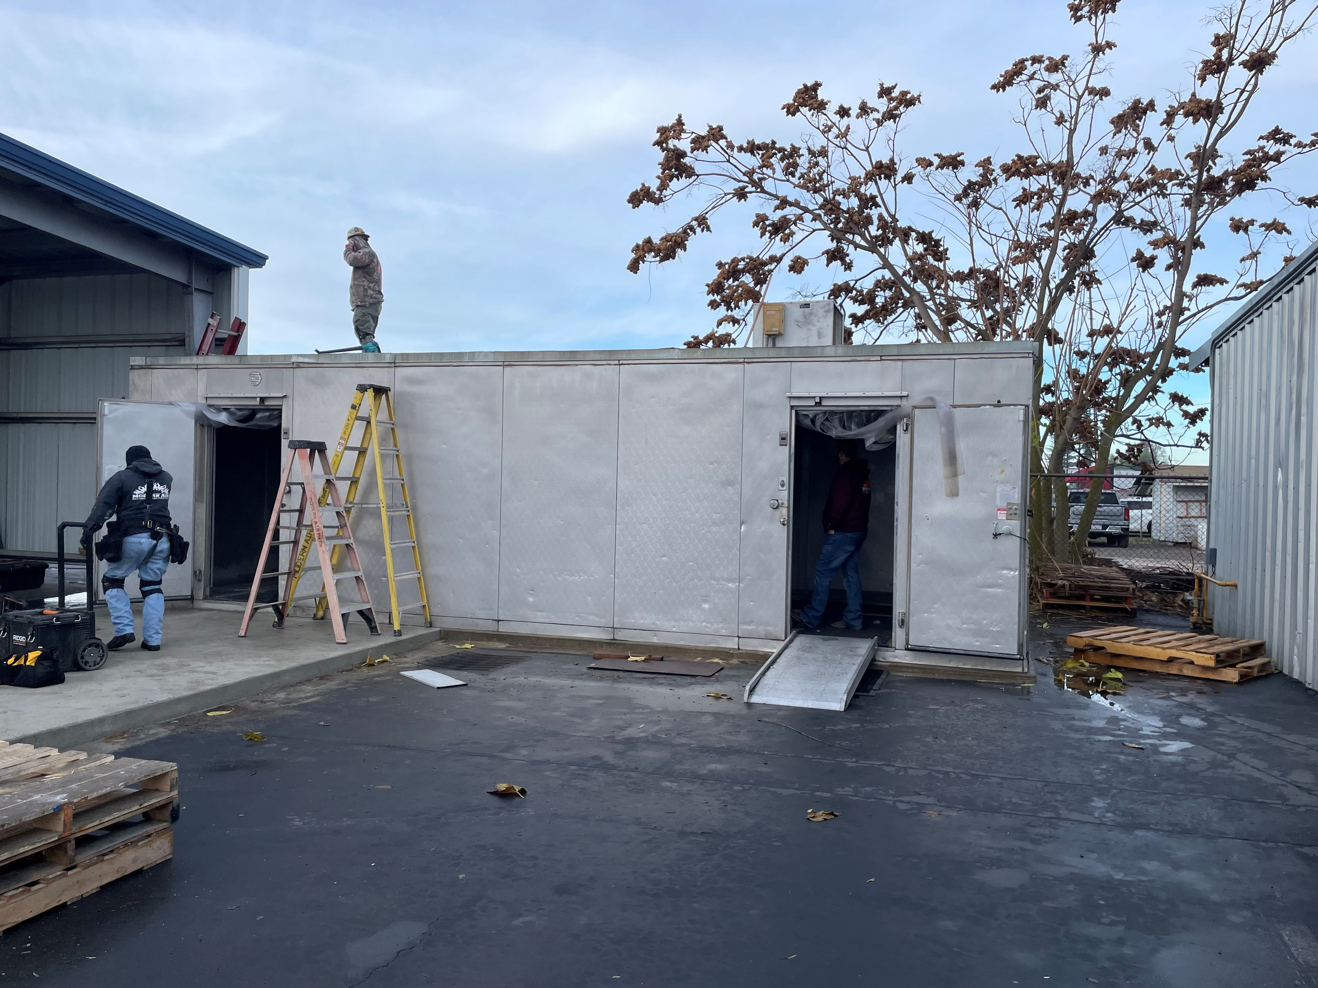
Kitchen Infrastructure and Training: Funding Spotlight: Winton School District's Standalone Freezer Project

Slide 16
2025 Kitchen Infrastructure and Training (KIT) and Retention & Recruitment (R&R) Grants (1)
$145 million to support Universal Meals and assist school food authorities with improving meal quality in the SNPs.
$10 million to support the retention and recruitment of school food service workers.
Unlike previous KIT allocations, these are competitive grants.

Slide 17
2025 KIT and R&R Grants (2)
KIT Funding History
 | KIT 2025 | R&R 2025 | KIT 2022 | KIT 2021
Total Funding | $145 million | $10 million | $600 million | $150 million
Disbursement Model | Competitive Grant | Competitive Grant | Allocation | Allocation

Slide 18
2025 KIT & R&R Grants (3)
Request for Applications (RFA) will be available online by December 2025.
Web page with information on allowable costs, application information and scoring criteria will be available soon.
NSD will provide training to assist School Food Authorities (SFA)s in completing the RFA.
Listserv will be sent once web page is live and RFAs is available.

Slide 19
Fresh Fruit and Vegetable Program (FFVP) Grant (1)
School Year (SY) 2026–27 RFAs will be available online in early December 2025
Funding Amount: Per student award between $50 to $75
Eligible Agencies: Public school districts, county offices of education, charter schools, private schools, or residential child care institutions operating the National School Lunch Program (NSLP)
SFA may apply on behalf of elementary school sites that have at least 50 percent or more of its students eligible for free or reduced-price meals

Slide 20
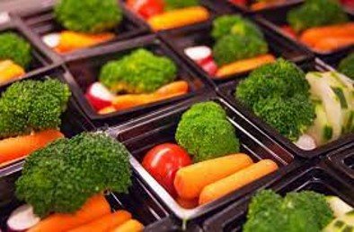
Fresh Fruit and Vegetable Program (FFVP) Grant (2)
The listserv will be sent once the RFA is available.
For more information about the FFVP visit the FFVP web page at https://www.cde.ca.gov/ls/nu/sn/caffvp.asp.

Slide 21
School Breakfast Program and Summer Meals Program Start-up and Expansion Grants (1)
SY 2026–27 RFA will be available online in January 2026
Funding Amount: $1.017 million available with awards up to $15,000 per school site
Eligible Agencies: Public school districts, county offices of education and directly funded charter schools can apply
Note: School sites may be awarded no more than once every three years

Slide 22

School Breakfast Program and Summer Meals Program Start-up and Expansion Grants (2)
The listserv will be sent once the RFA is available.
For more information about the Breakfast Grant visit the CDE School Breakfast and Summer Meal Grants web page at https://www.cde.ca.gov/ls/nu/sn/sbsfgrant.asp.

Slide 23
Commercial Dishwasher Grant Final Report
All funds must be spent or obligated by January 5, 2026.
The final report is due on January 5, 2026.
Each SFA will receive a customized link from Snap WebHost at surveys@cde.ca.gov.
Send questions regarding this topic to the Commercial Dishwasher Grant team at cdg@cde.ca.gov.

Slide 24
Operational Reminders

Slide 25
Seamless Summer Option / Summer Food Service Program Meal Service During School Breaks
Sites must meet area eligibility requirements
School break period must meet the required number of days
Child Nutrition Program | Minimum School Break Period*
Seamless Summer Option (SSO) | More than 10 school days
Summer Food Service Program (SFSP) | 15 or more school days
*Holidays and weekends are not counted towards the school break period.

Slide 26
School Nutrition Program Verification
SFAs with standard counting and claiming sites, and Provision 2 (P2) sites during base year, must have started the verification process of NSLP meal applications.
Verification sample based on the number of approved NSLP meal applications on file as of October 1, and verification must be completed by Monday, November 17, 2025.
These requirements only apply to NSLP meal applications, SFAs must not include Universal Benefits Application (UBA)/SUN Bucks applications in sample.

Slide 27
SNP Verification Reporting
All SFAs must complete the mandatory verification report in the Child Nutrition Information and Payment System (CNIPS), regardless of whether your SFA was required to verify NSLP meal applications.
  Residential child care institutions (RCCI) and SFAs operating district-wide Community Eligibility Provision (CEP) or P2 in non-base years must still complete the verification report.
CNIPS verification report will be available Monday, November 17, 2025.
CNIPS verification report must be completed by Thursday, January 15, 2026.

Slide 28
SNP Verification Resources
CDE SNP Verification Materials web page includes the following resources:
  Updated trainings (verification process and reporting)
  Template letters
  Verification guidance materials
  Access the CDE SNP Verification Materials web page at https://www.cde.ca.gov/ls/nu/sn/verification.asp
USDA Verification Toolkit is available at https://www.fns.usda.gov/cn/verification-toolkit

Slide 29
SY 2026–27 Change Participation Method for Ordering and Receiving USDA Foods
Listserv with more details was sent on September 29, 2025
Deadline: December 15, 2025
If changing your participation method, email FoodDistribution@cde.ca.gov and include:
  Agency name and vendor number
  Contact name and phone number
  Selected participation method for SY 2026–27

Slide 30
Food Distribution Program Reminders (1)
Annual Processor Inventory Reconciliation (Sweeps)
Unused SY 2024–25 carryover pounds swept after October 31
Communicate extenuating circumstances for low usage to your Food Distribution Program (FDP) Order Coordinator
Assess processor balances in January prior to placing orders for SY 2026–27 processor diversions

Slide 31
Food Distribution Program Reminders (2)
USDA Annual Meal Count Reconciliation and Entitlement Update
  Reconciliation of SY 2024–25 lunch counts
  Work with your FDP Order Coordinator to manage entitlement changes
Preference Surveys for State Distribution Centers
  Released on October 24, 2025, and due on December 15, 2025
  Tool used to determine most popular products to bring into the State Distribution Centers

Slide 32
Important Operational Reminders (1)
Action | Date
Use all SY 2024–25 carryover pounds at USDA Foods Processors | Friday, October 31, 2025
Complete verification of NSLP meal applications | Monday, November 17, 2025
Upload SUN Bucks data to Education Data Collection System | Before Tuesday, December 30, 2025

Slide 33
Important Operational Reminders (2)
Action | Date
Submit the Commercial Dishwasher Grant Final Report | Monday, January 5, 2026

Slide 34
Resources and Other Announcements

Slide 35
NSD Trainings are Moving to the Learning Management System
Reminder: NSD is shifting state-developed trainings from the course catalog to the Learning Management System (LMS)
To create a new LMS account
  LMS Account 001 – LMS Account Setup Job Aid
  Questions? Contact us at NSDLearning@cde.ca.gov

Slide 36
LMS Account Setup & Site Overview Webinars
Another round of Account Setup & Guided Tour Webinars coming up!
Register for one of our step-by-step webinars
  Wednesday, November 12, 2025 at 1:30 p.m.
  Tuesday, November 18, 2025 at 1:30 p.m.
Prior to the webinar, download the LMS Account 001 - LMS Account Setup Job Aid accessed in the CNIPS
Questions? Contact us at NSDLearning@cde.ca.gov

Slide 37
Breakfast in the Classroom Learning Tool
No Kid Hungry California team has designed a tool to help you learn about Breakfast in the Classroom (BIC) programs
Provides Tracks with short videos, Resources, and Testimonials for BIC:
  Food Service Directors and their staff
  Simple way to train new staff
  Best practices
Access the BIC Tool! available on the No Kid Hungry web page at https://ca-breakfast.nokidhungry.org/

Slide 38
Procurement Training Reminder
Required annual procurement training:
Program directors, management, and staff who work on NSLP procurement
Effective date August 23, 2024
Training counts towards professional standards
Procurement training available in the CDE Course Catalog and LMS (coming soon)

Slide 39
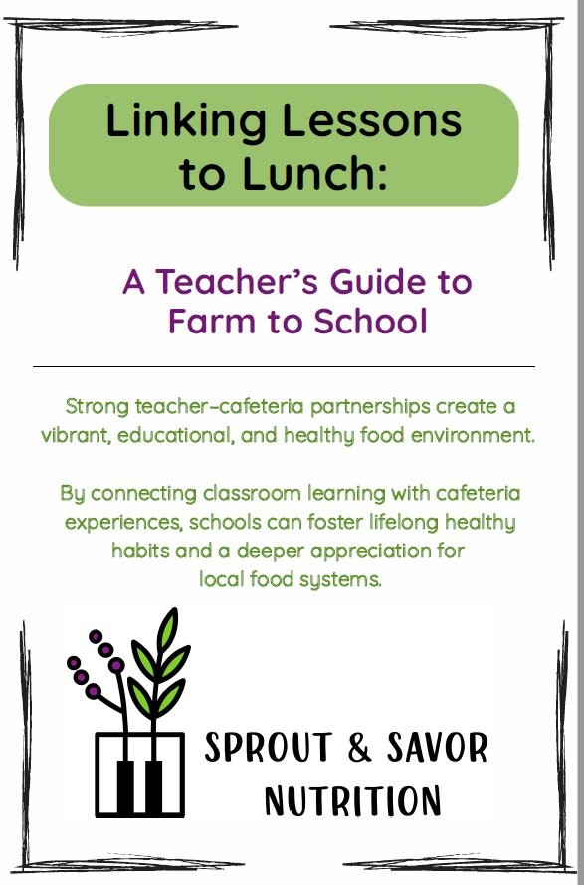
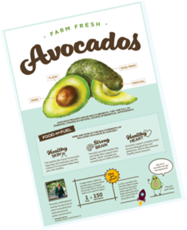
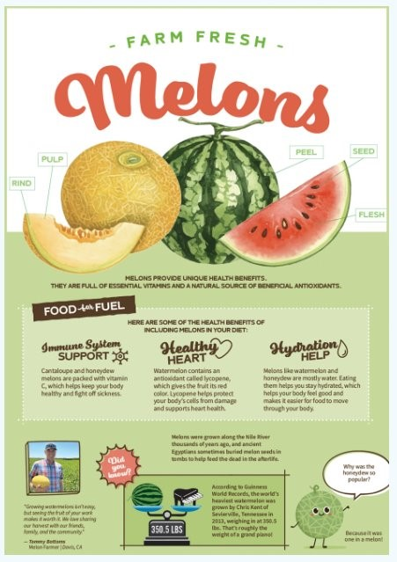
Resources: California Agriculture in the Classroom
Featured Fruits and Vegetables:
Tomatoes
Grapes
Apples
Citrus
Carrots
Herbs
Leafy Greens
Asparagus
Berries
Avocado
Melon
Corn
Access resources at https://learnaboutag.org/farmtoschool/

Slide 40

California Green Ribbon Schools (CA-GRS)
Recognition Program
Honors excellence in whole-school sustainability.
Awardees receive CDE recognition and an award plaque.
Applications due Monday, November 17, 2025.
Questions contact George Garcia at GREENRIBBONSCHOOLS@cde.ca.gov.

Slide 41

Photo Contest: Celebrating California's School Meals
Goal: Highlight the quality, delicious school meals that are served every day, and the staff that prepare them.
Enter now through Monday, November 3, 2025.
NSD will recognize winners for their efforts!
There are seven categories:
  Sow, Grow, and Show with Farm to School
  Mealtime Memories
  Cafeteria Creations
  Mealtime Legends
  Behind the Counter
  Super Selfies
  Offer Versus Serve

Slide 42
Tuesday at 2 Town Hall Schedule
Held on the fourth Tuesday of the month
Month | Format | Date
November and December | No Town Hall | N/A
January | State Update | January 27, 2026

Slide 43
Professional Standards Crediting Information
Key Area: Administration (3000)
Training Topic: Program Management (3200)
Learning Objective: Manage Staff Work Including Scheduling (3210)
Instructional Hours: 1.5 hours

Slide 44
THIS INSTITUTION IS AN
EQUAL OPPORTUNITY PROVIDER.

