Slide 1
A Guide to Conducting Verification for 2026 SUN Bucks
How to use this resource:
Here we explore the process of verification activities for 2026 SUN Bucks.
Note: This resource was created for Local Education Agencies (LEAs) and is not intended to be distributed to households.
California Department of Education
March 2026

Slide 2
Verification Sample Selection
California LEAs will be required to conduct verification of Universal Benefits Applications (UBAs)/SUN Bucks compliant applications for 2026 SUN Bucks.
On April 1, 2026, LEAs will pull a three [3] percent random sample of approved applications received between September 3, 2025 and April 1, 2026.

Slide 3
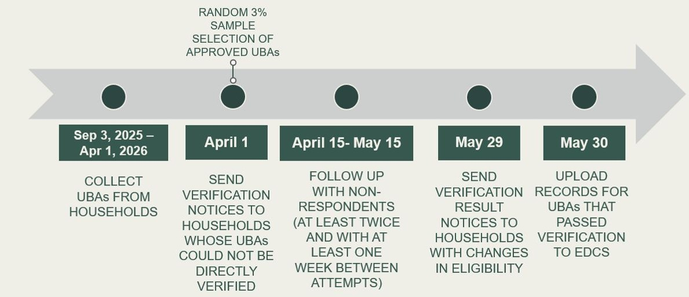
Verification Sampling
Example timeline of Sampling and Conducting Follow Up

Slide 4
Important Note
Per federal regulations, SUN Bucks benefits cannot be issued to families whose applications are selected for verification until after the verification has been completed and the approval has been substantiated. This means that LEAs should not upload SUN Bucks eligibility data to the Education Data Collection System for these children until after their eligibility has been verified.

Slide 5
End Slide

