Slide 1
Distance Learning Series: What Districts are Doing to Support their Students and English Learner Support Strategies
Partners:
Dr. Veronica Aguila, English Learner Support Division
Dr. Stepan Mekhitarian, Glendale Unified
Angela Herrera and Carol Swanson, Natomas Unified
April 9, 2020

Slide 2
Dr. Veronica Aguila
Presentation 1 of 3
ELSD

Slide 3
Distance Learning: Instructional Strategies and English Learner Support
Dr. Veronica Aguila, Director
English Learner Support Division
April 9, 2020

Slide 4
English Language Development (ELD) During COVID-19 School Closure
English learners must continue to receive designated and integrated English Language Development (ELD) as part of their educational curriculum.
LEAs have the flexibility to determine how services will be provided to English learners.
The LEA can determine where, when, and what the students receive in order to continue to make progress toward English language proficiency and meet grade level academic achievement.
Although there are no minimum number of minutes required, ELD is a required course of study for English learners.
Notes:
In this unprecedented time of COVID-19, we must ensure that English learners are continued to be served as LEAs implement their distance learning plans.
LEAs are to continue to provide English learners with designated and integrated English language development, or ELD, and access to grade-level instruction and assignments.
It is important to note that LEAs have the flexibility to design services that support English learners so they are able to access the grade level content they are learning.
The LEA determines where, when, and what services students receive in order to continue to make progress toward English language proficiency and meet grade level academic achievement.
It is also important to note that neither state nor federal law require a specific number of minutes for ELD, however, there must be sufficient instruction provided to ensure that English learners are meeting their language and academic goals.

Slide 5
Curriculum
Identify materials (sets of student texts, workbooks, etc.) to send home with students.
Determine if the current curriculum has a digital integrated or designated ELD component.
Keep in mind digital subscriptions the district may already have and make use of those.
Contact publishers and vendors to ask if free full access to components that support distance learning are available.
Notes:
Let’s remember that districts already have curriculum and resources that can be used to support distance learning instruction.
Current materials, such as textbooks, workbooks, and other materials can be checked out to students to support their learning.
If the curriculum has a digital component, districts are working with publishers to ensure full access to support the districts distance learning plan. It will be important to determine if there is a specialized ELD component.
The district might have digital subscriptions as well that may serve to support English Learners.

Slide 6
Equity of Access for English Learners
Providing designated time for designated ELD within distance learning schedule for EL students.
Importance for building scaffolds to continue providing integrated ELD within core subjects.
Consider a hybrid model for at-home learning (virtual learning and/or assignment packets).
Districts provide guidance on how and where to get internet access.
Rural areas with no internet access: packets, t.v. resources, etc.
Notes:
For English learners, equity includes the ability to learn the language students need to fully access grade level content. This begins with creating a dedicated time for designated ELD in the distance learning schedule.
Integrated ELD also provides access for English learners. Much of integrated ELD instruction includes providing scaffolding for learning in content areas.
Consider providing a hybrid model for at-home learning. Distance learning can be offered through a hybrid of virtual learning and assignment packets.
For those students who do not have access to computers or tablets, many districts are providing the equipment for students to check out. Districts can also guide families on how to access low-cost or free internet for their devices. For rural areas where internet access is not available, working with the local tv stations may provide the access needed to be able to provide grade level curriculum during designed times of the day and independent packets can me delivered to students.

Slide 7
Equity of Access for Multilingual Students
Bilingual, Dual Language and Language Acquisition programs can continue to be offered through distance learning.
Distance learning provides the opportunity to deepen and capitalize on students’ use of their home language.
Provide all EL students and families with resources for literacy in their home languages.
Design culturally responsive lessons.

Slide 8
English Learner and Multilingual Parent and Teacher Resources
https://ca.pbslearningmedia.org/collection/recursos-de-prek-12-para-cierres-de-emergencia/
Notes:
The Public Broadcasting System, or PBS, created a set of online resources in both English and Spanish for both educators and families to access.

Slide 9
Distance Learning Guidance
The guidance contains considerations in the following areas:
Developing a distance learning plan
Ensuring access and equity for all students
Continuum of options
Serving students with disabilities
Serving English learners and multilingual students
Leveraging transportation resources to support distance learning
Resources for internet access
CDE COVID-19 Guidance for K–12 Schools: https://www.cde.ca.gov/ls/he/hn/guidance.asp
Notes:
Two weeks ago, this valuable Distance Learning Guidance was posted on the CDE website. I want to highlight that this resource continues to be updated and contains information to ensure access and equity for all students. Including students with disabilities who may or may not be English learners, English learner, multilingual students and resources on how parents and districts can Access free internet or low cost internet.

Slide 10
Appendix 1: Resources that Support Distance Learning
English Language Development Learning, Games, and Activities
Multilingual Resources
Pre-K Learning, Games, and Activities
Current Events and News Outlets for Students
Free Educational Resources for Distance Learning
Online Learning Resources and Tools
Digital Res. by Content Area
Online Engagement Systems and Platforms
State, County Office of Education, and District Resources
Teaching Tools: Presentation and Content Supports
Supporting Students with Disabilities in Distance Learning
Articles to Navigate Distance Learning
Notes:
Appendix 1 contains links to resources and activities for English Language Development and to Multilingual Resources.

Slide 11
English Language Development Resources
English Media Lab: http://www.englishmedialab.com/index.html
BrainPOP ELL: https://ell.brainpop.com/
Colorín Colorado: https://www.colorincolorado.org/
Education.com: https://www.education.com/
Learning English: https://learningenglish.voanews.com/p/5373.html
My Writing Coach: https://mysbaccoach.com/login/
Read Works: https://www.readworks.org/
Scholastic Learn at Home: https://classroommagazines.scholastic.com/support/learnathome.html
Additional resources are posted on the CDE Resources That Support Distance Learning web page at: https://www.cde.ca.gov/ls/he/hn/appendix1.asp#eight
Notes:
Here are a few English Language Development Resources highlighted. Additional resources are posted and updated weekly.

Slide 12
Multilingual Learning Resources
Biblioteca Infantil: https://biblioteca.org.ar/infantil.htm
Khan Academy en Español: https://es.khanacademy.org/
NASA Ciencias en Español: https://www.nasa.gov/exploration/home/espanol.html#.XnkmEIhKg2y
CommonLit: https://www.commonlit.org/
NewsELA: https://newsela.com/rules/spanish
Tween Tribune en Español: https://www.tweentribune.com/category/spanish/
Duolingo: https://www.duolingo.com/
Chinese Boost: https://www.chineseboost.com/blog/10-best-free-resources-learn-chinese/
Additional resources are posted on the CDE Resources that Support Distance Learning web page at: https://www.cde.ca.gov/ls/he/hn/appendix1.asp#eight
Notes:
The multilingual learning resources page highlight resources in other languages. Since 80% of the 1.2 English Learners have spanish as their primary language, we are highlighting those resources here. We will continue to update this page to be able to provide resources in various languages.

Slide 13
CDE COVID-19 Guidance for K–1 Schools: https://www.cde.ca.gov/ls/he/hn/guidance.asp

Slide 14
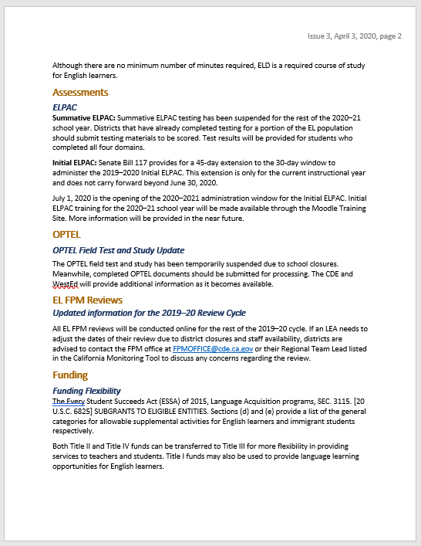
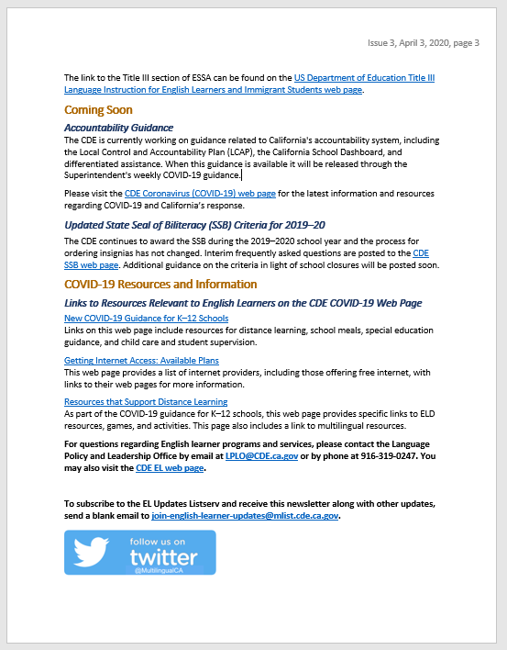
English Learner Updates Newsletter
https://www.cde.ca.gov/sp/el/er/elnewsletters.asp
Notes:
The English Learner Support Division has a newsletter that, during the time of COVID-19, will be published on a weekly basis. The CDE will send out the newsletter to BCN members and other groups. Please share them widely. They are also posted on the CDE___________________ web page, so LEAs can view back issues of the newsletter.

Slide 15
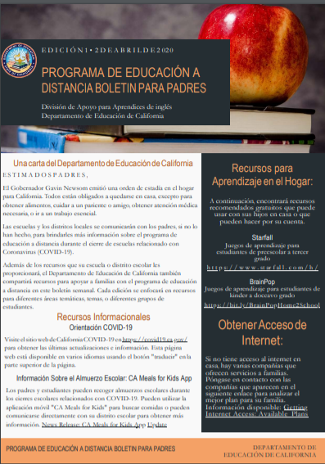
Distance Learning Parent Newsletter
https://www.cde.ca.gov/ls/he/hn/guidance.asp
Notes:
The English Learner Support Division is also publishing an online parent newsletter in both English and Spanish. This newsletter will be published biweekly and _____

Slide 16
Grading and Graduation
The decision of whether or not to require graded work from students is a local one.
LEAs should weigh their policies with the lens of equity and with the primary goal of first, doing no harm to students.
Further, the distance learning grading plan that LEAs adopt in the short term, may differ from a plan that is created for the long term.
CDE College Admissions, Grading, and Graduation Requirements web page: https://www.cde.ca.gov/ls/he/hn/collegereqsinformation.asp
Notes:
Last week, the CDE issued new guidance and flexibilities for grading, graduation, and financial aid. (Read Slide) The California State Board of Education, California Department of Education, California State University, University of California, California Community Colleges and the Association of Independent California Colleges and Universities issued a joint statement outlining support for distance learning, Strategies for flexibility in grading, and guidance for adjustments of local graduation requirements.
This includes:
Pass/Fail or Credit/No Credit will be accepted for A—G courses without affecting Grade Point Average (GPA)
Will re-evaluate financial aid needs for families whose circumstances have changed
Flexibilities associated with receipt of official transcripts and confirmation of admissions offers, including deferments of deposits or fees
Flexibility and support for students currently enrolled in dual enrollment course offerings
Community college students seeking to transfer to a four-year university: Acceptance of Credit/No Credit in lieu of letter grades in “Golden Four” and General Education/prerequisite courses completed at a community college in winter/spring/summer 2020.

Slide 17
State Seal of Biliteracy
The State Seal of Biliteracy (SSB) will still be offered in the 2019–20 school year.
The process for requesting insignias has not changed.
Visit the CDE SSB web page at https://bit.ly/StateSealofBiliteracy for the latest information and to order insignias.
Additional guidance is being developed and will be posted on the CDE SSB web page as soon as it is available.
Notes:
The CDE will still award the SSB during the 2019–20 school year and the process for requesting insignias has not changed.
Please visit the CDE SSB web page for the latest information and to order insignias.
The following information is taken directly from the interim COVID-19 frequently asked questions posted to the CDE SSB web page.

Slide 18
Example: Distance Learning In Action Kern County Office of Education
Aligns English Language Arts (ELA) standards with ELD content
All content is online, is standards-aligned, and standards-driven
Both designated and integrated ELD lessons are available
Nine weeks of lessons until the end of the school year
ELA/ELD and Math lessons are separated by grade and by week
For more information, contact Katie Gregory, Kern County Office of Education, by email at kagregory@kern.org
Notes:
The Kern County Office of Education was kind enough to share the work they have dedicated to supporting distance learning.
They created a full distance learning curriculum, standards-based and standards-driven, which provides nine weeks of lessons until the end of the school year.
The curriculum is aligned with the English language arts, or ELA, standards and addresses the ELD standards through the content.
All modules are separated by grade and by week and are designed to address the needs of English learners.
To learn more about their distance learning work, contact Katie Gregory. Her information is listed on this slide.
What does designated ELD look like in distance learning?
Which districts are examples that can be featured?
What are some systems challenges districts might encounter?

Slide 19
Thank you
Notes:
The Kern County Office of Education was kind enough to share the work they have dedicated to supporting distance learning.
They created a full distance learning curriculum, standards-based and standards-driven, which provides nine weeks of lessons until the end of the school year.
The curriculum is aligned with the English language arts, or ELA, standards and addresses the ELD standards through the content.
All modules are separated by grade and by week and are designed to address the needs of English learners.
To learn more about their distance learning work, contact Katie Gregory. Her information is listed on this slide.
Now, I have the pleasure of introducing ________ from Notomas Unified who will be sharing how this district is serving English Learners and their parents through distance learning. And, what are some systems challenges they have faced and how they are overcoming them.

Slide 20
Dr. Stepan Mekhitarian
Presentation 2 of 3
Glendale Unified SD

Slide 21
Glendale Unified School District Remote Learning Plan Rollout
Thursday, April 9, 2020
Presenter: Dr. Stepan Mekhitarian

Slide 22
Overview of The Remote Learning Rollout Plan
Hardware distribution
Training for teachers, principals and parents/guardians
Remote learning considerations
Recommendations
Notes:
During this brief overview, we will share how our district addressed hardware distribution and training for teachers, principals and parents/guardians. We will also share remote learning considerations and recommendations.

Slide 23
Hardware Distribution
Chromebooks and WiFi Hotspots
Distribution schedule designed around predicted results based on parent survey
Notes:
Thousand of our students needed Chromebooks to access online learning. We sent a parent survey to identify needs and used an extrapolation model to predict need for our 26,000 students based on approx. 10,000 initial respondents. We used these numbers to determine the number of hours needed at each school for distribution and developed a schedule. Six teams lead the distribution and nearly 7,500 Chromebooks were distributed. Hotspots have been ordered for families who require it.

Slide 24
Training for Teachers and Principals
One starting point for stakeholders
Webinars for remote learning programs
Lesson plan templates for students with and without tech access
Organized resource pages for Elementary and Secondary
Screencasts for technical steps (setting security settings for videoconferencing, etc.)
Notes:
There is an overwhelming amount of information out there so organization is key. We have one starting point for stakeholders that leads to all necessary resources. The document includes webinars for remote learning programs, lesson plan templates for students with and without tech access, organized resource pages for Elementary and Secondary, and screencasts for technical steps (setting security settings for videoconferencing, etc.).

Slide 25
Training for Parents / Guardians
Expectations message sent
Website with information on online instruction, meals, technology and more (https://www.gusd.net/remotelearning)
Special hotline for Tech Support
Special hotline for SpEd Support
Fast-tracked translation services for all communication (written and teleconferencing)
Notes:
A translated message was sent to all families with information on online learning, frequency of lessons, and more. The public remote learning page is frequently updated (https://www.gusd.net/remotelearning). We also established special hotline numbers for SpEd and tech support. Finally, prioritized translation for all public communication.

Slide 26
Remote Learning Considerations
Differentiated instruction and support
Effective questioning
Actionable feedback
Notes:
Teachers new to remote learning may need additional support on effective implementation of differentiated instruction and support, questioning, and actionable feedback. Collaborate with your Teaching & Learning teams to offer PD in these areas.

Slide 27
Recommendations
Prioritize student safety and privacy
Emphasize the importance of digital citizenship
Organize directions and content and add hyperlinked directions
Include screencasts for directions
Develop systems to build school leader capacity with remote learning
Collect data points to measure effectiveness
Notes:
Consider these recommendations:
Prioritize student safety and privacy
Emphasize the importance of digital citizenship BEFORE remote learning begins
Organize directions and content and add hyperlinked directions
Include screencasts for directions – two good programs are Screencast-o-matic and Screencastify
Develop systems to build school leader capacity with remote learning, such as checklists for training and Google Classroom accounts
Collect data points to measure effectiveness

Slide 28
Contact Information Glendale Unified SD
Dr. Stepan Mekhitarian
Email: smekhitarian@gusd.net

Slide 29
Angela Herrera and Carol Swanson
Presentation 3 of 3
Natomas Unified SD

Slide 30
Distance Learning in
Natomas Unified School District:
What We’ve Done So Far
April 9, 2020
Angela Herrera, Chief Academic Officer
Carol Swanson, Associate Superintendent, SELPA
Notes:
Thank you for the opportunity to share some of the things we are trying in Natomas Unified to support our students, families and staff through distance learning. This is about what we have learned so far. We recognize there is much more to learn, and that the context of our district has allowed us to approach distance learning the way that we have. We know that this is not every district’s context, but nonetheless, we hope that there are at least a few ideas or resources shared today as we all look how to best move forward.

Slide 31
NUSD Demographics (1 of 2)
Natomas Unified, located about 5 minutes north of the state capitol building, has steady growth enrollment with over 16,000 students in 14 district-run schools (four K-5 elementary, five K-8 schools, one middle school, three high schools, a 6-12th dependent charter school) and 3 independently operated charter systems.
For our district-run schools, approximately 12% of students are English learners, with nearly 1,350 students speaking 44 different languages
Approximately 14% of Natomas’ students are students with disabilities, with more than 1,600 students in special education
Notes:
Natomas is a very diverse community. We have over 16000 students in 14 district-run sites and 3 independent charter school systems.
12% of our students are English learners and represent 44 different languages. 14% of our students are in special education.
In Natomas, 61% of our students classify as high risk, with 6500 students receiving free and reduced lunch. We have a total of 375 foster and homeless families.

Slide 32
NUSD Demographics (2 of 2)
The unduplicated count in Natomas Unified is 61%:
More than 6,500 students receive free or reduced lunch
1,350 students are English Learners
Over 300 homeless families
75 foster students
Notes:
Natomas is a very diverse community. We have over 16000 students in 14 district-run sites and 3 independent charter school systems.
12% of our students are English learners and represent 44 different languages. 14% of our students are in special education.
In Natomas, 61% of our students classify as high risk, with 6500 students receiving free and reduced lunch. We have a total of 375 foster and homeless families.

Slide 33
NUSD’s Approach to Distance Learning
Key factors we have focused on as we plan for distance learning:
Communication with our community
Understanding the needs that exist in our community, with equity as a major commitment
Utilizing existing resources
Orientation, training & piloting
Being flexible in our approach
Learning for the future as we explore virtual learning in NUSD
Notes:
We have focused on several key areas as we developed our distance learning plan.
The first, communication with our community which paved the way for us to be able to engage in this challenging new work.
Second, understanding the needs that exist in our community, with equity as a major commitment and driver for identifying those needs.
Third, how we can launch a distance learning platform by utilizing existing resources rather than trying to stretch ourselves to learn new platforms.
Fourth, how we engage our stakeholders including the orientation process, training and how we have chosen to pilot distance learning
Last, being flexible in our approach and learning for the future helps us not be wrapped up in this moment, feeling like our efforts might be in vain. There are valuable lessons we can learn from the process even if we have to make adjustments as the landscape changes day to day and sometimes even hour to hour.

Slide 34
Timeline for Distance Learning (1 of 2)
Friday, March 13: First day of school closure in NUSD
Week of March 16: Working with labor partners on 3 MOUs
Week of March 23: teachers will plan and prepare lessons using existing instructional platforms suitable for Distance Learning. If a staff member struggles with remote Internet access, they will contact their Principal, and the District will endeavor to support them with temporary remote Internet access. (plus 4th MOU re: Special Education was signed)
**In light of state testing being suspended this spring, and no end-of-year activities and trips, we believe that students will be engaged in instruction for roughly the equivalent number of days.
Notes:
As a note, our first day of school closure was Friday March 13. The next week, we worked extensively and quickly with our labor partners to sign four MOUs, which helped set the course for the following weeks. During the weeks of 3/16 and 3/23, we worked with our labor partners to establish a timeline to roll out Distance Learning. We did this in stages because we knew that there were too many issues if we tried to negotiate everything, such as special education with all its moving parts, in one MOU. First, we finalized our agreements with CSEA and next our general education teacher agreements with NTA. Then, we tackled special education.
During the week of 3/23, teachers began the planning process to prepare lessons using instructional platforms. We were also available to assist parents as they addressed technological issues at home.
During the weeks of 3/30 and 4/6: Teachers will pilot lessons with students. We started with this pilot because, in light of state testing being suspended, and no end-of-year activities and trips, we believed that students will be engaged in instruction for the equivalent number of days with these pilot weeks.
4/13: spring break
4/20: School will resume and distance learning will begin

Slide 35
Timeline for Distance Learning (2 of 2)
Weeks of March 30 and April 6: teachers will begin to "pilot" lesson plans with students as families are provided orientation and necessary resources.
Week of April 13: the District will be on its regularly scheduled spring break and students will not be provided new instruction.
Weeks of April 20 - May 21: Staff will provide instruction through Distance Learning.
**In light of state testing being suspended this spring, and no end-of-year activities and trips, we believe that students will be engaged in instruction for roughly the equivalent number of days.
Notes:
As a note, our first day of school closure was Friday March 13. The next week, we worked extensively and quickly with our labor partners to sign four MOUs, which helped set the course for the following weeks. During the weeks of 3/16 and 3/23, we worked with our labor partners to establish a timeline to roll out Distance Learning. We did this in stages because we knew that there were too many issues if we tried to negotiate everything, such as special education with all its moving parts, in one MOU. First, we finalized our agreements with CSEA and next our general education teacher agreements with NTA. Then, we tackled special education.
During the week of 3/23, teachers began the planning process to prepare lessons using instructional platforms. We were also available to assist parents as they addressed technological issues at home.
During the weeks of 3/30 and 4/6: Teachers will pilot lessons with students. We started with this pilot because, in light of state testing being suspended, and no end-of-year activities and trips, we believed that students will be engaged in instruction for the equivalent number of days with these pilot weeks.
4/13: spring break
4/20: School will resume and distance learning will begin

Slide 36
Communication with Our Community

Slide 37
Communication with Our Community (1 of 2)
Our community has been by our side on this journey, day to day. Our goal has been to focus on:
Providing routine communications
Working with our labor partners along the way
Recognizing the importance of timeliness
Being forthright about the gaps and bumps in the road and not making promises we may not be able to keep
Sharing resources and supports to families
Providing a central source for staff and families to ask questions and provide feedback as the plan unfolds
Notes:
Our community has been on this journey with us since the beginning, which has been a crucial part of any major undertaking in our community for many years. Our goals and focus have been consistent: to provide regular communications, to work with our labor partners, to develop and maintain timelines, and to be forthright about gaps and bumps- we don’t make promises we cannot keep.
We are committed to sharing our resources and supports with families and we have provided a central source for families and staff to ask questions and provide feedback, so that they feel confident that while they may not get an immediate answer, they have spoken to someone who is finding out the best next steps. Our calls to Constituent and Customer Service have been consistent everyday through this pandemic, and CCS has helped us not lose site of those individual needs and concerns.

Slide 38
Communication with Our Community (2 of 2)
Early work with our labor partners
MOU process: both parties brought interests to the table, focusing on the big picture
Challenges: understanding that not every issue can be addressed in a single MOU, so making a note of what needs to be revisited (i.e. supporting students with IEPs)
Timely and frequent communication and check-ins
Notes:
As we discussed, we knew that there were too many issues to address with one MOU. To expedite the process and get staff planning, sites sanitized, computers cleaned and distributed, and kids fed, we first worked with CSEA and within two work days had two MOUS about essential workers and expectations during this time. In rapid succession, we began negotiating with NTA, by bringing interests of both sides to the table. Our focus was general education to start. When this was completed and signed, we began to discuss, and make agreements, regarding special education. These MOUs allowed work to happen, teachers to start planning, and kids to be served. We made agreements with our labor partners early and as a priority which is why we have a clear path ahead right now and our teachers are already engaging with our students across the district.

Slide 39
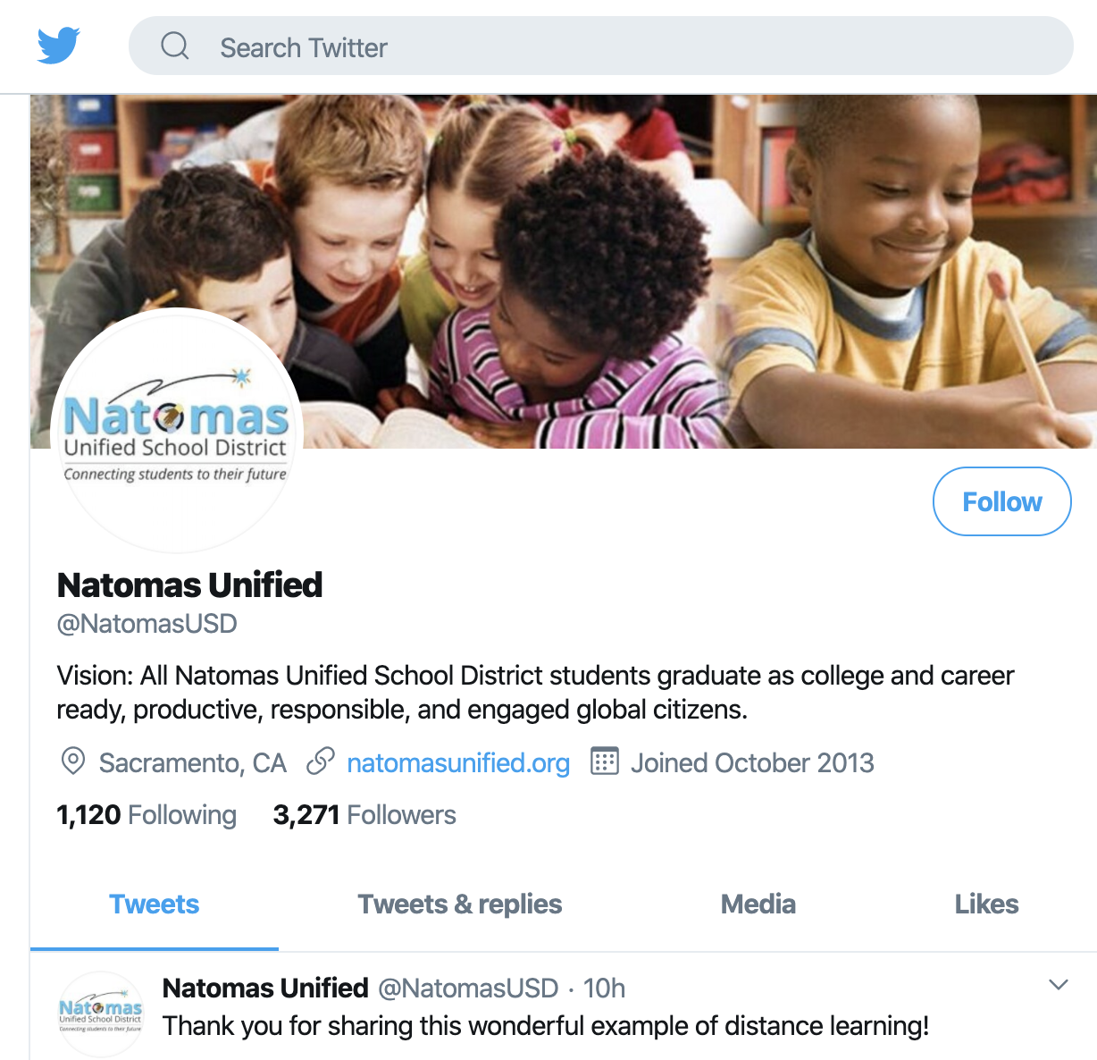
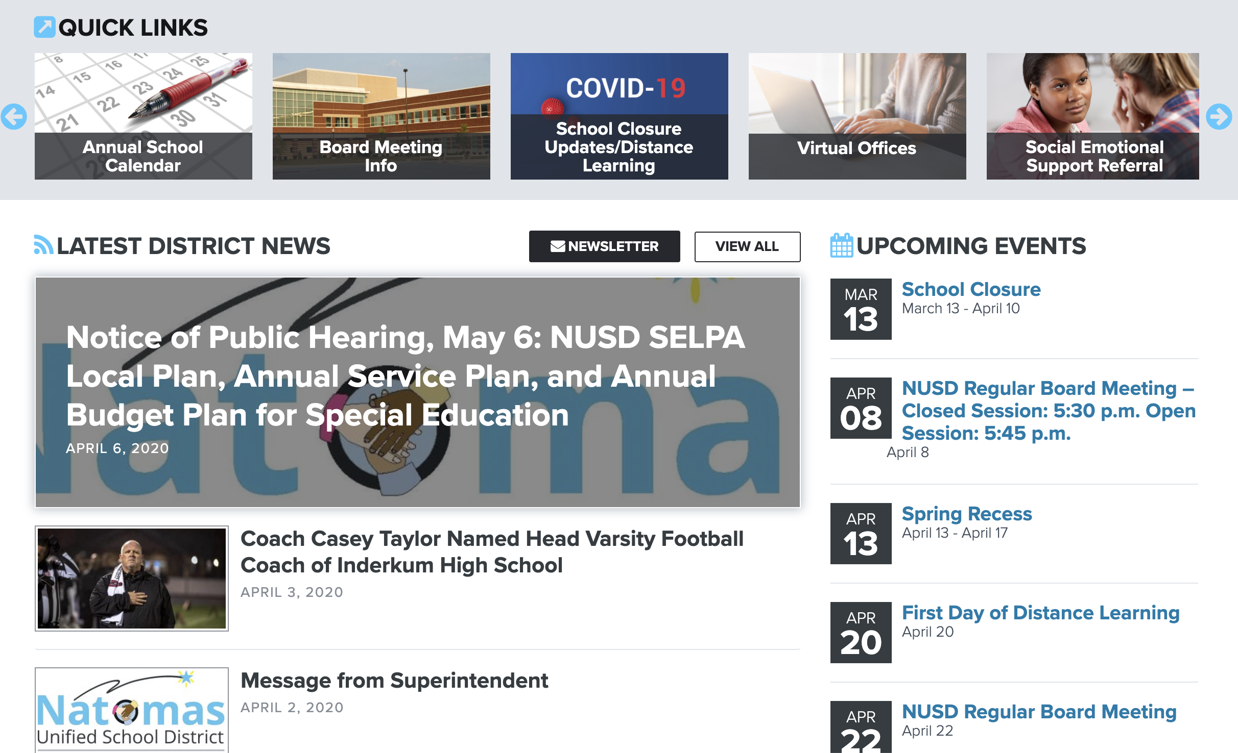
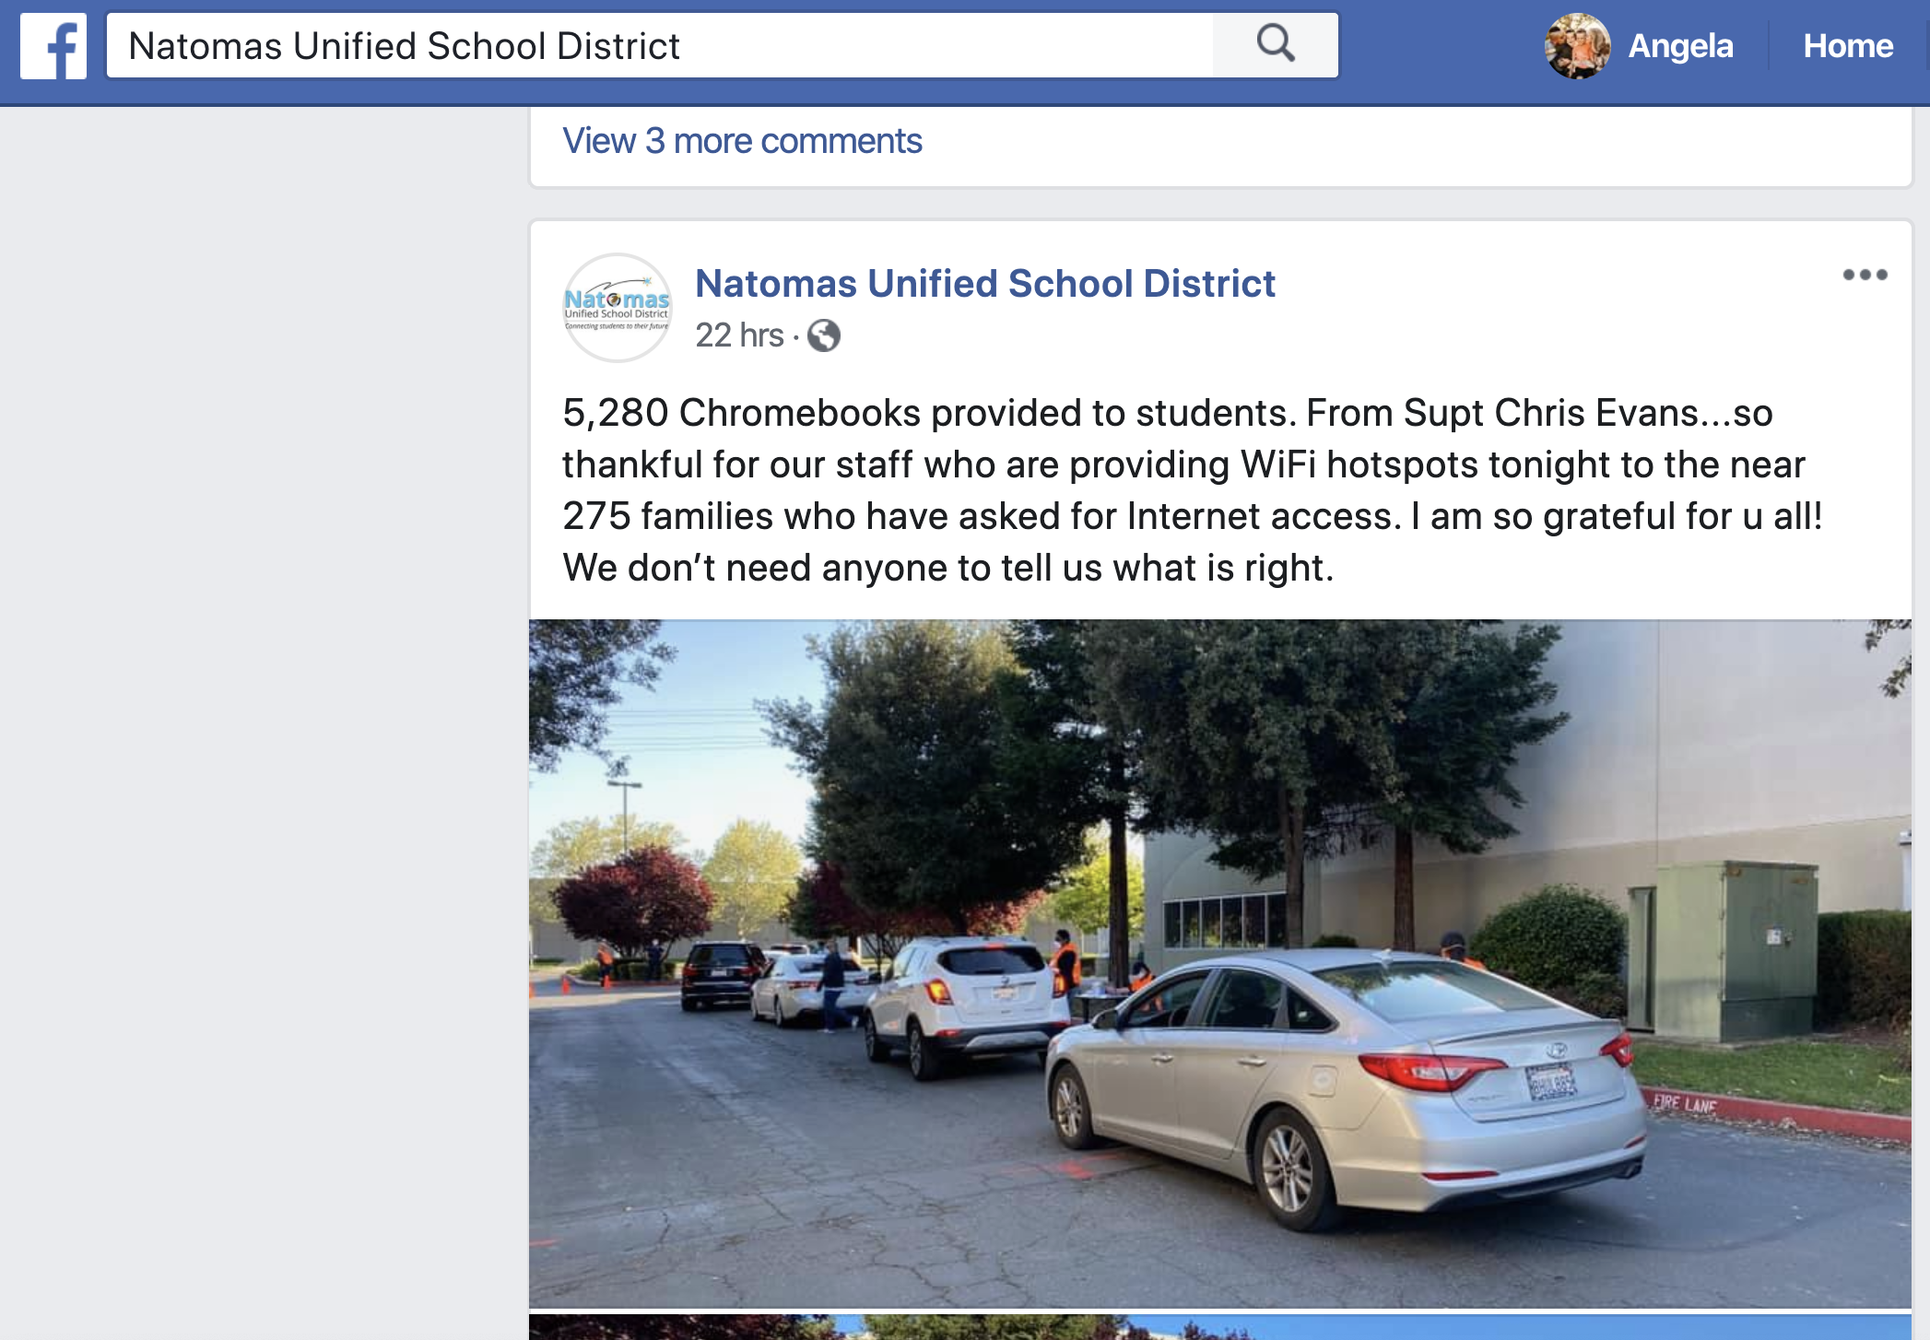
Communication with Our Community - Samples
SAMPLE CONTENT
NUSD Headlines:
https://natomasunified.org/category/news-alerts/
How we have communicated:
Website
Facebook
Twitter
YouTube
Infinite Campus
Site/Teacher tools
Emails to staff
Constituent & Customer Service: https://natomasunified.org/departments/ccs
Notes:
Communication has been a central focus for Natomas. To ensure clear communication, we have created a centralized website and other virtual tools we will talk about later. But from a big-picture perspective we use the tools listed here. We also provided a couple links for reference. We use our website to push out information, and we have our 24/7 Constituent and Customer Service hotline as well as our staffed virtual Constituent and Customer Service office. Constituent and Customer Service has been instrumental in keeping the lines of communication open with the community and minimizing confusion and misinformation. It’s been critical for us to make sure that CCS has all the information they need to point people in the right direction, or come to us as needed.

Slide 40
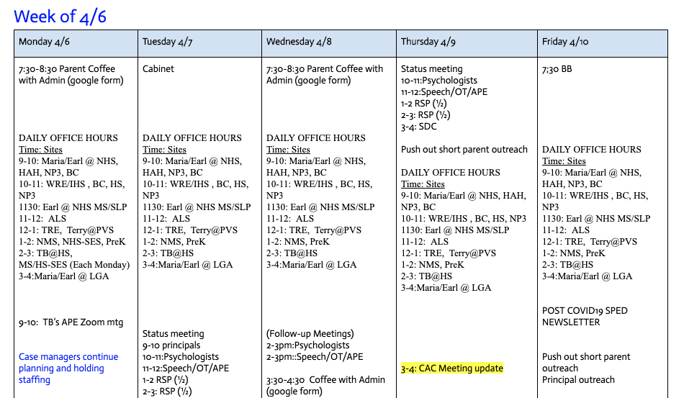
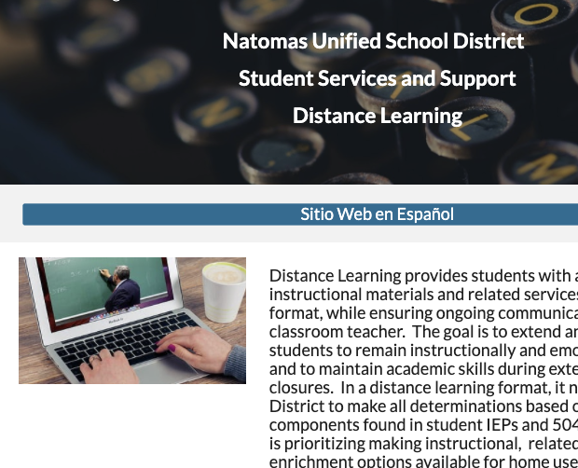
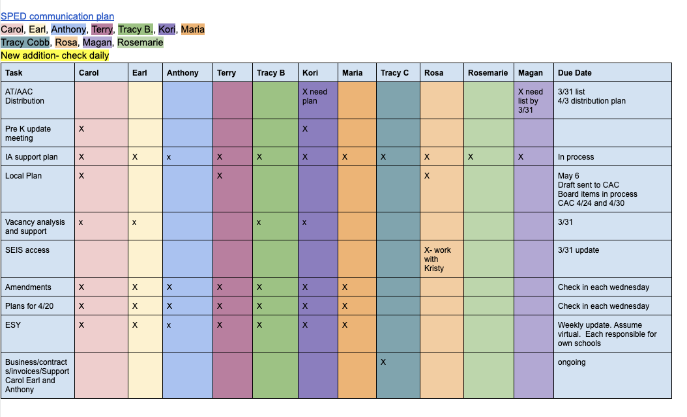
Communication with Our Community
Special Education
Build a clear plan
Backward map
Take one step at a time
Communication Plan
Website
Clear, consistent, collaborative communication
Work Plan
Notes:
In Student Services which includes the SELPA, we focused on developing a clear plan based on an analysis of our needs. Early on, we developed a website as a tool to help lighten the load on our teachers and keep staff and the community informed. The website includes community and educational resources as well as quick access to staff.
With a district commitment to equity and services for students in special education, we developed an action and communication plan that we used to guide us, to make sure all staff have access to support and to keep us focused.

Slide 41
Understanding the Needs that Exist

Slide 42
Understanding the Needs that Exist Continued
Community needs
Academic needs with equity as a major commitment
English Learners
Students with IEPs
Social emotional supports
Access to technology
Preschool program
Finding the unforgotten students
Notes:
In order to plan appropriately, and to be equitable in our decision making, we needed to understand the needs that exist in our community.
These needs included the personal needs of the families in the community, such as shelter and food, as well as the plans for how we would work with our English Learners and students with disabilities, in addition to the overall academic needs of all of our students. We knew heading forward on this path that equity was a major commitment.
As we considered our needs, we knew we could not lose site of our students with required social emotional support, regardless of whether we were open or not.
We needed to understand student access to technology and to make sure all students were on an even playing field and that families were getting access to the resources they needed to have every opportunity possible to engage.
For preschool, we needed to understand the needs of a group of students who are very young and who may need a more unique approach to distance learning.
Last, as we began focusing on the needs that exist, we started to identify a group of student we call the “unforgotten”. We will talk more about this in a minute.

Slide 43
Understanding the Needs that Exist
Community Needs (1 of 2)
Information, Social Emotional, Food, Shelter, etc.
Centralized communication: https://natomasunified.org/distance-learning/
SES Referral and continued SES from all providers regardless of special education status: https://natomasunified.org/gethelp/
Connection plan for Foster students and Homeless families
How to talk to your children about COVID-19: https://natomasunified.org/coronavirus/talking-to-children-about-covid-19/
Notes:
We have spent a great deal of time understanding our community needs. such as food and shelter and mental health supports, have been a consideration from the beginning.
In order to ensure clear communication, we have developed a centralized website and communication system. We make it a point to be transparent and to over communicate with staff and the community.
Mental health continues to be a focus. We have an existing SES referral process that we continue to respond to for emergencies. For non emergencies, we have created a contact process for our mental health team. Staff are all still working to support our students and families. We know that human contact right now is critical.
61% of our population is considered at risk. We started our Mobile Meal service (serving lunch and breakfast) on March 16- only 1 school day after we announced closure. By April 3, we have provided nearly 49,000 meals at a rate of 3700 meals per day. Joey’s Food Locker is our community food locker run by our Adult Special Education Students in collaboration with the Sacramento Food Bank. Since March 17 we have provided nearly 1000 families with a weeks worth of meat and fresh fruits and vegetables- enough to feed a family of 4.
In Natomas, our community’s well-being and equity will always be a focus.

Slide 44
Understanding the Needs that Exist
Community Needs (2 of 2)
Information, Social Emotional, Food, Shelter, etc.
Joey’s Food Locker-
served nearly 1000 families of 4 with food for a week
Mobile Meal Service- served nearly 49,000 meals as of 4/3
Website information regarding food and shelter: https://sites.google.com/natomasunified.org/communityresourcesdistancelear/home
Notes:
We have spent a great deal of time understanding our community needs. such as food and shelter and mental health supports, have been a consideration from the beginning.
In order to ensure clear communication, we have developed a centralized website and communication system. We make it a point to be transparent and to over communicate with staff and the community.
Mental health continues to be a focus. We have an existing SES referral process that we continue to respond to for emergencies. For non emergencies, we have created a contact process for our mental health team. Staff are all still working to support our students and families. We know that human contact right now is critical.
61% of our population is considered at risk. We started our Mobile Meal service (serving lunch and breakfast) on March 16- only 1 school day after we announced closure. By April 3, we have provided nearly 49,000 meals at a rate of 3700 meals per day. Joey’s Food Locker is our community food locker run by our Adult Special Education Students in collaboration with the Sacramento Food Bank. Since March 17 we have provided nearly 1000 families with a weeks worth of meat and fresh fruits and vegetables- enough to feed a family of 4.
In Natomas, our community’s well-being and equity will always be a focus.

Slide 45
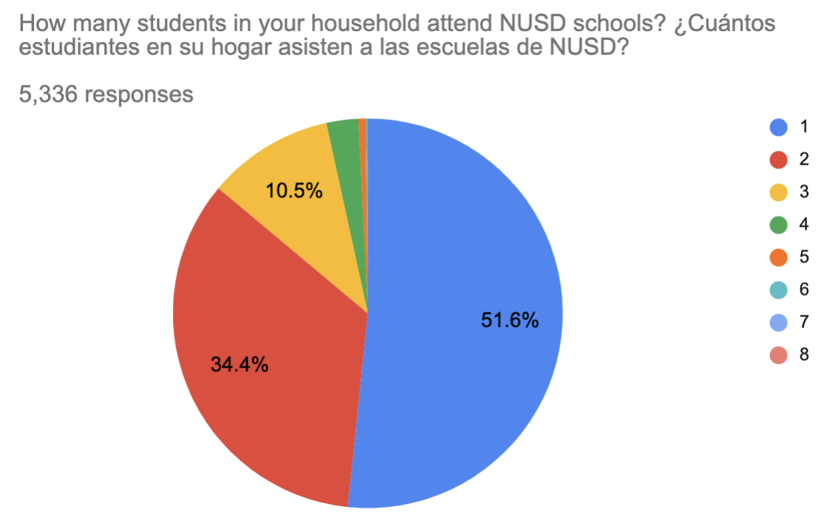
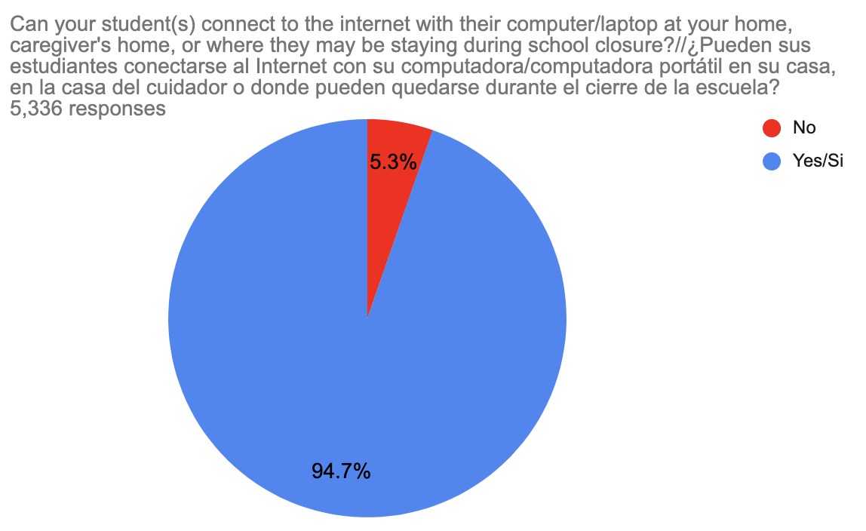
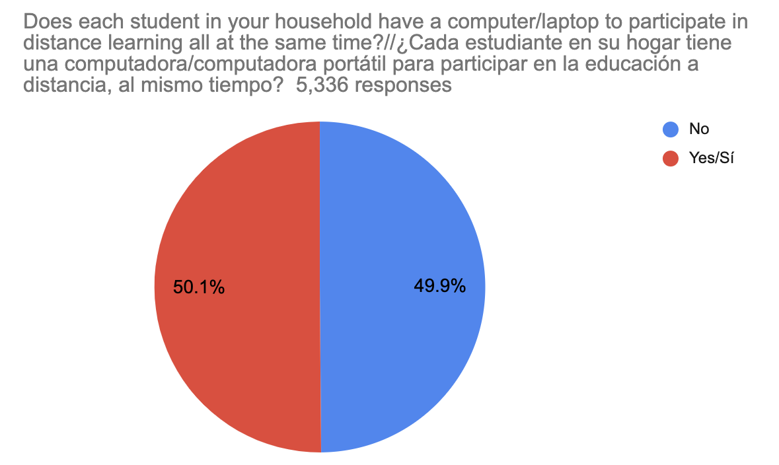
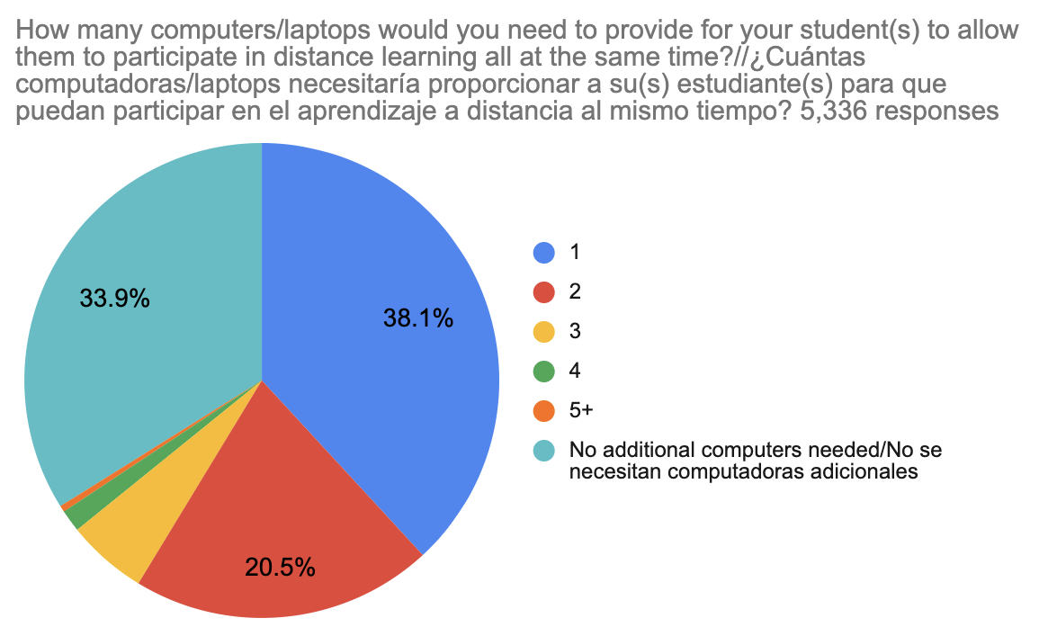
Understanding the Needs that Exist
Technology Survey Results
These 5,336 responses represent over 8,900 students, 80% of student population
How many students in your household attend NUSD schools?
Can you student(s) access the internet from where they are staying?
Does each student have a computer/laptop to participate simultaneously in DL?
How many Chromebooks do you need for your student(s) to work simultaneously?
Notes:
Equity is critical for distance learning to be successful. Before we could roll out a distance learning platform, we needed to understand our community needs for technology and internet connection. We sent out a technology survey and 77% of our families responded. Since March 30, we have distributed nearly 6000 computers and 210 hotspots to students and staff.
Distributing the computers was a huge process. We had 12000 chromebooks at the school sites. They all needed to be cleaned, the district network needed to be disabled so wifi would work off our property and we had to make sure they all functioned properly. In addition, we had to locate, order and have shipped the estimated number of chromebooks we would need to ensure each student had access to a computer at home.

Slide 46
Understanding the Needs that Exist
Students with IEPs (1of 2)
https://sites.google.com/natomasunified.org/distance-learning/home
Goal: All students will have an Amendment and will receive virtual learning to the extent feasible.
Know end goal - clearly communicate and stay consistent with messaging
Hold multiple meetings and scaffold support
Give permission:
We are not going to be able to do everything, but we will do what we can to the best of our ability.
We are not at the same place with technology or ability to instruct virtually. Identify what we can do as a team that speaks to individual strengths and serves students.
This is not a “gotcha”- hold harmless, no one is an expert.
Notes:
NUSD’s commitment to equity and services to special education students required us to develop an end goal- all students will have amendments and will receive virtual services to the extent feasible.
We recognized that this was a huge undertaking- over 1600 amendment IEPs in two weeks, while working with staff and parents to understand the why and the how of DL for special education.
We over communicated. We gave permissions for staff to try and fail and try again. We built teams. We stressed the need for home-school collaboration, especially for students with moderate to severe disabilities.

Slide 47
Understanding the Needs that Exist
Students with IEPs (2of 2)
Goal: All students will have an Amendment and will receive virtual learning to the extent feasible.
Minimize regression of skills through home-school collaborative efforts.
Plan now for next steps - Extended School Year, and the fall...develop a plan for students who lose ground...convey the message that we are in this together and we haven’t lost sight of your student.
https://sites.google.com/natomasunified.org/distance-learning/home
Notes:
NUSD’s commitment to equity and services to special education students required us to develop an end goal- all students will have amendments and will receive virtual services to the extent feasible.
We recognized that this was a huge undertaking- over 1600 amendment IEPs in two weeks, while working with staff and parents to understand the why and the how of DL for special education.
We over communicated. We gave permissions for staff to try and fail and try again. We built teams. We stressed the need for home-school collaboration, especially for students with moderate to severe disabilities.

Slide 48
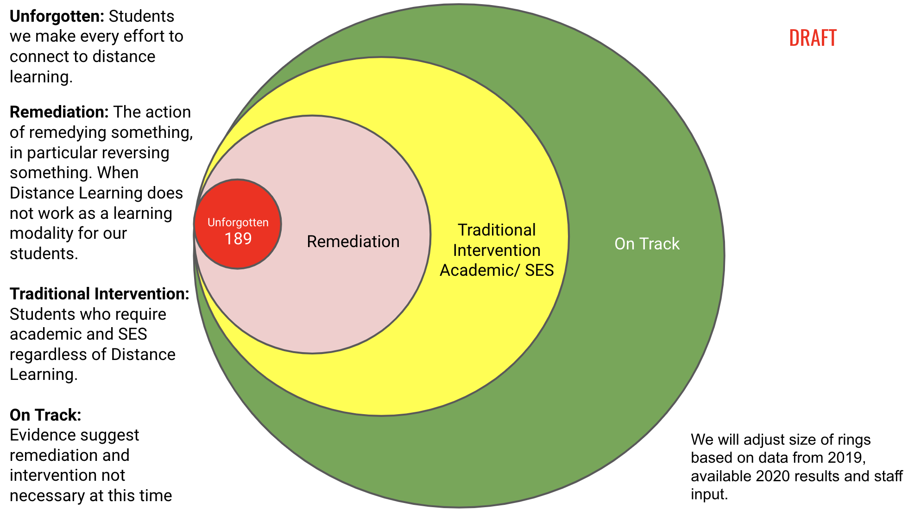
The Unforgotten Students
Who responded to the tech survey?
Who received Chromebook and/or hotspot?
Who had engaged with at least one teacher or site staff?
Whatever is left =
The Unforgotten Students*
*as of 4/7/20=
121 students districtwide
Long description
121
Notes:
Once we got feedback from our families, we had to figure out who was still not engaged in any fashion. We had a fairly straightforward list from the survey responses, and from checking out devices to families. But that still left a few thousand students who we were not sure were connected to school. The sites led the initiative to work with teachers to identify every student that had at least connected with the site, be it through the front office, or by already engaging with teachers during the pilot period of distance learning. This is allowing us to really focus on those last few hundred students that we haven’t forgotten by any means, but we are not sure what they need. Maybe they moved into another household out of the area during this time, and we just don’t know that yet. As a first step in supporting our students through distance learning, we need to find them.

Slide 49
Utilizing Existing Resources

Slide 50
Utilizing Existing Resources
We had existing resources that allowed us to move forward:
All teachers have MacBooks (and iPads if they want)
2:1 ratio of teachers to Chromebook carts
Google Suite usage for 5 years
Online curriculum for core textbooks
Online alternative curriculum for moderate-severe students
Other site-specific online curricular resources
Notes:
Part of the agreement with our labor partner was that teachers would only have to use existing resources- they would not have to learn a new platform while trying to launch distance learning. We are very fortunate that for several years, all of our teachers have had macbooks and some have Ipads as well, so we didn’t have to focus on training to use those devices. A few of our sites are 1:1 with chromebooks, but we have a 2:1 ratio overall of teachers to chromebook carts throughout the district. We use Google Suite already, and a great deal of our core and alternative curriculum is already online for student use.

Slide 51
Utilizing Existing Resources (1 of 2)
Before teachers began prepping for distance learning lessons, we provided a list of resources on our website for families to begin using if they desired: https://natomasunified.org/coronavirus/free-online-enrichment-resources/
Then focused the attention to online programs that students are familiar using or have Single Sign-On access to:
(Image on slide 53)
https://docs.google.com/document/d/14q41YvROWAzh2FdWD6aHnJY7lY97cd17PgGD3LTeNbs/edit?usp=sharing
Notes:
In addition, our teams created links on the website to engagement resources by grade level and subject, including special education and related services, and we included, by site, the Splash Page you see here- this is what the student and teacher will see if they click on the links for their school, which we will show you on the next page. These are our online curriculum and engagement materials in an easy to access format. Last, the same multidisciplinary team developed the ABCs of Distance Learning- a one stop for all information teachers and parents may need to access academic engagement and enrichment activities, to communication regarding COVID 19, all the way to the importance of structure and awareness of social emotional needs during isolation.

Slide 52
Utilizing Existing Resources (2 of 2)
Multi-disciplinary team compiled resources in The ABCs of Distance Learning for engagement ideas for teachers & families
Includes all core subjects
Social-emotional learning
Motor, sensory, speech and language
Lifeskills
Fun family activities
Notes:
In addition, our teams created links on the website to engagement resources by grade level and subject, including special education and related services, and we included, by site, the Splash Page you see here- this is what the student and teacher will see if they click on the links for their school, which we will show you on the next page. These are our online curriculum and engagement materials in an easy to access format. Last, the same multidisciplinary team developed the ABCs of Distance Learning- a one stop for all information teachers and parents may need to access academic engagement and enrichment activities, to communication regarding COVID 19, all the way to the importance of structure and awareness of social emotional needs during isolation.

Slide 53
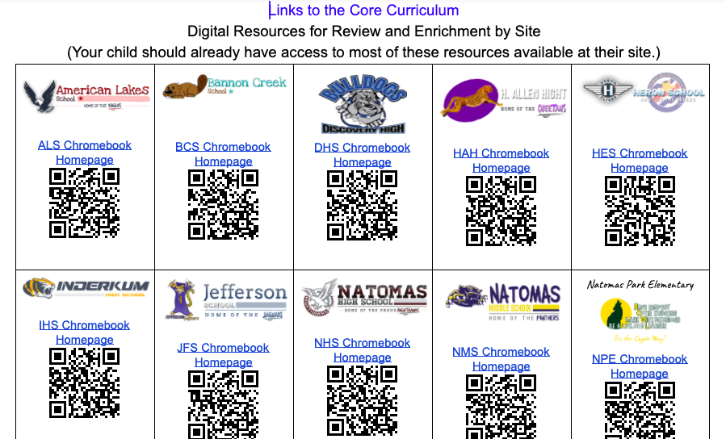
Links to Online Programs
for Each Site
Notes:
To help our teachers and students with easy access, our teams worked together to create quick links, such as this digital link to core and enrichment activities. Students are used to accessing programs on Chromebooks at school, so we worked on ways to make sure students could access these same programs no matter what device they might be using from home.

Slide 54
Orientation, Training & Piloting

Slide 55
Orientation, Training & Piloting Continued
Disbursing teams to work virtually
Teacher orientation for how to use existing resources and strategies to engage with students in distance learning
Student & Family orientation for how to engage in distance learning from home
Special Education orientation with teachers, classified staff, parents and the Community Advisory Committee on how NUSD was going to to meet the needs of students in special education
Getting devices to families before distance learning officially begins
Creating a virtual office for family and staff support
Notes:
Once we had our agreements, we dispersed teams to worked virtually. We set up teacher orientations, family and student orientations and special education orientations. We pushed these out virtually, added them to our website and used social media and Superintendent communications to inform the public that they were available. In addition, we surveyed parents regarding their household technology access and we continue to work to make sure students all had the appropriate technology to access distance learning. Finally, we created a virtual school office as well as a virtual district office so we are open and available to our staff and families.

Slide 56
Piloting Distance Learning
A part of our roll-out has been the concept of “piloting” distance learning while we distribute technology and support teachers with getting set up with digital platforms, resources and websites.
We KNOW there will be bumps and glitches, and this gives us an opportunity to work out many of those issues prior to the formal launch.
Notes:
As part of our roll-out we are piloting distance learning. This allows us to work out technology issues, provide parent support, and address any glitches with instruction or materials. Also, with state testing and end of year field trips and activities being suspended, we believe that students will be engaged in instruction for roughly the equivalent amount of time, even considering utilizing pilot weeks. We explained this timeline to our families with the “why”.

Slide 57
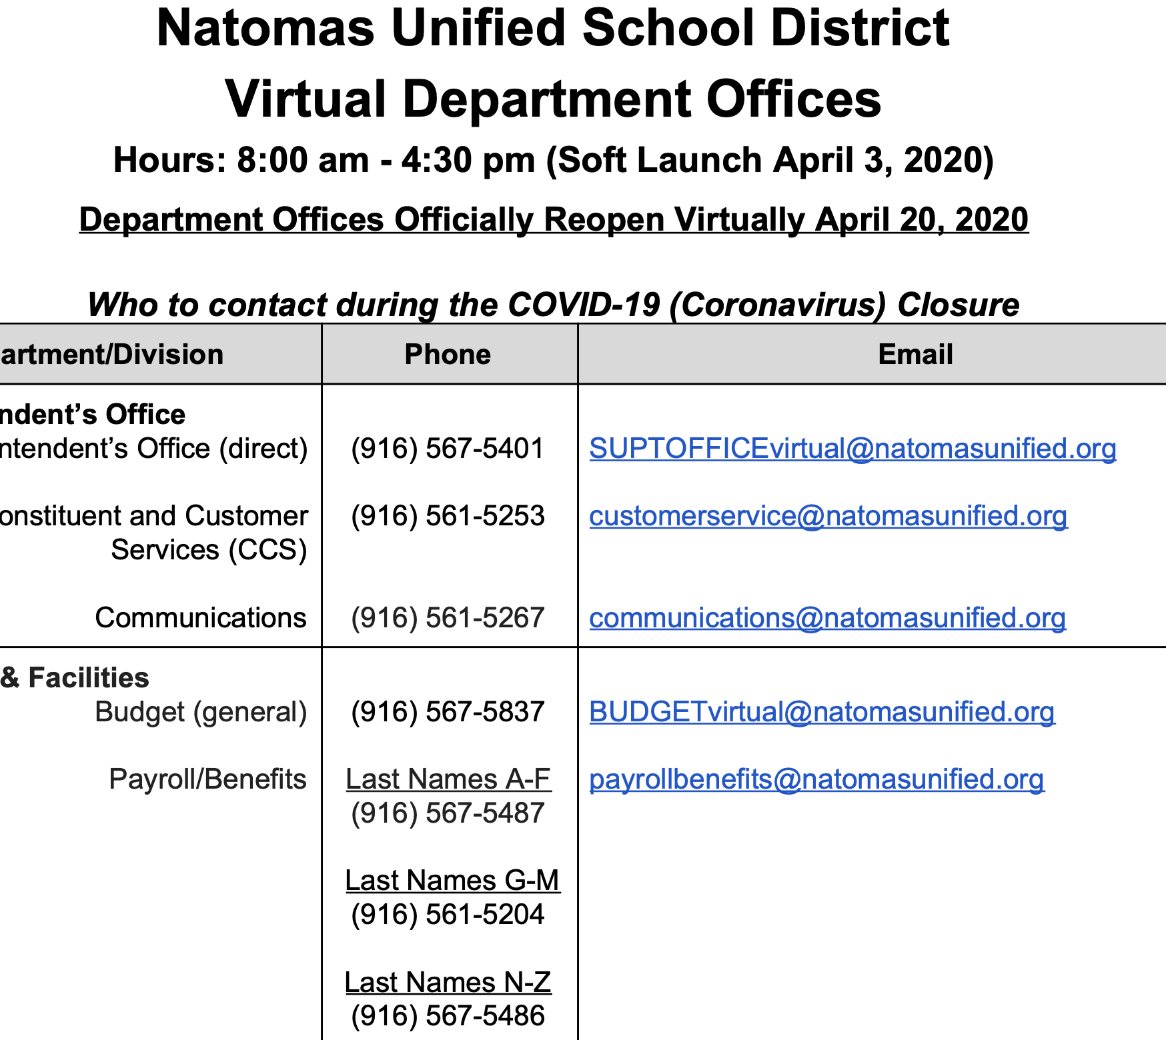
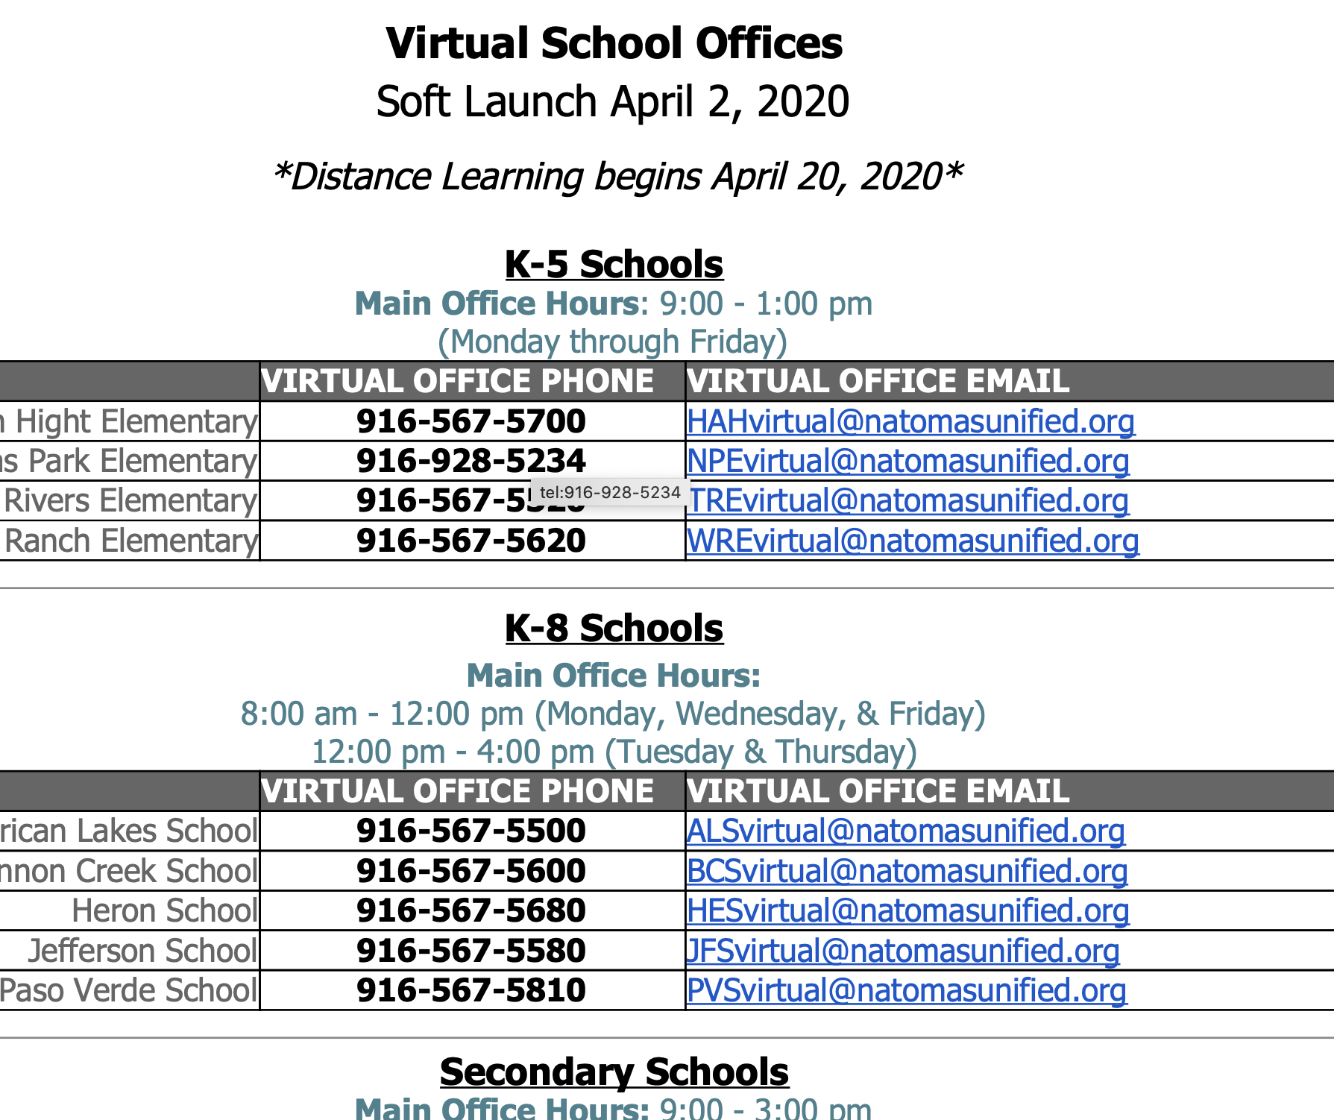
Piloting Virtual Offices
Virtual Offices - Starting with a “Soft Launch”
Notes:
These are just examples of how we have communicated to staff, parents and students how they can access the virtual offices. This information is also posted in English and Spanish for families at each of the schools’ websites.

Slide 58
Teacher Orientation (1 of 7)
SAMPLE CONTENT
Notes:
We are sharing sample content. The Distance Learning Teacher Orientation is a live document that was pushed out to teacher so they can add ideas- similar to teachers helping teachers. This document started as Version 1.0, but it has been so successful in gathering teacher ideas, that it is now Version 2.0.

Slide 59
Teacher Orientation (2 of 7)
SAMPLE CONTENT
Notes:
Sample content- sharing importance of equity, common language and technology support

Slide 60
Teacher Orientation (3 of 7)
SAMPLE CONTENT
Notes:
Samples of issues of importance and common questions regarding student privacy, internet safety tips and lesson planning.

Slide 61
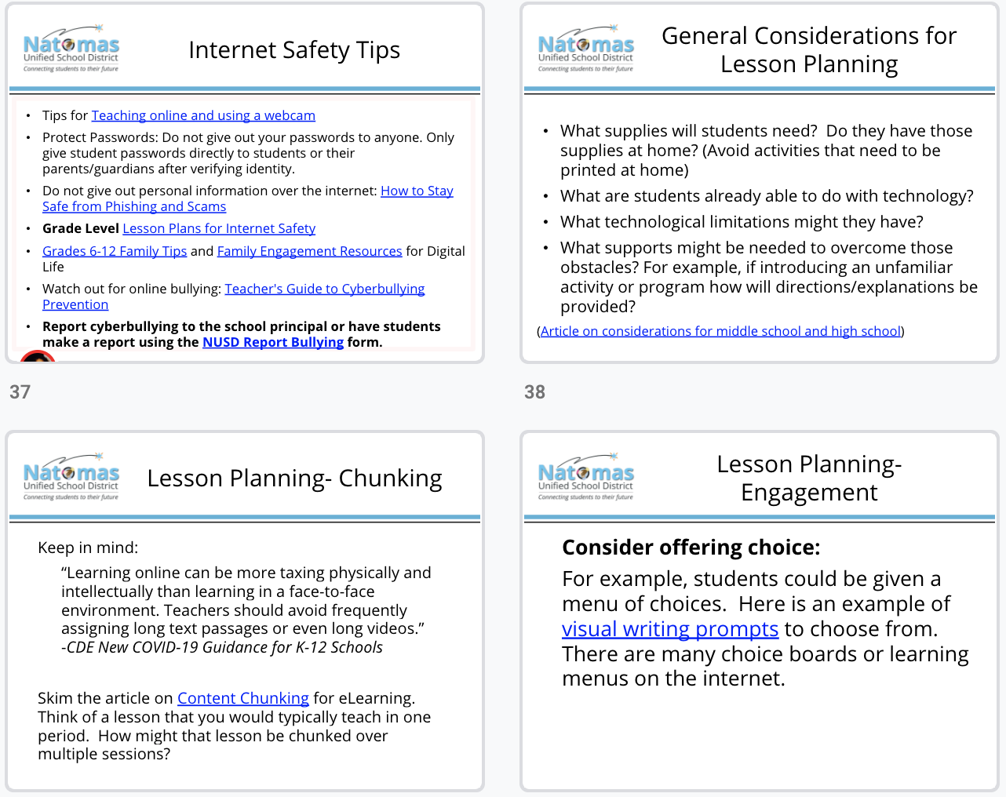
Samples of issues of importance and common questions
SAMPLE CONTENT
Notes:
Samples of issues of importance and common questions regarding student privacy, internet safety tips and lesson planning.

Slide 62
Teacher Orientation (5 of 7)
SAMPLE CONTENT
Notes:
Sample content regarding Version 2.0, including samples of questions that have asked and answered in the document, such as how to assign Wonders material and directions on how to find student information in our student information system.

Slide 63
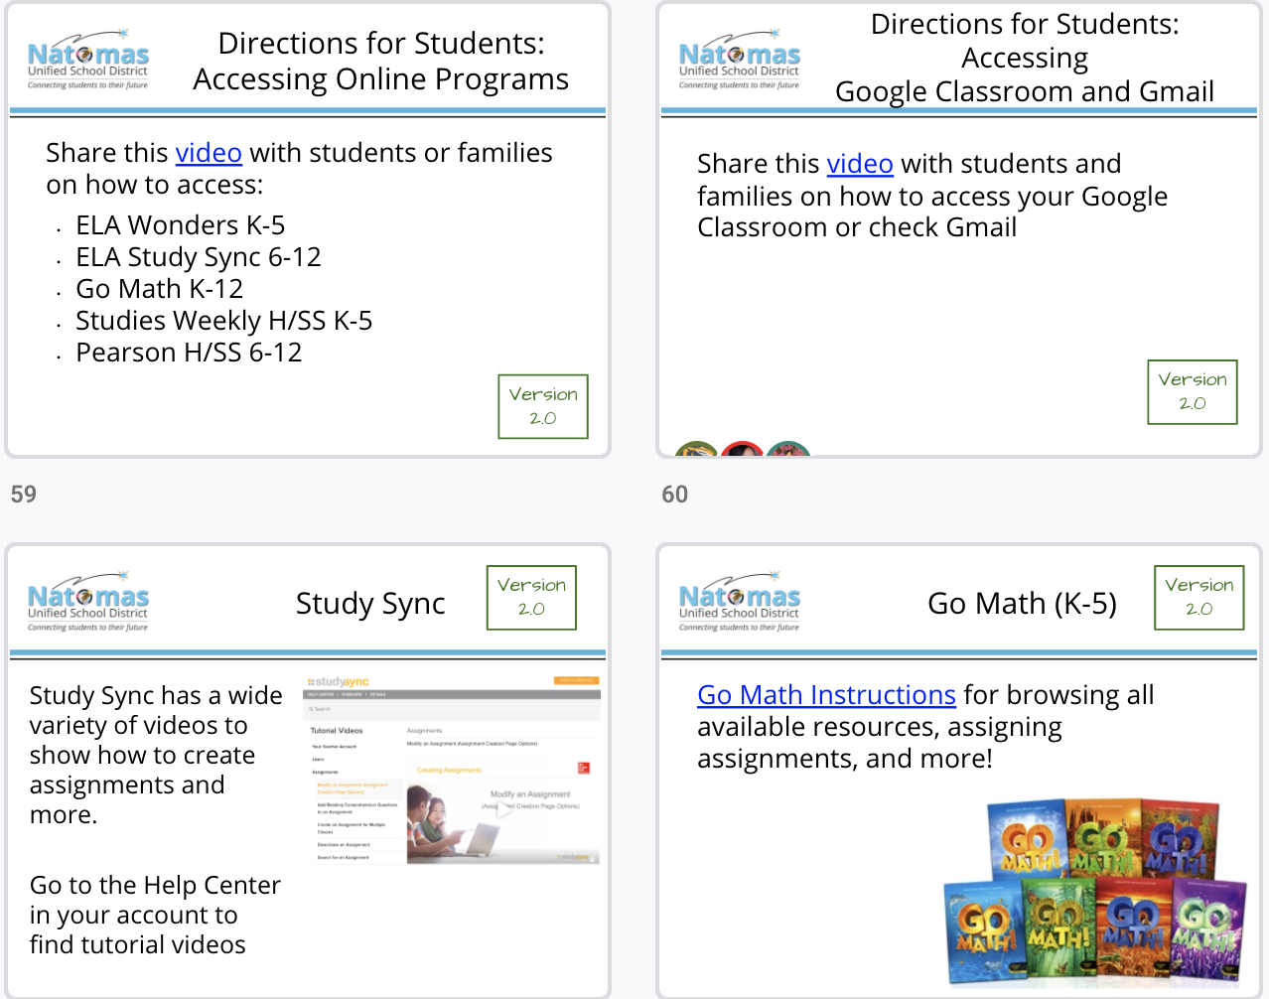
Teacher Orientation (6 of 7)
SAMPLE CONTENT
Notes:
Sample content from Version 2.0- again support for curriculum access and use, not only for the teachers to use for themselves, but as something for them to have readily available if they are asked for support from families.

Slide 64
Teacher Orientation (7 of 7)
SAMPLE CONTENT
Notes:
More samples from Version 2.0- sharing ideas about maintaining relationships, hotlines for support and how to check in with students during school closure

Slide 65
Student & Family Orientation (1 of 5)
Student & Family Orientation
https://natomasunified.org/coronavirus/covid-19-resources/
Notes:
Communicating with our families and community is critical. In addition to our Constituent and Customer Service, our biweekly communication through social media, our superintendent messaging, our website and our site and teacher communications, we have pushed out distance learning videos in English and in Spanish.

Slide 66
Student & Family Orientation (2 of 5)
SAMPLE CONTENT
Notes:
We wanted to provide some tips and strategies to parents to support their students at home. Including the importance of a daily schedule

Slide 67
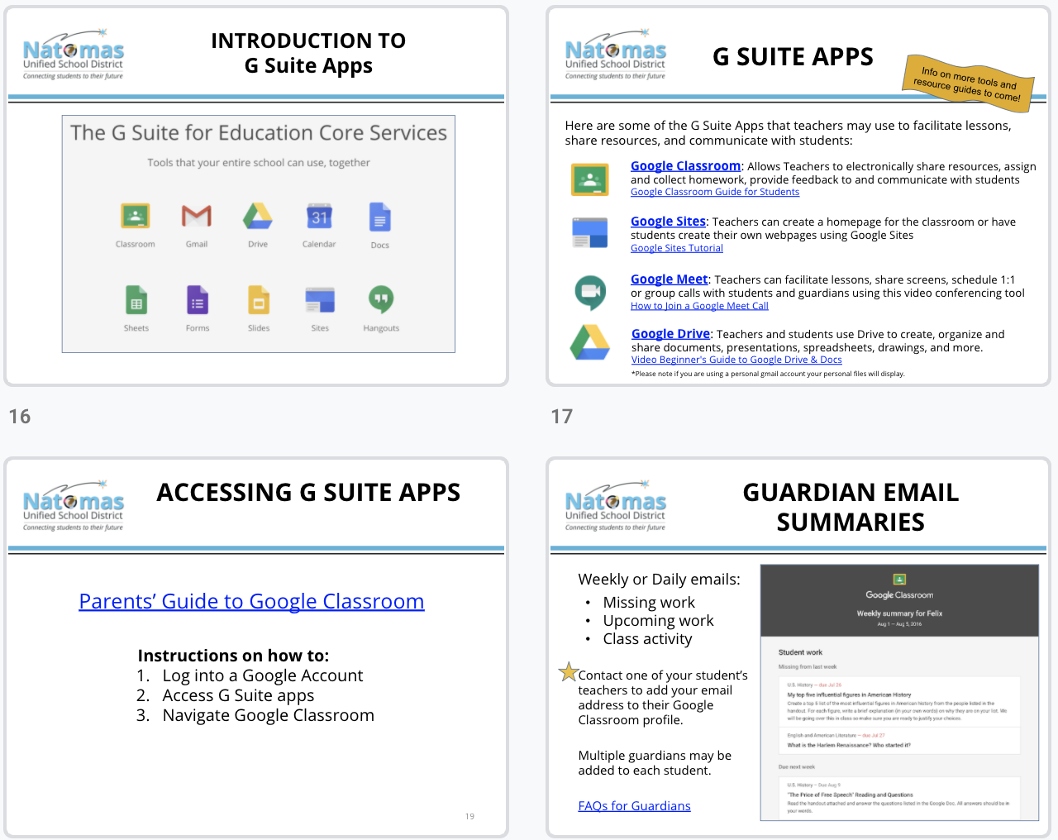
Student & Family Orientation (3 of 5)
SAMPLE CONTENT
Notes:
Sample content includes how-to on technology, as well as information on email

Slide 68
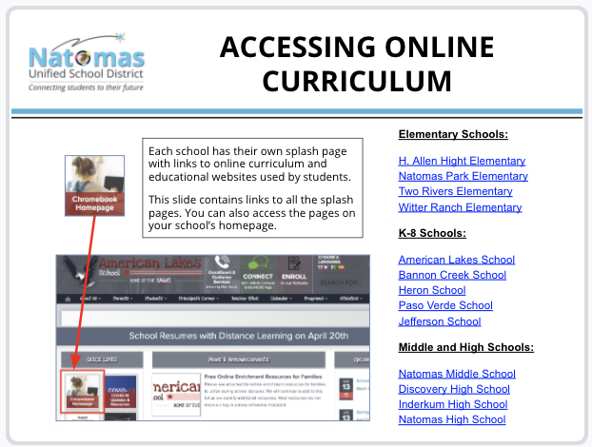
Student & Family Orientation (4 of 5)
SAMPLE CONTENT
Notes:
We spent time teaching about Google Classroom, Zoom and how to access curriculum online

Slide 69
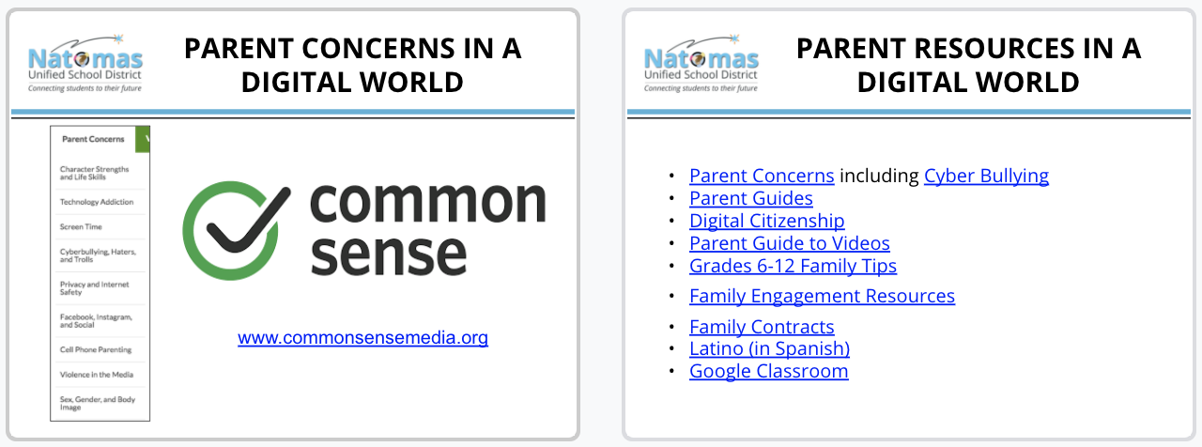
Student & Family Orientation (5 of 5)
SAMPLE CONTENT
Notes:
Last, we provided another reminder regarding Social Emotional supports, and addressed parent concerns regarding the digital world

Slide 70
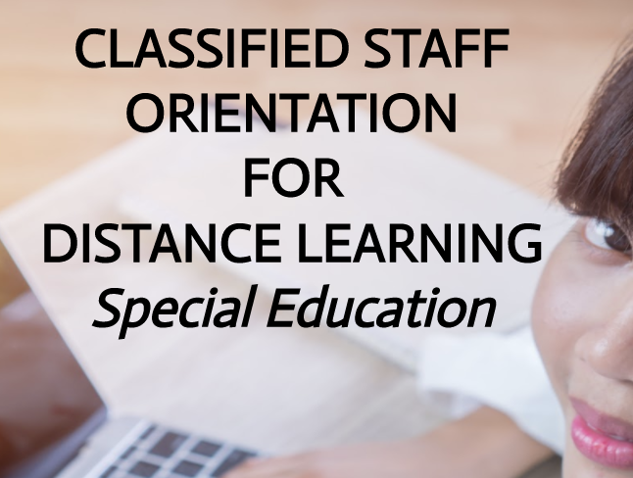
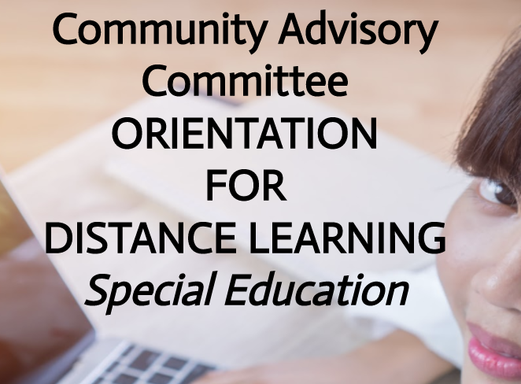
Special Education Orientation
Push out orientation communication
Provide ongoing, clear, consistent communication
Clearly define roles of all staff and community partners
Support staff and parents with the WHY-
Involve CAC
Website
ppt videos
Biweekly messaging
Amendment template
Amendment Language
Prior Written Notice language
Goal: All students will have an Amendment and will receive virtual learning to the extent feasible.
Notes:
We cannot stress enough the importance of clear, consistent, collaborative communication. This is critical, regardless of the department, to making distance learning work and be successful. In special education we started by providing consistent messaging through our orientations to all teachers, all classified staff, parents in English and Spanish, and to the Community Advisory Committee- where we asked them to approve our Special Education Distance Learning plan. We shared these orientation videos through our student information system, social media, the superintendent messaging, the CAC and we posted them on our website.
Since March 16, our team of 8 has held no fewer than 200 zoom meetings with staff and the community. We provide targeted support wherever it is needed.

Slide 71
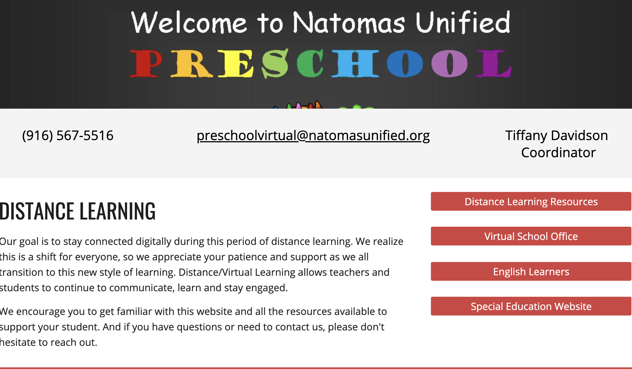
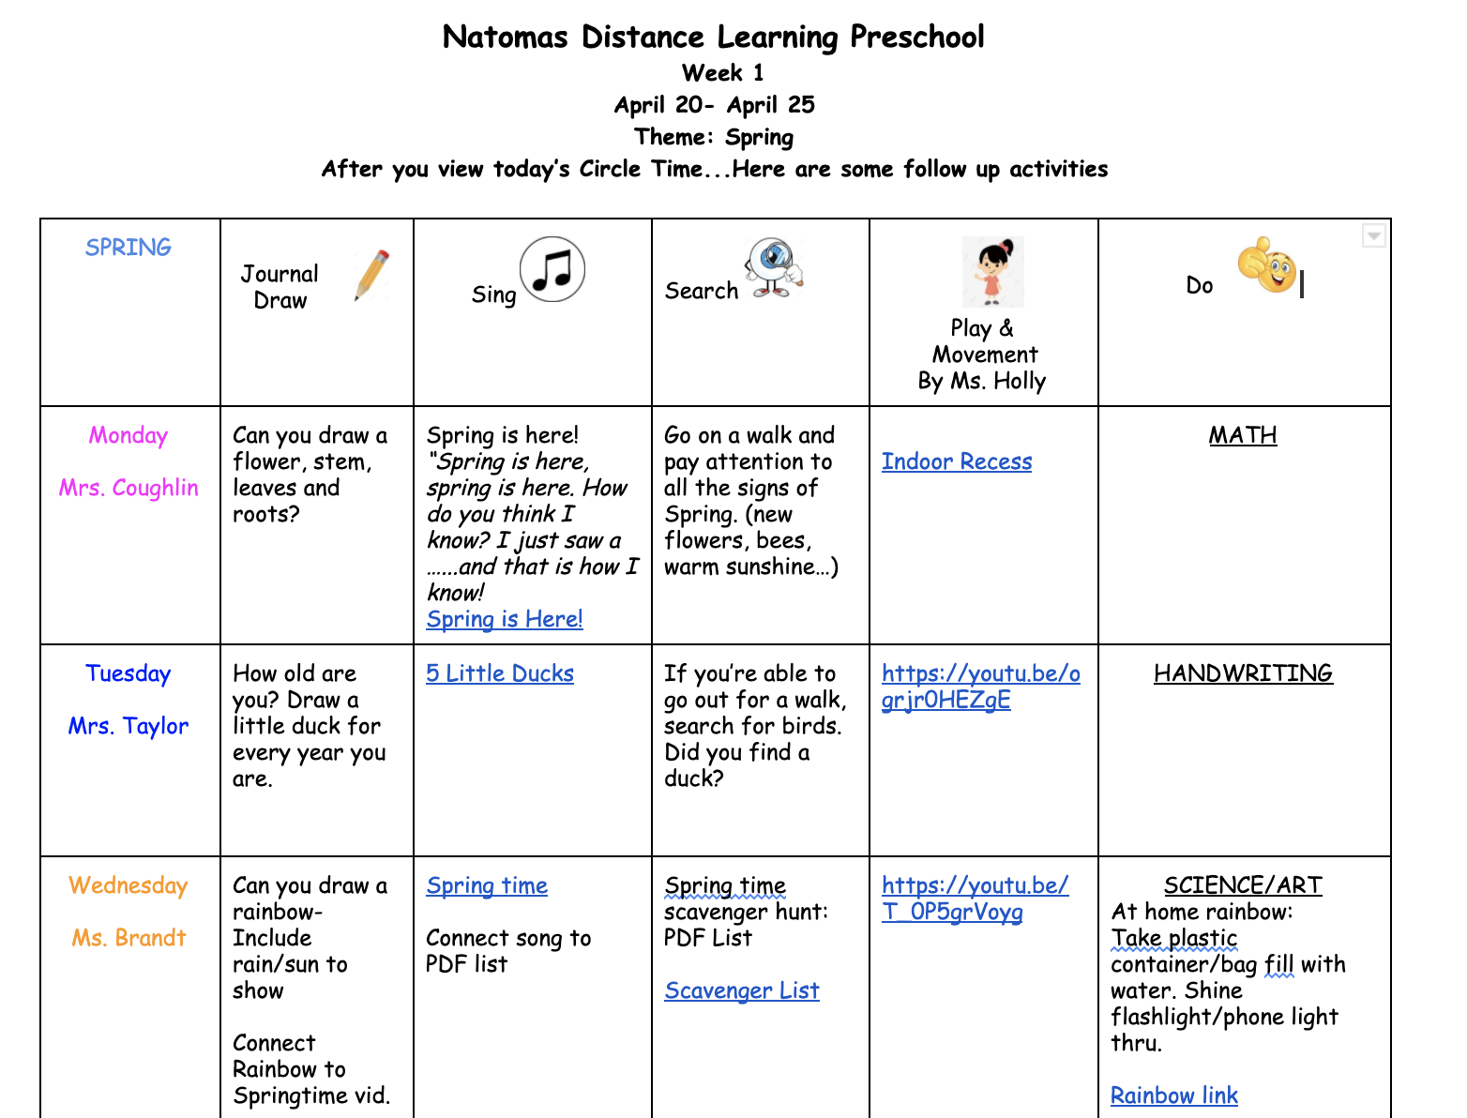
Supporting Preschool Families
Notes:
In Natomas we have twelve First Five preschool classes at six school sites. In addition, we have five preschool classrooms for students with moderate to severe disabilities at three of the six sites. We serve walk on prek speech and language at two sites and in our First Five preschool classrooms.
In order to develop a distance learning plan for typically developing students as young as 4, and students with moderate to severe disabilities as young as 3, general education and special education staff worked together to develop a daily activity matrix as well as our own YouTube channel for circle time, music, differentiated enrichment, and speech and language communication activities. In addition, our occupational and physical therapists will be hosting a motor channel so students can follow along, with the appropriate level of parent support, and continue with their individualized planning. This collaboration allowed the staff to differentiate for the unique needs of this young population. Our team is currently piloting weekly virtual check-ins with families to help provide tips and resources parents may need to support their PreK child during distance learning, as we recognize how challenging this can be.

Slide 72
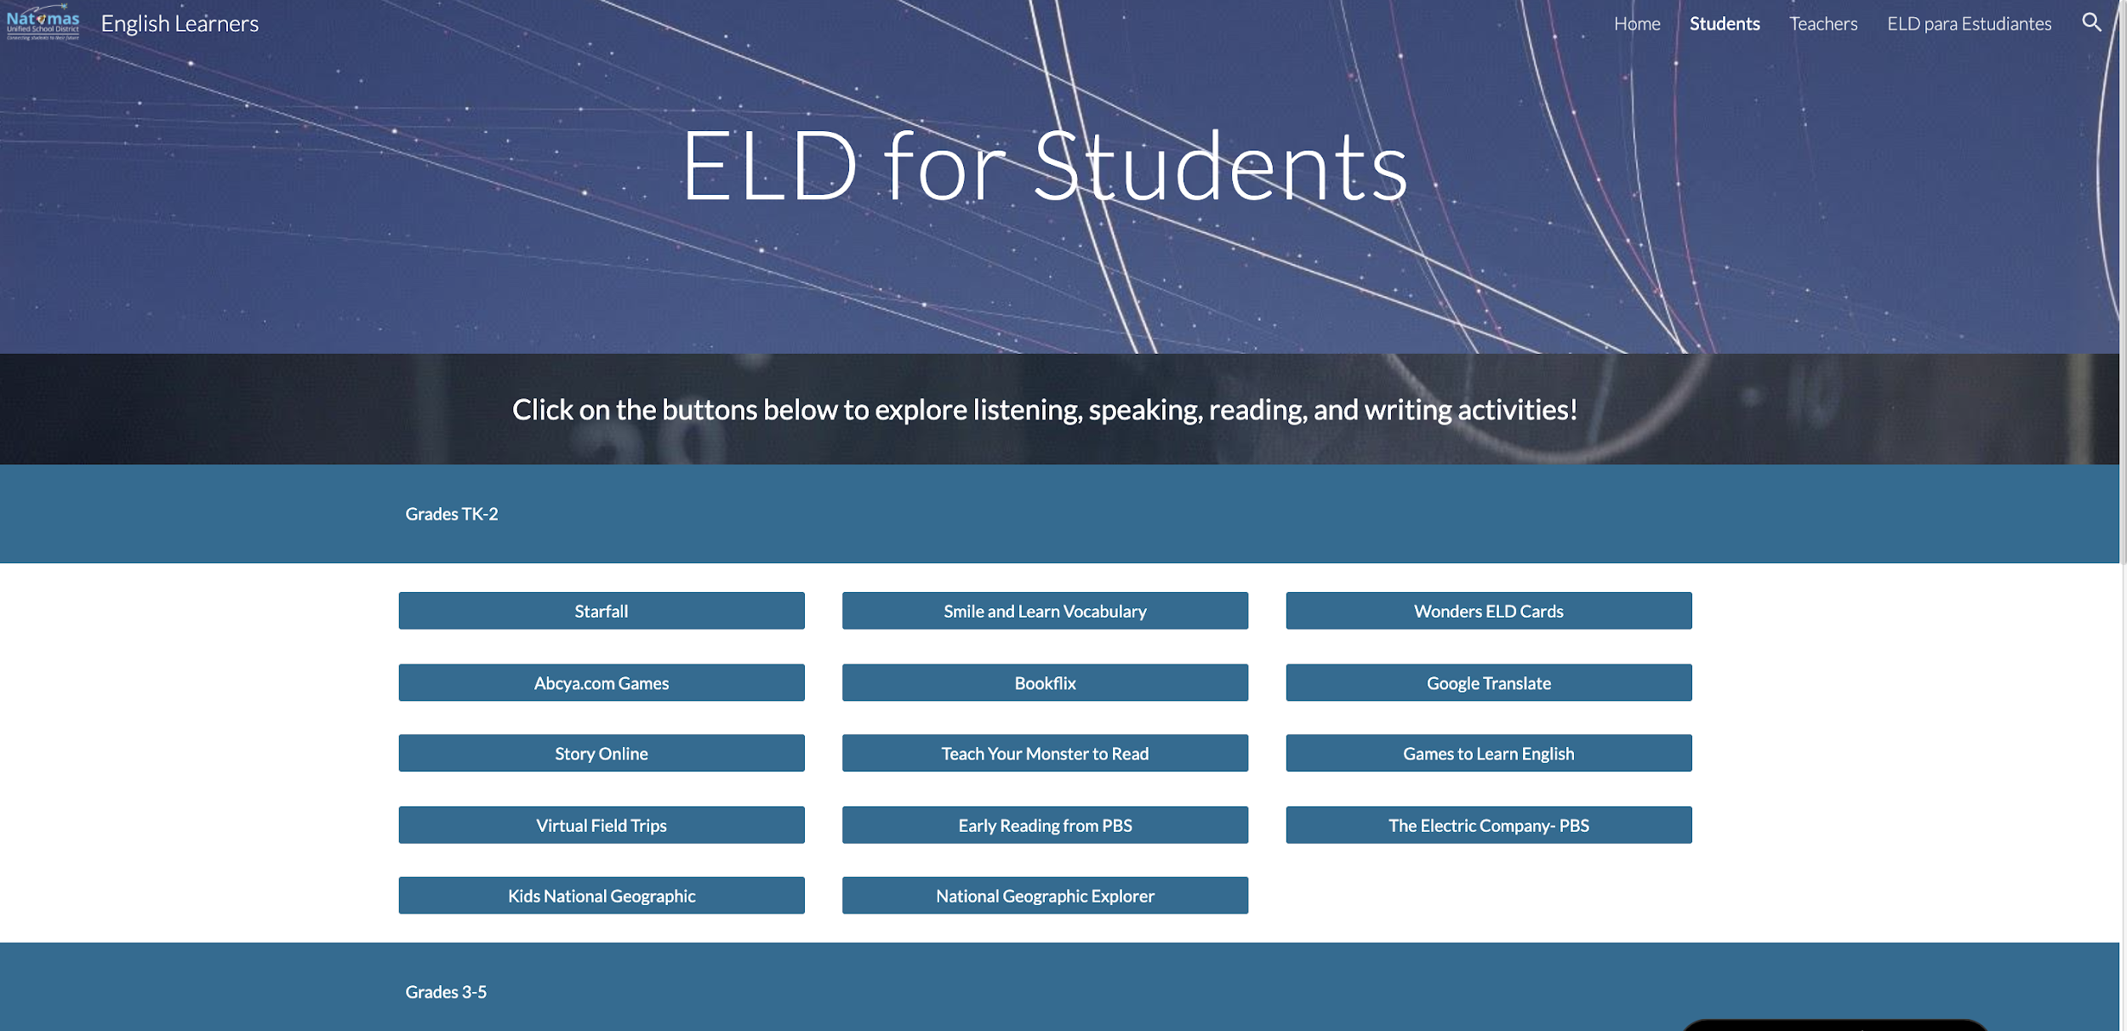
Supports for English Learners
Keep momentum going with ELD instruction
Student page - “click and explore” activities to support language development
Teacher page - links to many resources to incorporate into ELD lessons
Notes:
As teachers balance the learning curve for creating distance learning lessons and thinking about equity, we created an ELD website to help support. The website can be used in couple of ways. 1) Teachers can direct their EL students to the student page where they can click and explore on a variety of activities for language development. 2) Teachers can look at the resources on both the student page and teacher page and utilize the resources into their own language development plans. Many of the resources are from the CDE list of ELD resources. Our ELD TOSAs are also available to connect with students for support. Principals just recently shared this website with teachers and ELD TOSAs have been collaborating with ELD teachers on how best to provide distance learning for ELs.

Slide 73
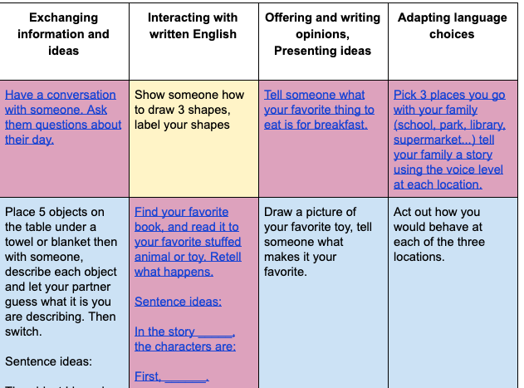
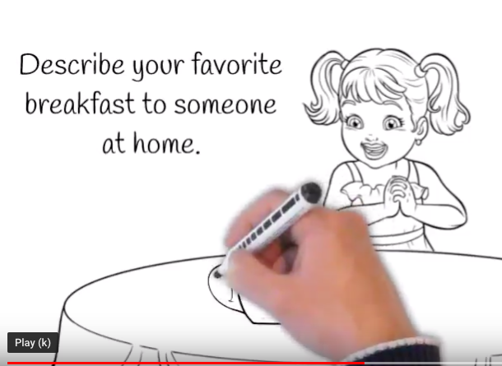
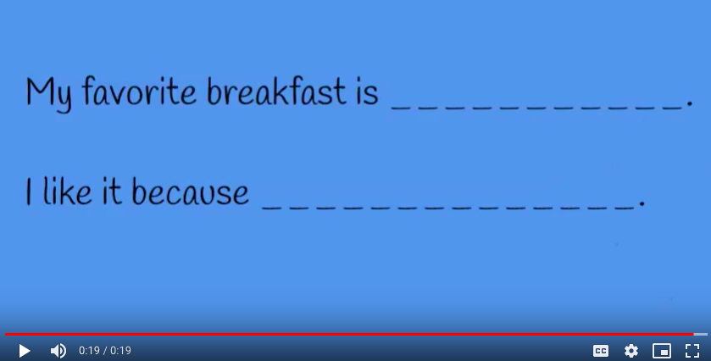
Sample Elementary ELD
Pilot Lessons
“Speaking Menus” for primary students with a accompanying video to help model
Notes:
Regardless of the subject area, we know there will be many reading and writing tasks during distance learning, and possibly some listening activities. The ELD TOSAs are piloting lessons that help promote interaction and speaking, which is a vital part of ELD instruction. They are having some teachers try these out with their students and will get feedback to evaluate the effectiveness of the lessons. The ideas for this speaking menu were inspired by Beaverton School District in Oregon.

Slide 74
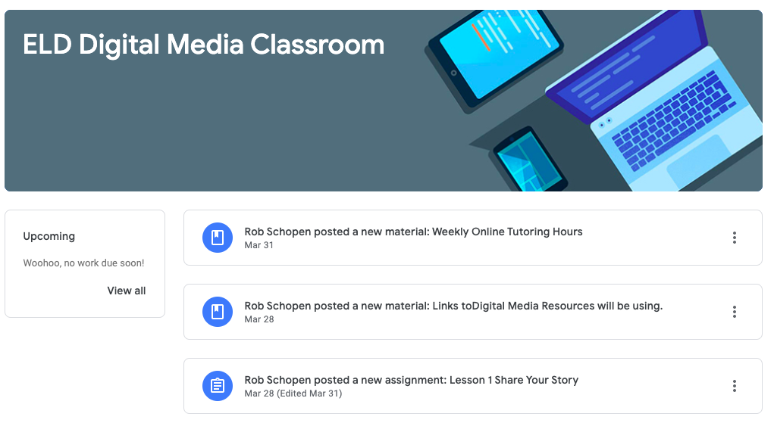
Sample Secondary ELD
Pilot Lessons
Lesson ideas include students creating digital media projects to promote interaction and speaking
Notes:
Students will possibly use Google Slides, Wevideo, Padlet, and Screencastify to continue to develop interaction and speaking. Our ELD TOSA is providing consistent office hours for extra support to EL students if needed.

Slide 75
Finally…

Slide 76
Being Flexible in Our Approach & Learning for the Future
We know that information is constantly developing and it is impacting everyone...families, staff, leaders.
This requires us to be flexible and to understand that each family has a different starting point, which can be magnified with distance learning
Notes:
We know that information is constantly developing and it is impacting everyone...families, staff, leaders.
This requires us to be flexible and to understand that each family has a different starting point, which can be magnified with distance learning.

Slide 77
Contact Information
Angela Herrera, Chief Academic Officer
anherrera@natomasunified.org
Carol Swanson, Associate Superintendent, SELPA
cswanson@natomasunified.org

Slide 78
For questions or to get more information on future webinars, please contact us at: Covid19@cde.ca.gov
For weekly email updates from the California Department of Education on COVID-19, send a blank email to:
join-covid19-update@mlist.cde.ca.gov

Slide 79
Long Description for Slide 48
Unforgotten: Students we make every effort to connect to distance learning
Remediation: The action of remedying something in particular reversing something. When Distance Learning does not work as a learning modality for our students.
Traditional Intervention: Students who require academic and SES regardless of Distance Learning
On Track: Evidence suggest remediation and intervention not necessary at this time.
In the Venn diagram the largest circle represents “On Track”, inside that is a smaller “Traditional Intervention”, inside this is Remediation, and inside that is the representation of 121 “Unforgotten”. RETURN to slide 48

