Slide 1
Tuesday @ 2 School Nutrition
Town Hall
April 22, 2025

Slide 2

Town Hall at a Glance
District Spotlight & Standardized Recipes
Federal & State Updates
Guest Speaker
Operational Reminders
Resources & Other Announcements

Slide 3
District Spotlights

Slide 4
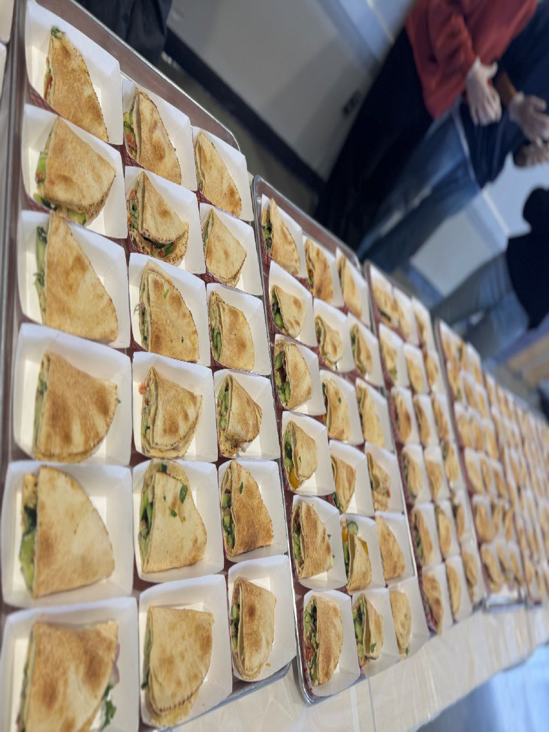
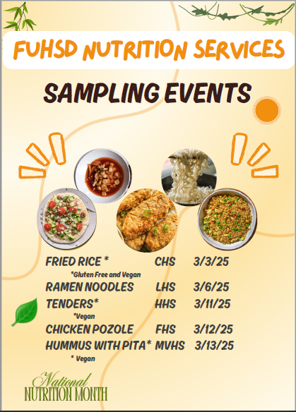
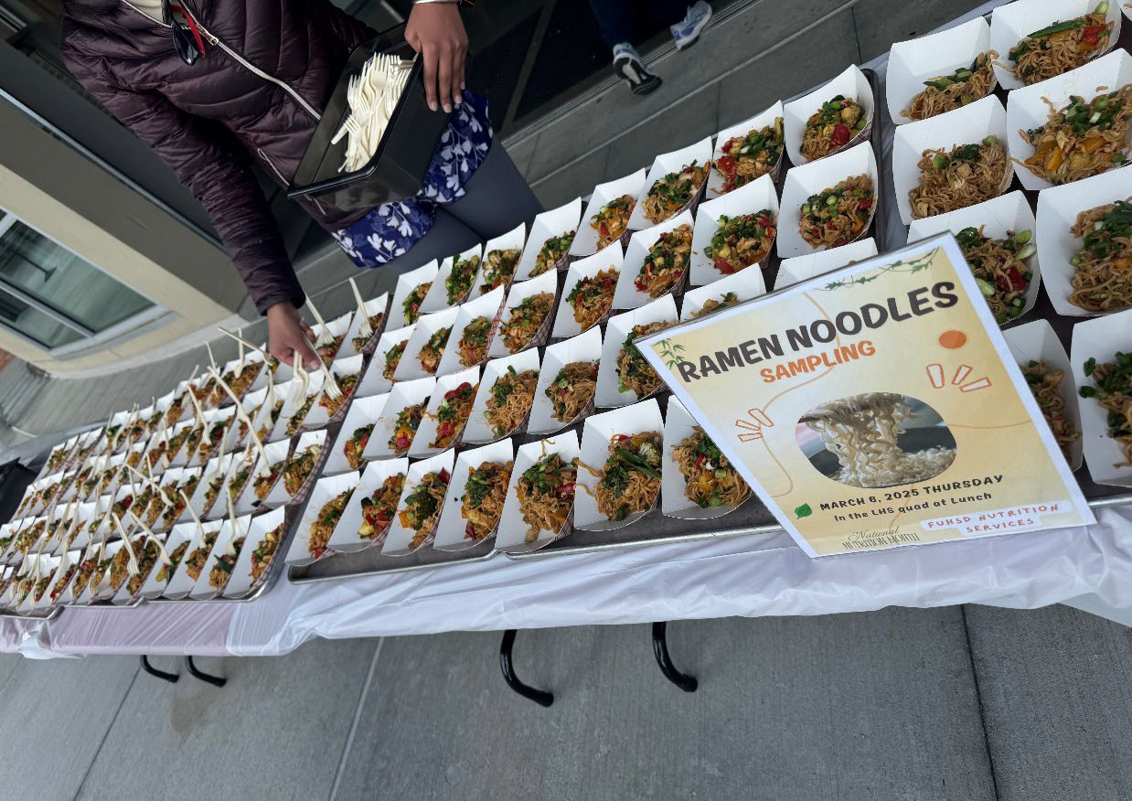
District Spotlight: Fremont Union High School District Celebrates National Nutrition Month
National Nutrition Month Promotional Poster
Ramen Noodles Sampling
Hummus Sampling

Slide 5
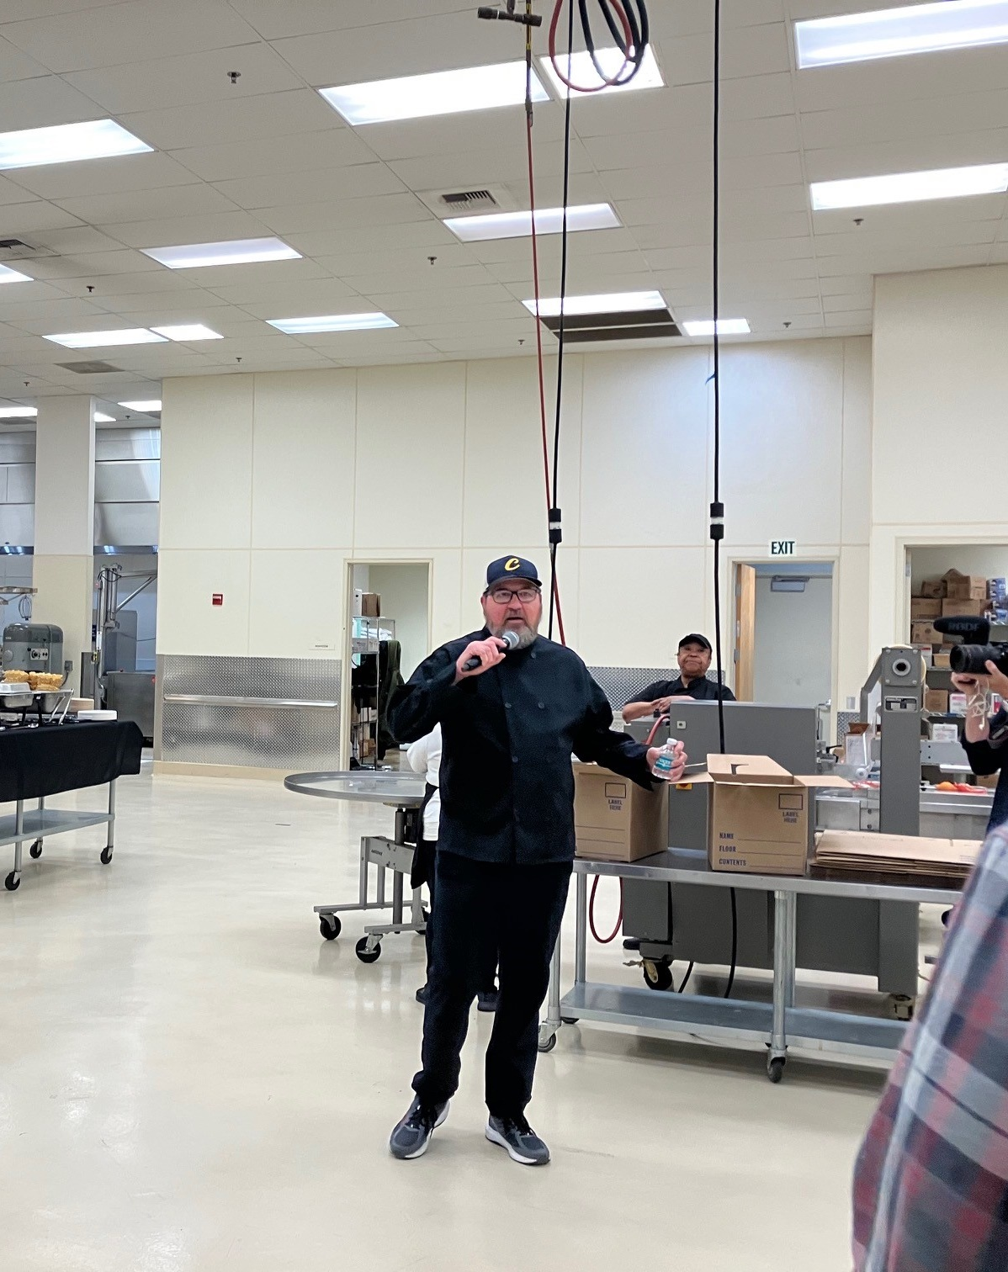
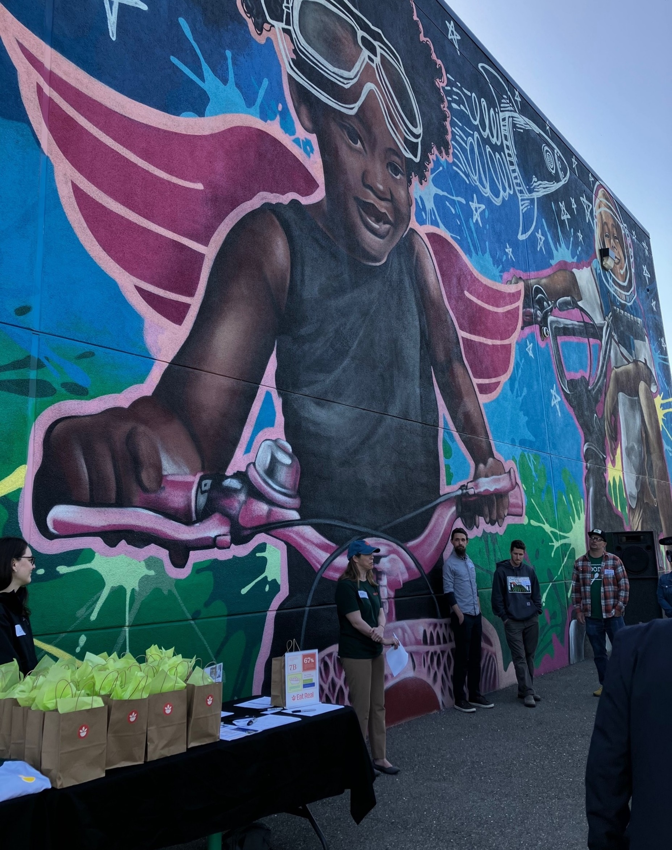
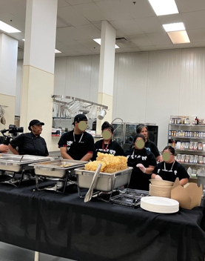
Natomas Unified School District - Eat Real Celebration

Slide 6
Standardized Recipes

Slide 7
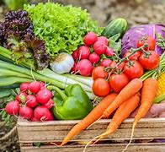
Fresh From California:
Standardized Recipes (1)
California Foods for California Kids and the Center for Ecoliteracy
11 standardized lunch recipes by:
  Monterey Peninsula Unified School District (USD)
  Tahoe Truckee USD
  San Luis Coastal USD
  Santa Ana USD
  Mt Diablo USD
  Orcutt Union School District
  Oxnard Union High School District

Slide 8
Fresh From California:
Standardized Recipes (2)
Featured quotes from additional districts
More at https://www.californiafoodforcaliforniakids.org/fresh-from-ca

Slide 9
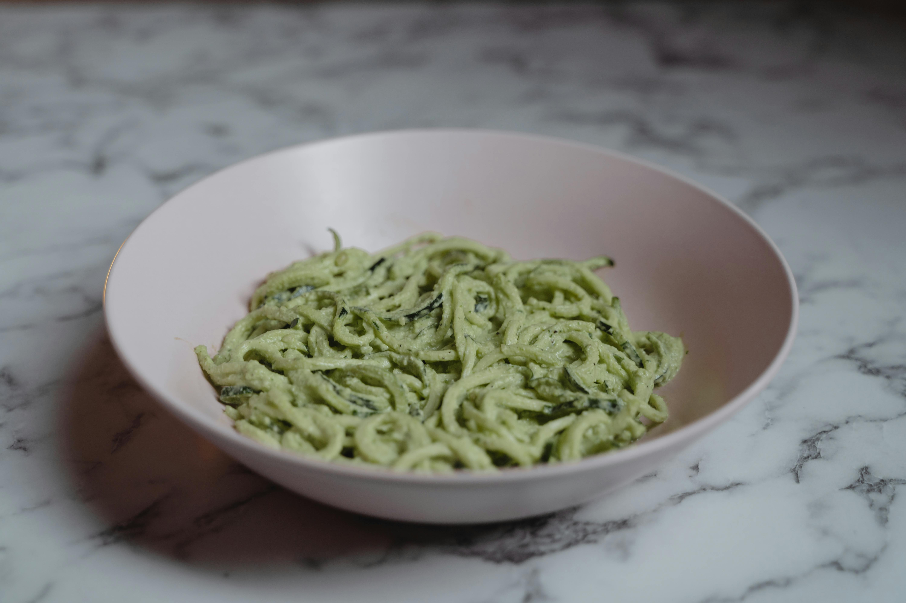
Spinach Basil Pesto
Monterey Peninsula USD
This pesto dish features fresh spinach, basil, parmesan cheese, lemon juice, garlic, and spices.
Add this pesto to your favorite whole grain pasta or sandwich.

Slide 10
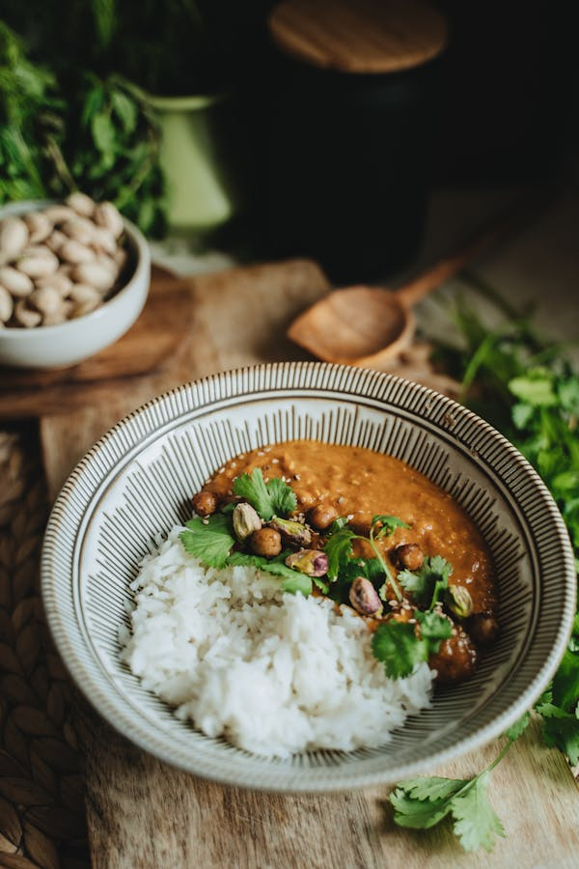
Chana Masala with Chutney
Mt. Diablo USD
The Chana Masala recipe features chopped onions, garlic, and ginger, garam masala, turmeric, cumin, coriander, diced tomatoes, marinara, and garbanzo beans served over Hourani with white rice.

Slide 11
Federal Updates

Slide 12
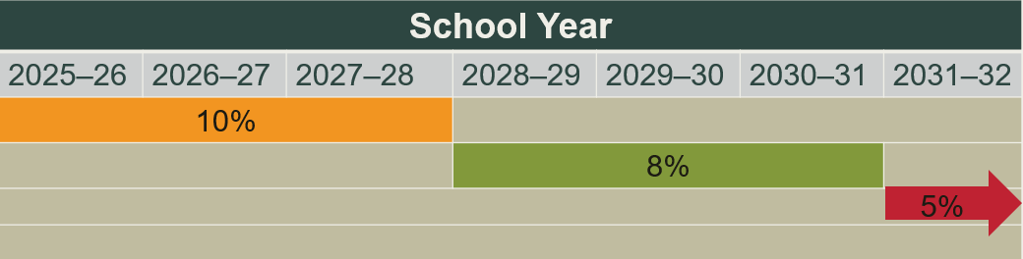
Buy American New Threshold
Non-domestic food purchases cannot exceed 10% of total food purchases.
Exceptions must be counted towards the 10% cap of non-domestic purchases.

Slide 13
Buy American Accommodation Process
U.S. Department of Agriculture (USDA) Policy Memorandum SP-09-2025 authorizes the California Department of Education (CDE) to grant temporary accommodations.
If approved, program operators in School Year (SY) 2025–26 may exceed the 10% cap when:
    The product is on the Federal Acquisition Regulation (FAR) Nonavailable Articles List or is not available in sufficient quantity or quality in the U.S.
    Competitive bids reveal a domestic product’s cost is significantly higher than a non-domestic product.

Slide 14
Buy American Accommodation Request
Accommodation request:
  Submission: Use the link in the Buy American Accommodation Plan for School Year (SY) 2025–26 listserv.
  Timeline: Requests may be submitted until June 30, 2026. Accommodations apply from the date of approval forward.
  Rolling Basis: Apply as soon as you anticipate exceeding the non-domestic purchase limit.
Refer to USDA Policy Memorandum SP 09-2025 for more details.
For questions, email NSDBuyAmericanProvision@cde.ca.gov.

Slide 15
Buy American Applicability
Items received through USDA Foods are not included in total food purchases.
Buy American requirements do not apply to the Fresh Fruit and Vegetable Program.

Slide 16
Nondiscrimination Statement Update
The USDA has updated the long version of the nondiscrimination statement (NDS).
Update all Child Nutrition Program materials that include the long version of the NDS, such as web pages and notification letters.
Continue to use the 2019 And Justice for All poster because updated posters have not been made available yet.
The new NDS is available on the CDE USDA NDS web page at https://www.cde.ca.gov/ls/nu/cr/crfactsheet.asp.

Slide 17
State Updates

Slide 18
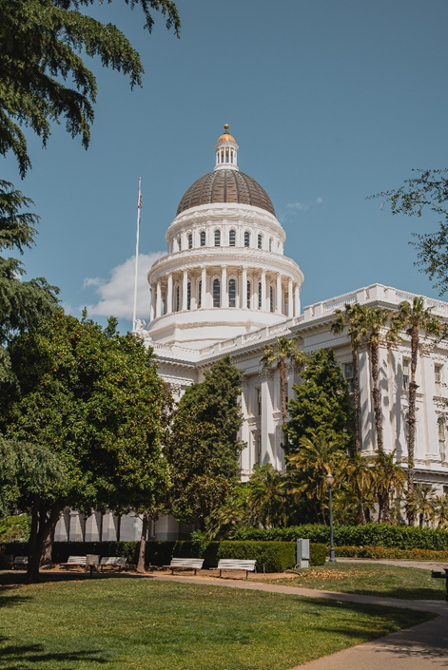
May Budget Revise
State law requires the Governor to revise their proposed budget for the upcoming fiscal year by May 14.

Slide 19
Bills CDE is Following (1)
Proposed Senate Bills (SB):
SB 225 (McNerney) School nutrition: guardian meal reimbursement
SB 341 (Perez) Instructional School Gardens Program
SB 393 (Gonzalez) Pupil Health: school nutrition
SB 411 (Perez) Stop Child Hunger Act of 2025

Slide 20
Bills CDE is Following (2)
Proposed Assembly Bills (AB):
AB 675 (Aguiar-Curry) Office of Farm to Fork: California Farm to School Program
AB 1264 (Gabriel) Pupil Nutrition

Slide 21
Ultra Processed Foods Survey-Available Now
Responses due: Monday, April 28, 2025
Survey link: https://surveys3.cde.ca.gov/go/ca-healthy-meals-survey.asp [Please note: the survey is now closed]
Survey questions are available in Child Nutrition and Information Payment System (CNIPS): CNIPS Download Forms, Survey 001 Achieving Higher Standards for Healthy School Meals Survey
Questions: Email RestrictUPFs@cde.ca.gov

Slide 22
Notifications for Scheduled Reviews
CDE notifications for upcoming reviews will be sent in June 2025.
Administrative Reviews
Local Agency Procurement Reviews

Slide 23

SUN Bucks 2025 CA Plan Approved
April 9, 2025: USDA approved California's Plan of Operations and Management
Next Step: USDA to issue local assistance funding to support the eligibility & verification activities

Slide 24
SUN Bucks 2025

Slide 25
SUN Bucks 2025 Update
The USDA approved plan does not authorize California to utilize data from alternative income forms to issue SUN Bucks benefits. This is a change from Pandemic Electronic Benefit Transfer (EBT) and SUN Bucks 2024.
The California Universal Benefits Application (UBA) fully meets interim final rule requirements for SUN Bucks eligibility.

Slide 26
Universal Benefits Application (1)
The draft template was shared with Student Information Systems vendors in January 2025.
The finalized 508-accessible template was distributed to local education agencies (LEA) on March 6, 2025.
The application is dual purpose; it contains all required components to establish eligibility for SUN Bucks and can be used for Unduplicated Pupil Counts for the Local Control Funding Formula (LCFF).

Slide 27
Universal Benefits Application (2)
Only required at school sites operating Community Eligibility Provision or Provision 2 during a non-base year
Necessary for students who are free and reduced-price meal eligible only based on income
Not required from children directly certified or categorically eligible

Slide 28
Universal Benefits Application (3)
Standard Counting and Claiming Schools continue to utilize school meal applications.
The meal Application meets requirements for School Nutrition, LCFF, and SUN Bucks.

Slide 29
Universal Benefits Application (4)
School Meals Participation Model | Application Type
Standard Counting and Claiming | School Meals Application
Community Eligibility Provision (CEP) or Provision 2 Non-Base Year | Universal Benefits Application
Provision 2 Base Year | School Meals Application

Slide 30
Universal Benefits Application (5)
Individual Student Eligibility Method | UBA Required for SUN Bucks Benefit
Directly Certified | No
Categorically Eligible | No
Income Eligible | Yes – only if attending a CEP or Provision 2 school during a non-base year

Slide 31
2025 SUN Bucks Data Collection
  Supplemental SUN Bucks Collection (SSBC) in CDE’s Education Data Collection System (EDCS) coming soon
  Continue to submit all eligibility records in the California Longitudinal Pupil Achievement Data System (CALPADS)
  CALPADS changes coming in future school years

Slide 32
SUN Bucks Resources
CDE SUN Bucks Webinar (4/29): https://www.cde.ca.gov/ls/nu/sunbuckwebinarresched.asp
CDE SUN Bucks Web Page: https://www.cde.ca.gov/ls/nu/sunbucks.asp
CDSS SUN Bucks Web Page: https://cdss.ca.gov/sun-bucks
CDE Univeral Benefits Application: https://www.cde.ca.gov/ls/nu/universalbenefitsapp.asp
CDE CALPADS Flash: https://www.cde.ca.gov/ds/sp/cl/calpadsupdflash297b.asp
CDE SUN Bucks Inbox (LEA inquiries only): SummerEBT@cde.ca.gov
SUN Bucks Helpline (household inquiries): (877) 328-9677

Slide 33
Summer Food Service Program Annual Updates
Summer Food Service Program (SFSP) operators must submit a complete and correct application by Thursday, May 15 or 30 days prior to the start of SFSP meal service, whichever comes first.
The SFSP Mandatory Training is available in the Nutrition Services Division (NSD) Learning Management System.
  SFSP operators must complete the training before the CDE can approve the SFSP application packet [7 Code of Federal Regulations 225.7(a) and 225.15(d)(1)].
Access the Form ID SFSP Job Aid 2 Application Packet in the SFSP CNIPS Download forms section.
For support with your application packet, contact the SFSP Team at SFSP@cde.ca.gov.

Slide 34
Seamless Summer Option (1)
Applications for the Seamless Summer Option (SSO) are available in CNIPS.
The SSO site application was recently updated to include additional questions and new required fields.
Access the following resources:
  Form ID SSO 9 Seamless Summer Site Application Job Aid in the School Nutrition Program (SNP) Download Forms section
  SSO Training in the NSD Learning Site

Slide 35
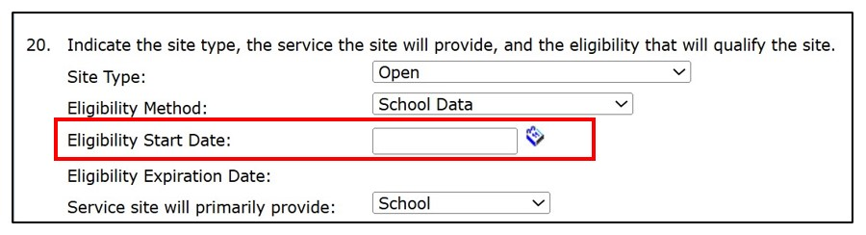
Seamless Summer Option (2)
To expedite approval of your SSO site application(s), pay careful attention to the Eligibility Start Date field at question #20.
For help with your SSO site applications, email SSFO@cde.ca.gov.

Slide 36
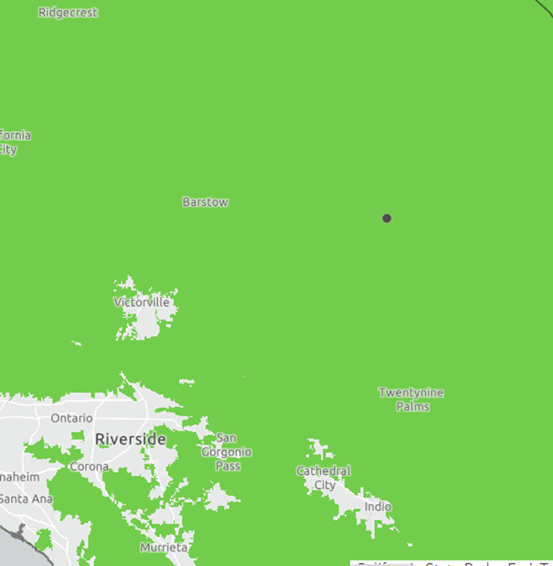
Rural Non-congregate Meal Service (1)
Proposed feeding sites must be rural and area eligible.
Use the USDA Rural Designation Map to determine if your proposed site is rural.
USDA expanded the definition of rural, so sites that were not rural in the past may be considered rural now.

Slide 37

Rural Non-congregate Meal Service (2)
Meal Service Options include:
  Multi-Day Meal Distribution
  Parent or Guardian Meal Pickup
  Bulk Meal Distribution
  Home Delivery

Slide 38
Rural Non-congregate Meal Service (3)
Complete the Non-congregate Meal Service Operation section of your SSO or SFSP site application
Program Integrity Plan required at the time of application
  For SSO Operators see Form ID SSO 2 in the Download Forms section
  For SFSP Operators see Form ID SFSP 36 in the Download Forms section
Resources:
  CDE Management Bulletin SNP-05-2024; SFSP-06-2024
  CDE Rural Non-congregate Meal Service Webpage

Slide 39
How to Find Summer Meal Sites
California Meals for Kids Mobile App (updated daily)
  Available in the app store for all iOS, Android or Microsoft devices or online at https://www.cde.ca.gov/re/mo/cameals.asp
CDE Summer Meal Service Site webpage (updated weekly)
  Available online at https://www.cde.ca.gov/ds/sh/sn/summersites25.asp
USDA Summer Meals Site Finder will launch on May 9 (updated weekly)
  Available online at https://www.fns.usda.gov/summer/sitefinder

Slide 40
Rural Non-congregate Meal Service
Nick Dramis
Marysville Joint Unified School District

Slide 41
Operational Reminders

Slide 42
Important Operational Dates:
Next 30-90 Days (1)
Action | Date
Use Fresh Fruits and Vegetables Order Receipt System (FFAVORS) entitlement | May 1, 2025
Submit Summer 2025: SSO applications* | 30 days prior to the start of meal service
Submit Summer 2025: SFSP applications* | May 15th or 30 days prior to the start of operations
*Applications must be approved prior to the start of meal service.

Slide 43
Important Operational Dates:
Next 30-90 Days (2)
Action | Date
Advertise Availability of Summer Meals | Prior to the end of the SY
Site Visit for New Summer Meal Sites (SFSP only) | First week of operations

Slide 44
Important Operational Dates:
Next 30-90 Days (3)
Action | Date
Community Eligibility Provision (CEP) Applications Due | June 30, 2025
Provision 2 Applications Due | June 30, 2025
Request Food Safety Inspections (x2) | End of SY 2024–25

Slide 45
Resources and Other Announcements

Slide 46
Test Your Knowledge
What annual weeklong celebration recognizes school nutrition culinary professionals?
Hint:
Occurs each spring, this year's celebration is during the week of April 28 through May 2
Includes School Lunch Hero Day

Slide 47

Test Your Knowledge: Answer
What annual weeklong celebration recognizes school nutrition culinary professionals?
School Nutrition Employee Week is April 28–May 2, 2025
School Lunch Hero Day is May 2, 2025

Slide 48

Farm to Summer Celebration Week
Dates: June 16-20, 2025
Theme: Summer Foods Around the World
Earn Recognition:
  Pre- and Post-survey
  Taste, Teach, and Connect

Slide 49
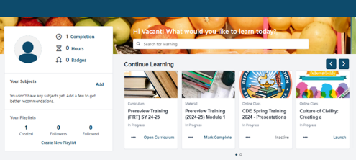
Nutrition Services Division Learning Management Site: Registration Reminder!
For food service and food service management company staff only:
Instructions are available in CNIPS Download Forms:
  LMS Reg 001 - LMS Account Self-Registration Access for Child Nutrition Program (CNP) Operators Job Aid
  LMS Reg 002 - LMS Account Self-Registration and Access Set-up Slides for CNP Operators
Questions contact us at NSDLearning@cde.ca.gov

Slide 50
Tuesday @ 2 Town Hall Schedule
Held on the fourth Tuesday of the month
Month | Format | Date
May | State Update | May 27, 2025
June | State Update and Guest Speaker | June 24, 2025
July | No Town Hall | N/A

Slide 51
Professional Standards Crediting Information
Key Area: Administration (3000)
Training Topic: Program Management (3200)
Learning Objective: Manage Staff Work Including Scheduling (3210)
Instructional Hours 1.5 hours

Slide 52
0

