Slide 1
Welcome to the California Universal Meals Listening Session #7
May 17, 2022

Slide 2

Universal Meals
Listening Session #7
California Department of Education
Nutrition Services Division

Slide 3

Welcome
Housekeeping:
  Line muted
  Recorded
  Use the Q&A for questions related to today’s topics
  Questions: UniversalMealsSY22@cde.ca.gov

Slide 4
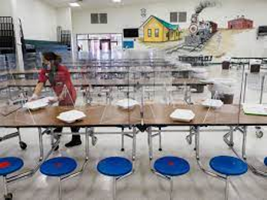
Agenda
Overview of Universal Meals (UM)
Recap of Listening Sessions
Strategies for Complementing the SNP
Compliance Reminders
FAQ
Resource Guides

Slide 5
Governor’s Budget Proposal and May Revise
Continued investments in School Nutrition Programs:
  Universal Meals Reimbursements
  Kitchen Infrastructure and Training Grants

Slide 6

California Universal Meals Program
Three Components to Universal Meals:
Update of State Meal Mandate
Federal Provision Participation Requirement
Supplemental State Meal Reimbursement

Slide 7
Universal Meals and the National School Lunch Program (NSLP) and School Breakfast Program (SBP)
Universal Meals builds upon participation in the NSLP and SBP
  Sponsors will still be expected to comply with current federal regulations to operate the NSLP and SBP
  Sponsors will either operate under a federal provision, or conduct standard counting and claiming

Slide 8
Universal Meals and Provisions
Federal Meal Provision Requirement:
High poverty schools that are eligible for the Community Eligibility Provision (CEP) must apply for a federal provision
May apply for CEP or another Provision

Slide 9
Universal Meals and Reimbursement
FRPM Level | Federal Funds | State (Prop 98) Funds | Universal Meal State Funds | Total
Free | $3.75 | $0.2487 | $0 | $3.9987
Reduced - Price | $3.35 alt te | $0.2487 | $0.40 | $3.9987
Paid | $0.44 | $0 | $3.5587 | $3.9987
Example Based on NSLP Reimbursement for School Year (SY) 21–22 for agency eligible for high needy reimbursement with additional $.07 for menu certification

Slide 10

Recap of all the Universal Meals Listening Sessions
Available Recordings:
  Provisions under Universal Meals
  School Breakfast Program
  Food Services Management Company

Slide 11
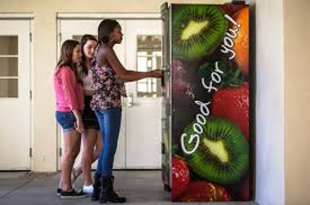
Common Questions related to Universal Meals
Complementing the School Nutrition Program (SNP) with nonprogram foods
Compliance reminders
Utilizing United States Department of Agriculture (USDA) commodities

Slide 12
Competitive Foods
A food or beverage:
  Sold
  To Students
  On School Campus
  During the School Day
  Outside of the Federal Reimbursable Meal

Slide 13
Nutrition Requirements of Competitive Foods
Nutrition requirements: In general, a food must be a fruit, vegetable, dairy, whole grain, or protein, or have fruit, vegetable, dairy, whole grain, or protein as the first ingredient; AND meet required standards for total fat, saturated fat, trans fat, sugar, sodium, and calories

Slide 14
Nonprogram Foods
Food and beverages that are sold, and not reimbursable
Examples:
  Smart snack compliant food and beverages
  A la carte entrees
  Second and adult meals
  Vended meals and catered foods
  Note: Nonprogram foods fitting the competitive foods criteria must meet applicable nutrition requirements.

Slide 15
Increasing Revenue Through Nonprogram Food Sales
Positive responses:
  Increase overall revenues
  Healthier alternatives to off campus meals
  Keep students on campus
Potential to earn 5 - 20% of total revenues from nonprogram sales.

Slide 16
Compliment Instead of Compete
Items that compliment reimbursable meals:
  Beverages
  Snacks
  Desserts
Best practice: Limiting purchases to 2-3 items encourages meal consumption

Slide 17
Starting Out
To make tracking nonprogram foods easier:
  Sell items easily identified with per unit cost
  Talk to your POS provider about tracking sales
Best practice: order these items separately from program foods

Slide 18
Catering and Vending
Foods and beverages outside meal service:
  School meetings
  Fundraisers
  School stores or kiosks
Best practice: provide set menus, and ordering/invoicing processes

Slide 19
Vending to Outside Agencies
Districts vending program meals
  Nonprogram food compliance
  Create a written agreement
  Reassess pricing regularly
Remember: Maintain competitive pricing and program integrity

Slide 20
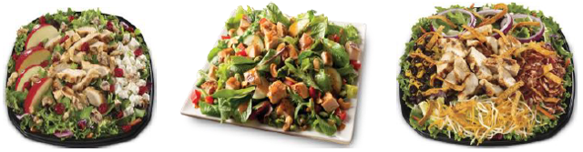
Adult Meals
Offer individual a la carte items or meals to adults
  Sandwiches, soups, or hand-crafted salads
  Holiday specials
  Special sign-up lists

Slide 21
Compliance Overview:
Revenue Ratio
Overview of compliance for nonprogram foods:
  Assess annually
  Meet compliance ratio
USDA and California Department of Education Tools in the Child Nutrition Information and Payment System (CNIPS)
  Form: SNP Nonprogram Food Tool
  Form: USDA Nonprogram Foods Calculator

Slide 22
Compliance Overview:
Pricing of Nonprogram Foods
Aggregate revenue of items sold should meet revenue ratio
Catering/vending/adult meals
  Total food costs = food + supplies + labor + USDA foods
Best Practice: Price items 2-3 times
their food cost

Slide 23
Compliance Overview:
Nutrition Requirements
Overview of compliance for competitive foods:
  For foods and beverages
  Strict nutritional content
  Second meals must meet requirements

Slide 24
Nonprogram | Competitive Foods
Non Program Foods | Competitive Foods
Food purchased using cafe funds and is not part of the reimbursable meal | foods and beverages sold to students, on school campus, during the school day, outside of the reimbursable meal program

Slide 25
Compliance Overview:
Paid Lunch Equity (PLE) (1)
PLE will not apply to public schools, charter schools and county offices of education approved to operate both NSLP and SBP under Universal Meals.
The additional state funding you will receive in per meal reimbursement will satisfy this federal requirement.

Slide 26
Compliance Overview:
PLE (2)
Schools not participating in the Universal Meals Program will still be required to comply with paid lunch equity:
LEAs not participating in both the NSLP and SBP will not receive Universal Meals funding
May not charge for meals and must support with nonfederal funds

Slide 27
Contacts
Nonprogram Foods – Resource Management Unit:
SNPcafefundquestions@cde.ca.gov
Competitive Foods: competitivefoods@cde.ca.gov

Slide 28
U.S. Department of Agriculture (USDA) Foods Program
Helps fund approximately 15–20 percent of annual food purchases
Supports American agricultural market and removes surplus
California receives approximately $210 million in USDA Foods entitlement annually

Slide 29
Entitlement for School Year
(SY) 2022–23
Entitlement: $210,144,011
  Meal rate: $0.3960 (SY 2021–22: $0.3975)
U.S. Department of Defense Fresh Fruit and Vegetable Program (DoD Fresh) Entitlement: $46,500,000
USDA’s Commodity Credit Corporation (CCC) Funds: $33,000,000

Slide 30
Brown Box and Bulk Item Examples
Direct Delivery (Brown Box) Items
  Chicken fajita meat; beef crumbles
  Canned and frozen fruits and vegetables
  Rice, beans and pasta
Bulk Items for Processing
  Raw chicken, beef, turkey
  Cheese
  Flour
  Fresh and frozen fruits and vegetables

Slide 31
Department of Defense (DoD) Fresh Fruit and Vegetable Program
Fresh produce such as fruits and vegetables
Order through the DoD’s on-line ordering system, FFAVORS
Entitlement drawn down with each order

Slide 32
Reminders for Successfully Maximizing Entitlement
Tip One: Plan
Start with the menu
Determine usage
Tip Two: Track
Monthly draw-downs/usage
Reach out

Slide 33

Questions Related to the FDP?
Email: FoodDistribution@cde.ca.gov

Slide 34

Special Guest
Wendi Gosliner: Nutrition Policy Institute, University of California, Division of Agriculture and Natural Resources

Slide 35

Frequently Asked Questions
UniversalMealsSY22@cde.ca.gov

Slide 36
Resource Guide
California Universal Meals web page
  Resources and FAQ
Universal Meals Quick Reference Guides, available in CNIPS Download forms
  All 16 resources can be found under Form ID: UM QR
USDA More than a Meal toolkit/resource
SNP Guidance, Manuals, and Resources web page

Slide 37

Webinar: Tuesdays @ 2
Town Hall
Tuesday, May 24 @ 2 p.m.
For Questions on Town Halls, email: NSDTownHall@cde.ca.gov

Slide 38

Contact Information
For Questions on Universal Meals UniversalMealsSY22@cde.ca.gov

Slide 39

Thank you
This institution is an equal opportunity provider.

