Slide 1
Title II, Part A
Consolidated Application and Reporting System (CARS)
Winter Release
[Note: Slide notes are used throughout this PowerPoint.]
Notes:
Good afternoon, thank you for taking the time to learn more about the Consolidated Application & Reporting System or CARS Winter Release. My name is Lisa Fassett and I am one of the Title II, Part A team members. Additional Title II, Part A Team members joining us in the Chat today are Mindi Parsons and Alice Ng from the Professional Learning Support Division, and Tamara Dow from the Education Data Office.
Today we will go over the Title II, Part A Winter forms in the CARS the timeline and provide links to information in the chat or at the end of the PPT.
Please use the Chat to ask questions about the CARS Winter forms. Although the focus of today’s webinar is the CARS Winter forms. For questions regarding program, please contact our office. Our contact information is presented at the end of the presentation.
A copy of the PPT will be posted to the Title II, Part A Technical Assistance Webinar webpage https://www.cde.ca.gov/pd/ti/tii-webinars.asp. A link is provided in the Chat

Slide 2
Check In
Knowing who is in the room helps to ensure our presentation is tailored to your needs. Please share with us your experience with the Consolidated Application and Reporting System (CARS).
How familiar are you with CARS Forms?
      Not familiar
      Somewhat familiar
      Very familiar
Notes:
Knowing who is in the room helps to ensure our presentation is tailored to your needs. Please share with us your experience with the Consolidated Application and Reporting System (CARS).
How familiar are you with CARS Forms?
Not familiar
Somewhat familiar
Very familiar
Please provide your answer in the chat.
We will give some time for everyone to provide their response in the Chat.
We have noticed over the years – quite a bit of turn over in staff completing CARS forms. We are providing this webinar to help support local educational agencies or (LEAs) and their staff who complete the forms.
Check-In with Mindi for poll results

Slide 3
Agenda
Purpose of Title II, Part A
CARS Winter Forms
Federal Transferability
Expenditure Deadlines
Important Dates
Notes:
Agenda for today
Purpose of Title II, Part A
CARS Winter Forms
Federal Transferability
Expenditure Deadlines
Important Dates

Slide 4
Title II, Part A Purpose
Increasing student achievement consistent with the challenging state academic standards.
Improving the quality and effectiveness of teachers, principals, and other school leaders.
Increasing the number of teachers, principals, and other school leaders who are effective in improving student academic achievement in schools.
Providing low-income and minority students greater access to effective teachers, principals, and other school leaders.
20 United States Code (U.S.C.) Section 6601
Notes:
Let’s take a moment to review the purpose of Title II, Part A which is to:
Increase student achievement consistent with the challenging state academic standards
Improve the quality and effectiveness of teachers, principals, and other school leaders
Increase the number of teachers, principals, and other school leaders who are effective in improving student academic achievement in schools
Provide low-income and minority students greater access to effective teachers, principals, and other school leaders
​
Title II, Part A funded activities in your district should address the areas of greatest need identified through a needs assessment.

Slide 5
2023–24 CARS Title II, Part A
Winter Forms
Reports Due:
Federal Transferability, if applicable
2021–22 Title II, Part A Fiscal Year Expenditure Report, Closeout 27 months
2023–24 Title II, Part A Nonprofit Private School Participation
2023–24 Title II, Part A Local Educational Agency (LEA) Allocations
Consolidation of Administrative Funds, if applicable
  20 U.S.C. Section 6613, 6614
Notes:
A list of the 2023–24 CARS Title II, Part A Winter Forms due includes –
In Winter, LEAs are reporting data for two separate Fiscal Years (FY). The close out of the previous cycle of funding and the nonprofit private school participation as a result of consultation that occurred the previous spring as well as their planned distribution of funds for the current cycle of funding based on their preliminary allocation.
Program Monitors review the CARS forms when performing a Supporting Effective Instruction (SEI) Federal Program Monitoring Review for specific local educational agencies (LEAs). Every Student Succeeds Act (ESSA) Sections related to each form are included in this section for reference. 20 USC Section 7801[47][A]
There will be a separate webinar on the Title II, Part A CARS Spring Release Forms on May 14, 2024. To register for this webinar, a link is provided in the Chat at https://www.cde.ca.gov/pd/ti/tii-webinars.asp
Another great resource is the CARS Data Collection Forms Calendar webpage https://www.cde.ca.gov/fg/aa/co/carscalendar.asp. A link to this webpage is provided in the Chat
Let’s PAUSE for a few questions from the Chat
Let’s walk through each form.

Slide 6
Federal Transferability
  The purpose of federal transferability is to allow LEAs the flexibility to target federal funds to the programs and activities that most effectively address the unique needs of LEAs (Every Student Succeeds Act Section 5102).
  An LEA may transfer all, or any lesser amount, of the funds from Title II, Part A; and Title IV, Part A to:
    Title I, Part A;
    Title I, Part C;
    Title I, Part D;
    Title III, Part A; and
    Title V, Part B.
    20 U.S.C. Section 7305a, 7305b
Notes:
The Federal Transferability form is a Winter form which is required for all LEAs that transfer funds into or out of Title II.
For context - the purpose of federal transferability is to allow LEAs the flexibility to target federal funds to the programs and activities that most effectively address the unique needs of LEAs.
For more information regarding federal transferability go to the CARS Guidance for the Federal Transferability Form webpage https://www.cde.ca.gov/fg/aa/co/ca22wguifedtransfer.asp. A link is provided in the Chat

Slide 7
Federal Transferability (Continued)
  The Every Student Succeeds Act (ESSA) also notes that LEAs may transfer all, or any lesser amount, of funds between Title II, Part A and Title IV, Part A.
    20 U.S.C. Section 7305a, 7305b
Notes:
Federal Transferability continued
LEAs may also transfer all, or a portion of the funds between Title II, Part A and Title IV, Part A.

Slide 8
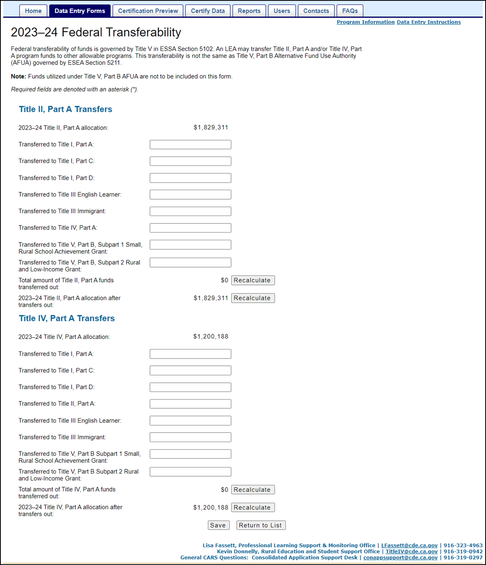
  Federal Transferability Form
Notes:
Here is a copy of the Federal Transferability Form. We have broken the form in half for better viewing on the next two slides.

Slide 9
Federal Transferability Form (2)
Notes:
If an LEA decides to transfer funds out of Title II, Part A, the top portion of the form is where the LEA would enter which Title program(s) they are transferring the Title II, Part A funds into.

Slide 10
Federal Transferability Form (3)
Notes:
If an LEA decides to transfer funds into Title II, Part A, from Title IV, Part A, the LEA would enter the transfer amount on the bottom portion of this form.
Once all data entry fields have been completed, the LEA submits the form.

Slide 11
Title II, Part A Fiscal Year Expenditure Report, Closeout 27 Months
Title II, Part A funds have 27 months to be fully expended or obligated.
A final 27-month closeout report is required in the Winter Release.
There is no carryover provision beyond 27 months.
This page is used to recover unexpended Title II, Part A funds.
  20 U.S.C. Section 6613, 6614
Notes:
Our next form is the Title II, Part A Fiscal Year Expenditure Report, Close out 27 Months Form
LEAs have 27 months to fully expend or obligate Title II, Part A funds
This form is used to report the year-to-date expenditures and encumbrances for the Title II, Part A federal funding by activity.
This close out expenditure reporting is for the period of July 1, 2021, through September 30, 2023.
Expenditure Deadlines / Grant Award Period
Under the federal Tydings Amendment, Section 421(b) of the General Education Provisions Act, any funds that are not obligated at the end of the federal funding period, July 1, 2021, through September 30, 2022, shall remain available for obligation for an additional period of 12 months, through September 30, 2023, within the limits specified in Section 1127 of the ESSA.
A final 27-month closeout report is required in the Winter Release.
Each LEA that received Title II, Part A SEI funding must complete this report.
There is no carryover provision beyond 27 months.
Lastly, this page is used to recover unexpended Title II, Part A funds.
If an unexpended amount is reported on the Title II, Part A Fiscal Year Expenditure Report, Close out 27 Months form, the California Department of Education (CDE) will invoice the LEA for the amount listed.

Slide 12
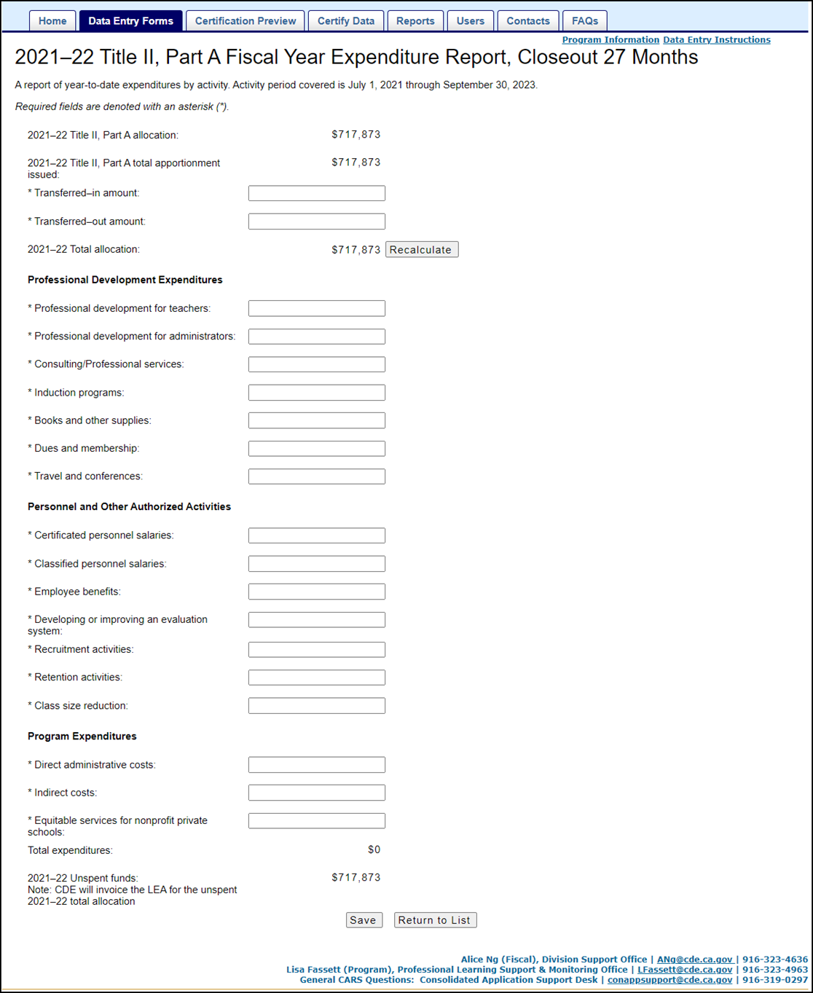
Title II, Part A Fiscal Year Expenditure Report, Closeout 27 Months
Notes:
Here is a copy of the Title II, Part A Fiscal Year Expenditure Report, Closeout 27 Months Form. We have broken the form in half for better viewing on the next two slides.

Slide 13
Title II, Part A Fiscal Year Expenditure Report, Closeout 27 Months (2)
Notes:
Starting from the top – some fields are prepopulated while others are input by the LEA
Allocation – prepopulated
Apportionment – prepopulated
Title II, Part A funding transferred in from other Title/Categorical Programs – LEA enters
Title II, Part A funding transferred out from Title II, Part A – LEA enters
The form then calculates the Total allocation based upon the total apportionment (payments) issued amount, plus the transferred-in amount, minus the transferred-out amount.
Use of Funds Section – LEA enters
these sections include PD Expenditures (which we see here), Personnel and Other Authorized Activities, Program Expenditures

Slide 14
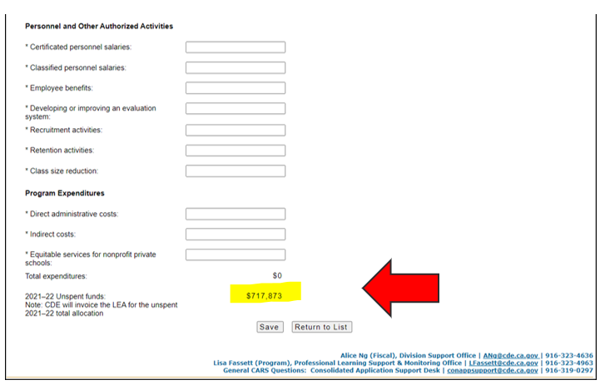
Title II, Part A Fiscal Year Expenditure Report, Closeout 27 Months (3)
Notes:
Use of Funds Section continued (PD Expenditures, Personnel and Other Authorized Activities, Program Expenditures) – LEA enters
Admin & Indirect (15% maximum guideline) – LEA enters
There is no limit on administration in ESSA for Title II. That being said, based upon past LEA costs and following Title I as a guideline, the CDE allows up to 15% for administrative and indirect costs. If an LEA goes beyond 15%, they are contacted for more information.
Equitable Services (required if non-profit private schools elected to participate in Title II, Part A funding) – LEA enters
Once all data entry fields have been completed, the LEA submits the form.
There will be a separate webinar regarding Title II, Part A Equitable Services on March 19, 2024. To register for this webinar, a link is provided in the Chat at https://www.cde.ca.gov/pd/ti/tii-webinars.asp
Another great resource regarding equitable services is the Equitable Services calculation webpage https://www.cde.ca.gov/pd/ti/tiiapscalculation.asp A link to this webpage is provided in the Chat
Please Note: As shown on the example above with the yellow highlight and the red arrow, if the LEA reports an unexpended/unspent amount on the “2021-22 Unspent funds” line item of the Closeout form, the CDE will invoice the LEA for the remaining funds.

Slide 15
Title II, Part A / Title III Nonprofit Private School Participation
LEAs must provide eligible elementary and secondary private school teachers, principals, and other educational personnel with Title II, Part A educational services that are equitable in comparison to services provided to teachers, principals, and other educational personnel in public schools.
The purpose of this data collection form is to document that the nonprofit private schools were contacted and made decisions regarding their participation in equitable services under Title II, Part A.
Notes:
Moving on to the Title II, Part A / Title III Nonprofit Private School Participation Form
LEAs must offer to provide eligible elementary and secondary private school teachers, principals, and other educational personnel with Title II, Part A educational services that are equitable in comparison to services provided to teachers, principals, and other educational personnel in public schools. These services shall address the needs of nonprofit private school students, teachers and other educational personnel.
Participation is based on the number of eligible students enrolled in the grade levels in a nonprofit private school located in areas served by the LEA.
The purpose of this data collection form is to document that the nonprofit private schools were contacted and made decisions regarding their participation in equitable services under Title II, Part A.
When performing a SEI Federal Program Monitoring Review for a specific LEA, this completed data collection form, along with the LEA’s records of contact and consultation, will serve to document that the nonprofit private schools were contacted and made decisions regarding whether to participate in Title II, Part A. ESSA Sections related to each form are included in this section for reference. 20 USC Section 7801[47][A]

Slide 16
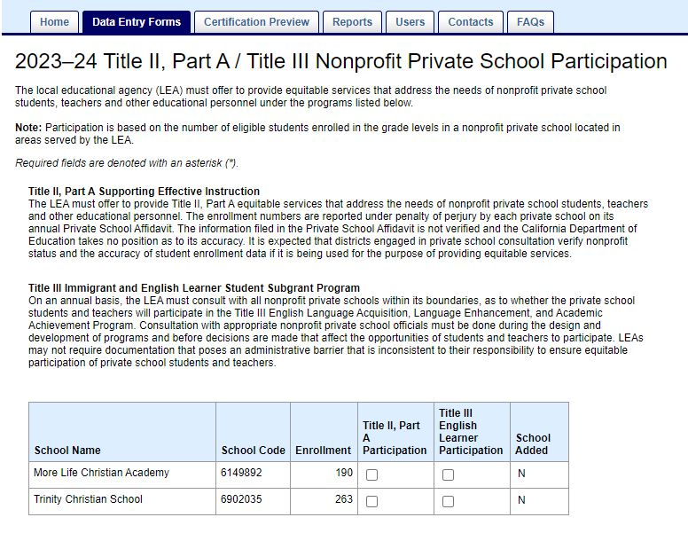
Title II, Part A / Title III Nonprofit Private School Participation
Notes:
Here is a copy of the Title II, Part A / Title III Nonprofit Private School Participation Form
School name – prepopulated (from the Nonprofit Private School Consultation form)
School code – prepopulated (from the Nonprofit Private School Consultation form)
Enrollment – prepopulated (from the Nonprofit Private School Consultation form)
Title II, Part A Participation – If the school is participating, then the LEA selects the participation checkbox.
The Participation option will not display if the LEA did not apply for related funds and/or does not have a related allocation and/or if the school does not have a signed written affirmation on file.
Title III – (This column is reviewed by the Title III Program Office) If the school is participating, then the LEA selects the participation checkbox.
Participation option will not display if the LEA did not apply for related funds and/or does not have a related allocation and/or if the school does not have a signed written affirmation on file.
School Added – prepopulated (from the Nonprofit Private School Consultation form)
Once all data entry fields have been completed, the LEA submits the form.
______________________________________________________________
Background Info:
Possibilities if a school was not listed:
Private school did not complete the Private school affidavit correctly
Private school moved and now in within or outside of the LEAs boundary
The (student enrollment) numbers are reported under penalty of perjury by each private school on its annual Private School Affidavit. The information filed in the Private School Affidavit is not verified, and the CDE takes no position as to its accuracy.
Note: This data collection will not display if the LEA did not apply for Title II or Title III funding and/or is not assigned an allocation amount, is a county office of education or direct funded charter, or did not complete the Nonprofit Private School Consultation form. The option to add nonprofit private schools to an LEA’s school grid can only be done via the Nonprofit Private School Consultation form.
clarification details:
If a district is non-unified, then both nonprofits from within their district boundaries as well as nonprofits from outside their district boundaries, that were added to the same fiscal year’s spring Nonprofit Private School Consultation form, will populate into Title II, Part A / Title III Nonprofit Private School Participation, when those nonprofits had consultation and signed written affirmation on file noted as “Yes” in Nonprofit Private School Consultation. If a district is unified, then only the nonprofits from within their district boundaries that had consultation and signed written affirmation on file noted as “Yes” in Nonprofit Private School Consultation will populate into Title II, Part A / Title III Nonprofit Private School Participation.
School name/school code/enrollment details come from CDS database and cannot be manually changed in CARS. The district and/or private school staff would have to contact CDE CDS Admin and/or Private Schools office for assistance in changing those details (and other details, like tax exempt status, etc.) in those databases before the change could be reflected in CARS (whether the change appears in CARS depends on the timing of the change in the CDS database).
As mentioned above, the time for adding nonprofits from outside district boundaries to a district’s CARS data is in spring, via the Nonprofit Private School Consultation form; nonprofits cannot be added directly to the winter Title II, Part A / Title III Nonprofit Private School Participation form.

Slide 17
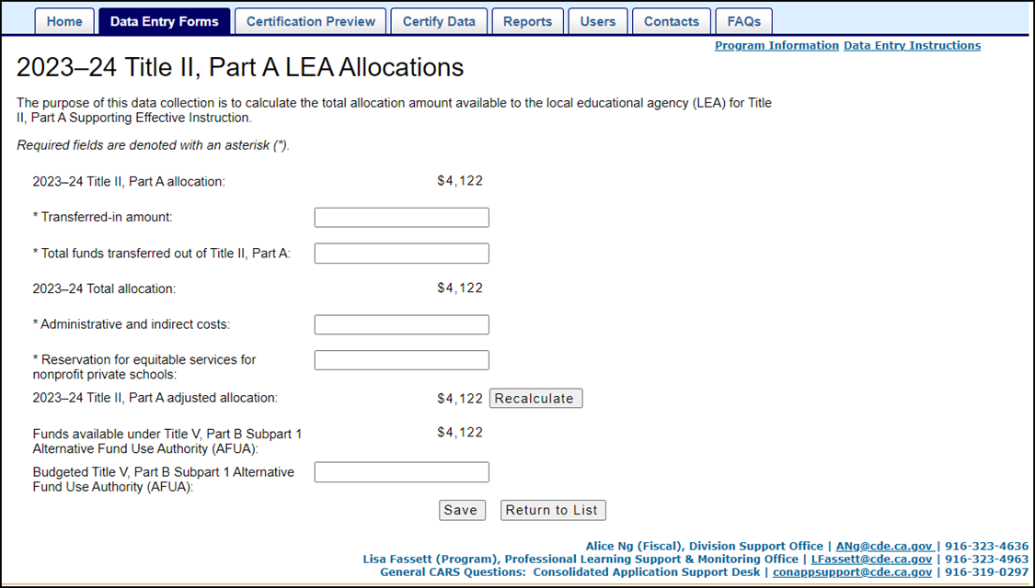
Title II, Part A Local Educational Agency Allocations
Notes:
And now for the Title II, Part A Local Educational Agency Allocations Form. The purpose of this form is to calculate the total allocation amount available to the LEA for Title II, Part A.
Allocation – prepopulated from school fiscal services
Title II, Part A funding transferred in from other Title/Categorical Programs – LEA enters
Title II, Part A funding transferred out from Title II, Part A – LEA enters
The form calculates the Total allocation amount based upon the allocation amount plus the transferred-in amount minus the transferred-out amount.
Admin & Indirect (15% maximum guideline) – LEA enters
There is no limit on administration in ESSA for Title II. That being said, based upon past LEA costs and following Title I as a guideline, the CDE allows up to 15% for administrative and indirect costs. If an LEA goes beyond 15%, they are contacted for more information.
Reservation for Equitable Services (required if non-profit private schools elected to participate in Title II, Part A funding) – LEA enters
Title II, Part A adjusted allocation – prepopulated (the form calculates this amount based upon the total allocation minus the admin and indirect amount minus the reservation for equitable services amount.)
The following field is only applicable to LEAs that are eligible for the Small, Rural School Achievement (SRSA) program.
Funds available under Title V, Part B, Subpart 1 Alternative Fund Use Authority (AFUA) – prepopulated
Eligible LEAs will see this data field on all CARS forms
Very few – 30 LEA in a given year
Budgeted Title V, Part B – LEA enters
For more information regarding AFUA go to the Title V, Part B Alternative Fund Use Authority Webpage Title V, Part B Alternative Fund Use Authority - Title V, Part B Rural Education Initiative (CA Dept of Education) A link is provided in the Chat
Once all data entry fields have been completed, the LEA submits the form.
_________________________________________
Background info:
Eligibility
If eligible for SRSA, the LEA may participate in the AFUA. In other words, all SRSA eligible LEAs may use Title II, Part A and Title IV, Part A funds to carry out local activities under any of the allowable uses for SRSA grant funds (ESSA Section 5211[b][1]). An LEA that meets the SRSA program eligibility requirements may use Title II, Part A or Title IV, Part A funds alternatively without approval. Dual–eligible LEAs may use the AFUA even if electing to participate in the Rural and Low-Income School (RLIS) program, instead of the SRSA program.
Notification
All eligible LEAs that decide to participate in the AFUA shall notify the California Department of Education (CDE) through the Consolidated Application and Reporting System (CARS) Application for Funding form during the Spring Release (ESSA Section 5211[a][2]).
Alternative Use of Funds
An eligible LEA may use Title II, Part A and Title IV, Part A funding to carry out local activities authorized under any of the following provisions:
Title I, Part A;
Title II, Part A;
Title III; and
Title IV, Part A or B (ESSA Section 5211[A][1]).

Slide 18
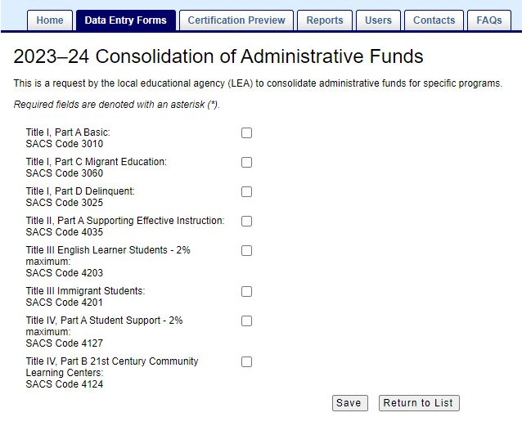
Consolidation of Administrative Funds
Notes:
The Consolidation of Administrative Funds Form is for LEAs to request to consolidate administrative funds for specific programs.
LEAs electing to consolidate admin funds would select the appropriate checkbox(s).
Once all data entry fields have been completed, the LEA submits the form.
For more information go to the CARS Guidance for the Consolidation of Administrative Funds Form webpage https://www.cde.ca.gov/fg/aa/co/ca22wguiconsadmin.asp. A link is provided in the Chat)
___________________________________________________________________________
Background info:
Of the 1770 LEAs that submitted the Consolidation of Administrative Funds Form in 2022-23; 396 of those receiving Title II, Part A funds elected to consolidate administrative funds.
A local educational agency (LEA) that consolidates administrative funds for any fiscal year (FY) shall not use any other funds under the programs included in the consolidation for administration for that FY (Every Student Succeeds Act [ESSA] Section 8203). Indirect costs are a part of costs of administration; thus, indirect costs pertaining to programs included in the consolidation may only be paid out of the funds available for the administrative cost pool. For example, if a program must budget and expend at least 85 percent on direct services to students, then the total allowable for administration (e.g., program administration plus indirect costs) cannot exceed 15 percent.
Programs that may be included in the consolidation of administrative funds are:
- Title I, Part A (Basic)
- Title I, Part C (Migrant Education)
- Title I, Part D (Delinquent)
- Title II, Part A (Supporting Effective Instruction)
- Title III (Immigrant Students)
- Title III (English Learner Students)
- Title IV, Part B (21st Century Community Learning Centers)
- Title IV, Part A (Student Support and Academic Enrichment)
The consolidated funds may be used for the administration of the programs included in the consolidation and for uses, at the school district and school levels, designed to enhance the effective and coordinated use of funds under those programs, including such activities as:
The coordination of the ESSA programs with other federal and non-federal programs;
The establishment and operation of peer-review mechanisms under ESSA;
The administration of Title VIII of ESSA (General Provisions);
The dissemination of information regarding model programs and practices;
Technical assistance under any ESSA program;
State-level activities designed to carry out Title VIII; and/or
Training personnel engaged in audit and other monitoring activities.

Slide 19
Important Dates
  2023–24 Winter Release
  Open Date: December 1, 2023
  Deadline Date: January 15, 2024
  Final Close Date: February 15, 2024
Notes:
Important Dates
Aside from our contact information, this is the single MOST important slide in this PPT.
The CARS Winter Release forms opened on December 1, 2023.
LEAs may begin submitting their forms on this date.
LEAs should submit their CARS Winter forms by the Deadline Date of January 15, 2024.
Between January 15 to February 15, LEAs are able to make corrections to their Winter forms, if needed.
A list of LEAs that have not submitted their Title II, Part A CARS Winter forms by January 15th is generated by the CARS Office.
All LEAs on the list will be contacted by the Title II, Part A Program Office.
February 15, 2024 is the Final Close Date.
After February 15, CARS Winter forms will be CLOSED and will not be reopened.
Which means NO changes may be made to the CARS forms once they have closed.
RECAP The winter release documents the previous cycle’s close out, the current cycle’s preliminary allocation amounts, any federal transferability, and nonprofit private school participation in this program.
Again - Although the focus of today’s webinar is the CARS Winter forms. For questions regarding program, please contact our office. Our contact information is presented at the end of the presentation.
Let’s PAUSE for a few questions from the Chat

Slide 20
Resources
Program Questions:
Title II, Part A web page: https://www.cde.ca.gov/pd/ti/
Title II, Part A listserv: join-Title-II@mlist.cde.ca.gov
Technical Questions:
CARS Resources web page: http://www.cde.ca.gov/fg/aa/co/cars.asp
CARS listserv: join-consolidated-application@mlist.cde.ca.gov
Notes:
Program Questions:
Title II, Part A web page: https://www.cde.ca.gov/pd/ti/
Title II, Part A listserv: If you are not already signed up to receive updates via email notification, subscribe to the Title II, Part A listserv by sending a blank message to our listserv email address join-Title-II@mlist.cde.ca.gov
Technical Questions:
CARS Resources web page: http://www.cde.ca.gov/fg/aa/co/cars.asp
Please ensure your LEA has provided the current CARS Title II, Part A contact person. This is the individual our office will reach out to for reasons such as - a CARS form has not been submitted, how funds were expended, or to confirm an unexpended balance for invoicing purposes. The CARS Resource page provides a CARS User Guide with instructions on how to add, manage, or edit the CARS contacts.
CARS listserv: join-consolidated-application@mlist.cde.ca.gov

Slide 21
Contacts
Program Questions:
Title II Email: TitleII@cde.ca.gov
Technical Questions:
ConAppSupport@cde.ca.gov
Thank You!
Notes:
For Title II, Part A Program questions:
Professional Learning Support and Monitoring Office
916-323-5847
TitleII@cde.ca.gov
For technical questions such as login in issues or CARS release dates:
ConApp/CARS Support Desk
ConAppSupport@cde.ca.gov
916-319-0297
Let’s PAUSE for any last questions from the Chat
Thank you for joining us today!

