Slide 1
California Preschool Data Collection (CAPSDAC) Contractor Training Webinar
Applied Data Research and Evaluation Office
California Department of Education (CDE)
Date: July 8, 2025
Time: 10 – 11:30 a.m.

Slide 2
Agenda
Child, Family, Staff Last Name Field in CAPSDAC Second Iteration Update
Timeline to Finalize Data Fields, Domains, and Certifications
Managing Site Information for CAPSDAC
CAPSDAC California State Preschool Program Identification Number (CSPPID) Field Details
CAPSDAC Responsibility Matrix Tool
Upcoming CAPSDAC Customer Service Request Form
CAPSDAC Resources and Upcoming Webinar Reminder
Question and Answer Session

Slide 3
Child, Family, Staff Last Name Field in CAPSDAC Second Iteration Update
In the previously shared draft of the CAPSDAC Data Domains, Fields, and Certification Frequency workbook, the Child, Family (Head of Household), and Staff Last Name fields were separated as LastName1 and LastName2
The California Department of Education (CDE) is modifying these last name fields to combine into one field: ChildLastName, HeadofHousehold1LastName, HeadofHousehold2LastName, and StaffLegalLastName
Will allow up to 50 characters in the last name fields

Slide 4
Timeline to Finalize Data Fields, Domains, and Certifications for Second Iteration of CAPSDAC
The CDE is continuing to review the completed domain files and applicable code sets
Completed review: Attendance, Child, Classroom, Classroom Enrollment, and Education Programs domains
When the code set is finalized, the CDE will schedule two interest holder meetings: one for local educational agencies (LEAs), and one for software vendors
The CDE is planning to have everything finalized and sent to LEAs and software vendors by December 2025

Slide 5
Managing Site Information
All California State Preschool Program (CSPP) contractors must continue to manage their site information in the Child Development Management Information System (CDMIS)
This includes entering and updating site details such as site name, address, setting type, and site supervisor contact information
This includes sites operating under both licensed and unlicensed capacities, as well as those in Center-Based and Family Child Care Home settings.

Slide 6
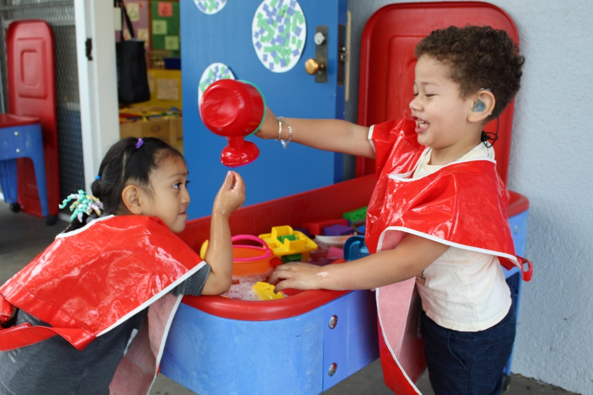
Updating Agency Information (Demo)
Live Demonstration:
During this portion of the webinar, a team member will share their screen to walk through how to update agency information in the CDMIS, with a focus on adding, updating, and removing sites.
Photo Credit: Breed St. Elementary, Deaf & Hard of Hearing Program

Slide 7
CSPPID Field Details
CAPSDAC CSPPID Field: Statewide unique ID issued by the CDE to all LEA CSPP students
If the child is new to the CSPP program, please submit a blank field and CAPDAC will assign a CSPP or find a near match for the LEA to resolve
Allowed values: 10 digits, all numeric values 0-9

Slide 8
CAPSDAC Responsibility Matrix Tool
CAPSDAC responsibility matrix tool the CAPSDAC Responsible, Accountable, Consulted, and Informed (RACI) Chart in the CAPSDAC Planning Resources for Upcoming Release webpage: https://www.cde.ca.gov/sp/cd/ci/capsdacchanges.asp
A project management tool that suggests who fills what role for each task involved in developing a CAPSDAC Data Team and local CAPSDAC Data governance policy. An example is provided but each agency may choose their own tools or assign different tasks and roles based on the needs of their organization.
Also includes a Contacts list with an example of personnel that could comprise an agencies CAPSDAC data team, and Definitions and Quick Tips to support an agency in developing their CAPSDAC data team and assigning roles for the RACI.
Agencies may find it a beneficial tool to support the planning for the transition to the updated CAPSDAC

Slide 9
Upcoming CAPSDAC Customer Service Request Form
The CAPSDAC Customer Service Request Form will be used exclusively for those who do not already have a CAPSDAC account and are at an LEA with no active CAPSDAC users, to request the creation of their account.
Required information when filling out the form: First Name, Last Name, Agency Name, Agency Vendor Number, Phone Number, and Email Address.
Once the form is submitted, the CAPSDAC Support Team will reach out to you regarding the creation of your account.

Slide 10
CAPSDAC: Resources (1)
Resources
CAPSDAC Online Portal: https://www.capsdac.org/
CDE CAPSDAC Support Web Page: https://www.cde.ca.gov/sp/cd/ci/capsdacsupportlanding.asp
CAPSDAC Customer Support Training PowerPoint Slide Deck and Training Video have been posted on the CDE CAPSDAC Customer Support Resource Page: https://www.cde.ca.gov/sp/cd/ci/servicenow.asp
Individual or small group training can be provided by the CDE CAPSDAC Support Team upon requests

Slide 11
Upcoming Monthly Webinars
Webinars:
August 12, 2025, 10 to 11:30 a.m.
September 16, 2025, 10 to 11:30 a.m.
More information is available at: https://www.cde.ca.gov/sp/cd/ci/capsdacwebinars.asp

Slide 12

Questions and Answers
Photo Credit: Kidango Decoto Center; Union City, CA

Slide 13
Thank you!

