Slide 1
California Preschool Data Collection (CAPSDAC) Training Webinar
Applied Data Research and Evaluation Office
California Department of Education (CDE)
Date: March 17, 2026
Time: 10:00 to 11:30 a.m.

Slide 2
Agenda
CAPSDAC 1.0 and CAPSDAC 2.0 Transition
Certification Phases and First Certification
Certification Phases Suggested Timeline
System Access
Beta Testing
Hands on Data Entry Practice
Manual Entry Demonstration
Electronic File Upload Demonstration
Questions and Answers

Slide 3
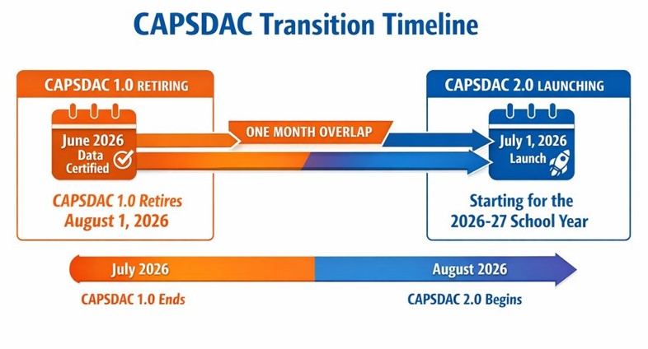
CAPSDAC 1.0 and CAPSDAC 2.0 Transition
CAPSDAC 1.0 is being retired August 1, 2026, after the certification of the June 2026 data.​
CAPSDAC 2.0 is launching July 1, 2026, for the 2026–27 fiscal year! (Notice the one-month overlap)

Slide 4
Certification Phases and First Certification (1)
Phase 1, July 2026: Classroom, Staff, Staff Assignment, Staff Classroom, Child, Family, Language, Supplemental DLL, Enrollment, Classroom Enrollment
Phase 2, January 2027: Attendance, Education Programs
Phase 3, 2030: Incident, Incident Result
The first certification time phase and timeline is shown in the table in slide 6.

Slide 5
Certification Phases and First Certification (2)
Certification Type | First Certification
Monthly (Enrollment, Attendance) | August 2026 (July 2026 Data)
Fall (All other records) | December 2027 (Census Day Data 2027)
End of Year (All other records) | July 2027 (FY 2026–27 Data)

Slide 6
Certification Phases: Suggested Timeline (1)
Note: The following tables (slides 8,9,10) offers a suggested timeline for submitting and certifying data. Information is not yet finalized and can be superseded by updated versions.

Slide 7
Certification Phases: Suggested Timeline (2)
CAPSDAC Submission | Primary Data Submitted | Official Submission Window | Recommended Date for Zero Errors | Certification Deadline | Amendment Window
Monthly (Prior month's data) | Enrollment Records Attendance Information | First day of the month through the last day of the month | Not Applicable | 15th of the month | Certification deadline date through the last day of the month

Slide 8
Certification Phases: Suggested Timeline (3)
CAPSDAC Submission | Primary Data Submitted | Official Submission Window | Recommended Date for Zero Errors | Certification Deadline | Amendment Window
Fall (Census Day data) | All Data Records Except Attendance and Enrollment | First Wednesday of October (Census Day) through late January Example: October 6, 2027 to January 22, 2028 | Two weeks prior to Certification Deadline Example: November 19, 2027 | Early/Mid December Example: December 10, 2027 | Certification Deadline through Late January Example: December 10, 2027 through January 21, 2028

Slide 9
Certification Phases: Suggested Timeline (4)
CAPSDAC Submission | Primary Data Submitted | Official Submission Window | Recommended Date for Zero Errors | Certification Deadline | Amendment Window
End of Year (Cumulative data) | All Data Records Except Attendance and Enrollment | Beginning of May through end of July Example: May 3, 2027 to July 30, 2027 | Two weeks prior to Certification Deadline Example: June 25, 2027 | Mid July Example: July 16, 2027 | Certification Deadline through End of July Example: July 19, 2027 through July 30, 2027

Slide 10
Beta Testing
Beta versions of CAPSDAC 2.0 will allow LEAs and vendors to try out the new system beforehand.
  Beta-1 (released on 11/21/25) - Electronic file upload. Instructions on CAPSDAC Planning Resource for Upcoming Release web page: https://www.cde.ca.gov/sp/cd/ci/documents/capsdacappendixb2.docx
  Beta-2 (released on 2/18/26) - Manual input/edit. Instructions on CAPSDAC Planning Resource for Upcoming Release web page: https://www.cde.ca.gov/sp/cd/ci/documents/capsdac2man.docx
  Beta-3 (scheduled for mid April) - Certification

Slide 11
System Access
All CAPSDAC 1.0 users have had accounts created for them in CAPSDAC 2.0.
No new accounts for CAPSDAC 2.0 will be created until the next Beta testing phase, Beta 3.
If additional staff members wish to participate in the Beta 3 testing phase, please ensure that CAPSDAC 1.0 accounts are created for them in advance.

Slide 12
Hands On Data Entry Practice
URL: https://uat.staging.capsdac.org/
Login in: Use your CAPSDAC 1.0 credential
Manual Entry
Electronic File Upload

Slide 13
Electronic File Upload Live Demonstration
Add Record
Modify Record
Delete Record
Generate Reports & CSPPID Data Exports
Review Data Discrepancies
Use Search Function
Reminder: This is a longitudinal system. All data submitted will remain in the system month to month, year to year. It is not recommended to reupload files of the same information as it will create multiple records for the same child.

Slide 14
Upcoming In-Person Trainings (1)
In-person at Sacramento County Office of Education (COE)
  Wednesday, April 1, 2026, 9:00–12:00pm
  https://proflearn.scoe.net/Home/Event/1017
  Wednesday, April 15, 2026, 9:00–12:00pm
  https://proflearn.scoe.net/Home/Event/1018
  Additional sessions upon requests

Slide 15
Upcoming In-Person Trainings (2)
In-person at Los Angeles COE
  Wednesday, April 8, 2026, 9:00–12:00pm
  (LA links are still being developed)
  Thursday, April 9, 2026, 9:00–12:00pm
  (LA links are still being developed)
In-person at Santa Clara COE
  Date and time TBD

Slide 16
Upcoming Webinars/Office Hours
April 21, 2026 10 to 11:30a.m.
May 19, 2026 10 to 11:30a.m.
June 16, 2026 10 to 11:30a.m.

Slide 17
Resources and Documentation
CAPSDAC Support web page:
https://www.cde.ca.gov/sp/cd/ci/capsdacsupportlanding.asp
CAPSDAC Planning Resources for Upcoming Release:
https://www.cde.ca.gov/sp/cd/ci/capsdacchanges.asp
  CAPSDAC Data Domains and Fields
  CAPSDAC Code Sets
  CAPSDAC 2.0 File Upload Template
  CAPSDAC 2.0 User Manual Appendix B: Electronic file upload instructions

Slide 18
Thank you!

