Slide 1
California Preschool Data Collection
Accessing CAPSDAC Customer Service Portal
Applied Data Research and Evaluation Office
California Department of Education

Slide 2
Accessing the Customer Portal
This section provides a brief overview of how to access the CAPSDAC Customer Service Portal.
To use the portal, users must have an existing CAPSDAC account. Access begins by logging into the CAPSDAC system, where users can then navigate to the Customer Service Portal directly from the dashboard.
This PowerPoint slides will walk you through the key steps to help you get started and show you where to find support options within the system.

Slide 3
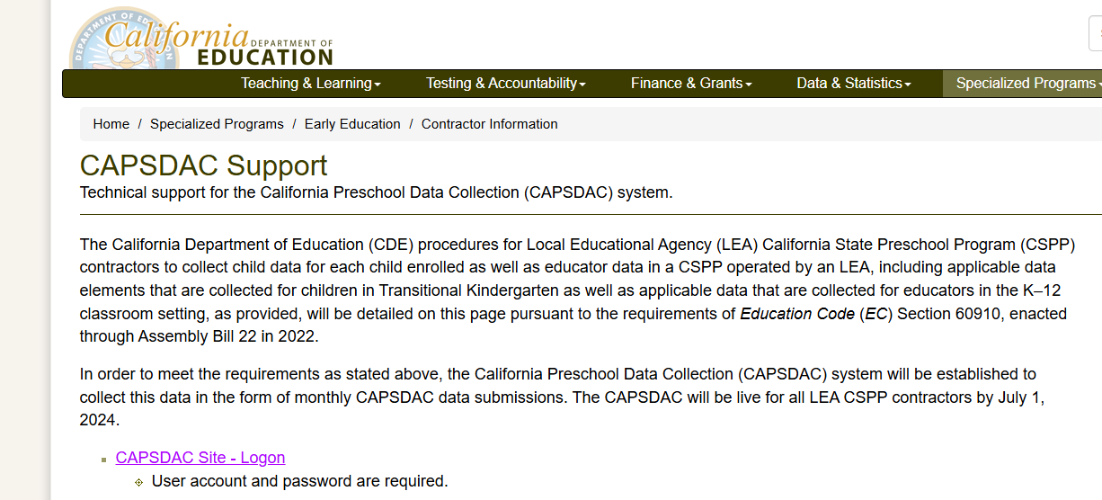
Log into CAPSDAC
To begin, users must log into the CAPSDAC system.
You can do this by either:
Clicking the “CAPSDAC Site – Logon” hyperlink on the CAPSDAC Support webpage (as shown here), or
Using your preferred bookmark or method of access.
A user account and password are required to proceed.

Slide 4
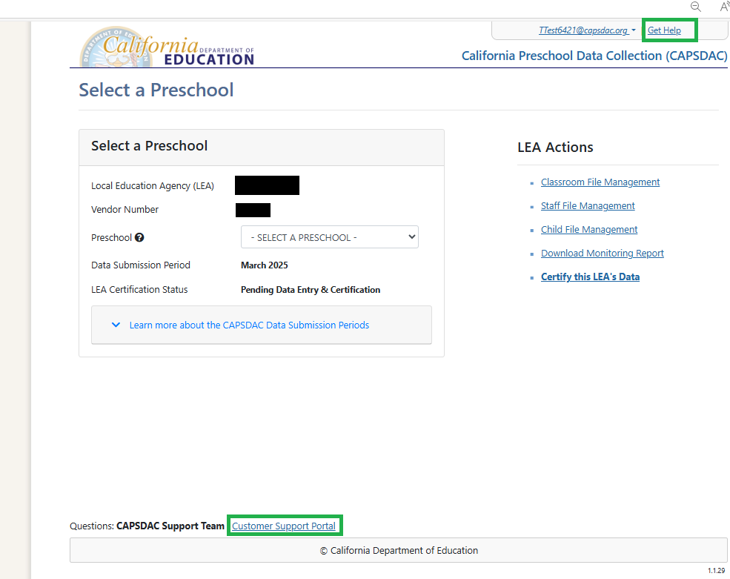
Navigate to the CAPSDAC Customer Service Portal
Once you arrive on the CAPSDAC Dashboard, you can access the CAPSDAC Customer Service
Portal in one of two ways:
Click "Get Help" in the upper-right corner of the screen
Or select "Customer Support Portal" at the bottom of the page
Both options are highlighted with green boxes in the image shown here.

Slide 5
Thank you!

