Slide 1
California Preschool Data Collection (CAPSDAC) System Updates
Applied Data Research and Evaluation Office (ADRE)
California Department of Education (CDE)
Date: April 23, 2024
Time: 10 a.m. - 11:30 a.m.

Slide 2
Agenda
CAPSDAC Updates
What to Expect
CAPSDAC Local Educational Agency (LEA) Review
CDE Early Education Division (EED) Data Systems
California English Learner (EL) Roadmap Principles
CAPSDAC Phased Development
CAPSDAC 1.0 Reporting Frequency
CASPDAC 1.0 Data Submission Options
CASPDAC 1.0 Accounts
CAPSDAC 1.0 Best Practices
CAPSDAC 1.0 Demonstration
CAPSDAC Resources
Question and Answer

Slide 3
CAPSDAC Updates (1)
CAPSDAC will be a web portal outside of the Child Development Management Information System (CDMIS) and the Preschool Language Information System (PLIS) that Local Educational Agency (LEA) California State Preschool Program (CSPP) contractors will use to submit data monthly.
Assembly Bill 22, now codified in Education Code (EC) Section 60910, requires the CDE to collect:
Child data for each child enrolled in a CSPP operated by an LEA, including all applicable data elements that are collected for children in transitional kindergarten pursuant to EC Section 48000, which, in combination with the data collected pursuant to EC Section 60900, will provide longitudinal child data.
The same data for educators in CSPPs operated by a LEA that is collected for educators in the K–12 classroom setting, to the extent that data is collected.

Slide 4
CAPSDAC Updates (2)
There is a four-phase plan for the development of CAPSDAC to fully implement requirements from legislation to provide longitudinal child data for children enrolled in state preschool programs operated by LEAs, linking to the K through grade 12 data system.
These phases will lead to a transition from the initial roll out of CAPSDAC 1.0 in July 2024, to the roll out of CAPSDAC 2.0 in an estimated date of January 2026.
The CAPSDAC Support Webpage has been posted and we sent an email notifying everyone in our CAPSDAC Listserv (Program Directors, Executive Directors, and Active Users in the CDMIS).
Reminder, what is presented is subject to change as the development of CAPSDAC is ongoing.

Slide 5
What to Expect (1)
CAPSDAC Training
CAPSDAC User Manual, Data Submission Schedule, Electronic File Templates
If you have not begun to review these forms, please start now as there are new data that is required to collect and collection should begin as soon as possible for the first submission due date of August 15th, 2024 of July 2024 month's data.
Continued monthly webinars. Today's webinar includes a demonstration. Current planned dates for the next webinars are:
May webinar: 05/14/2024, 10:00–11:30 a.m. This webinar will be an active training session
June webinar: 06/11/2024, 10:00–11:30 a.m.
Management Bulletins on CAPSDAC Data Submission that will provide further information.

Slide 6
What to Expect (2)
New Data Fields
To fully implement requirements from the legislation to provide longitudinal child data for children enrolled in state preschool programs operated by LEAs through grade 12, CAPSDAC data fields will align with the California Longitudinal Pupil Achievement Data System (CALPADS).
CAPSDAC 1.0 data fields are listed in the user manual on the support webpage.
CAPSDAC 2.0 will include the other new data fields that will fully align with the CALPADS. To view the types of data collected in CALPADS for reference, please refer to the CDE CALPADS webpage: https://www.cde.ca.gov/ds/sp/cl/
Changes to the 9600 form and the development of a family information collection form.
We have begun emailing interested LEAs and vendors regarding beta testing and will schedule multiple sessions with those groups to gather feedback.

Slide 7
CAPSDAC LEA Review (1)
Only LEA CSPP contractors will transition to submitting data into CAPSDAC.
All subcontracted agencies, including community based organizations and family child care homes, under an LEA fall under the LEA and their CSPP data would need to be reported into CAPSDAC.
LEA is defined in EC Section 8205 (ad) as a county office of education, school district, community college district, or a school district acting on behalf of one or more schools within the school district for the purpose of operating a CSPP.

Slide 8
CAPSDAC LEA Review (2)
Am I a LEA who needs to submit data in CAPSDAC?
Please review the definition of LEA. If you meet the definition and you have CSPP contracts, then you are required to submit CSPP data into CAPSDAC.
If you do not meet the definition (are not an LEA), but are subcontracted by an LEA and operate a CSPP you are required to submit CSPP data. For example, licensed-based child care centers, or family child care homes that subcontract with LEAs and provide services to children under a CSPP contract. It is up to the LEA who will submit the data in CAPSDAC.

Slide 9
CDE Early Education Division Data Systems (1)
LEA CSPP contractors
Whether part-day or full-day, will move to submitting data to CAPSDAC and will not need to submit data to PLIS or CDMIS CDD-801A. They will continue to submit the Subsidized Provider Report (SPR), if applicable (applicable if they provide CSPP services through an approved CSPP Family Child Care Home Education Network), and any site information changes on CDMIS.
LEAs will need to complete the Family Language Instrument for CAPSDAC as it is replacing PLIS.

Slide 10
CDE Early Education Division Data Systems (2)
Non-LEA CSPP contractors
Will continue to report to PLIS and CDMIS.
LEA CSPP contractors with CDE and CDSS
Will submit data to the CAPSDAC for children enrolled in CSPP and will also submit the CDD-801A Report to the CDMIS for their CDSS contracts until further notice.

Slide 11
California English Learner (EL) Roadmap Principles (1)
Principle One: Assets-Oriented and Needs-Responsive Schools
Principle Two: Intellectual Quality of Instruction and Meaningful Access
Principle Three: System Conditions that Support Effectiveness
Principle Four: Alignment and Articulation Within and Across Systems

Slide 12
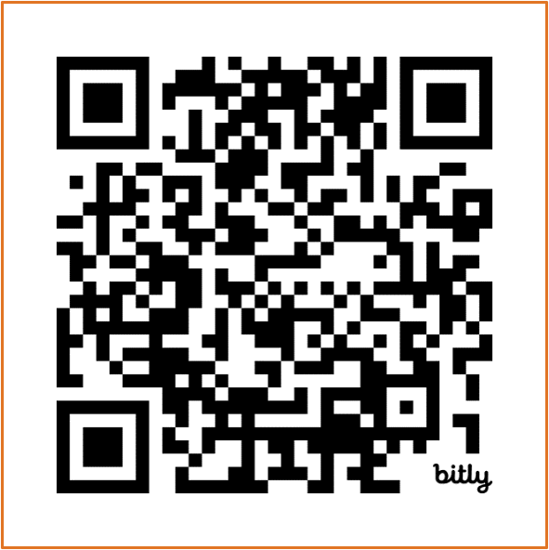
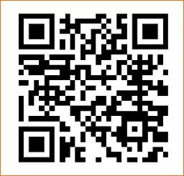
California English Learner (EL) Roadmap Principles (2)
Multilingual learners "fully and meaningfully access and participate in a 21st century education from early childhood through grade twelve that results in their attaining high levels of English proficiency, mastery of grade level standards, and opportunities to develop proficiency in multiple languages."
Scan QR codes to access EL Roadmap Resources at https://www.cde.ca.gov/sp/el/rm/index.asp and https://www.elroadmap.org/

Slide 13
CAPSDAC Phased Development
CAPSDAC 1.0 (Phase I)
Release Date: July 1st, 2024
Required Data Submission Periods: July 2024 to December 2025
First date of required data submission: August 1st, 2024
Data Collection: Classroom, Staff, and Child records
CAPSDAC 2.0 (Phase II-IV)
Release Date: December 1st, 2025
Required Data Submission Periods: December 2025 on
First date of required data submission: February 1st, 2026
Additional Data Collection: Expanded Disability Type and Service, Disciplinary, Attendance, and etc.

Slide 14
CAPSDAC 1.0 - Data Submission Frequency
Certification Frequency
The CAPSDAC data submission will be required monthly, and the due date will always be on the fifteenth of the month following the end of the report period. This due date is subject to change as technical guidance for contractors is still being developed.
However, the Monthly Data Submission certification period will be closing approximately fifteen (15) days after the due date. This timeline is significantly shorter than the current “Locking Schedule” that is used for the CDD-801A report.
Example:
For example, the March 2024 CAPSDAC Monthly Data Submission is due on April 15th, 2024. Late notifications will be sent via email to agencies who have failed to upload and certify their data on the following business day.

Slide 15
CAPSDAC 1.0 – Data Submission Options (1)
Manual Entry:
The CAPSDAC will provide users with the capability to manually add, edit, and delete records within the system
When conducting manual entry, a Classroom record must be successfully saved prior to adding any Staff or Child records
Electronic File Upload:
The CAPSDAC allows users to add records by uploading Comma Separated Value (CSV) files. Users are required to submit three separate CSV files dedicated to the Classroom, Staff, and Child
When uploading electronic files, the Classroom file must be successfully uploaded first before uploading the Staff or Child files
Files will overwrite any previously entered or uploaded data for the certification period

Slide 16
CAPSDAC 1.0 – Data Submission Options (2)
Download Previous Records:
The CAPSDAC provides users with the convenience of downloading the previous month's records into the CAPSDAC
This enables users to download their prior Monthly Data Submission from the previous month in CSV format and subsequently upload these files during the current submission and certification period
This feature functions are similar to the "Copy Forward' feature in the Child Development Management Information System (CDMIS)

Slide 17
CAPSDAC 1.0 – Accounts (1)
Logging in to the CAPSDAC
Upon first access to CAPSDAC, Program Directors & Executive Directors will receive an email containing the default usernames and passwords from the CAPSDAC Support Team
To access CAPSDAC, the agency must log in with their credentials via CAPSDAC account authentication
Following initial log in, users will be prompted to change their password by entering the old password and setting a new one
After successful log in, users will be navigated to the CAPSDAC Terms and Conditions page

Slide 18
CAPSDAC 1.0 – Accounts (2)
Creating a New CAPSDAC User Account
After logging in to the CAPSDAC, navigate to the "Accounts" button in the top right corner to navigate to the User Accounts screen.
From this screen, find the "Add New User" button in the top right corner of the screen
New CAPSDAC User Accounts require the following information for creation:
First Name
Last Name
Email
Username
Role
After entering user information, "Submit" and wait for the confirmation message "New user is successfully submitted."

Slide 19
CAPSDAC 1.0 – Accounts (3)
Maintaining a CAPSDAC Account
On the “View/Edit” User Screen, AppUsers can modify their:
First Name
Last Name
Phone Number
Email Address
LEAAdmins can modify the Role and Status of each of their LEA's users
Click “Update” to save changes or “Cancel” to discard them
Suspending a CAPSDAC Account
On the “View/Edit" User Screen, uncheck the box “Status” and select the “Update” button
This will make a user inactive and unable to log in to the CAPSDAC

Slide 20
CAPSDAC 1.0 – Best Practices (1)
Data Certification:
LEAs are required to certify the accuracy of their data submissions for each report period.
Validation Reports are available in the “Data Certification” web page, providing warning messages if the LEA’s data is not completed, such as missing child records within a classroom.
Monitoring Reports are available in the “Data Certification” web page, providing aggregate counts of the preschool site's total enrollment by race and ethnicity. These reports also include percentage breakdowns comparing the last month's count to the current report period's child counts.
Failure to certify may lead to fiscal apportionment withholdings.

Slide 21
CAPSDAC 1.0 – Best Practices (2)
Data Management:
Users of CAPSDAC Online Portal are advised to download their Electronic Transfer Files (ETF) directly from the system and save them on their school's network or local machine for safekeeping on a regular basis.
Unlike the CDD-801A report in the Child Development Management Information System (CDMIS), users can only access their current month's submission and the previous month's submission. Therefore, it's crucial for users to develop the habit of regularly downloading their records and keeping track of what's been submitted.
The CAPSDAC Development team has made this process incredibly easy by allowing users to download the current records directly to their web browsers. They can then save these records wherever they prefer, ensuring they have a copy for reference and safekeeping.

Slide 22

CAPSDAC 1.0 – Demonstration
Live Demonstration:
During this portion of the webinar, a staff member will share their web browser to showcase the CAPSDAC Online Portal and the Manual Entry, Copy Forward, and Electronic File Data Submission options.
Photo Credit: Breed St. Elementary, Deaf & Hard of Hearing Program

Slide 23
Resources and Contact Information (1)
CAPSDAC Technical Assistance Inbox:
CAPSDAC@cde.ca.gov
CAPSDAC Support Webpage:
https://www.cde.ca.gov/sp/cd/ci/capsdacsupportlanding.asp
CAPSDAC User Manual
https://www.cde.ca.gov/sp/cd/ci/capsdacusermanual.asp
CAPSDAC User Manual Appendix A: Data Definitions
https://www.cde.ca.gov/sp/cd/ci/documents/capsdacappendixa.docx
23

Slide 24
Resources and Contact Information (2)
CAPSDAC User Manual Appendix B: Creating Electronic Files
https://www.cde.ca.gov/sp/cd/ci/documents/capsdacappendixb.docx
CAPSDAC User Manual Appendix C: Electronic File Format Specifications
https://www.cde.ca.gov/sp/cd/ci/documents/capsdacappendixc.docx
Education Code 60910
https://leginfo.legislature.ca.gov/faces/codes_displaySection.xhtml?sectionNum=60910&lawCode=EDC

Slide 25

Questions and Answers
Photo Credit: Kidango Decoto Center; Union City, CA

Slide 26
Thank you!

