Slide 1
California Preschool Data Collection (CAPSDAC) Demonstration and Q&A
Applied Data Research and Evaluation Office (ADRE)
California Department of Education (CDE)
Date: May 14, 2024
Time: 10 a.m. – 11:30 a.m.

Slide 2
Agenda
California English Learner (EL) Roadmap Principles
Preschool county-district-school (CDS) Codes and Pre-populated California State Preschool Program (CSPP) Sites in CAPSDAC
CAPSDAC 1.0 Demonstration
Question and Answer

Slide 3
California English Learner (EL) Roadmap Principles (1)
Principle One: Assets-Oriented and Needs-Responsive Schools
Principle Two: Intellectual Quality of Instruction and Meaningful Access
Principle Three: System Conditions that Support Effectiveness
Principle Four: Alignment and Articulation Within and Across Systems

Slide 4
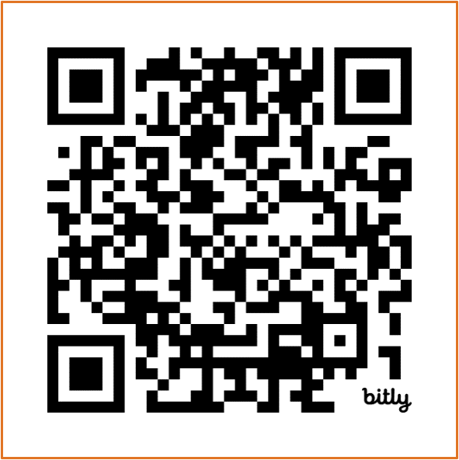
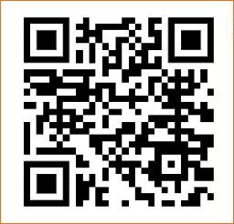
California English Learner (EL) Roadmap Principles (2)
Multilingual learners "fully and meaningfully access and participate in a 21st century education from early childhood through grade twelve that results in their attaining high levels of English proficiency, mastery of grade level standards, and opportunities to develop proficiency in multiple languages."
Scan QR codes to access EL Roadmap Resources at https://www.cde.ca.gov/sp/el/rm/index.asp and https://www.elroadmap.org/

Slide 5
Preschool CDS Codes
Local Educational Agency (LEA) operated California State Preschool Programs (CSPP) have been issued CDS codes. They will be accessible on the CAPSDAC system.
  There is no action needed on the part of the LEA.
New LEA operated CSPP sites will need to obtain a CDS code.
  Additional guidance will be released on this process.

Slide 6
Pre-populated CSPP Sites in CAPSDAC
CAPSDAC users will have the ability to download their LEA's Site List along with corresponding CDS codes directly from the system. This feature is accessible through a report titled 'Information (including CDS Code) for each preschool site within this LEA.’
CAPSDAC users will have the flexibility to select between sites when manually adding records for the monthly submission. The overview window will automatically populate the selected site's name and its corresponding CDS code, ensuring accuracy and efficiency in data entry.

Slide 7
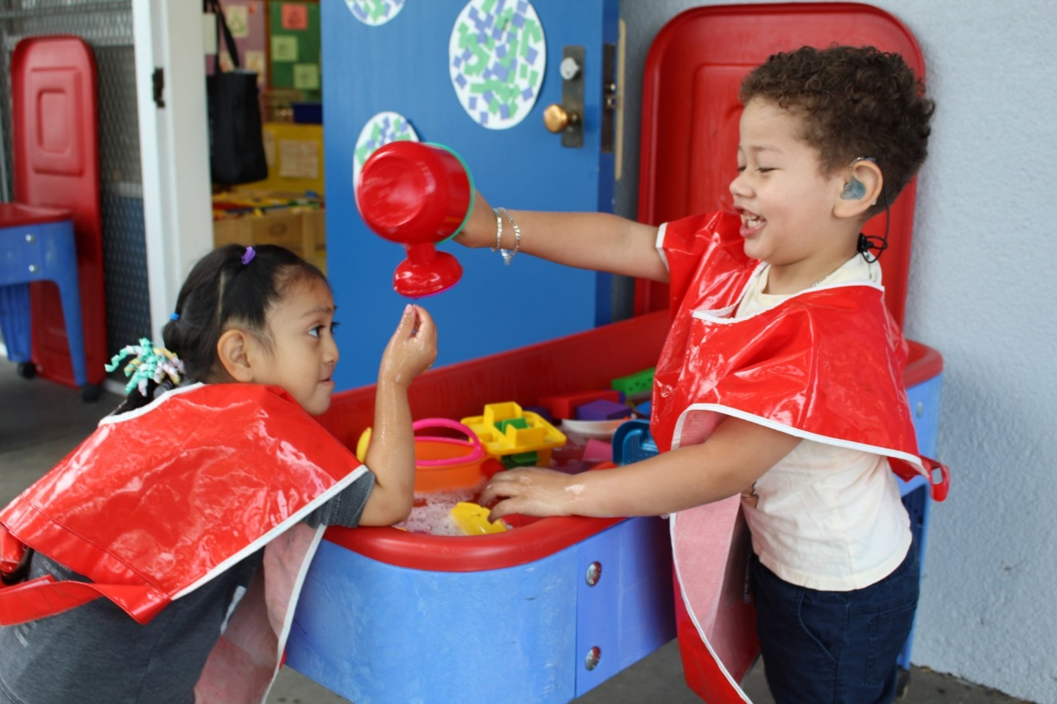
CAPSDAC 1.0 – Demonstration
Live Demonstration:
During this portion of the webinar, a staff member will share their web browser to showcase the CAPSDAC Online Portal and the Manual Entry, Copy Forward, and Electronic File Data Submission options.
Photo Credit: Breed St. Elementary, Deaf & Hard of Hearing Program

Slide 8

Questions and Answers
Photo Credit: Kidango Decoto Center; Union City, CA

Slide 9
Thank you!

