Slide 1
California Preschool Data Collection (CAPSDAC) Contractor Training Webinar
Applied Data Research and Evaluation Office (ADRE)
California Department of Education (CDE)
Date: August 27, 2024
Time: 10 a.m. – 11:30 a.m.

Slide 2
Agenda (1)
What is CAPSDAC?
Account Management & User Permissions
Manually Data Entry
Electronic File Transfer
Copy Forwarding
Certifying Data Submission & Reporting No Services

Slide 3
Agenda (2)
Updating Agency Information
Reporting Schedule & Due Dates
Frequently Asked Questions (FAQs)
Resources and Contact Information
Upcoming Webinars & Office Hours
Questions and Answers

Slide 4
What is CAPSDAC? Web address: www.capsdac.org
Pursuant to Education Code (EC) Section 60910 and Assembly Bill (AB) 22, the California Department of Education (CDE) is required to collect data elements for children, staff, and classrooms for local educational agencies (LEAs) in the California State Preschool Program (CSPP).
In response to this requirement, the California Preschool Data Collection (CAPSDAC) System was developed and launched in July 2024.
For the purposes of CAPSDAC, an LEA is defined as a county office of education, school district, or charter school.
Agencies submitting the CAPSDAC Monthly Data Submission are no longer responsible for submitting the CDD-801A Monthly Child Care Population Report (CDD-801A) or the Preschool Language Information System (PLIS) Report.

Slide 5
CAPSDAC: Account Management
To access CAPSDAC: Each LEA already had accounts created for the Agency Program Director and Executive Director.
The Program Director and Executive Director can create accounts for other users in their agency that they want to have access to CDMIS.
When creating an account:
The information that is needed for the new user is the first name, last name, phone number, email and user permission level.

Slide 6
CAPSDAC: User Permissions (1)
LEAAdmins:
In addition to adding accounts for their agency, LEAAdmins will have the permissions to edit and delete accounts within their LEAs.
LEAAdmins are responsible for reactivating and deactivating accounts that need to be active or need to become inactive.
LEAAdmins will also have all the same functions as the App Users.

Slide 7
CAPSDAC: User Permissions (2)
App Users
App Users are able to edit their own accounts, which includes editing their first name, last name, phone number and email address.
App Users will have the ability to upload teacher, classroom and child data as well as edit and delete that data.

Slide 8
CAPSDAC: Manual Data Entry (1)
Manual entry involves directly inputting data into the CAPSDAC system one record at a time, suitable for immediate updates.
Select Preschool:
Under the "Preschool" dropdown menu, select the preschool of your choice.
Automatic Redirection:
You will be automatically directed to the Classroom Records section.

Slide 9
CAPSDAC: Manual Data Entry (2)
Complete Manual Entry in Order: Follow the required sequence as each section depends on the previous one:
Classroom Records: Enter details such as classroom name, teacher assignment, and capacity.
Staff Records: Enter staff information including name, role, and classroom assignment.
Child Records: Enter child information such as name, date of birth, and enrollment status.
Certification:
Once all sections are completed, you may certify the data at the LEA's discretion.
If corrections are needed, click "Uncertify Data," make the necessary corrections, and then recertify.

Slide 10

CAPSDAC: Manual Data Entry Demo
During this portion of the webinar, a CAPSDAC Support staff member will share their screen and showcase how users can manually enter Classroom, Staff, and Child Records into the system.
P– 3 Learning Progressions Harvest

Slide 11
CAPSDAC: Electronic File Transfer (1)
Step 1: Understand The Upload Process
This process allows LEAs to upload data for Child, Staff, and Classroom records for all preschools at once.
File Format: Must be a Comma-separated Values (CSV) file, created using any spreadsheet software.
File Structure: Rows represent entity records; columns represent data values. Ensure every row has data for all columns (except optional ones).
Important Note: Uploading a validated file will overwrite existing data for the entity type.

Slide 12
CAPSDAC: Electronic File Transfer (2)
Step 2: Download A CSV File To Work With
Download a blank template or the previous month's data file from the "File Downloads" section to ensure correct setup.
Step 3: Modify the CSV File and Upload
Add or modify entity data in the CSV file following guidelines. Use appropriate codes as per the "Data Columns" section.
Error Handling: Fix any errors encountered during upload and try again.

Slide 13

CAPSDAC: Electronic File Transfer Demo
During this portion of the webinar, a CAPSDAC Support staff member will share their screen and showcase how users can upload Classroom, Staff, and Child Records into the system via Electronic File Transfer.
California Preschool/Transitional Kindergarten Learning Foundations (PTKLF) Harvest

Slide 14
CAPSDAC: Copy Forwarding Records (1)
CAPSDAC users will have the ability to easily "Copy Forward" their records from one month to the next by downloading an electronic file copy of a previous month, and reuploading this file to the current submission period. This feature streamlines data entry and reduces duplicate effort, ensuring efficient data management within the system.
Classroom Record File
Staff Record File
Child Record File

Slide 15
CAPSDAC: Copy Forwarding Records (2)
Classroom Record File
Click on "Classroom File Management" on the top right under "LEA Actions"
Under "File Downloads", click [Download] next to "This LEA's most recent previous Data Submission Period (Month Year) Classroom records:"
Locate and open the downloaded file on your device
Review information and update, delete, or add as necessary

Slide 16
CAPSDAC: Copy Forwarding Records (3)
5. Confirm all information in the Classroom Record file is correct before saving your file
6. Upload the updated Classroom Record file for the current reporting period by following the same upload steps as the Electronic File Transfer Method

Slide 17
CAPSDAC: Copy Forwarding Records (4)
Staff Record File
Click on "Staff File Management" on the top right under "LEA Actions"
Under "File Downloads", click [Download] next to "This LEA's most recent previous Data Submission Period (Month Year) Staff records:"
Locate and open the downloaded file on your device
Review information and update, delete, or add as necessary

Slide 18
CAPSDAC: Copy Forwarding Records (5)
5. Confirm all information in the Staff Record file is correct before saving your file
6. Upload the updated Staff Record file for the current reporting period by following the same upload steps as the Electronic File Transfer Method

Slide 19
CAPSDAC: Copy Forwarding Records (6)
Child Record File
Click on "Child File Management" on the top right under "LEA Actions"
Under "File Downloads", click [Download] next to "This LEA's most recent previous Data Submission Period (Month Year) Child records:"
Locate and open the downloaded file on your device
Review information and update, delete, or add as necessary

Slide 20
CAPSDAC: Copy Forwarding Records (7)
5. Confirm all information in the Child Record file is correct before saving your file
6. Upload the updated Child Record file for the current reporting period by following the same upload steps as the Electronic File Transfer Method

Slide 21
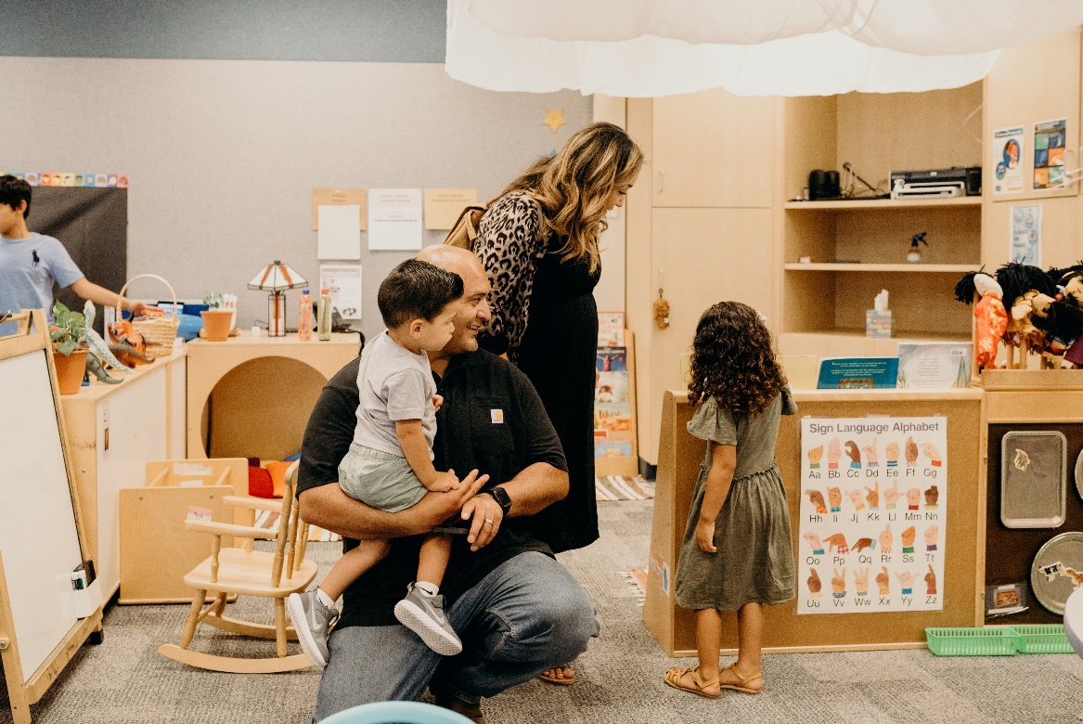
CAPSDAC: Copy Forward Demo
During this portion of the webinar, a CAPSDAC Support staff member will share their screen and showcase how users can upload Classroom, Staff, and Child Records into the system via Copy Forward.
Back to School Barbeque 2022

Slide 22
CAPSDAC: Certifying Data Submission (1)
After submitting data and completing a review of the data submitted, begin the certification process. To certify:
Click on "Certify this LEAs data" under "LEA Actions"
Review the Validation Report and its' respective warnings for any preschool sites that are missing Child, Staff, and/or Classroom Data
Review the LEA’s Monitoring Report
Enter your name, email, and phone number in the designated fields, and then click the "Certify and Submit" button to complete the certification process. After certifying, you will see a "Certification Successful" message.
This will certify the data for the entire LEA, not just one preschool site.

Slide 23
CAPSDAC: Certifying Data Submission (2)
You can confirm if you have or have not certified your data by looking at the "LEA Certification Status" in the Overview window.
If the text next to it states, "Pending Data Entry & Certification," then you have not certified that data.
After certifying the data, the certification status will change to "Data Certified for [Month Year] by [User's Name] on [Month, Date, & Year] at [Time].
After you have completed certification, make sure to download your certified data and keep a record of each month's data, as only one month of previous data will be accessible.

Slide 24
CAPSDAC: Reporting No Services (1)
If an agency has a contract, but does not have any children enrolled in CSPP, or the programs are not providing the service of CSPP during a given month, the agency must certify with no data submitted, indicating no children were enrolled that month, and so no services were provided for that month.
This process of certifying with zero class, staff, and child data is reporting no services.

Slide 25
CAPSDAC: Reporting No Services (2)
To report no services, follow the same certification process.
After clicking to certify, a notification will pop up regarding a warning for any preschool sites that are missing Child, Staff, and/or Classroom Data. Continue with the certification process and enter your name, email, and phone number in the designated fields, and then click the "Certify and Submit" button to complete the certification process or reporting no services.

Slide 26

CAPSDAC: Certification Demo
During this portion of the webinar, a CAPSDAC Support staff member will share their screen and showcase how users can certify their data submissions each month.
Trauma Informed Care Module

Slide 27
CAPSDAC: Updating Agency Information
The agencies manage their site data for CAPSDAC in CDMIS (Child Development Management Information System).
The agencies continue to manage their sites data including sites name, address, program director and executive director contact information, Family Childcare Home (FCCH) information, etc.
Super Users can navigate to the User Settings and select “Update Agency Information” to manage their data

Slide 28
CAPSDAC: Reporting Schedule and Due Dates
CAPSDAC Submission | Official Submission Window | Certification Deadline | Amendment Window
July 2024 | August 1–15, 2024 | August 15, 2024 | August 16–31, 2024
August 2024 | September 1–16, 2024 | September 16, 2024 | September 17–30, 2024

Slide 29
CAPSDAC: Frequently Asked Questions (1)
CAPSDAC FAQs Link (See Below):
https://www.cde.ca.gov/sp/cd/ci/capsdacfaqs.asp
General
Which CSPP contractors are required to submit data to the CAPSDAC?
The CSPP contractors that are required to submit child and family, staff, and classroom data to the CAPSDAC System, CAPSDAC Users, per EC 60910 are LEAs defined by EC 60900 as a county office of education, a school district, and a charter school.

Slide 30
CAPSDAC: Frequently Asked Questions (2)
System Access
Will I automatically get access to CAPSDAC if I have a CDMIS and/or PLIS account?
No, access to CAPSDAC is not automatically granted to all users with a CDMIS and/or PLIS account. Only Program Directors and Executive Directors will automatically receive access to CAPSDAC and will be assigned the "LEA Admin" role. LEA Admin users can create CAPSDAC accounts for other users within their agency as needed.

Slide 31
CAPSDAC: Frequently Asked Questions (3)
Data Collection
How does CAPSDAC accommodate sensitive staff data that our Human Resource department manages for California Longitudinal Pupil Achievement Data System (CALPADS) reporting?
CAPSDAC follows a similar approach to CALPADS by allowing the contracted agency to designate authorized staff members with access to the system. This enables contractors to maintain confidentiality and meet their data security requirements.

Slide 32
CAPSDAC: Frequently Asked Questions (4)
Data Submission Frequency
Why does the CAPSDAC Certification Deadline fall on the 15th of each month? What is the purpose of the shorter locking time?
The CAPSDAC certification deadline is set on the 15th of each month to allow sufficient time for technical assistance and issue resolution before the data submission period fully locks at the end of the month.

Slide 33
CAPSDAC: Frequently Asked Questions (5)
CAPSDAC Submission – Staff
Do all staff members need to have California Statewide Educator Identifiers (SEIDs)?
No, not all staff members are issued SEIDs by the Commission on Teacher Credentialing (CTC). SEIDs are issued by the CTC to all certificated staff (teaching and non-teaching) that have a valid application or hold a valid certificate, permit or credential maintained by CTC. Certificated staff are individuals that provide educational services including teachers, administrators, counselors, librarians, nurses, speech therapists, and others. This is reported in the CTC SEID FAQ page located here https://www.ctc.ca.gov/credentials/assignment-resources/SEID-FAQs

Slide 34
CAPSDAC: Frequently Asked Questions (6)
CAPSDAC Submission – Child
Can we use our Statewide Student Identifier (SSID) from CALPADS in the CAPSDAC?
Yes, you can use the SSID from California Longitudinal Pupil Achievement Data System (CALPADS) in the CAPSDAC for the Child ID field if the child has been issued an SSID. System users are required to develop and maintain the Child ID field locally for all children, ensuring it remains unique for each child within their data. If the child has been issued an SSID, agencies are encouraged to use the SSID as their local Child ID.

Slide 35
CAPSDAC: Resources & Contact Information
Resources
CAPSAC Support Page: https://www.cde.ca.gov/sp/cd/ci/capsdacsupportlanding.asp
Contact Information
CAPSDAC Support Team: CAPSDAC@cde.ca.gov

Slide 36
Upcoming Webinars and Office Hours
Webinars:
September 17, 2024, 10 a.m. to 11 a.m.
Office Hours:
September 10, 2024, 10 a.m. to 11 a.m.
Also found at https://www.cde.ca.gov/sp/cd/ci/capsdacwebinars.asp

Slide 37

Questions and Answers
Photo Credit: Kidango Decoto Center; Union City, CA

Slide 38
Thank you!

