Slide 1
Child Development Management Information System (CDMIS) Updates
Early Education Division
Date: October 23, 2026
Time: 10:30 a.m. to 12:00 p.m.

Slide 2
Agenda
Introduction of CDMIS 2.0
CDMIS 2.0 Timeline
Consolidation of CDMIS and the Preschool Language Information System (PLIS)
Preschool, Classroom, Staff, and Children Data
CDMIS 2.0 Data Domains and Code Sets
Reviewing and Certifying Submitted Data
Training, Resources, and Future CDMIS 2.0 Updates

Slide 3
Introduction of CDMIS 2.0
Preliminary plans of a new interface for CDMIS 2.0
Alignment of many data fields from the California Preschool Data Collection (CAPSDAC) System 2.0 will begin to be collected in CDMIS 2.0 for data comparability
  Classroom, Staff, Child
  The 801A Report will be replaced by the CDMIS Monthly Report
Tentative plans to collect additional data and transition to new CDMIS 2.0 for July 2027 data

Slide 4
CDMIS 2.0 Timeline
Ongoing User Acceptance Testing (UAT) sessions for contractors and software vendors
  Testing interface and login, update agency information, manual input and electronic file upload of CDMIS Monthly Report
  First UAT session is planned for December 2026, focused on logging in and user management
Soft launch of the CDMIS 2.0 planned for release in late spring 2027
Official submissions planned for July 2027 report period

Slide 5
Consolidation of CDMIS and PLIS
The primary goal of CDMIS 2.0 is to consolidate the CDMIS 801A Monthly Population Report and the PLIS Report
New CDMIS Monthly Report will include all dual language learner data elements from the PLIS Report
No more multiple CSPP Early Education Division data systems for reporting child data!
Final PLIS Report due in the PLIS: 2026-27 Quarter 4 PLIS Report

Slide 6
Accessing CDMIS 2.0 and Managing Agency Information
Upon the release of the CDMIS 2.0, all existing CDMIS users will receive a new username and temporary password
LEAs that do not currently submit the 801A Report will still be required to use the CDMIS 2.0 for updating and maintaining agency and site information

Slide 7
Preschool, Classroom, Staff, and Children Data
The new CDMIS CSPP Monthly Report will organize information into linked preschool, classroom, staff, and child records
Each preschool site will receive a unique, system-generated Site ID (SiteID)
Agencies will enter each preschool and classroom once, and then add the children that are enrolled to that preschool

Slide 8
CDMIS 2.0 Data Domains and Code Sets
CDMIS 2.0 Data Domains and Fields (Draft) and CDMIS 2.0 Code Sets (Draft) have been published to the CDMIS 2.0 Support web page
Includes all proposed data fields and applicable code options that will be included in the CDMIS CSPP Monthly Report for CDMIS 2.0
All fields for children and family are included in either the Confidential Application for the CSPP EED-9600 and the Confidential Application for the CSPP EED-9600 Appendix

Slide 9
Reviewing and Certifying Submitted Data
Updated reporting process will require CDMIS 2.0 users to review each report’s data and certify that their data is accurate and complete
This will include the agency’s program administrator or designated individual to enter contact information formally attesting their data
Certification will lock the report against further changes, and will be due by the 15th of each month, and allow for changes during the amendment window

Slide 10
First CDMIS 2.0 User Acceptance Testing Sessions
Recruiting UAT volunteers for the first CDMIS 2.0 testing session!
  Demonstration session on December 1, 2026, from 1:30 p.m. – 3:00 p.m.
  Feedback session on December 15, 2026, from 2:00 – 3:30 p.m.
First UAT will be focused on the new user interface, login, and user management
If interested in participating, please send an email to CDMIS@cde.ca.gov by November 20, 2026

Slide 11
Training, Resources, and Future CDMIS 2.0 Updates
The CDMIS 2.0 Upcoming Changes web page will be the support web page with:
  User manuals
  Data domains and fields
  Code sets
  CDMIS Updates
  Webinars and office hours dates
  In-person training dates and locations
More virtual webinars and in-person trainings to come!

Slide 12
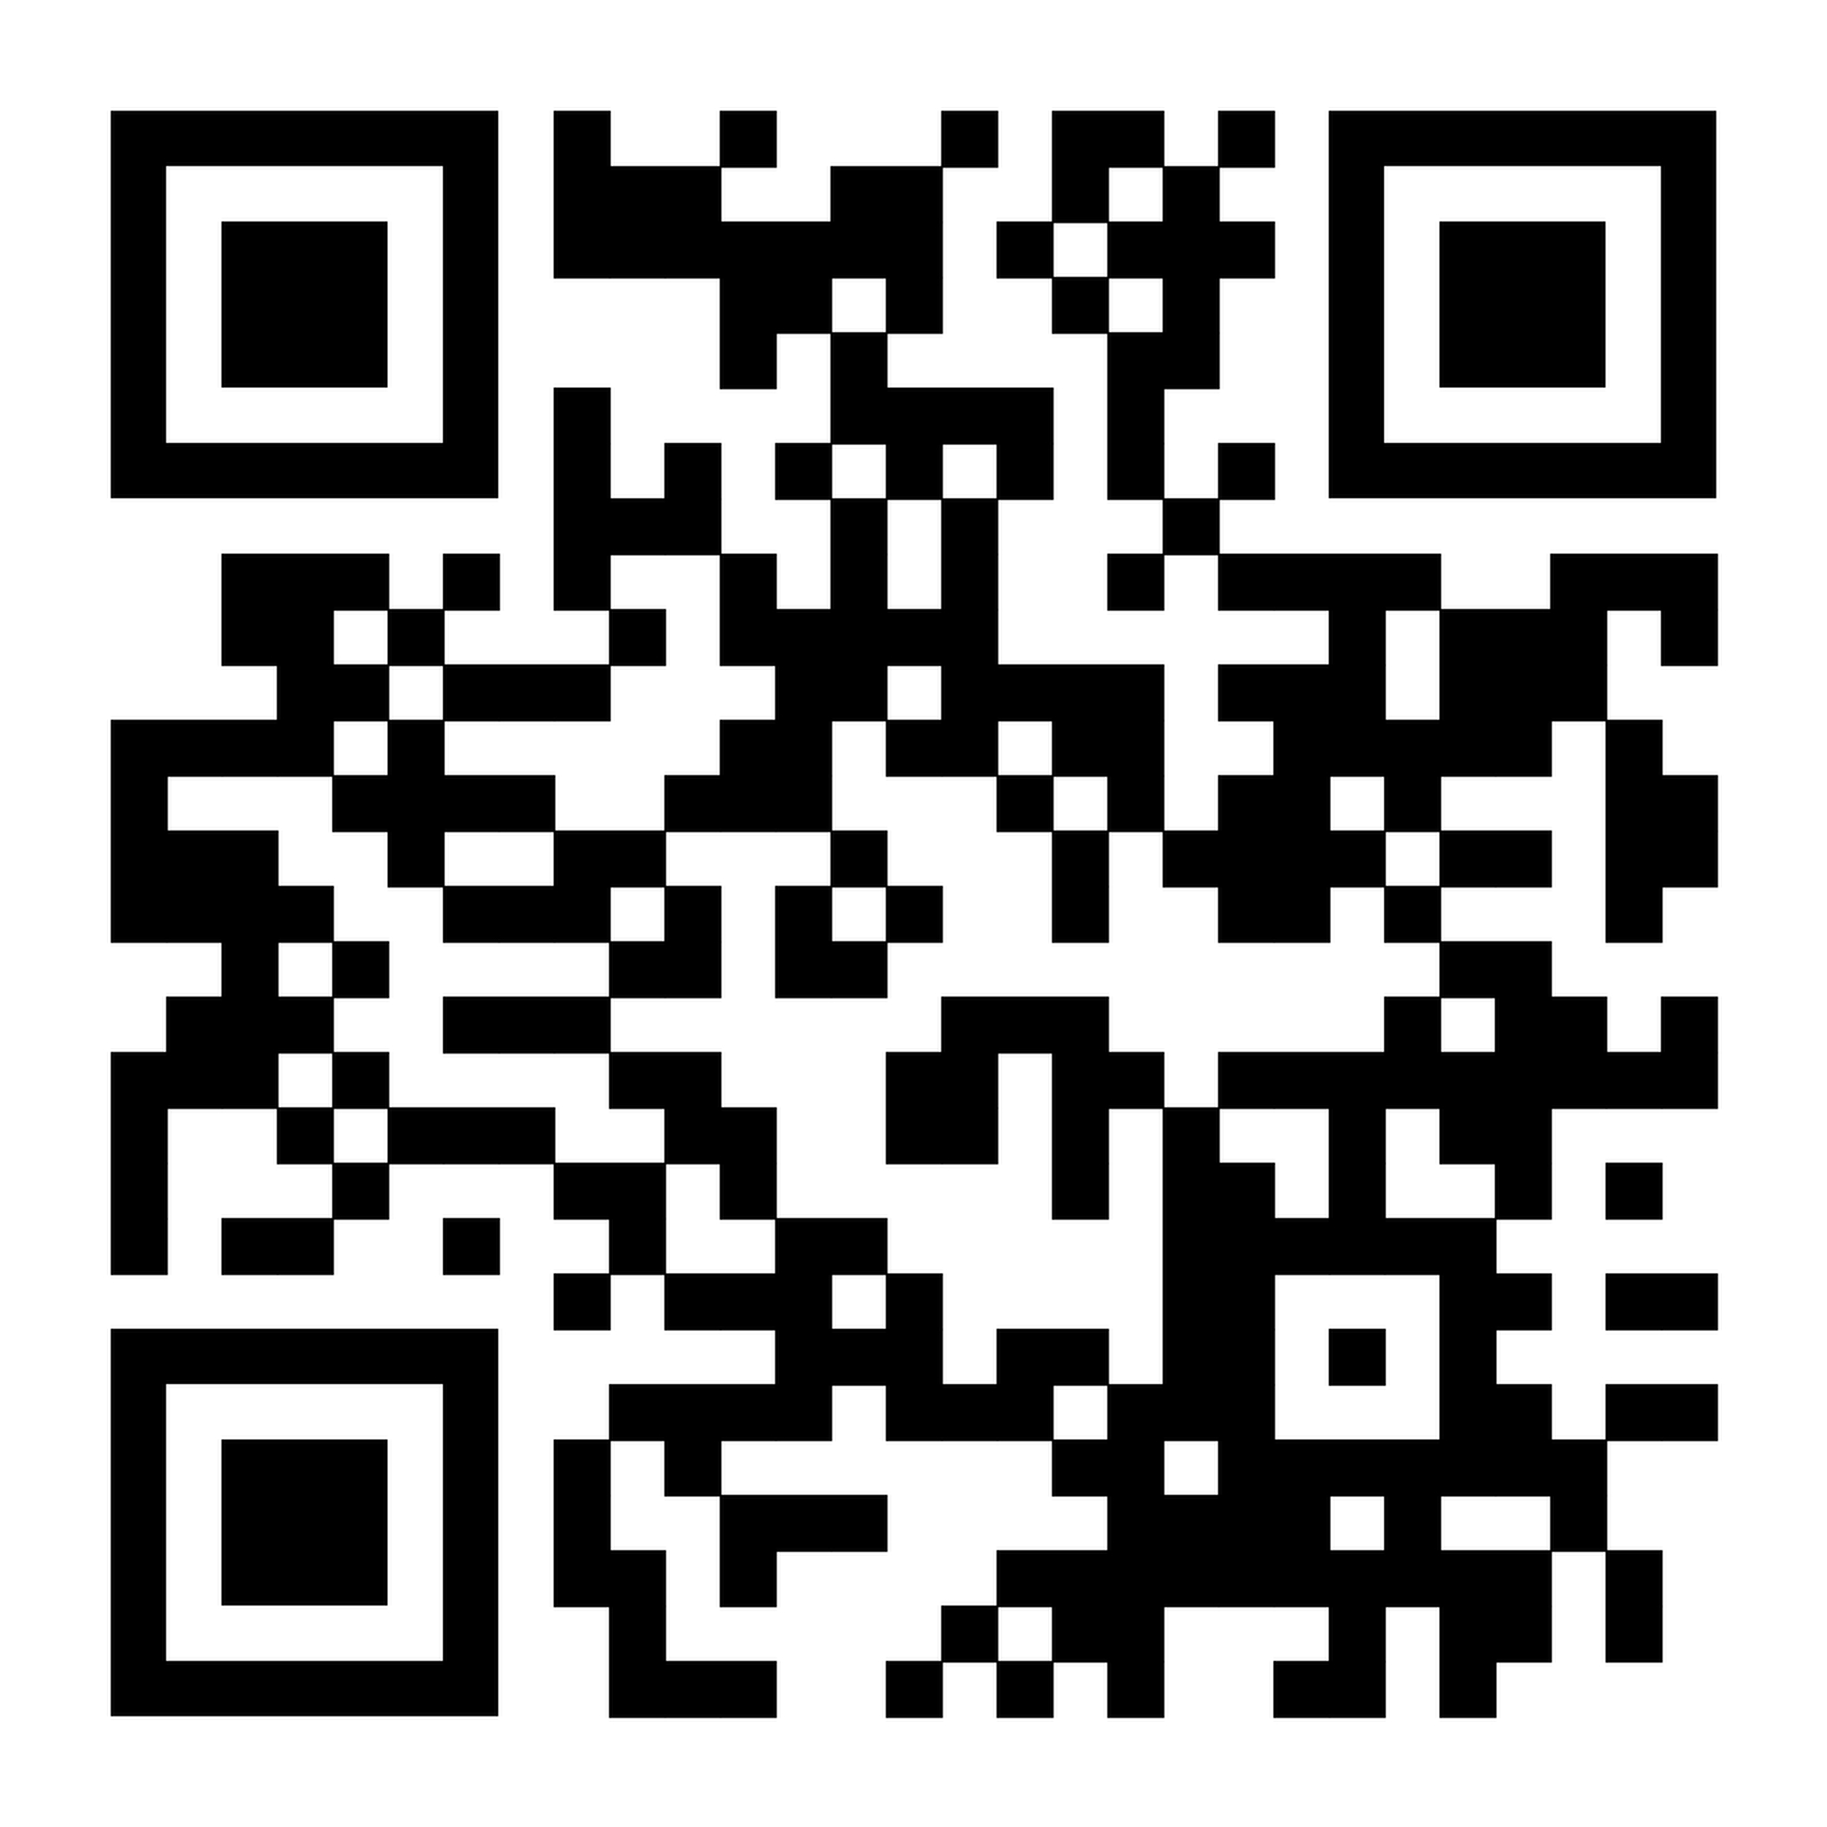
CDMIS Resource Web Page
CDMIS 2.0 Support Web Page
https://www.cde.ca.gov/sp/cd/ci/cdmis2changes.asp

Slide 13

Thank you!
Photo Credit: Kidango Decoto Center; Union City, CA

