Slide 1
Child Development Management Information System (CDMIS), Preschool Language Information System (PLIS), and California Preschool Data Collection (CAPSDAC) System Updates
Applied Data Research and Evaluation Office (ADRE)
California Department of Education (CDE)
Date: March 12, 2024
Time: 10–11:30 a.m.

Slide 2
Agenda (1)
CDMIS Updates
Reason Code V vs. Reason Code Q
Accurate Data Submission Regarding Children With Disabilities (CWD)
Updating Agency Site and Office Information
Reporting Type of Childcare
Updating Family Child Care Home (FCCH) Information
PLIS Updates

Slide 3
Agenda (2)
CAPSDAC System Updates
Local Educational Agency (LEA) and Non-LEA Reporting
CASPDAC 1.0 vs 2.0
CASPDAC 1.0 Basic Data Submission
CASPDAC 1.0 Expected Data Elements
Resources
Question and Answer

Slide 4
CDMIS Updates (1)
Reminder: The CDMIS Support Team regularly releases updates on future changes to the CDMIS to keep users informed about upcoming reporting changes and system improvements, ensuring transparency and facilitating a smooth user experience.
https://www.cde.ca.gov/sp/cd/ci/update.asp
Issue #32: Reason Code U & V
The “Reason for Receiving Child Care Services” information field in the CDMIS includes two new reason codes, "U - CSPP Early Enrollment" and "V - Means-Tested Government Program," added starting February 1, 2024.
https://www.cde.ca.gov/sp/cd/ci/cdmisupdate32.asp

Slide 5
CDMIS Updates (2)
Issue #33: Services Type and Length Field
The CDMIS enhanced the 'Child Receives Part-Day Care' field to become the 'Services Type and Length' field, now allowing users to specify whether a child is enrolled in direct or subcontracted services, with options for full-day or part-day care.
https://www.cde.ca.gov/sp/cd/ci/cdmisupdate33.asp
Issue #34: Copy Forward Issues
Users experiencing issues with copying forward CDD-801A reports from December 2023 to January 2024 can find assistance from the CDMIS Support Team. This update provides instructions for users to export and transfer data to the new format for a smooth transition.
https://www.cde.ca.gov/sp/cd/ci/cdmisupdate34.asp

Slide 6
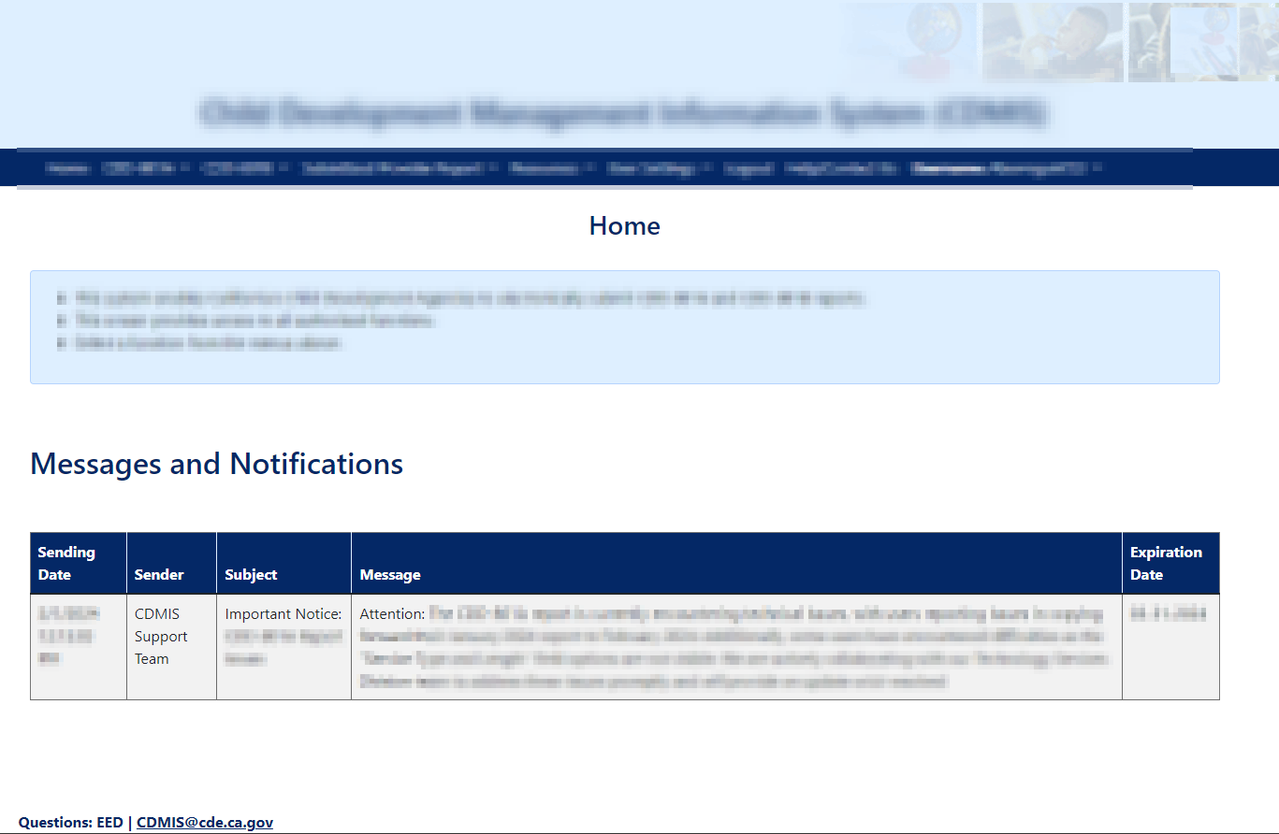
CDMIS Updates (3)
Messages and Notifications:
The CDMIS Support Team disseminates important updates, including a summary of recent changes, through the "Messages and Notifications" window on the CDMIS Landing Page.
Contractors are advised to regularly check this section for crucial information such as system outages, extensions to report deadlines, and other essential announcements to stay informed and ensure compliance.

Slide 7
Reason Code V vs. Reason Code Q (1)
Reason Code V – Means-Tested Government Program vs Reason Code Q – Part-Day CSPP
Who Should be Using Reason Code V – Means-Tested Government Program:
Children and families who are over the allowable income threshold but are eligible for subsidized services through Means-Tested Government Programs under the provisions of Education Code (EC) 8213.5 (a) – (c)
Children and families who fulfill the above requirements and do not qualify for any other reason code
Restrictions:
This code can be used when any of the children in the family are receiving services in California State Preschool Program (CSPP), General Child Care and Development Programs (CCTR), Migrant Child Care and Development Programs (CMIG), California Family Child Care Home Education Networks (CFCC), California Alternative Payment Programs (CAPP), CalWORKs Stage 2 (C2AP), CalWORKs Stage 3 (C3AP), and Migrant Child Care Alternative Payment Programs (CMAP).

Slide 8
Reason Code V vs. Reason Code Q (2)
This code can be used when all of the children received Full-Day Services, Part-Day Services, or a mix of both length of care types.
This code can only be used when all of the children in the family are age eligible for their respective contract types.
This code has no income limits, and the family can exceed the 100% x 1.15 State Median Income Threshold limits.
This code can only be used in the following report periods: July 2023 into perpetuity.

Slide 9
Reason Code V vs. Reason Code Q (3)
Who Should be Using Reason Code Q – Part-Day CSPP:
Families where all children in the family receive only part-day CSPP services
“Services Type and Length of Care” must be "B: Direct Services Part-Day" OR "D: Subcontracted/Voucher/FCCHEN Services Part-Day"
AND the family's eligibility is based on income, not Child Protective Services (CPS) or Homelessness

Slide 10
Reason Code V vs. Reason Code Q (4)
Reason Code V – Means Tested Government Program | Reason Code Q – Part-Day CSPP
All program codes | CSPP only
Full-Day, Part-Day or a mix of both | Part-Day Services Only
Eligibility based on Means-Tested Government Programs | Eligibility based on income
No other reason code applies | N/A
Important: The CDMIS, PLIS, and CAPSDAC should not be used to determine whether a family or child is eligible for a program. We recommend that you direct these questions over to your assigned CDE/CDSS PQI Consultant, as they are the experts on eligibility and enrollment.

Slide 11
Accurate Data Submission Regarding Children with Disabilities (CWD) (1)
EC Sections 8208(c)(1) and (d)(2)(A) outline the requirements for enrolling children with disabilities into a CSPP.
For the 2023−24 and 2024−25 fiscal years, 5 percent of the CSPP contractor's funded enrollment must be reserved for children with disabilities.
Compliance is being tracked through quarterly fiscal enrollment and attendance reporting, supplemented by an annual survey on Children with Disabilities in CSPP and monthly CDD-801A reporting.

Slide 12
Accurate Data Submission Regarding Children with Disabilities (CWD) (2)
The 801A has a child-level field that indicates whether the child has an active Individualized Education Plan (IEP) or Individual Family Services Plan (IFSP).
Maintaining up-to-date IEP and IFSP information in your monthly 801A report assures you are not only submitting accurate data, but will also assist in the completion of the annual CWD Survey.
20 agencies did not submit the CWD Survey for 2022−23; there are potential fiscal consequences for not submitting it for 2023−24.

Slide 13
Agency Site and Office Information
Site: The physical location where subsidized care is occurring
Sites are typically used for CCTR, CHAN, CMIG and CSPP
Office: The administrative location where subsidized care is applied for
Offices are typically used for C2AP, C3AP, CAPP, CFCC, CMAP, and CRRP. They would also be used for the other four contract types when the care is outside of the office location, such as in a family childcare home.

Slide 14
Updating Agency Site and Office Child Counts
"Number of Children Served in Each Contract" changing to capture Licensed Capacity
FCCH child counts are not captured in this area. Those numbers are captured in the FCCH Information section.
CSPP Example:
Licensed Capacity is 28
3 Year Olds: 14
4 Year Olds: 14
Other: 0
CCTR Example:
Licensed Capacity is 28
Infants: 4
Toddlers: 4
Pre School: 10
School Age: 10

Slide 15
Reporting Type of Child Care
Users should only be able to use a Family Child Care Home Type of Child Care if, the "Number of Homes" in CDMIS is greater than or equal to one AND at least one Office or Site is listed.
CDD-801A Field: Type of Child Care 02 – Licensed family child care home 03 – Licensed large family child care home
04 - Licensed center-based care 05 – License-exempt in child’s home by a relative 06 – License-exempt in child’s home by a nonrelative 07 – License-exempt outside the child’s home by a relative 08 – License-exempt outside the child’s home by a nonrelative
11 – License-exempt center-based care

Slide 16
Updating FCCH Information
Login to CDMIS
Select
User Settings
Update Agency Information
Click on
Add/Edit FCCH Information
Add a FCCH Contract
Select each contract associated with a FCCH and input the number of home and child count information.
* Please note - Only agency Super Users can update agency information

Slide 17
California English Learner (EL) Roadmap Principles (1)
Principle One: Assets-Oriented and Needs-Responsive Schools
Principle Two: Intellectual Quality of Instruction and Meaningful Access
Principle Three: System Conditions that Support Effectiveness
Principle Four: Alignment and Articulation Within and Across Systems

Slide 18
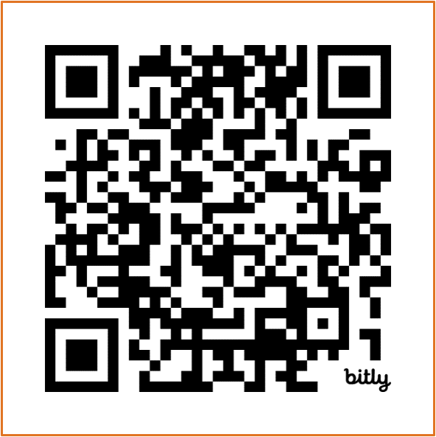
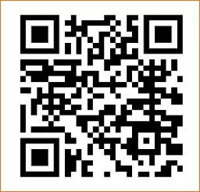
California English Learner (EL) Roadmap Principles (2)
Multilingual learners "fully and meaningfully access and participate in a 21st century education from early childhood through grade twelve that results in their attaining high levels of English proficiency, mastery of grade level standards, and opportunities to develop proficiency in multiple languages."
Scan QR codes to access EL Roadmap Resources at https://www.cde.ca.gov/sp/el/rm/index.asp and https://www.elroadmap.org/

Slide 19
Preschool Language Information System (PLIS): Updates
Teacher and Other Staff Language Options
1200 Teachers and Other Staff reported with the language used in the classroom and most proficient language as "Unknown".
Unknown should only be used when a child deemed a dual language learner disenrolls before the Family Language and Interest Interview is conducted.
If the language the teacher or other staff uses in the classroom or is proficient in is a language option that is not currently available, please use the language 99 - Other non-English Language.
If this code is used, PLIS Support Staff will reach out and inquire about what language option is not available.

Slide 20
CAPSDAC Updates
CAPSDAC will be a web portal outside of the Child Development Management Information System (CDMIS) and Preschool Language Information System (PLIS).
Intending external testing with existing Local Education Agency (LEA) CSPP contractor CDMIS and PLIS users tentatively in late March 2024 or early April.
There is a CAPSDAC email address now.
CAPSDAC@cde.ca.gov
There are four phases planned for the development of CAPSDAC to fully implement Assembly Bill 22 requirements to collect the same data as CALPADS collects for TK from LEAs
Phase 1 Demographics, enrollments, and limited staff: July 2024
Phase 2 Limited LEA facing reporting and program records collection: December 2024
Phase 3 Identity management & full collection development: July 2025
Phase 4 Transition to full collection: December 2025

Slide 21
What to Expect
Continued monthly webinars. Current planned dates for the next webinars are:
April webinar: 04/23/2024, 10:00–11:30 a.m.
May webinar: 05/14/2024, 10:00–11:30 a.m.
June webinar: 06/11/2024, 10:00–11:30 a.m.
Outreach regarding participation in the external user acceptance testing.
CDE is asking for volunteers to get involved in the CAPSDAC system development and user acceptance testing. Please email us at CAPSDAC@cde.ca.gov if you can volunteer.
Management Bulletins on CAPSDAC Data Submission that will provide instructions, timelines, and schedules.
Webinar based training on use of the CAPSDAC for data submission.
Changes in data submission with the transition of each of the four phases of CAPSDAC.

Slide 22
LEA and Non-LEA CSPP Reporting (1)
LEA CSPP Contractors with CDE
Will transition to submitting data containing pupil, educator, classroom, and enrollment elements through CAPSDAC on a monthly basis.
Data submission will need to be certified by the LEA CSPP contractor.
Will have a shortened data submission period compared to the CDMIS; once the period is over, no further changes can be made in the CAPSDAC.
Will no longer be required to submit data to the PLIS or the CDD-801A Report to the CDMIS.
LEA CSPP contractors that provide CSPP services through an approved CSPP Family Childcare Home Education Network (FCCHEN) will still be required to submit the Subsidized Provider Report (SPR) to the CDMIS.
LEA CSPP contractors will still be responsible for updating and maintaining their agency information via the CDMIS.

Slide 23
LEA and Non-LEA Reporting (2)
Non-LEA CSPP Contractors with CDE
Will continue to submit data in the PLIS and the CDMIS for the respective reports.
LEA CSPP contractors with CDE and CDSS
Will submit pupil data to the CAPSDAC for children enrolled in CSPP and will also submit the CDD-801A Report to the CDMIS for their CDSS contracts until further notice.

Slide 24
CAPSDAC 1.0 - Phased Rollout
CAPSDAC 1.0 (Phase I)
Release Date: July 1st, 2024
Required Data Submission Periods: July 2024 to December 2024
First date of required data submission: August 1st, 2024
Data Collection: Classroom, Staff, and Child records
CAPSDAC 1.0 (Phase II)
Release Date: January 1st, 2025
Required Data Submission Periods: January 2025 to June 2025
First date of required data submission: February 1st, 2025
Additional Data Collection: Expanded Disability Type and Service, Disciplinary, Attendance, etc.

Slide 25
CAPSDAC 1.0 - Reporting Frequency
Reporting Frequency
The CAPSDAC Data Submission will be collected monthly, and the due date will always be on the fifteenth the month following the end of the report period. This due date is subject to change as technical guidance for contractors is still being developed.
However, the data submission reporting period will be closing approximately fifteen (15) days after the due date. This timeline is significantly shorter than the current “Locking Schedule” that is used for the CDD-801A report.
Example:
For example, the October 2024 CAPSDAC Data Submission is due on November 15th, 2024. Late notifications will be sent via email to agencies who have failed to upload and certify their data on the following business day.

Slide 26
CAPSDAC 1.0 – Data Submission Options
Manual Entry:
The CAPSDAC will provide users with the capability to manually add, edit, and delete records within the system.
Electronic File Upload:
The CAPSDAC will provide users with the capability to add records through the upload of Comma Separated Value (CSV) files, with a specific requirement for users to submit three separate CSV files dedicated to the Classroom, Staff, and Child
Copy Forward:
The CAPSDAC will provide users the convenience of “Copy Forwarding” their records into the system by allowing them to download their prior report data in CSV format and subsequently upload these files during the submission of subsequent report periods, ensuring a seamless and efficient data transfer process.

Slide 27
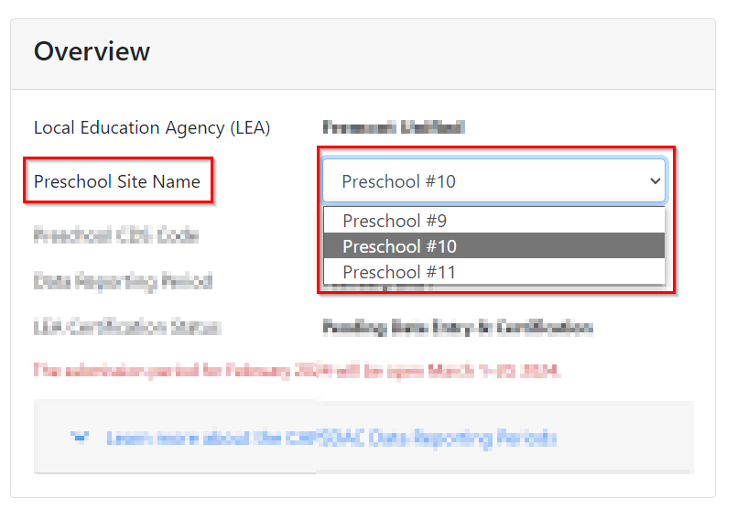
CAPSDAC 1.0 - Site Level Submission
Site Level Data Submission:
The CAPSDAC Data Submission requires that users submit their data at the site level. Users must verify the correct Preschool Site Name and Preschool CDS Code is visible in the “Overview” pop-up window prior to adding any Classroom, Staff, or Child records.
The site list for each agency was imported from the CDMIS’s Site Data in the “Update Agency Information” section.

Slide 28
CAPSDAC 1.0 - Certification
Certification:
After entering all Classroom, Staff, and Child Records into the California Preschool Data Collection (CAPSDAC) system, users are required to certify their data submission.
Users must formally attest to the accuracy and completeness of their submitted data, ensuring a reliable and trustworthy dataset for analysis and reporting purposes.

Slide 29
New Data Fields Collected in CAPSDAC Classroom Records
Data Field | Definition | Examples
Preschool CDS Code | The County-District-School code of the preschool site that this classroom is at. | 12345678987654
Classroom ID | The unique identifier for a classroom assigned by an LEA. | CLASS320
Classroom Name | The unique name or label assigned to a specific learning space within a preschool site. | Apple Classroom
Care Type | Indicates whether the classroom offers full-day or part-day care. | Full-Day

Slide 30
New Data Fields Collected in CAPSDAC Staff Records (1)
Data Field | Definition | Examples
Staff ID | LEA-assigned identifier unique to this child | GAR-4393
Staff Last Name | The last name of a staff member | Brown
Staff Date of Birth | The date the child disenrolls from CSPP with this LEA | 02/29/1990
Staff Gender | A coded value representing the person's gender | F
Staff Hispanic Ethnicity Indicator | The staff is Hispanic (regardless of other Race) | Y
Staff Race | Racial background(s) | Asia

Slide 31
New Data Fields Collected in CAPSDAC Staff Records (2)
Data Field | Definition | Examples
Staff Role | The educational service job classification of this staff. | Teacher
Staff Highest Degree | The highest degree the staff has earned | Master's Degree
Staff Years of Experience in LEA | The count of years a staff member has been providing educational service for a particular LEA | 7 years
Staff Waiver | Indicates whether the staff has received a local assignment waiver that is different from a permit or credential. | No
California Statewide Educator Identifier (SEID) | The staff's California Statewide Educator Identifier (SEID). | 123456690
Staff Permit/Credentials | The staff's highest level of teaching permit or credential. | Child Development Master Teacher Permit
Classroom Assignments | The classroom that the staff is assigned | 123

Slide 32
New Data Fields Collected in CAPSDAC Child Records (1)
Data Field | Definition | Examples
Child ID | LEA-assigned identifier unique to this child | GAR-4393
End Date of CSPP Enrollment | The date the child disenrolls from CSPP with this LEA | 02/29/2024
Child Country, State, and City of Birth | The country, state, and city the child was born in. | Country: US; State: California; City: San Diego
Child Eligibility Status* | The criteria in which the child was eligible and enrolled into CSPP. | Income Eligible
Head of Household Education (1st & 2nd) | The highest level of education obtained by the Head of Household (both HoH 1 and HoH 2) | Master's Degree
Head of Household 2 First and Last Name | The first and last name of the second head of household | John I. Doe
Home Address | The home address (including street, city, state, and zip code) where the child resides | 123 Main Street San Diego, CA 92101
Mailing Address | The mailing address (including street, city, state, and zip code) where the family receives mail (if different from home address) | PO Box 58 San Diego, CA 92101

Slide 33
New Data Fields Collected in CAPSDAC Child Records (2)
Data Field | Definition | Examples
Reason for Needing Service* | The reason the family qualifies for needing CSPP. | Actively Seeking Employment
Service Type | Indicates whether the child is enrolled in direct or subcontracted services at the LEA. | Direct Services
Full-Time Enrollments | Indicates the classroom names and IDs the child is enrolled in full-time. | HappySchool-Apple Classroom (09876)
Part-Time Enrollments | Indicates the classroom names and IDs the child is enrolled in part-time. | HappySchool-Carrot Classroom (12345)
Note: All data fields are subject to change; final guidance will be in a forthcoming Management Bulletin.

Slide 34
Resources and Contact Information (1)
CDMIS technical assistance inbox:
CDMIS@cde.ca.gov and CDMIS@dss.ca.gov
CDMIS Resources Webpage:
https://www.cde.ca.gov/sp/cd/ci/main.asp
CDMIS Site:
https://www4.cde.ca.gov/cdmis

Slide 35
Resources and Contact Information (2)
CAPSDAC technical assistance inbox:
CAPSDAC@cde.ca.gov
CDE is asking for volunteers to get involved in the CAPSDAC system development and user acceptance testing. Please reach out to the email address listed above if you are interested.
CAPSDAC Resources web page (Coming Soon):
CAPSDAC Site (Coming Soon):

Slide 36

Questions and Answers
Photo Credit: Kidango Decoto Center; Union City, CA

Slide 37
Thank you!

