Slide 1
Fiscal Year 2026–27 Continued Funding Application for California State Preschool Program and Prekindergarten and Family Literacy Support Contractors Presented by the Early Education Division ​​ Date: September 17, 2025 Time: 10 to 11:30 a.m.

Slide 2

Welcome and Introductions

Slide 3
Agenda
Management Bulletin (MB) 25-08
Statutory Background
Autorenewal
Continued Funding Application (CFA) Updates for Fiscal Year (FY) 2026–27
CFA Instructions and Walkthrough
CFA Submission
CFA Office Hours and Contact Information
Questions
Closing

Slide 4
Management Bulletin (MB) 25-08: Continued Funding Application Fiscal Year 2026–27
MB 25-08 was released on September 4, 2025.
Provides information and guidance to current California State Preschool Program (CSPP) and Prekindergarten and Family Literacy Support (CPKS) contractors regarding how to request continued funding for fiscal year (FY) 2026–27.
This MB supersedes the CFA information found in MB 24-09.

Slide 5
Management Bulletin 25-08: Continued Funding Application Fiscal Year 2026–27 (continued)
CFA Due Date: November 14, 2025
The FY 2026–27 CFA web page.
Each contractor is to review this information as soon as possible to ensure appropriate time and resources are reserved to complete and submit the FY 2026–27 CFA in a timely manner.

Slide 6
Statutory Background
The California Department of Education (CDE) Early Education Division (EED) administers the CSPP and CPKS Program.
California Code of Regulations, Title 5, § 17726 - Continued Funding
(d) Contractors who intend to accept the offer to continue services in the subsequent contract period shall respond to a continued funding application request from the EED in accordance with the instructions and timelines specified in the request.
(e) Failure to respond within the timelines specified in the continued funding application request shall constitute notification to the EED of the contractor's intent to discontinue services at the end of the current contract period unless the contractor has received a written extension.

Slide 7
Autorenewal
CSPP and CPKS contractors who apply for and are approved for continued funding will not need to sign and return a contract to provide services for FY 2026–27.
CSPP and CPKS contracts approved for continued funding will be automatically renewed in accordance with all applicable federal and state laws, as well as all CSPP and CPKS Contract Terms and Conditions that will be incorporated into the subsequent contract, as applicable.
Contracts and contract terms and conditions shall be issued via email to each contractor’s Executive Director and Program Director no later than June 1, 2026.

Slide 8
CFA Updates for Fiscal Year 2026–27 (1)
Each contractor received a copy of their CFA by email.
The email was sent from FLavelle@cde.ca.gov on 9/1/2025.
Sent to the individuals listed in the Child Development Management Information System (CDMIS) as the agency’s Executive Director and Program Director.
To request a copy of your agency’s CFA, email CFA@cde.ca.gov. Include agency name and vendor ID number.

Slide 9
CFA Updates for Fiscal Year 2026–27 (2)
The CFA is shortened to 3 sections and no longer requires data entry. Authorized representative signature and attachments are still required as they were before.
The CFA is prepopulated with current contract and program information. Agency Information is directly from CDMIS.
The process for changing and updating this information has not changed; Contractors still submit changes via CDMIS or Program Narrative Change form, the assigned Consultant reviews and approves.

Slide 10
CFA Updates for Fiscal Year 2026–27 (3)
Contact Information of Board/Governing Individuals, formerly its own section in the CFA, is now collected as an attachment:
Only required for non-public agencies (non-profit, community-based organizations).
Attach a list of the agency’s current officers/board of directors/individuals with governing authority. Must include each person’s name, title, telephone number, mailing address, and email address.
Subcontractors and Program Narrative Change are no longer their own section in the CFA. The corresponding forms are still required, as applicable, and if included should be checked on the required attachments checklist (final page of CFA).

Slide 11
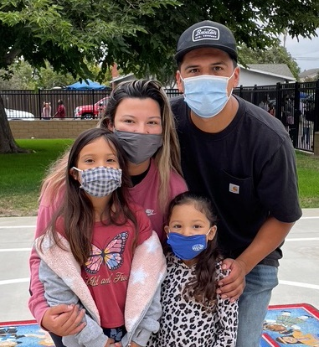
Instructions Overview
Contractors must review the FY 2026–27 CFA Instructions and Frequently Asked Questions (FAQs) posted on the CFA web page.
Verify that all information in the CFA and in CDMIS is complete and accurate.
Complete the CFA and all required attachments.
Photo Credit: University Preparation School at CSU Channel Islands

Slide 12
Section I – Contractor Information (1)
Section I – Contractor Information is prepopulated with the information currently approved in the CDMIS.
If updates are needed, log in to the CDMIS and refer to CDMIS User Manual - Chapter 5: Agency Information.
Notify CFA@cde.ca.gov when you have submitted changes in CDMIS. Once changes are approved, we will supply an updated copy of the CFA.

Slide 13
Section I – Contractor Information (2)
The person listed as the “Executive Director” in the CDMIS should be the primary administrator responsible for the overall operations of the agency, such as the Chief Executive Officer or President of a private corporation, President or Chancellor of a College, Superintendent of a local educational agency (e.g., County Office of Education, School District), City Manager or Mayor of a city, etc.
Questions regarding who should be listed as the Executive Director should be directed to the agency’s Consultant.

Slide 14
Section II – Contract and Program Type
Section II – Contract and Program Type is prepopulated with currently approved contract and program information.
To request a change to Program Type, Minimum Days of Operation (MDO), or other programmatic information, complete a Program Narrative Change (EED 3704A) and return it with your CFA.
If the contractor has approved subcontractors or license exemption status, this is noted in Section II. Note these must be renewed annually.

Slide 15
Section III – Contractor Certification (1)
Contains required Personnel Certifications, Certification of Information in CDMIS, Contractor Certifications.
Certifies compliance with all applicable program statutes and regulations, including but not limited to requirements for subcontracting, conflicts of interest, cost reimbursement, operational and programmatic requirements, and personnel requirements.
Page 4 must be signed by the agency’s Authorized Representative.

Slide 16
Section III – Contractor Certification (2)
The State of California requires any contractor receiving early education funding disbursed by the CDE, to employ fully qualified personnel as stipulated in the California Education Code; and the California Code of Regulations, Title 5; and the Contract Terms and Conditions.

Slide 17
Section III – Contractor Certification (3)
CSPP contractors are required to review and update all information in the CDMIS and certify under penalty of perjury that the information in CDMIS is complete and accurate as of the date of the certification.
The information in the CDMIS becomes part of the agency’s contract.
Incomplete or inaccurate information in the CDMIS can result in an audit finding at the state level and a finding of noncompliance for your agency.
CDMIS technical support: CDMIS@cde.ca.gov

Slide 18
CFA Checklist (1)
The final page of the CFA is a checklist of required attachments.
Download required attachments from the CFA web page. (Do not use templates from previous years).
Check each box to confirm the required attachment is included with your CFA submission.

Slide 19
CFA Checklist (2)
Refer to the requirements for your Agency Type.
If the contractor is a state agency, city, county, special district, school district, community college district, county superintendent of schools, or charter school, use the Public Agency checklist.
Other types of contractors, such as a non-profit community-based organizations, use the Non-Public Agency checklist.

Slide 20
Who signs the CFA?
The CFA must be signed by a person with the legal authority to contractually bind the agency, or the contractor's "authorized representative."
Typically, this is the person listed as your “Executive Director” in CDMIS (the primary administrator responsible for the overall operations of the agency).
Requirements differ for Public versus Non-Public Agencies.
Refer to the CFA Instructions and FAQs for details.

Slide 21
Who signs the CFA? – Public Agencies
LEAs and other Public Agencies must include a resolution that authorizes the FY 2026-27 CFA and identifies the individuals authorized to sign it on the agency’s behalf. The CFA must be signed by the person(s) identified on that resolution.
Important: Use the template resolution posted on the CDE CFA web page.
For County Offices of Education, a resolution is not required as long as the County Superintendent signs the CFA and all related documents.
If anyone else signs, delegation of signature authority is required.

Slide 22
Who signs the CFA? – Non-Public Agencies
For Non-Public agencies, a resolution is not required if the CFA and all related contract documents are signed by the agency's Executive Director, Owner, or President/Chief Executive Officer.
If anyone else signs, delegation of signature authority is required; provide (1) a letter on company letterhead, (2) board resolution, or (3) board meeting minutes indicating the signee has been delegated the legal authority to sign the CFA and related contract documents on behalf of the agency.
Tip: use the language in the template resolution posted on the CDE CFA web page.

Slide 23
Required Attachments – All Contractors (1)
All required attachments are posted on the CFA web page.
All contractors must provide these documents:
CFA (EED 3704)
CSPP Program Calendar(s) (EED 9730)
California Civil Rights Laws Certification (CO-005)
Contractor Certification Clauses (CCC)
Federal Certifications (CO.8)
CDMIS Agency Information Certification

Slide 24
Required Attachments – All Contractors (2)
Program Calendar (EED 9730)
Check each date the program will provide services to certified children.
If a contractor operates both a full-day and a part-day program, a separate Program Calendar must be provided for each.
Total days of operation must align with the contractor’s approved MDO unless an MDO change is being requested.
Current approved MDO is noted in CFA Section II.

Slide 25
Required Attachments – Public Agencies
Public Agencies must include a Board Resolution authorizing execution of the 2026–27 CFA and identifying the individual(s) authorized to sign.
Use template resolution posted on the CDE CFA web page
Add to agenda of next Board meeting
After passed and adopted, ensure you provide a copy signed by the Board Clerk with your CFA submission.

Slide 26
Required Attachments – LEAs
LEAs must include verification of LEA name and address
California School Directory or California Community College Chancellor’s web page, as applicable

Slide 27
Required Attachments – Non-Public Agencies (1)
Non-Public agencies (non-profit community-based organizations) must include:
State of California Payee Data Record (STD. 204)
May only be signed by an Authorized Representative
Please complete all sections
Secretary of State certification or search results to verify legal business name and address.
Attach a list of the agency’s current officers/board of directors/individuals with governing authority. The list must include each person’s name, title, telephone number, mailing address, and email address.

Slide 28
Required Attachments – Non-Public Agencies (2)
Non-Public Agencies:
A resolution is not required from a non-public agency if all CFA documents are signed by the agency’s Executive Director, Owner, or President/CEO.
If anyone else signs, delegation of signature authority is required; provide (1) a letter on company letterhead, (2) board resolution, or (3) board meeting minutes indicating the signee has been delegated the legal authority to sign the CFA and related contract documents on behalf of the agency.

Slide 29
Required Attachments – If Applicable
Contractors with Programmatic or MDO changes include the Program Narrative Change Form (EED 3704A).
Contractors using subcontractors include the Subcontract Certification Form (EED 3704B).
LEAs applying to renew exemption from licensure pursuant to Health & Safety Code Section 1596.792(o) include the Application for License Exemption and required attachments listed on that form.

Slide 30
Submission of the 2026–27 CFA (1)
Receive CFA via email.
Download all required attachments from the CFA web page.
Complete all required documents, including signatures by Authorized Representative. Save a copy for your records.
Submit by mail or email.
Due Date: November 14, 2025, by 5:00 p.m.

Slide 31
Submission of the 2026–27 CFA (2)
Option 1: Email completed documents to CFA@cde.ca.gov.
Documents may be signed electronically or signed by hand, scanned, and emailed.
Include the required certification statement in the body of the email (see Management Bulletin 25–08)
Option 2: Submit hard copy by mail to:
California Department of Education
Early Education Division
Attention: Continued Funding Application 2026–27
1430 N Street, Suite 3410
Sacramento, CA 95814-5901

Slide 32
CFA Timeline
September 4, 2025: MB 25-08 released
September 17, 2025: CFA Webinar
November 14, 2025: CFA Due Date
November 14, 2025 – February 27, 2026: Review and Processing of CFAs by EED
CDE Contracts Office and Fiscal Services receive all CFAs by March 1, 2026
Contracts and funding terms and conditions shall be issued to contractors no later than June 1, 2026

Slide 33
CFA Office Hours
Drop in with questions and receive additional technical assistance:
Friday, September 19, 2025, 10 to11a.m.
Friday, September 26, 2025, 10 to11a.m.
Friday, October 3, 2025, 10 to11a.m.
Friday, October 10, 2025, 10 to11a.m.
Zoom Link: https://us02web.zoom.us/j/89078320354
Passcode: 730492

Slide 34
Contact Information
Submit questions regarding the application and submission process to the CFA team by email at CFA@cde.ca.gov.
Submit programmatic questions to your assigned PQI office consultant.
Submit fiscal-related questions to your assigned Early Education Nutrition Fiscal Services apportionment analyst.
For technical assistance with CDMIS, email CDMIS@cde.ca.gov.

Slide 35
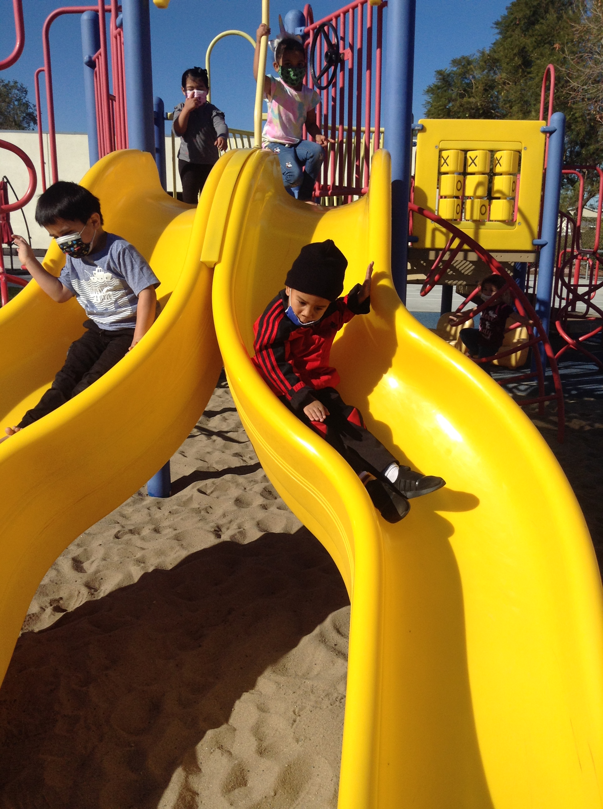
Questions
Photo Credit: University Preparation School at CSU Channel Islands

Slide 36
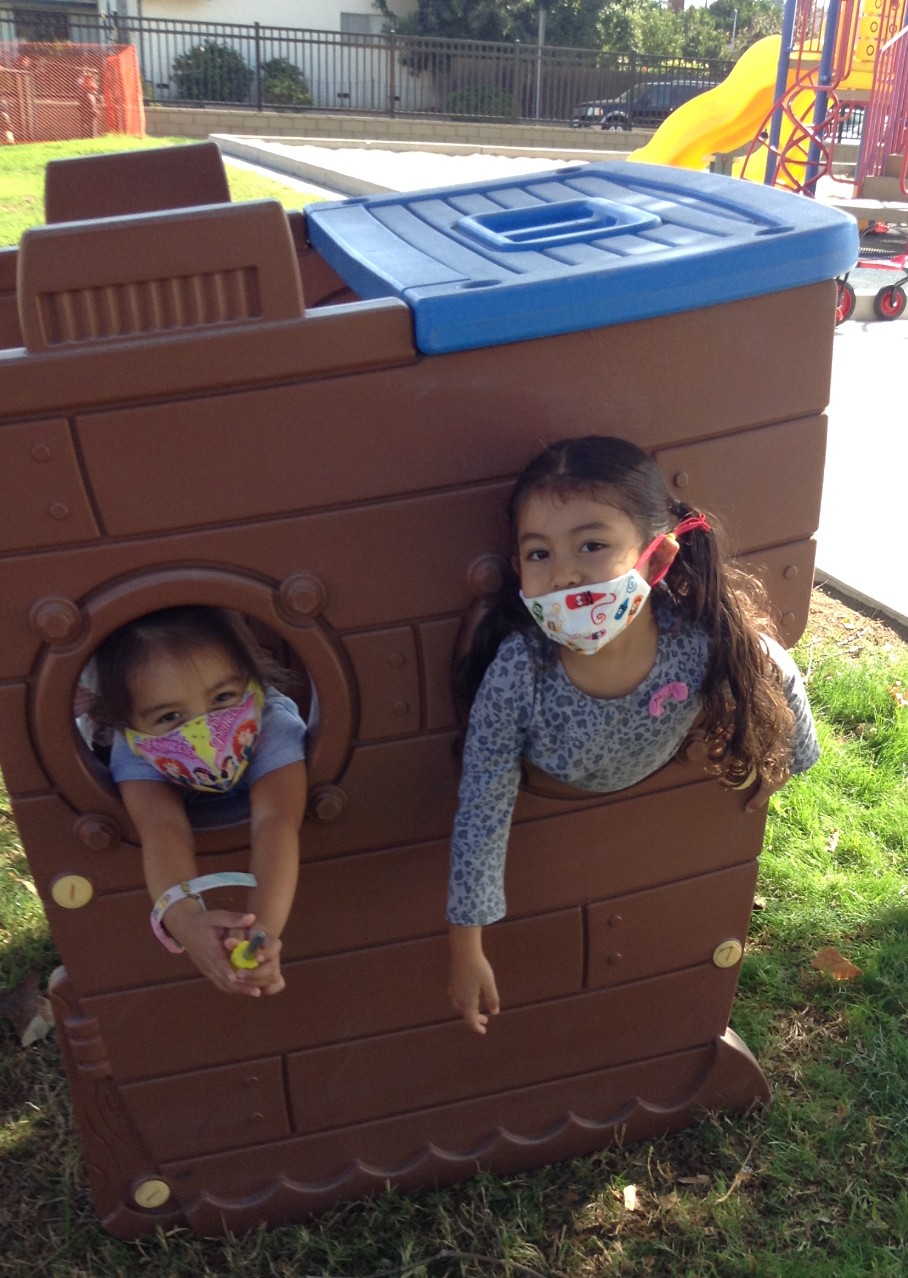
Closing
Photo Credit: University Preparation School at CSU Channel Islands

