Slide 1
Identifying Dual Language Learners (DLLs) in California State Preschool Programs (CSPP)
Early Education Division (EED)
Date: May 9, 2023
Time: 3:00 - 4:30 p.m.

Slide 2
Webinar Overview
Policy Background
Importance of Multilingualism and Cultural Diversity
Video from Early Edge Co-Sponsors of Assembly Bill 1363
Policy and Procedures Guidance
Resources and Supports
Frequently Asked Questions (FAQs)
Practitioner Perspective

Slide 3
Policy Background
•Recommendations from the Master Plan for Early Learning and Care: California for All Kids
  Create equitable learning and focus on supporting Dual Language Learners (DLLs)
•Aim of Assembly Bill 1363
  Develop a systematic approach for providers to identify and support DLLs in California State Preschool Programs (CSPP)
•What will be asked of providers and those in the field?
  Identify and collect data on DLLs
•The purpose of DLL identification
  Better understand the child’s language background
  Inform program curriculum
  Identify other supports for dual language learner children

Slide 4
Multilingualism is an Asset
According to the Migration Policy Institute, 59 percent of California children from birth to five speak a language other than English in the home.
Multilingualism is associated with benefits in cognitive and social and emotional development, academic achievement, and expanded future career opportunities.
According to the National Academies of Sciences, Engineering, and Medicine, early development of both English and the home language is critical for academic success.

Slide 5
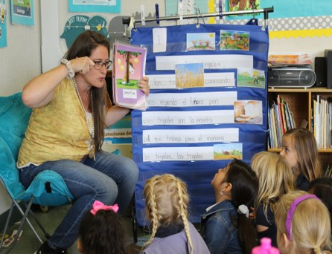
California's Dual Language Learner Identification Process Supports Young Children, their Families, and Teachers - Early Edge
https://www.google.com/url?q=https://www.youtube.com/watch?v%3DSN9TGK0PvQE&sa=D&source=editors&ust=1682722094437165&usg=AOvVaw0SkpkZ4P-D5GRkke1S9YkI
Photo Credit: Tree of Life International Charter School, Anderson, CA

Slide 6
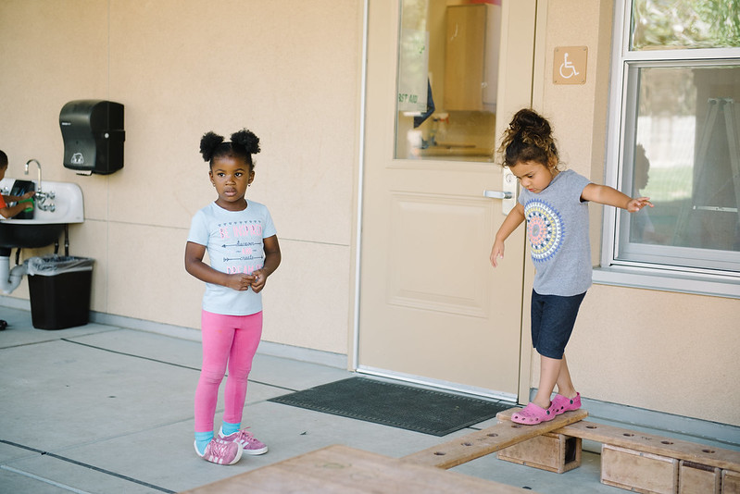
Preschool Dual Language Learners (DLLs)
Management Bulletin (MB) 23-03
Photo Credit: Lighthouse for Children CDC, Fresno CA

Slide 7
Revisions in MB 23-03
Updated links for Attachment A and Attachment B (updated to reflect new MB number)
Updated link for MB 23-03 Translations (updated to reflect new MB number)
Data Reporting Updates:
  Attachment C and Attachment D links removed
  Preschool Language Information System (PLIS) Landing Page
  The submission period for the optional report opened on January 1, 2023, and remained open until March 31, 2023.

Slide 8
MB 23-03 Requirements
MB 23-03 provides the requirements for identifying and collecting data on dual language learners' language characteristics of preschool programs and language composition of program staff.
As of January 1, 2023, contractors must follow the guidance of MB 23-03 for all currently enrolled children that will continue to receive services after January 1, 2023.
Implementation of Assembly Bill (AB) 321 required that the Family Language Instrument be completed no later than upon enrollment beginning January 1, 2023.

Slide 9
CSPP DLL Identification
Contractors must determine dual language learner status for every child enrolled in CSPP by one of two approaches:
Conduct the Family Language Instrument to determine dual language learner status, or
Obtain information on the child’s designation as an English learner in Transitional Kindergarten (TK) or kindergarten (K). (This approach is only possible if the child is dually enrolled in TK or K and CSPP for Extended Learning and Care.)

Slide 10
DLL Identification for Dually Enrolled Children
For children that are dually enrolled in CSPP for Extended Learning and Care around their Transitional Kindergarten or Kindergarten program day, CSPP contractors can seek to obtain the child's English Learner (EL) designation to determine DLL status by:
Asking the families for the child’s English Language Proficiency Assessments for California (ELPAC) Student Score Report document,
Having families sign a consent form to have the information directly shared with the contractor, or
Having the contractor enter into a written agreement following Family Educational Rights and Privacy Act (FERPA) guidelines in order to share that information.
If a contractor is unable to get the EL designation they must conduct the Family Language Instrument to determine the dual language learner status of the child.

Slide 11
CSPP DLL Status
DLL Status (When Using the Family Language Instrument)
A child is designated a dual language learner if:
  A language other than English is the answer to questions 1, 3, or 4.
  If initially indicated English only, but program staff determine within 30 calendar days, though child observations, that the child demonstrates they speak, respond to, or understand a language other than English, the contractor must share these observations with the family and review with the family the responses to the Family Language Instrument, updating as necessary to ensure proper designation.

Slide 12
Updating the DLL Designation
Parent Update
  Occurs when the parent or guardian updates the responses to the Family Language Instrument to ensure proper designation.
Teacher Designation
  Can ONLY occur if during the meeting to ensure proper designation, the parent or guardian refuses to update their answers to the Family Language Instrument, the child’s teacher may designate the child as a DLL through a Teacher Designation. Teacher Designation can only occur after 30 calendar days and after meeting with the parent or guardian.

Slide 13
Teacher Designation Documentation in Family File
If Teacher Designation is used, contractors must include the following in the family file:
    Written observations for how the child has demonstrated they speak, respond to, or understand a language other than English.
    Documentation from conversation with the family about their responses to the Family Language Instrument.
The initial date the Family Language Instrument was administered should not change as this date demonstrates you are meeting compliance of conducting the instrument no later than upon enrollment.

Slide 14

Family Language Instrument
The Family Language Instrument will be utilized to help identify the language or languages a child is exposed to at home and in their community; which languages the child understands; and which languages the child can speak.
The Family Language Instrument should be completed no later than upon enrollment.
Sample Question:
Which language(s) does your child hear at home?
Photo Credit: University Preparation Charter School Preschool, Camarillo, CA

Slide 15

Family Language and Interest Interview
This Interview between families and program staff will be used to build relationships, identify and support the strengths and interests of the child, the language background of the child; and the needs of parents, guardians, or family members to support the language and development of the child.
This will be conducted only for those children who have been identified as a DLL. The Family Language and Interest Interview must be completed within 30 calendar days of enrollment.
Sample Question:
How can we help support your child’s language and development at home? (For example, books to read at home, materials, activity ideas)
Photo Credit: University Preparation Charter School Preschool, Camarillo, CA

Slide 16
CSPP DLL Support
The Family Language Instrument and the Family Language and Interest Interview will help contractors support DLLs by:
Learning about the student's language background and needs
Building a relationship with families
Helping parents support their child's language development at home
To support contractors with the costs of serving DLLs, the 2022–23 Budget Act increased the DLL adjustment factor for full-day CSPP to 1.2.

Slide 17
Supports for Implementation
Photo Credit: Lighthouse for Children CDC, Fresno CA

Slide 18
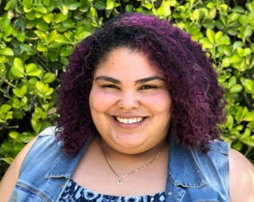

Fresno Unified School District (USD)
Guest Speaker
Presenter
Jessica Gutierrez
Program Manager

Slide 19
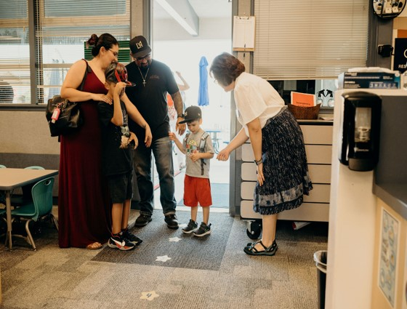
Building Trust With Families
When building relationships with families and conducting the Family Language and Interest interview we:
Share the purpose and benefits of the process
Share the value of bilingualism
Share how this will support us in partnering with them to support their child’s home language and English development
Photo Credit: University Preparation Charter School Preschool, Camarillo, CA

Slide 20
Process for the Family Language Instrument
We adhere to the following process for the Family Language Instrument:
The instrument is included in the application forms that families complete during the enrollment process
We follow up with families based on teacher observations to ensure home language support

Slide 21

Compassionate Communication:
Key to Encouraging Families
Sometimes families might feel reluctant to answer questions. To encourage them, we:
Set the stage by focusing on the purpose and benefits
Approach the conversations with patience and empathy
Revisit the purpose of the identification process
Photo Credit: Tulare City School District, Garden School (Preschool), Tulare, CA

Slide 22
Continuing the Process for the Family Language Instrument
The Family Language and Interest Interview is conducted for all families, not just DLLs as required by MB 23-03. This helps to gather information on child interests and strengths, as well as build connections with families.
Our program has family connection days at the start of the year. These allow families to visit the classroom, get familiar with the environment, and begin to build trust with the teacher. During this time, teachers conduct the Family Language and Interest Interview with families.

Slide 23
The Art of Interviewing:
Conduct Successful Interviews
Place importance on teacher-family relationships.
Interviews should be:
Led by teaching staff
Done as an informal conversation
An opportunity to get to know the family and vice versa
This serves as a starting point to build a trusting relationship.

Slide 24
How to Conduct Successful Interviews
Scheduling interviews:
Allot about 15 minutes for each interview
Embed interviews in existing family engagement structures
During the interview, teachers:
Engage in rich dialogue with families
Share resources and tools families can use at home

Slide 25
Personalized Planning
This process has greatly benefited our children, families, and teachers. Teachers:
Learn about the child’s linguistic and cultural background
Personalize their planning around each child’s specific language needs
Create meaningful engagement opportunities for children and families
Incorporate relevant learning materials and activities in the classroom including books and music in the child’s home language

Slide 26
Fresno USD Speaker Contact Information
Contact
Jessica Gutierrez
jessica.gutierrez@fresnounified.org

Slide 27
MB Frequently Asked Questions (FAQ)
Are programs able to use previous intake forms or packets?
Contractors can put the required questions from the Family Language Instrument on any existing forms or integrate asking the required questions into any existing process as long as the requirements of the Management Bulletin (MB) are followed.
The questions in the instrument are required unless the children are dually enrolled in TK or kindergarten and documentation has been provided identifying English learner status in TK or kindergarten.

Slide 28
MB FAQ (2)
How is this reported in the Child Development Provider Accounting Reporting Information System (CPARIS)?
In order for full-day CSPP to utilize the dual language learner adjustment factor, the process for identification of a dual language learner set forth in this MB must be used as of January 1, 2023.
Contractors who enroll children after January 1, 2023, must have made the determination that the child is a dual language learner as described in the Determining Dual Language Learner Status section in the MB in order to report the child under the dual language learner adjustment factor category. Documentation of dual language learner status using the process described above will support the reporting of the child days of enrollment under the dual language learner adjustment factor category.

Slide 29
MB FAQ (3)
Do the requirements for identifying and collecting data on dual language learners, language characteristics of preschool programs, and language composition of program staff apply to both part-day and full-day California State Preschool Program (CSPP)?
Yes, these requirements must be followed by both part-day and full-day CSPP.

Slide 30
MB FAQ (4)
What do we do if a child is transferring from General Child Care and Development (CCTR) to CSPP?
If a child is transferring from CCTR to CSPP, the Family Language Instrument must be completed no later than upon enrollment and if the child is identified to be a DLL, the Family Language and Interest Interview must be completed within 30 calendar days of enrollment.

Slide 31

Management Bulletin and PLIS
Question and Answer

Slide 32
Upcoming Webinars
Part Two: Data Reporting Dual Language Learners in California State Preschool Programs
  May 16, 2023, 3:00 - 4:30pm
Part Three: Supporting Dual Language Learners in California State Preschool Programs
  June 13, 2023, 3:00 - 4:30pm

Slide 33
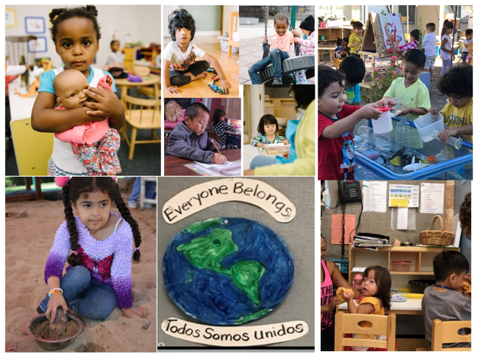
Thank You
“One language sets you in a corridor for life. Two languages open every door along the way.”
Frank Smith, Psycholinguist

Slide 34
Resources to Share with Families
  Ways to develop your child’s multilingualism (Spanish): https://www.multilinguallearningtoolkit.org/wp-content/uploads/2021/08/Support-Billingualism-Spanish-1.pdf(PDF)
  Keeping Your Home Language (available in 16 languages): https://cmascanada.ca/2018/05/15/keeping-your-home-language/%20
  Benefits of Multilingualism: https://ncela.ed.gov/sites/default/files/legacy/files/announcements/20200805-NCELAInfographic-508.pdf
  The Importance of Home Language Series (available in English, Spanish, Arabic, Chinese, and other languages): https://eclkc.ohs.acf.hhs.gov/culture-language/article/importance-home-language-series

Slide 35
Resources (1)
Management Bulletin 23-03:
https://www.cde.ca.gov/sp/cd/ci/mb2303.asp
CSPP DLL Identification Tools Translations: https://www.cde.ca.gov/sp/cd/ci/csppdlltools.asp
Management Bulletin 23-03 and the PLIS FAQs: https://www.cde.ca.gov/sp/cd/ci/plissupportlanding.asp

Slide 36
Resources (2)
If you have programmatic questions regarding the information in this MB, please contact your assigned Early Education Division (EED) Program Quality Implementation (PQI) office Regional Consultant. The CDE, EED Consultant Regional Assignments directory web page can be located at https://www.cde.ca.gov/sp/cd/ci/assignments.asp.
If you have fiscal questions regarding the information in this MB, please contact your assigned Early Education Nutrition and Fiscal Services (EENFS) fiscal apportionment analyst. The EENFS fiscal analyst directory web page can be located at https://www.cde.ca.gov/fg/aa/cd/faad.asp.
ELPAC is a requirement for TK and K students as specified, if you have further questions around ELPAC please reach out to English Language Proficiency and Spanish Assessments office at elpac@cde.ca.gov.

