Slide 1
Serving Children with Disabilities (Exceptional Needs) in California State Preschool Program (CSPP)
Early Education Division (EED)
Date: February 10, 2023
Time: 10:00 a.m. to 11:30 a.m.

Slide 2

Welcome and Introductions

Slide 3

A Holistic Approach for California's Schools
Together in California we are transforming our education system to meet the needs of all children and set them up for success in learning and life.

Slide 4
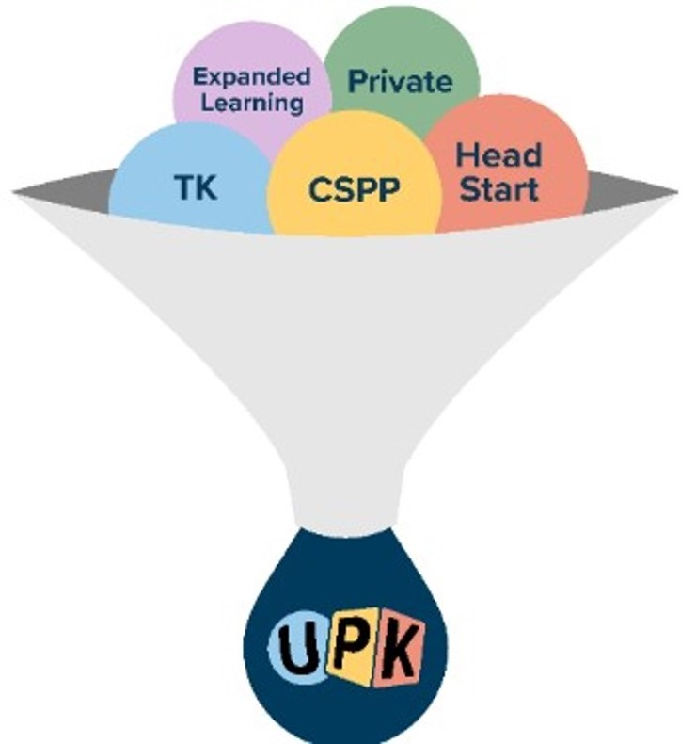
What is Universal PreKindergarten (UPK)?
UPK brings together Transitional Kindergarten (TK) and all existing state preschools and federal early education (include CSPP and Head Start), private child care, and expanded learning opportunities, including before and after school programs, into the same system. Long description slide 42

Slide 5
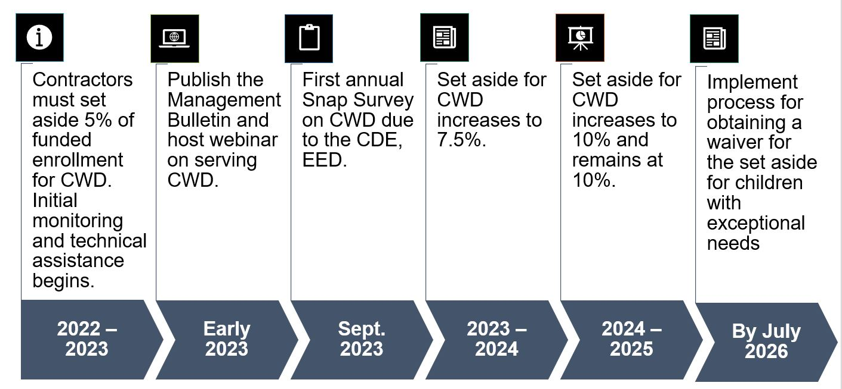
Implementation Timeline for Serving
Children with Disabilities
Long description slide 43

Slide 6
Children with Exceptional Needs
The Management Bulletin (MB) includes guidance on the following:
Change to the definition of children with exceptional needs
New categorical eligibility for children with exceptional needs
Enrollment set-aside and reserving space for children with exceptional needs
Prioritizing and enrolling children with exceptional needs
The increased adjustment factor for children with exceptional needs and severe disabilities
New data collection requirements for contractors
Children with exceptional needs being educated in the least restrictive environment (LRE)

Slide 7
Defining Children with Exceptional Needs
From Education Code (EC) Section 8205(h):
  Children with an active individualized family service plan (IFSP) and receiving early intervention services, or
  Children with an active individualized education program (IEP) and receiving early intervention services or appropriate special education.
Children with Disabilities
  Children with exceptional needs are also known as children with disabilities
  The California Department of Education (CDE) encourages contractors to use the term children with disabilities at the local level during implementation

Slide 8
Documentation Required for
Children with Exceptional Needs
Documentation must be kept in the family data file and should include a copy of the active IFSP or the IEP
  Eligibility for the IFSP or IEP
  Instructional goals or measurable outcomes
  Special education or specific services
  Parent consent for services
Contractors must develop and implement a written policy to inform families of the family's obligation to provide up-to-date copies of the IFSP or the IEP, as well as any changes to the status of the IFSP or the IEP

Slide 9
Transitioning from an IFSP to an IEP
A child with an IFSP undergoing an assessment continues to count toward the set aside and can receive the adjustment factor until the determination is made whether the child is eligible for an IEP
  If the child qualifies for an IEP, and the parent consents to services, the child continues to count towards the set aside and receive the adjustment factor
  If the child qualifies for an IEP, but the parent does not consent to services, the child no longer counts toward the set aside and may not receive the adjustment factor
  If the child does not qualify for an IEP or is determined eligible for an Individual Program Plan (IPP), the child no longer counts toward the set aside and may not receive the adjustment factor

Slide 10
Counting Children Towards the Set Aside and Receiving the Adjustment Factor
A child (without an IFSP, already enrolled in CSPP) referred for a special education assessment, does not count toward the set aside and will not receive the adjustment factor
Contractors are required to have a copy of the current IFSP or IEP
Contractors must develop and implement a written policy to inform families of the family’s obligation to provide up-to-date copies of the IFSP or IEP, and status changes
Contractors must keep case notes in the family data file about the status of children

Slide 11
Children with Exceptional Needs as an Eligibility Category for CSPP
Children with exceptional needs do not have to qualify with income eligibility
Families must self-certify their income
For full-day CSPP, families must still establish a need for services
Only children with exceptional needs may be enrolled under this eligibility category. Any other children in the family who do not meet the definition of exceptional needs may be enrolled based on any of the other eligibility categories for which the family is otherwise eligible

Slide 12
Family Fees for Children with Exceptional Needs Enrolled in Full-day CSPP (1)
All contractors must assess a family fee for families qualifying for full-day CSPP
All families are required to self-certify their income
Family fees are waived for all families through June 30, 2023

Slide 13
Family Fees for Children with Exceptional Needs Enrolled in Full-day CSPP (2)
For children with exceptional needs who are placed in a CSPP pursuant to an IEP, no fees shall be collected from the family
  Any family fee shall be paid by the local educational agency (LEA) placing the child in the CSPP because the LEA placing the child in the CSPP is responsible for providing the child with a free appropriate public education (FAPE)

Slide 14
24-Month Eligibility
If a child’s status of being a child with exceptional needs changes during their 24-month eligibility period, the family is not required to provide additional eligibility documentation nor recertify early.
Once a child is no longer classified as a child with exceptional needs, then that child does not count in the required set aside of funded enrollment and the exceptional needs adjustment factor cannot be used for that child.

Slide 15
Set Aside Reserved for Children with Exceptional Needs (1)
All CSPP contractors must set aside and reserve a percentage of their funded enrollment, for both part-day and full-day programs, for children with exceptional needs
Fiscal Year | Set Aside Percentage
2022–23 | At least 5%
2023–24 | At least 7.5%
2024–25 and beyond | At least 10%

Slide 16
Set Aside Reserved for
Children with Exceptional Needs (2)
Within the set aside of funded enrollment, contractors are required to enroll children with exceptional needs from families with the lowest income, according to the income ranking table, first
Children with exceptional needs from families with incomes above the income eligibility threshold as described in EC Section 8213, shall not count towards the 10 percent limit of families above the income eligibility threshold

Slide 17
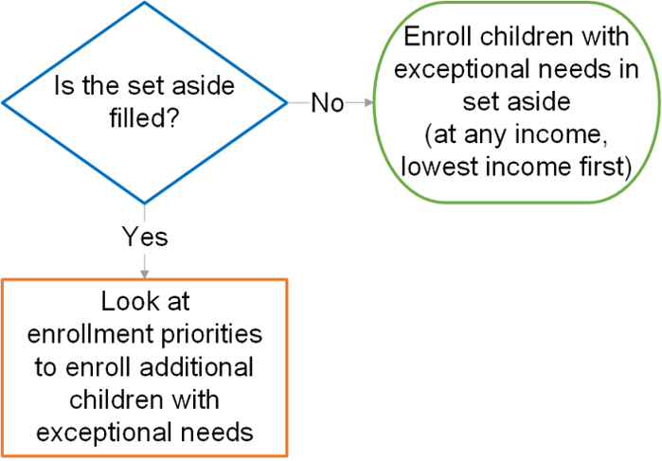
CSPP Enrollment for Children with Exceptional Needs
Long description slide 44

Slide 18
Enrollment Priorities for
Children with Exceptional Needs
Contractors must set aside a percentage of their funded enrollment for children with exceptional needs
  Children enrolled in the set aside will be prioritized by income
After the set aside is filled:
  Children with exceptional needs from families with income below the eligibility threshold get second priority
  Children with exceptional needs from families with incomes up to 15 percent above the eligibility threshold get fifth priority
  Children with exceptional needs from families with incomes higher than 15 percent above the income threshold are not prioritized for services

Slide 19
Monitoring and Technical Assistance
Consultants will receive quarterly reports from the Child Development Provider Accounting Reporting Information System (CPARIS) and the Child Development Management Information System (CDMIS). These reports will provide the Program Quality Implementation (PQI) consultant with the enrollment percentages of children with exceptional needs for each contractor.
When the minimum set aside is not met, the PQI consultant will reach out to the contractor and provide technical assistance and support, to help the CSPP contractor attain the minimum requirements.

Slide 20
Creating Inclusive Classrooms and
Providing the Least Restrictive Environment
Contractors must make every effort to equally distribute their enrollment of children with exceptional needs across throughout their program, across all contracted counties, sites, and classrooms.
The CDE will be continuously looking at program data in order to monitor that children with exceptional needs are not concentrated in selected counties, sites, or classrooms.

Slide 21
CSPP Staff on IFSP and IEP Teams
The Individual with Disabilities Education Act (IDEA) requires for the IEP team: not less than one regular education teacher, if the child is, or may be, participating in the regular education environment. Therefore, CSPP staff may be required as part of the IEP team.

Slide 22
Enrollment, Attendance, and Fiscal Report Updates
The adjustment factor for children with exceptional needs and children with severe disabilities increased to 2.4
The Child Development Provider Accounting Reporting Information System (CPARIS) Enrollment, Attendance, and Fiscal Report has been updated to reflect the new adjustment factors for Fiscal Year (FY) 2022–23
There is no change to reporting, as contractors will continue to report subsidized children enrolled as exceptional needs or severely disabled under the applicable reporting categories
  Reporting the child’s days of enrollment in these adjustment factor categories will provide additional reimbursement due to the application of the adjustment factor

Slide 23
Calculating the Set Aside
Pursuant to EC Section 8208(c)(1), in FY 2022–23, CSPP contractors are required to set aside five percent of funded enrollment for children with exceptional needs as defined in EC Section 8205.
For FY 2022–23, the five percent set aside will be calculated by multiplying the contract Maximum Reimbursable Amount (MRA) by the full-time exceptional needs adjustment factor of 2.4 by five percent.
Example: A contractor has a CSPP contract MRA of $1,000,000. For FY 2022–23, $120,000 will be reserved to serve children with exceptional needs, which is a result of the following calculation:
Required Set Aside = Contract MRA x 2.4 adjustment factor x 5 percent
= $1,000,000 x 2.4 x 5 percent = $120,000

Slide 24
Determining the Number of Children Associated with the Set Aside Requirement
Early Education and Nutrition Fiscal Services (EENFS) has developed an Exceptional Needs Funded Enrollment Calculator which contractors can use as a tool to determine the number of children associated with the five percent set aside requirement for this fiscal year.
The Exceptional Needs Funded Enrollment Calculator will be available on the EENFS web page at https://www.cde.ca.gov/fg/aa/cd/.

Slide 25
Reimbursement for the Required Set Aside
To ensure funding is available to enroll children with exceptional needs within the required set aside, contractors will be fully funded for the percentage of funded enrollment set aside, pursuant to EC Section 8208(c)(2)(B).
The CDE will advance the funding set aside for children with exceptional needs based on the normal apportionment schedule, regardless of whether the contractor is fully earning their set aside amount.
Contractors who are not fully earning the amount set aside will receive a service-level exemption credit, which allows the contractor to be reimbursed for identified expenses without meeting the service requirement

Slide 26
Service-Level Exemption Credit Calculation Examples
Contract Terms / Reported Data​ | Fully Earning​ Set Aside ​ | Partially Earning Set Aside​ | Not Earning Set Aside​
Contract MRA ​ | $1,000,000 ​ | $1,000,000 ​ | $1,000,000 ​
Exceptional Needs and Severely Disabled Set Aside​ (MRA x 2.4 x 5%) | $120,000 ​ | $120,000 ​ | $120,000 ​
Projected FY Exceptional Needs and Severely Disabled Adjusted Days of Enrollment​ (based on Enrollment, Attendance, and Fiscal Report) | 2,171.1598 ​ | 1,171.1598 ​ | 0 ​
Projected FY County Exceptional Needs and Severely Disabled Service Earnings ​(projected adjusted days of enrollment x service county rate) | $120,000 ​ | $64,730 ​ | $0 ​
Exceptional Needs and Severely Disabled Service Level Exemption (set aside – projected service earnings) | $0​ | $55,270 ​ | $120,000 ​

Slide 27
Monitoring Set Aside Earnings
The CPARIS contract earnings calculation has been updated to include the required set aside amount, the earnings associated with the set aside amount, and the service-level exemption credit.

Slide 28
Updates to 801A Reporting
The Child Development Management Information System (CDMIS) has updated the "Child has an IEP" CDD-801A data field to reflect "Child has an IEP or IFSP."
  Current data collection directive: if a child has an IFSP or IEP, indicate "Y" in an electronic file, or check the applicable box in the 801A manually submitted report
When submitting the CDD-801A report, ensure information related to IEP and IFSP is as up to date as possible.
  If IEP or IFSP status changes, this should be reflected in the respective 801A reporting period
The 801A will be used to determine the number of children with exceptional needs currently enrolled in CSPP per contractor.

Slide 29
Reporting Children with an IEP in 801A
Demonstration of the "Child has an IEP" field in the 801A

Slide 30
Collecting Data on
Children with Exceptional Needs
Beginning in FY 2022–23, data on meeting and filling the set aside for children with exceptional needs will be collected
Contractors must include how they were or were not able to fill the set-aside percentage of funded enrollment for children with exceptional needs
If the set aside was not filled, the survey must include information about conducted community outreach to special education partners to recruit additional children with exceptional needs

Slide 31
Upcoming Snap Survey
To assist in determining whether the set aside for funded enrollment per agency is being met for children with exceptional needs, the EED is creating a survey for contractors to submit this information by September 30, 2023.
The survey questions will be uploaded on the Inclusive Early Education Resources webpage in the coming weeks.

Slide 32
Exceptional Needs Information
Snap Survey Questions (1)
Part 1: Contractor Information
Part 2: Total Funded Enrollment Information (Slots)
  How many total children were funded to be enrolled at your agency during FY 2022–23?
  How many children in specified county were funded to be enrolled?
  What was your total number of classrooms?

Slide 33
Snap Survey Questions (2)
Part 3: Enrollment of Children with Exceptional Needs Information
  Of your total number of sites, how many served children with exceptional needs?
  Of the total number of classrooms, how many of these served children with exceptional needs?
  For FY 2022–23, the set aside reserve for children with exceptional needs is five percent. For your entire contract, what percent of children with exceptional needs did you serve?

Slide 34
Snap Survey Questions (3)
Part 4: Barriers, Community Outreach, and Referrals
  What barriers did you face in trying to enroll children with exceptional needs for 2022-23?
  What community outreach did you do to recruit children with exceptional needs? If you met the set aside, in the narrative response, please include how you were able to enroll children with exceptional needs
  Between July 1, 2022 – June 30, 2023, how many children did you refer to an LEA for an IEP assessment?
    Of these, how many qualified for an IEP
    Of these, how many are still pending an assessment?

Slide 35
Snap Survey Questions (4)
Part 5: Optional Additional Information
  The CDE is collecting information on topics of technical assistance, and will use this information to leverage existing resources and inform future technical assistance opportunities. What technical assistance would be most helpful related to serving children with exceptional needs?
  Is there any other information related to the questions in this survey you would like to add?
Part 6: Certification Page

Slide 36
Upcoming Interest Holder Feedback Sessions
The CDE is planning on having Interest Holder Sessions to get feedback related to children with exceptional needs, specifically on the set aside and waiver process
The purpose of these input sessions is to inform CDE when developing regulations related to the set aside and the waiver process
These sessions will be split up into small groups led by a CDE facilitator
An email with more details and registration information will be sent via the EED email distribution list

Slide 37
Resources (1)
Inclusive Early Education Resources
  Resources to support inclusive policies and practices for early care and education
  https://www.cde.ca.gov/sp/cd/op/ieeresources.asp
Regional Centers
  Provide and coordinate services and supports for individuals with development disabilities
  https://www.dds.ca.gov/services/early-start/family-resource-center/regional-center-early-start-intake-and-family-resource-centers/

Slide 38
Resources (2)
Early Start
  California's early intervention program for infants and toddlers with disabilities and their families
  https://www.dds.ca.gov/services/early-start/family-resource-center/
Special Education Local Plan Areas (SELPAs)
  Provide all special education service needs of children residing within the region
  https://www.cde.ca.gov/sp/se/as/caselpas.aspas/caselpas.asp

Slide 39

Questions
Photo Credit: Kidango Decoto Center; Union City, CA

Slide 40
Thank you!

Slide 41
Appendix A – Image Text Descriptions

Slide 42
Long description of what is UPK image
A picture of a funnel with UPK at the bottom of the funnel, and five circles inside the funnel at the top of the picture representing Expanded learning, Private Child Care, Transitional Kindergarten, the California State Preschool Program and Head Start. Back to figure

Slide 43
Long description of timeline graphic
A graphic of a timeline showing stages from 2022–2023 when contractors must set aside 5% of funded enrollment and initial monitoring and technical assistance begins, to early 2023 when the Management Bulletin is published and the webinar is hosted, to September 2023 when the first annual snap survey is due to the Early Education Division, to 2023–2024 when the set aside increases to 7.5%, to 2024–2025 when the set aside increases to 10% and remains at 10%, to July 2026 when the process for obtaining a waiver for the set aside has been implemented. Back to figure

Slide 44
Long description of diagram
The diagram uses a depiction of three shapes with connecting arrows to indicate how to enroll children with exceptional needs based on whether the set aside is filled or not. A diamond with a blue outline in the upper left of the visual contains a question asking if the set aside is filled. It indicates with an arrow leading from the blue diamond to a rectangle with an orange outline beneath it that if the answer is yes, the contractor should look at enrollment priorities to enroll additional children with exceptional needs. It indicates with an arrow leading from the blue diamond to an oval with a green outline to the right that if the answer is no, the contractor should enroll the child with exceptional needs at any income in the set aside, enrolling children with the lowest income first. Back to figure.

