Slide 1
California State Preschool Program
Neighborhood School Eligibility
Early Education Division (EED)
Date: June 13, 2024
Time: 10:00 – 11:00 a.m.

Slide 2

Welcome and Introductions

Slide 3
Agenda
Definition of the California State Preschool Program (CSPP) Neighborhood School Eligibility Provision from Management Bulletin (MB) 24-01
Initial Site Verification Process
Approved Sites and Family Residence Documentation Requirements
Annual Reverification Process
Timing Considerations
Questions
Closing

Slide 4
California State Preschool Program
Neighborhood School Eligibility
Same provision, new name! Previously called Free and Reduced-Price Meal (FRPM) eligibility.
As outlined in MB 24-01: CSPP Neighborhood School Eligibility Criteria to Enroll Three- and Four-Year-Old Children, pursuant to Education Code (EC) Section 8217, contractors operating within the attendance boundary of a qualified FRPM elementary school may enroll, after all other priorities:
  Any three- and four-year-old children whose families reside within the attendance boundary of the same qualified FRPM elementary school.
  These children must, to the extent possible, be enrolled from lowest to highest income.
CSPP Neighborhood School Eligibility is valid for one program year and must be verified or reverified each year.

Slide 5
California State Preschool Program
Neighborhood School Initial Site Verification
To qualify to enroll children in CSPP through the Neighborhood School Eligibility provision, the site must be within the attendance boundaries of a qualified FRPM school.
Contractors must complete three steps to determine and document each site’s eligibility (detailed on the next slides).

Slide 6
Step One: Identify and Document the Neighborhood School of the California State Preschool Program Site
Option 1: Utilize a local school district or county office of education website tool to verify that the CSPP site is located within the school’s attendance boundaries and save a copy of the results, noting the expiration date if applicable.
Option 2: Utilize a printed or online map of the school district’s attendance boundaries, and ensure it is the map for the current school year. Indicate the location of the CSPP site on the school boundary map.
Option 3: Contact the elementary school for attendance boundary information and have the principal or authorized representative sign the statement on the Site Verification Form certifying that the CSPP site falls within the attendance boundaries of that school.

Slide 7
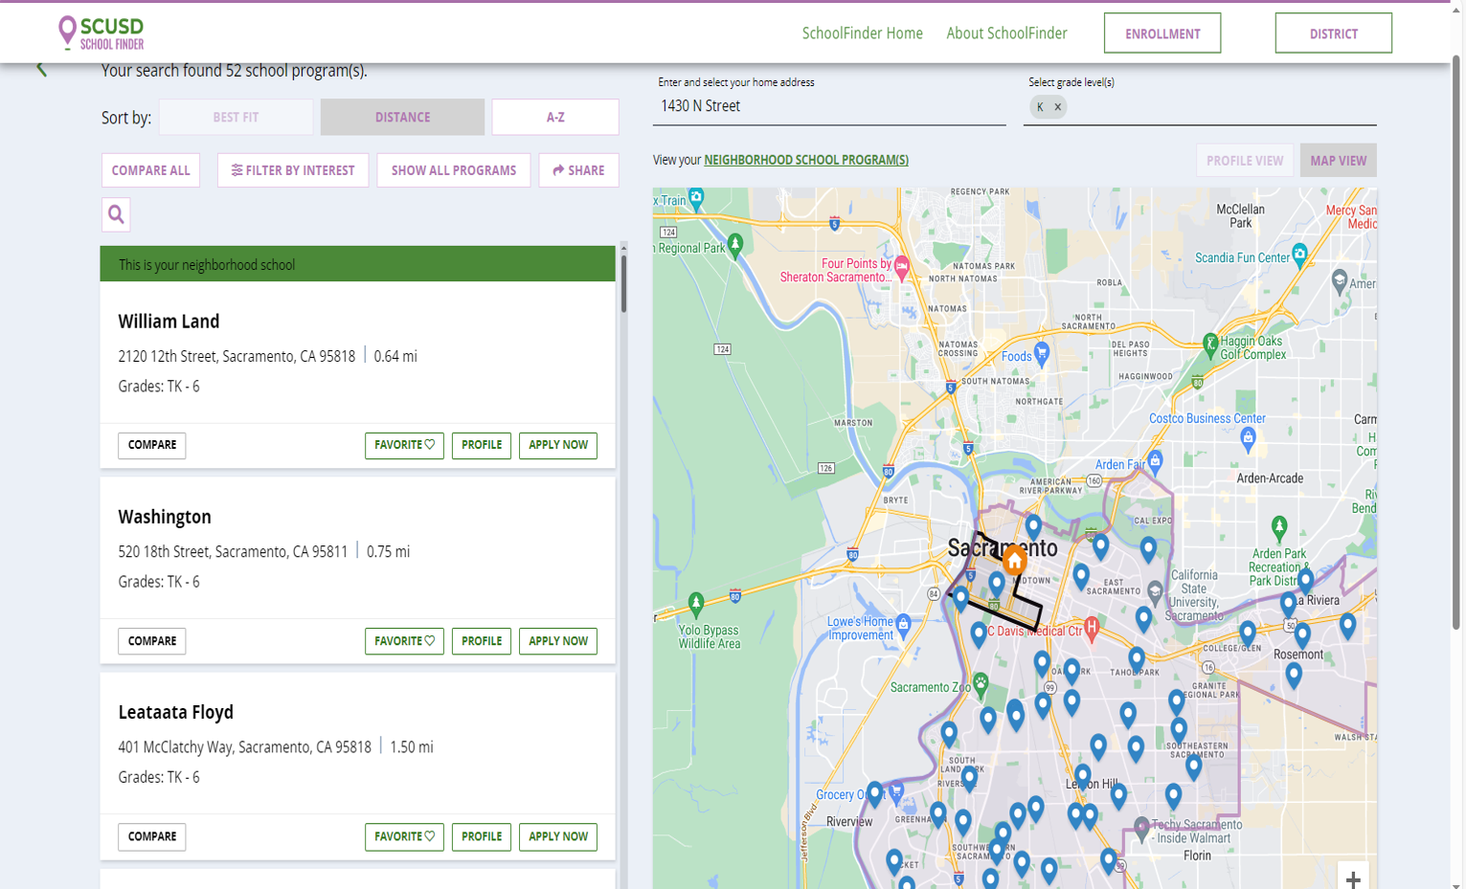
Example Website Tool

Slide 8
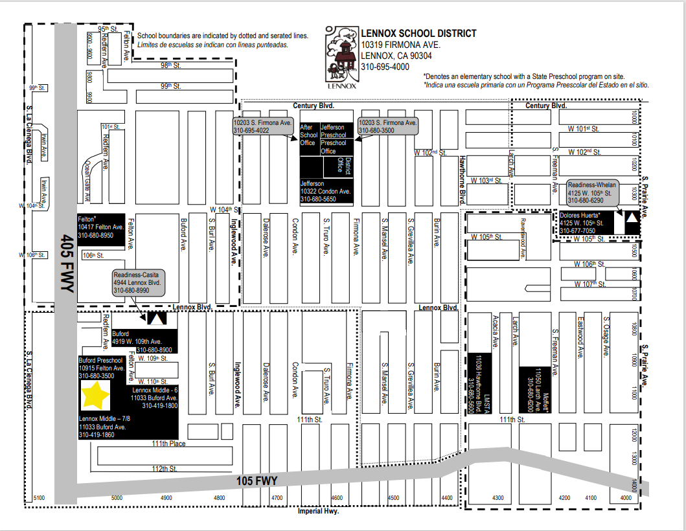
Example
Map

Slide 9
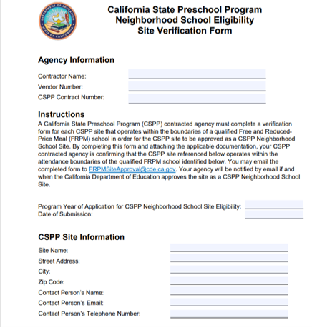
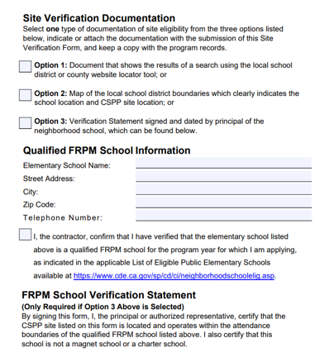
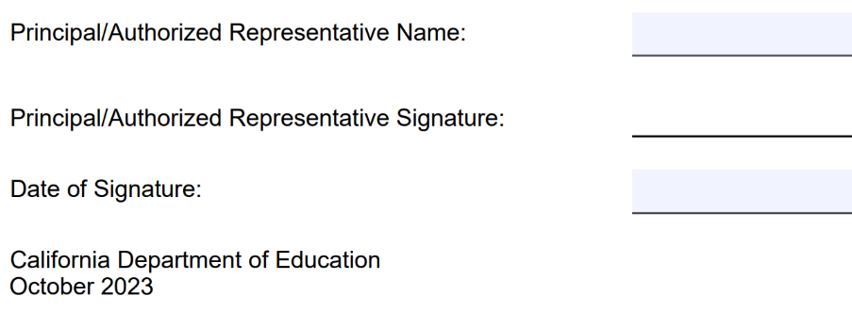
Site Verification Form
https://www.cde.ca.gov/sp/cd/ci/neighborhoodschoolelig.asp

Slide 10
Step Two: Determine if the Neighborhood School is a Qualified Free and Reduced-Price Meal School
Once the neighborhood school has been determined and documented, check the List of Eligible Public Elementary Schools on the CSPP Neighborhood School Site Verification web page.
Find the elementary school district name first, then the elementary school within that district to ensure that you have the correct location.
Note that schools that do not appear on the list are not qualified FRPM schools in that year.

Slide 11
Qualified Free and Reduced-Price Meal Elementary Schools
Elementary schools which are non-magnet and non-charter schools.
80 percent or more of students must be eligible for the FRPM program.
List is established by the California Department of Education (CDE) each year, using data from the previous October (Fall 1) certification period.

Slide 12
List of Eligible Public Elementary Schools
The List of Eligible Public Elementary Schools is posted annually by June 1 to the Neighborhood School Site Verification web page on the CDE website.
Note: Many schools across the state share the same name. The list includes the county and school district to help find the correct elementary school.
Available at: https://www.cde.ca.gov/sp/cd/ci/neighborhoodschoolelig.asp

Slide 13
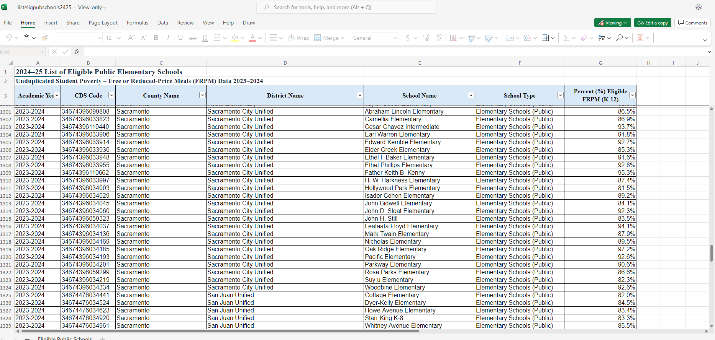
Example 1
William Land in Sacramento City Unified School District

Slide 14
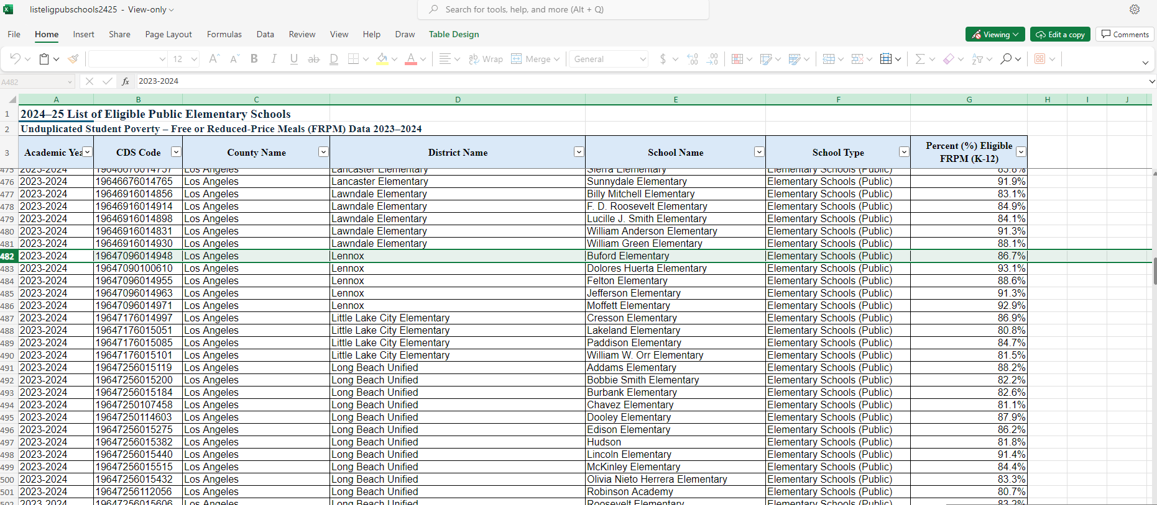
Example 2
Buford Elementary in Lennox School District

Slide 15
Example 3 Martin Luther King Jr. Elementary (Three Different Districts)

Slide 16
Step Three: Apply for Approval
Submit the Site Verification Form and documentation to FRPMSiteApproval@cde.ca.gov
CDE will respond to email with written approval or denial (if not eligible)

Slide 17
Approved Sites
Once approved in writing by the CDE, the contractor may begin to enroll families who reside within the attendance boundaries of the same qualified FRPM school for the program year (July 1 through June 30).
Documentation from the site verification must be maintained in the program records for five years.

Slide 18
Family Residency Documentation
Documentation for residency can include (California Code of Regulations, Title 5, Section 17774[b]):
Current utility bill;
Current property tax bill;
Current rental or lease agreement with landlord's information;
Current voter registration;
Current government agency letter;
Current employment pay stub; or
Any documentation that a contractor reasonably relies upon to prove a family's residency.

Slide 19
Annual Reverification Process
For sites that have already received written approval from the CDE for the previous program year:
Complete the Annual Reverification Survey available on the CSPP Neighborhood School Site Verification page on the CDE website by June 1 to verify:
  The CSPP site remains within the boundaries of the same elementary school
  The elementary school is still a qualified FRPM school
Complete once for each CSPP site that has already been approved in writing by CDE the previous year

Slide 20
Annual Reverification Results
Contractors will receive an immediate response indicating either:
  The site is eligible for the new fiscal/program year, or
  The site is not eligible for the new fiscal/program year, or
  The site will need to complete the initial verification process due to changes in the site location or school boundaries
After completing the survey, contractors should:
Print the page and keep in the program records for five years
Press submit to record the site’s status with CDE

Slide 21
Reverification Survey
The survey asks:
Was this site approved as a CSPP Neighborhood School Eligibility Site for the 2023–24 program year ?
Did the approved CSPP Neighborhood School Eligibility Site address change since it was approved?
What was the name of the qualified FRPM school that served as the basis for approval for the 2023–24 program year?
What school district is the qualified FRPM in?
Is the qualified FRPM elementary school on the list of qualified FRPM elementary schools released for FY 2024–25?
Has the identified qualified FRPM elementary school address changed?
Have the attendance boundaries of the identified qualified FRPM elementary school changed?

Slide 22
Timing Considerations
Programs that have received written approval of a CSPP site’s eligibility can enroll children using the Neighborhood School Eligibility provision through June 30 of the program year
  This includes part-day programs which may be enrolling children in the current program year for the upcoming program year through the 120-day enrollment flexibility
CDE will post the updated List of Eligible Public Elementary Schools and Annual Reverification Survey by June 1, to be used for verifying site eligibility for the upcoming program year
Programs must reverify their site’s eligibility using the updated list and receive written approval by July 1, or before certifying or enrolling any new children under the Neighborhood School Eligibility provision

Slide 23

Questions?
Photo Credit: Kidango Decoto Center; Union City, CA

