Slide 1
2025–26 Comprehensive Support and Improvement
County Office of Education
Reporting Webinar
School Improvement and Support Office
June 10, 2026

Slide 2
Acronyms (1)
BR—Budget Revision
CDE—California Department of Education
COE—County Office of Education
CSI—Comprehensive Support and Improvement
EBI—Evidence-based Intervention
ER—Expenditure Report
ESSA—Every Student Succeeds Act
FAQ—Frequently Asked Question
FY—Fiscal Year

Slide 3
Acronyms (2)
GMART—Grant Management and Reporting Tool
GMR—Grant Management Report
LCAP—Local Control and Accountability Plan
LEA—local educational agency
PA—Plan Approval
PDIS—Plan Development and Implementation Support
Q & A—Question and Answer
SBE—State Board of Education
SISO—School Improvement and Support Office

Slide 4

Housekeeping
Please use the Zoom Q & A to post questions.
Today’s presentation is located on the CDE ESSA School Support Webinar Resources web page at: https://www.cde.ca.gov/sp/sw/t1/essawebinars.asp.

Slide 5
FY 2025 COE Webinar Information (1)
The SISO is conducting ONE webinar for COEs receiving CSI funds for PA and/or PDIS.
We are conducting one webinar for both subgrants because the reporting procedures and timeline in the GMART are the same.
Today’s presentation will address reporting requirements for both ESSA CSI COE subgrants.

Slide 6
FY 2025 COE Webinar Information (2)
While reporting in the GMART is similar for both subgrants, please note they are separate subgrants with different allowable uses and target audiences.
Please see our Conflict of Interest guidance for more information. (The link is on slide 10).

Slide 7
Agenda
Overview
GMART
Project Budget Revisions
Expenditure Reports
Mid-Year Reflection
Closeout
Apportionments

Slide 8
CSI COE Subgrants: PDIS and PA
The Budget Act of 2025 appropriated $5,000,000 of ESSA, Section 1003 funds to COEs to support LEAs with the development and implementation of their 2026–27 CSI plans in coordination with the statewide system of support.
The Budget Act of 2025 also appropriated $5,000,000 of ESSA, Section 1003 funds to COEs to review and approve 2026–27 CSI plans via the CSI Prompts of the LEA LCAPs.
There are requirements to report expenditures for each reporting period in the GMART.

Slide 9
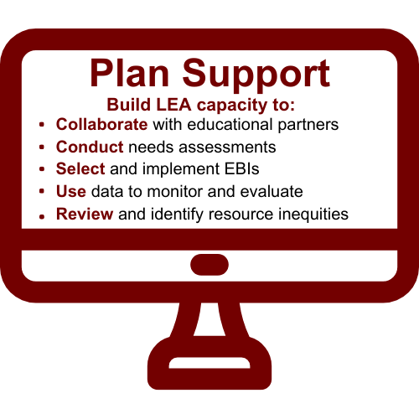
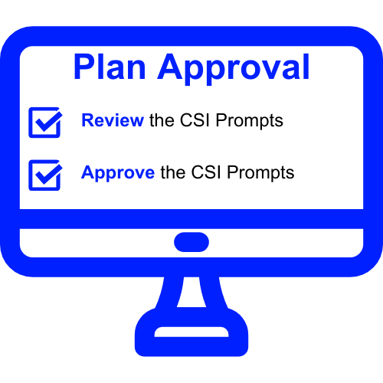
PDIS and PA Differences

Slide 10
Conflict of Interest Guidance
A complete guide on how to avoid a conflict of interest with CSI funds for COEs is located on the CSI COE Program Information web page at https://www.cde.ca.gov/sp/sw/t1/csicoeproginformation21.asp.
COEs are encouraged to review the posted guidance and make any appropriate changes to their policies and/or procedures, where and if needed.
An example of a potential conflict of interest is having one person work on both subgrants.

Slide 11
Reporting Timeline (1)
Reporting happens three times a year:
    July (Reports 1 and 4)
    October (Reports 2 and 5)
    February (Report 3)
Budget Revisions are due mid-month prior to the GMR due date.
GMRs are due at the end of the month after the month the reporting period closes.*

Slide 12
Reporting Timeline (2)
ER | Reporting Data | Performance Period | Reporting Deadline
ER 1 | Expenditures | 2/9/2026, to 6/30/2026 | 7/31/2026
ER 2 | Expenditures | 7/1/2026, to 9/30/2026 | 10/31/2026
ER 3 | Expenditures Mid-Year Reflection | 10/1/2026, to 1/31/2027 | 2/28/2027
ER 4 | Expenditures | 2/1/2027, to 6/30/2027 | 7/31/2027
Final Report | Expenditures Subgrant Performance Report (SPR) | 7/1/2027, to 9/30/2027 | 10/15/2027

Slide 13
GMART Overview
The GMART is a web-based system that:
  Allows the COE to complete, submit, and print the application for funding.
  Allows the COE to submit, view, and modify fiscal data, including expenditure reports.
  Requires usernames and passwords.
For more information, visit the CDE GMART Instructions web page located at https://www.cde.ca.gov/sp/sw/t1/gmartinstructions.asp.

Slide 14
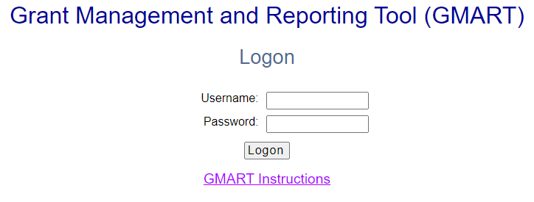
GMART: Logging On
CDE GMART home page: https://www3.cde.ca.gov/gmart/gmartlogon.aspx
Refer to Appendix 1 for alternative text version.

Slide 15
The GMART
Usernames and passwords:
    Are the same as in prior years.
    Are the same for both subgrants.
    Were emailed to county superintendents.
    Are case-sensitive.
For more information, visit the CDE GMART Instructions web page located at https://www.cde.ca.gov/sp/sw/t1/gmartinstructions.asp.

Slide 16
Selecting the Subgrant
Please select the subgrant:
FY 2025–26
Plan Development and Implementation Support
FY 2025–26
Plan Approval

Slide 17
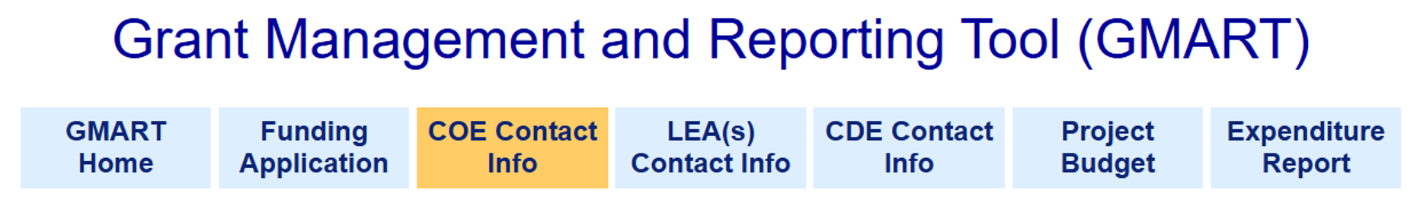
GMART Tabs
Refer to Appendix 2 for alternative text version.

Slide 18
COE Contact Information
Please ensure that the most accurate and recent contact information for the Primary, Secondary, and Fiscal Coordinator/s/ are always in the GMART.
To edit, select the Edit Contact Information button and revise the following as appropriate:
      First and Last Name
      Title
      Phone
      Ext
      Email

Slide 19
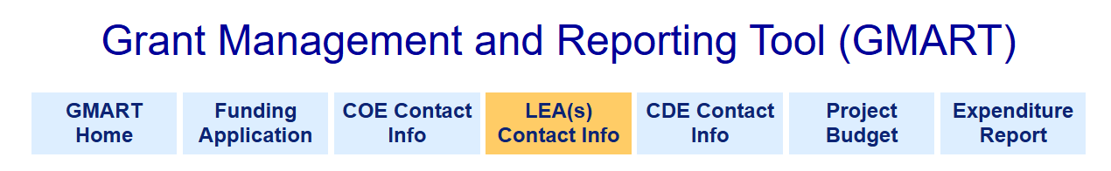
LEA Contact Information Tab
Refer to Appendix 3 for alternative text version.

Slide 20
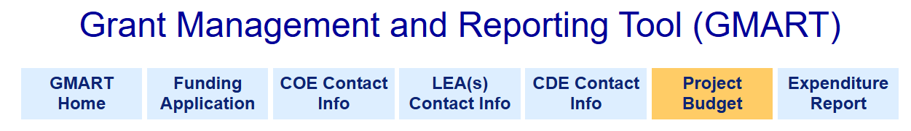
Project Budget Tab
Refer to Appendix 4 for alternative text version.

Slide 21
COE Allocation Amount
County Office of Education | FY 2025–26 Allocation Amount
Sample COE | $26,596
A table of final allocation amounts is located on the CDE Funding Results web page at
https://www.cde.ca.gov/fg/fo/r16/csicoefundingresults25.asp.

Slide 22
When to Submit a Project BR
The COE is required to submit a Project Budget Revision when expenditure amounts claimed for Object Codes are in excess of 10 percent of the last approved budget.
Also, the COE must submit a Project Budget Revision when there is a significant change to the description of planned expenditures.
Note that all Project Budget Revisions must be approved by the CDE before the COE will be able to submit Expenditure Reports. BRs are always due mid-month in reporting months.

Slide 23
PA Project Budget Example
Object Code | Last Approved Budget | Current Expenditure Description | +/- Any Adjustments | Revised Budget Amount | Revised Expenditure Description | Revision Justification
1000-1999 | 0 | NA | 0 | 0 | NA | NA
2000-2999 | 0 | NA | 0 | 0 | NA | NA
3000-3999 | 0 | NA | 0 | 0 | NA | NA
4000-4999 | 0 | NA | 0 | 0 | NA | NA
5000-5999 | $20,000 | Data Analysis Training | 0 | $20,000 | Conflict of Interest Training | Need to Develop Procedures
7310 | $188 | Indirect Cost | 0 | $188 | NA | NA
5100 | 0 | NA | 0 | 0 | NA | NA
Total: | $20,188 | - | - | $20,188 | - | -

Slide 24
PDIS Project Budget Example
Object Code | Last Approved Budget | Current Expenditure Description | +/- Any Adjustments | Revised Budget Amount | Revised Expenditure Description | Revision Justification
1000-1999 | $15,000 | 3 FTE Staff to Coach LEAs | -$10,000 | $5,000 | 1 FTE Staff to Coach LEAs | Reduce 3 FTE to 1
2000-2999 | 0 | NA | 0 | 0 | NA | NA
3000-3999 | $5,000 | Benefits | -$4,000 | $1,000 | NA | Reduce 3 FTE to 1
4000-4999 | 0 | NA | 0 | 0 | NA | NA
5000-5999 | 0 | NA | +$14,000 | $14,000 | Data Consultant | Data Interpretation Needed
7310 | $188 | Indirect Cost | 0 | $188 | NA | NA
5100 | 0 | NA | 0 | 0 | NA | NA
Total: | $20,188 | - | - | $20,188 | - | -

Slide 25

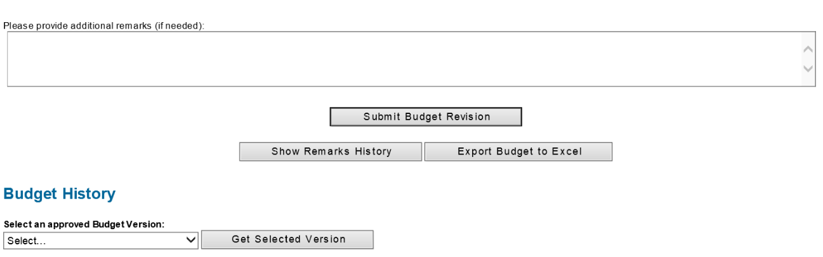
Budget Revision Submission
Refer to Appendix 5 for alternative text version.

Slide 26
Project BR Status Emails
Project Budget Revision Pending CDE Review: a Project Budget Revision has been submitted and the CDE is reviewing the submission.
Project Budget Revision Approved: the Project Budget Revision has been reviewed and is approved.
Project Budget Revision Needs Revision: the Project Budget Revision has been reviewed and requires revision.

Slide 27
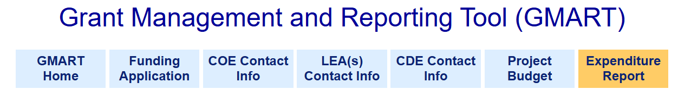
Expenditure Report Tab
Refer to Appendix 6 for alternative text version.

Slide 28
PA Example: ER 1
Object Code | Last Approved Budget | Expenditure Report 1 (3/17/25-6/30/25 Reporting Period) | COE Action
1000-1999 Certificated Salaries | $385,000 | 0 | Edit
2000-2999 Classified Salaries | 0 | 0 | Edit
3000-3999 Benefits | $136,000 | 0 | Edit
4000-4999 Books and Supplies | $246 | $246 | Edit
5000-5999 Services | $333 | $333 | Edit
7310 Indirect Cost | $50,000 | $0 | Edit
5100 (Sub-agreements over $50,000) | 0 | 0 | Edit
Total: | $571,579 | $579 | -

Slide 29
PDIS Example: ER 1
Object Code | Last Approved Budget | Expenditure Report 1 (3/17/25-6/30/25 Reporting Period) | COE Action
1000-1999 Certificated Salaries | 0 | 0 | Edit
2000-2999 Classified Salaries | 0 | 0 | Edit
3000-3999 Benefits | 0 | 0 | Edit
4000-4999 Books and Supplies | 0 | 0 | Edit
5000-5999 Services | $20,000 | $4,812 | Edit
7310 Indirect Cost | $188 | $188 | Edit
5100 (Sub-agreements over $50,000) | 0 | 0 | Edit
Total: | $20,188 | $5,000 | -

Slide 30
Reports 2, 3, 4, and Final
Enter expenditure data for each Object Code.
Enter zeroes for each Object Code if there is no expenditure data.
Make sure there are no red error messages.
Select the “Submit Report” button.
Receive automated emails regarding status.

Slide 31
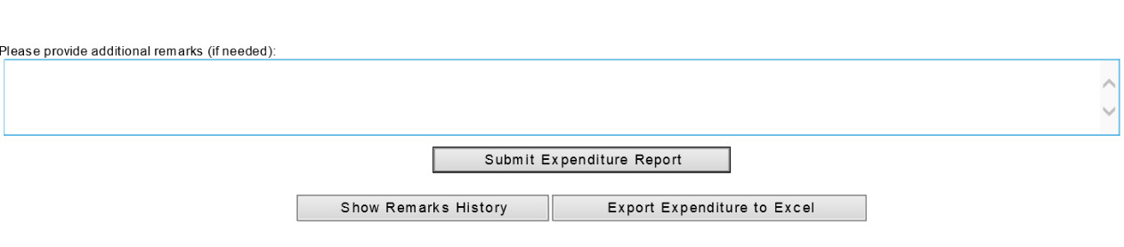
Expenditure Report Submission
Refer to Appendix 7 for alternative text version.

Slide 32
ER Status Emails
Expenditure Report Pending CDE Review: an Expenditure Report has been submitted and the CDE is reviewing the submission.
Expenditure Report Approved: the Expenditure Report has been reviewed and is approved.
Expenditure Report Needs Revision: the Expenditure Report has been reviewed and requires revision.

Slide 33
New! Mid-Year Reflection
The goal of the Mid-Year Reflection is to give COEs space to reflect on current progress, evaluate spending, and determine any adjustments (if any) going forward.
It will take place in ER 3 with the 2025–26 funds in February 2027.
The PDIS Mid-Year Reflection will focus on the development and implementation activities of the of the 2026–27 CSI plans.
The PA Mid-Year Reflection will focus on the review and approval process of the 2026–27 CSI prompts in LEA LCAPs.

Slide 34
PDIS Mid-Year Reflection
COEs will:
Comment on their spending thus far.
Describe the specific actions they have taken to support their LEAs with CSI-eligible schools.
Evaluate their progress.
Share any adjustments they might make to ensure improvement on student and school outcomes.

Slide 35
PA Mid-Year Reflection
For COEs who spend less than 50% of their allocation as of ER 3:
Does the COE have a plan to fully expend all of its 2025–26 school improvement funds?
Now that 2026–27 LCAPs have been approved by the COE, please provide more details regarding the activities/expenditures the COE will charge to the PA subgrant for the remainder of the subgrant period.

Slide 36
Program Cost Account (PCA)
Subgrant | PCA | Resource
CSI COE PDIS | 15439 | 3183
CSI COE PA | 15565 | 3183
CSI LEA | 15438 | 3182
Refer to Appendix 8 for alternative text version.

Slide 37

Closeout (1)
When the COE has expended 100% of its funds with a $0 cash balance, it will be prompted in the GMART to closeout.
When the COE has $25 or less of its final allocation amount, a pop-up message will appear giving the COE the option to closeout.
If the COE proceeds to the Closeout section of the GMART, the Closeout Report will be viewable.

Slide 38
Closeout (2)
If the COE does not want to closeout, do not select the button to proceed to the Closeout section.
If the COE wants to closeout, complete the Closeout section and submit the report. The SISO will confirm that all requirements have been met.
When entering expenditure data, be aware that only numbers are allowed. No decimals, commas, or dollar signs are accepted.

Slide 39
PDIS Closeout Prompt
There is a final evaluation prompt that must be addressed when the COE closes out in the GMART.
Instructions:
Describe the challenges and successes experienced as the CSI funds were used to build LEA capacity to develop, implement, monitor, and evaluate CSI plans designed to improve student and school outcomes.

Slide 40
PA Closeout Prompt
There is a final evaluation prompt that must be addressed when the COE closes out in the GMART.
Instructions:
Describe how well the COE processes worked for reviewing and approving the CSI prompts in the LEA’s LCAP Plan Summary.

Slide 41
Track Your Spending!
The goal for every COE is to expend all their funds by the subgrant end date (September 30).
If funds are remaining at the end of the subgrant, the COE will be prompted to provide additional information regarding why they did not spend their entire allocation.
In addition, CDE staff may schedule informational meetings to discuss spending with COEs throughout the subgrant period as well as before and/or after closeout.

Slide 42
PDIS Spending Cycle
Most COEs receiving PDIS funds use the funds throughout the subgrant cycle (reporting some expenditures in each reporting period).
Support to LEAs with CSI-eligible schools looks different with each LEA that a COE supports.
Each CSI-eligible school is in a different place regarding its improvement efforts, from initial data analysis with educational partners to determining root causes of identification, to researching EBIs, to monitoring progress, and evaluating how to abandon, adapt, or adopt as appropriate.

Slide 43
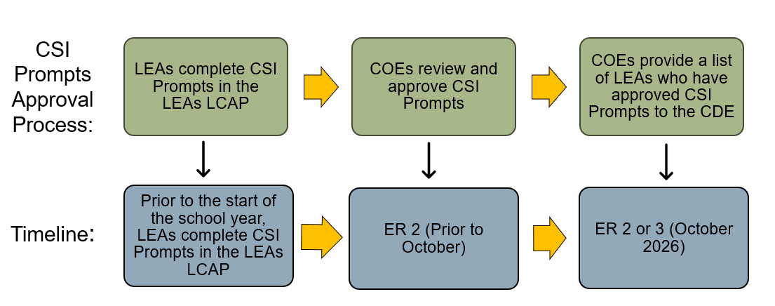
PA Spending Cycle (1)

Slide 44
PA Spending Cycle (2)
2025-26 PA funds must be used on reviewing and approving the 2026-27 CSI Prompts in the 2026-27 LEA LCAPs.
No other year LCAP work is allowable with these funds.
This means, COEs should not be using a “FIFO” (First In First Out) Accounting method with these funds, because the dollars are tied to a specific LCAP.
For example, any dollars spent in March 2027, must still be tied to the review and approval of 2026-27 LEA LCAPs.

Slide 45
Allowable Uses of Funds
PA | PDIS
Funds authorized under this subgrant shall be spent on the review and approval of 2026–27 LEA CSI plans through the CSI prompts in the 2026–27 LEA LCAP. | Funds authorized under this subgrant shall be spent on supporting LEAs to develop and implement CSI plans in the 2026–27 school year.

Slide 46
PDIS and PA Apportionments
First Apportionment | Reports 1 through Final
25 percent of the COE’s Final Allocation | Claimed expenditures less prior payment
The CDE will apportion funds approximately 12-16 weeks after the final date of each reporting period.

Slide 47
GMART Reporting Tips
The COE must confirm it is not reporting expenditures higher than its allowable indirect cost rate.
The COE must ensure zeroes are in each Object Code series if it does not have expenditures for the reporting period.
If the “Submit” button does not appear, scroll up and down to check for any red error messages.
Use the Remarks box to provide additional information.
CDE CSI COE Fiscal Reporting Instructions are located at https://www.cde.ca.gov/sp/sw/t1/gmartcsicoeins25.asp

Slide 48
Questions

Slide 49
Reporting Requirements Recap (1)
2025–26 ESSA CSI COE subgrant recipients may submit budget revisions by July 15, 2026, if necessary.
ALL ESSA CSI COE subgrant recipients MUST submit Expenditure Report 1 by July 31, 2026.
Zeroes can be submitted if there are no expenditures.

Slide 50
Reporting Requirements Recap (2)
ALL reports must be submitted using the CDE GMART web page located at https://www3.cde.ca.gov/gmart/gmartlogon.aspx.
The PDIS PCA is 15439.
The PA PCA is 15565.
The Final Report (Closeout) includes a response to an evaluation prompt in the GMART and must be completed upon closing out.

Slide 51
Reporting Requirements Recap (3)
The 2024–25 ESSA CSI COE subgrants:
Started March 17, 2025.
End September 30, 2026.
Have optional BRs due by July 15, 2026.
Have required ERs (Report 4) due by July 31, 2026.
The 2025–26 ESSA CSI COE subgrants:
Started February 9, 2026.
End September 30, 2027.
Have optional BRs due by July 15, 2026.
Have required ERs (Report 1) due by July 31, 2026.

Slide 52
Web Pages for FY 2025–26 Subgrantees
CSI COE Program Information
CSI COE Background information
Program Requirements (includes Guidelines for the Review and Approval Process of CSI Prompts)
Guidance on Conflict of Interest
LCAP Resources
CSI Resources
FAQs

Slide 53
CDE CSI COE Resources
CDE Comprehensive Support and Improvement: https://www.cde.ca.gov/sp/sw/t1/csi.asp
CDE GMART:
https://www3.cde.ca.gov/gmart/gmartlogon.aspx
CDE GMART Instructions: https://www.cde.ca.gov/sp/sw/t1/gmartinstructions.asp
CDE CSI COE Fiscal Reporting Instructions: https://www.cde.ca.gov/sp/sw/t1/gmartcsicoeins25.asp
CDE CSI COE Program Information: https://www.cde.ca.gov/sp/sw/t1/csicoeproginformation21.asp

Slide 54

Feedback Helps Us Continuously Improve!
  In our efforts to continuously improve, we would appreciate you completing a survey.
  The survey will be available until June 30, 2026.
  We will consider your input as we develop future webinars.

Slide 55
Contacts
School Improvement and Support Office
ESSACOE@cde.ca.gov
(916) 319-0833
Robert Bernstein, RBernstein@cde.ca.gov
April Tormey, Atormey@cde.ca.gov

Slide 56

Thank You for All That You Do For California Students!

Slide 57
Appendix 1 for Slide 14
Grant Management and Reporting Tool
Logon (This is the logon page).
There is a text box for the county office of education to enter its Username.
There is a text box for the COE to enter its Password.
There is a “Logon” button for the COE to select when logging on to the GMART platform.
There is a GMART Instructions link for instructions and guidance for using this online system.
Return to Slide 14

Slide 58
Appendix 2 for Slide 17
Grant Management and Reporting Tool
Six menu options across the top of the page which link to individual GMART pages: GMART Home, Funding Application, COE Contact Info, California Department of Education Contact Info, Project Budget, and Expenditure Report.
This is an illustration of the six tabs in the GMART.
CDE Contact Info is highlighted.
Return to Slide 17

Slide 59
Appendix 3 for Slide 19
Grant Management and Reporting Tool
Six menu options across the top of the page which link to individual GMART pages: GMART Home, Funding Application, COE Contact Info, California Department of Education Contact Info, Project Budget, and Expenditure Report.
CDE Contact Info is highlighted.
Return to Slide 19

Slide 60
Appendix 4 for Slide 20
Grant Management and Reporting Tool
Six menu options across the top of the page which link to individual GMART pages: GMART Home, Funding Application, COE Contact Info, California Department of Education Contact Info, Project Budget, and Expenditure Report.
Project Budget tab is highlighted.
Return to Slide 20

Slide 61
Appendix 5 for Slide 25
Please provide additional remarks (if needed).
A button is displayed with Submit Budget Revision.
A button shows Show Remarks History next to another button with Export Budget to Excel.
Budget History
Select an approved Budget Version: There is a button with Select and one with Get Selected Version.
Return to Slide 25

Slide 62
Appendix 6 for Slide 27
Grant Management and Reporting Tool
Six menu options across the top of the page which link to individual GMART pages: GMART Home, Funding Application, COE Contact Info, California Department of Education Contact Info, Project Budget, and Expenditure Report.
The Expenditure Report tab is highlighted.
Return to Slide 27

Slide 63
Appendix 7 for Slide 31
Please provide additional remarks (if needed).
A button is displayed with Submit Expenditure Report.
A button shows Show Remarks History next to another button with Export Budget to Excel.
Return to Slide 31

Slide 64
Appendix 8 for Slide 36
Table showing the Program Cost Accounting (PCA) for every Comprehensive Support and Improvement (CSI) program.
CSI for County Office of Education (COE) Plan Development and Implementation Support has Resource Code 3182 and PCA 15439.
CSI for COE Plan Approval has Resource Code 3183 and PCA 15569.
CSI for Local Education Agencies has Resource Code 3182 and PCA 15438.
Return to Slide 36

Slide 65
Appendix 9 for Slide 43
Table showing the life cycle of every Plan Approval grant.
After completing the Comprehensive Support and Improvement (CSI) Plan, Local Educational Agencies (LEAs) must complete the CSI required prompts in the Local Control Accountability Plan (LCAP.)
Then, County Offices of Education (COEs) review and approve CSI prompts in the LCAP.
Then, COEs provide a list of LEAs with approved CSI prompts to the California Department of Education (CDE.)
CDE provides the list of LEAs with approved CSI prompts to the State Board of Education for their approval.
Return to Slide 43

