Slide 1
California’s System of Support 2. Assess Needs Module 2B: Designing a Needs Assessment for Continuous Improvement

Slide 2
Acronyms
CCEE: California Collaborative for Educational Excellence
CDE: California Department of Education
COE: County Office of Education
LCAP: Local Control and Accountability Plan
LEA: local educational agency
SPSA: School Plan for Student Achievement

Slide 3
California’s System of Support Goal
The overarching goal of California's System of Support is to help LEAs and their schools meet the needs of each student they serve, with a focus on building local capacity to sustain improvement and to effectively address disparities in opportunities and outcomes.

Slide 4
Overview of Modules
Set Direction and Purpose
1A: Overview of Continuous Improvement and the LCAP
Assess Local Needs and Determine Causal Factors of Greatest Needs
2A: Planning a Needs Assessment for Continuous Improvement
2B: Designing a Needs Assessment for Continuous Improvement
2C: Introduction to Root Cause Analysis

Slide 5
Purpose of Module 2B
To provide LEAs and local educational partners with specific guidance and questions to consider when designing needs assessments for use within the LCAP and school planning processes.

Slide 6
Designing the Needs Assessment

Slide 7
Steps in a Needs Assessment (1)
Onsite analysis meetings are a crucial component during which data is analyzed, root cause analysis occurs, and plan development begins.
Pre-populate the needs assessment with readily available data (e.g., demographic, student outcomes).
Gather survey data.
Review data and compile into an easily digestible format.

Slide 8
Steps in a Needs Assessment (2)
Continued
Facilitate onsite meetings to gather more data, analyze existing data, and determine initial discoveries and action items.
Create summary of discoveries to inform plan creation.

Slide 9
Designing a Successful Needs Assessment
Organizing Principles
Content
Process
Presentation
Research-based Elements
Diverse and rigorous data
Needs-driven, context-specific data collection
Educational partner engagement
Collaborative identification of improvement needs

Slide 10
Organizing Principle: Content
What will the needs assessment cover and include?
What data sources will be utilized and how will they align to the overall focus?

Slide 11
Organizing Principle: Process
How will the needs assessment unfold at the LEA level?
Who is responsible for the process?
Who will collect the data?
How does the process connect to the chosen organizing framework and expectations?
How will the COE support implementation of the needs assessment process?

Slide 12
Organizing Principle: Presentation
How will the needs assessment process and outcomes be organized and disseminated?
How will data and discoveries be presented?
How will results of the needs assessment be documented and connect to the next steps (e.g., LCAP Annual Update)?
What tools and collateral will the COE create to support implementation at the LEA level?

Slide 13
Research-based Element: Diverse and Rigorous Data
Diverse: consisting of many different elements
Synonyms: different, unlike, dissimilar, distinct, separate
Rigorous: extremely thorough, exhaustive
Synonyms: precise, accurate, trustworthy, high-quality
Enables triangulation: cross-checking data to identify trends

Slide 14
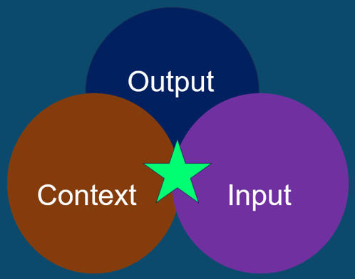
Data Types

Slide 15
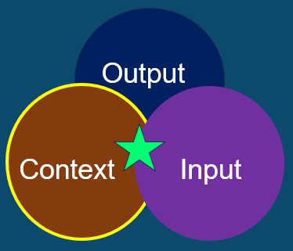
Data Types: Context
Demographics
Total student population and trends
Student groups
Mobility
Overall Climate and Culture
Educational partner perceptions and engagement
LEA Policies and Practices
Local school board decision-making
Policies for magnet programs

Slide 16
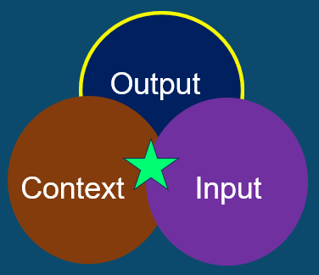
Data Types: Output
Achievement
Behavior
Attendance
Performance

Slide 17
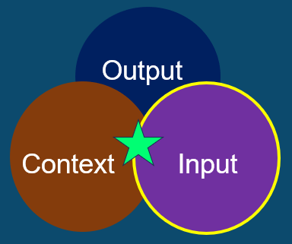
Data Types: Input
Resources
Materials
Plans
Training
Support

Slide 18
Quantitative Data Sources
Assessments, accountability metrics (e.g., achievement, attendance, graduation, behavior data)
Demographic trend data
Classroom observations (scored)
Survey data (Likert scale)

Slide 19
Qualitative Data Sources (1)
LEA policies and practices
local school board decision-making; policies for magnet programs
Personnel policies and procedures
recruitment and hiring, placement, evaluation differentiation, advancement, and termination
Interviews
Focus groups
Observations (descriptive)
Survey data (open response)
LEA and school plans

Slide 20
Qualitative Data Sources (2)
Professional practice
Leadership and decision-making
Leadership development
Planning
Curriculum and Instruction
Vendor/partner practices and outcomes
Resource scan of current vendor services
Use of performance contracts

Slide 21
LEA Specific Topics
Questions about the effectiveness and functionality of the LEA should be included in the needs assessment. Topics may include:
Operational effectiveness of the central office and local school board in addressing LEA functions.
Infrastructure for school leadership; teaching and learning.
Support for the improvement of individual schools.

Slide 22
COE Specific Topics
Questions about the effectiveness and functionality of the COE should be included in the needs assessment. Topics may include:
Operational effectiveness of the county office in addressing county office functions.
Infrastructure for LEA leadership; teaching and learning.
Support for the improvement of individual districts.

Slide 23
Worksheet 2: Designing Your Needs Assessment (1)
Which data do you anticipate including?
Contextual variables
Demographics (student, community, personnel, etc.)
LEA policies and supports (operations, learning infrastructure, support for school improvement, etc.)
Student variables
Student outcomes/performance (assessment results, graduation rates, postsecondary success, accountability metrics, etc.)
Student engagement (attendance, behavior, etc.)
Student opportunities (enrollment/participation in various programs, curricular areas, equity of access to quality instruction, etc.)

Slide 24
Worksheet 2: Designing Your Needs Assessment (2)
Personnel policies and procedures
Recruitment, hiring, placement, development, evaluation, differentiation, advancement, termination, etc.
Professional practice
Leadership and decision-making, leadership development, planning, curriculum and instruction, family/community engagement, student support services, etc.
Climate and culture
Student and adult (including parent) perceptions, educational partner engagement, etc.
Vendor/partner practices and outcomes
For example: do contracts include performance management provisions?

Slide 25
Research-based Element: Needs-driven and Context-specific Data Collection
Put guardrails/structure in place to focus on key areas (segmented needs assessment) rather than creating a comprehensive needs assessment that focuses on everything.
Develop a theory of action, select a research-based framework, and identify high-level areas of improvement using the California School Dashboard to determine key areas of focus.
Guiding topics:
What do we need to know?
About what or whom?
This leads to coherence and connection between the needs.

Slide 26
Methods of Data Collection
Compilation of data from available sources (CDE, COE, LEA, educational partners)
Consensus compilation by LEA-based team, arriving at consensus on needs assessment query items
Guided compilation by LEA-based team with COE, CDE, or external partner facilitation
Surveys or questionnaires (paper and pencil, scannable, and/or online)
Focus groups (conference call, Zoom, and/or in-person)
Interviews (phone call, Zoom, and/or in-person)
Onsite analysis team (external, internal, or hybrid)

Slide 27
Worksheet 3: Designing Your Needs Assessment Template (1)
Which data collection methods do you anticipate including in your needs assessment?
Compilation of data from available sources (CDE, COE, LEA, educational partner)
Consensus compilation by LEA-based team
Guided compilation by LEA-based team with CDE, CCEE, COE, or educational partner facilitation

Slide 28
Worksheet 3: Designing Your Needs Assessment Template (2)
Continued
Surveys or questionnaires (paper/pencil, scannable, online)
Interviews (phone call, Zoom, or in-person)
Focus groups (conference call, Zoom, or in-person)
Data collected by onsite analysis team (facilitated externally by CDE, CCEE, COE, internally by the LEA, hybrid)

Slide 29
Key Questions Graphic Organizer
Identify and capture key questions that need to be answered, to ensure the needs assessment is a success at the local level.
Element | Content | Process | Presentation
Diverse and rigorous data | x | x | x
Needs-driven, context-specific data | x | x | x
Educational partner engagement | x | x | x
Collaborative identification of improvement needs | x | x | x

Slide 30
Research-based Element: Educational Partner Engagement
Educational Partner Engagement is:
Necessary for data collection
Important for analyzing discoveries
Crucial for implementing an improvement plan
The educational partner groups that should be engaged depend on the scope of the needs assessment.

Slide 31
Engaging Educational Partners…
Builds ownership
Builds trust
Increases local capacity and knowledge
Increases utility of data
Leverages implementation science
Leads to action
“Change happens at the speed of trust.”

Slide 32
Required Educational Partners
Pursuant to Education Code Sections 52060(g) and 52066(g), the following educational partners are required to meet minimum consultation requirements for the LCAP process.
Parent advisory committee
English learner parent advisory committee, as applicable
Parents
Students
Teachers
Principals
Administrators
Other school personnel
Local bargaining units
Local community

Slide 33
Other Educational Partners
CDE, COE, and/or LEA personnel
Local board of education
Broad community (e.g., enrollment area, business leaders, faith-based organizations, social service providers)
School Site Council
School support staff
School volunteers

Slide 34
Worksheet 4: Designing Your Needs Assessment Roles and Responsibilities (1)
Check off the roles and responsibilities for each educational partner group identified:
Educational Partner Group | Establishment of Design Requirements | Development of Tools and Processes | Data Collection | Analysis | Onsite Analysis | Plan Development
CDE Staff | x | x | x | x | x | x
COE Staff | x | x | x | x | x | x
LEA Staff | x | x | x | x | x | x
Local governing board | x | x | x | x | x | x

Slide 35
Worksheet 4: Designing Your Needs Assessment Roles and Responsibilities (2)
Continued
Educational Partner Group | Establishment of Design Requirements | Development of Tools and Processes | Data Collection | Analysis | Onsite Analysis | Plan Development
Families and community | x | x | x | x | x | x
School Staff | x | x | x | x | x | x
Students | x | x | x | x | x | x
External Partners | x | x | x | x | x | x
Other | x | x | x | x | x | x

Slide 36
Research-based Element: Collaborative Identification of Improvement Needs
Promotes transparency
Provides LEA communities an authentic voice and a role in the process
Educational partners don’t own what they didn’t identify
Develops a process that involves a variety of people from across the system

Slide 37
Decision Points to Consider (1)
Who participates in the needs assessment?
Does the needs assessment occur off site, on site, online or a combination?
If the needs assessment is on site, how much time is required? What is the cost?
What training/capacity building is needed for anyone participating?
Is there pre-work to be done (e.g., information gathered, compiled, distributed, and reviewed)?
What is the format for the deliverables/results of the needs assessment?

Slide 38
Decision Points to Consider (2)
What is the total cost of developing and administering a needs assessment?
What is the follow-up process for engaging educational partners about the results and discoveries from the needs assessment?
How will the results be used?
How are the results connected to plans and funding applications for school or LEA improvement work (e.g., Comprehensive Support and Improvement)?
How can the results inform ongoing monitoring processes?

Slide 39
Resources (1)
CDE California School Dashboard
CDE California's System of Support
CDE Continuous Improvement Resources
CDE Worksheet 2: Designing Your Needs Assessment

Slide 40
Resources (2)
CDE Worksheet 3: Designing Your Needs Assessment Template
CDE Worksheet 4: Designing Your Needs Assessment Roles and Responsibilities
CDE Worksheet 5: Designing an Effective Onsite Analysis Meeting
CDE Worksheet 6: Designing Your Needs Assessment Decision Points to Consider
CDE Worksheet 7: Key Questions for Implementing a Needs Assessment

Slide 41
Resources (3)
Council on Chief State School Officers (CCSSO) Utilizing Integrated Resources to Implement the School and District Improvement Cycle and Supports
CCSSO Using Needs Assessments for School and District Improvement: A Tactical Guide
U.S. Department of Education Scaling Needs Assessment Learning Cycle Resources

