Slide 1

Achieving Success in Positive Interactions, Relationships, and Environments (ASPIRE)
Date: September 15, 2025

Slide 2
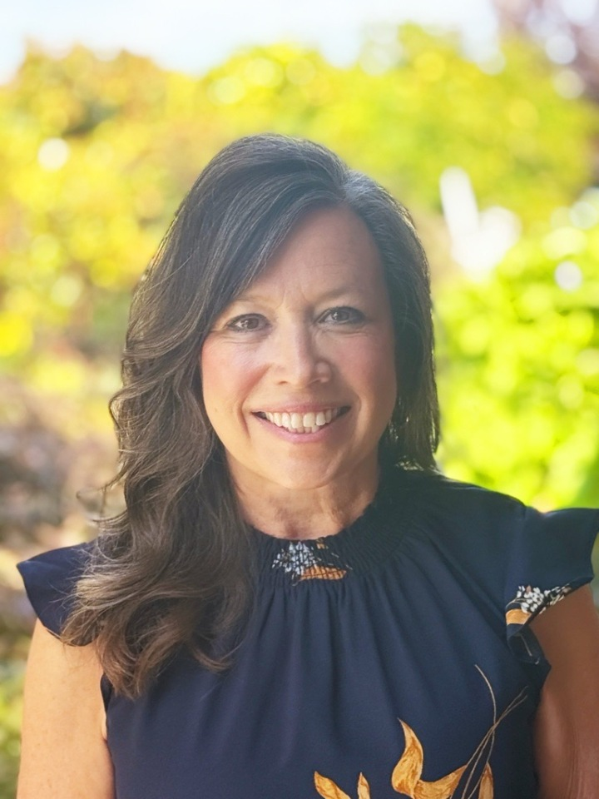
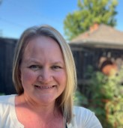
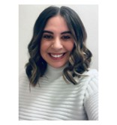
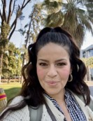
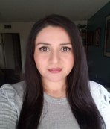
The California Department of Education Early Education Division Classroom Assessment Scoring System Team
Stephanie Myers
Administrator
Gretchen Williams
Consultant
Jade
Miehl
Consultant
Yvette Martin Consultant
Johana Cabeza Consultant

Slide 3
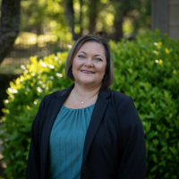
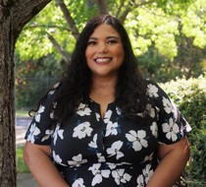
Statewide Lead El Dorado County Office of Education
Photo of new person
New person
Program Coordinator
Laura Earley
Coaching and Professional Development Coordinator
Melissa Wheelahan
Director

Slide 4
Agenda
Policy and Purpose
Implementation of the Classroom Assessment Scoring System (CLASS) 2nd Edition
Implementation of CLASS Environment
myTeachstone Requirements
ASPIRE Regions
ASPIRE Accomplishments
What is Next for ASPIRE
Panel Presentation
Questions and Answers

Slide 5

Policy and Purpose

Slide 6
Policy and Purpose (1)
Management Bulletin 23-10 notifies and provides guidance for California State Preschool Programs (CSPPs) on the requirements to use CLASS and CLASS Environment and changes to Title 5 regulations:
For the 2025–26 program year, all CSPP contractors are required to begin implementing CLASS 2nd Edition Pre-K-3rd and CLASS Environment for 30 percent of all classrooms; and the additional environment requirements as specified.
CLASS will continue to be implemented with a graduated phase-in approach until full implementation in program year 2028–29.

Slide 7
Policy and Purpose (2)
Beginning July 1, 2025, CSPP contractors must ensure that all CLASS and CLASS Environment observations are entered into myTeachstone no later than 30 days after the observation data is received by the CSPP contractor.​
At this time, the CLASS tools and data will not be used by the California Department of Education (CDE) to determine a finding during monitoring, but rather to identify where additional support is needed for continuous quality improvement in the CSPP.

Slide 8
Policy and Purpose (3)
CLASS data should be used by CSPPs to inform professional development, coaching, and other continuous quality improvement efforts.
Contractors shall not use CLASS scores to evaluate staff competency.
If violations of state or federal law are observed during a CLASS 2nd Edition Pre-K-3rd or CLASS Environment observation, the person observing shall continue to follow all applicable laws.

Slide 9
Implementation of CLASS 2nd Edition Pre-K-3rd

Slide 10
Implementation of CLASS: Timeline
Program Year | Percent of CSPP Classrooms Within the Agency’s Contract That Must Have Annual CLASS Observation Completed
2024–25 | 15%
2025–26 | 30%
2026–27 | 60%
2027–28 | 90%
2028–29 and beyond | 100%

Slide 11
Requirements for CLASS Observers
Any certified CLASS observer who is conducting an observation in a CSPP classroom must also have completed the CLASS Observer Support Series, including:​
Settings with Dual Language Learners
Settings with Children with Disabilities
Reducing Bias​
The purpose of this additional training requirement is to ensure California is centering diversity, equity, inclusion, and belonging in CLASS implementation.

Slide 12
Implementation of CLASS Environment

Slide 13
Implementation of CLASS Environment: Timeline
Program Year | Percent of CSPP Classrooms Within the Contract That Must Have an Annual CLASS Environment Observation Completed
2024–25 | 15%
2025–26 | 30%
2026–27 | 60%
2027–28 | 90%
2028–29 and beyond | 100%

Slide 14
Requirements for License-Exempt Classrooms
Prior to full implementation of the CLASS Environment in 2028–29, any local educational agency with license-exempt classrooms are required to:
Prioritize all CSPP license-exempt classrooms for CLASS Environment observations
Specifically, contractors must ensure CLASS Environment observations are completed for all license-exempt classrooms before CLASS Environment observations for licensed classrooms are started

Slide 15
Requirements for CLASS Environment Observers
CLASS Environment observers must have completed all the following requirements:
CLASS Certification
CLASS Support Series
Settings with Dual Language Learners
Settings with Children with Disabilities
Reducing Bias
​

Slide 16
Requirements for CLASS Environment Observers (2)
CLASS Environment training
CLASS Environment Foundations
CLASS Environment within a CLASS Observation
The purpose of this additional training requirement is to ensure California is centering diversity, equity, inclusion, and belonging in CLASS Environment implementation ​

Slide 17
myTeachstone Requirements

Slide 18
myTeachstone Set Up
Contractors are required to populate classroom-level detail into the myTeachstone hierarchy by July 1, 2025
As of August 12, 2025:
30 percent have at least one classroom identified
70 percent have zero classrooms identified

Slide 19
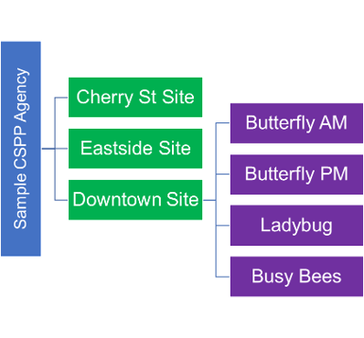
Building your myTeachstone Hierarchy
The California Department of Education (CDE) worked with Teachstone to pre-populate CSPP agency and site details in myTeachstone
​

Slide 20
Building your myTeachstone Hierarchy (2)
CSPP Contractor Responsibility:
Adding classroom and educator details
​

Slide 21
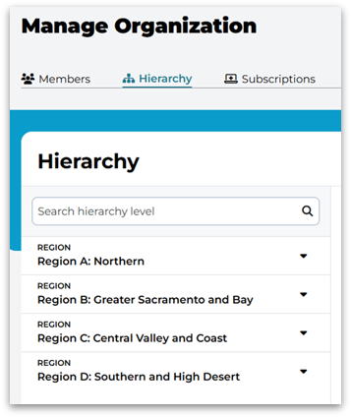
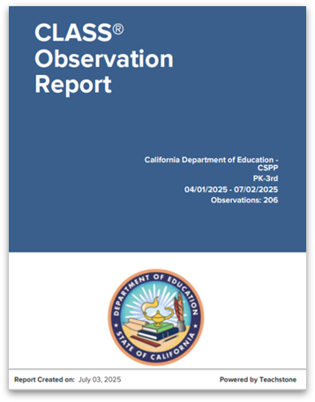
CSPP Contractor Role in myTeachstone
Gain familiarity with platform
Locate agency, confirm sites are accurate, and ensure classrooms are entered in hierarchy
Use platform to review CLASS and CLASS Environment data
Generate CLASS summary reports for agency, site, and classroom audiences

Slide 22
myTeachstone and CLASS Resources
Classroom Assessment Scoring System Data Guidance
myTeachstone User Navigation Resource
myTeachstone Step-by-Step for Key Actions
supportca@teachstone.com

Slide 23
ASPIRE

Slide 24
Statewide Lead
Responsibilities of Statewide Lead for CLASS implementation for CSPP are the following:
Coordinate four ASPIRE Regional Leads
Contract with Teachstone to support CLASS implementation
Coordinate CLASS quality improvement supports and coaching
Create equitable access to resources and training
Ensure coordinated data sharing and reporting

Slide 25
Regional Leads
Responsibilities of the Regional Leads for CLASS implementation for CSPPs are the following:
CLASS implementation and capacity building through educator, observer and program lead training
Data collection to inform planning for contractor needs
Communication with CSPP contractors and CSPP Quality Rating Improvement System (QRIS) Block Grant leads
The goal of each regional plan is to meet the needs of all CSPPs specific to the region

Slide 26
Regional A Lead Contact Information
Region A: Northern​
Butte, Del Norte, Glenn, Humboldt, Lake, Lassen, Mendocino, Modoc, Plumas, Shasta, Siskiyou, Sonoma, Tehama, and Trinity Region​
Regional Lead: Shasta County Office of Education​
Rea McFadden​
rmcfadden@shastacoe.org ​

Slide 27
Regional B Lead Contact Information
Region B: Greater Sacramento and Bay​
Alameda, Alpine, Amador, Calaveras, Colusa, Contra Costa, El Dorado, Marin, Monterey, Napa, Nevada, Placer, Sacramento, San Benito, Santa Clara, Santa Cruz, San Francisco, San Joaquin, San Mateo, Sierra, Solano, Stanislaus, Sutter, Tuolumne, Yolo, and Yuba Region​
Regional Lead: EDCOE​
Denise Gale​
ASPIRERegionB@edcoe.org

Slide 28
Regional C Lead Contact Information
Region C: Central Valley and Coast​
Fresno, Kern, Kings, Madera, Merced, Mariposa, San Luis Obispo, Santa Barbara, Tulare, and Ventura Region​
Regional Lead: Ventura County Office of Education​
Alicia McFarland​
aspireregionc@vcoe.org

Slide 29
Regional D Lead Contact Information
Region D: Southern and High Desert​
Imperial, Inyo, Los Angeles, Mono, Orange, Riverside, San Bernardino, and San Diego Region​
Regional Lead: San Diego County Office of Education​
Eunice Munro​
ASPIRE-RegionD@sdcoe.net ​

Slide 30
ASPIRE Accomplishments

Slide 31
ASPIRE Accomplishments (1)
Regional and Statewide Leads completed CLASS implementation needs assessments and surveys which led to the creation of the ASPIRE Regional and Statewide Coordination and Implementation Plan
Partnered with the CDE team overseeing CSPP QRIS Block Grant on gathering data from Block Grant Leads to inform year two of CLASS implementation

Slide 32
ASPIRE Accomplishments (2)
In partnership with Teachstone, hosted two professional development webinars
The Statewide Lead facilitated four observer and trainer Communities of Practice
The Statewide Lead and the CDE presented across the state to many early learning partners

Slide 33
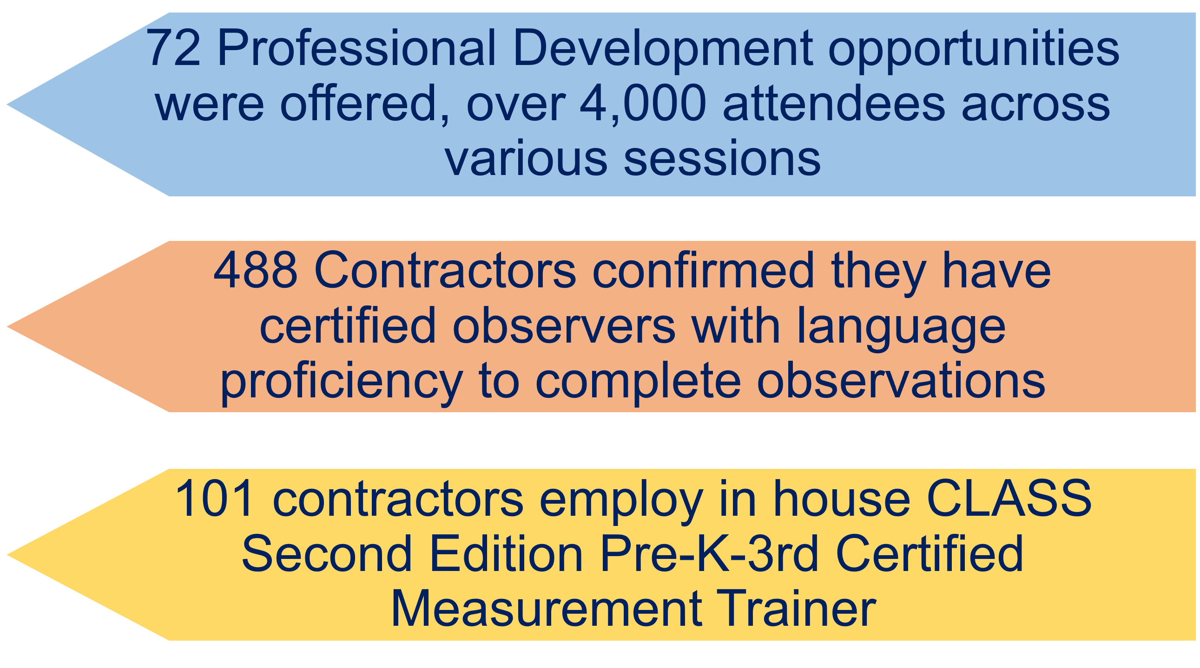
ASPIRE Accomplishments (3)

Slide 34
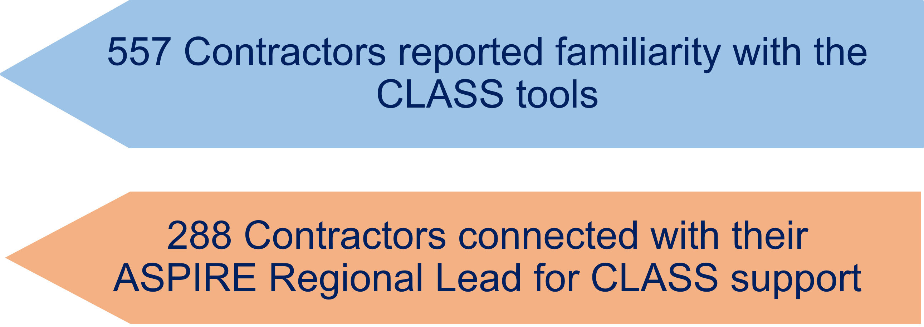
ASPIRE Accomplishments (4)

Slide 35
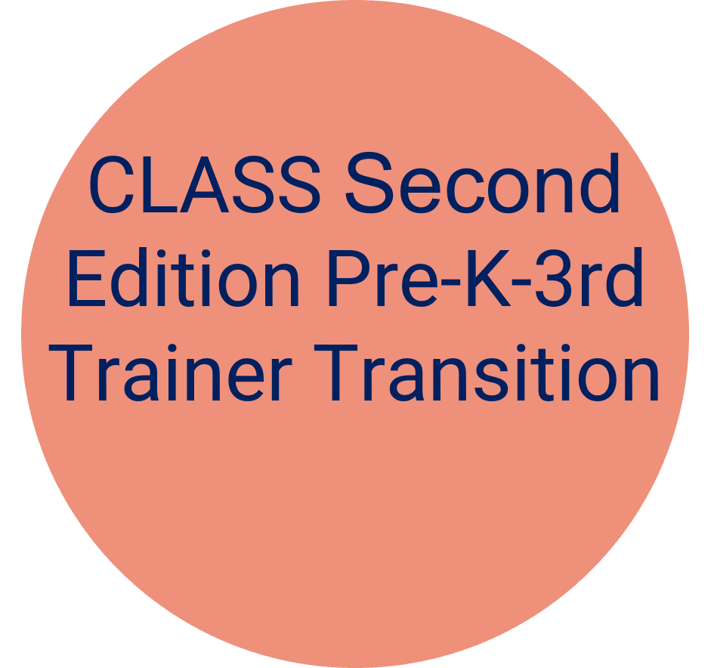
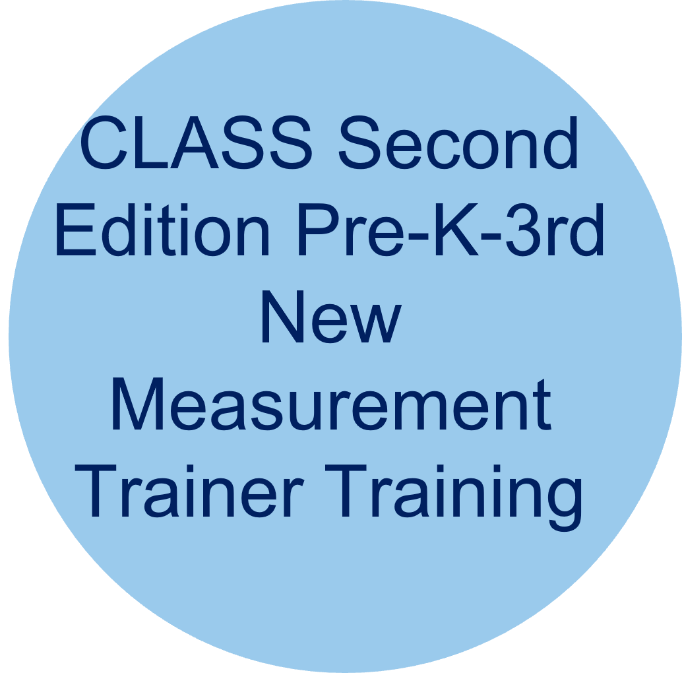

State ASPIRE Accomplishments (5)
Continued to build trainer and observer capacity across the state by delivering the following trainings:

Slide 36
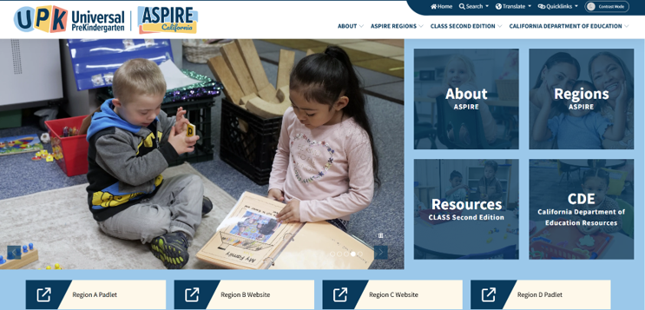
ASPIRE Accomplishments (6)
ASPIRE website: aspireca.org

Slide 37
ASPIRE Statewide and
Regional Lead Teams:
What’s Next….

Slide 38
What’s Next for ASPIRE
Interactions Essentials Trainer trainings to support coaching and training capacity
Presentations across the state to provide support
Monthly ASPIRE newsletter for administrators, trainers, observers, and coaches
Fiscal support for observer and trainer recertifications
Fiscal support for trainer materials and CLASS environment codes

Slide 39
What’s Next for ASPIRE (2)
Communities of Practice
Trainers (focusing on training strategies)
Coaches (focusing on coaching strategies)
Interaction Essentials Trainers
Support from Regional Leads
Training
Office hours

Slide 40
What’s Next for ASPIRE (3)
Observer Office Hours
Observers who are certifying or renewing
New observers who need support
CLASS Environment support
Support for observing in inclusive classrooms

Slide 41
What’s Next for ASPIRE (4)
Continue to partner with the CDE and CSPP QRIS Block Grant on office hours and CLASS capacity building
Continue to partner with Inclusive Early Education Expansion Program and Supporting Innovative Practices to support children with disabilities

Slide 42
Panel Presentation

Slide 43
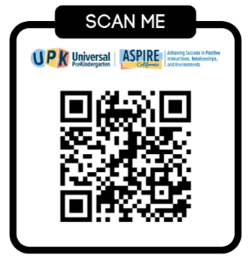
CLASS Support
https://forms.gle/Q5UMvB9mZrznLLPi9

Slide 44
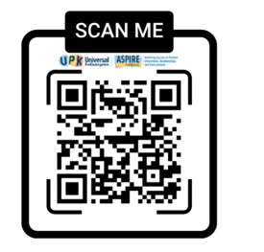
Join our Listserv
bit.ly/ASPIREList
Scan the code above to be added to our ASPIRE trainer and observer listserv to receive updates from the Statewide Lead

Slide 45
Questions and Answers

Slide 46
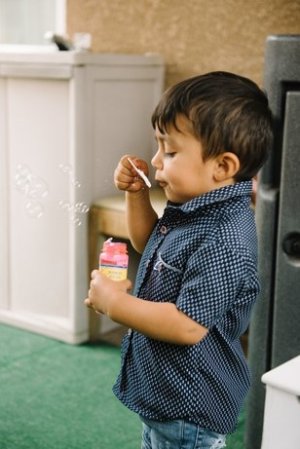
Thank You
Photo Credit: Debra Manrique Family Child Care; Oxnard, CA

