Slide 1
Targeted Support and Improvement / Additional Targeted Support and Improvement
January 20, 2026
Presented by:
Student Achievement and Support Division
Analysis, Measurement, and Accountability Reporting Division
Building Educational Success Together Division

Slide 2

Acronyms (1)
Acronym | Definition
AFF | Application for Funding
ATSI | Additional Targeted Support and Improvement
CDE | California Department of Education
COE | County Office of Education
CoP | Community of Practice
CSI | Comprehensive Support and Improvement
DASS | Dashboard Alternative School Status
EBI | Evidence-based Intervention/Strategy/Activity
EC | Education Code

Slide 3
Acronyms (2)
Acronym | Definition
ESSA | Every Student Succeeds Act
LCAP | Local Control and Accountability Plan
LEA | local educational agency
PA | Plan Approval
PDIS | Plan Development and Implementation Support
SISO | School Improvement and Support Office
SPSA | School Plan for Student Achievement
TSI | Targeted Support and Improvement

Slide 4
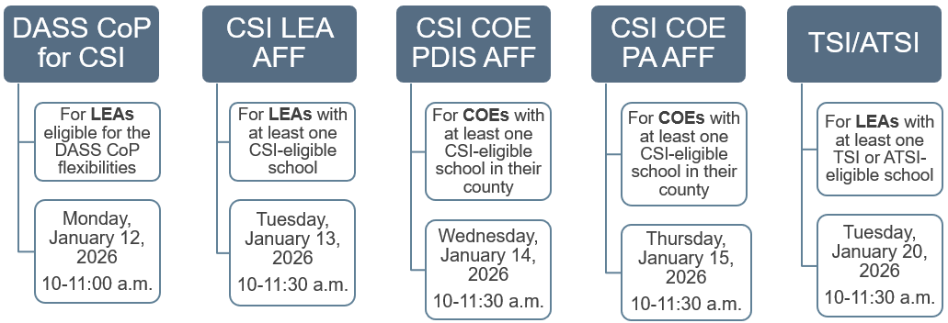
ESSA School Support Webinars
Reference Appendix 1 for long descriptive text.

Slide 5

Office Hours
What: Join SISO for Office Hours!
When: January 21, 2026, at 10:00 to 11:00 a.m.
Who: LEAs, COEs, and charter schools that have AFF or program questions.
Register:
ESSA School Support Webinars Resources

Slide 6
Agenda
Overview of TSI and ATSI
TSI and ATSI Eligibility/Exit
Data File and Student Group Report
Planning Requirements
Title II Prioritization of Funds
EBI Consideration
Plan Development Process
Summary and Resources

Slide 7
Reminders
Please use the Zoom Question and Answer feature to post any questions you may have.
A copy of today’s presentation is located on the TSI/ATSI tab of the CDE ESSA School Support Webinar Resources web page.

Slide 8
TSI and ATSI Overview

Slide 9

Statutory Authority
TSI and ATSI planning requirements: ESSA, Section 1111(d)(2)(B–C)
TSI and ATSI eligibility and exit requirements: ESSA, Section 1111(c)
California ESSA State Plan

Slide 10
What is TSI and ATSI?
TSI and ATSI are ESSA school support categories assigned to schools in need of targeted support based on performance outcomes of one or more student groups.
Schools can only be eligible for one support category at a time. Therefore, a school eligible for TSI cannot also be eligible for ATSI or CSI at the same time.
Both Title I-funded and non-Title I-funded schools can be eligible for TSI and ATSI.

Slide 11
TSI and ATSI Eligibility Overview
Per California’s ESSA State Plan, TSI and ATSI both require one or more student group(s) that, for two consecutive years based on the California School Dashboard (Dashboard), meet the same criteria used to determine CSI–Low Performing.
While TSI and ATSI have the same entry criteria, determinations for these categories are made at different intervals.

Slide 12
TSI and ATSI Comparison
Topic | TSI | ATSI
When | Non-CSI/ATSI years (2025 Dashboard) | Every three years (2026 Dashboard)
Who | Student Group Focus | Student Group Focus
Exit | Does not meet entry criteria | Meet specific exit criteria (Status and Change)
Notification | LEA must notify school | LEA must notify school
Plan | School must develop | School must develop
Funding | No funding | No funding

Slide 13
Why do we make TSI determinations?
A provision of ESSA and California’s ESSA State Plan requires California to make TSI determinations. 2025–26 is the second year California has made TSI determinations.
TSI-eligible schools have at least one student group that is consistently underperforming, and this signals to school leaders that one or more student groups require targeted support and intervention. TSI determinations are made in non-CSI/ATSI entry years to draw timely attention to student groups in need and to avoid improvement delays which could impact future ESSA school support determinations.

Slide 14
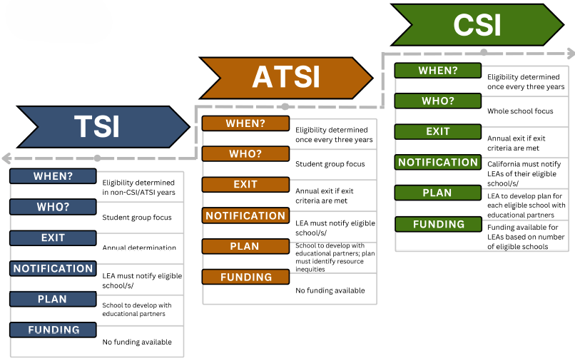
Categories of Support
Reference Appendix 2 for long descriptive text.

Slide 15
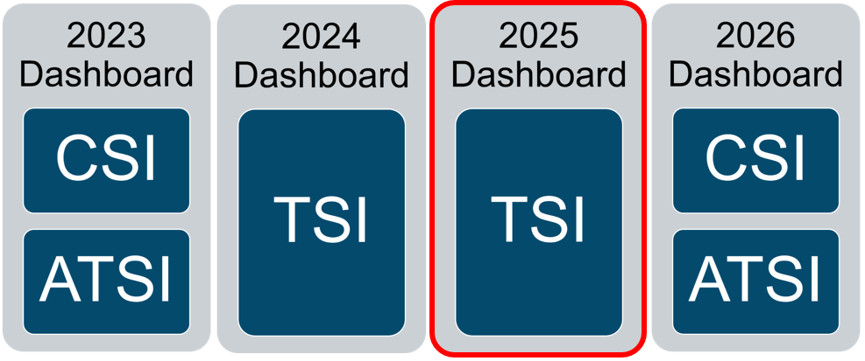
Timeline of Federal School Support Determinations
Reference Appendix 3 for long descriptive text.

Slide 16
TSI and ATSI in California
All schools that were not eligible for CSI or ATSI, even those schools that exited CSI or ATSI based on the results of the 2025 Dashboard, were placed into the eligibility pool for TSI determinations.
Based on the 2025–26 ESSA Assistance Status Data File,
640 schools are eligible for TSI
256 schools are eligible for ATSI

Slide 17
TSI and ATSI Student Groups
The student groups used for TSI and ATSI determinations are:
Race/ethnicity (i.e., Black/African American, American Indian/Alaska Native, Asian American, Filipino, Hispanic, Pacific Islander, White, and Two or More Races)
Homeless Students
English Learner (EL) Students
Foster Youth Students
Students with Disabilities (SWD)
Socio-economically Disadvantaged Students

Slide 18
TSI Eligibility Criteria
All schools with a student group that meet the criteria below are eligible for TSI.
Criteria | 2025 TSI Entry Criteria Based on the 2024 and 2025 Dashboards
Criterion 1 | All Red indicators
Criterion 2 | All Red indicators except for one indicator of another performance color
Criterion 3 | Five or more indicators where the majority are Red

Slide 19
TSI Entry
and
ATSI Exit
Examples

Slide 20
Example 1: School Is Eligible for TSI
State Indicator | 2024 Performance Color (SWD) | 2025 Performance Color (SWD)
English Language Proficiency Indicator (ELPI) | Not Applicable | Not Applicable
Academic – English Language Arts (ELA) | No Color | No Color
Academic – Math | No Color | No Color
Suspension Rate | Red | Yellow
Chronic Absenteeism | Red | Red
Met Criterion 1: All Red
Met Criterion 2: All Red except one.

Slide 21
ATSI Exit Criteria (1)
Exit Criterion 1: Student group does not meet any of the ATSI eligibility criteria for entry.
Criteria | Eligibility Criteria Based on the 2024 and 2025 Dashboards
Criterion 1 | All Red indicators
Criterion 2 | All Red indicators except for one indicator of another performance color
Criterion 3 | Five or more indicators where the majority are Red

Slide 22
ATSI Exit Criteria (2)
Exit Criterion 2: On the 2025 Dashboard, the student group showed improvement in Change on at least one state indicator that was Red on the 2024 Dashboard.
Indicator | Amount of Change +/-
ELA Math | +0.1 distance from standard points
ELPI Graduation Rate College/Career | +0.1 percentage points
Suspension Rate Chronic Absenteeism | -0.1 percentage points

Slide 23
ATSI Exit Criteria (3)
ATSI Exit Criterion 1 and ATSI Exit Criterion 2 must both be met by the same student group that contributed to the school’s ATSI eligibility in order to exit ATSI.
As a reminder,
Exit Criterion 1: Student group does not meet any of the ATSI eligibility criteria for entry.
Exit Criterion 2: Student group showed improvement in at least one state indicator that was Red on the 2024 Dashboard.

Slide 24
Example 2: School Exits ATSI (1)
ATSI Exit Criterion 1: MET
State Indicator (SWD) | 2024 Performance Color | 2025 Performance Color | Exit Criterion 2: 2025 Change | Improvement in Change from 2024 to 2025
Suspension Rate | Orange | Yellow | -4.2 | N/A
Chronic Absenteeism | Red | Orange | -2.8 | Yes
2024 Entry Criteria Met
(All Red except one)
2025 Entry Criteria Not Met

Slide 25
Example 2: School Exits ATSI (2)
ATSI Exit Criterion 2: MET
State Indicator (SWD) | 2024 Performance Color | 2025 Performance Color | Exit Criterion 2: 2025 Change | Improvement in Change from 2024 to 2025
Suspension Rate | Orange | Yellow | -4.2 | N/A
Chronic Absenteeism | Red | Orange | -2.8 | Yes
The SWD student group showed Improvement in Change by decreasing its Chronic Absenteeism rate by 2.8 percentage points.

Slide 26
Example 2: School Exits ATSI (3)
The SWD student group met ATSI Exit Criterion 1 and ATSI Exit Criterion 2. As a result, this school exits ATSI based on the performance of its SWD student group.

Slide 27
Data File and Student Group Report

Slide 28
ESSA Assistance Status Data File (1)
The 2025–26 ESSA Assistance Status Data File indicates which schools continue to be eligible for CSI and ATSI and which schools are newly eligible for TSI. The Data File indicates the student group that contributed to a school’s eligibility for ATSI (based on the 2023 Dashboard) and TSI (based on the 2025 Dashboard).
School | FOSTER | HISPANIC | HOMELESS | Total
School A | 0.0 | 0.0 | 0.0 | 0.0
School B | 0.0 | 1.0 | 0.0 | 1.0
School C | 1.0 | 0.0 | 1.0 | 2.0

Slide 29
ESSA Assistance Status Data File (2)
The ESSA Assistance Status Data File also indicates CSI and ATSI exits.
School | Assistance Status 2024 | Assistance Status 2025 | Exit
School D | ATSI | No Status | ATSI Exit
School E | CSI Low Perform | CSI Low Perform | No Exit
School F | CSI Low Grad | No Status | CSI Exit
School G | No Status | TSI | No Exit
School H | CSI Low Perform | TSI | CSI Exit
School I | TSI | No Status | No Exit

Slide 30
Student Group Report (1)
The School Dashboard Additional Reports and Data web page contain numerous additional reports that provide LEAs and educational partners with data that expands on the information reported on the Dashboard.
The Student Group Report may be particularly helpful to LEAs with schools eligible for TSI or ATSI as it displays the performance for all student groups across all state indicators (as applicable to the school).

Slide 31
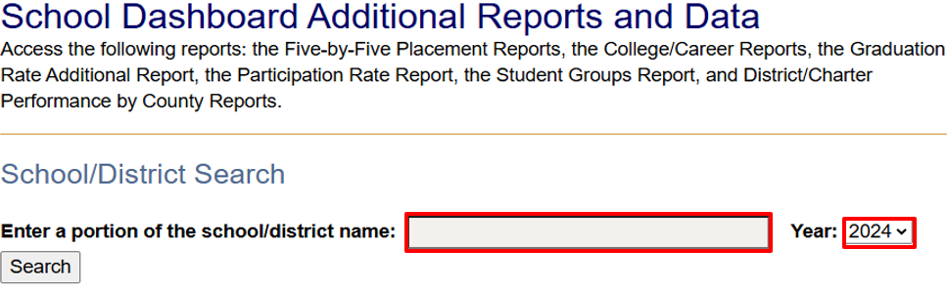
Student Group Report (2)
Enter a portion of the LEA or school’s name and select the year.
Reference Appendix 4 for long descriptive text.

Slide 32
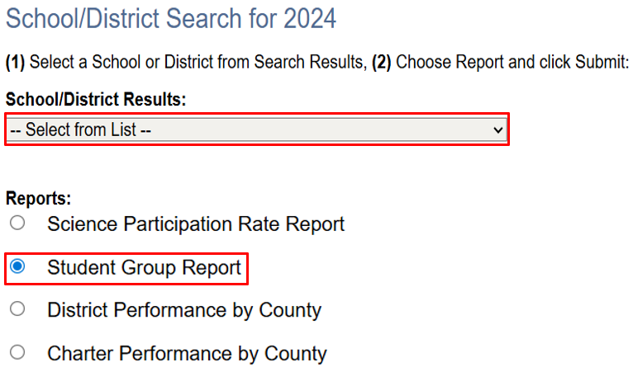
Student Group Report (3)
Reference Appendix 5 for long descriptive text.

Slide 33
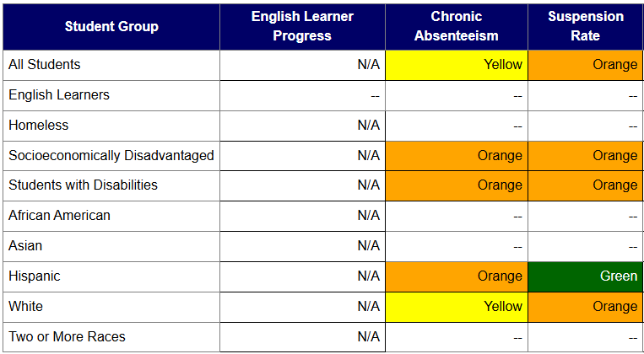
Student Group Report (4)
Reference Appendix 6 for long descriptive text.

Slide 34
Planning Requirements

Slide 35

TSI and ATSI Requirements for LEAs
For each of its TSI- and ATSI-eligible schools, LEAs must:
Notify the school of its TSI or ATSI designation, including which student group/s/ is consistently underperforming.
Approve the TSI or ATSI plan.
Monitor the implementation of TSI or ATSI plan.

Slide 36
TSI and ATSI Requirements for Schools
Each TSI- or ATSI-eligible school must:
Develop and implement a school-level plan to improve outcomes for each student group that was the subject of notification.
Collaborate with educational partners.
Integrate the TSI or ATSI plan into the SPSA, LCAP (single school districts and charter schools only pursuant to EC Section 64001[j]), or an alternative plan that meets federal planning requirements.

Slide 37
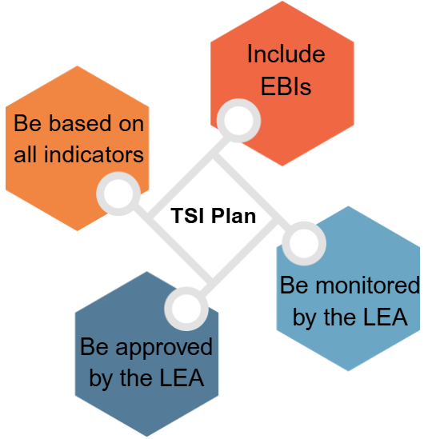
TSI Plan Elements
In collaboration with educational partners (including principals and other school leaders, teachers, and families), the school shall develop a TSI plan to improve student outcomes.
The TSI plan must:
Reference Appendix 7 for long descriptive text.

Slide 38
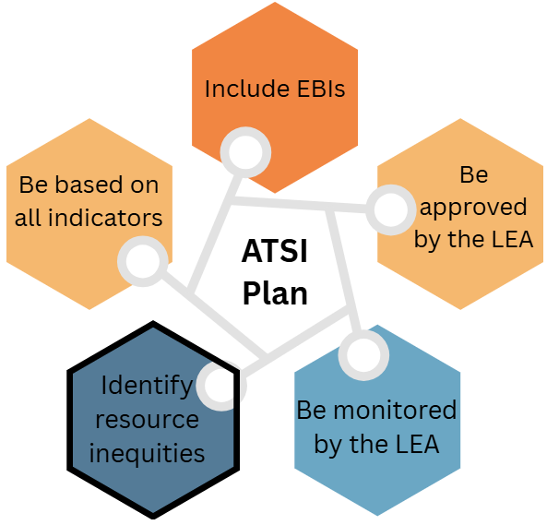
ATSI Plan Elements
The ATSI plan must include all elements of the TSI plan, with the addition of the identification of resource inequities.
Reference Appendix 8 for long descriptive text.

Slide 39
Using the SPSA for Planning
EC Sections 64001–65001 streamlines state and federal planning processes and allows the SPSA to meet ESSA requirement for TSI and ATSI. As a convenience, the SPSA templates for TSI and ATSI include instructions that guide schools in using the templates for TSI and ATSI planning.

Slide 40
Using the LCAP for Planning
Single school districts and charter schools may reference the TSI/ATSI Planning Summary web page to assist in using the LCAP for TSI and ATSI planning.
The Planning Summary:
Provides a summary of the TSI and ATSI plan requirements.
Identifies where each TSI and ATSI plan requirement may be addressed within the LCAP.

Slide 41
Who Approves the TSI or ATSI Plan? (1)
If the school utilizes the SPSA process, the plan must be approved by the Schoolsite Council (SSC), as well as by the governing board of the LEA.
The LEA governing board may approve the TSI or ATSI plan through the SPSA or LCAP (single school districts and charter schools only) process pursuant to EC Section 64001(i) or EC Section 47606.5.

Slide 42
Who Approves the TSI or ATSI Plan? (2)
If single school districts and charter schools use the LCAP to meet TSI or ATSI requirements, the governing board of the LEA approves the plan. The LEA must consult with educational partners, and the plan must meet all TSI or ATSI planning requirements. The LEA governing board may approve the TSI or ATSI plan through the LCAP process pursuant to EC Section 64001(i) or EC Section 47606.5.
If an LEA uses an alternative planning process, the LEA is responsible for educational partner engagement and approving the plan. The LEA has local control/decision-making authority to determine how the school’s TSI or ATSI plan is approved.

Slide 43
Plan Approval and Implementation Timeline
December–June 2026: TSI/ATSI plan development
July 2026–June 2027: TSI/ATSI plan implementation
The LEA must approve a school’s TSI or ATSI plan prior to implementation. The plan is expected to be approved prior to the first day of the 2026–27 school year.

Slide 44
Federal Program Monitoring
LEAs with schools eligible for TSI or ATSI may be selected for a Federal Program Monitoring review using the School Support and Improvement Instrument.
For more FPM-related information, contact the Title I Monitoring and Support Office by email at TIMSO@cde.ca.gov.

Slide 45

No School Improvement Funding
TSI- and ATSI-eligible schools are not eligible to receive ESSA school improvement funds.
ESSA school improvement funds prioritized for CSI (i.e., ESSA, Section 1003 funds) may not be used at an LEA’s TSI- or ATSI-eligible schools.

Slide 46
Title II Prioritization of Funds

Slide 47
Title II, Part A – Purpose
Increasing student achievement consistent with the challenging state academic standards;
Improving the quality and effectiveness of teachers, principals, and other school leaders;
Increasing the number of teachers, principals, and other school leaders who are effective in improving student academic achievement in schools; and
Providing low-income and minority students greater access to effective teachers, principals, and other school leaders.

Slide 48
LCAP Federal Addendum – Title II (1)
Prioritizing Funding
ESSA, Section 2102(b)(2)(C)
Provide a description of how the LEA will prioritize funds to schools served by the agency that are implementing CSI and TSI activities under ESSA, Section 1111(d) and have the highest percentage of children counted under ESSA, Section 1124(c).
THIS ESSA PROVISION IS ADDRESSED BELOW [Address the provision here]

Slide 49
LCAP Federal Addendum – Title II (2)
LEAs will address these questions in the Title II section of the LCAP Federal Addendum Prioritizing Funding:
Please describe the LEA’s process for determining Title II, Part A funding among the schools it serves.
Please describe how the LEA determines funding that prioritizes CSI and TSI schools and schools serving the highest percentage of children counted under Section 1124(c).
Please describe how CSI and TSI schools and schools that have the highest percentage of children counted under Section 1124(c) that the LEA serves receive priority in Title II, Part A funding decisions compared to other schools the LEA serves.

Slide 50
Title II Prioritization Examples (1)
Instructional Coaching and Mentoring
Expand coaching hours for CSI/TSI sites – evidence will be on time and effort records.
Training paraeducators at CSI/TSI sites on effective instructional support.
Professional Learning Focused on Student Needs
Evidence-based strategies aligned to identified performance gaps (English Language Development strategies, literacy interventions, culturally responsive pedagogy).
Training for staff in data driven instruction to better target student groups.

Slide 51
Title II Prioritization Examples (2)
3. Leadership Development
Professional development for site administrators on turnaround leadership and supporting continuous improvement.
4. Recruitment and Retention of Effective Teachers
Incentives for effective teachers to remain at or transfer into CSI/TSI sites (stipends, retention bonuses).

Slide 52
Evidence-Based Intervention

Slide 53
High-Impact Tutoring (1)
What is it?
High-Impact Tutoring (HIT) is personalized, high-quality instruction in one-on-one or small group settings that creates positive relationships between tutors and students that are motivating and engaging. HIT supplements (does not replace) students’ classroom experiences.
What are the Design Principles of HIT?
Tutoring occurs at least three times per week for 10 or more weeks.
Students work with a consistent, well-trained tutor.
Tutoring aligns with high-quality class curriculum.
Close monitoring of student knowledge and skills.
Tutoring is part of the school day.

Slide 54
High-Impact Tutoring (2)
HIT Reduces Absenteeism.
In a case study conducted through Stanford University, students were 1.2 percentage points less likely to be absent on days they were scheduled for tutoring, a 7.0 percent decrease in students’ overall likelihood of being absent.
Extremely absent students (i.e., absent more than 30 percent of school days) attended 2.8 more days of school per year if tutoring was scheduled as part of their day.
The greatest impact on attendance occurs when multiple design elements of HIT are incorporated.

Slide 55
High-Impact Tutoring (3)
HIT is effective across various models.
Research conducted through the University of Chicago found that virtual tutoring models were just as impactful as in-person models.
This finding suggests that LEAs can employ less expensive tutoring interventions without sacrificing impact.

Slide 56
Funding Source for HIT
Learning Recovery Emergency Block Grant (LREBG)
Pursuant to EC Section 32526(c)(2)(B)(i), LREBG funds may be expended on accelerating progress to close learning gaps through the implementation, expansion, or enhancement of evidence-based learning supports, such as: Tutoring or other one-on-one or small group learning supports provided by certificated or classified staff.

Slide 57
High-Impact Tutoring Resources
National Student Support Accelerator
HIT tools, research briefs, and videos from Stanford University
What is High Impact Tutoring?
Overview of HIT, including the basics, benefits, and research (presentation and one-pager)
California Educators Together
Resources that support the importance of tutoring plans for sustainability

Slide 58
Plan Development Process

Slide 59
TSI Plan Development (1)
As an example, ABC Middle School is eligible for TSI based on its homeless student group’s performance in the chronic absenteeism, math, and ELA indicators.
While the SPSA meets schoolwide planning requirements for ABC Middle School, the SPSA can also meet its TSI planning requirements if additional information is added to each section of the SPSA.
EC sections 64001–65001 allows for schools to streamline its state and federal planning processes through the SPSA.
The following slides will highlight how state and federal planning can be streamlined through the use of CDE’s SPSA for TSI template.

Slide 60
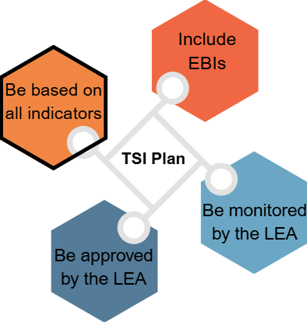
TSI Plan Development (2)
The SSC and educational partners meet to develop the TSI plan to support the homeless student group.
Various types of data (state and local) can be collected and analyzed:
Dashboard indicators
Student group reports
Attendance data
School services and activities
Results of empathy interviews
Reference Appendix 9 for long descriptive text.

Slide 61
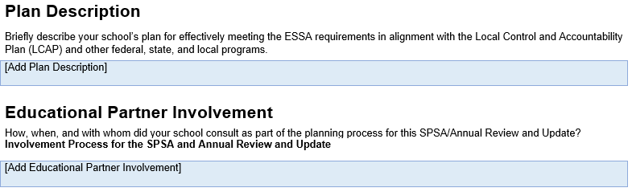
TSI Plan Development (3)
The Plan Description section of the SPSA requires that schools eligible for TSI must state that the SPSA will be used to meet TSI planning requirements.
Completion of the Educational Partner Involvement section of the SPSA template meets the TSI requirement to collaborate with educational partners.
Reference Appendix 10 for long descriptive text.

Slide 62
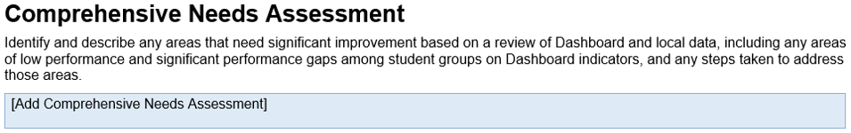
TSI Plan Development (4)
A needs assessment and root cause analysis is not required by ESSA for the TSI plan, but it is highly recommended to inform the selection of EBIs and to ensure the plan is meaningful and tailored to the student group’s needs.
NOTE: The Comprehensive Needs Assessment is required as part of the SPSA requirements for schools operating a schoolwide program.
Reference Appendix 11 for long descriptive text.

Slide 63
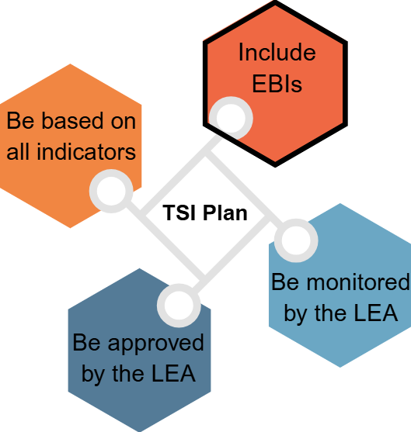
TSI Plan Development (5)
ESSA requires that EBIs are selected and implemented to address the needs of the targeted student group.
ABC Middle School elects to implement High-Impact Tutoring as its EBI to address the homeless student group’s performance in Math, ELA, and chronic absenteeism.
Reference Appendix 12 for long descriptive text.

Slide 64
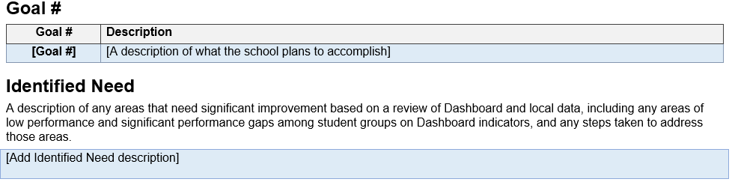
TSI Plan Development (6)
EBIs such as HIT will be incorporated into a goal and included in the Goals, Strategies/Activities, and Expenditures section of the SPSA template. Completing this section as described in the SPSA instructions meets TSI planning requirements.
Reference Appendix 13 for long descriptive text.

Slide 65
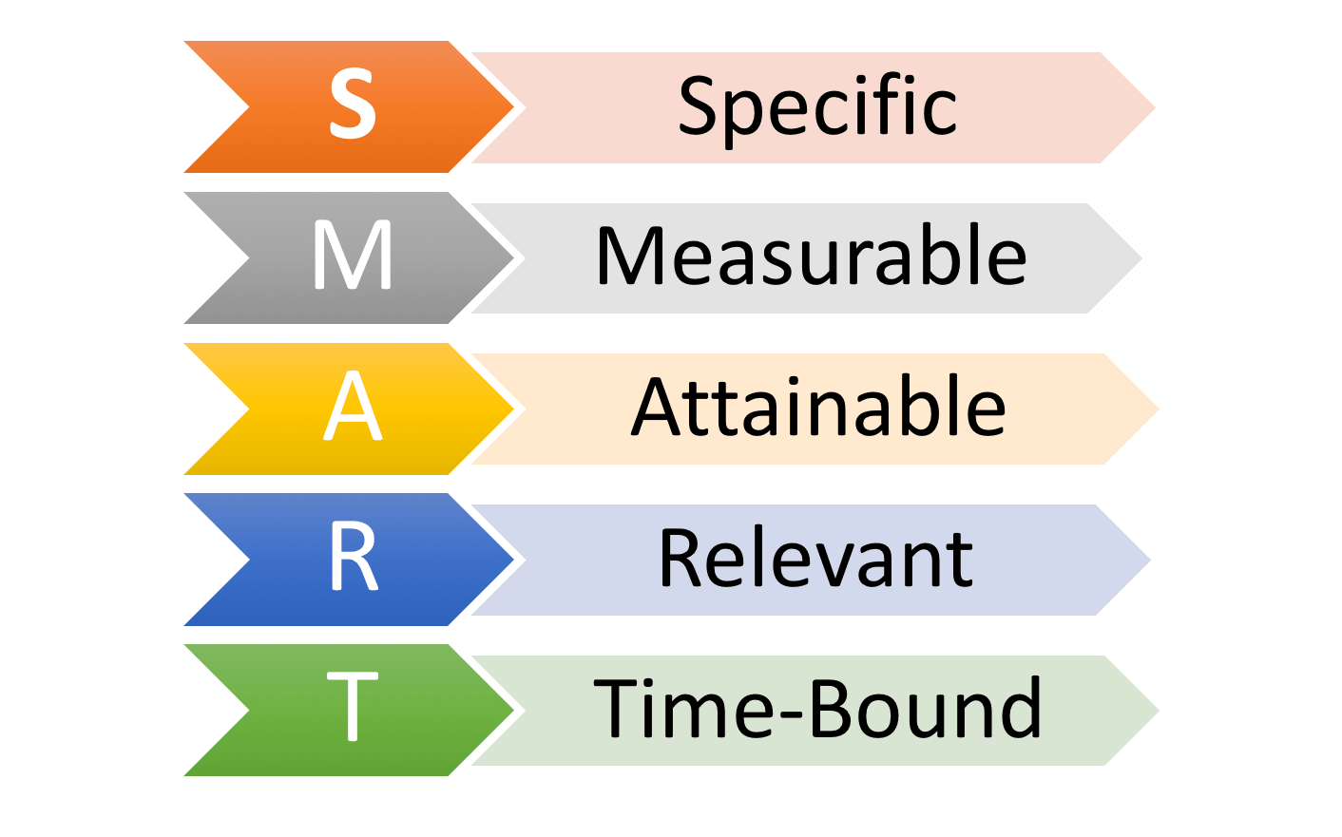
TSI Plan Development (7)
Strategy/Activity to Meet the Goal: A classified instructional assistant will provide one-on-one instruction (High-Impact Tutoring) supporting the homeless student group using individualized coaching techniques and skills to improve literacy and ELA competency. The homeless student group will receive this support three times per week at 20 minutes per session for the duration of school year 2025–26.

Slide 66
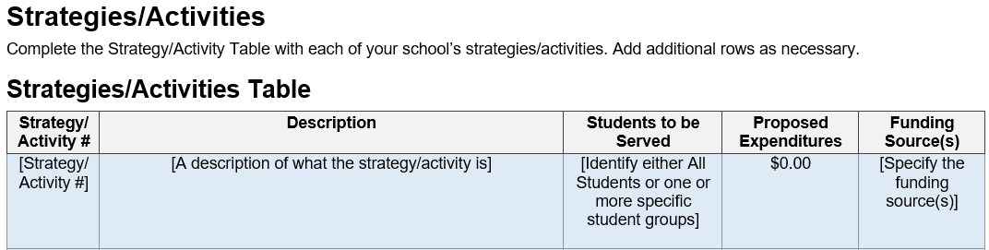
TSI Plan Development (8)
Strategies and activities inclusive of EBIs that were developed to meet a goal, will be included in the Strategies/Activities section of the SPSA template. EBIs must align to the goals, actions, and services in the LEA’s LCAP. Student groups that led to the school’s TSI eligibility must be included.
Reference Appendix 14 for long descriptive text.

Slide 67
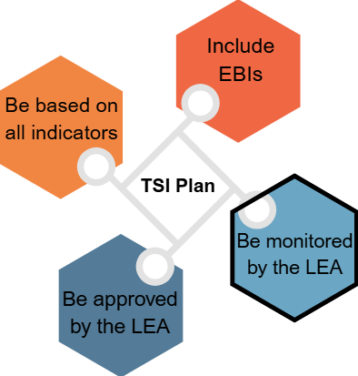
TSI Plan Development (9)
The LEA is required to monitor the implementation of the TSI plan. The SSC and educational partners will assess the impact of the TSI plan and examine progress made toward its goals.
Monitoring is an important part of the improvement cycle to ensure effective implementation of the plan. Minor or major adjustments may be necessary.
Reference Appendix 15 for long descriptive text.

Slide 68
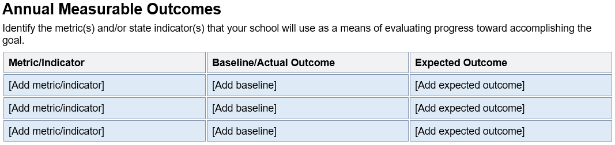
TSI Plan Development (10)
The Annual Measurable Outcomes section of the SPSA template must include metrics related to the specific student group that led to the school’s TSI eligibility. The metrics identified in the SPSA will be measured against any collected data when monitoring the implementation of the TSI plan.
Reference Appendix 16 for long descriptive text.

Slide 69
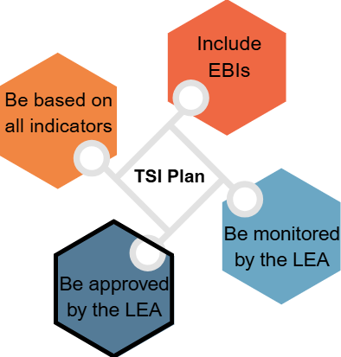
TSI Plan Development (11)
The LEA is required to approve the TSI plan. The plan is expected to be approved prior to the first day of the 2026–27 school year.
Reference Appendix 17 for long descriptive text.

Slide 70
ATSI Plan Development (1)
The ATSI plan must include all elements of the TSI plan, with the addition of the identification of resource inequities.
Reference Appendix 8 for long descriptive text.

Slide 71
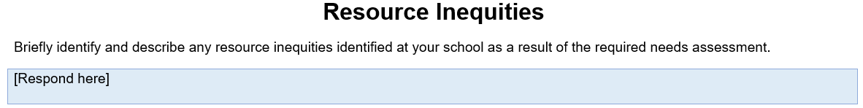
ATSI Plan Development (2)
Completion of the Resource Inequities section of the SPSA template is required for ATSI-eligible schools. Identified resource inequities must be addressed through implementation of the ATSI plan.
Reference Appendix 18 for long descriptive text.

Slide 72
Summary
and Resources

Slide 73
Summary (1)
The 2025–26 ESSA Assistance Status Data File provides the schools with continued eligibility for CSI and ATSI, schools new to or continuing its TSI eligibility, and schools that have exited CSI or ATSI.
Schools eligible for TSI and ATSI must develop and implement a plan to improve outcomes for each student group that was the subject of notification.
ESSA school improvement funding is not available to LEAs for their TSI- and ATSI-eligible schools.

Slide 74
Summary (2)
Title II funds must be prioritized to support CSI- and TSI-eligible schools.
Schools eligible for any ESSA school support (CSI, TSI, or ATSI) category may be selected for FPM reviews.
TSI and ATSI plans should be approved and ready for implementation by the first day of the 2025–26 school year.
Review the TSI and ATSI SPSA template instructions for guidance on how to incorporate the TSI and ATSI plan elements into the SPSA planning process.

Slide 75

Resources (1)
CDE ESSA School Support Webinar Resources https://www.cde.ca.gov/sp/sw/t1/essawebinars.asp
CDE ESSA Assistance Status Data File https://www.cde.ca.gov/sp/sw/t1/essaassistdatafiles.asp
School Dashboard Additional Reports and Data https://www6.cde.ca.gov/californiamodel/default
CDE TSI/ATSI https://www.cde.ca.gov/sp/sw/t1/tsi.asp
CDE LCAP https://www.cde.ca.gov/re/lc/

Slide 76
Resources (2)
CDE SPSA (TSI) template https://www.cde.ca.gov/re/lc/documents/spsatsitemplate2024.docx
CDE SPSA (ATSI) template https://www.cde.ca.gov/re/lc/documents/spsaatsitemplate2024.docx
CDE TSI/ATSI Planning Summary https://www.cde.ca.gov/sp/sw/t1/atsiplansummary.asp
California School Dashboard https://www.caschooldashboard.org/
CDE 2025 Dashboard Technical Guide for ESSA School Support https://www.cde.ca.gov/ta/ac/cm/documents/dbguideessa25.docx

Slide 77
Resources (3)
CDE Title II, Part A https://www.cde.ca.gov/pd/ti/
CDE Title II Use of Funds Webinar https://www.cde.ca.gov/ci//pl/documents/use-of-funds-webinar.pptx
CDE Learning Recovery Emergency Block Grant https://www.cde.ca.gov/fg/aa/ca/lrebgpgminfo.asp
National Student Support Accelerator https://nssa.stanford.edu/studies/effects-high-impact-tutoring-student-attendance-evidence-osse-hit-initiative-district
What is High Impact Tutoring? https://nssa.stanford.edu/about/high-impact-tutoring

Slide 78

Contact Information
ESSA School Support: School Improvement and Support Office SISO@cde.ca.gov
TSI Eligibility and Dashboard Questions: Dashboard@cde.ca.gov
Title II, Part A Funds: Professional Learning Support and Monitoring TitleII@cde.ca.gov
Planning Support: Local Agency Systems Support Office LCFF@cde.ca.gov

Slide 79
Thank You

Slide 80
Appendices

Slide 81
Appendix 1: Long Description for Slide 4 (1)
Return to Slide 4: ESSA School Support Webinars
DASS CoP for CSI is shown in the first column. This webinar is for LEAs eligible for the DASS CoP flexibilities. The webinar is on Monday, January 12, 2026, at 10–11:00am.
CSI LEA AFF is shown in the second column. This webinar is for LEAs with at least one CSI-eligible school. This webinar is on Tuesday, January 13, 2026, at 10–11:30am.

Slide 82
Appendix 1: Long Description for Slide 4 (2)
Return to Slide 4: ESSA School Support Webinars
CSI COE PDIS AFF is shown in the third column. This webinar is for COEs with at least one CSI-eligible school in their county. The webinar is on Wednesday, January 14, 2026, at 10–11:30am.
CSI COE PA AFF is shown in the fourth column. This webinar is for COEs with at least one CSI-eligible school in their county. The webinar is on Thursday, January 15, 2026, at 10–11:30am.

Slide 83
Appendix 1: Long Description for Slide 4 (3)
Return to Slide 4: ESSA School Support Webinars
TSI/ATSI is shown in the fifth column. This webinar is for LEAs with at least one TSI- or ATSI-eligible school. The webinar is on Tuesday, January 20, 2026, at 10–11:30 a.m.

Slide 84
Appendix 2: Long Description for Slide 14 (1)
Return to Slide 14: Categories of Support
TSI is shown in the first column. Under the TSI heading are the following subheadings: When, Who, Exit, Notification, Plan, and Funding.
Corresponding content for each subheading, in the same order, includes the following: Eligibility determined in non-CSI/ATSI years, Student group focus, Annual determination, LEA must notify eligible school/s/, School to develop with educational partners, No funding available.

Slide 85
Appendix 2: Long Description for Slide 14 (2)
Return to Slide 14: Categories of Support
ATSI is shown in the second column. Under the ATSI heading are the following subheadings: When, Who, Exit, Notification, Plan, and Funding.
Corresponding content for each subheading, in the same order, includes the following: Eligibility determined once every three years, Student group focus, Annual exit if exit criteria are met, LEA must notify eligible school/s/, School to develop with educational partners; plan must identify resource inequities, No funding available.

Slide 86
Appendix 2: Long Description for Slide 14 (3)
Return to Slide 14: Categories of Support
CSI is shown in the third column. Under the CSI heading are the following subheadings: When, Who, Exit, Notification, Plan, and Funding.
Corresponding content for each subheading, in the same order, includes the following: Eligibility determined once every three years, Whole school focus, Annual exit if exit criteria are met, California must notify LEAs of their eligible school/s/, LEA to develop plan for each eligible school with educational partners, Funding available for LEAs based on number of eligible schools.

Slide 87
Appendix 3: Long Description for Slide 15
Return to Slide 15: Timeline of Federal School Support Determinations
2023 Dashboard: CSI, ATSI
2024 Dashboard: TSI
2025 Dashboard: TSI
Red circle around 2025 Dashboard to indicate the current year.
2026 Dashboard: CSI, ATSI

Slide 88
Appendix 4: Long Description for Slide 31
Return to Slide 31: Student Group Report (2)
School Dashboard Additional Reports and Data
Access the following reports: the Five-by-Five Placement Reports, the College/Career Reports, the Graduation Rate Additional Report, the Participation Rate Report, the Student Groups Report, and District/Charter Performance by County Reports.
School/District Search: enter a portion of the school/district name and select the year from the dropdown box.

Slide 89
Appendix 5: Long Description for Slide 32
Return to Slide 32: Student Group Report (3)
School/District Search for 2024
Select a School or District from Search Results
Choose Report and click Submit.
School/District Results: Select from the dropdown list.
Reports: Science Participation Rate Report, Student Group Report, District Performance by County, Charter Performance by County.
A red box is placed around the Student Group Report indicating the option to select for this topic.

Slide 90
Appendix 6: Long Description for Slide 33 (1)
Return to Slide 33: Student Group Report (4)
Image of the Student Group Report with the following column headings: Student Group, English Learner Progress (ELPI), Chronic Absenteeism, Suspension Rate
The following student groups are listed under the Student Group column: All Students, English Learners, Homeless, Socioeconomically Disadvantaged, Students with Disabilities, African American, Asian, Hispanic, White, Two or More Races
N/A is indicated under the ELPI column for all student groups except English Learners.

Slide 91
Appendix 6: Long Description for Slide 33 (2)
Return to Slide 33: Student Group Report (4)
Under the Chronic Absenteeism column, yellow is indicated for All Students and the White student group; orange is indicated for Socioeconomically Disadvantaged, Students with Disabilities, and the Hispanic student groups.
Under the Suspension Rate column, orange is indicated for All Students, Socioeconomically Disadvantaged, Students with Disabilities, and the White student groups. Green is indicated for the Hispanic student group.

Slide 92
Appendix 7: Long Description for Slide 37
Return to Slide 37: TSI Plan Elements
Image of the TSI plan elements in a graphic.
TSI Plan is written at the center of the graphic. Surrounding the center of the graphic the following plan elements are listed: be based on all indicators, include EBIs, be monitored by the LEA, and be approved by the LEA.

Slide 93
Appendix 8: Long Description for Slides 38 and 70
Return to Slide 38: ATSI Plan Elements
Return to Slide 70: ATSI Plan Development (1)
Image of the ATSI plan elements in a graphic.
ATSI Plan is written at the center of the graphic. Surrounding the center of the graphic the following plan elements are listed: be based on all indicators, include EBIs, be monitored by the LEA, be approved by the LEA, and identify resource inequities.
“Identify resource inequities” is outlined in black to distinguish it as an additional plan element.

Slide 94
Appendix 9: Long Description for Slide 60
Return to Slide 60: TSI Plan Development (2)
Image of the TSI plan elements in a graphic.
TSI Plan is written at the center of the graphic. Surrounding the center of the graphic the following plan elements are listed: be based on all indicators, include EBIs, be monitored by the LEA, and be approved by the LEA.
“Be based on all indicators” is outlined in black to highlight the plan element being discussed on the slide.

Slide 95
Appendix 10: Long Description for Slide 61
Return to Slide 61: TSI Plan Development (3)
Image of the SPSA template showing Plan Description: Briefly describe your school’s plan for effectively meeting the ESSA planning requirements in alignment with the LCAP and other federal, state, and local programs. [Add plan description]
Educational Partner Involvement: How, when, and with whom did your school consult as part of the planning process for this SPSA/Annual Review and Update? Involvement Process for the SPSA and Annual Review and Update. [Add Educational Partner Involvement]

Slide 96
Appendix 11: Long Description for Slide 62
Return to Slide 62: TSI Plan Development (4)
Image of the SPSA template showing Comprehensive Needs Assessment: Identify and describe any areas that need significant improvement based on a review of Dashboard and local data, including any areas of low performance and significant performance gaps among student groups on Dashboard indicators, and any steps taken to address those areas. [Add Comprehensive Needs Assessment]

Slide 97
Appendix 12: Long Description for Slide 63
Return to Slide 63: TSI Plan Development (5)
Image of the TSI plan elements in a graphic.
TSI Plan is written at the center of the graphic. Surrounding the center of the graphic the following plan elements are listed: be based on all indicators, include EBIs, be monitored by the LEA, and be approved by the LEA.
“Include EBIs” is outlined in black to highlight the plan element being discussed on the slide.

Slide 98
Appendix 13: Long Description for Slide 64
Return to Slide 64: TSI Plan Development (6)
Image of the SPSA template showing the heading of Goal # and subheadings of Goal # and Description. Enter goal number and a description of what the school plans to accomplish.
Next heading showing Identified Need: A description of any areas that need significant improvement based on a review of Dashboard and local data, including any areas of low performance and significant performance gaps among student groups on Dashboard indicators, and any steps taken to address those areas. [Add identified need description]

Slide 99
Appendix 14: Long Description for Slide 66
Return to Slide 66: TSI Plan Development (8)
Image of the SPSA template showing the section heading of Strategies/Activities: Complete the Strategy/Activity Table with each of your school’s strategies/activities. Add additional rows as necessary.
Next section heading showing Strategies/Activities Table. Table headings are Strategy/Activity #, Description (a description of what the strategy/activity is), Students to be Served (identify either All Students or one or more specific student groups), Proposed Expenditures ($0.00), Funding Sources (specify the funding source/s/).

Slide 100
Appendix 15: Long Description for Slide 67
Return to Slide 67: TSI Plan Development (9)
Image of the TSI plan elements in a graphic.
TSI Plan is written at the center of the graphic. Surrounding the center of the graphic the following plan elements are listed: be based on all indicators, include EBIs, be monitored by the LEA, and be approved by the LEA.
“Be monitored by the LEA” is outlined in black to highlight the plan element being discussed on the slide.

Slide 101
Appendix 16: Long Description for Slide 68
Return to Slide 68: TSI Plan Development (10)
Image of the SPSA template showing the section heading of Annual Measurable Outcomes. Identify the metric(s) and/or state indicator(s) that your school will use as a means of evaluating progress toward accomplishing the goal.
The Annual Measurable Outcomes table headings are: Metric/Indicator (add metric/indicator), Baseline/Actual Outcome (add baseline), and Expected Outcome (add expected outcome).

Slide 102
Appendix 17: Long Description for Slide 69
Return to Slide 69: TSI Plan Development (11)
Image of the TSI plan elements in a graphic.
TSI Plan is written at the center of the graphic. Surrounding the center of the graphic the following plan elements are listed: be based on all indicators, include EBIs, be monitored by the LEA, and be approved by the LEA.
“Be approved by the LEA” is outlined in black to highlight the plan element being discussed on the slide.

Slide 103
Appendix 18: Long Description for Slide 71
Return to Slide 71: ATSI Plan Development (2)
Image of the SPSA template showing the section heading of Resource Inequities: Briefly identify and describe any resource inequities identified at your school as a result of the required needs assessment. [Respond here]

