Slide 1
California’s System of Support
1. Set Direction and Purpose
Module 1A: Overview of Continuous Improvement and the Local Control and Accountability Plan

Slide 2
Acronyms
CCSSO: Council of Chief State School Officers
CDE: California Department of Education
COE: County Office of Education
EBIs: Evidence-based Interventions, Strategies, and Activities
LCAP: Local Control and Accountability Plan
LEA: local educational agency

Slide 3
California’s System of Support Goal
The overarching goal of California's System of Support is to help LEAs and their schools meet the needs of each student they serve, with a focus on building local capacity to sustain improvement and to effectively address disparities in opportunities and outcomes.

Slide 4
Overview of Modules
Set Direction and Purpose
    1A: Overview of Continuous Improvement and the LCAP
Assess Local Needs and Determine Causal Factors of Greatest Needs
    2A: Planning a Needs Assessment for Continuous Improvement
    2B: Designing a Needs Assessment for Continuous Improvement
    2C: Introduction to Root Cause Analysis

Slide 5
Purpose of Module 1A
The purpose of Module 1A is to assist LEAs and their educational partners as they plan and implement their continuous improvement efforts through the LCAP and school planning processes.

Slide 6
Introduction to Continuous Improvement

Slide 7
Why Continuous Improvement?
The CCSSO publication, Utilizing Integrated Resources to Implement the School and District Improvement Cycle and Supports, states that the goal of continuous improvement is to reduce “the gap between actual practice and the most effective practice.”

Slide 8
What is Continuous Improvement?
Continuous improvement is a process of:
Identifying what is working and what needs to change.
Developing a sound plan (e.g., LCAP, school plan) and including effective EBIs in the plan.
Implementing the plan.
Using data to monitor outcomes and make timely adjustments to improve those outcomes.

Slide 9
What Drives Continuous Improvement?
Change in practice is the core driver of improvement. This is true for state educational agencies, LEAs, schools, and individuals.

Slide 10
What is the Continuous Improvement Process? (1)
The continuous improvement process is sometimes described as Plan, Do, Study, Act (PDSA) or the “planning cycle”.

Slide 11
What is the Continuous Improvement Process? (2)
The PDSA cycle can be broken down into five steps:
Set Direction and Purpose
Assess Local Needs and Determine Causal Factors of Greatest Needs
Plan for Improvement: Select EBIs Responsive to Greatest Needs
Implement and Monitor Work
Reflect and Adjust Course

Slide 12
What is the Continuous Improvement Process? (3)
The Plan phase of the PDSA cycle includes Steps 1–3:
Set Direction and Purpose
Assess Local Needs and Determine Causal Factors of Greatest Needs
Plan for Improvement: Select EBIs Responsive to Greatest Needs

Slide 13
What is the Continuous Improvement Process? (4)
The Do phase of the PDSA cycle includes Step 4:
4. Implement and Monitor Work

Slide 14
What is the Continuous Improvement Process? (5)
The Study phase of the PDSA cycle includes Steps 4–5:
4. Implement and Monitor Work
5. Reflect and Adjust Course

Slide 15
What is the Continuous Improvement Process? (6)
The Act phase of the PDSA cycle includes Step 5:
5. Reflect and Adjust Course

Slide 16
PDSA Cycle Summary
Module 1A: Continuous Improvement Cycle | Plan, Do, Study, Act Cycle
Set Direction and Purpose | Plan
Assess Local Needs and Determine Causal Factors of Greatest Needs | Plan
Plan for Improvement: Select EBIs Responsive to Greatest Needs | Plan
Implement and Monitor Work | Do, Study
Reflect and Adjust Course | Study, Act

Slide 17
Implications for the LCAP

Slide 18
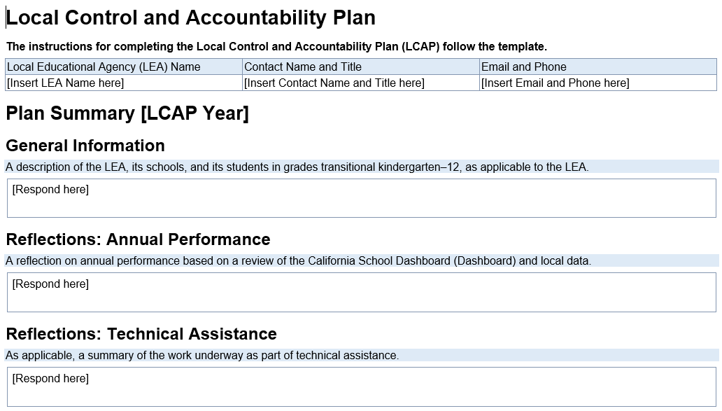
Integrating Continuous Improvement and the LCAP
Set Direction and Purpose
Assess Local Needs and Determine Causal Factors of Greatest Needs
Plan for Improvement: Select EBIs Responsive to Greatest Needs
Implement and Monitor Work
Reflect and Adjust Course

Slide 19
Step 1: Set Direction and Purpose (1)
An LEA’s direction is used as a filter for all work.
When in place, staff know how their work influences or impacts student-focused goals and commits to continuous capacity building and improvement.

Slide 20
Step 1: Set Direction and Purpose (2)
Setting the direction is the foundation upon which an improvement cycle is built. It is comprised of identifying the LEA’s:
Mission and/or vision
Goals
Goal performance measures
Statement of purpose for its improvement efforts (theory of action). See Module 2C for more information.

Slide 21
Step 2: Assess Local Needs and Determine Causal Factors (1)
The needs assessment process allows the LEA to:
Address the problem itself, rather than the symptoms of the problem.
Prioritize causes by those most likely to have a significant impact on the problem.
Focus on actionable causes of the problem.

Slide 22
Step 2: Assess Local Needs and Determine Causal Factors (2)
A needs assessment is used to identify strengths and weaknesses within the context and constraints of the LEA and dig deeper into root causes.
The needs assessment goes beyond student data to include data on the effectiveness of current practices—to evaluate what is and isn’t working (e.g., Annual Update process in the LCAP). This step is addressed in Modules 2A–2C.

Slide 23
Step 3: Plan for Improvement (1)
Selecting EBIs most likely to produce results to inform the goals and actions in the improvement plan increases the likelihood of achieving improvement goals.
Planning allows LEA and COE staff to coordinate supports and resources to ensure effective implementation.

Slide 24
Step 3: Plan for Improvement (2)
The plan for improvement (e.g., LCAP) is created based on the prioritized needs identified through the needs assessment. It focuses on what the LEA does to address its improvement needs and includes:
EBIs (effective practices aligned with needs and context)
Goals and Actions (what the LEA plans to accomplish and how)

Slide 25
Step 3: Plan for Improvement (3)
Continued
Metrics (how the LEA will track progress)
Outcomes (produced in completing actions)
Timeline (for completing goals and actions)

Slide 26
Step 4: Implement and Monitor Work (1)
Data from regular monitoring can be aggregated across multiple schools within an LEA (or multiple LEAs within a county) to provide an overall analysis of progress relative to a particular practice.

Slide 27
Step 4: Implement and Monitor Work (2)
Effective implementation involves regularly:
Examining progress on goals, actions, outcomes, and results (e.g., in the Annual Update, Goal Analysis).
Meeting to discuss progress, celebrate successes, and identify challenges and possible solutions.
Providing status reports to the leadership team so they can provide support and make timely adjustments.

Slide 28
Step 5: Reflect and Adjust Course (1)
If EBIs are not achieving the desired outcomes, use implementation and monitoring data to determine how to adjust course to stay on track with goals and minimize the loss of time and resources.

Slide 29
Step 5: Reflect and Adjust Course (2)
Implementation data are used to make adjustments to the plan and are monitored carefully to determine if they are positively impacting progress.
Monthly and quarterly reviews inform what adjustments are needed.
Reporting routines built across the system keep data accessible and educational partners in the loop.

Slide 30
Full Cycle: Step 5 back to Step 1 (1)
Discussions are more results-focused than compliance-driven.
Adjustments to the plan are determined collaboratively, are justified, and are communicated to staff (promotes buy-in).
LEAs use school-level data to make adjustments, so their responsive supports are more effective.

Slide 31
Full Cycle: Step 5 back to Step 1 (2)
The continuous improvement cycle is ongoing.
At the end of each school year, outcomes are reviewed and those not completed/not achieved are examined and adjusted based on data results (e.g., Annual Update, Goal Analysis).
Other goals and actions are added, and improvement plans are detailed.

Slide 32
Questions to Outline the Continuous Improvement Process (1)
Will you work with a framework of effective practice? If so, which one(s)? (You may incorporate portions of more than one.)
How does the needs assessment fit into your overall theory of action for improvement?
How do the results from the needs assessment inform the creation of a plan?

Slide 33
Questions to Outline the Continuous Improvement Process (2)
Continued
How do the results from the needs assessment inform immediate next steps for the school, the LEA, and the COE?
How do the monitoring processes (by the school, LEA, and/or COE) connect back to the needs assessment?
How do the results from the monitoring processes inform future needs assessments and subsequent improvement plans?

Slide 34
Resources

Slide 35
Resources (1)
CDE California School Dashboard
CDE California's System of Support
CDE Continuous Improvement Resources
CDE Local Control and Accountability Plan

Slide 36
Resources (2)
CCSSO Utilizing Integrated Resources to Implement the School and District Improvement Cycle and Supports
CCSSO Using Needs Assessments for School and District Improvement: A Tactical Guide

