Slide 1
California’s System of Support 2–Assess Needs
Module 2C: Introduction to Root Cause Analysis

Slide 2
Acronyms
CDE: California Department of Education
COE: County Office of Education
LCAP: Local Control and Accountability Plan
LEA: local educational agency

Slide 3
California’s System of Support Goal
The overarching goal of California's System of Support is to help LEAs and their schools meet the needs of each student they serve, with a focus on building local capacity to sustain improvement and to effectively address disparities in opportunities and outcomes.

Slide 4
Overview of Modules
Set Direction and Purpose
    1A: Overview of Continuous Improvement and the LCAP
Assess Local Needs and Determine Causal Factors of Greatest Needs
    2A: Planning a Needs Assessment for Continuous Improvement
    2B: Designing a Needs Assessment for Continuous Improvement
    2C: Introduction to Root Cause Analysis

Slide 5
Purpose of Module 2C
To provide LEAs and educational partners with an introduction to root cause analysis and share specific guidance, questions, and tools to consider when determining the root causes of improvement needs for use within the LCAP and school planning processes.

Slide 6
Introduction to Root Cause Analysis

Slide 7
Steps in a Needs Assessment (1)
Onsite analysis meetings are a crucial component during which data is analyzed, root cause analysis occurs, and plan development begins.
1. Pre-populate the needs assessment with readily available data (e.g., demographic, student outcomes).
2. Gather survey data.

Slide 8
Steps in a Needs Assessment (2)
Continued
3. Review data and compile into an easily digestible format.
4. Facilitate onsite meetings to gather more data, analyze existing data, and determine initial discoveries and action items.
5. Create summary of discoveries to inform plan creation.

Slide 9
Why is Root Cause Analysis Necessary?
Root cause analysis addresses the problem rather than the symptom, eliminates wasted effort, conserves resources, and informs strategy selection.
The California School Dashboard identifies the symptoms of the problem. The problem causing those symptoms is revealed through root cause analysis.

Slide 10
What is Root Cause Analysis? (1)
Root cause analysis is part of the needs assessment process. Root cause is defined as “the deepest underlying cause or causes of positive or negative symptoms within any process that, if dissolved, would result in elimination or substantial reduction of the symptom.”
(Preuss, Paul. 2003. Root Cause Analysis: School Leader’s Guide to Using Data to Dissolve Problems)

Slide 11
What is Root Cause Analysis? (2)
Root cause analysis is a strategy used to thoroughly examine practices, processes, and routines to determine their impact on outcomes. It answers the “Why?” behind each identified area of improvement.

Slide 12
When Does Root Cause Analysis Occur in the Needs Assessment Process?
Pre-populate the needs assessment with readily available data (e.g., demographic, student outcomes).
Gather survey data.
Review data and compile into an easily digestible format.
Facilitate onsite meetings to gather more data, analyze existing data, and determine initial discoveries and action items.
Create summary of discoveries to inform plan creation.

Slide 13
What is a Process for Conducting a Root Cause Analysis?
Onsite analysis meetings are an opportunity for representatives from the LEA and other educational partners to come together as a team to analyze the data collected during the needs assessment process and collaboratively identify LEA needs and root causes of those needs.

Slide 14
Return to Worksheet 4: Designing Your Needs Assessment Roles and Responsibilities (1)
Check off the roles and responsibilities for each educational partner group identified:
Educational Partner Group | Establishment of Design Requirements | Development of Tools and Processes | Data Collection | Analysis (highlighted) | Onsite Analysis (highlighted) | Plan Development
CDE Staff | x | x | x | x | x | x
COE Staff | x | x | x | x | x | x
LEA Staff | x | x | x | x | x | x
Local governing board | x | x | x | x | x | x

Slide 15
The Data Analysis Team
The Quality Schooling Framework web page features an Analyzing Data and Assessing Local Needs video.
The video’s discussion guide includes activities for establishing and defining an effective data analysis team.

Slide 16
Establishing a Highly Effective Data Analysis Team
The onsite data analysis team provides a dissemination point for distributed leadership responsibilities by:
Establishing and supporting schoolwide efforts to improve teaching and learning.
Building collaboration among educational partners.
Modeling cultural and collaboration norms that are needed from educational partners.

Slide 17
Defining an Effective Data Analysis Team (1)
An effective data analysis team will:
Have an agreed-upon structure and norms for team conduct.
Define for itself the roles and responsibilities of its members.

Slide 18
Defining an Effective Data Analysis Team (2)
The team can consider the following questions to establish a workable structure:
Who will conduct or facilitate the meetings?
How will norms be established?
Who should be on the team?
Is there a need for subcommittees?
How will the participation of the larger school community be encouraged and supported?
How will the work be monitored, recognized, and supported?
What is the system to ensure accountability?

Slide 19
Defining the Data Analysis Team’s Work and Roles (1)
An Effective Data Analysis Team:
Is inclusive with representation across the school community, tapping varied perspectives and expertise.
Is a real team with clearly defined responsibilities and a shared commitment, rather than a team in name only.
Develops a culture of continuous improvement and serves as the model team for other school teams.

Slide 20
Defining the Data Analysis Team’s Work and Roles (2)
An Effective Data Analysis Team:
Frequently communicates with the broader school community in an effort to solicit perspectives and secure ‘buy-in’.
Uses data to identify and set clear and measurable goals for student learning outcomes.
Utilizes consistent structures and processes, modeling these for the broader school community.

Slide 21
Defining the Data Analysis Team’s Work and Roles (3)
The previous statements about effective data analysis teams are provided as examples. Engage participants in identifying additional descriptions to develop a common definition of what an effective data analysis team is and what an effective data analysis team does.
Revisit these guidelines periodically to further fine-tune these descriptions.

Slide 22
Root Cause Analysis Tools and Protocols

Slide 23
Tools for Understanding the Problem
Fishbone Diagram
Interrelationship Digraph
Expert Convening
Empathy Interviews
Digging Into Data
Process Mapping
Driver Diagram

Slide 24
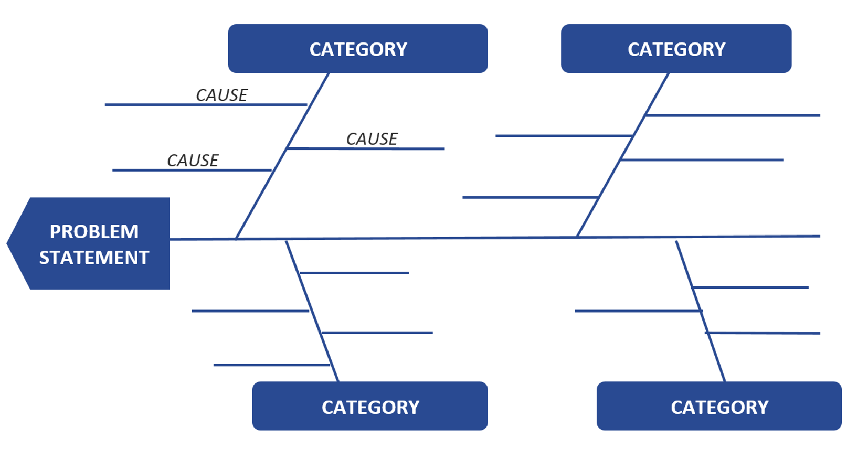
Fishbone Diagram
The purpose of a Fishbone Diagram is to understand a problem at a deep level before trying to solve it.

Slide 25
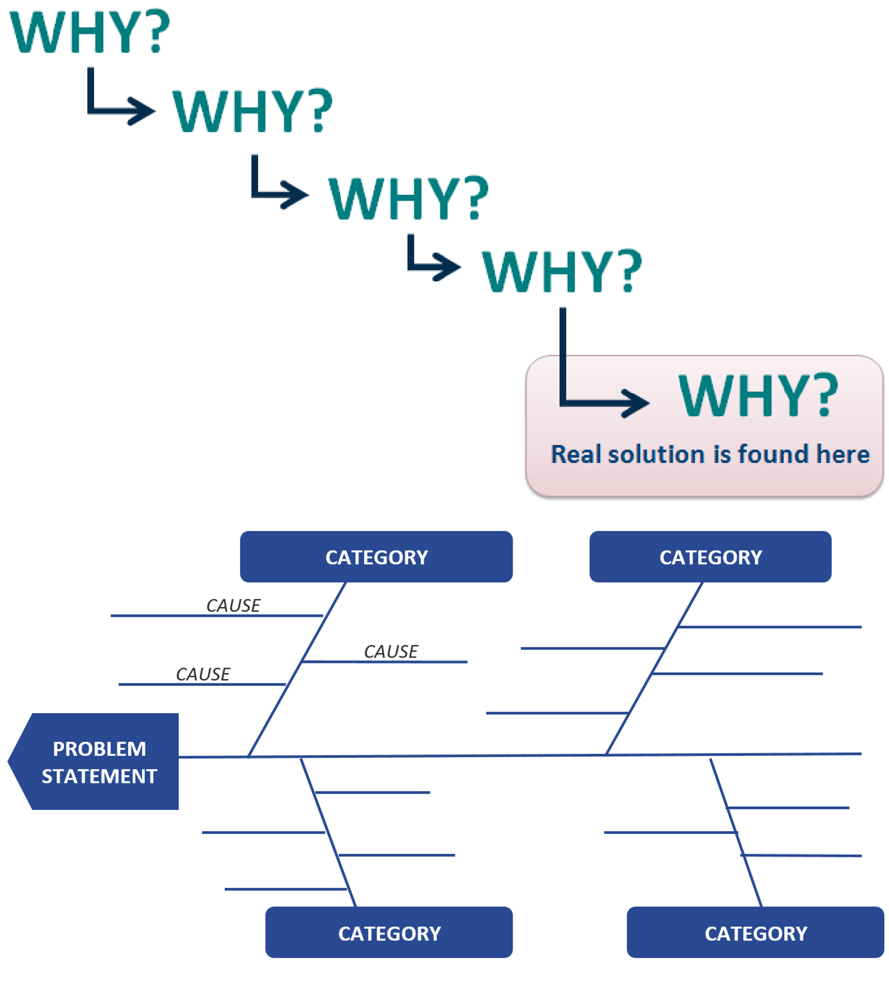
Fishbone Generation Protocol
Write the problem in one sentence.
Brainstorm causes. Ask five “Whys?”
Share and categorize causes.
Post and reflect.
Debrief.

Slide 26
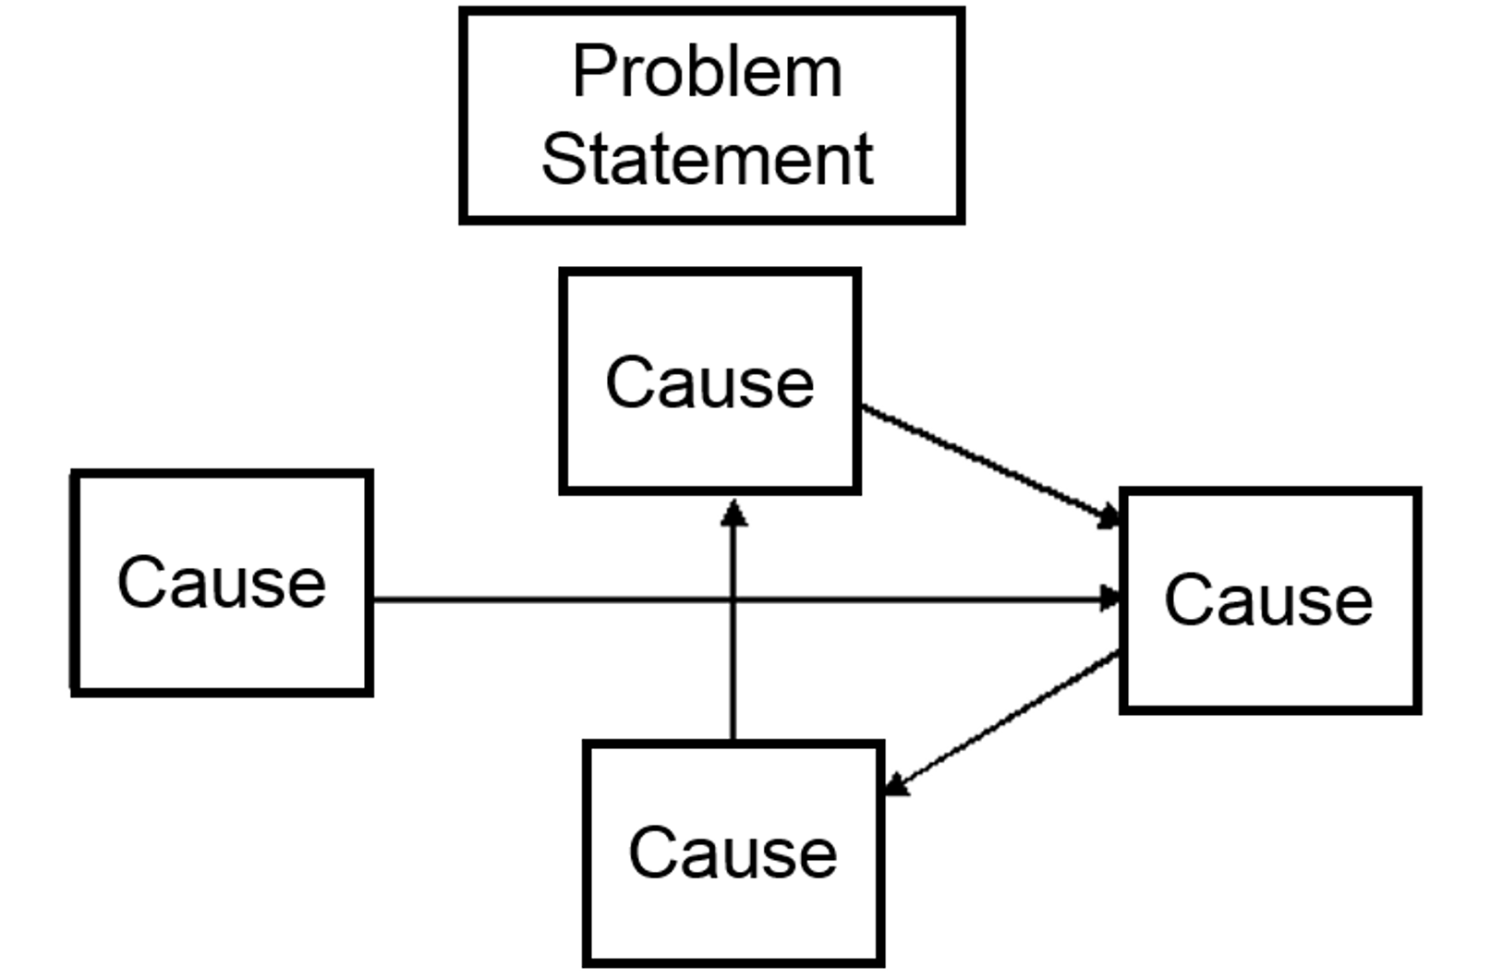
Interrelationship Digraph
The purpose of an interrelationship digraph is to identify which root causes from the fishbone diagram have the most impact on the problem.
This enables the onsite review team to determine where to focus improvement efforts.

Slide 27
Interrelationship Digraph Protocol
Write the problem statement from the Fishbone Diagram at the top of the Interrelationship Digraph.
Arrange root causes from the Fishbone Diagram in a circle.
Start with a root cause and ask if there is any relationship between it and the others.
  Does X cause Y or vice versa?
Repeat until all relationships between causes have been established.
Tally arrows out. The root cause with the most outgoing lines has a greater impact on the problem.

Slide 28
Expert Convening
The purpose of an expert convening is to learn from people with relevant expertise and provide multiple perspectives on a problem and its root causes. Ideally, the onsite review team should leave with a deeper understanding of the factors contributing to the problem and clear next steps for moving the work forward.

Slide 29
Expert Convening Protocol
Introduce protocol and participants.
Experts ask probing questions of the group.
Experts reflect on what they would like to contribute to the discussion.
Conduct discussion rounds.
Team reflection on conversations.
Debrief.

Slide 30
Empathy Interviews
The purpose of an empathy interview is to gain a deeper understanding of an educational partner’s (e.g., principal, teacher, student, parent, community member, etc.) experience of the problem to resolve by seeing the problem from their point of view.

Slide 31
Empathy Interview Protocol
Each group member prepares questions.
Share and identify/organize the top five to six questions as a group.
Predict and plan.
Conduct interview.
Reflect.

Slide 32
Digging into Data
The purpose of digging into data is to help a group engage in productive dialogue about data and to build collective capacity to make sense of data relevant to continuous improvement. You can use this protocol with multiple small groups, each unpacking different data and sharing out to the larger group or you can use this protocol to have everyone unpack the same data.

Slide 33
Digging into Data Protocol
Participants individually review the data.
Conduct structured discussion rounds to discuss observations, celebrations, questions, hypotheses, and next steps (this can be done as one large group or in small groups).
Share highlights with the group (skip if only one group).
Debrief.

Slide 34
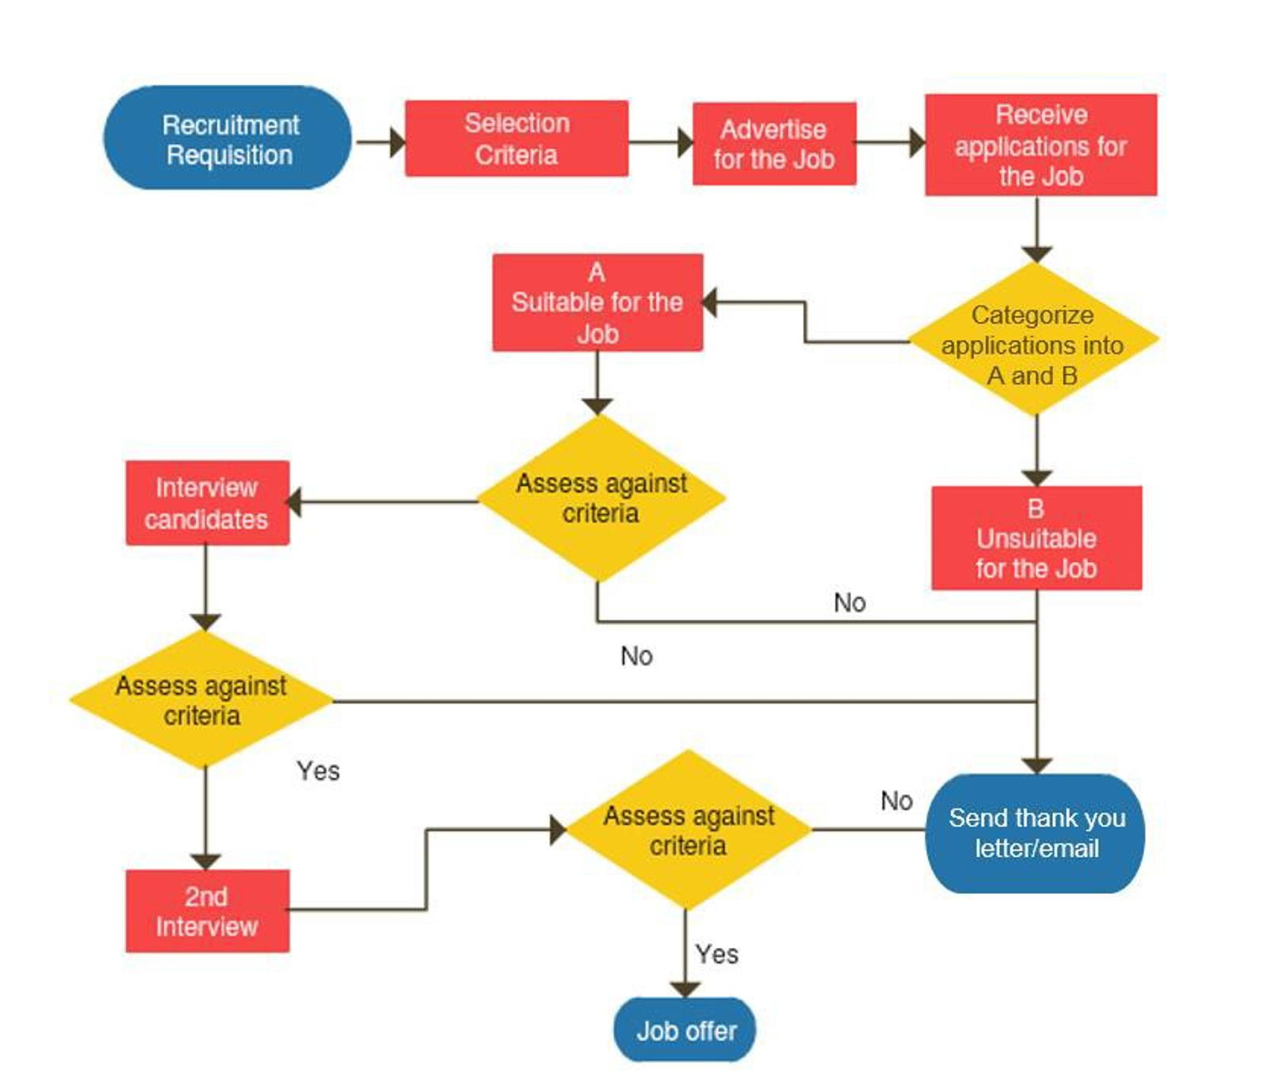
Process Mapping
The purpose of process mapping is to better understand the process leading to a particular outcome and identify potential breakdown points in order to focus continuous improvement efforts.

Slide 35
Process Mapping Protocol
Brainstorm and identify the end point (i.e., goal) of the process map.
Create the map:
If X is the goal, where do you begin the process to X?
Then what?
Listen for decision points.
Ask what was most challenging about the process and what could be changed.
“Interrogate” the map and identify change ideas (How might the process breakdown?).

Slide 36
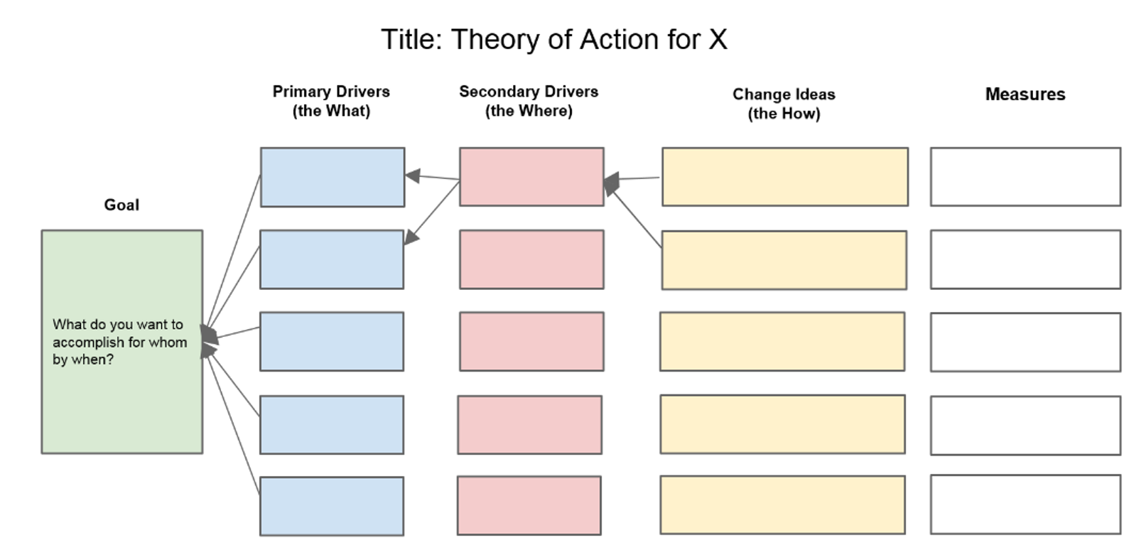
Driver Diagram Generation
The purpose of a driver diagram is to generate or refine a shared theory of action to drive a team’s improvement efforts and achieve the goal.
Driver diagrams are not intended to be set in stone. Your team’s theory of action should evolve as you learn more about the problem/gap you want to address, the change ideas you are trying, and how best to achieve your goal.

Slide 37
Driver Diagram Protocol
Clarify the goal (is it measurable?).
  What do you want to accomplish, for whom, by when?
Identify primary drivers (the what).
“If we figured out X, we could achieve our goal” or “If we don’t figure out X, it is unlikely we would achieve our goal.”
Identify secondary drivers (the where).
  On what structures and processes can you focus your efforts to impact the primary drivers?
Identify high-leverage change ideas (the how).
Note the alignment (or lack of) between change ideas and drivers to determine whether a new driver is needed or a driver is not helpful.
Debrief.

Slide 38
Worksheet 5: Designing an Effective Onsite Analysis Meeting
Who participates in the onsite analysis meeting(s)?
Who facilitates the onsite analysis meeting(s)?
What data analysis should be completed in preparation for the onsite analysis meeting(s)?
How can the onsite analysis meeting be a safe space to discuss issues that may be controversial or politically sensitive?
How can the onsite analysis meeting be structured to complete root-cause analysis (e.g., fishbone diagrams, five whys)?
How do the results from the onsite analysis meeting(s) inform creation of an LCAP for the LEA?

Slide 39
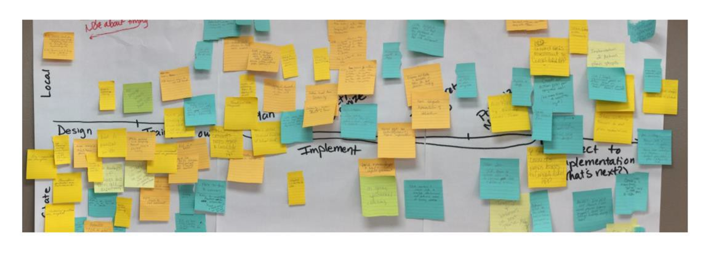
Return to Implementation Path Activity
Now that you have completed the Needs Assessment Modules, are there any milestones that need to be added, edited, or rearranged?

Slide 40
Resources (1)
CDE California School Dashboard
CDE California's System of Support
CDE Continuous Improvement Resources
CDE Root Cause Analysis Toolkit
CDE Driver Diagram Template
CDE Worksheet 5: Designing an Effective Onsite Analysis Meeting

Slide 41
Resources (2)
CDE Analyzing Data and Assessing Local Needs
Council on Chief State School Officers (CCSSO) Utilizing Integrated Resources to Implement the School and District Improvement Cycle and Supports
CCSSO Using Needs Assessments for School and District Improvement: A Tactical Guide
U.S. Department of Education Scaling Needs Assessment Learning Cycle Resources
High Tech High Graduate School of Education Protocols and Tools for Supporting Improvement Science

