Slide 1
2025–26 Every Student Succeeds Act Comprehensive Support and Improvement County Office of Education Plan Approval Application for Funding Webinar
California Department of Education January 15, 2026

Slide 2
Acronyms (1)
CDE—California Department of Education
COE—County Office of Education
CSI—Comprehensive Support and Improvement
ESSA—Every Student Succeeds Act
FY—Fiscal Year
GMART—Grant Management and Reporting Tool
GMR —Grant Management Report

Slide 3
Acronyms (2)
LCAP—Local Control and Accountability Plan
LEA—Local Educational Agency
PCA—Program Cost Accounting
SBE—State Board of Education
SEA—State Educational Agency
SPSA—School Plan for Student Achievement

Slide 4

Housekeeping
Please use the Zoom question feature to post any questions you may have.
The slide deck of today’s presentation is located on the CDE ESSA School Support Webinar Resources web page.

Slide 5
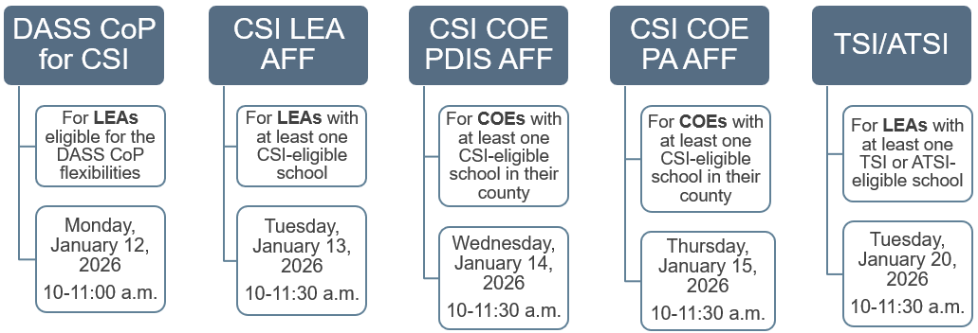
ESSA School Support Webinars
Reference Appendix 1 for long descriptive text.

Slide 6

2025–26 ESSA School Support Office Hours
If you have application or program questions…
JOIN US!
January 21, 2026
10:00 - 11:00 a.m.
Register here: ESSA School Support
Webinar Resources

Slide 7



Overview of Today’s Webinar
Part 1:
Subgrant Information
Part 2:
Technical Assistance
Part 3:
Completing and Submitting the Application

Slide 8
Part 1: Subgrant Information
Purpose and Statutory Authority
Eligibility Requirements
Allowable and Disallowable Costs
Reporting Requirements and Closeout
Apportionments
Timeline

Slide 9
Part 2: Technical Assistance
COE Web Pages
Conflict of Interest Guidance
Guidelines for the Review and Approval Process of CSI Prompts
Frequently Asked Questions (FAQs)

Slide 10
Part 3: Completing and Submitting the Application
Process
Sections
Status

Slide 11

Subgrant Information
Part 1

Slide 12
Purpose of PA CSI Funds
The Budget Act of 2025 appropriated $5,000,000 of ESSA, Section 1003 funds to COEs for the purposes of review and approval of 2026–27 CSI plans through the CSI prompts in the 2026–27 LEA LCAP.

Slide 13



Statutory Authority
ESSA Section 1003 School Improvement, pages 9 through 11.
ESEA Section 1111(d)(1) CSI, pages 33 through 35.
Senate Bill 105, Budget Act of 2025 Item 6100-134-0890 Provision 11 Schedule 2.

Slide 14
2025 Budget Act: Provision 11 of Schedule 2
The COE reviews and approves CSI prompts in the LCAP Plan Summary and submits to the CDE a list of LEAs with approved CSI prompts and the dates they were approved.
In this manner the COE is working on behalf of the SBE to meet the ESSA SEA requirement to approve LEA CSI plans.

Slide 15
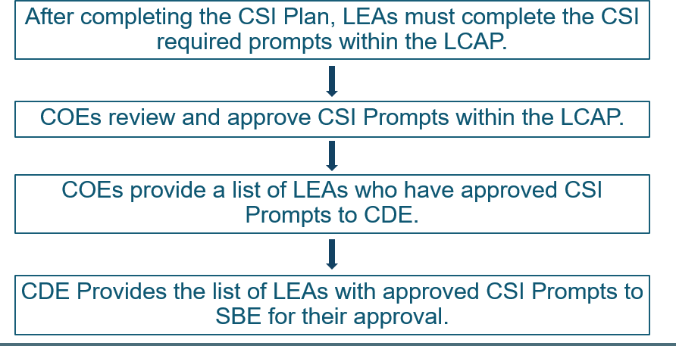
Life Cycle of the PA Subgrant
Reference Appendix 2 for long descriptive text.

Slide 16
Which COEs are Eligible to Apply for FY 2025–26 Funding?
Eligible COEs that have at least one LEA in their county that serve schools eligible for CSI based on the 2025–26 ESSA Assistance Status Data File are eligible to apply for funding.

Slide 17
2025–26 ESSA Assistance Status Data File
Please visit the CDE ESSA Assistance Status Data File web page to view the 2025–26 ESSA Assistance Status Data File.

Slide 18
Allowable Activities and Costs (1)
Funds authorized under this subgrant shall be spent on the review and approval of 2026–27 LEA CSI plans through the CSI prompts in the 2026–27 LEA LCAP. The COE will only be reimbursed for actual work performed. Refer to the CDE’s CSI COE Program Information web page.

Slide 19
Allowable Activities and Costs (2)
Plan Approval funds are for the review and approval of CSI Plans via the CSI Prompts in an LEA’s LCAP.
The focus is on LCAP support, specifically the CSI prompts within the LCAP, not the CSI plans themselves.

Slide 20
Disallowable Activities and Costs
The use of federal funds, including ESSA, Section 1003 funds must be consistent with the Office of Management and Budget (OMB) Uniform Administrative Requirements, Cost Principles, and Audit Requirements for Federal Awards. For federal guidance on Supplement not Supplant for School Improvement, see question 29a, pages 21 to 22.

Slide 21

Reporting Timeline (1)
Reporting happens three times a year:
July (Reports 1 and 4)
October (Reports 2 and 5)
February (Report 3)
Budget Revisions are due mid-month prior to the GMR due date.
GMRs are due at the end of the month after the month the reporting period closes.

Slide 22
Reporting Timeline (2)
GMR | Reporting Data | Performance Period | Reporting Window
GMR 1 | Expenditures | 2/9/2026, to 6/30/2026 | 7/31/2026
GMR 2 | Expenditures | 7/1/2026, to 9/30/2026 | 10/31/2026
GMR 3 | Expenditures Mid-Year Reflection | 10/1/2026, to 1/31/2027 | 2/28/2027
GMR 4 | Expenditures | 2/1/2027, to 6/30/2027 | 7/31/2027
Final Report | Expenditures Subgrant Performance Report (SPR) | 7/1/2027, to 9/30/2027 | 10/31/2027

Slide 23
Reporting Requirements (1)
When expenditure amounts claimed for object codes are in excess of 10 percent of the last approved budget, a project budget revision request must be submitted.
Budget revision requests require CDE approval and are due 15 business days prior to the expenditure reporting due date.
COE expenditures must be submitted with each report.
GMR 3 includes a Mid-Year Reflection
Closeout includes a SPR

Slide 24
Reporting Requirements (2)
Budget revision requests and GMRs must be submitted using the GMART.
The PCA number is 15565.
The Final Report must be completed in the GMART prior to closeout.
More information regarding reporting will be provided in a webinar this June, prior to the GMR 1 reporting period.

Slide 25




Closeout
When a COE has spent 75 percent or more of its funds, the GMART will ask the COE if it wants to closeout.
The final Subgrant Evaluation Prompt asks the COE to describe how well the COE process worked for reviewing and approving the CSI prompts in the LEA LCAP Plan Summary.
The Final Report includes the final expenditures and a response to a final Subgrant Evaluation Prompt.
If the COE is closing out without spending its entire allocation, additional prompts will ask the COE to clarify why it did not spend its allocation.

Slide 26
Apportionments (1)
First Apportionment (Approved Application) | Subsequent Apportionments
Fifty Percent of the total COE Allocation | Claimed expenditures for each performance period less prior payments.

Slide 27
Apportionments (2)
Note: Reported expenditures are used for the purpose of calculating the COE’s apportionment. The use of federal funds must be consistent with the OMB Uniform Administrative Requirements, Cost Principles, and Audit Requirements for Federal Awards, ESSA requirements, and requirements in the 2025‒26 ESSA CSI COE Plan Approval Application for Funding.

Slide 28
Apportionments (3)
The acceptance and approval of reported expenditures does not preclude the CDE in any way from conducting program monitoring or audits.
The COE can expect to receive its apportionments approximately twelve to sixteen weeks after a reporting period has ended.

Slide 29
Application and Funding Timeline
Activity | Due Date
Funding Profile Posted to the CDE Web Page | December 2025
2025–26 ESSA Assistance Status Data File available | December 2025
2025–26 ESSA CSI COE PA AFF Release Date | January 12, 2026
2025–26 ESSA CSI COE PA AFF Webinar | January 15, 2026, at 10 a.m.
2025–26 ESSA CSI COE PA AFF Due to the CDE | January 31, 2026, by 5 p.m.
2025–26 ESSA CSI COE PA AFF Review by CDE Staff | February 2026
Funding Results and Schedule of Apportionments Posted to the CDE Web Page | April/May 2026

Slide 30

Technical Assistance
PART 2

Slide 31
Web Pages for FY 2025–26 Subgrantees
CSI COE Program Information
CSI COE Background information
Program Requirements
Guidance on Conflict of Interest
LCAP Resources
CSI Resources
FAQs

Slide 32
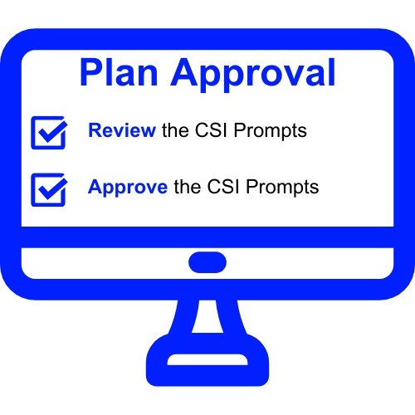
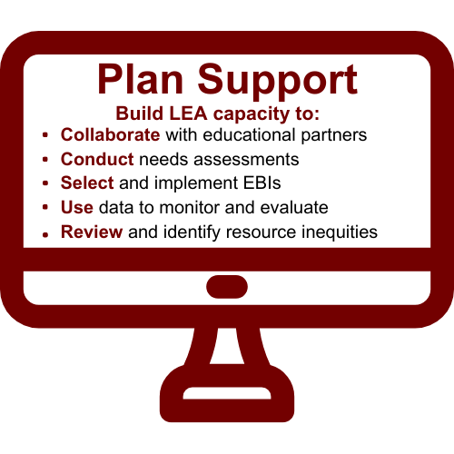
PA and PDIS: CSI COE Subgrants

Slide 33
Impact of Dual Roles for COEs
With these two subgrants, it is possible for a COE to receive funding to support LEAs with their CSI plans, and also to receive funding in order to review and approve CSI plans.
CDE provides recommendations to COEs in order to avoid conflicts in the event that COEs are allocated funds for both CSI plan development and implementation support AND the review and approval of CSI plans.

Slide 34
Guidelines for Preventing Conflicts of Interest
A complete guide on how to avoid a conflict of interest with CSI funds for COEs is located on the Conflict of Interest tab of the CDEs CSI COE Program Information web page.
COEs are encouraged to review the posted guidance with their legal departments and make any changes, where and if needed.

Slide 35

Guidelines for the Review and Approval Process of CSI Plans

Slide 36
CSI Prompts in the LCAP
CSI Prompts in the LCAP:
Prompt 1:
A list of the schools in the LEA that are eligible for comprehensive support and improvement.
Prompt 2:
A description of how the LEA has or will support its eligible schools in developing CSI plans.
Prompt 3:
A description of how the LEA will monitor and evaluate the plan to support student and school improvement.

Slide 37
Guidelines for the Review and Approval Process of CSI Prompts (1)
In reviewing CSI prompts, COEs should:
See the extent that educational partners were involved and considered in the development of the CSI plans.
See how CSI plans were informed by the indicators.
See that evidence-based interventions were selected and align to the reasons why the school is eligible for CSI.
See how the LEA identified resource inequities.

Slide 38
Guidelines for the Review and Approval Process of CSI Prompts (2)
Under ESSA Section 1111(d)(1)(B)(iii), CSI plans must be based on a school-level needs assessment.
CSI plans should describe the LEA's needs assessment, including the type(s) of data and information examined and how the data informed the development of the CSI plan.
COEs should ensure that CSI prompts correlate to needs identified in the needs assessment and any relevant data.

Slide 39

Frequently Asked Questions

Slide 40
What Does it Mean for a COE to Approve CSI Plans?
The COE approves LEA CSI plans through the review and approval process of the CSI prompts in the LEA LCAP.
Per Senate Bill 105, Budget Act of 2025 Item 6100-134-0890 Provision 11 Schedule 2.

Slide 41
Must a COE Approve CSI Plans for Charter Schools?
Yes. Charter schools eligible for CSI will complete the CSI prompts in the Plan Summary section of the LCAP. The charter school will submit only the Plan Summary section of the LCAP to the County Superintendent of Schools of the county in which the charter school is located for review and approval.

Slide 42
What is the COE Required to do After it Approves the CSI Plans?
In Fall 2026, the COE will submit to the CDE a list of LEAs with approved CSI plans. The CDE will present this list of LEAs to the SBE for final approval.
It is the expectation that the COE ensures that all LEAs with schools eligible for CSI within its county, including charter schools, complete and submit to the COE the CSI prompts for review and approval.
The COE should contact the CDE as soon as possible if its list of LEAs is incomplete.

Slide 43
Which CSI Plans do the 2025–26 Funds Support?
The COE will use its 2025–26 CSI funds under this application to approve the 2026–27 CSI plans through review and approval of CSI prompts in the LEA LCAP.
2025–26 CSI funds support plan development and implementation support activities for the 2026–27 CSI plans. In most LEAs, CSI plan development activities begin as early as January 2026. It is the expectation that CSI plan implementation should begin by the first day of the 2026–27 school year.

Slide 44
When Will the 2025–26 CSI Funds for COEs Become Available?
First apportionments are expected to be distributed in Spring 2026.

Slide 45
What if the COE Declines Funding?
Regardless of whether or not the COE elects to accept funding authorized under this application, the COE is expected to approve CSI plans for all LEAs, including charter schools, in its county with schools eligible for CSI. This requirement is carried out through COE review and approval of CSI prompts in the LEA LCAP.
California Education Code Section 52070

Slide 46

Questions?

Slide 47

Part Three: Application for Funding

Slide 48
The GMART (1)
The application and all reporting will be managed in the GMART.
The GMART is a web-based system that allows COEs to submit, view, print, and modify the application for funding.
A reference-only PDF of the application is posted to the CDE’s CSI COE Application for Funding web page.

Slide 49
The GMART (2)
Usernames and passwords
Are the same as in prior years.
Were emailed to county superintendents.
Are case-sensitive.
For more information, visit the CDE’s GMART Instructions web page.

Slide 50
Logging on to the GMART
On the GMART landing page, the COE will enter their unique username and password.
The COE will be prompted to select a link labeled “2025–26 Comprehensive Support and Improvement County Office of Education Plan Approval Application for Funding.”
The COE will be directed to the Application Overview.
The Application Overview page will show tabs for all sections of the application.

Slide 51
Selecting the Subgrant Application
GMART
Select Grant
Logoff
Please select the link below to begin or continue with your application:
2025–26 ESSA CSI COE Plan Approval Application for Funding

Slide 52
Application Sections
The 2025–26 application includes five sections: Section 1: Intent to Apply Section 2: General Assurances, Certifications, Terms, and Conditions Section 3: COE Applicant Information Section 4: Proposed Project Budget Section 5: Signatures

Slide 53
Application Overview (1)
GMART HOME | Application Overview | Sec. 1 Intent to Apply | Sec. 2 Assurances, etc.
Sec. 3 COE Info | Sec. 4 Project Budget | Sec. 5 Signatures | Application Status
2025-26 Every Student Succeeds Act Comprehensive Support and Improvement County Office of Education Plan Approval Application for Funding Due: January 31, 2026 Application Status: Not Submitted

Slide 54
Application Overview (2)
I have read the Application Overview and would like to proceed to Section 1 of the application.
Save and Continue to Section 1
Save and Logoff

Slide 55

Section 1: Intent to Apply (1)
The COE intends to apply for FY 2025–26 ESSA, Section 1003 funds. By selecting this option, the COE must complete the remaining four sections of the application.

Slide 56

Section 1 Intent to Apply (2)
The COE does not intend to apply for FY 2025–26 ESSA, Section 1003 funds. By selecting this option, the COE understands its statutory obligation to meet the CSI requirements of ESSA and will be redirected to Section 5 to sign and submit the application.
If the COE declines its FY 2025–26 ESSA, Section 1003 funds for CSI, it must provide a reason for why it chooses not to accept these funds.

Slide 57
Section 2: General Assurances and Certifications
Assurances, certifications, terms, and conditions are requirements of applicants and sub-grantees as a condition of receiving funds.
General Assurances and Certifications are available on the CDE’s Funding Forms web page.

Slide 58
Section 2: Terms and Conditions (1)
The 2025–26 ESSA CSI COE Plan Approval AFF must be electronically signed by the authorized designee of the COE and submitted to the CDE using the web-based application.
All funds must be encumbered, expended, and legally obligated within the dates designated and must not exceed the maximum amount indicated in the Apportionment Letter. No extensions or carryover of this subgrant will be allowed.

Slide 59
Section 2: Terms and Conditions (2)
The COE agrees that 2025–26 ESSA, Section 1003 funds allotted under this application shall be used only for costs associated with 2026–27 CSI plan approval through the review and approval of the CSI prompts in the 2026–27 LEA LCAP.
The COE will submit a list of LEAs with approved CSI prompts, including the dates of approval, to the CDE at such time, in such form, and including such information as the CDE may require.

Slide 60
Terms and Conditions (3)
The COE will not increase its allotment under this application with ESSA, Section 1003 funds received by the COE for the purposes of supporting 2026–27 CSI plan development and implementation activities for LEAs.
Regardless of whether or not the COE elects to accept funding authorized under this application, the COE agrees to review and approve 2026–27 CSI plans through the CSI prompts in the 2026–27 LEA LCAP for those LEAs in its county with schools eligible for CSI.

Slide 61
Section 3: COE Information (1)
COE Applicant Information
Applicant information can be verified on the CDE’s California School Directory web page.
The Preliminary FY 2025–26 Allocation Amount for the COE can be verified on the CDE’s CSI COE Fiscal Information web page.

Slide 62
Section 3: COE Information (2)
Edit Contact Information
The COE provides name and contact information for:
Primary Grant Coordinator
Secondary Grant Coordinator
Fiscal Coordinator

Slide 63
Section 3: COE Information (3)
The required information for each coordinator is:
First and Last Name
Title
Phone
Email
The optional information for each coordinator is:
Extension
FAX

Slide 64
Section 3: COE Information (4)
If the information is inaccurate, do not submit the application.
Use the “Save and Logoff” button and contact the School Improvement and Support Office for assistance.
Phone: 916-319-0833
Email: ESSACOE@cde.ca.gov
If the information is correct and you want to continue, select the “Save and Continue to Section 4” button.

Slide 65

Section 4: Budget
Provide an expenditure description for all proposed expenditures within the major Object Codes.
Descriptions should directly align to the allowable use of funds described in this application and include how the costs are necessary and reasonable to execute the subgrant requirements.
The Total Budget Amount must match the Preliminary FY 2025–26 Allocation Amount. Questions/Concerns about the budget is the most common reason applications get returned!

Slide 66
Section 5: Signatures (1)
The County Office Superintendent or authorized designee will be prompted to check the following:
ASSURANCES/CERTIFICATIONS/TERMS/CONDITIONS:
As the duly authorized representative of the applicant, I have read all assurances, certifications, terms, and conditions associated with the 2025–26 ESSA CSI COE Plan Approval Application for Funding and I agree to comply with all requirements as a condition of funding.

Slide 67
Section 5: Signatures (2)
The County Office Superintendent or authorized designee will be prompted to check the following:
ASSURANCES/CERTIFICATIONS/TERMS/CONDITIONS:
I certify that all applicable state and federal rules and regulations will be observed and that to the best of my knowledge, the information contained in this application is correct and complete.

Slide 68
Application Status
The COE should adhere to its record retention policies and print this application for record keeping.
Application Submission and Review History:
Application Version | Application Status | Date and Time | Name | Notes
1 | Submitted | 1/27/26 10:23:31 | Abcdefg | ***

Slide 69
Final Questions?

Slide 70

Feedback Helps us Continuously Improve!
In our efforts to continuously improve, we would appreciate you completing a survey.
The survey will be available until February 5, 2026.
We will consider your input as we develop future webinars.

Slide 71

Contacts
School Improvement and Support Office ESSACOE@cde.ca.gov
(916) 319-0833
Robert Bernstein, RBernstein@cde.ca.gov
Ryan Bell, RBell@cde.ca.gov

Slide 72

Thank You for All That You Do For California Students!
This Photo by Unknown Author is licensed under CC BY-SA

Slide 73
Appendix 1: Long Description for Slide 5 (1)
Return to Slide 5: ESSA School Support Webinars
DASS CoP for CSI is shown in the first column. This webinar is for LEAs eligible for the DASS CoP flexibilities. The webinar is on Monday, January 12, 2026, at 10-11:00am.
CSI LEA AFF is shown in the second column. This webinar is for LEAs with at least one CSI-eligible school. This webinar is on Tuesday, January 13, 2026, at 10-11:30am.

Slide 74
Appendix 1: Long Description for Slide 5 (2)
Return to Slide 5: ESSA School Support Webinars
CSI COE PDIS AFF is shown in the third column. This webinar is for COEs with at least one CSI-eligible school in their county. The webinar is on Wednesday, January 14, 2026, at 10-11:30am.
CSI COE PA AFF is shown in the fourth column. This webinar is for COEs with at least one CSI-eligible school in their county. The webinar is on Thursday, January 15, 2026, at 10-11:30am.

Slide 75
Appendix 1: Long Description for Slide 5 (3)
Return to Slide 5: ESSA School Support Webinars
TSI/ATSI is shown in the fifth column. This webinar is for LEAs with at least one TSI- or ATSI-eligible school. The webinar is on Tuesday, January 20, 2026, at 10-11:30am.

Slide 76
Appendix 2: Long Description for Slide 15 (1)
Return to Slide 15: Life Cycle of the PA Grant
After completing the Comprehensive Support and Improvement (CSI) Plan, Local Educational Agencies (LEAs) must complete the CSI required prompts in the Local Control Accountability Plan (LCAP.)
Then, County Offices of Education (COEs) review and approve CSI prompts in the LCAP.
Then, COEs provide a list of LEAs with approved CSI prompts to the California Department of Education (CDE.)
CDE provides the list of LEAs with approved CSI prompts to the State Board of Education for their approval.

