Slide 1
A Site Administrator’s Guide:
Talking to Parents
About the California School Dashboard
California Department of Education March 2015

Slide 2
Purpose of This Deck
  This slide deck is intended for use by site administrators to provide information to Parents about the California School Dashboard. It includes:
    An overview of the CA School Dashboard
    An overview of the Measures in the multiple-measure system
    A list of the school’s performance on each measure
    Available resources for parents related to the Dashboard

Slide 3
How to Use This Deck (1)
This deck has been created for you to customize and edit as needed:
  Choose the slides you want to use.
      Select the “View” tab, and then select “Normal.”
      In the slide list on left, right-click on the slide/s you do not want and select “Hide Slide” at the bottom of the menu.
  Add your school’s logo and change colors.
  Change wording for your audience−you know your audience best!
  Talking points, provided in the “Notes” section, can be customized to your audience.

Slide 4
How to Use This Deck (2)
  Change color scheme.
      Select “View” tab, and then “Slide Master.”
        For titles, select slide ─ highlight header text ─ select “Home” tab ─ choose text color ─ return to “View” tab.
        For the body, select slide ─ highlight body text ─ select “Home” tab ─ choose text color ─ return to “View” tab.
        For the green line, select slide ─ highlight line ─ select “Home” tab ─ select “Shape Outline” ─ choose color ─ return to “View” tab.
        When all changes are made ─ select “Slide Master” tab ─ select “Close Master View.”
  The changes should apply to all slides in the deck.

Slide 5
How to Customize This Deck
  Slides 13 through 18 allow you to show how your school is performing on each of the state indicators.
  To use these slides:
    Fill in the status (e.g., High) and change (e.g., Maintained) for each indicator
    Copy the correct color level from slide 12 into the slide under the performance level section
    Fill in the speakers notes as needed

Slide 6
Understanding the
California School Dashboard and our
School’s Progress
[Add School Logo Here if Desired]
[Add School Motto Here if Desired]
Notes:
Good Evening Families!
My name is [insert name] and I’m very excited about all the learning that will take place this year here at [insert school name].
Tonight, I’d like to share with you a few of the ways that we measure our school’s performance and progress from year to year using a system called the California School Dashboard, which is developed and maintained by the California Department of Education.
Let’s get started!

Slide 7
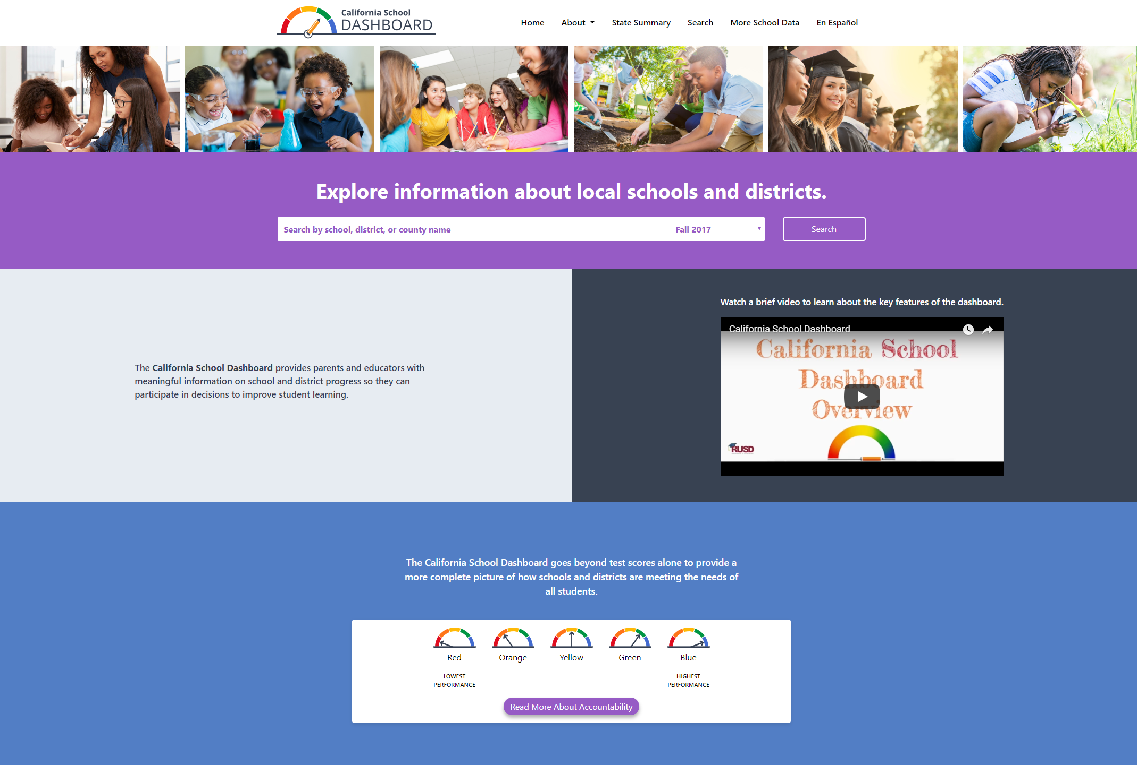
What is the Dashboard?
6
state measures
5
local measures
Notes:
Let’s start with an overview of the California School Dashboard, also called the Dashboard.
The Dashboard is an online tool that shows how districts and schools are performing on the state and local measures that are included in California's school accountability system.
The dashboard provides information about how local educational agencies and schools are meeting the needs of California’s diverse student population based on a set of measures.
There are six state measures and five local measures.
State measures are calculated by the state using data reported throughout the year
Information about local measures are entered by our district based on information we collect at the local level.

Slide 8

When is the Dashboard Updated?
Updated Every December
Notes:
The Dashboard is updated each December with the most recent data from the previous school year.
For example, the 2018 the dashboard will use graduation data from the class of 2018.

Slide 9


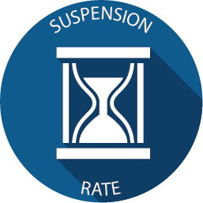



State Measures
Notes:
As stated earlier, there are six state measures. Lets go through them quickly.
Academic performance looks at our scores on the Smarter Balanced Summative Assessment, specifically how far above or below our students are from the grade-level standard. A separate score is provided for both mathematics and English language arts/literacy (also called ELA).
This measure is important because it allows us to see, on average, the performance of our students and if they are above or below standards.
The Graduation rate looks at how many of our students attending comprehensive high schools, within four years.
This measure is important because graduation from high school leads to more opportunities for our students in the long term and enables them to pursue a higher education.
The Suspension Rate looks at how many of our students were suspended.
This measure is important because it allows us to see if all student groups are receiving equal treatment and whether discipline policies are working.
College/Career Readiness looks at how many of our students graduate better prepared for success after high school.
This measure is important because it allows us to see how well high schools and districts are preparing students for likely success after high school graduation.
Chronic Absenteeism looks at how many of our students were chronically absent.
This measure is important because attendance is important to student success, and it is difficult for students to learn if they are absent from the classroom.
And English Language Progress looks at how well our English learners are progressing from year to year.
This measure is important because having all English learners reach English proficiency is the goal for California.

Slide 10
How Performance Colors Are Determined
Current Year Data
minus
Prior Year Data
Current Year Data
Notes:
The Dashboard gives a performance color for every measure.
Each performance color looks at both the current year data
And the difference between current and prior year data

Slide 11
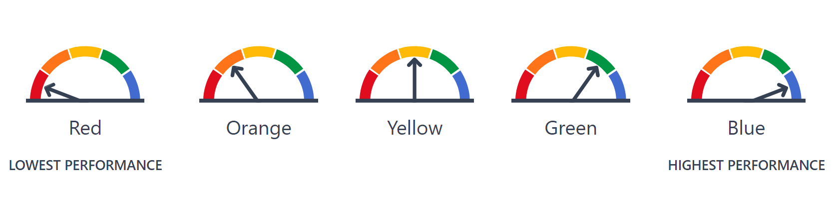
Performance Color
Level | Declined Significantly from Prior Year | Declined from Prior Year | Maintained from Prior Year | *Increased from Prior Year | Increased Significantly from Prior Year
Very High in Current Year | Yellow | Green | Blue | *Blue | Blue
*High in Current Year | *Orange | *Yellow | *Green | *Green | Blue
Medium in Current Year | Orange | Orange | Yellow | Green | Green
Low in Current Year | Red | Orange | Orange | Yellow | Yellow
Very Low in Current Year | Red | Red | Red | Orange | Yellow
Notes:
Current year data and how that data varies from the prior year data are represented on a 5x5 grid.
The grid layout will vary for each measure.
The performance level, or color, is determined by the point at which the two data levels intersect.
In the example shown, the district has current year data that falls into the “high” category. When we compare that data with the prior year, we find that the district maintained this level. “High level” and “maintained” meet on the five-by-five grid for an overall performance level of green.
Performance levels go from Red, which is the lowest, to Blue, which is the highest. Every school and district in California has a goal of trying to get green on all measures.

Slide 12
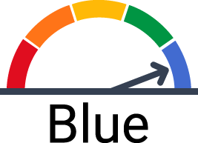
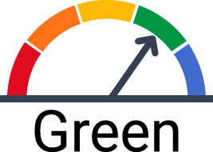
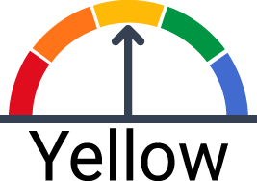
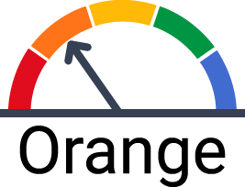
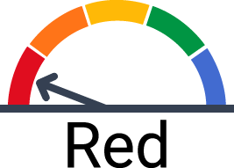
Color Wheels
Copy the image of the gauge into each indicator slide.
Then delete or hide this slide.

Slide 13
Our School –
Academic ELA
Current Year = *Fill in for your school*
Current Year – Prior Year = *Fill in for your school*
Performance Color = *Fill in for your school*
Notes:
[insert your current year level (e.g., High) and your current year minus prior year level (e.g., maintained). Then paste in the gauge from slide 11 as needed]
The Academic Measure for ELA is calculated using student scores from the Smarter Balanced Summative Assessment in ELA.
Students in grades three through eight and grade eleven take this test every spring.
Our current year data is _____________
Our current year minus prior year is ____________________
These come together to give us a performance level, or color, of [insert color here]
[site can discuss more about their color, what it means for the school, and what they plan to do to continuously improve]

Slide 14
Our School –
Academic Mathematics
Current Year = *Fill in for your school*
Current Year – Prior Year = *Fill in for your school*
Performance Color = *Fill in for your school*
Notes:
[insert your current year level (e.g., High) and your current year minus prior year level (e.g., maintained). Then paste in the gauge from slide 11 as needed]
The Academic measure for mathematics is calculated using student scores from the Smarter Balanced Summative Assessment in mathematics.
Students in grades three through eight and grade eleven take this test every spring.
Our current year data is _____________
Our current year minus prior year is ____________________
These come together to give us a performance level, or color, of [insert color here]
[site can discuss more about their color, what it means for the school, and what they plan to do to continuously improve]
[Its is still unclear how the CDE will display data for schools serving multiple grade spans (e.g., K-12)]

Slide 15
Our School –
Grad Rate
Current Year = *Fill in for your school*
Current Year – Prior Year = *Fill in for your school*
Performance Color = *Fill in for your school*
Notes:
[insert your current year level (e.g., High) and your current year minus prior year level (e.g., maintained). Then paste in the gauge from slide 11 as needed]
The Graduation Rate measure is calculated using graduation data that our district provides to the state every year.
Our current year data is _____________
Our current year minus prior year is ____________________
These come together to give us a performance level, or color, of [insert color here]
[site can discuss more about their color, what it means for the school, and what they plan to do to continuously improve]

Slide 16
Our School –
Suspension Rate
Current Year = *Fill in for your school*
Current Year – Prior Year = *Fill in for your school*
Performance Color = *Fill in for your school*
Notes:
[insert your current year level (e.g., High) and your current year minus prior year level (e.g., maintained). Then paste in the gauge from slide 11 as needed]
The Suspension Rate measure is calculated using suspension rate data that our district provides to the state.
Our current year data is _____________
Our current year minus prior year is ____________________
These come together to give us a performance level, or color, of [insert color here]
[site can discuss more about their color, what it means for the school, and what they plan to do to continuously improve]

Slide 17
Our School – Chronic Absenteeism
Current Year = *Fill in for your school*
Current Year – Prior Year = *Fill in for your school*
Performance Color = *Fill in for your school*
Notes:
[insert your current year level (e.g., High) and your current year minus prior year level (e.g., maintained). Then paste in the gauge from slide 11 as needed]
The Chronic Absenteeism measure is calculated using attendance data that our district provides to the state.
Our current year data is _____________
Our current year minus prior year is ____________________
These come together to give us a performance level, or color, of [insert color here]
[site can discuss more about their color, what it means for the school, and what they plan to do to continuously improve]

Slide 18
Our School – College/Career
Current Year = *Fill in for your school*
Current Year – Prior Year = *Fill in for your school*
Performance Color = *Fill in for your school*
Notes:
[insert your current year level (e.g., High) and your current year minus prior year level (e.g., maintained). Then paste in the gauge from slide 11 as needed]
The College/Career measure is calculated based on graduating classes and uses the courses and exams that students took during their four-years in high school.
Our current year data is _____________
Our current year minus prior year is ____________________
These come together to give us a performance level, or color, of [insert color here]
[site can discuss more about their color, what it means for the school, and what they plan to do to continuously improve]

Slide 19
Learn More:
Getting to Know the Dashboard
Getting to Know the Measures
How Colors are Determined on the Dashboard
College/Career flyer
The Dashboard has a New Look
[URL goes here]
Notes:
As you can see on the screen we have many resources to help parents, families, and community members get to know the California School Dashboard.

