Slide 1



Implementation of the 2019 California Arts Standards and Distance Learning
July 2, 2020
Armalyn De La O
Region 10 Lead
CCSESA Arts Initiative
Courtney Sawada,
Director
Southern Counties California Arts Project
California Department of Education
Tony Thurmond, State Superintendent of Public Instruction

Slide 2
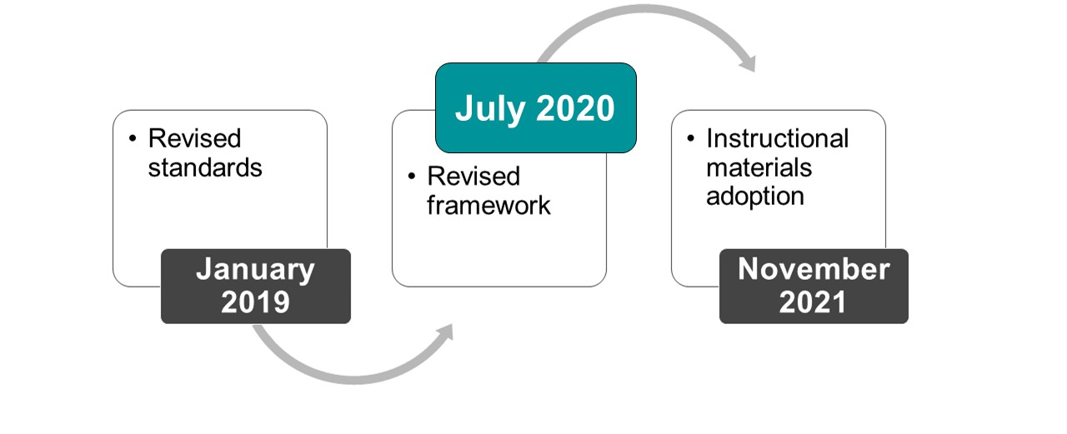
VAPA Revision Project Milestones

Slide 3
CCSESA & TCAP: Supporting Arts Educators in California
California County Superintendents Educational Services Association Statewide Arts Initiative
Represents 58 County Offices of Education
Provides arts education service and support to schools and districts
Utilizes regional model to design and implement programs and educational practices
Regional Arts Leads – represent all 11 service regions of the state
A California Subject Matter Project
Five regional sites, with Regional Site Directors and Teachers Leaders, and a statewide leadership and development center serving all areas of the state
Utilizes a collaborative regional and statewide approach to provide support to and leadership development in arts education for educators, schools, and districts
Brings K–12 and university educators together in communities of practice to promote high-quality teaching, leadership, and educational equity in the arts.

Slide 4
CCSESA & TCAP Regions
Region 1: Humboldt
Region 2: Butte
Region 3: Sacramento
Region 4: Alameda
Region 5: Santa Clara
Region 6: Stanislaus
Region 7: Fresno & Tulare
Region 8: Ventura
Region 9: San Diego
Region 10: San Bernardino
Region 11: Los Angeles
The California Arts Project Statewide Leadership and Learning Center, CSU San Bernardino
Northern California Arts Project, CSU Chico
Bay Area California Arts Project, San Jose State University
Los Angeles Basin California Arts Project, Cal State Los Angeles
RIMS California Arts Project, CSU San Bernardino
Southern Counties California Arts Project, San Diego State University

Slide 5

Contexts for arts learning in school
Arts education instruction in K–12 (per Education Code sections 51210 and 51220) develops “aesthetic appreciation and the skills of creative expression.”
Career technical education standards for arts media and entertainment integrate career, technical, and academic education so students can emerge from school ready to pursue their career and college goals.
Preschool instruction focuses on artistic play, process, and arts learning in the context of child development.
Integrated arts instruction provides opportunities to connect arts and other content area learning.

Slide 6
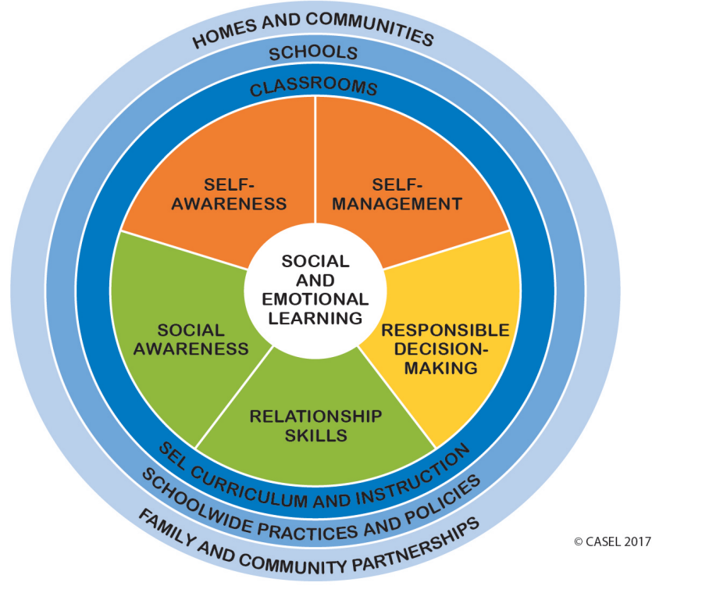
The Arts as Means to Wellbeing
Learning in the arts as creators, performers, and audience members (responders) develops mental, physical, and emotional wellbeing.
Long Description

Slide 7
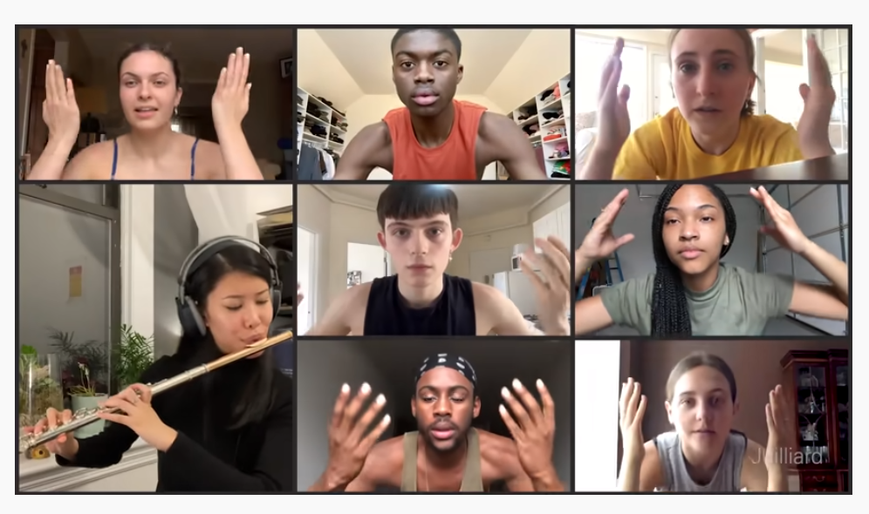
Inspirational yes!

Slide 8
Overview of 2019 Arts Standards
Focus on Process

Slide 9


The Goal: Artistic Literacy
The ultimate goal of the PK–12 California Arts Standards is to develop artistic literacy.
Artistic Literacy involves recognizing and utilizing:
  Arts as Communication
  Arts as Creative Personal Realization
  Arts as Culture, History, & Connectors
  Arts as a Means to Wellbeing
  Arts as Community Engagement
  Arts as Profession

Slide 10

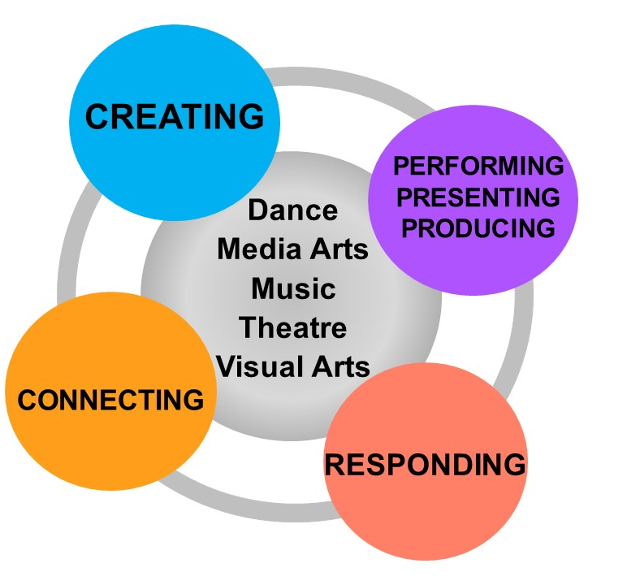
Artistic Processes
& Process Components

Slide 11

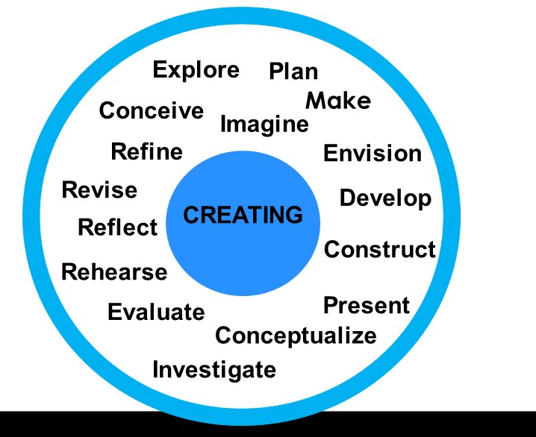
Process Components: Creating

Slide 12
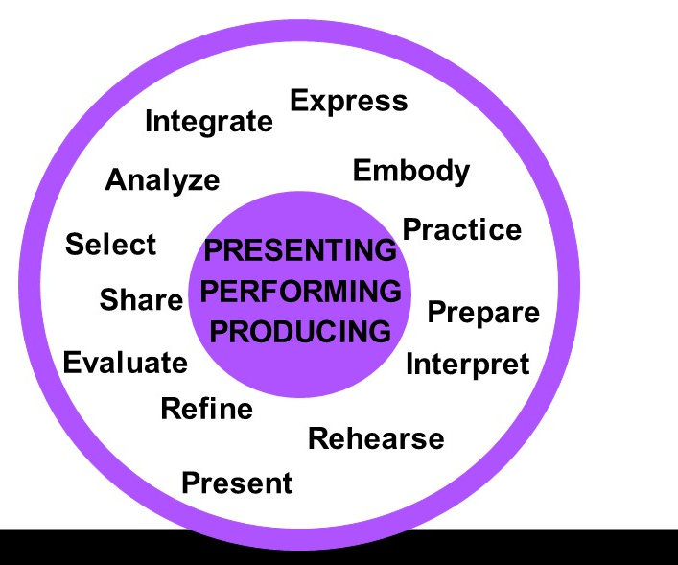
Process Components: Presenting/Performing/Producing

Slide 13
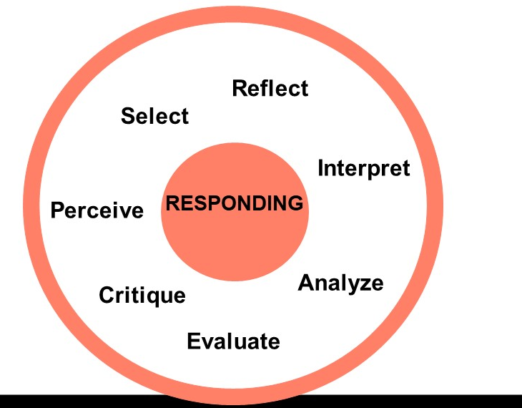
Process Components: Responding

Slide 14

Process Components: Connecting

Slide 15
Shared
Artistic Processes
Creating | Performing/ Presenting/ Producing | Responding | Connecting
Conceiving and developing new artistic ideas and work. | Realizing artistic ideas and work through interpretation and presentation. | Understanding and evaluating how the arts convey meaning. | Relating artistic ideas and work with personal meaning and external context.

Slide 16
Shared
Anchor Standards
Creating | Performing/ Presenting/ Producing | Responding | Connecting
Shared
Artistic Processes
1. Generate and conceptualize artistic ideas and work. 2. Organize and develop artistic ideas and work. 3. Refine and complete artistic work. | 4. Analyze, interpret, and select artistic work for presentation. 5. Develop and refine artistic work for presentation. 6. Convey meaning through the presentation of artistic work. | 7. Perceive and analyze artistic work. 8. Interpret intent and meaning in artistic work. 9. Apply criteria to evaluate artistic work. | 10. Synthesize and relate knowledge and personal experiences to make art. 11. Relate artistic ideas and works with societal, cultural and historical context to deepen understanding.

Slide 17
Discipline-specific Performance Standards
Creating | Performing/ Presenting/ Producing | Responding | Connecting
6.TH:Cr1.1 Explore a scripted or improvised character by imagining the given circumstances in a drama/theatre work. | 5.DA:Pr5 a. Recall and execute a series of dance phrases using technical dance skills (e.g. alignment, coordination, balance, core support, clarity of movement). Prof.VA:Pr4 Analyze, select and curate artifacts and/or artworks for presentation and preservation. | Acc.MU:E.Re7.1 Apply criteria to select music for a variety of purposes, justifying choices citing knowledge of the music and the specified purpose and context. | 8.MA:Cn11 Analyze and responsibly interact with media arts tools, environments, legal and technological contexts, considering ethics, media literacy, social media, and virtual worlds.

Slide 18
What’s New: Inquiry Supports
Enduring Understandings (EUs)
and
Essential Questions (EQs)
support inquiry within
and across disciplines

Slide 19
What’s new?
2001 Content Standards
2019 Performance Standards
Identify the specific content to teach at each grade level.
Identify what students should be able to do or demonstrate at each grade level.
It is the teacher’s discipline expertise that determines the most appropriate content to teach in order for students to achieve the standard

Slide 20

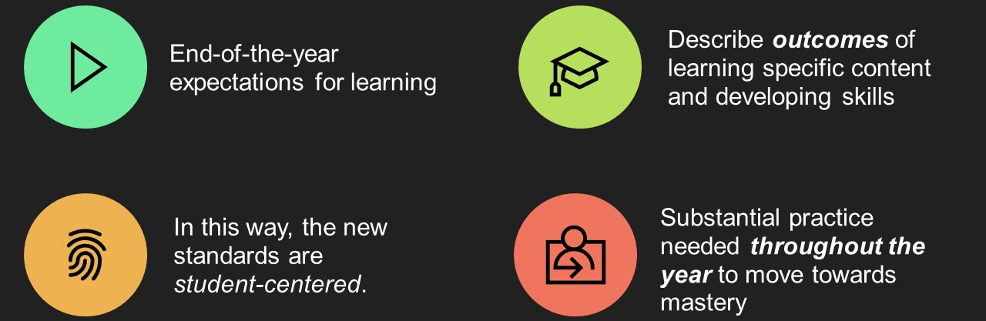
Performance Standards

Slide 21
Distance Learning for Arts Education
Lessons from the Field: There are perks…who knew?

Slide 22
Distance Learning Perks … for Teachers
Opportunity to heighten conversation in districts to address inequities
  Lack of technology in many arts classrooms
  Access to the “traditional” materials
Rethinking Curriculum
Authentic learning opportunities in “real-life” contexts
Professional networking and Social Media platforms

Slide 23
Distance Learning Perks … for Students
More flexibility to accommodate students’ time
Student centered – student choice – student agency to direct learning
Having a tool/device that they didn’t have access to before
Connection/access to the teacher – more individual interaction
Heightened attention to social and emotional needs from teachers

Slide 24
Voices from the Field
Nicole Robinson, Dance Educator
Zack Pitt-Smith, Music Educator
Kimberly Ramos, Visual Art Educator

Slide 25
Nicole Robinson, Dance Educator (1)
Discoveries
Reinventing Choreographic Ideas and Uses of Space
Rethinking Dancing Together
Redefining Collaboration
Refined Artistic Processes and Design (creating and performing)
Focused attention on choreographic process, revision and performance for the camera

Slide 26
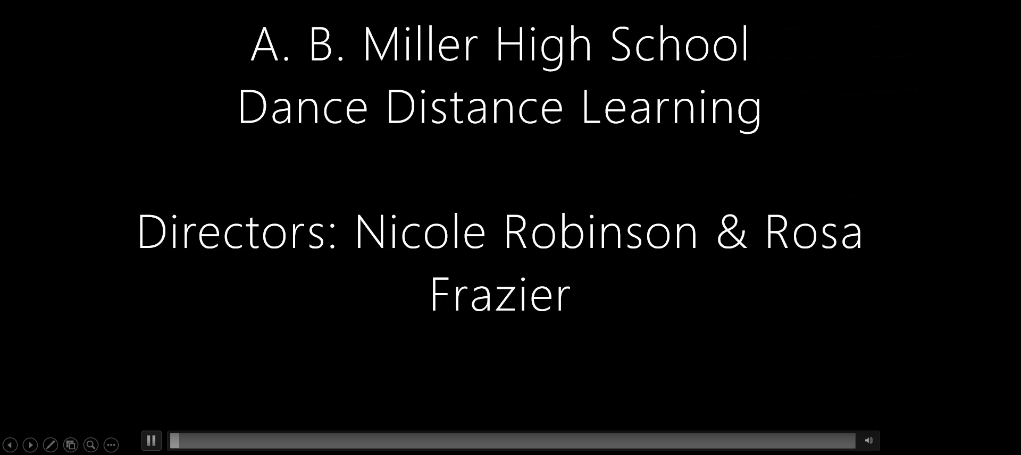
Video Clip
available to view at
https://www.youtube.com/watch?v=T2U-lgJdABw&feature=youtu.be
this clip begins at 24:17

Slide 27
Nicole Robinson, Dance Educator (2)
Discoveries
Reinventing Choreographic Ideas and Uses of Space
Rethinking Dancing Together
Redefining Collaboration
Refined Artistic Processes and Design (creating and performing)
Focused attention on choreographic process, revision and performance for the camera
New Tools and Software

Slide 28
Nicole Robinson, Dance Educator (3)
Challenges
Difficulties recreating the studio space at home
Unrealistic student expectations (Teacher)
Unrealistic teacher expectations (District)
Understanding teacher privilege
Student engagement
Delays and stalling in technology during live studio classes

Slide 29

Zachary Pitt-Smith, Music Educator

Slide 30
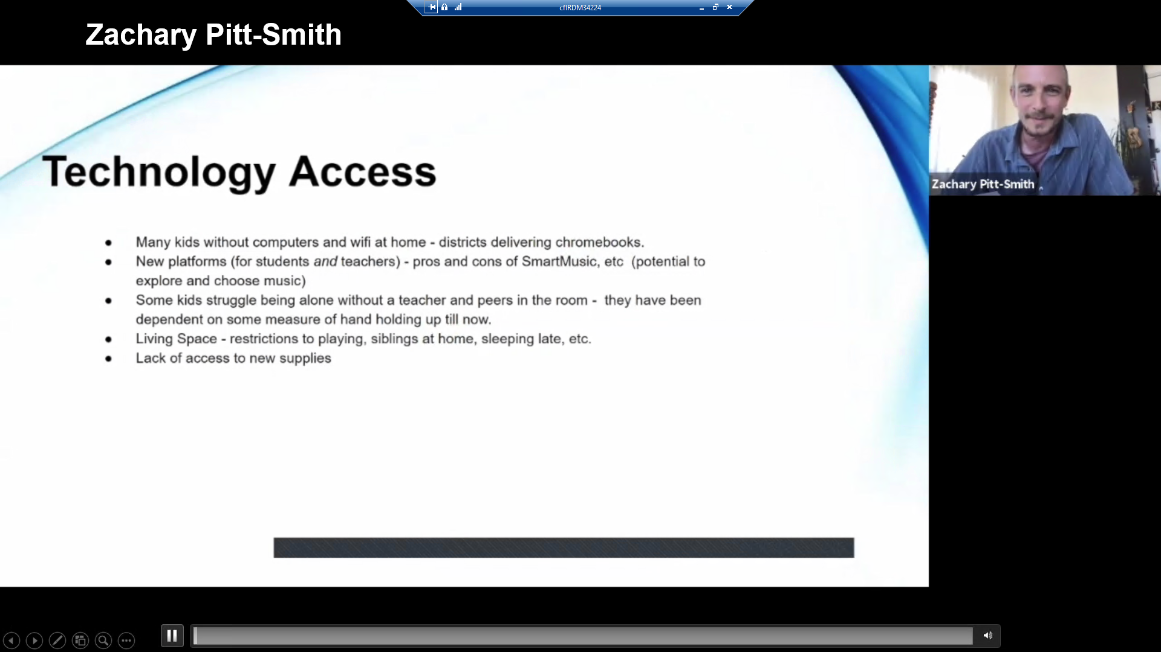
Video Clip of Zachary Pitt-Smith
available to view at
https://www.youtube.com/watch?v=T2U-lgJdABw&feature=youtu.be
this clip begins at 34:49

Slide 31
Kimberly Ramos, Visual Arts Educator (1)
What did I discover?
  Challenges
Lesson design and planning
  Artistic Processes: Creating, Presenting, Responding, Connecting

Slide 32

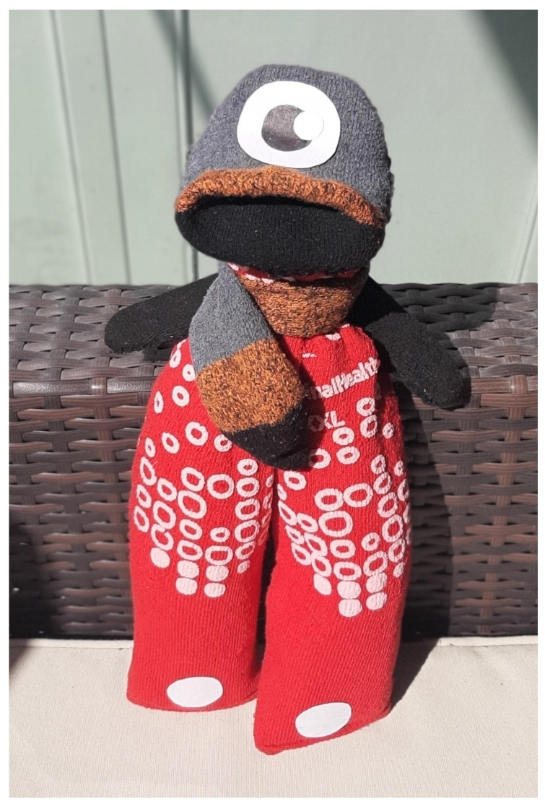
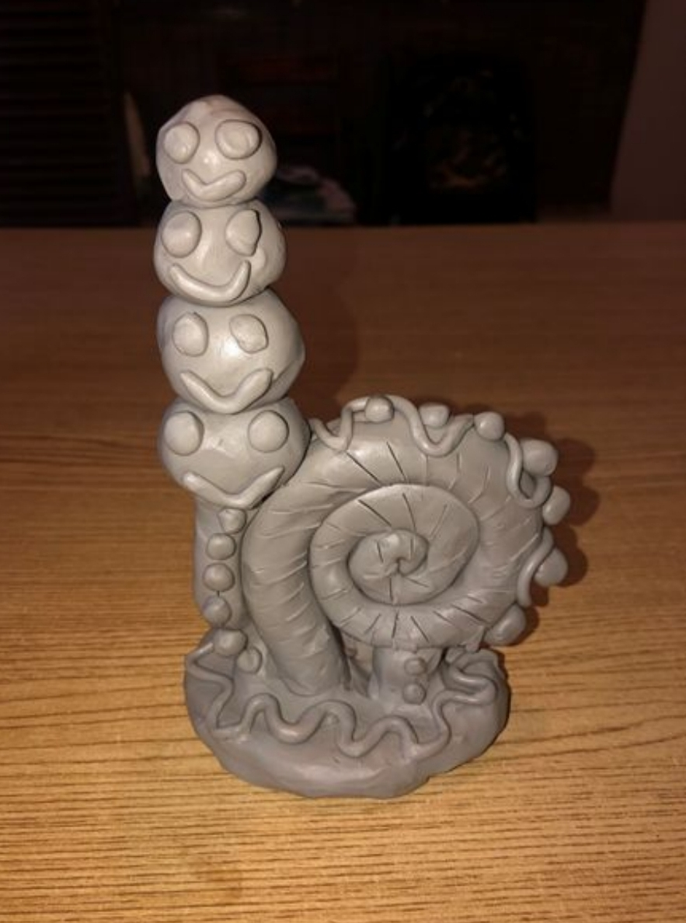
Imaginary Friend

Slide 33

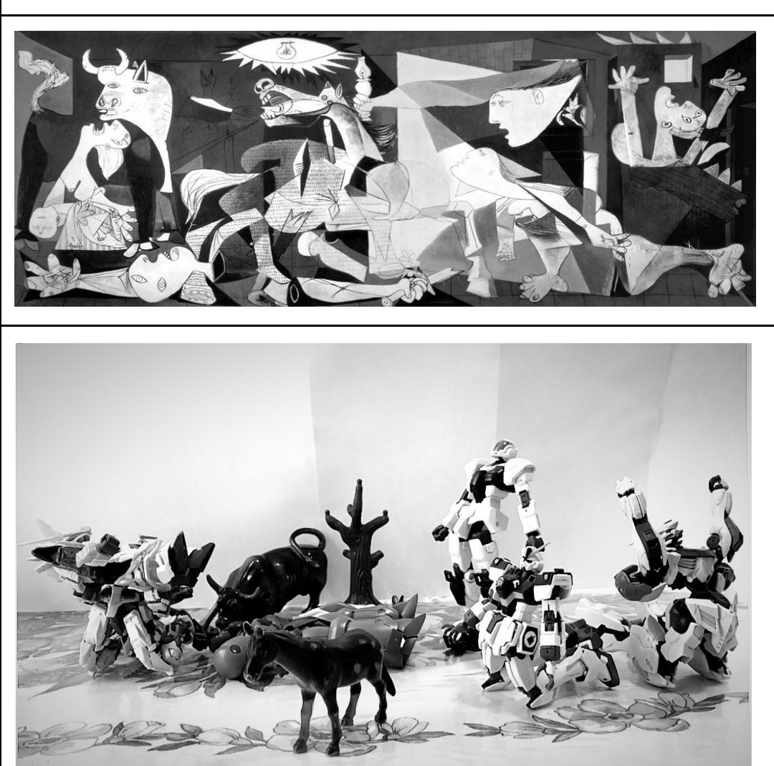
Getty Challenge

Slide 34
Kimberly Ramos, Visual Arts Educator (2)
What did I discover?
  Challenges
Lesson design and planning
  Artistic Processes: creating, presenting, responding, connecting
How I evolved…

Slide 35
Reflections from arts teachers doing synchronous and asynchronous teaching…
All students need to have similar platforms.
Teachers need a student account so we can experience our lessons the same way our students do.
Plan on 6 hours of prep for each hour of content.
We need to teach [and model] digital responsibility – not just citizenship – basics like:
  Check email daily.
  Actually respond to email.
  Proofread before clicking ”send.”
  Read the directions.

Slide 36
Considerations for moving forward (1)
Enabling student choice is effective and critical.
Balance flexibility and understanding with accountability and expectations.
Co-teaching/teaching collaboratively is useful/needed to support synchronous online learning.
Sufficient practice (rehearsal) of instruction enables fluid and well-implemented instruction.
Students need to be taught how to use a tool, before actually using the tool – demo videos and tutorials are needed.

Slide 37
Considerations for moving forward (2)
Establishing relationships and systems that enable timely constructive, critical feedback in conjunction with positive feedback and encouragement
Preventing and responding to feelings of isolation – especially in traditional ensemble settings that may now be individual practice and work
Experimentation, reflection, and patience is vital for innovation – we need space to try, augment, and adapt

Slide 38

R. Duckworth, Music Teacher, Colton Joint Union School District
“The problem isn’t a lack of ideas. The problem is too many ideas. It’s not that we need more training, but rather the time to figure out what’s really effective. This whole Distance Learning thing was really an exercise in crisis management. If we knew now that we would be doing this again in the fall, I could probably create a very successful sequence of lessons. But not knowing what the fall will look like means having to wait to implement anything and risking another semester of crisis teaching.”

Slide 39
Discipline specific networks and resources to support teachers

Slide 40
The California Arts Project (TCAP) Resources (1)
Summer 2020 Upcoming ‘From a Distance’ Virtual Offerings
  TCAP’s Conversations with California Artists, Creatives, & Educators
  TCAP’s Latin Music Initiative, summer webinars
  TCAP’s Arts Standards Webinars
  Regional and Statewide Arts Education Networks and Communities of Practice
  New Arts Education Framework Update
  Customized district or school-based professional learning supporting arts education

Slide 41
The California Arts Project (TCAP) Resources (2)
Upcoming 2021 Professional Learning
  TCAP’s 14th Courageous Creativity Conference
  TCAP’s Summer of Studios

Slide 42
CCSESA Arts Initiative
Resources (1)
Resources available at ccsesaarts.org
Creativity at the Core Professional Learning Modules: Module 2 focuses on Distance Learning
Publications such as Counties on the Move: Arts Education for All Students, and Culturally and Linguistically Responsive Arts Learning in Action
Rural Arts Initiative which highlights strategic plans and successes
District Spotlights of school districts who are building momentum in arts education
Resources, guides, and lessons

Slide 43
CCSESA Arts Initiative
Resources (2)
Professional Learning
State, regional, and county professional learning opportunities, colloquia, conferences, and events
Creativity at the Core: Annual summer institute
Insider’s Guide to Arts Education Planning

Slide 44
Examples of County Office of Education Support
Humboldt COE: Create Humboldt & Arts and Creativity Initiative
Fresno COE: Wednesday statewide arts resources posted
San Bernardino CSS: SBCSS Fall Arts Virtual Festival in Dance, Media Arts, Music, Theatre, and Visual Arts.
Riverside COE: Arts Webinars for teachers and administrators
Orange County DOE: disciplinary bi-monthly Zoom network meetings
San Diego COE: Arts Leadership Community in partnerships with SouthCAP

Slide 45
Additional resources & supports
Arts Standards Webinar Series produced by CDE https://bit.ly/31mFrVY [Link no longer available]
California Art Education Association (CAEA)
California Dance Education Association (CDEA)
California Educational Theatre Association (CETA )
California Music Educators Association (CMEA)

Slide 46
For questions or to get more information on future webinars, please contact us at:
DistanceLearning@cde.ca.gov ​
Visit our Distance Learning web page at: https://www.cde.ca.gov/ci/cr/dl/index.asp
For weekly email updates from the California Department of Education, send a blank email to:​
join-covid19-update@mlist.cde.ca.gov​

Slide 47
Long description text
Title: Social Emotional Learning
Description: The relationships between social and emotional learning (SEL) competencies and contexts are represented by the Collaborative for Academic, Social, and Emotional Learning as a “wheel” which places SEL at the center, or hub, surrounded by five core competencies, self-awareness, self-management, responsible decision-making, relationship skills, and social awareness (represented as “spokes”). Wrapped around the five core competencies are the “where” and “how” SEL can be taught: in classrooms, through SEL curriculum and instruction; in schools, through schoolwide practices and policies; and in homes and communities, through family and community partnerships.
Return to Slide

