Slide 1

Virtual Support Circle for Educators During COVID-19

Slide 2
Welcome
Dr. Stephanie Gregson
Chief Deputy Superintendent of Public Instruction

Slide 3
Opening Remarks
Tony Thurmond,
State Superintendent of Public Instruction

Slide 4
Educator Voices
Educator Voices
Juan Garibay: Education Support Professional, Newhall Unified School District
Jose Alcala: Alternative High School History/Social Studies Teacher, Moreno Valley Unified School District
Brannin Dorsey: 1st Grade Teacher, Fremont Unified School District
Sarah Robinson: High School Spanish Teacher, Redondo Beach Unified School District

Slide 5
Online Resources (1)
California Teachers Association
  https://www.cta.org/for-educators/covid19
California Federation of Teachers
  https://www.cft.org/covid-19
Employee Assistance Program (EAP)
  Consult with your local Human Resources department

Slide 6
Online Resources (2)
CFIRD Distance Learning web page
  https://www.cde.ca.gov/ci/cr/dl/
CDE COVID-19 web page
  https://www.cde.ca.gov/ls/he/hn/coronavirus.asp
CDE Coronavirus (COVID-19) webinars
  https://www.cde.ca.gov/ls/he/hn/covid19webinars.asp

Slide 7



California Teacher of the Year 2020
Mandy Kelly: 6th Grade Teacher in Saddleback Valley Unified School District
The SEAKers!
@the_seakers

Slide 8
Prioritizing the Wellness of Self
Mara Madrigal-Weiss, Director
Student Wellness &
Positive School Climate and
Foster and Homeless Youth Education Programs
San Diego County Office of Education

Slide 9
More than Educators, We are….
Parents
Caregivers
Spouses
Sons
Daughters
Siblings
Aunts
Uncles
Friends
Colleagues
Mentors
Neighbors

Slide 10
Survey Says…
Anxious
Fearful
Worried
Overwhelmed
Sad
Yale Center for Emotional Intelligence and CASEL

Slide 11
As Time Goes On….
Unsafe
Lack of control
Hopelessness
Powerlessness
Confusion
Grief

Slide 12
What We Need To Feel Most
A sense of safety
Connectedness
Balance
Hope

Slide 13
Strategies to Promote Wellness
Psychological Regulation
  Mindful breathing
  Positive Self-Talk
Positive relationships
Engaging in joyful activities
Self-Care
  Sleep, Nutrition, Movement
Practicing gratitude
Practicing forgiveness
Adapted from the of work of Marc Brackett, Yale Center for Emotional Intelligence

Slide 14
Self-Compassion
Self –
Kindness
Common
Humanity
Mindfulness
Extending kindness and understanding to oneself rather than harsh self-criticism and judgment.
Seeing one’s experiences as part of the larger human experience rather than as separating and isolating.
Holding one’s painful thoughts and feelings in balanced awareness rather than over-identifying with them.
Based on work by Kristin Neff. Self and Identity

Slide 15
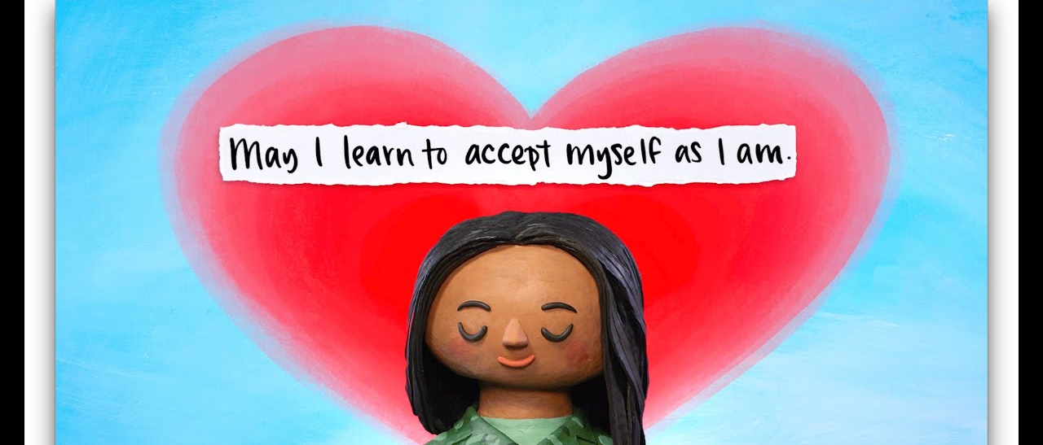
Self Compassion Break
https://youtu.be/AyQdeYjXUhE

Slide 16
Activity Steps 1–3
STEP 1 - Think of a situation that is causing you pain, stress, or fear
STEP 2 - See if you can feel the sensation of the emotion in your body—shoulders, back, stomach, muscles...
STEP 3 - Say to yourself: “This is a moment of suffering”- Notice what is going on without judgment if it’s good or bad- It just is.- Say whatever you feel: “This hurts”- “This is stress”- “This sucks”- Whatever feels right for you

Slide 17
Activity Steps 4–5
STEP 4 - Say to yourself: “Suffering is a part of life”- Here it is important to recognize common humanity with others- You can say: “Other people feel this way- “I am not alone”- We all have struggles in our lives”
STEP 5 - Put your hands over your heart- Feel the warmth- Tell yourself: “May I be kind to myself”- Express self-kindness- May “I give myself the compassion I need”- “May I learn to accept myself as I am”- “May I be strong”- Whatever feels right for you

Slide 18

Final Thoughts…
Remember your HUGS.
Do everything with:
Humility
Understanding
Grace & in a spirit of
Service

Slide 19
Resources - Websites for Well-Being
Self-Compassion.org https://self-compassion.org/
Greater Good Science Center https://greatergood.berkeley.edu/
Mindful Schools https://www.mindfulschools.org/
Pixel Thoughts https://www.pixelthoughts.co/

Slide 20
Resources - Apps for Well-Being
Calm https://www.calm.com/
Chill https://apps.apple.com/us/app/chill-mindfulness-inspiration/id986509491
Happify https://apps.apple.com/us/app/happify-for-stress-worry/id730601963
Insight Timer https://insighttimer.com/
Peak https://apps.apple.com/us/app/peak-brain-training/id806223188

Slide 21

Thank you!

Slide 22
Thank you!
Please let us know how we can continue to support you and your families at COVID19@cde.ca.gov

Slide 23
Posted by the California Department of Education | May 2020

