Slide 1
Universal Design for Learning (UDL) in a Distance Learning Environment
Partner(s):
California UDL Coalition
James McKenna, Los Angeles County Office of Education
Sung Park, Santa Clara County Office of Education
Kelly Wylie, Santa Clara County Office of Education
April 24, 2020

Slide 2
Today’s (Short) Journey
How:
UDL Framework & UDL Guidelines
What and Why:
Overview of UDL
What UDL is and is not:
Foundational Concepts
Putting It All Together:
UDL & Distance Learning

Slide 3
What and Why
Overview of UDL

Slide 4
Today’s (Short) Journey: What and Why
How:
UDL Framework & UDL Guidelines
What and Why:
Overview of UDL
What UDL is and is not:
Foundational Concepts
Putting It All Together:
UDL & Distance Learning

Slide 5
What is UDL?
Universal design for learning (UDL) is a framework to improve and optimize teaching and learning for all people based on scientific insights into how humans learn.

Slide 6
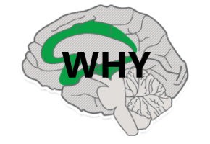
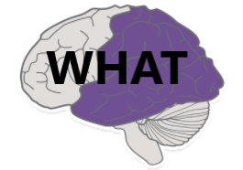
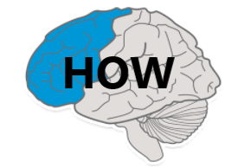
UDL Networks
Affective
Recognition
Strategic

Slide 7
Learner Variability
There is no single way a human brain will engage with, perceive, or act upon a task.
Variability is predictable.
What we can predict, we can plan for.

Slide 8
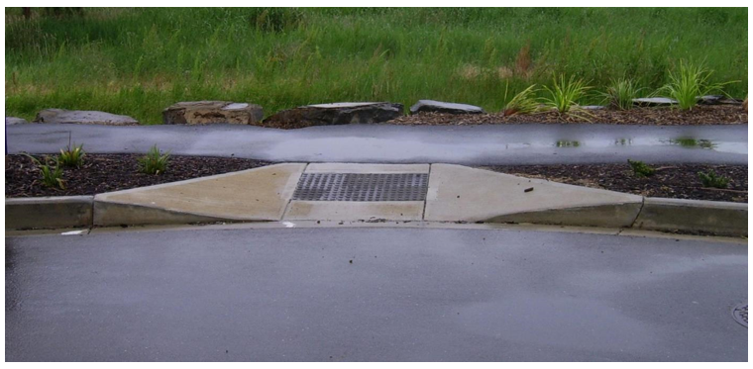
Curb-Cut Effect

Slide 9
What UDL is and is not
Foundational Concepts and Myth-Busting

Slide 10
Today’s (Short) Journey: What UDL is and is not
How:
UDL Framework & UDL Guidelines
What and Why:
Overview of UDL
What UDL is and is not:
Foundational Concepts
Putting It All Together:
UDL & Distance Learning

Slide 11
Universal Design for Learning is...
a lens, not a checklist
a marathon, not a sprint
a journey, not a destination
standards-based, not standardized

Slide 12
MYTHBUSTERS

Slide 13
Myth vs Reality (1)
MYTH
“UDL is just good teaching."
REALITY
Good teaching is subjective.
UDL is an organized framework based on neuroscience and education psychology.

Slide 14
Myth vs Reality (2)
MYTH
“I do all of this already.”
REALITY
You may employ a strategy that could be coherent with UDL, but UDL requires intent, deliberate practice, and consistency.

Slide 15
Myth vs Reality (3)
MYTH
“I have to make individual lessons for every student.”
REALITY
Supports set for some can benefit all.
Students need opportunities for self-reflection and strategic thinking.

Slide 16
Myth vs Reality (4)
MYTH
"Barriers to learning exist in students."
REALITY
Barriers exist in designs.
Variability is only a liability if our designs fail to account for it.

Slide 17
UDL Framework & UDL Guidelines
How

Slide 18
Today’s (Short) Journey: How
How:
UDL Framework & UDL Guidelines
What and Why:
Overview of UDL
What UDL is and is not:
Foundational Concepts
Putting It All Together:
UDL & Distance Learning

Slide 19
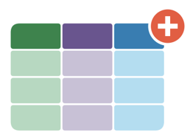


The UDL Framework
Set Clear, Rigorous Goals
Anticipate Barriers
Design Options

Slide 20
Set Clear, Rigorous Goals
Clear Goals, Flexible Means
Goals should be flexible
–avoid including the “how.”
Goals should be clear and discreet –only one goal at a time.
Goals should be rigorous!

Slide 21
Clarified Goals
UDL is not about lowering expectations.
It’s about clarifying them!

Slide 22
Anticipate Barriers
Where/What can we anticipate that students will find difficult?
Why is that problem occurring?

Slide 23
Design Options
Design options to address barriers
Engagement Options
Representation Options
Action & Expression Options

Slide 24
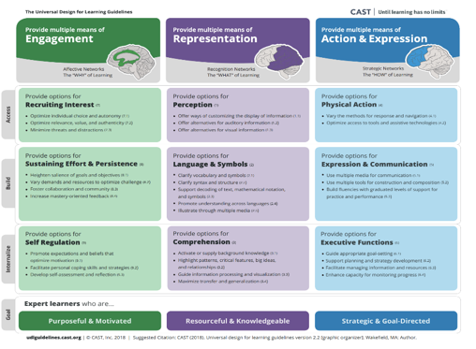
The UDL Guidelines
The interactive UDL Guidelines can be found at http://udlguidelines.cast.org/.

Slide 25

Goals of UDL

Slide 26
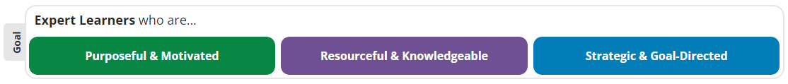
The Goal of Universal Design for Learning
Teach students how to learn, not just what to learn.

Slide 27
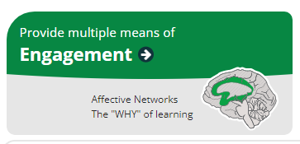
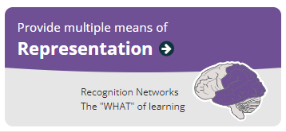
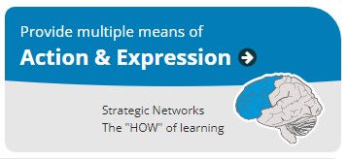
Teaching Students How to Learn
How will students engage?
How will students perceive?
How will students act on their understanding?

Slide 28
More on the UDL Guidelines

Slide 29
Access - Provide Multiple Means of Engagement
Provide options for Recruiting Interest (7)
Optimize individual choice and autonomy (7.1)
Optimize relevance, value, and authenticity (7.2)
Minimize threats and distractions (7.3)

Slide 30
Access - Provide Multiple Means of Representation
Provide options for Perception (1)
Offer ways of customizing the display of information (1.1)
Offer alternatives for auditory information (1.2)
Offer alternatives for visual information (1.3)

Slide 31
Access - Provide Multiple Means of Action & Expression
Provide options for Physical Action (4)
Vary the methods for response and navigation (4.1)
Optimize access to tools and assistive technologies (4.2)

Slide 32
Build - Provide Multiple Means of Engagement
Provide options for Sustaining Effort & Persistence (8)
Heighten salience of goals and objectives (8.1)
Vary demands and resources to optimize challenge (8.2)
Foster collaboration and community (8.3)
Increase mastery-oriented feedback (8.4)

Slide 33
Build - Provide Multiple Means of Representation
Provide options for Language & Symbols (2)
Clarify vocabulary and symbols (2.1)
Clarify syntax and structure (2.2)
Support decoding of text, mathematical notation, and symbols (2.3)
Promote understanding across languages (2.4)
Illustrate through multiple media (2.5)

Slide 34
Build - Provide Multiple Means of Action & Expression
Provide options for Expression & Communication (5)
Use multiple media for communication (5.1)
Use multiple tools for construction and composition (5.2)
Build fluencies with graduated levels of support for practice and performance (5.3)

Slide 35
Internalize - Provide Multiple Means of Engagement
Provide options for Self Regulation (9)
Promote expectations and beliefs that optimize motivation (9.1)
Facilitate personal coping skills and strategies (9.2)
Develop self-assessment and reflection (9.3)

Slide 36
Internalize - Provide Multiple Means of Representation
Provide options for Comprehension (3)
Activate or supply background knowledge (3.1)
Highlight patterns, critical features, big ideas, and relationships (3.2)
Guide information processing and visualization (3.3)
Maximize transfer and generalization (3.4)

Slide 37
Internalize - Provide Multiple Means of Action & Expression
Provide options for Executive Functions (6)
Guide appropriate goal-setting (6.1)
Support planning and strategy development (6.2)
Facilitate managing information and resources (6.3)
Enhance capacity for monitoring progress (6.4)

Slide 38
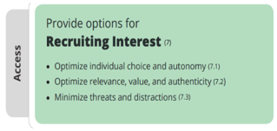
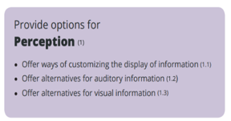
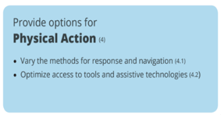
Starting Small—Access

Slide 39
Putting It All Together
UDL & Distance Learning

Slide 40
Today’s (Short) Journey: Putting it All Together
How:
UDL Framework & UDL Guidelines
What and Why:
Overview of UDL
What UDL is and is not:
Foundational Concepts
Putting It All Together:
UDL & Distance Learning

Slide 41
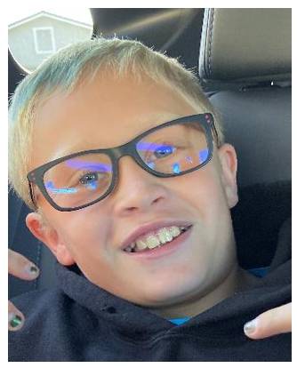
Meet Alex….
Alex is a 4th grader with two older siblings at home also doing distance learning, with only one computer to share, he does have smartphone access.
Alex has anxiety about not having direct access to his teacher and classmates. He is greatly concerned that he is going to do the assignments wrong.
Alex is creative and enjoys assignments that allow him to use his creativity while not requiring a lot of writing.

Slide 42
Alex’s Week in Distance Learning
Learning Goal: This week students will explore California’s transformation from the early statehood to present day. Students will demonstrate their knowledge of California’s resources and what has influenced the growth of the state over time.
Standard: History/Social Science 4.4 – Students explain how California became an agricultural and industrial power, tracing the transformation of the California economy and its political and cultural development since the 1850s.

Slide 43
How
Students can access the material through:
Their textbook
Curated videos
Audio clips
Authentic documents
Virtual field trips

Slide 44
What (1)
Students have been provided with:
Tier 2 & 3 vocabulary words/definitions
Opportunities to make connections amongst the influences on the transformation of CA’s economy

Slide 45
Why (1)
Alex’s teacher has:
Provided multiple means for students to demonstrate their understanding
Built-in checkpoints throughout the lesson for students to monitor their progress towards the learning goal

Slide 46

Meet Gabi….
Gabi is a junior in high school and a recently redesignated English learner.
Gabi is hoping to go to nursing school, so she is taking advanced placement math and science.
Gabi agonizes over maintaining her perfect GPA. She gets anxious when her teachers assign group projects and/or projects that require creativity.

Slide 47
Gabi’s Week in Distance Learning
Learning Goal: Using a model, students will illustrate mitosis in complex organisms. Students are encouraged to work with a virtual lab partner, but may also complete it individually. Examples of illustration may simply be labeling the events of mitosis, may be a hand-drawn or computer-generated mitosis model, a written report, or another medium of the student’s choosing.
Standard: HS-LS1-4. Use a model to illustrate the role of cellular division (mitosis) and differentiation in producing and maintaining complex organisms.

Slide 48
How (2)
Students can access the material through:
Their textbook
Curated videos
Audio clips
Virtual lab experiments that demonstrate mitosis
Students were given clarification as to how to “illustrate” their understanding of mitosis.

Slide 49
What (2)
Students have been provided with:
Tier 2 & 3 vocabulary words/definitions
A model of a complex organism

Slide 50
Why (2)
Gabi’s teacher has:
Provided multiple means for students to demonstrate their understanding
Built-in checkpoints throughout the lesson for students to monitor their progress towards the learning goal

Slide 51
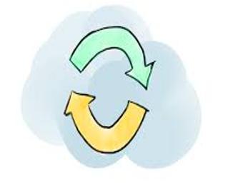
Importance of Mastery Feedback
Needs to be timely and frequent
Needs to be informative
Should emphasize effort, improvement, and achieving a standard rather than on relative performance

Slide 52

Takeaways
Methods, materials, and assessments need to be flexible.
Design to the edges – the average learner is a myth.
Start small – it’s a journey, not the destination.
It’s the environment that needs to change, not the students.

Slide 53
For Additional Resources
TinyURL.com/UDL424 [Link no longer available]

Slide 54
Posted by the California Department of Education
May 2020

