Slide 1
PROMOTING EQUITY AND ACCESS THROUGH CAREER TECHNICAL EDUCATION Prepared for: California Workforce Pathways Joint Advisory Committee Posted by: California Department of Education September 2019
Untapped Provider of Professional Learning – www.jspac.org

Slide 2
Professional Learning
Researchers note that EFFECTIVE professional learning programs are:
content-focused,
support collaboration, and job-embedded practice.
Darling-Hammond, Hyler, et al. 2017; Kraft, Blazar, and Hogan 2018; OECD 2019)

Slide 3
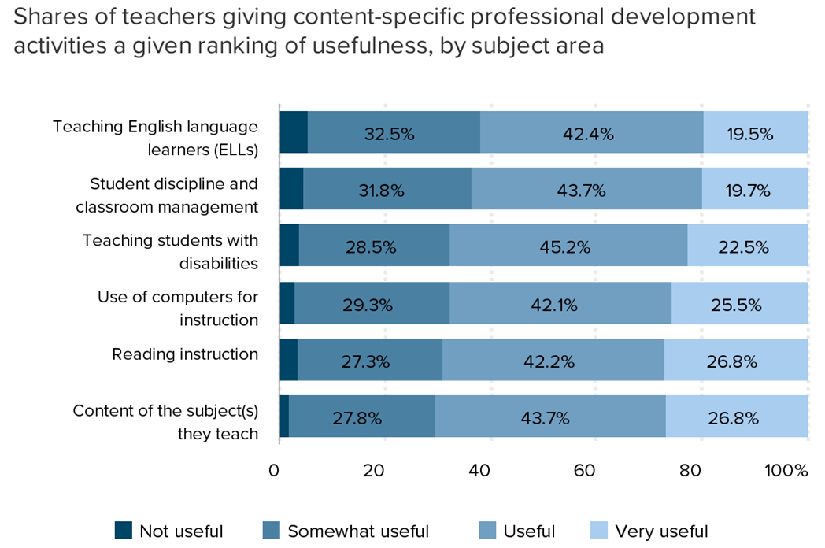
Low shares of teachers find professional development “very useful”

Slide 4
National Alliance for Partnerships in Equity (NAPE)
State affiliation funded through Perkins Leadership Grant
State membership representation on the executive committee and foundation board from Chancellor’s Office and Department of Education: Carolyn Zachary, Mary Wiberg, Judith D’Amico
Instrumental in ensuring special populations was included in Perkins 5
NAPE Educational Model provides a framework for professional learning
Participation in focus groups that influence future equity summits

Slide 5
Statewide Professional Learning
Cohesively integrates cultural responsiveness, equity, and diversity
Emphasizes a broader movement in secondary and post-secondary
Deeper attention to professional learning and training for practitioners to address disparities or gaps related to special populations
Multiple delivery modalities: in person (annual conferences) and online (webinars)

Slide 6
JSPAC & State Collaborative Equity Professional Learning = F.A.S.T.
Frameworks to effectively teach students, particularly special populations, which also includes second chance students (Universal Design for learning, behavioral interventions and support).
Advance knowledge and skills to improve instruction and pedagogical/andragogical practices for special populations and personal growth.
Support implementation strategies to improve student achievement and close the opportunity gaps in participation and performance.
Technical assistance (data disaggregation) on how to close gaps in student participation and performance in CTE Programs.

Slide 7
F.A.S.T.
Engages/
Re-engages
Supports Accountability
Increases Direct Focus
Notes:
Engages/Re-engages opportunity for participation and performance in CTE for historically, underserved and Special Populations
Supports Accountability in Perkins V ensuring all CTE Students have equitable access and skills necessary for in-demand occupations with high growth industry sectors
Increase direct focus on serving underserved /special populations including second chance students

