Slide 1
Universal PreKindergarten (UPK) Implementation
Office Hour
Early Education Division (EED)
March 23, 2022

Slide 2
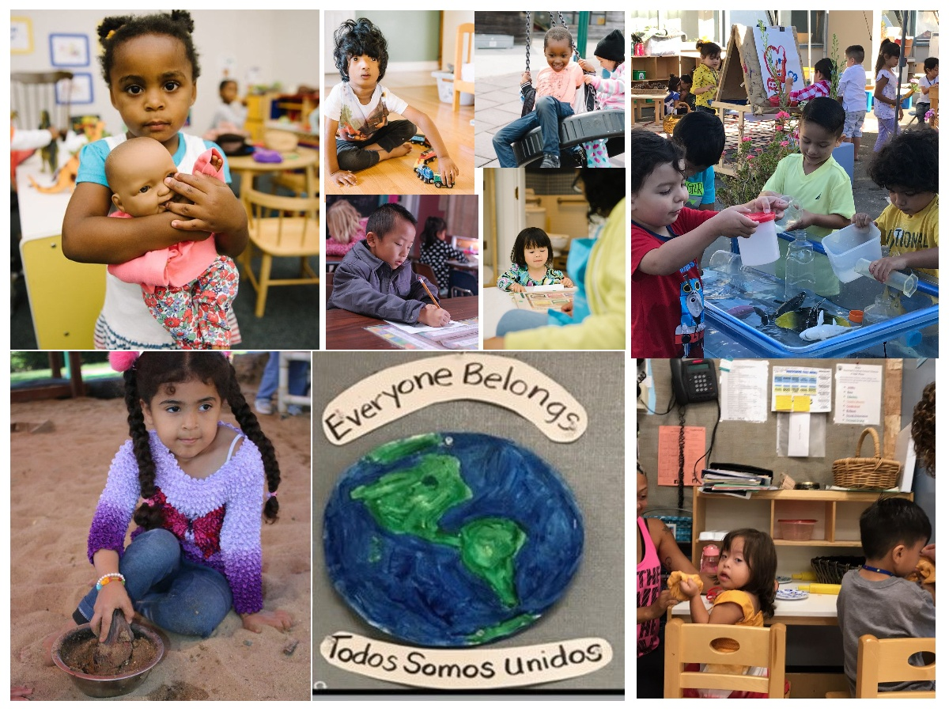
Welcome and Introductions

Slide 3
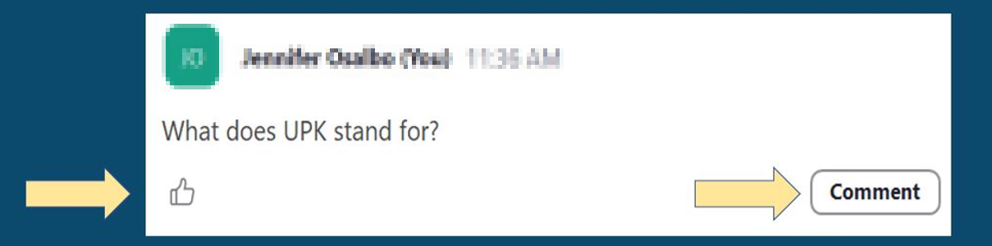
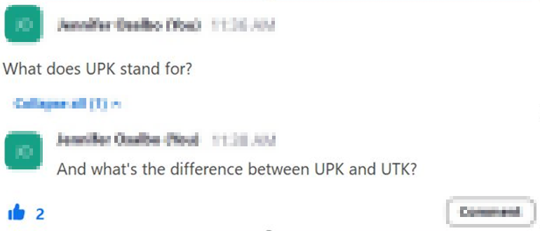
Asking Questions and Upvoting

Slide 4
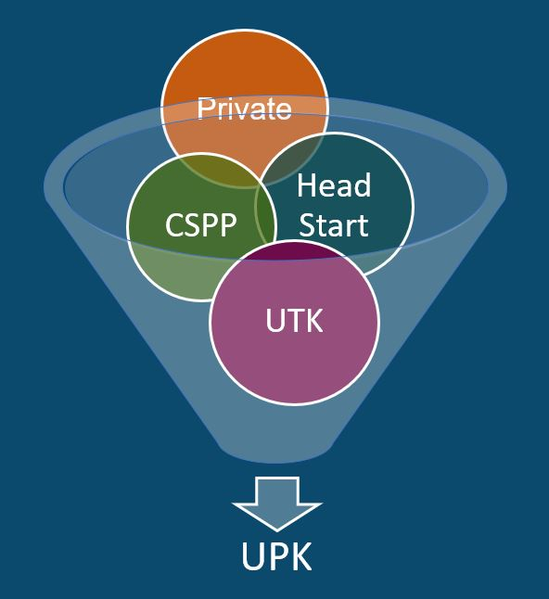
What is UPK?
UPK will bring together programs across early learning and K-12, relying heavily on Universal Transitional Kindergarten (UTK) and California State Preschool Program (CSPP), as well as Head Start, community-based organizations (CBOs), and private preschool.
Universal means that by 2025–26,
regardless of background, race, zip code, immigration status, or income level – every child– has access to a quality learning experience the year before Kindergarten.

Slide 5
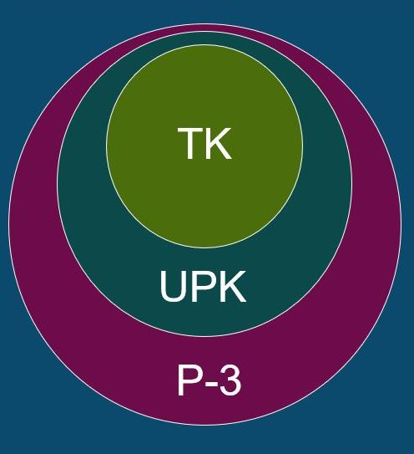
How Do Transitional Kindergarten (TK),
UPK, and PreKindergarten through Third grade (P-3) Alignment Work Together?
TK is an integral program in the mixed delivery system for achieving UPK. It will be the only program that must serve any four-year-old child that wants to enroll by 2025–26.
UPK is a mixed-delivery system of UTK, CSPP, Head Start, expanded learning, private providers, and more. It provides every four-year-old child access to high-quality learning the year before Kindergarten.
P-3 Connects UPK with Kindergarten, First, Second, and Third grade. It aligns developmentally informed best practices, UPK–Third grade.

Slide 6
California’s P-3 Vision
Through our P-3 Alignment Approach we can:
  Give Children a Strong Start through equitable access to effective early education programs.
  Focus on PreK – Third Grade Educators to ensure schools, teachers, and staff are prepared and supported to guide every child’s social, emotional, and academic development through inclusive, joyful, and culturally and linguistically affirming programs from PreK to Third grade.
  Equip Education Leaders at the County, District, and School Level with a deep knowledge and understanding of early education and organizational strategies that support meaningful alignment from PreK to Third grade.
  Empower and Support Families as children’s first and most important teachers, bolster resources and opportunities for families in community programs and schools, and empower families as valued, supported, and well-informed partners.
Intentionally aligning this work helps early investments endure through children’s lives.

Slide 7
UPK Templates and Guidance
The California Department of Education (CDE) has released references on the https://www.cde.ca.gov/ci/gs/em/
  1. Local educational agency (LEA) Planning Template from December
    Outlines the data that will be required for submission to the CDE to meet the requirements of EC 8281.5 through a survey after June 30, 2022
    Provides additional deep planning questions for LEAs
  2. UPK Planning and Implementation Guidance Volume 1 from February
    Corresponds to the template and introduces early education concepts, research, resources, programs, partnership opportunities, and policies
  3. County Office of Education (COE) Countywide Planning and Capacity Template – coming soon
    Includes data that will be required for COE submission
    Provides planning questions on how COEs will support LEAs

Slide 8
Full-Day Programs That Meet Family Needs
Statute requires LEAs to plan how children in their attendance area will have access to full-day programs the year before Kindergarten that meet family needs
These needs can be met through a variety of programs providing rich early learning and care, including TK, CSPP, Head Start, other early learning and care programs, expanded learning, private preschool, and more
Having different UPK models builds capacity to provide high-quality programs to support child outcomes, and allows families meaningful choice while also providing equitable opportunities

Slide 9
Live Questions and Answers (Q&A)

Slide 10
Closing and Next Steps
  Inbox for questions and comments: UPK@cde.ca.gov
  We will post this webinar: https://www.cde.ca.gov/ci/gs/em/
We look forward to more opportunities to discuss
the implementation of UPK!
Thank you!

