Slide 1
Universal PreKindergarten (UPK) Implementation
Office Hour
Early Education Division (EED)
June 22, 2022

Slide 2

Welcome and Introductions

Slide 3
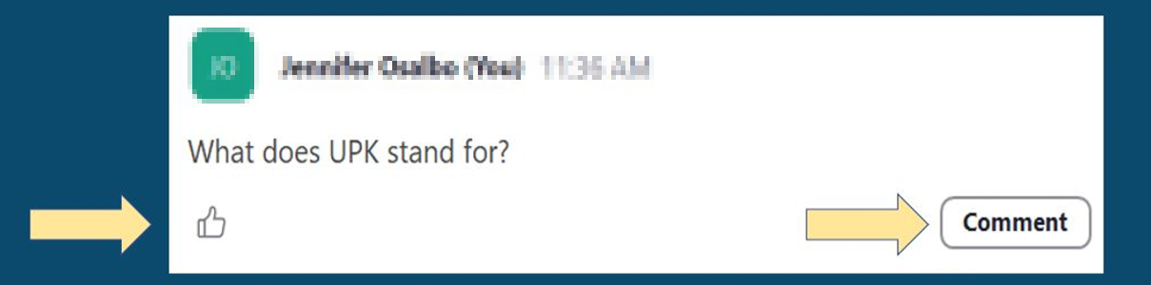
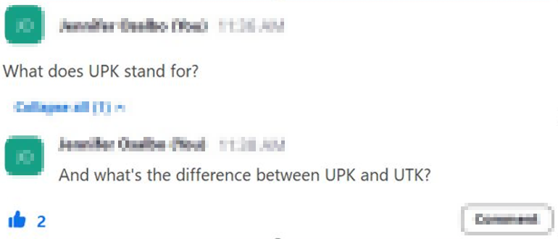
Asking Questions and Upvoting

Slide 4
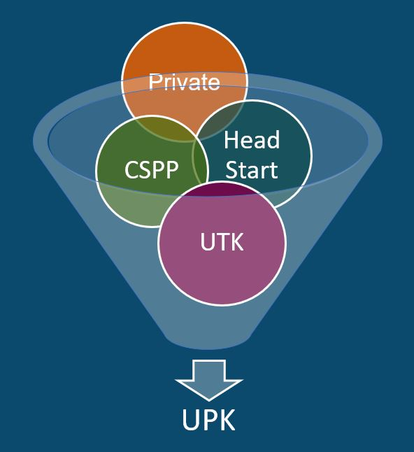
What is UPK?
UPK will bring together programs across early learning and K-12, relying heavily on Universal Transitional Kindergarten (UTK) and California State Preschool Program (CSPP), as well as Head Start, community-based organizations (CBOs), and private preschool.
Universal means that by 2025–26,
regardless of background, race, zip code, immigration status, or income level – every child– has access to a quality learning experience the year before Kindergarten.

Slide 5
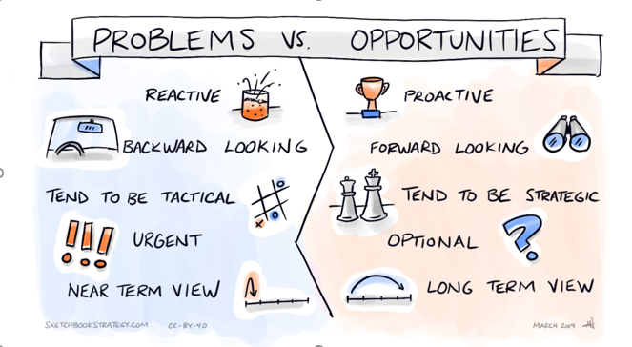
Problems versus Opportunities
Reactive vs. Proactive
Backward looking vs. Forward looking
Tend to be Tactical vs. Tend to be Strategic
Urgent vs. Optional
Near Term View vs. Long Term View
Image Credit: Sketchbookstrategy.com, CC-BY-40, March 2019

Slide 6

Elephants and Rumors
Districts don’t actually need to plan for UPK (rumor)
All TK classroom must be 1350 square feet (rumor)
Most unserved students reside in districts that don’t offer TK (rumor)
Image Credit: https://artprojectsforkids.org/elephant-tutorial/

Slide 7
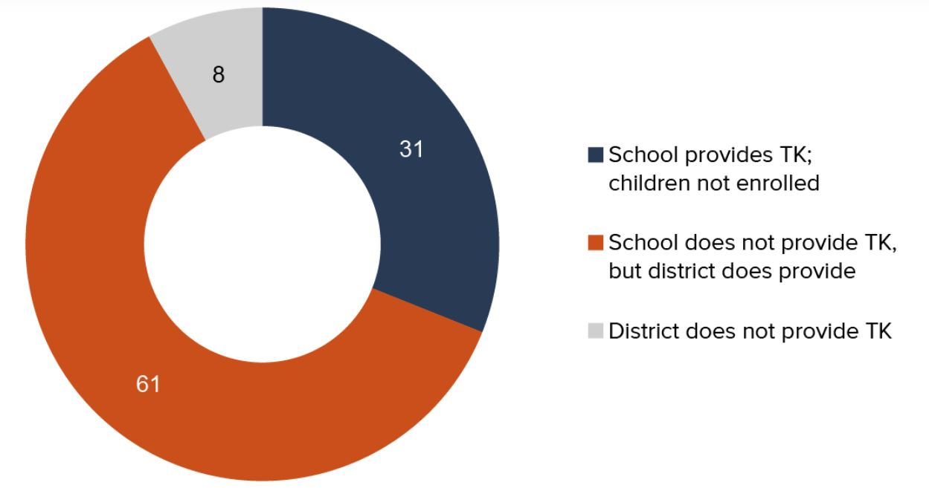
Most unserved children attend a school that does not offer TK, even though their district offers TK
Setting the Stage for Universal Preschool: Is Transitional Kindergarten Serving Students Equitably? by Laura Hill and Emmanuel Prunty. Supported with funding from the Sobrato Family Foundation. Long description of graph on slide 17.

Slide 8

New Proposed Investments in UPK Implementation
Photo Credit: Kidango Decoto Center; Union City, CA

Slide 9
Universal Transitional Kindergarten (UTK)
Funds the first year of TK expansion to expand eligibility for TK to all children turning five-years-old between September 2 and February 2.
Funding to support an additional educator in TK classrooms
Includes fiscal penalties for not meeting TK class size, ratio, and teacher requirements
Requires TK data to be collected separately from kindergarten data.
Includes additional $300 million one-time Proposition 98 (P98) general funding (GF) for Prekindergarten Planning and Implementation Grants
$650 million additional for the Preschool, TK, and Full-Day Kindergarten Facility Program
Adopts the Governor’s proposal for ELOP funding ($4.4 billion ongoing)

Slide 10
California State Preschool Program (CSPP)
Increases support for inclusive preschool classrooms
Invests in family choice and program stability
Supports programs to serve younger children
Supports programs to better serve dual language learners
Increase Reimbursement Rates to the 85th percentile

Slide 11

Live Questions and Answers (Q&A)

Slide 12
Closing and Next Steps
  Inbox for questions and comments: UPK@cde.ca.gov
  We will post this week's slides on: https://www.cde.ca.gov/ci/gs/em/
We look forward to more opportunities to discuss
the implementation of UPK!
Thank you!

Slide 13
UPK Resources
California Educators Together:
  https://www.caeducatorstogether.org/groups/e0cfjrjf/upk-p-3
UPK Resources:
  https://www.cde.ca.gov/ci/gs/em/
UPK FAQs:
  https://www.cde.ca.gov/ci/gs/em/kinderfaq.asp
UPK Office Hour:
  https://www.cde.ca.gov/ci/gs/em/upkofficehours.asp
System of Support for Expanded Learning:
  https://www.cde.ca.gov/ls/ex/sosexplearncontacts.asp
K-12 Omnibus Trailer Bill:
  https://esd.dof.ca.gov/trailer-bill/public/trailerBill/pdf/527 [Link no longer available]

Slide 14
Expanded Learning Opportunities Program (ELO-P) Resources
ELO-P Main Page:
  https://www.cde.ca.gov/ls/ex/elopinfo.asp#elopfaqs
ELO-P Program Plan Guide:
  https://www.cde.ca.gov/ls/ex/documents/elopprogplanguide.pdf
ELO-P FAQs:
  https://www.cde.ca.gov/ls/ex/elofaq.asp
ELO-P Fireside Chats:
  https://www.afterschoolnetwork.org/elo-program
ELO-P Email Box:
  ExpandedLearning@cde.ca.gov

Slide 15
Facilities Resources
Access California Preschool, Transitional, Kindergarten and Full-Day Kindergarten Facilities Grant Program Funding (FDK grant program)
  https://www.dgs.ca.gov/OPSC/Services/Page-Content/Office-of-Public-School-Construction-Services-List-Folder/Access-Full-Day-Kindergarten-Facilities-Grant-Program-Funding
  Facilities Contacts:
  Joshua Potter
    Phone: 279-946-8454
    E-mail: Joshua.Potter@dgs.ca.gov
  Lindsey Gordon
    Phone: 279-946-8458
    E-mail: Lindsey.Gordon@dgs.ca.gov

Slide 16
Image long descriptions

Slide 17
Circle graph on slide 7
Image of a circle graph with a white circle in the center and color on the outer edge representing the percentages of Transitional Kindergarten children enrolled. Graph show a portion of the circle color in orange with the number 61. The color blue with the number 31 and the color grey with the number 8. Next to the circle graph, square bullets in blue for, schools provides TK; children not enrolled. Orange for, schools does not provide TK, but district does provide, and grey for, district does not provide TK. Return to slide 7

