Slide 1
Welcome and Introductions

Slide 2
Elephants and Rumors
All local educational agencies (LEAs) and county offices of education (COEs) receiving the 2022–23 Universal Prekindergarten (UPK) Planning and Implementation (P&I) Grant must develop a new plan to be presented for consideration by the governing board or body at a public meeting on or before March 30, 2023.
The 2022–23 UPK P&I Grant allocations replace the allocations from the 2021–22 UPK P&I Grant.

Slide 3
2022–23 UPK P&I Grant
UPK Plans
LEAs that did not develop the plan required for the 2021–22 UPK P&I Grant, are required to develop a plan for the 2022–23 UPK P&I Grant.
This plan must be presented for consideration by the governing board or body at a public meeting on or before March 30, 2023.
Updated UPK Program Templates
The UPK Program Template has been updated to: (1) offer planning and implementation questions for LEA consideration in developing a UPK Program that meet community and family needs, and (2) outline the data that will be required for submission to the CDE to meet the requirements of Education Code (EC) Section 8281.5.

Slide 4
Allowable Fund Usage
Allowable costs shall include, but are not necessarily limited to, classroom operating costs, planning costs, hiring and recruitment costs, staff training and professional development, classroom materials, and supplies.
Updates for the 2022–23 UPK P&I Grant now include classroom operating costs.
Cover costs associated with expanding Transitional Kindergarten (TK) age eligibility faster than required by law
All funds must be spent by June 30, 2026

Slide 5
Required Reporting
UPK Program Report | UPK Expenditure Report
Annual | Semi-annual
CDE is collecting data around the required questions from the updated 2022–23 UPK Templates Next UPK Program Report due Summer 2023 | CDE is collecting expenditure data around fund use Starting with Expenditure Report #3: Expenditures from May 1, 2023, to October 31, 2023, are due to the CDE on November 30, 2023.

Slide 6
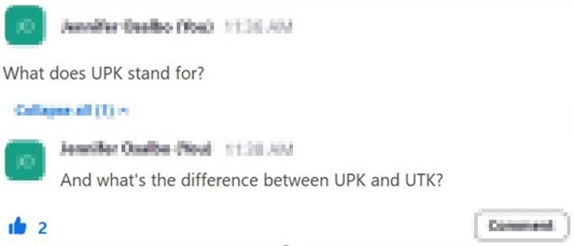
Asking Questions

Slide 7
Questions​ &​ Answers
Photo Credit: Kidango Decoto Center; Union City, CA

Slide 8
Closing and Next Steps
Inbox for questions and comments:
UPK@cde.ca.gov ​
Inbox for UPK P&I Grant questions:
UPKPlanningGrant@cde.ca.gov
We will post this week's slides on:
https://www.cde.ca.gov/ci/gs/em/upkofficehours.asp
We look forward to more opportunities to discuss ​
the implementation of UPK! ​
Thank you!​

Slide 9
UPK Resources
California Educators Together:
https://www.caeducatorstogether.org/groups/e0cfjrjf/upk-p-3
UPK Resources:
https://www.cde.ca.gov/ci/gs/em/
UPK FAQs:
https://www.cde.ca.gov/ci/gs/em/kinderfaq.asp
UPK Office Hour:
https://www.cde.ca.gov/ci/gs/em/upkofficehours.asp
System of Support for Expanded Learning:
https://www.cde.ca.gov/ls/ex/sosexplearncontacts.asp

Slide 10
Expanded Learning Opportunities Program (ELO-P) Resources
ELO-P Main Page:
https://www.cde.ca.gov/ls/ex/elopinfo.asp#elopfaqs
ELO-P Program Plan Guide:
https://www.cde.ca.gov/ls/ex/documents/elopprogplanguide.pdf
ELO-P FAQs:
https://www.cde.ca.gov/ls/ex/elofaq.asp
ELO-P Fireside Chats:
https://www.afterschoolnetwork.org/elo-program
ELO-P Email Box:
ExpandedLearning@cde.ca.gov

Slide 11
Facilities Resources
Access California Preschool, Transitional, Kindergarten and Full-Day Kindergarten (FDK) Facilities Grant Program Funding
https://www.dgs.ca.gov/OPSC/Services/Page-Content/Office-of-Public-School-Construction-Services-List-Folder/Access-Full-Day-Kindergarten-Facilities-Grant-Program-Funding
Facilities Contacts:
Joshua Potter
Phone: 279-946-8454
E-mail: Joshua.Potter@dgs.ca.gov
Lindsey Gordon
Phone: 279-946-8458
E-mail: Lindsey.Gordon@dgs.ca.gov

Slide 12
Other Resources
Program Quality Implementation (PQI) Office Regional Consultants ​
https://www.cde.ca.gov/sp/cd/ci/assignments.asp​
Consultants are most easily reached by email ​
or by phone at 916-322-6233​
Early Education and Nutrition Fiscal Services (EENFS), Fiscal Apportionment Analyst Directory​
https://www.cde.ca.gov/fg/aa/cd/faad.asp ​
Regulation Related Questions​
EEDTitle5@cde.ca.gov​

