Slide 1
2023 Educator Workforce Investment Grant Program: Computer Science Professional Learning Grant Partner Entity Request for Applications
Application Webinar Presented by the
Educator Excellence and Equity Division on
February 1, 2023

Slide 2
Housekeeping
Webinar participants have been placed on mute
Question/Answer session toward the end of the webinar
PowerPoint will be available on the California Department of Education (CDE) Educator Workforce Investment Grant (EWIG) Program: Computer Science (CS) web page

Slide 3
2023 Educator Workforce Investment Grant Program
Assembly Bill 185, Chapter 571, Statutes of 2022, Section 55 of the Education Omnibus Budget Trailer Bill provides $15 million from the General Fund for the EWIG Program: CS for allocation to one or more county offices of education (COEs). The selected grantee will become an important member of the Statewide System of Support, providing targeted support focused on strategies for providing high-quality CS instruction learning experiences aligned to California Computer Science Content Standards (CA CS Content Standards) developed pursuant to California Education Code (EC) Section 60605.4.
Grant period: May 1, 2023, through February 28, 2025.

Slide 4
Educator Workforce Investment Grant Program: Computer Science
Develop and provide professional learning to teachers and paraprofessionals in public schools serving kindergarten and grades one to twelve, inclusive
Provide high-quality instruction and CS learning experiences that support system-wide implementation of the CA CS Content Standards developed pursuant to EC Section 60605.4
In order to impact students in a variety of learning contexts throughout California, the CDE will attempt to fund an EWIG: CS Partner Entity that partners with multiple entities and creates a statewide CS PL network.

Slide 5
Educator Workforce Investment Grant: Computer Science, the Statewide System of Support, and Quality Professional Learning Standards
The selected grantee will become an important member of the Statewide System of Support, providing targeted support focused on strategies for providing high-quality CS instruction and CS learning experiences aligned to the CA CS Content Standards.
The Quality Professional Learning Standards (QPLS) serve as a foundation for the content, processes, and conditions essential to all educator professional learning over time, which leads to improved educators' knowledge, skills, and dispositions.
The QPLS are available

Slide 6
Educator Workforce Investment Grant: Computer Science Grant Funding and Duration
One successful applicant
Total grant budget of $15 million
Grant period is from May 1, 2023, through February 28, 2025
Deadline for Applications:
Thursday, March 9, 2023, before 3 p.m.
The timeline is subject to change. Refer to the CDE 2023 EWIG: CS RFA web page at https://www.cde.ca.gov/fg/fo/r12/csewig23rfa.asp for the most up-to-date timeline.

Slide 7
Educator Workforce Investment Grant: Computer Science Eligibility
Lead applicants must be a COE.
Applicants may submit an application in partnership with one or more local educational agency (LEA), institution of higher education, or nonprofit organization.
The Lead Applicant and the Fiscal Agent must be the same entity.

Slide 8
Educator Workforce Investment Grant: Computer Science Goals
Build the capacity of educators through professional learning opportunities for teachers, paraprofessionals, school leaders, and counselors
Professional learning opportunities must conform to the best evidence regarding effective learning for educators. This includes, but is not limited to, the QPLS.

Slide 9
2021 Educator Workforce Investment Grant Program
The Budget Act of 2021, Item 6100-195-0001, provides $5 million on a one-time basis to establish the EWIG: CS. This EWIG: CS Professional Learning Grant will fund one successful applicant $5 million from March 3, 2022, through March 29, 2024.

Slide 10
2021 Educator Workforce Investment Grant Program: Computer Science
Grantee: University of California, Los Angeles (UCLA)
Seasons of CS

Slide 11

Seasons of CS Background
CSforCA Mission:
Ensure equity and access to high-quality teaching and learning opportunities in CS in California while prioritizing the needs of low-income students, students of color, and girls.
CSforCA Goal:
By the year 2025, all schools in California will provide all students with access to, and engagement in, high-quality computer science that prepares them for college, careers, and community engagement.

Slide 12
Summer of CS Pilot
Computer Science (CS) Summer Professional Development (PD) Week
Built upon summer PD models in the national CsforALL movement, and evolved from a National Science Foundation research-practice partnership
Included teachers, paraprofessionals, school counselors, and school leaders
Was a collaboration with Sacramento County Office of Education
While teachers are key in the delivery of CS education, we wanted to support them by addressing equity among the full education ecosystem required for fundamental systemic change

Slide 13
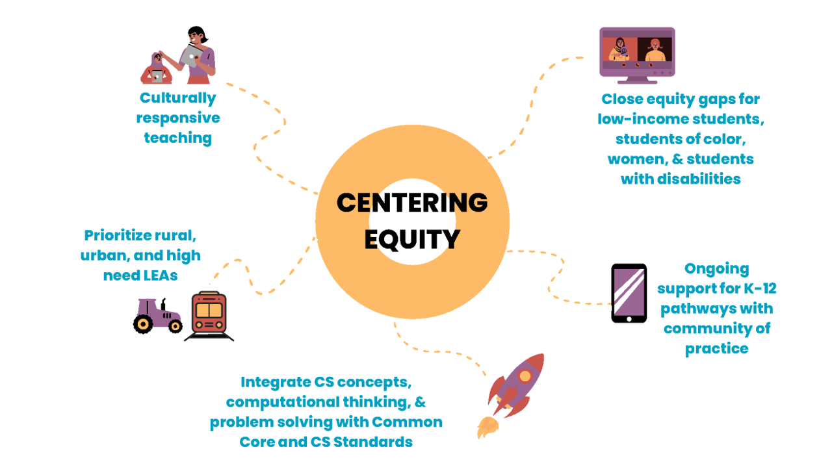
Centering Equity
*see Appendix A for descriptive text

Slide 14
Seasons of CS Leadership Team and Roles
Build capacity and coach in the Statewide System of Support
  CS Capacity Builder and Applicant: UCLA
Facilitate delivery of the Summer of CS for 700 teachers, paraprofessionals, LEA leaders, and counselors
  CS Facilitator: Sacramento COE
Connect educators with ongoing professional learning communities (PLCs)
  CS Resource Connector: Californians Dedicated to Education Foundation

Slide 15
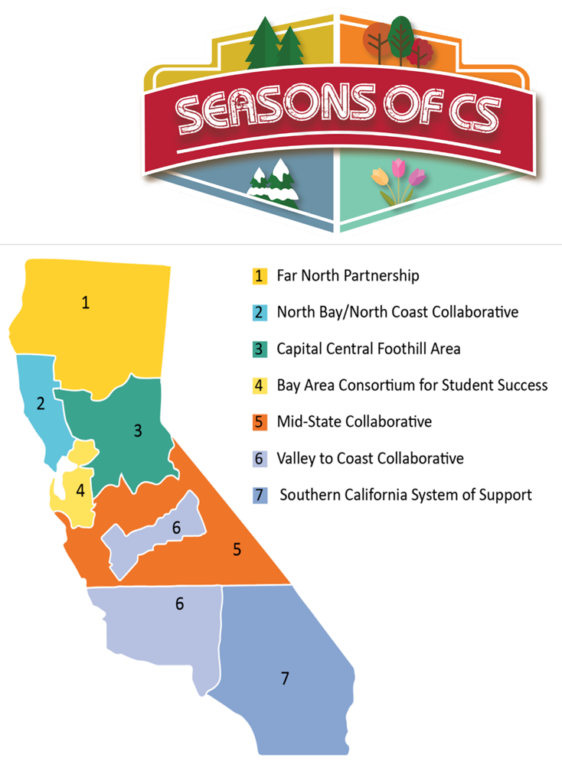
Educator Workforce Investment Grant: Computer Science 2021–24
Building Capacity of CS Champions in
Statewide System of Support to scale and sustain equity in CS in CA.
Region leadership from 7 COEs
Action plans to implement Seasons of CS
Ongoing Coaching/PLC
Data analysis & evaluation
Funding
*see Appendix A for descriptive text

Slide 16
Regional Lead Agencies (County Offices of Education)
Far North Partnership: Del Norte and Butte
North Bay/North Coast Collaborative: Mendocino and Sonoma
Capital Central Foothill Area: San Joaquin, Placer, and Sacramento
Bay Area Consortium for Student Success: San Mateo, Contra Costa, and Santa Clara
Mid-State Collaborative: Stanislaus, Monterey, and Tulare
Valley to Coast Collaborative: Santa Barbara
Southern California System of Support: San Bernardino, Riverside, San Diego, and Orange

Slide 17
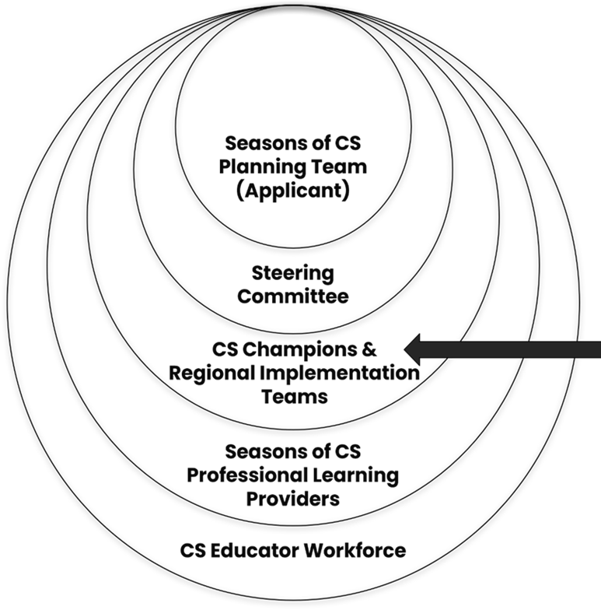
CS Champions across Statewide System of Support
Regional Lead Agencies (RLAs) participate in monthly sessions that:
Identify CS education visions for school, district, and county teams.
Establish goals and implementation plans for:
  Professional learning offerings
  Community building
  Expanding partnerships
  Leadership development
  Infrastructure to adapt Seasons of CS
  Wiki for best practices
*see Appendix A for descriptive text

Slide 18
Professional Learning
Providers
Address CA CS Content Standards
Align with QPLS
Attend to culturally responsive/sustaining pedagogy
History of successful implementation and/or pilot implementing research-based strategies

Slide 19
2023 Summer of CS
Professional Learning
RLAs selected providers based on regional needs
Online and In-person
“Hub and Spoke”
Financial incentives for teachers
Commitment to teach/integrate
Ongoing professional learning
More information about the Summer of CS is available at www.summerofcs.org

Slide 20
2023 Summer of CS Opportunities
Elementary4 CS
CS First
CS Fundamentals
Elementary Computing for All
PreK12STEM
Middle School
CS Discoveries
Bootstrap: Algebra
Bootstrap: Data Science
C-STEM
PreK12STEM

Slide 21
2023 Summer of CS Opportunities (2)
Secondary CS
CS Principles
CS Awesome
Mobile CSP
C-STEM
Bootstrap: Algebra
Bootstrap: Data Science
Counselors, School Leaders, and More Teaching
Counselors 4 Computing
CSforCS Equity Workshop for School Leaders
CSforAll SCRIPT
Kick-Off Event

Slide 22
Seasons of CS Ongoing Community of Practice
Quarterly “Just-In-Time” follow-up workshops with providers
Quarterly Community of Practice meetings with Computer Science Teachers Association
Coaching for CS Champions and CS teachers with UCLA Coaching Project
Advocate for CS with CSforCA Statewide Coalition and national CSforAll Movement

Slide 23
Evaluation by Kapor Center: CAPE Framework to Measure Success
CAPACITY: Are teachers trained? What are their perceptions? Do they have content and pedagogical knowledge?
ACCESS: Are more courses being offered?
PARTICIPATION: Are more students of color, from low-income households, within rural area, and girls taking CS?
EXPERIENCE: To what extent has participation in Seasons of CS impacted student experiences in CS classrooms within the target areas?

Slide 24
Join Professional Learning Opportunities via Seasons of CS
More information regarding the Seasons of CS are available at the following web pages:
Seasons of CS: www.seasonsofcs.org
Winter of CS: www.winterofcs.org (offerings currently available)
Summer of CS: www.summerofcs.org (registration will open soon)
Autumn of CS: www.autumnofcs.org
Spring of CS: www.springintocs.org

Slide 25
Requirements of the 2023 Educator Workforce Investment Grant: Computer Science Application

Slide 26
Submission Requirements
Complete application electronically through the 2023 EWIG: CS online application, which is available on the CDE 2023 EWIG: CS Request for Applications (RFA) web page at https://www.cde.ca.gov/fg/fo/r12/csewig23rfa.asp.
  Online application instructions are included in Appendix B.
Respond to all prompts in each section of the narrative description.
Separately attach supporting evidence as one zip file, including the EWIG: CS Proposed Budget, Letters of Commitment, Scope of Work, and Organizational Chart. No additional information included in the zip file will be reviewed.

Slide 27
Submission Requirements (continued)
Provide the appropriate digital signature.
Submit the application by Thursday, March 9, 2023, before 3 p.m.
Refer to the scoring rubric (Appendix A) to understand how responses will be evaluated by the reading panel.

Slide 28
Saving Responses
Select the Save Responses button on the first page of the online application if you do not intend to complete the application in one session.
Ensure the email address you provide is accurate.
Copy the unique URL (web address) for entrance back into the application.

Slide 29
Completing the Application Narrative
Two parts must be addressed.
Part 1 has six sections, which may also include multiple items to be addressed.
Part 2 pertains to proposed metrics.
Responses must be conceptually clear and technically feasible.

Slide 30
Application Narrative (continued)
Articulate a theory of action for implementation and meeting the vision and mission included in the Computer Science Strategic Implementation Plan (CSSIP).
Stay within specified character limits as noted for each item.

Slide 31
Completing the Application Budget
Covers the entire grant period (May 1, 2023, through February 28, 2025)
Available on the 2023 EWIG: CS RFA web page
Includes six tabs for completion
Will be reviewed and scored
Submit as an Excel file through the online application when zipped

Slide 32
Application Budget (continued)
Proposed Budget Detail must include a detailed budget description for each line item within the grant period.
  Provide sufficient detail and a breakdown/calculation that justifies each line item.
  Group line items by the Object Code services.
  Provide lines for Object Code totals.
Proposed Budget Summary must provide totals for each Object Code and should must align with the Proposed Budget Details.
Indirect administrative cost rate must be limited to a maximum 8 percent.

Slide 33
Review Process
Only fully completed applications will be considered eligible for consideration and advanced to the Reader Conference.
A panel of readers selected for their expertise will read, review, and score each eligible application using a scoring rubric (see Appendix A).
Readers will be instructed to read each proposal in its entirety to get an overall impression of the project and whether it makes sense overall.
Interviews with potential grantees may be conducted.
The selected applicant is subject to approval by the Executive Director of the State Board of Education.

Slide 34
Application Maximum Point Values
Part | Section | Point Value
Part 1 | Vision and Mission | 16 points
Part 1 | QPLS | 20 points
Part 1 | CS Capacity Builder | 28 points
Part 1 | CS Resource Connector | 16 points
Part 1 | CS Facilitator | 16 points
Part 1 | Project Participants | 8 points
Part 2 | Proposed Metrics | 16 points
Budget | Budget | 8 points

Slide 35
Educator Workforce Investment Grant: Computer Science Application Timeline*
Activity | Date
Applications Due | March 9, 2023, before 3 p.m. PST
Intent to Award posted | March 30, 2023
Last day for Appeals to be received by the CDE | April 13, 2023, before 3 p.m. PST
Final Awards posted | May 1, 2023
* Timeline subject to change. Refer to the CDE 2023 EWIG: CS RFA web page at https://www.cde.ca.gov/fg/fo/r12/csewig23rfa.asp for the most up-to-date timeline.

Slide 36
Resources
Applicants should be familiar with the following resources that contain further information pertinent to the
2023 EWIG: CS Partner Entity RFA:
QPLS: https://www.cde.ca.gov/pd/ps/qpls.asp
CA CS Content Standards: https://www.cde.ca.gov/be/st/ss/computerscicontentstds.asp
CSSIP: https://www.cde.ca.gov/pd/ca/cs/cssip.asp
California Statewide System of Support: https://www.cde.ca.gov/sp/sw/t1/csss.asp
Links are also available within the 2023 EWIG: CS Partner Entity RFA.

Slide 37
Questions?

Slide 38
Educator Excellence and Equity Division
For additional information, contact:
Program Questions:
Emily Oliva, Ed.D.; Education Programs Consultant
Downloading Questions:
Alyssa Khan, Associate Governmental Programs Analyst
Email: PLSMO@cde.ca.gov

Slide 39
Appendix A: Long Descriptions
Slide 13: This comprehensive approach to professional learning helped us to scale and sustain computer science (CS) education throughout California by centering equity with culturally responsive practices, prioritizing high-need students in rural and urban areas, integrating CS with math and science standards, ongoing support for kindergarten through grade twelve pathways, all while identifying and closing the equity gaps using research and data.
Slide 15: Seasons of CS logo and the seven Seasons of CS regions. Region 1: Far North Partnership, Region 2: North Bay/North Coast Collaborative, Region 3: Capital Central Foothill Area, Region 4: Bay Area Consortium for Student Success, Region 5: Mid-State Collaborative, Region 6: Valley to Coast Collaborative, and Region 7: Southern California System of Support.

Slide 40
Appendix A: Long Descriptions (2)
Slide 17: The layers within the 2021 Educator Workforce Investment Grant: Computer Science (CS), which includes the Seasons of CS Planning Team (applicant), Steering Committee, CS Champions and Regional Implementation Teams, Seasons of CS Professional Learning Providers, and the CS Educator Workforce. Arrow is pointing to CS Champions and Regional Implementation Teams.

