Slide 1
Youth Engagement to Address Tobacco-Related Health Disparities Grant
Request for Applications Webinar
Tobacco-Use Prevention Education (TUPE) Office
Educator Excellence and Equity Division
California Department of Education
Lisa McClung, Education Programs Consultant
Sarah Planche, Education Administrator

Slide 2
Health Disparities Grant
Purpose
The Health Disparities Grant Request for Applications (RFA) strives to offer a youth engagement approach in addressing youth tobacco education to maximize student, staff, peer, and community involvement and accelerate and monitor the rate of decline in tobacco-related disparities for the purpose of eliminating tobacco-related disparities.

Slide 3

Health Disparities Grant
Tobacco Sign

Slide 4
Health Disparities Grant
Funding
Approximately $7 million from Proposition 56 funding has been allocated to the California Department of Education (CDE) to fund a new Health Disparities Grant Program for three years, beginning July 1, 2019, to June 30, 2022.
Maximum cap of $250,000 per year.
The use of TUPE funds for any purpose other than the reduction or elimination of tobacco-use disparities for the priority subgroups identified in this RFA is not authorized.

Slide 5
Health Disparities Grant
Who May Apply?
Public school districts (local educational agencies [LEAs])
Direct-funded charter schools
Direct-funded state schools (School for the Blind, School for the Deaf)
County offices of education (COEs)—only if the COE provides direct supervision over a specific school

Slide 6
Health Disparities Grant
Eligibility Criteria
The application must: (1) show that the program meets the overall Program Requirements, (2) comply with the Application Narrative Requirements, (3) meet all other conditions, requirements, and deadlines, and (4) provide all required signatures before the designated due dates.
Applicants are ineligible for any TUPE grant funding if they have received directly or indirectly, any funding, educational materials, or services from the tobacco industry even if for the purpose of implementing tobacco-use prevention, youth development, intervention, or cessation programs.

Slide 7
Health Disparities Grant
Current Law
Assembly Bill 9, Thurmond, 2016
Requires all California public schools to prohibit the use of tobacco and nicotine products at any time on COE, charter school, or school district-owned or leased property including vehicles. The bill further requires all school districts, charter schools, and COEs to prominently display signs at all entrances to the school property stating “Tobacco Use is Prohibited.” This includes, but is not limited to, smokeless tobacco, snuff, chew, clove cigarettes, and other nicotine delivery devices, such as electronic cigarettes (e-cigarettes).
Senate Bill 5, Leno, 2016
Defines the term “smoking” and changes the definition of the term “tobacco products” to include electronic smoking devices. With these changes, it is no longer permissible for students to use or possess any tobacco products, including electronic smoking devices under Section 48901 of the California Education Code.

Slide 8
Health Disparities Grant
Current Law—Tobacco-Use Prevention Education
California Health and Safety Code Section 104385
The CDE/TUPE Office administers grants for projects directed at the prevention of tobacco-related diseases. The TUPE Office oversees grant programs that provide health education and promotion activities targeted to high-risk persons and groups in order to reduce the number of persons beginning to use tobacco, continuing to use tobacco, or developing tobacco-related diseases.
The TUPE Office also monitors and ensures implementation of district and COE’s tobacco-free policies and TUPE programs in districts receiving funding from the Cigarette and Tobacco Products Surtax Fund.

Slide 9
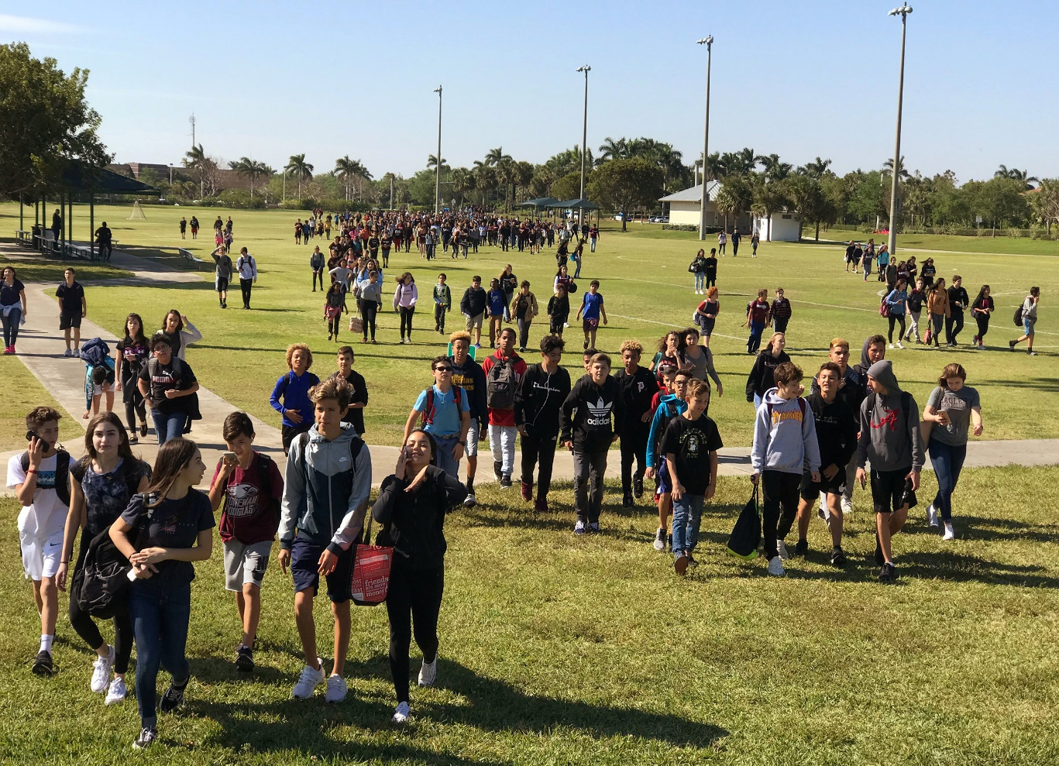
Health Disparities Grant
Students

Slide 10
Health Disparities Grant
Program Requirements (1)
Select a priority subgroup(s) in which to develop a specific program with strategies to accelerate and monitor the rate of decline in tobacco-related disparities for the purpose of eliminating tobacco-related disparities. Examples include, but are not limited to:
  African Americans,
  American Indians/Alaska Natives,
  Asians,
  Hispanics/Latinos,
  Native Hawaiian/Pacific Islanders,
  Foster Youth,
  Students experiencing homelessness,
  Pregnant minors or minor parents,

Slide 11
Health Disparities Grant
Program Requirements (2)
  Not Straight—Gay, Lesbian, or Bisexual,
  Transgender,
  Low Socio-Economic Status (Free and Reduced Price Meals Eligibility),
  Non-traditional students (including, but not limited to, continuation schools and community day schools),
  Other subgroups identified by the LEA as being in need and supported by existing data (e.g., State Special Schools that service blind or deaf students)
  Applicants may select more than one subgroup, however, the program should reduce the tobacco-related disparities for each and every subgroup selected, rather than the general student population, and each subgroup selected must have evidence of need to justify the application.

Slide 12
Health Disparities Grant
Program Requirements (3)
  (2) Implement an Evidence-Based Curriculum—Each school identified in the application that the LEA will serve, is required to implement an approved, evidence-based curriculum program.
  (3) Implement a Youth Development Strategy(ies)—Applicants are required to implement a tobacco-free focused youth development strategy or strategies.
(4) Provide Intervention Strategies—Applicants are required to identify the priority subgroup(s) that are most likely to begin tobacco use and provide intervention strategies to meet the needs of those students.
(5) Provide Cessation Strategies or a Referral Plan—Applicants are required to identify the specific subgroup(s) currently using tobacco and either provide current tobacco users with voluntary cessation services or describe a plan to refer them to cessation classes provided by the community.

Slide 13
Health Disparities Grant
Program Requirements (4)
  (6) Districts and schools are required to participate in the California Healthy Kids Survey (CHKS) and conduct the district-level CHKS Core Module to the subgroup population of students in grades seven, nine, and eleven.
  (7) Adopt and Enforce a Tobacco-Free Policy and Certification—Each school site identified in the application must adopt and enforce a tobacco-free policy and obtain official certification by the CDE no later than July 1 of each fiscal year.
  (8) Submit all required signatures as identified in the RFA, including Certified Assurances as a condition of receiving CDE funds.

Slide 14

Health Disparities Grant
Where Do We Begin?
Hire a District Hipster!

Slide 15

Health Disparities Grant
Where Do We Begin?
Not an Executive –
Too Far Removed

Slide 16


Health Disparities Grant
Evidence-Based Curriculum
Select one of the following curricula:
Catch My Breath
Project Alert
Project Towards No Drug Use
Project Towards No Tobacco Use
Stanford Tobacco Prevention Toolkit

Slide 17
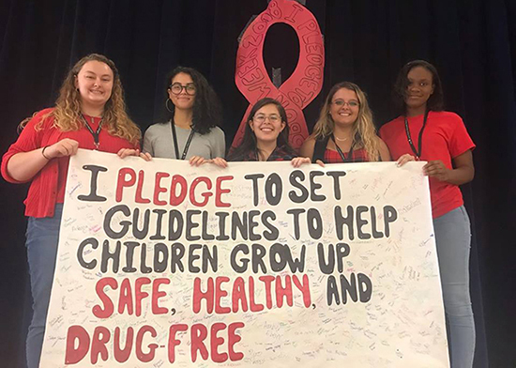
Health Disparities Grant
Youth Development Strategies
Select and implement one or more youth development strategies specific to tobacco-use prevention:
Youth Involvement in Anti-Tobacco Advocacy
Media Literacy and Youth Media Production to Counter the Influence of the Tobacco Industry
Peer-Educators
Service-Learning Projects

Slide 18

Health Disparities Grant
Intervention Strategies
Provide intervention services for your students:
Brief Intervention
Teen Intervene

Slide 19

Health Disparities Grant
Cessation Strategies (1)
Provide cessation services for your students:
Adolescent Smoking Cessation-Escaping Nicotine and Tobacco (ASCENT)
California Smokers’ Helpline
Enough Snuff: A Guide for Quitting Smokeless Tobacco
Project EX: Teen Tobacco Use Cessation Program
Project N-O-T (Not On Tobacco)

Slide 20

Health Disparities Grant
Cessation Strategies (2)
Text Resources
To access the new E-Cigarette Quit Program, users can text “QUIT” to
202-804-9884. Users can also enroll in This is Quitting or BecomeAnEx®, free digital quit programs from Truth Initiative® that integrate the text program at https://truthinitiative.org/news/truth-initiative-and-wellable-partner-deliver-comprehensive-smoking-cessation-resources

Slide 21
Health Disparities Grant
Application Narrative Requirements
Collaborative Process (1)
  Collaborative Process—Should include establishment of a collaborative oversight group, including, but not limited to:
  TUPE County Coordinator
    District TUPE Coordinator
    Youth engagement or community engagement coordinators from local public health and tobacco control agencies
    Local lead agencies
    School resource officers
    Counselors
    Other school staff and students
    Parents and interested members of the community at large

Slide 22
Health Disparities Grant
Application Narrative Requirements
Collaborative Process (2)
Example of a Collaborative Opportunity:
Identify student-oriented and age appropriate materials, resources, and tools, and provide tobacco prevention and control education to identified student subgroups, parents, teachers, school administrators, school resource officers, etc.
Sample Activities:
Provide feedback on educational materials, tools, and resources designed to reach students.
Provide trainings, resources, and tools for teachers, parents, and administrative staff.
Conduct out-of-classroom and after school events to educate students on community tobacco issues.

Slide 23
Health Disparities Grant
Application Narrative Requirements
Collaborative Process (3)
Example of a Collaborative Opportunity:
Identify and implement tobacco program messaging that is appropriate for students, parents, teachers, and administration.
Sample Activities:
Provide technical assistance and/or opportunities to share/promote tobacco educational materials and media at TUPE schools.
Enhance ongoing trainings or educational materials that share messaging with community-based education/awareness campaigns.
Provide tobacco prevention and reduction content, evaluation, and/or stories from the school environment through social media efforts.

Slide 24
Health Disparities Grant
Application Narrative Requirements
Collaborative Process (4)
Example of a Collaborative Opportunity:
Work with your local Lead Agencies to establish and maintain local coalitions and involvement with the planning and implementation of tobacco policy work.
Sample Activities:
Convene a tobacco control coalition comprised of diverse partners from local organizations to bring more skills, ideas, and resources to tobacco control efforts.
Develop and conduct surveys regularly (qualitative or quantitative).
Promote opportunities for students to engage in community-based initiatives, trainings, or events.

Slide 25
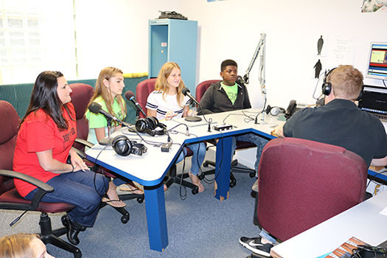
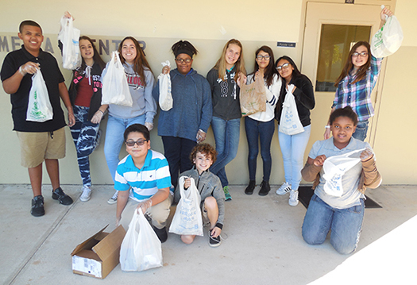
Health Disparities Grant
Application Narrative Requirements
Collaborative Process
Youth Engagement

Slide 26
Health Disparities Grant
Application Narrative Requirements
Needs Assessment (1)
  Needs Assessment—A description of the needs analysis conducted by the collaborative oversight group, including CHKS data about student tobacco use, descriptions of other funding or resources being used to meet the identified needs for the specific subgroup(s), and other relevant data.
  Elements:
  Describes the tobacco-use behaviors or attitudes at the school and within the community in which the subgroup(s) are identified.
  Describes the focus group data that emerged where students, parents, staff, and the community identified concerns and created a prioritized list(s) of unmet subgroup(s) needs.
  Identifies the specific data results that led to the selection of the identified subgroup(s).
  Describes how the collaborative group discussed, selected, and developed a process in which to address the priority subgroup(s) tobacco-use prevention needs.

Slide 27
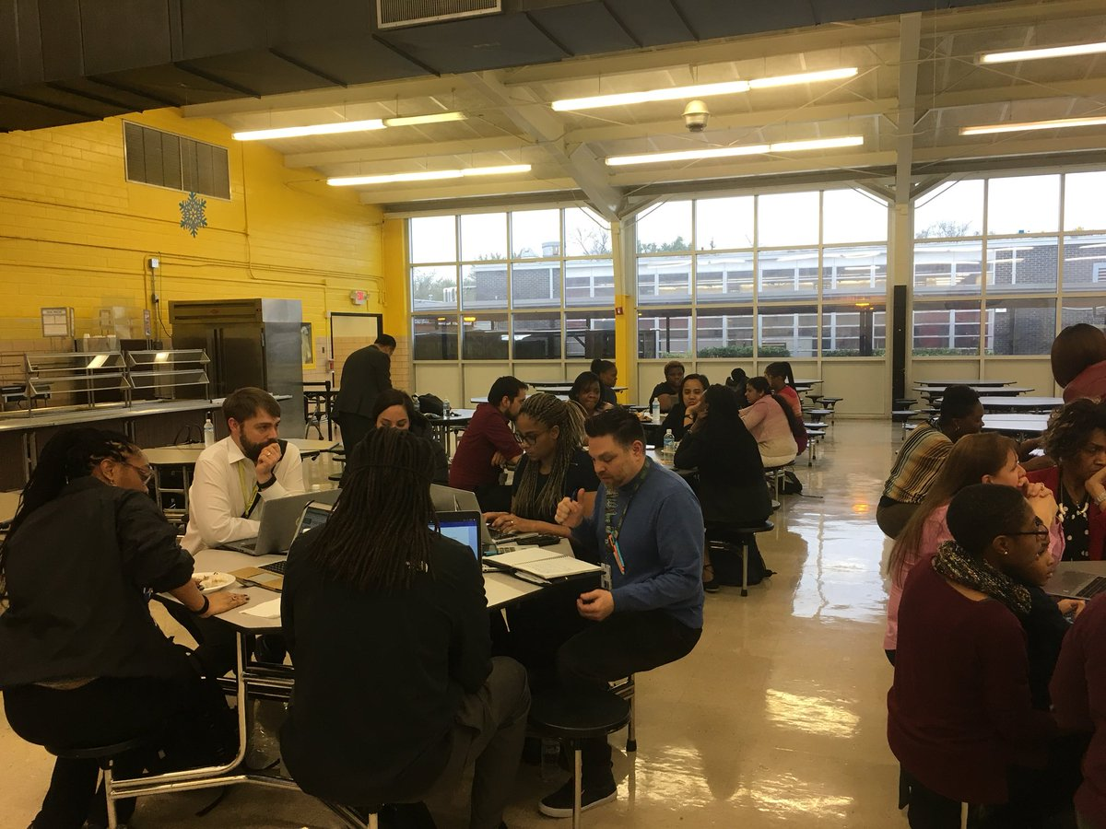
Health Disparities Grant
Application Narrative Requirements
Needs Assessment (2)

Slide 28
Health Disparities Grant
Application Narrative Requirements
Program Plan (1)
  Program Plan—Identify the activities and strategies chosen to address the unmet health disparity needs of the priority subgroup(s) that is above and beyond the current baseline program for the general student or previously identified disparity population.
  Elements:
  Curriculum—materials development
Youth Engagement Strategies—policy development, social media, student advocacy, peer-to-peer, and community outreach
Intervention and Cessation Strategies—alternatives to suspension, create local resources, pregnant minor, and minor parent services
Parent and Community Involvement—parent and community engagement activities
Training Strategies
Other Strategies

Slide 29
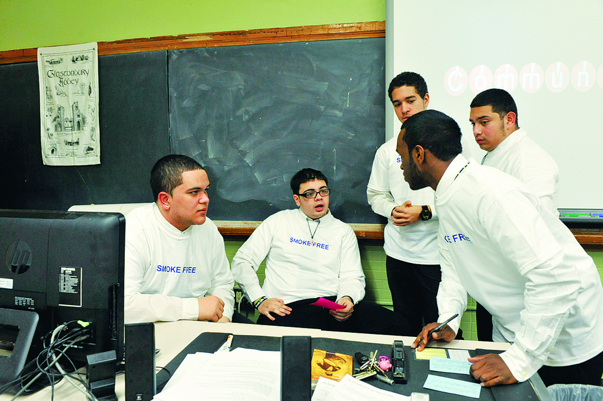
Health Disparities Grant
Application Narrative Requirements
Program Plan
Youth Engagement

Slide 30
Health Disparities Grant
Application Narrative Requirements
Pre- and Post-Subgroup Assessment (1)
Pre-and Post-Subgroup(s) Assessment—Include process measures to determine if the activities and strategies described in the application are actually implemented, and outcome measures to determine if the implemented activities and strategies are having the desired effect of reducing and preventing tobacco-related disparities for the selected priority subgroup(s).
Elements:
Who is keeping records and how often?
Who will be responsible for gathering and compiling records into progress reports?
A measurable objective of the designed activity or strategy.
An assessment tool (e.g., survey, observation tool).
Description of the data collection process and method of analysis.
How the collaborative will review and use the process and outcome measures to determine program effectiveness.

Slide 31
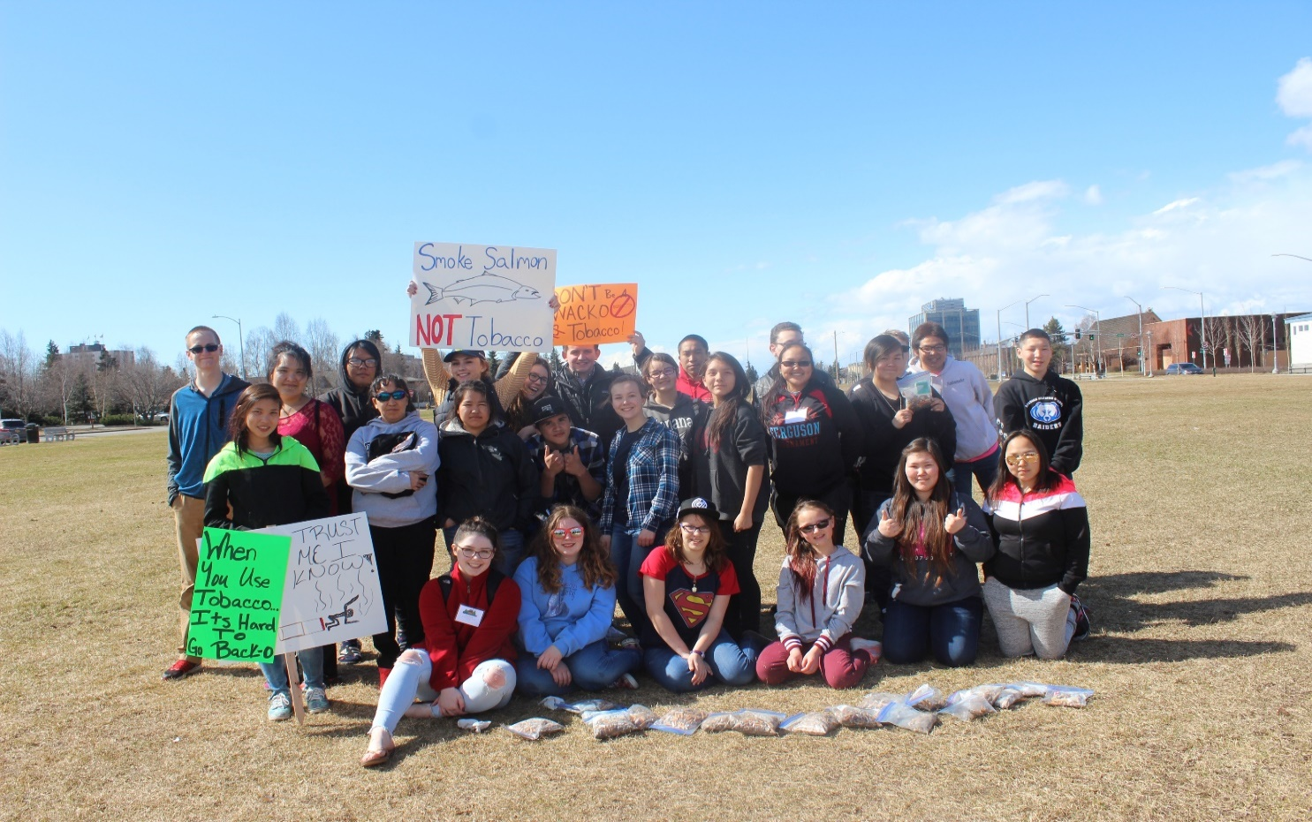
Health Disparities Grant
Application Narrative Requirements
Pre- and Post-Subgroup Assessment
Youth Engagement

Slide 32
Health Disparities Grant
Application Narrative Requirements
Project Budget (1)
  Project Budget—Provide a summary of costs as well as a justification for each item listed in the RFA. The proposed budget should not exceed $250,000 per year ($750,000 maximum for the three-year grant period).
  Elements:
  Every dollar amount proposed must be fully explained.
  Funds must be spent on priority subgroups to accelerate and monitor the rate of decline in tobacco-related disparities, for the purpose of eliminating tobacco-related disparities.
  Proposition 56 funds may be audited every two years.
  A Sample Budget Summary and Justification is included in the RFA Appendices.

Slide 33
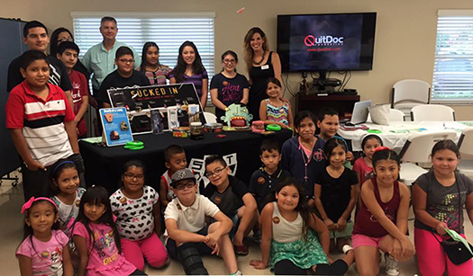
Health Disparities Grant
Application Narrative Requirements
Project Budget
Youth Engagement

Slide 34
Health Disparities Grant
Scoring Rubric (1)
Scoring Form and Rubric
Category Points (100)
Collaborative Process 12
Needs Assessment 20
Description of the Program Plan 40
Pre-and Post-Assessment Plan 16
Project Budget Justification 12

Slide 35
Health Disparities Grant
Scoring Rubric (2)
Each response provided will be evaluated on the following criteria:
Outstanding: The response is very clear, extremely detailed and relevant, and presents a compelling argument supporting the proposal and the intent of the program.
Complete: The response is clear and detailed and presents a persuasive argument supporting the proposal and the intent of the program.
Sufficient: The response addresses the question(s) adequately, provides support for the proposal, and supports the intent of the program.
Developing: The response partially addresses the questions, provides limited support for the proposal, or partially supports the intent of the program.
Weak: The response does not address the question(s) or a response was not provided. Information presented does not provide any understanding of the applicant’s intent, provides limited information requested by the RFA, or does not support the intent of the program.

Slide 36
Health Disparities Grant
Timeline
Intent to Submit an Application Due Date: Friday, May 24, 2019
Full Application Due Date: Friday, June 14, 2019, by 4:00 p.m.
Review of Application Narratives: June 2019
Intent to Award Posting: June 2019
Final Award Posting: July 2019
Grant begins: July 1, 2019

Slide 37
Health Disparities Grant
Helpful Resources
Review all RFA Requirements, Application Checklist, Attachments, Appendices, and all related forms at https://www.cde.ca.gov/fg/fo/r8/disparitiesrfa.asp.
Submit all RFA questions to the TUPE Helpdesk at TUPE@cde.ca.gov between May 15, 2019 to June 14, 2019.
Frequently Asked Questions (FAQs) and answers will be posted between May 28–June 14 2019, at https://www.cde.ca.gov/ls/he/at/disparitiesrfafaqs.asp. All questions submitted for FAQ posting must be received by June 7, 2019.
The information contained in the RFA, this RFA Guidance Webinar, and posted FAQs should be your primary resource documents.

Slide 38
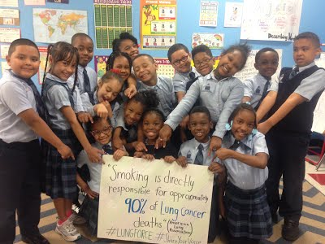
Health Disparities Grant
Thank You and Good Luck!

