Slide 1
All Access Restrooms
Presented by the
School Facilities and Transportation Services Division
Presentation date (February 2023)

Slide 2
Please Note: Today’s resources do not constitute a mandate that requires any new or existing restrooms be designed as all-access.
Today we are providing
Guidance
NOT
Mandates

Slide 3
Office of Learning Environments (OLE) gender-neutral restrooms research team
Diane Waters
Bryan D. Boyd
John Gordon
Molly Stitt
Lesley Taylor

Slide 4
When I say “public school restrooms” what comes to mind??

Slide 5
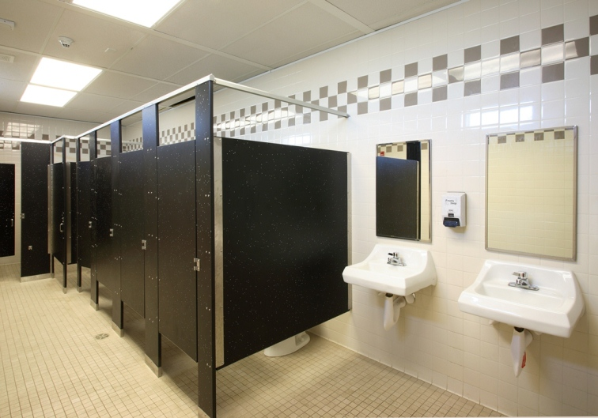
Standard Gender Specific Restroom

Slide 6
When I say
“All Access Restrooms”
What comes to mind?

Slide 7
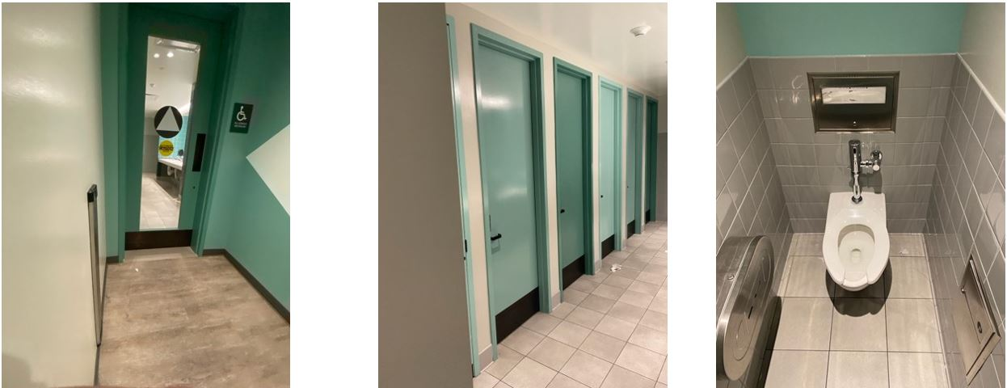
Examples of All Access Restrooms

Slide 8
Today’s Objectives
Provide a quick overview of our process.
Provide optimal design elements for multi-user gender-neutral restrooms from a broad base of stakeholder input.
Provide an opportunity for you to ask questions.

Slide 9
Why (Our Challenge)
Many schools have begun to favor inclusive multi-user toilet facilities over costly single-user facilities
LEAs and architects are submitting multi-user gender-neutral restrooms in their plan approval requests, as well as seeking early input and guidance from CDE during the design phase

Slide 10
What (Our Outcome)
Identify and disseminate best practices in multi-user gender-neutral restroom design.
One of our division’s main goals is to provide meaningful support to LEAs

Slide 11
Key Events: All Access Restroom Team
Conducted research.
Developed a “Primer” document to start the discussion.
In Jan 2021, we held a CDE internal stakeholder meeting.
Primer Document was edited based on feedback.
In Sept 2021, we two external stakeholder meetings.
(District, School, student, and industry perspectives were represented))

Slide 12
Key Events: All Access Restroom Team (cont.)
Primer Document was edited based on external stakeholder meetings.
November 19, 2021, State Superintendent Tony Thurmond Announces New Efforts to Expand Gender Neutral Efforts in California Schools, State Superintendent Thurmond will form a committee, comprised of students, school staff, and key partners like Equality California who will brainstorm solutions for ensuring that schools have these facilities.
The Document was reviewed by members of the committee..

Slide 13
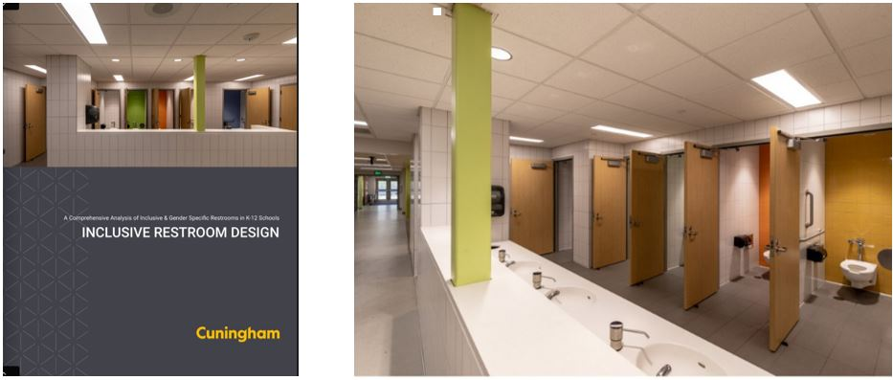
All Inclusive Restroom Design: Cunningham
The Inclusive Restroom Design document can be found at this link http://flipdocs.cuningham.com/rsch/18inclsv/.

Slide 14
External Focus Groups: Safety
Students learn in an environment that is physically and emotionally safe.
School climate
Anti-bullying
Substance abuse
Restorative justice
Crisis response
Safe Havens
Environmental quality
Supervision

Slide 15
Common Design Features
No outside corridor doors to the restrooms
Private individual stalls with floor-to-ceiling side walls that have a mesh screen at the bottom
Two entrance/egress points into the restroom
Placement of non-gendered and gendered restrooms in multiple locations throughout the campus
Principal stated “Many behavior issues and problems are located near the sinks. Providing sinks on the exterior of the restrooms may limit behavior issues.”

Slide 16
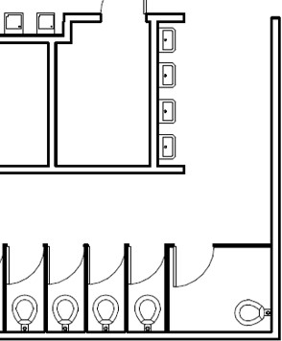
Example 1
Design:
No door
Hallway into restroom intentionally wider than standard
Sinks are towards the front of the restroom in the open
Considerations:
Plumbing “corridors” between multiple levels of a building
Gender-specific RR are also provided; Passing periods should allow for access of a student’s preferred RR
Strong site engagement in the design

Slide 17
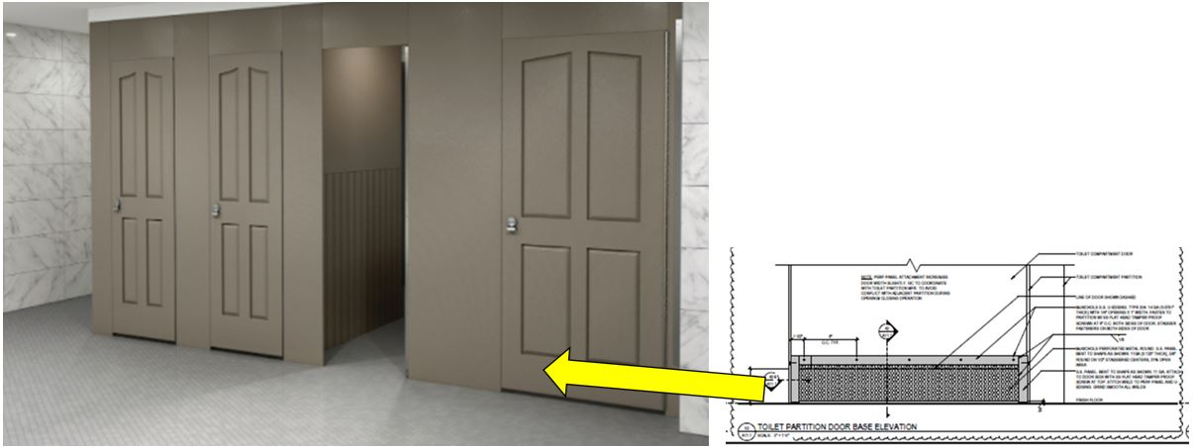
Example 2

Slide 18
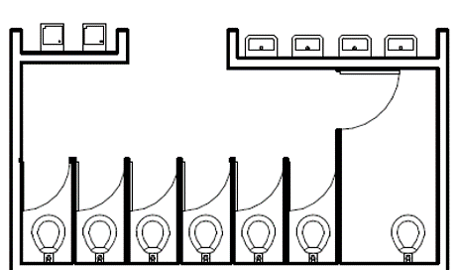
Example 3
Classroom door directly aligned to RR, sinks facing out toward hallway
Ingress/egress to RR much wider than standard
Solid wall above sinks provides venting for fixtures, increases privacy for who is going in/out of the RR

Slide 19
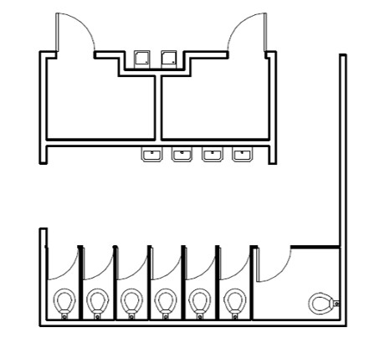
Example 4
Open on both ends
More lines of sight for supervision
Ingress/egress to RR much wider than standard

Slide 20
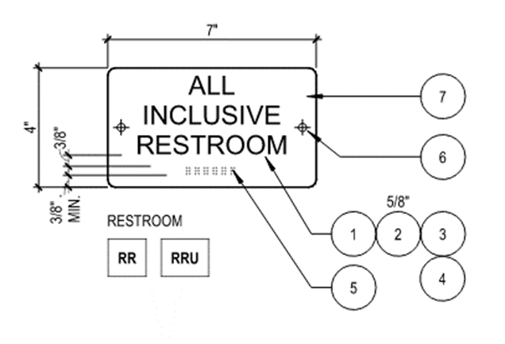
Example 5

Slide 21
Print Material vs. A Living Document
Link Rot, meaning cited links may change or be taken down.
Print Material Can Become Outdated.
Decision To Make the Guidance Document Web based.
The CDE All-Access Restrooms informational web page can be found here: https://www.cde.ca.gov/ls/fa/sf/allaccessrestroom.asp.

Slide 22
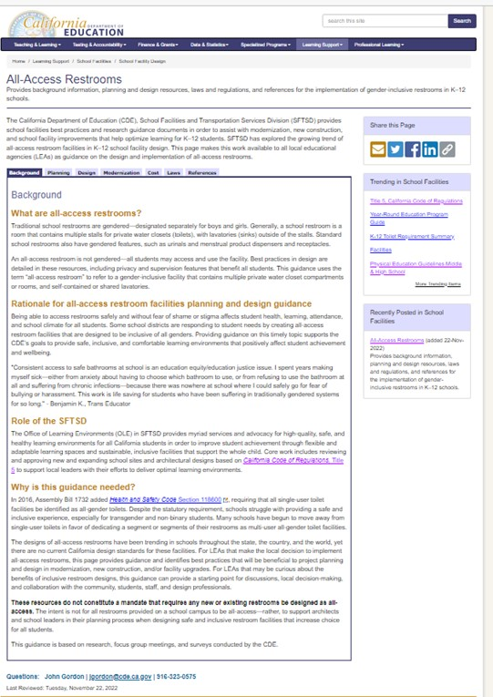
Key Elements of the
All-Access Restrooms Guidance Web Page
Tab 1 Background
Tab 2 Planning
Tab 3 Design
Tab 4 Modernization
Tab 5 Cost
Tab 6 Laws
Tab 7 References

Slide 23
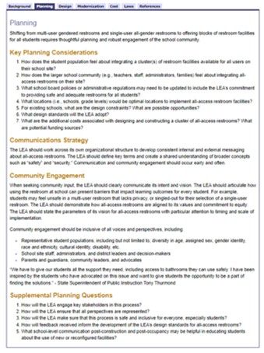
Tab 2 Planning
Planning Considerations
Communication Strategy
Community Engagement
Planning Questions

Slide 24
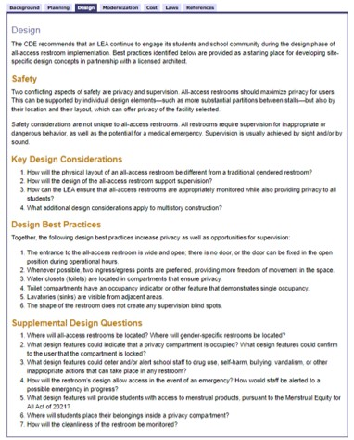
Tab 3 Design
Safety
Key Design Considerations
Design Best Practices
Supplemental Design Questions

Slide 25
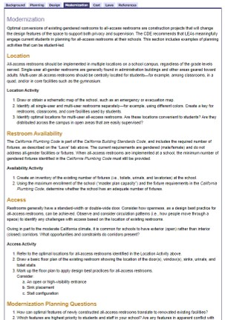
Tab 4 Modernization
Location
Restroom Availability
Access
Planning Questions

Slide 26
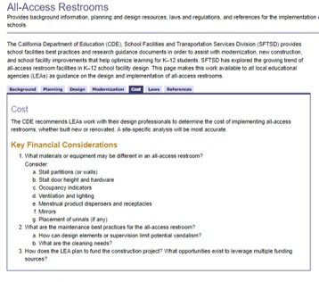
Tab 5 Costs
Key Financial Considerations

Slide 27
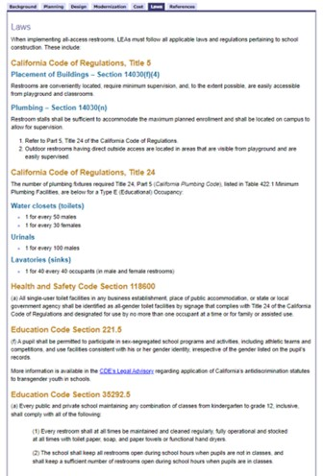
Tab 6 Laws
Laws: provided in one location

Slide 28
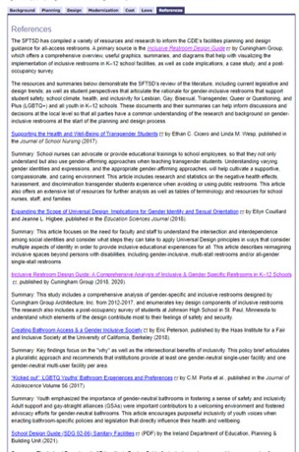
Tab 7 References
Cunningham Document
Other research provided

Slide 29
Wrap-Up
Questions?
Comments?

