Slide 1
2021–22 Every Student Succeeds Act
Comprehensive Support and Improvement
Local Educational Agency
Application for Funding
February 8, 2022

Slide 2
Housekeeping
Please use the Zoom Q & A feature to post any questions you may have.
Today’s presentation is located on the CDE CSI Webinars web page at https://www.cde.ca.gov/sp/sw/t1/csiwebinars.asp.
The School Improvement and Support Office can be reached at SISO@cde.ca.gov.
2

Slide 3
Acronyms and Initialisms (1)
CDE—California Department of Education
CSI—Comprehensive Support and Improvement
Dashboard—California School Dashboard
ESSA—Every Student Succeeds Act
FY—Fiscal Year
GEPA—General Education Provisions Act
GMART—Grant Management and Reporting Tool
3

Slide 4
Acronyms and Initialisms (2)
LCAP—Local Control and Accountability Plan
LEA—local educational agency
OMB—Office of Management and Budget
SB—Senate Bill
SPSA—School Plan for Student Achievement
4

Slide 5
Agenda
Overview of CSI and CSI Funding
Eligibility
Statutory and Spending Authority
Subgrant Information
Application for Funding
How to complete and submit
Points to Remember
CSI Plans
5

Slide 6
Overview of CSI and
CSI Funding
6

Slide 7
CSI Eligibility Criteria (1)
CSI Categories
CSI–Low Graduation Rate
CSI–Not less than the lowest performing five percent of Title I schools
The 2021‒22 ESSA CSI LEA Application for Funding is used to award FY 2021 CSI funds to LEAs with schools eligible for CSI on the 2021‒22 ESSA Assistance Status Data Files (Data Files).
7

Slide 8
CSI Eligibility Criteria (2)
California received a federal waiver and was not required to report performance levels (or colors) on the 2021 Dashboard. Because these data are not available, determination of exit from the CSI–Lowest Performing Schools category is not possible. Therefore, schools designated as such in 2019–20, remained in place through 2021–22 and are reflected in the 2021–22 Data Files.
8

Slide 9
CSI Eligibility Criteria (3)
Continued from previous slide:
However, LEAs were required to report graduation rate data which California used to determine if those schools designated as CSI–Low Graduation Rate in 2019–20 were eligible to exit.
Schools with a three-year school-wide (i.e., 2018–19, 2019–20, and 2020–21 school years) average graduation rate at or above 68 percent exited the CSI–Low Graduation Rate category on the 2021–22 Data Files
9

Slide 10
CSI Eligibility Criteria (4)
Please visit the CDE ESSA Assistance Status Data Files web page to view the 2021–22 Data Files and the corresponding record layouts.
For more information about CSI eligibility, please visit the CDE ESSA Assistance Status Data Files web page located at
https://www.cde.ca.gov/sp/sw/t1/essaassistdatafiles.asp and https://www.cde.ca.gov/ta/ac/cm/csilowgradrate.asp#accordionfaq.
10

Slide 11
Statutory and Spending Authority of CSI Funds (1)
Authorized under ESSA, Section 1003–School Improvement (https://go.usa.gov/xfAWr), pages 9 through 11.
ESSA Section 1111(d)(1)–CSI (https://go.usa.gov/xfAC2), pages 33 through 35.
The California Budget Act of 2021, SB 170 SEC.126, Item 6100-134-0890 Provision 6 of Schedule 2 (https://go.usa.gov/xenVa) appropriated $130,714,000 in local assistance CSI funding for LEAs.
11

Slide 12
Statutory and Spending Authority of CSI Funds (2)
  FY 2021 CSI funds are:
  Available to each LEA with at least one school eligible for CSI on the 2021–22 Data Files and submits an approvable application for funding
  Allocated on the basis of a formula
  Based on California’s annual Title I, Part A allocation
  Contingent upon the California Budget Act
12

Slide 13
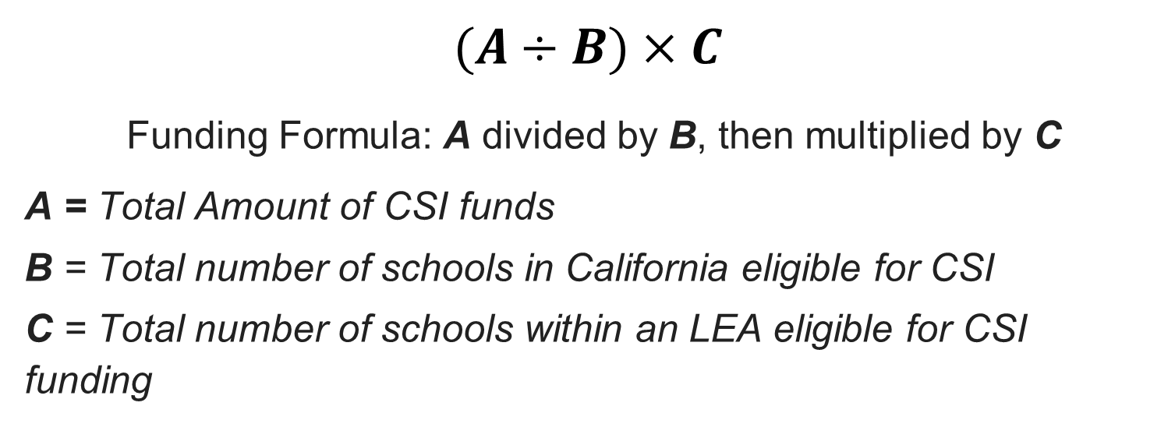
CSI Funding Formula (1)
  $$(A÷B)×C$$
  Funding Formula: A divided by B, then multiplied by C
  A = Total Amount of CSI funds
  B = Total number of schools in California eligible for CSI
  C = Total number of schools within an LEA eligible for CSI funding
13

Slide 14
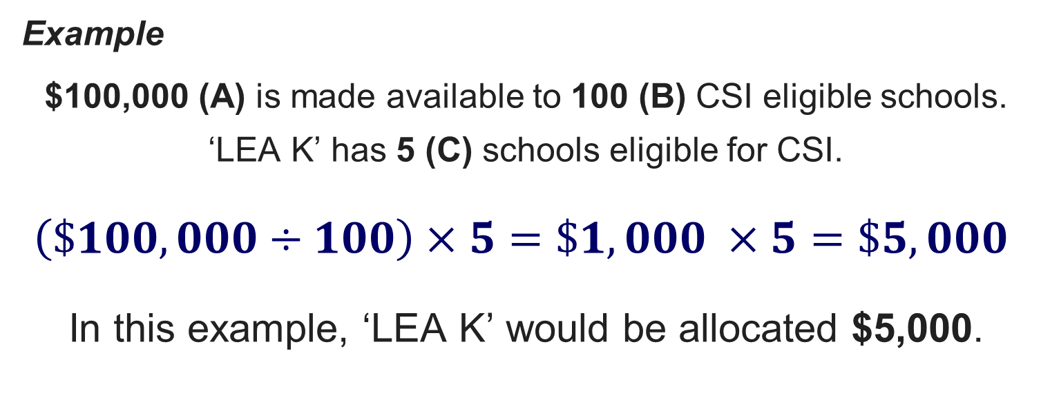
CSI Funding Formula (2)
  Example
  $100,000 (A) is made available to 100 (B) CSI eligible schools.
  ‘LEA K’ has 5 (C) schools eligible for CSI.
  $$\left(\$100,000÷100\right)×5=\$1,000 ×5=\$5,000$$
  In this example, ‘LEA K’ would be allocated $5,000.
14

Slide 15
Funding Results and Timeline
Activity | Due Date
Funding Profile Posted to the CDE Web Page | December 2021
2021–22 ESSA CSI LEA Application for Funding Release Date | February 7, 2022
2021–22 ESSA CSI LEA Application for Funding Due to CDE | February 28, 2022, by 4 p.m.
2021–22 ESSA CSI LEA Application for Funding Review by CDE Staff | March 2022
Funding Results and Schedule of Apportionments Posted to the CDE Web Page | April/May 2022
15

Slide 16
Preliminary and Final Award Amounts
Preliminary award amounts are pre-populated in the GMART for each eligible LEA.
FY 2021 preliminary award amounts are posted on the CDE LEA fiscal information web page at https://www.cde.ca.gov/sp/sw/t1/csileafiscalinfo.asp.
Award amounts for LEAs that decline funding are redistributed across remaining LEAs prior to calculating final awards.
FY 2021 final award amounts will be posted to the CDE CSI web page when the first apportionment is processed.
16

Slide 17
Subgrant Information (1)
Section 1003 of the ESSA provides resources and assistance to LEAs to improve student outcomes in schools that meet the criteria for CSI.
The project period for FY 2021 CSI LEA funds begins March 14, 2022, and ends on September 30, 2023.
FY 2021 ESSA, Section 1003 funds must be used to develop and implement a CSI plan for the 2022–23 school year for each CSI-eligible school.
17

Slide 18
Subgrant Information (2)
As a condition of funding, the LEA must collaborate with its educational partners, including school principals and other school leaders, teachers, and parents to locally develop and implement a plan for the school to improve student outcomes.
School planning and LEA assistance for each school receiving comprehensive support are incorporated into the LCAP and SPSA processes.
18

Slide 19
Subgrant Information (3)
Federal school planning requirements are established in Education Code Section 64001(a) located at https://go.usa.gov/xdcE6.
FY 2021 CSI funds that are distributed to the school from the LEA must be included in the SPSA.
Improvement strategies and activities must align to the goals, actions, and services in the LCAP.
19

Slide 20
Allowable Subgrant Activities (1)
Funds can only be spent on evidence-based interventions/strategies/activities directly related to the following CSI improvement plan development and implementation efforts:
Building capacity
Collaborating with educational partners­­­­
Conducting needs assessments and root c­­­­ause analysis
20

Slide 21
Allowable Subgrant Activities (2)
Continued from previous slide:
Selecting and implementing evidence-based interventions/strategies/activities
Using data and outcomes to monitor and evaluate improvement efforts
Reviewing/identifying and addressing, through implementation of the CSI plan, resource inequities, which may include a review of LEA- and school-level budgeting
21

Slide 22
Allowable Activities (3)
Under the ESSA, CSI plans are required to be evidence-based. Section 8101(21)(A) of the Elementary and Secondary Education Act defines an evidence-based intervention as being supported by:
Strong evidence
Moderate evidence
Promising evidence or
Evidence that demonstrates a rationale
22

Slide 23
Allowable Activities (4)
ESSA, Section 1003 funds require the use of “evidence-based” interventions that meet higher levels of evidence. The table on the next slide lists ESSA’s top three levels of evidence.
The United States Department of Education’s non-regulatory guidance on evidence-based interventions is located at https://go.usa.gov/xenG7.
23

Slide 24
Allowable Activities (5)
Evidence Level | Description
Level 1: Strong Evidence | Based on at least one well-designed and well-implemented experimental study
Level 2: Moderate Evidence | Based on at least one well-designed and well-implemented quasi-experimental study
Level 3: Promising Evidence | Based on at least one well-designed and well-implemented correlational study with statistical controls for selection bias
24

Slide 25
Allowable Activities (6)
Additional information on allowable activities including Capital Outlay expenditures, is located on the CDE ESSA CSI LEA Authorized Use of Funds web page at https://www.cde.ca.gov/sp/sw/t1/csileaauthusefunds.asp.
25

Slide 26
Disallowable Subgrant Activities (1)
The use of federal funds, including ESSA, Section 1003 funds must be consistent with the OMB Uniform Administrative Requirements, Cost Principles, and Audit Requirements for Federal Awards.
For Federal guidance on Supplement not Supplant for school improvement, see question 29a, page 21 to 22 located at https://go.usa.gov/xdcPV.
26

Slide 27
Disallowable Subgrant Activities (2)
In addition, the California legislature stipulated in SB 170 that ESSA, Section 1003 funds shall not be expended to hire additional permanent staff.
27

Slide 28
FY 2021–22 CSI Funds Reporting Requirements (1)
Report Name | Reporting Data | Performance Period | Reporting Window
Report 1 | Funding Plan Adjustment Budget Summary Expenditures | March 14, 2022, to June 30, 2022 | Open: July 1, 2022 Due: July 31, 2022
Report 2 | CSI Plan Approval/ Adoption Dates Expenditures | July 1, 2022, to September 30, 2022 | Open: October 1, 2022 Due: October 31, 2022
28

Slide 29
FY 2021–22 CSI Funds Reporting Requirements (2)
Report Name | Reporting Data | Performance Period | Reporting Window
Report 3 | Expenditures | October 1, 2022, to January 31, 2023 | Open: February 1, 2023 Due: February 28, 2023
Report 4 | Expenditures | February 1, 2023, to June 30, 2023 | Open: July 1, 2023 Due: July 31, 2023
29

Slide 30
FY 2021–22 CSI Funds Reporting Requirements (3)
Report Name | Reporting Data | Performance Period | Reporting Window
Final Report and Grant Evaluation | Final Expenditures and Closeout Report Grant Performance Report | July 1, 2023, to September 30, 2023 | Open: October 1, 2023 Due: October 31, 2023
30

Slide 31
FY 2021–22 CSI Funds Reporting Requirements (4)
Report 1: In addition to reporting expenditure data, the LEA must also adjust its Funding Plan and complete a Budget Summary that combines LEA- and school-level budget amounts for each object code series.
Report 2: In addition to reporting expenditure data, the LEA must report the date/s/ the CSI plan was approved and/or adopted by the school and LEA.
31

Slide 32
FY 2021–22 CSI Funds Reporting Requirements (5)
Reports 3 and 4: The LEA is only required to report expenditure data.
The Final Report and Grant Evaluation requires the LEA to submit final expenditure data, a final Budget Summary, and a Grant Performance Report.
32

Slide 33
FY 2021–22 CSI Funds Reporting Requirements (6)
The CDE will provide additional training and guidance for reporting requirements by early summer 2022.
If the CDE does not receive the required reports, funding may be delayed or the CDE may bill the LEA to recover funds distributed to the LEA.
33

Slide 34
Apportionments (1)
First Apportionment (Approved Application) | Subsequent Apportionments
Twenty-five percent of the total LEA allocation | Claimed expenditures for each performance period less prior cumulative payments.
34

Slide 35
Apportionments (2)
Note: Reported expenditures are used for the purpose of calculating the LEA’s apportionment. The use of federal funds must be consistent with the OMB Uniform Administrative Requirements, Cost Principles, and Audit Requirements for Federal Awards, ESSA requirements, and requirements in the 2021‒22 ESSA CSI LEA Application for Funding.
35

Slide 36
Apportionments (3)
The acceptance and approval of reported expenditures does not preclude the CDE in any way from conducting program monitoring or audits.
The LEA can expect to receive its apportionments approximately two months after a reporting period has ended.
36

Slide 37
Monitoring
LEAs and schools that receive FY 2021 ESSA, Section 1003 funds for CSI will be monitored through the CDE’s Federal Program Monitoring (FPM) process.
For questions about the FPM monitoring process for CSI, contact the Title I programs reviewer by email at fpmoffice@cde.ca.gov or phone at 916-319-0935.
37

Slide 38
Completing and Submitting the
2021–22 CSI LEA
Application for Funding
38

Slide 39
GMART (1)
The GMART is a web-based system that allows LEAs to complete and submit the 2021–22 ESSA CSI LEA Application for Funding.
For assistance with navigating the GMART, please visit the GMART instructions web page at https://www.cde.ca.gov/sp/sw/t1/gmartinstructions.asp.
39

Slide 40
GMART (2)
Usernames and passwords:
  Were emailed to county and district superintendents and charter school administrators
    Note: Usernames and passwords for the FY 2021–22 ESSA CSI LEA Application for Funding are the same as they were for previous applications for funding.
  Are case-sensitive
40

Slide 41
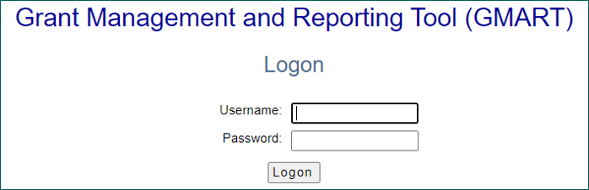
Logging On
The GMART home page is located at https://www3.cde.ca.gov/gmart/gmartlogon.aspx.
Reference Appendix (1) for long descriptive text.
41

Slide 42
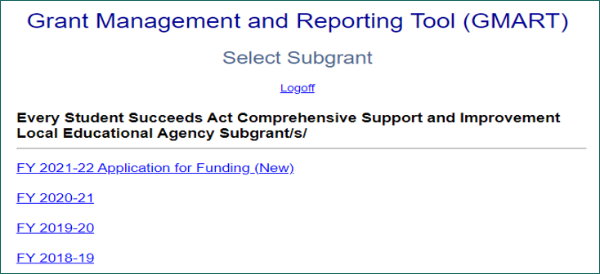
Selecting the Application
Reference Appendix (2) for long descriptive text.
42

Slide 43
Application for Funding Sections
The 2021–22 ESSA CSI LEA Application for Funding is an online application that includes six sections:
Intent to Apply
General Assurances, Certifications, Terms, and Conditions
LEA Applicant Information
Narrative Responses
2021–22 CSI Preliminary Funding Plan
Signatures
43

Slide 44
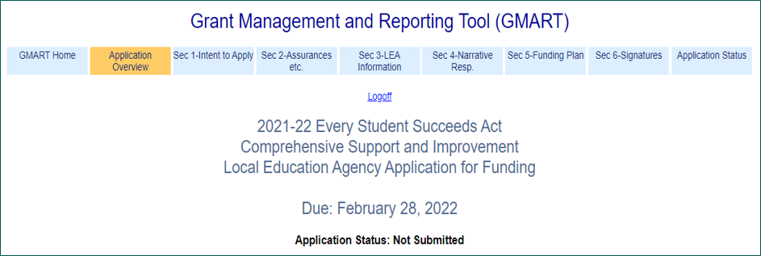
Application Overview (1)
Reference Appendix (3) for long descriptive text.
44

Slide 45
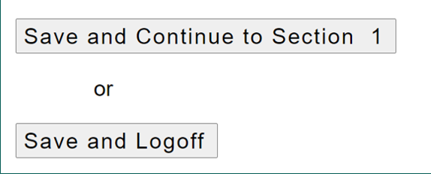
Application Overview (2)
I have read the Application Overview and would like to proceed to Section 1 of the application.
45

Slide 46
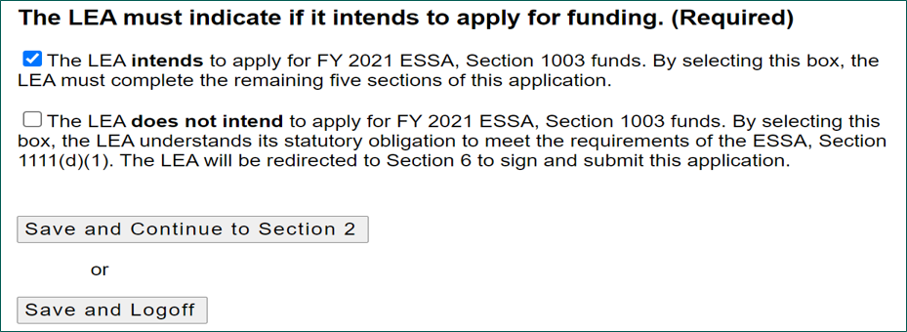
Section 1: Intent to Apply (1)
Reference Appendix (4) for long descriptive text.
46

Slide 47
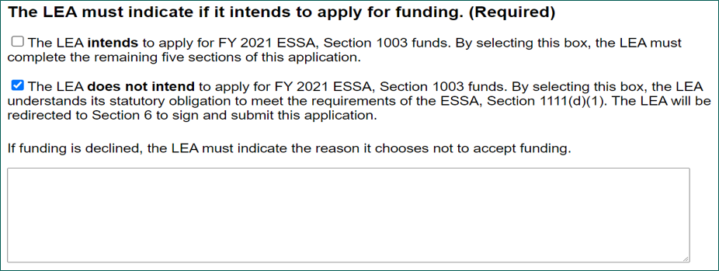
Section 1: Intent to Apply (2)
Reference Appendix (5) for long descriptive text.
47

Slide 48
Section 2: General Assurances, Terms, etc. (1)
TERMS AND CONDITIONS
The 2021–22 ESSA CSI LEA Application for Funding must be electronically signed by the authorized agent of the LEA and submitted to the CDE using the online application.
All FY 2021 ESSA, Section 1003 funds must be encumbered, expended, and legally obligated within the dates designated and must not exceed the maximum amount indicated in the Apportionment Letter.
48

Slide 49
Section 2: General Assurances, Terms, etc. (2)
In addition, the LEA agrees to comply with the following state and federal program terms and conditions:
Utilize the LCAP and SPSA processes to locally develop and implement a CSI plan that meets federal requirements for each school eligible for CSI in the 2022–23 school year.
Align improvement strategies and activities to the goals, actions, and services in the LEA’s LCAP.
Monitor schools receiving FY 2021 ESSA, Section 1003 funds for CSI.
49

Slide 50
Section 2: General Assurances, Terms, etc. (3)
Use a rigorous review process to recruit, screen, select, and evaluate any external partners, other than the COE and other agencies within the state system of support that the LEA would partner with to develop and implement the plan for CSI.
Align other federal, state, and local resources to carry out activities supported with funds received.
Modify practices and policies as appropriate, to provide operational flexibility that enables full and effective implementation of the plans to improve student outcomes in schools meeting the criteria for CSI.
50

Slide 51
Section 2: General Assurances, Terms, etc. (4)
Assure that each school that the LEA serves will receive all of the state and local funds it would have received in the absence of FY 2021 ESSA, Section 1003 funds.
Ensure that FY 2021 ESSA, Section 1003 funds are spent as indicated in this application, and agree that funds will be used only to provide support to the school/s meeting the criteria for CSI, including locally developing, implementing, monitoring, evaluating, and approving plans for the school to improve student outcomes.
51

Slide 52
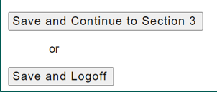
Section 2: General Assurances, Terms, etc. (5)
I have read the General Assurances, Certifications, and Terms and Conditions and would like to proceed to Section 3 of the application.
52

Slide 53
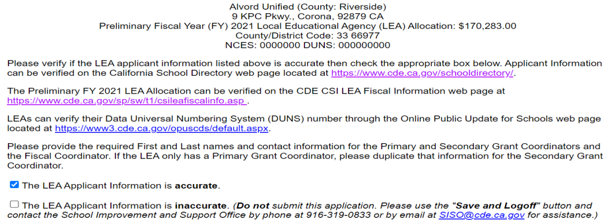
Section 3: LEA Applicant Information (1)
Reference Appendix (6) for long descriptive text.
53

Slide 54
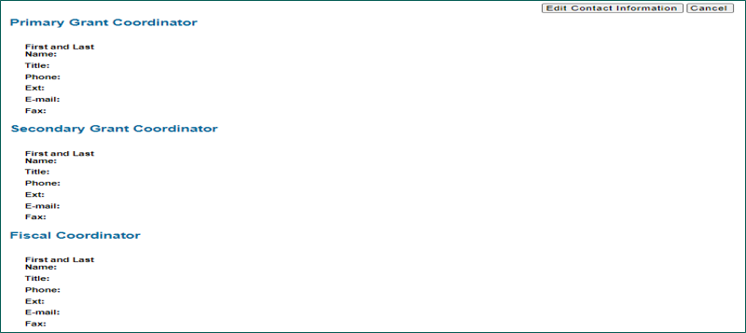
Section 3: LEA Applicant Information (2)
Reference Appendix (7) for long descriptive text.
54

Slide 55
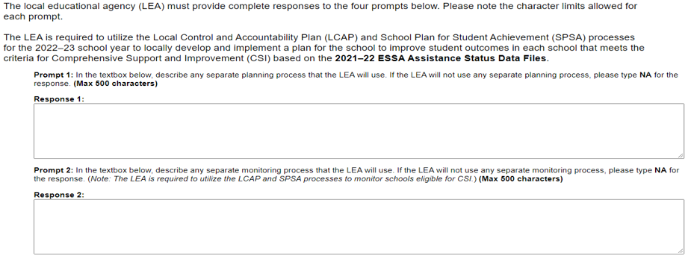
Section 4: Narrative Responses (1)
Reference Appendix (8) for long descriptive text.
55

Slide 56
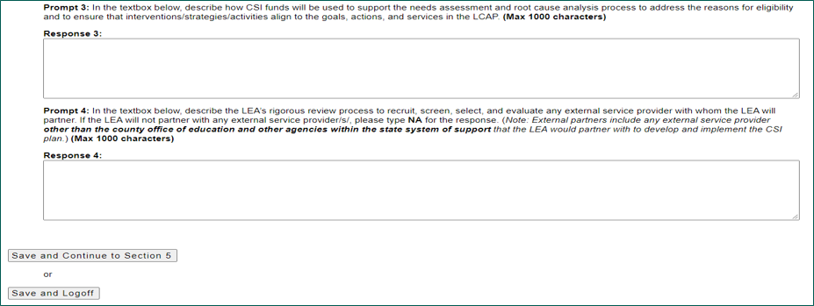
Section 4: Narrative Responses (2)
Reference Appendix (9) for long descriptive text.
56

Slide 57
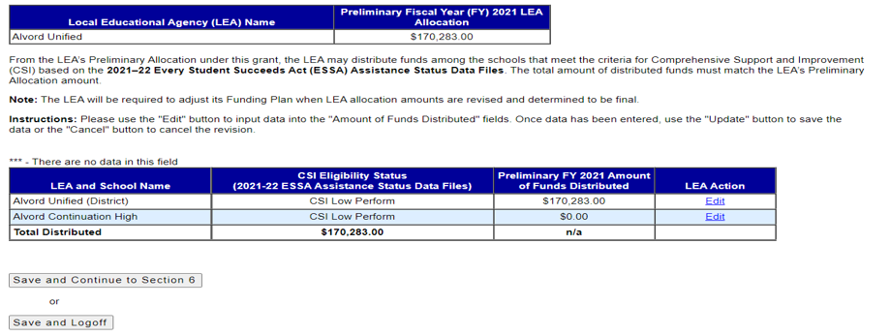
Section 5: Funding Plan
Reference Appendix (10) for long descriptive text.
57

Slide 58
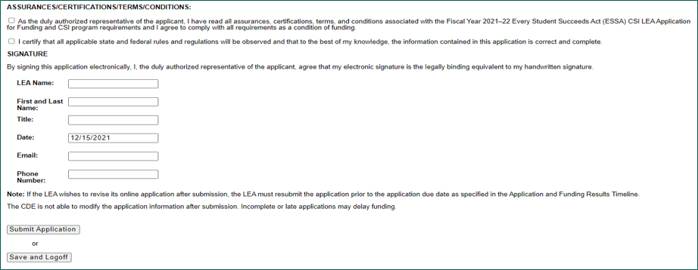
Section 6: Signatures
Reference Appendix (11) for long descriptive text.
58

Slide 59
After the Application Submission
If the LEA wishes to revise its online application after submission, the LEA must resubmit the application prior to the application due date, as specified in the Application and Funding Results Timeline.
The CDE is not able to modify LEA application information. Incomplete or late applications may delay funding.
Applications are due no later than
February 28, 2022, by 4 p.m.
59

Slide 60
FY 2021–22 Application and Subgrant Recap
Application for Funding:
Submission window opens: February 7, 2022
Submission window closes (due): February 28, 2022
The project period for FY 2021 CSI LEA funds begins March 14, 2022, and ends September 30, 2023.
      Subgrant end date: September 30, 2023
60

Slide 61
Points to Remember
CSI Plans
61

Slide 62
CSI Plan Approval Requirements (1)
It is the expectation that the 2022–23 CSI Plans are approved at the local level by the school and LEA prior to the start of the 2022–23 school year.
In addition to developing and implementing a 2022–23 CSI plan for each eligible school, the LEA must complete the CSI Prompts located in the Plan Summary section of its LCAP.
62

Slide 63
CSI Plan Approval Requirements (2)
The county office of education (COE) will approve the LEA’s CSI plans by way of reviewing and approving the CSI Prompts in the LEA LCAP.
The COE will provide a list of LEAs with approved CSI Prompts to the State Board of Education for State Educational Agency approval.
63

Slide 64
CSI Plan Approval Requirements (3)
As a result, it is critical that all LEAs with schools eligible for CSI complete the CSI Prompts in their LCAP. This includes charter schools.
64

Slide 65
Single School Districts and Charter Schools
Single School Districts and Charter Schools may use the LCAP as its CSI plan so long as the LCAP addresses all CSI planning requirements.
        For more information, refer to the CSI Program frequently asked questions on the CDE CSI web page under the Technical Assistance tab located at https://www.cde.ca.gov/sp/sw/t1/csi.asp.
65

Slide 66
Resources (1)
CDE ESSA
https://www.cde.ca.gov/re/es/
CDE CSI web page–Technical Assistance Tab for FAQs
https://www.cde.ca.gov/sp/sw/t1/csi.asp
CDE CSI Webinars
https://www.cde.ca.gov/sp/sw/t1/csiwebinars.asp
CDE LCAP
https://www.cde.ca.gov/re/lc/
66

Slide 67
Resources (2)
CDE CSI LEA Grant Reporting Requirements
http://www.cde.ca.gov/sp/sw/t1/csileagrantrpt.asp#fiscal2021
CDE CSI LEA Authorized Use of Funds https://www.cde.ca.gov/sp/sw/t1/csileaauthusefunds.asp
CDE Continuous Improvement https://www.cde.ca.gov/sp/sw/t1/continuousimprovement.asp
67

Slide 68
How to Reach Us
School Improvement and Support Office
916-319-0833
SISO@cde.ca.gov
68

Slide 69
Appendix (1)
Slide 41
Slide Title: Logging On
Screenshot of GMART logon page. The text “Grant Management and Reporting Tool (GMART)” is at the top of the page with text “Logon” beneath it. Below that is the text “Username:” followed by a text box where the LEA may enter its username. Beneath that is the text “Password:” followed by a text box where the LEA may enter its password. At the bottom there is a button labeled “Logon”.
69

Slide 70
Appendix (2) (1)
Slide 42
Slide Title: Selecting the Application
Screenshot of GMART Select Subgrant page. Text and Descriptive Text Links are shown in the following order:
Grant Management and Reporting Tool (GMART)
Select Subgrant
Logoff (hyperlink)
Every Student Succeeds Act Comprehensive Support and Improvement Local Educational Agency Subgrant/s/
70

Slide 71
Appendix (2) (2)
Slide 42-continued from previous slide
Slide Title: Selecting the Application
FY 2021–22 Application for Funding (New) (hyperlink)
FY 2020–21 (hyperlink)
FY 2019–20 (hyperlink)
FY 2018–19 (hyperlink)
71

Slide 72
Appendix (3) (1)
Slide 44
Slide Title: Application Overview (1)
Screenshot of the GMART subgrant Application Overview. It shows the following Eight Navigation tabs of the GMART:
GMART Home; Application Overview; Section 1‒Assurances; Section 2‒COE Information; Section 3‒Narrative Response; Section 4‒Project Budget; Section 5‒Signatures; Application Status; and CDE Contact Information.
72

Slide 73
Appendix (3) (2)
Slide 44-continued from previous slide
Slide Title: Application Overview (1)
Underneath the tabs is the following text and links in order:
Logoff (hyperlink)
2021–22 Every Student Succeeds Act Comprehensive Support and Improvement Local Education Agency Application for Funding
Due: February 28, 2022
Application Status: Not Submitted
73

Slide 74
Appendix (4) (1)
Slide 46
Slide Title: Section 1: Intent to Apply (1)
Screenshot of GMART Intent to Apply section. Text and elements are shown in following order:
The LEA must indicate if it intends to apply for funding. (Required)
Check box (selected): The LEA intends to apply for FY 2021 ESSA, Section 1003 funds. By selecting this box, the LEA must complete the remaining five sections of this application.
74

Slide 75
Appendix (4) (2)
Slide 46-continued from previous slide
Slide Title: Section 1: Intent to Apply (1)
Check box (not selected): The LEA does not intend to apply for FY 2021 ESSA, Section 1003 funds. By selecting this box, the LEA understands its statutory obligation to meet the requirements of the ESSA, Section 1111(d)(1). The LEA will be redirected to Section 6 to sign and submit this application.
Save and Continue to Section 2 (button) or
Save and Logoff (button)
75

Slide 76
Appendix (5) (1)
Slide 47
Slide Title: Section 1: Intent to Apply (2)
Screenshot of GMART Intent to Apply section. Text and elements are shown in following order:
The LEA must indicate if it intends to apply for funding. (Required)
Check box (not selected): The LEA intends to apply for FY 2021 ESSA, Section 1003 funds. By selecting this box, the LEA must complete the remaining five sections of this application.
76

Slide 77
Appendix (5) (2)
Slide 47-continued from previous slide
Slide Title: Section 1: Intent to Apply (2)
Check box (selected): The LEA does not intend to apply for FY 2021 ESSA, Section 1003 funds. By selecting this box, the LEA understands its statutory obligation to meet the requirements of the ESSA, Section 1111(d)(1). The LEA will be redirected to Section 6 to sign and submit this application.
77

Slide 78
Appendix (5) (3)
Slide 47-continued from previous slide
Slide Title: Section 1: Intent to Apply (2)
If funding is declined, the LEA must indicate the reason it chooses not to accept funding.
Textbox is visible for the LEA to provide a response.
78

Slide 79
Appendix (6) (1)
Slide 53
Slide Title: Section 3: LEA Applicant Information (1)
Screenshot of GMART Applicant Information section of application. Text and links are shown in the following order:
Alvord Unified (County: Riverside)
9 KPC Pkwy., Corona, 92879 CA
Preliminary FY 2021 LEA Allocation: $170,283.00
County/District Code: 33 66977
NCES: XXXXXXX DUNS: XXXXXXXXX
79

Slide 80
Appendix (6) (2)
Slide 53-continued from previous slide
Slide Title: Section 3: LEA Applicant Information (1)
Please verify if the LEA Applicant Information listed above is accurate then check the appropriate box below. Applicant Information can be verified on the California School Directory web page located at https://www.cde.ca.gov/schooldirectory/.
80

Slide 81
Appendix (6) (3)
Slide 53-continued from previous slide
Slide Title: Section 3: LEA Applicant Information (1)
The Preliminary FY 2021 LEA Allocation can be verified on the CDE CSI LEA Fiscal Information web page at https://www.cde.ca.gov/sp/sw/t1/csileafiscalinfo.asp.
LEAs can verify their Data Universal Numbering System (DUNS) number through the Online Public Update for Schools web page located at https://www3.cde.ca.gov/opuscds/default.aspx.
81

Slide 82
Appendix (6) (4)
Slide 53-continued from previous slide
Slide Title: Section 3: LEA Applicant Information (1)
Please provide the required First and Last names and contact information for the Primary and Secondary Grant Coordinators and the Fiscal Coordinator. If the LEA only has a Primary Grant Coordinator, please duplicate that information for the Secondary Grant Coordinator.
82

Slide 83
Appendix (6) (5)
Slide 53-continued from previous slide
Slide Title: Section 3: LEA Applicant Information (1)
Check box (selected): The LEA Applicant Information is accurate.
Check box (not selected): The LEA Applicant Information is inaccurate. (Do not submit this application. Please use the "Save and Logoff" button and contact the School Improvement and Support Office by phone at 916-319-0833 or by email at SISO@cde.ca.gov for assistance.)
83

Slide 84
Appendix (7) (1)
Slide 54
Slide Title: Section 3: LEA Applicant Information (2)
Screenshot of GMART Contact Information section. Text and elements are shown in the following order:
Edit contact information (button); Cancel (button)
Primary Grant Coordinator (with the following fields to complete below it): First and Last Name, Title, Phone, Extension, Email, and Fax
84

Slide 85
Appendix (7) (2)
Slide 54-continued from previous slide
Slide Title: Section 3: LEA Applicant Information (2)
Secondary Grant Coordinator (with the following fields to complete below it): First and Last Name, Title, Phone, Extension, Email, and Fax
Fiscal Coordinator (with the following fields to complete below it): First and Last Name, Title, Phone, Extension, Email, and Fax
85

Slide 86
Appendix (8) (1)
Slide 55
Slide Title: Section 4: Narrative Responses (1)
Screenshot of GMART Application Section 4 prompts 1 and 2. The following text and elements are shown in the following order:
The LEA must provide complete responses to the four prompts below. Please note the character limits allowed for each prompt.
86

Slide 87
Appendix (8) (2)
Slide 55-continued from previous slide
Slide Title: Section 4: Narrative Responses (1)
The LEA is required to utilize the LCAP and SPSA processes for the 2022–23 school year to locally develop and implement a plan for the school to improve student outcomes in each school that meets the criteria for CSI based on the 2021–22 Data Files.
87

Slide 88
Appendix (8) (3)
Slide 55-continued from previous slide
Slide Title: Section 4: Narrative Responses (1)
Prompt 1: In the textbox below, describe any separate planning process that the LEA will use. If the LEA will not use any separate planning process, please type NA for the response. (Max 500 characters)
Response 1: (text box for the LEA to provide a response.)
88

Slide 89
Appendix (8) (4)
Slide 55-continued from previous slide
Slide Title: Section 4: Narrative Responses (1)
Prompt 2: In the textbox below, describe any separate monitoring process that the LEA will use. If the LEA will not use any separate monitoring process, please type NA for the response. (Note: The LEA is required to utilize the LCAP and SPSA processes to monitor schools eligible for CSI.) (Max 500 characters)
Response 2: (text box for the LEA to provide a response.)
89

Slide 90
Appendix (9) (1)
Slide 56
Slide Title: Section 4: Narrative Responses (2)
Screenshot of GMART Application Section 4 prompts 3 and 4. The following text and elements are shown in the following order:
Prompt 3: In the textbox below, describe how CSI funds will be used to support the needs assessment and root cause analysis process to address the reasons for eligibility and to ensure that interventions/strategies/activities align to the goals, actions, and services in the LCAP. (Max 1000 characters)
90

Slide 91
Appendix (9) (2)
Slide 56-continued from previous slide
Slide Title: Section 4: Narrative Responses (2)
Response 3: (text box for the LEA to provide a response.)
Prompt 4: In the textbox below, describe the LEA’s rigorous review process to recruit, screen, select, and evaluate any external service provider with whom the LEA will partner. If the LEA will not partner with any external service provider/s/, please type NA for the response.
91

Slide 92
Appendix (9) (3)
Slide 56-continued from previous slide
Slide Title: Section 4: Narrative Responses (2)
(Note: External partners include any external service provider other than the COE and other agencies within the state system of support that the LEA would partner with to develop and implement the CSI plan.) (Max 1000 characters)
Response 4: (text box for the LEA to provide a response.)
92

Slide 93
Appendix (9) (4)
Slide 56-continued from previous slide
Slide Title: Section 4: Narrative Responses (2)
Save and Continue to Section 5 (button)
Or
Save and Logoff (button)
93

Slide 94
Appendix (10) (1)
Slide 57
Slide Title: Section 5: Funding Plan (1)
Screenshot of GMART Application funding plan section. The following text and elements are shown in the following order:
(Table with two columns and two rows)
Row 1 (Table Headings):
LEA Name; Preliminary FY 2021 LEA Allocation
Row 2
Alvord Unified; $170,283.00
94

Slide 95
Appendix (10) (2)
Slide 57-continued from the previous slide
Slide Title: Section 5: Funding Plan (1)
From the LEA’s Preliminary Allocation under this grant, the LEA may distribute funds among the schools that meet the criteria for CSI based on the 2021–22 Data Files. The total amount of distributed funds must match the LEA’s Preliminary Allocation amount.
Note: The LEA will be required to adjust its Funding Plan when LEA allocation amounts are revised and determined to be final.
95

Slide 96
Appendix (10) (3)
Slide 57-continued from the previous slide
Slide Title: Section 5: Funding Plan (1)
Instructions: Please use the "Edit" button to input data into the "Amount of Funds Distributed" fields. Once data has been entered, use the "Update" button to save the data or the "Cancel" button to cancel the revision.
*** - There are no data in this field
96

Slide 97
Appendix (10) (4)
Slide 57-continued from the previous slide
Slide Title: Section 5: Funding Plan (1)
(Table with four columns and four rows)
Row 1: (Table Headings)
LEA and School Name; CSI Eligibility Status (2021-22 Data Files); Preliminary FY 2021 Amount of Funds Distributed; LEA Action
97

Slide 98
Appendix (10) (5)
Slide 57-continued from the previous slide
Slide Title: Section 5: Funding Plan (1)
Row 2
Alvord Unified District; CSI Low Perform; $170,283.00; Edit (hyperlinked text)
Row 3
Alvord Continuation High; CSI Low Perform; $0.00; Edit (hyperlinked text)
98

Slide 99
Appendix (10) (6)
Slide 57-continued from the previous slide
Slide Title: Section 5: Funding Plan (1)
Row 4 (Totals row)
Total Distributed; $170,283.00; n/a; (empty cell)
Save and Continue to Section 6 (button)
or
Save and Log Off (button)
99

Slide 100
Appendix (11) (1)
Slide 58
Slide Title: Section 6: Signatures
Screenshot of GMART Application Signatures section. The following text and elements are shown in the following order:
ASSURANCES/CERTIFICATIONS/TERMS/CONDITIONS
Check box (unchecked): As the duly authorized representative of the applicant, I have read all assurances, certifications, terms, and conditions associated with the FY 2021–22 ESSA CSI LEA Application for Funding and CSI program requirements and I agree to comply with all requirements as a condition of funding.
100

Slide 101
Appendix (11) (2)
Slide 58-continued from previous slide
Slide Title: Section 6: Signatures
Check box (unchecked): I certify that all applicable state and federal rules and regulations will be observed and that to the best of my knowledge, the information contained in this application is correct and complete.
101

Slide 102
Appendix (11) (3)
Slide 58-continued from previous slide
Slide Title: Section 6: Signatures
SIGNATURE
By signing this application electronically, I, the duly authorized representative of the applicant, agree that my electronic signature is the legally binding equivalent to my handwritten signature.
102

Slide 103
Appendix (11) (4)
Slide 58-continued from previous slide
Slide Title: Section 6: Signatures
LEA Name (LEA Name text box)
First and Last Name (First and Last Name text box)
Title (Title text box)
Date (Date text box with date 12/15/2021 filled in)
Email (Email text box)
Phone Number (Phone Number text box)
103

Slide 104
Appendix (11) (5)
Slide 58-continued from previous slide
Slide Title: Section 6: Signatures
Note: If the LEA wishes to revise its online application after submission, the LEA must resubmit the application prior to the application due date as specified in the Application and Funding Results Timeline.
The CDE is not able to modify the application information after submission. Incomplete or late applications may delay funding.
104

Slide 105
Appendix (11) (6)
Slide 58-continued from previous slide
Slide Title: Section 6: Signatures
Submit Application (button)
or
Save and Logoff (button)
105

